Slide 1

Modeling the Interactions of Congestion Control and
Switch Scheduling
Alex Shpiner
Joint work with Isaac Keslassy
Faculty of Electrical Engineering,
Technion IIT, Haifa, Israel

Slide 2
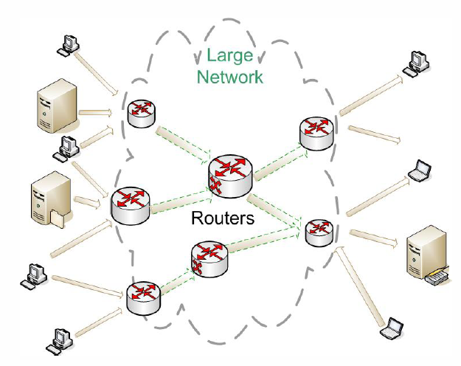

Users Vs. Routers
Users
Users
Congestion Control
Switch Scheduling
Congestion Control

Slide 3
User-Centric View
End-to-end congestion control algorithms (TCP) regulate the Internet
Routers are just passive elements.
Users
Users

Slide 4
Related Work: User-Centric View
Flow rate equilibrium
  F. Kelly, “Mathematical modeling of the Internet”, 2001.
Router Buffer Sizing
  G. Appenzeller, I. Keslassy, and N. McKeown, “Sizing router buffers”, 2004.
TCP Dynamics
  M. Wang, “Mean-field analysis of buffer sizing”, 2007.
Weighted Fair Queuing (WFQ)
  H. Hassan, O. Brun, J. M. Garcia, and D. Gauchard, “Integration of streaming and elastic traffic: a fixed point approach”, 2008.
Active Queue Managemnet (AQM)
  T. Bu and D. F. Towsley, “A fixed point approximation of TCP behavior in a network”, 2001.

Slide 5
Router-Centric View
Switch scheduling algorithms regulate the Internet.
Users are just passive elements.

Slide 6
Related Work: Router-Centric View
Maximum Weight Matching (MWM)
  N. McKeown, V. Anantharan, and J. Walrand, “Achieving 100% throughput in an input-queued switch”, 1996.
Birkhoff von-Neumann (BvN)
  C. S. Chang, W. J. Chen, and H. Y. Huang, “On service guarantees for input buffered crossbar switches”, 1999.
iSLIP
  N. McKeown, “The iSLIP scheduling algorithm for input-queued switches”, 1999.

Slide 7
Single Port Model (Nx1)
No switch scheduling:
FIFO (OQ)

Slide 8
Single Port Model (Nx1)
With switch scheduling:
iSLIP ⇒ RR
Maximum Weight Match (MWM) ⇒ LQF

Slide 9
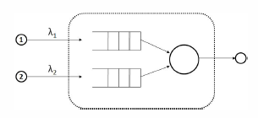
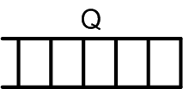
Simple Example – The Two Views
UDP
TCP
FIFO
MWM
TCP cong. control +
Ideal switch (FIFO)
TCP rate equilibrium
No starvation
UDP +
MWM switch sched.
C₁ = λ₁
C₂ = λ₂
As long as λ₁+λ₂< C_{out}
No starvation
W₁, W₂
t
[Kelly ’01]
(UDP is non-responsive traffic)
[Shah and Wischik ’06]

Slide 10
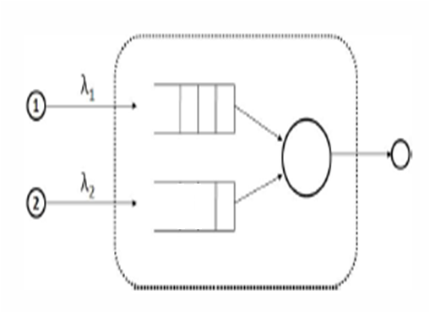

Simple Example – The Interaction
TCP congestion control
+ MWM switch scheduling
Starvation!
Q₁
Q₂
Q₁
Q₂
t

Slide 11
Two Conflicting Views of Regulation
 | Routers | Users
OK | - | +
 | Routers | Users
OK | - | +
OK | + | -
 | Routers | Users
OK | - | +
OK | + | -
X | + | +

Slide 12
Related Work
Interaction of responsive flows with MWM switch scheduling
  P. Giaccone, E. Leonardi, F. Neri, “On the behavior of optimal scheduling algorithms under TCP sources”, 2006.
  Prove fair system equilibrium.
  But: rely on RED AQM and doesn’t reflect the possible extreme unfairness which occur without AQM.
Interaction of responsive flows in wireless networks
  A. Eryilmaz and R. Srikant, “Fair resource allocation in wireless networks using queue-length-based scheduling and congestion control”, 2005.
  Assume congestion control fundamentally different from TCP.

Slide 13
Our Contributions
Study interactions between congestion control and switch scheduling
Discover different modes of interaction
  Starvation, oscillation, equalization.
Describe system dynamics using differential equations

Slide 14
Outline
  Introduction
  Fairness
  Network Dynamics
  NxN Switch
  Simulations

Slide 15
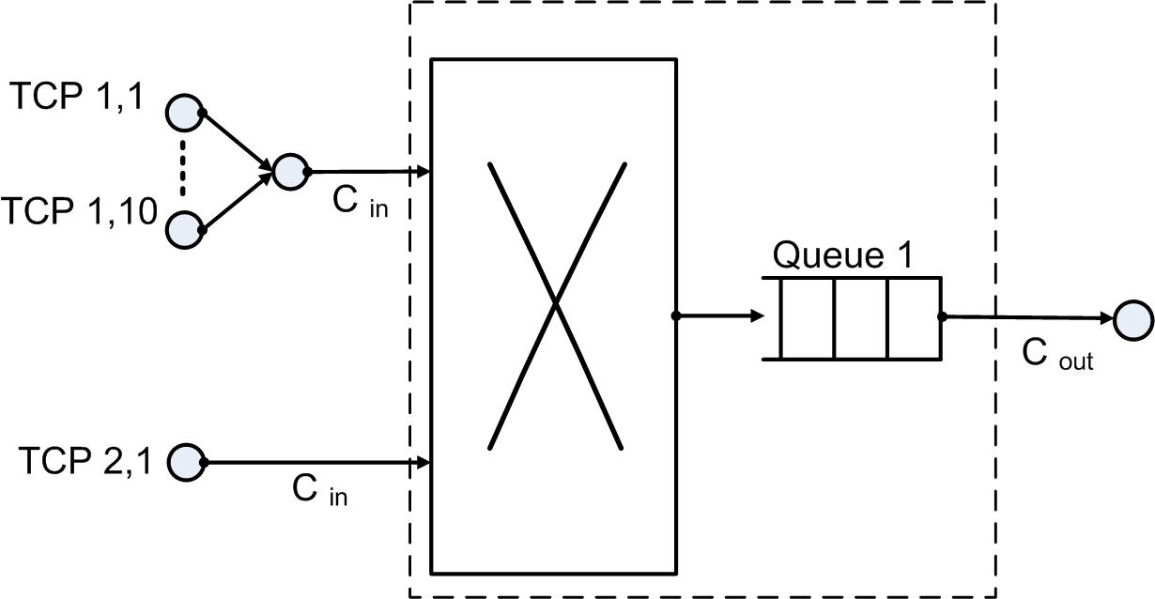
Fairness in Ideal (FIFO / OQ) Switch
Example:
Throughput
of flow k:
In general:
  Intuition: symmetry
Fair for flows

Slide 16
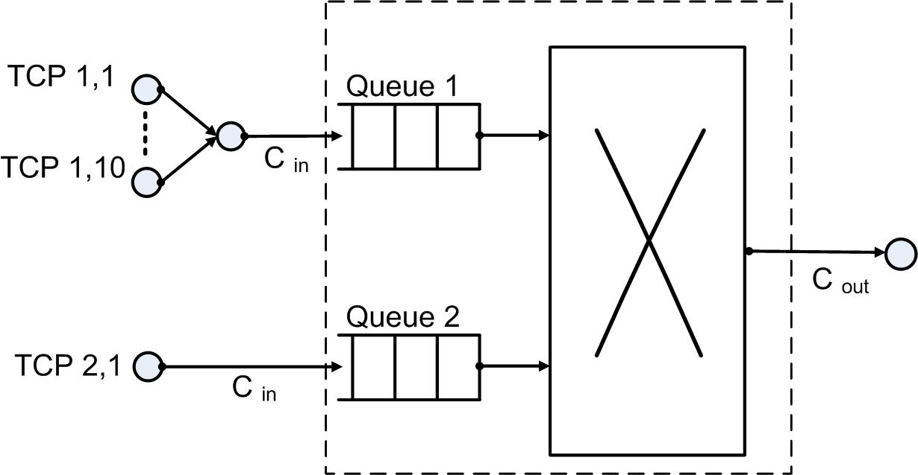
Fairness of IQ Switch with iSLIP Scheduling
Example:
Throughput of flow k
in port i:
In general:
  Intuition: round-robin between ports
Fair for ports, but not for flows!
RR

Slide 17
MWM Scheduling
Three modes:
  Starvation
  Oscillation
  Equalization
LQF

Slide 18
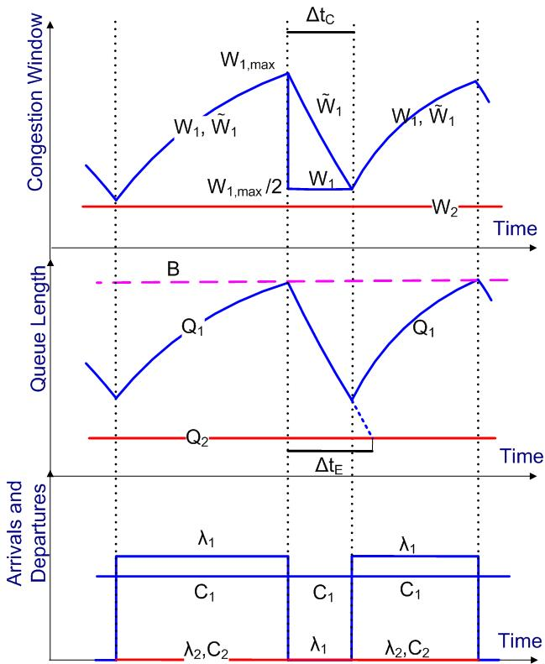
MWM – Starvation Mode
Congestion
Δt_{C} – time before window starts growing again
Δt_{E} – time to equalize the queue
Δt_{E} >Δt_{C}
Always Q₁ > Q₂ : Starvation mode

Slide 19
MWM – Oscillation Mode
Congestion
Δt_{C} – time before window starts growing again
Δt_{E} – time to equalize the queues
Δt_{E} <Δt_{C}
Any of the queues might start growing after congestion:
Oscillation mode

Slide 20
MWM – Equalization Mode
Until now we talked about TCP only.
How does UDP (non-responsive traffic) affect the model?
In equalization mode - roughly Q₁(t)=Q₂(t)
If whenever Q₁(t)>Q₂(t) ⇒ ,
then no prevailing queue
For UDP arrivals rate large enough, the model looks like
UDP + MWM
UDP + MWM
C₁ = λ₁
C₂ = λ₂
As long as λ₁+λ₂< C_{out}
Fair

Slide 21
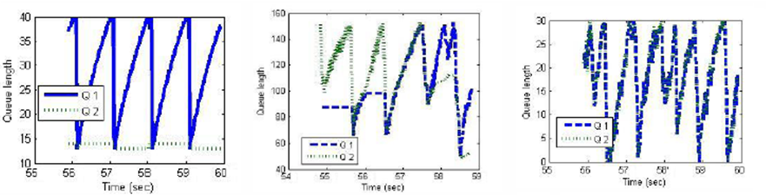
Simulations - MWM Modes
2x1 MWM Starvation Mode
2x1 MWM Oscillation Mode
2x1 MWM Equalization Mode
Simulation parameters:
Fig. 1 –
2 TCP flows, no UDP, C_{out}=1Mbps, B=41KB , avg. t_{p} = 100/150 ms
Fig. 2 –
10 TCP flows, no UDP, C_{out} = 5Mbps, B=150KB , avg. t_{p} = 100/150 ms
Fig. 3 –
2 TCP flows, Cout = 2Mbps, B=31KB, UDP = 20%*C , avg. t_{p} = 100/150 ms

Slide 22
Outline
  Introduction
  Fairness
  Network Dynamics
  NxN Switch
  Simulations

Slide 23
Network Dynamics
Set of equations describing the dynamics of Internet traffic through Nx1 IQ switch.
Congestion control equations (users)
  TCP Stable phase
  TCP Congestion phase
  UDP flow
Switch scheduling equations (routers)
  iSLIP
  MWM

Slide 24
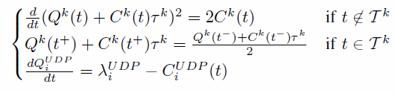
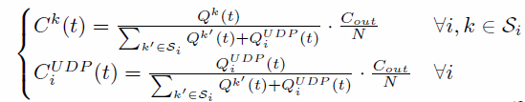
Network Dynamics - iSLIP
Set of equations describing the dynamics of Internet traffic through Nx1 IQ switch.
Congestion control equations
  TCP Stable phase
  TCP Congestion phase
  UDP flow
Switch scheduling equations
  iSLIP
2 equations per flow:
  - Congestion control
  - Switch scheduling
2 variables per flow:

Slide 25
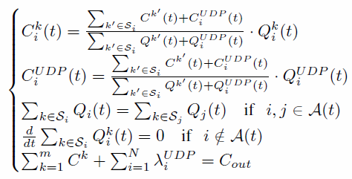

Network Dynamics - MWM
Set of equations describing the dynamics of Internet traffic through Nx1 IQ switch.
Congestion control equations
  TCP Stable phase
  TCP Congestion phase
  UDP flow
Switch scheduling equations
  MWM
2 equations per flow
  - Congestion control
  - Switch scheduling
2 variables per flow

Slide 26
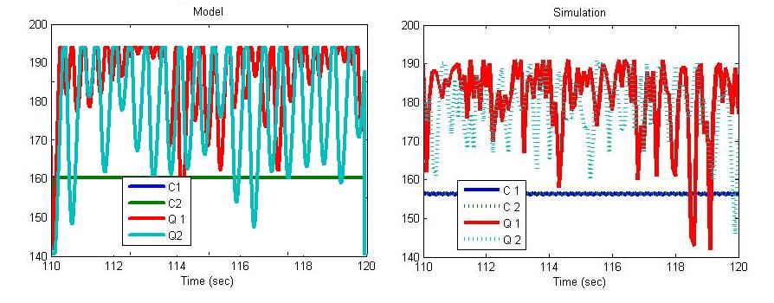
Simulations – iSLIP Network Dynamics
Matlab Model
Ns2 Simulation
Time (sec)
Time (sec)
Simulation parameters:
2x1, 100 TCP flows, 5%*C_{out} UDP rate, C_{out}= 100Mbps, B=180KB, avg. t_{p} = 100/150 ms

Slide 27
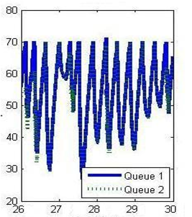
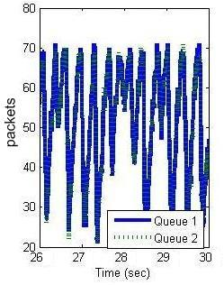
Simulations –
MWM Network Dynamics
Matlab Model
Ns2 Simulation
Time (sec)
Time (sec)
(equalization mode)
Simulation parameters:
2x1, 100 TCP flows, UDP rate 5%*C_{out}, C_{out}= 5Mbps, B=70KB, avg. t_{p} = 100/150 ms

Slide 28
Outline
  Introduction
  Fairness
  Network Dynamics
  NxN switch
  Simulations
28

Slide 29
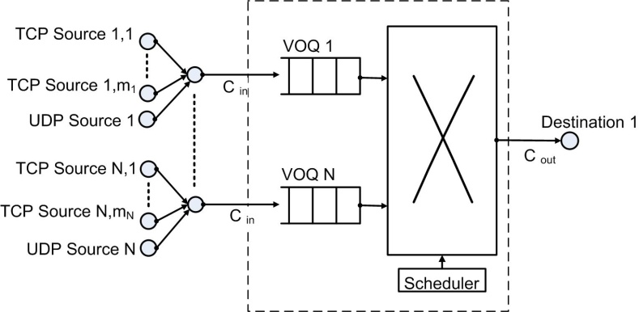
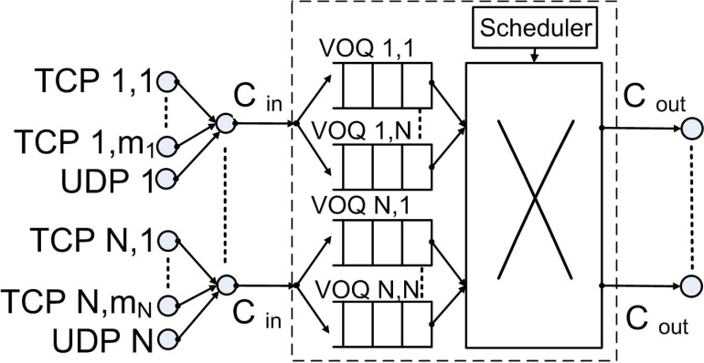
NxN switch
Nx1 → NxN
MWM: We expect equalization/starvation of the number of packets in permutations, not in individual queues.

Slide 30
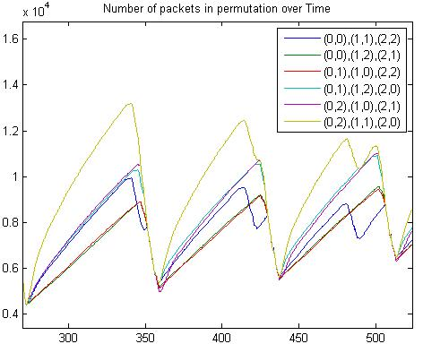
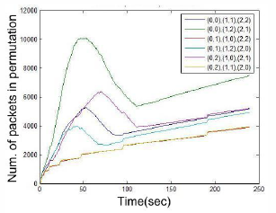
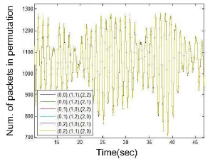
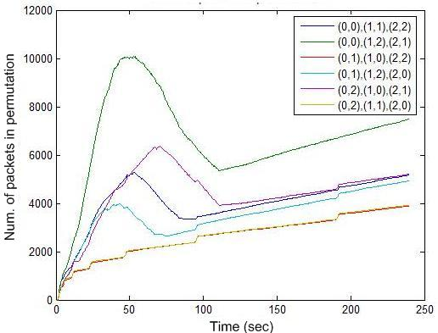
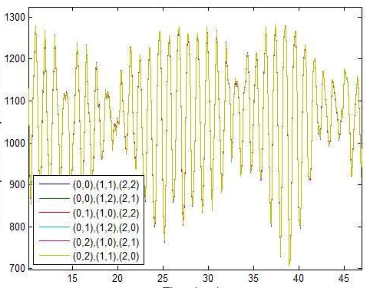
Simulations –
3x3 MWM
Equalization mode
(for permutations)
Starvation mode
(for permutations)
Simulation Parameters:
100 TCP flows per input/output pair and UDP rate 5%*C_{out}
C_{out} = 100Mbps, B=2.5MB, avg. t_{p}=100ms
C_{out} = 1Mbps, B=10MB, avg. t_{p}=100ms

Slide 31
Summary
Interactions of congestion control and switch scheduling can lead to extreme unfairness and flow starvation.
iSLIP switch model can be fair for ports, not for flows.
Three modes of MWM behavior: starvation, oscillation and equalization.
Dynamics of Internet traffic in real iSLIP and MWM switches.
iSLIP less unfair than MWM.

Slide 32
Thank you.

