Slide 1

A Switch-Based Approach to Starvation in Data Centers
Alex Shpiner
Joint work with Isaac Keslassy
Faculty of Electrical Engineering,
Technion, Haifa, Israel

Slide 2


The Problem
Temporary starvation
of long TCP flows
in datacenter networks
Crucial effect on applications (e.g. real-time, distributed computing).
Outline:
  Characterization of the datacenter network.
  Why does starvation happen?
  Switch-based solution.
Cooperated with (formerly )

Slide 3
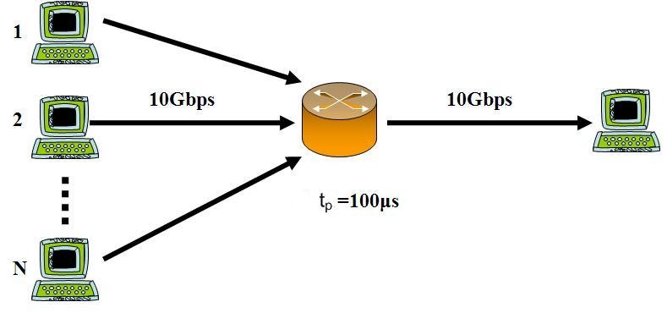

Datacenter Network
Low propagation times (t_{p})
  t_{p} ≈ 10 - 100 µs, instead of t_{p} ≈ 10 - 100 ms in Internet
Simple datacenter model:
Small t_{p} => Small buffers
  B=C* t_{p} (rule-of-thumb) [Villamizar et al., 1994]
Many users with long TCP flows (Large N)
B
C= 10Gbps
C= 10Gbps

Slide 4

Why Starvation?
Links and buffers cannot hold all packets of all flows, even if for each flow, congestion window Cwnd_{i} = 1.
Total sum of packets (∑Cwnd) >> Network capacity.
packets
flows
links
buffers
B
C=
Large
Small
High drop rate Timeouts Starvation

Slide 5
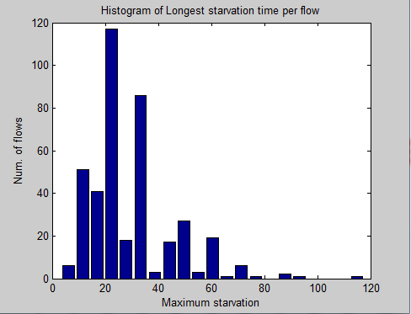
Starvation (Simulations)
Distribution of max. starvation time
= time between two successfully transmitted packets
Number of flows
Max. starvation time (sec)
Simulation parameters: 400 TCP flows, Link Capacity = 100 Mbps, prop. RTT = 0.1 ms, buffer = 20 packets, packet size = 1500 Bytes , UDP rate = 5% of link capacity.

Slide 6
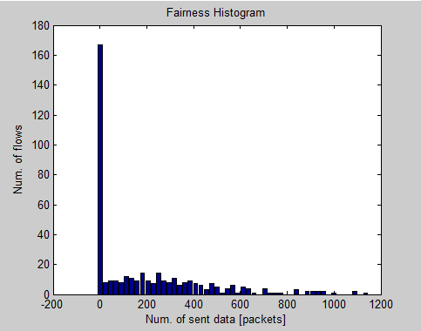
Unfairness (Simulations)
Distribution of throughput per flow (Unfairness)
Number of flows
Throughput (pkts/T)
Simulation parameters: 400 TCP flows, Link Capacity = 100 Mbps, prop. RTT = 0.1 ms, buffer = 20 packets, packet size = 1500 Bytes , UDP rate = 5% of link capacity, examined time (T) = 10 sec.

Slide 7
The Goal
Reduce starvation of the long TCP flows.
Switch-based solution for datacenter.
Alternative solutions:
TCP throughput collapse (InCast) solutions
(requires changes in TCP or in application)
  Reducing and randomizing retransmission timeouts [V. Vasudevan et al., 2009].
  Increasing SRU size, changing TCP [A. Phanishayee et al., 2008].
  Limiting the number of servers, global scheduling [E. Krevat et al., 2007].
Larger buffers [R. Morris, 1997]
  High delays, requires DRAM memories.

Slide 8
Objectives
Transparent to the end hosts.
No change in network topology.
No significant impact on the switch architecture.
No additional buffering.

Slide 9

The Idea
B=2 pkts
X
B=2 pkts
OK

Slide 10
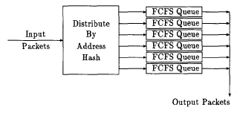
Alternative Fairness Algorithm
  Deficit Round-Robin (DRR) [M. Shreedhar and G. Varghese, 1996].
Stochastic Fair Queuing (SFQ) [P.McKenney, 1990]
Drawbacks:
  Inefficient buffer utilization (e.g. with bursts).
  Complicated queue management (RR, LQF).

Slide 11
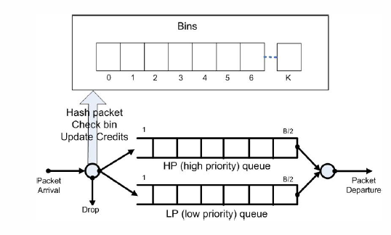
Hashed Credits Fair (HCF)
3
1
0
6
1
0
2
5
2
4
Credits
Bins provide fairness
HP queue avoids starvation
LP queue provides high output link utilization
Time divided into priority periods:
  at the start of each – reset credits and change parameters to hash function

Slide 12
Hashed Credits Fair (HCF) Complexity
Credits
Complexity: Enqueueing: O(1)
Dequeuing: O(1)
Initialization: O(num. of bins)
Memory space: Bin array: O(num.of bins* log(Max. Credits))
Additional queue pointers: O(1)
}
practically:
O(1)

Slide 13
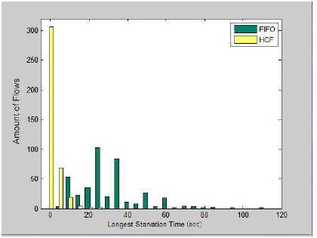
FIFO vs. HCF
Starvation
Distribution of Max. Starvation Times
after
Number of flows
before
Max. Starvation time (sec)
Simulation parameters: 400 TCP flows, Link Capacity = 100 Mbps, Prop. RTT = 0.1 ms, Buffer = 20 packets, Packet Size = 1500 Bytes , UDP Rate = 5% of link capacity.

Slide 14
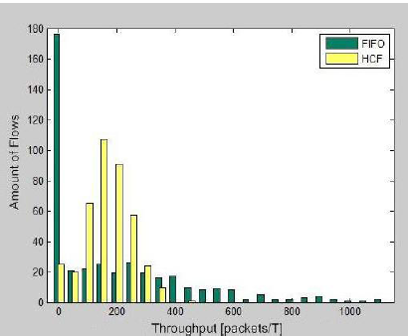
FIFO vs. HCF
Unfairness
Distribution of Throughput per flow (Unfairness)
before
after
Number of flows
Throughput (pkts/T)
Simulation parameters: 400 TCP flows, Link Capacity = 100 Mbps, Prop. RTT = 0.1 ms, Buffer = 20 packets, Packet Size = 1500 Bytes , UDP Rate = 5% of link capacity, Examined Time (T) = 10 sec.

Slide 15
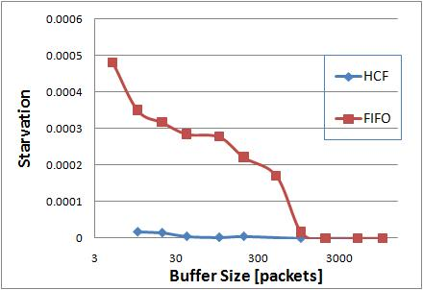

Influence of Buffer Size
Starvation ratio –
Percentage of starved flows in 10 seconds
Large buffers prevent starvation.
Simulation parameters: N = 400 TCP flows, UDP rate = 5%*C_{out}, C_{out} = 100 Mbps, t_{p} = 0.1 ms, Packet size = 1500 Bytes, Examined time = 10 sec.

Slide 16
Another Application:
Throughput Collapse (InCast)
Servers
1
Client
R
2
2
R
R
N
N
Links are idle
High drop rate Timeouts Low Goodput

Slide 17
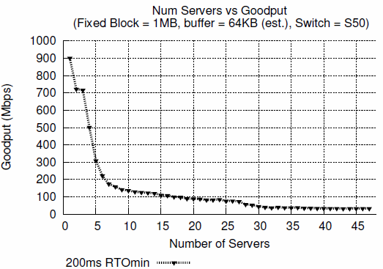
Throughput Collapse (InCast)
(Simulations)
[V. Vasudevan et al., 2008, 2009]

Slide 18
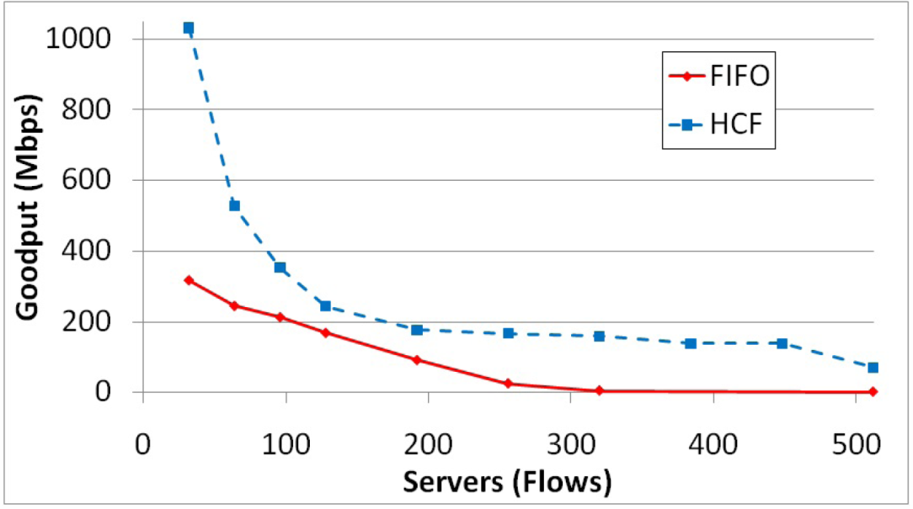
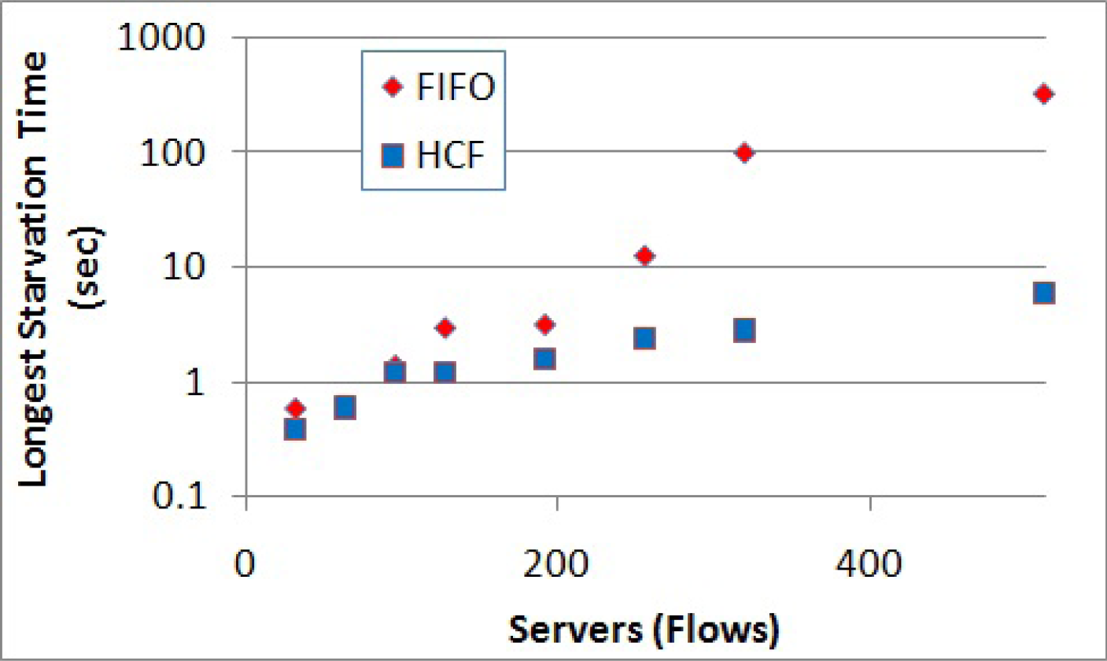
FIFO vs. HCF
Incast
Goodput
Max. starvation time
Simulation parameters: Link Capacity = 10 Gbps, Prop. RTT = 0.02 ms, Buffer = 32 packets, Block Size = 80 MB, Packet Size = 1000 Bytes, no UDP.

Slide 19
Summary
Novel Observation:
  Long TCP flows in datacenter networks can severely
  suffer from starvation.
New Algorithm:
  Reduces the starvation.
  Transparent to end-user.
Application to TCP InCast Problem.
More in the paper:
  Solution to packet reordering in HCF.
  Dynamic priority periods.

Slide 20
Thank you.

