Slide 1

Towards Sub-Nyquist Tissue
Doppler Imaging
Avinoam Bar Zion, Martino Alessandrini,
Jan Dhooge, Dan Adam and Yonina Eldar

Slide 2
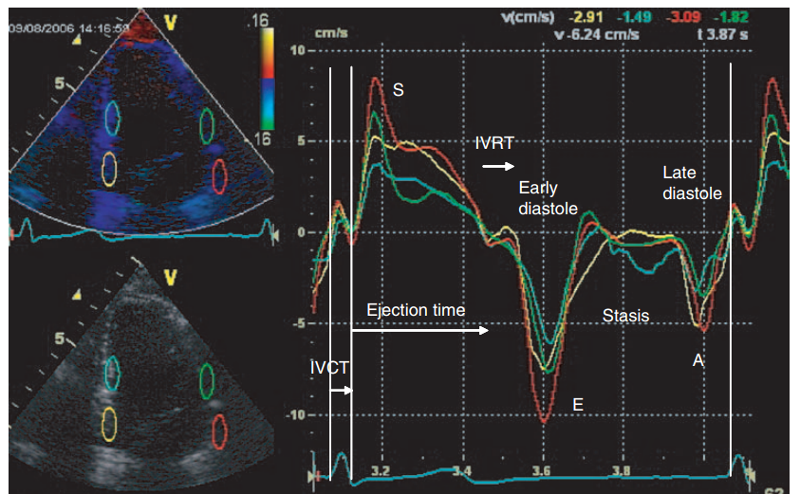

Compressed Sensing (CS)
Tissue Doppler
Why ?
Currently:
  Limited to few measurement points
  Tradeoff between spectral and spatial resolution
  Signals are sampled at frequencies higher than the Nyquist rate
B-mode
Spectral Doppler
High data volumes
few measurement points
Marwick, et al. ”Myocardial imaging: tissue Doppler and speckle tracking,” 2008.

Slide 3

Sampling rate reduction via CS
The system of equations:
Representation
(sparse)
Samples
PSF
Fourier
Fourier
T
.
.
.
$$≈$$
.
.
fast time
frequencies
.
.
.
.
.
MxP
.
KxP
KxK
KxN
.
NxM
pulses
The sparse representation matrix A is estimated from the measurements by solving an l₁ minimization problem

Slide 4
Results: Depth-Doppler Maps
The representation matrices (40% Fast Time):
With 20% of the pulses the map’s correlation coef. R > 0.8
100% Slow Time
50% Slow Time
20% Slow Time
Depth
Doppler Frequency
Doppler Frequency
Doppler Frequency

Slide 5
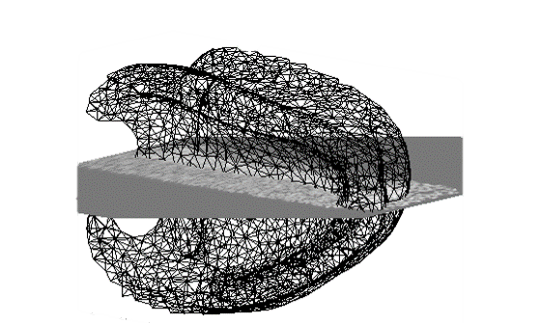
Septum
RESULTS: tdi PLOTS
Scan
Plane
Spectral estimations from specific depths
concatenated to produce spectral Doppler images
100% Slow Time
50% Slow Time
30% Slow Time
Depth = 6.2 cm; 40% fast time

Slide 6
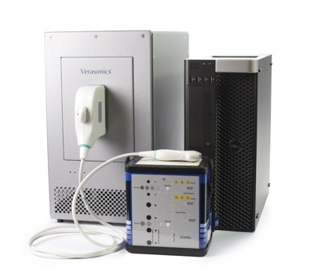
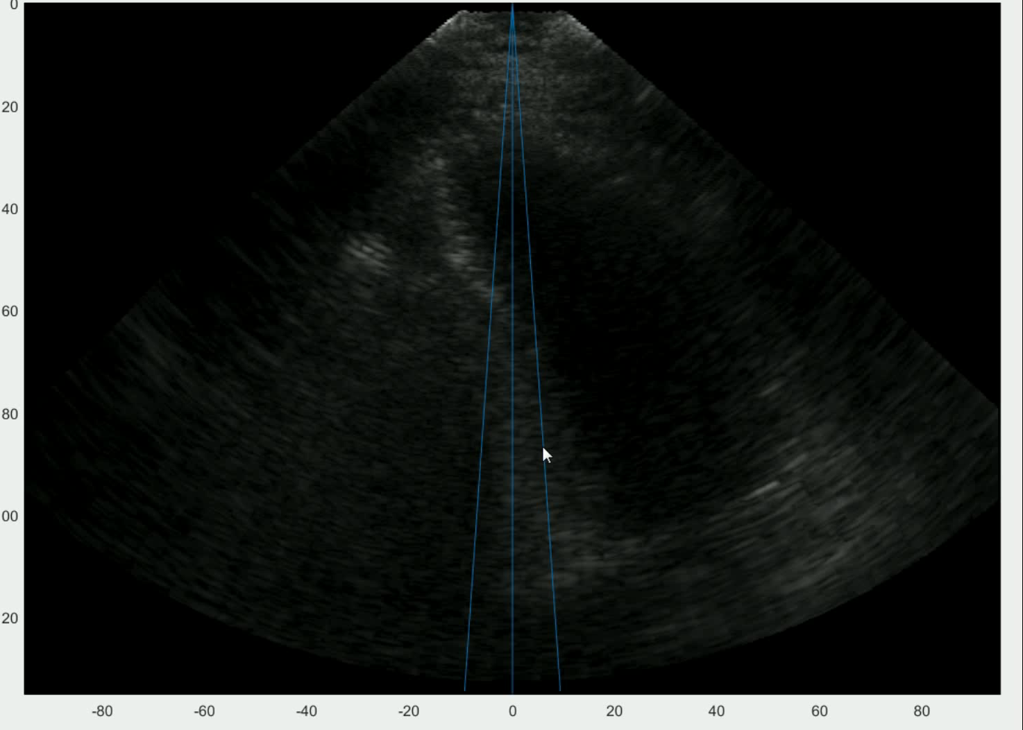
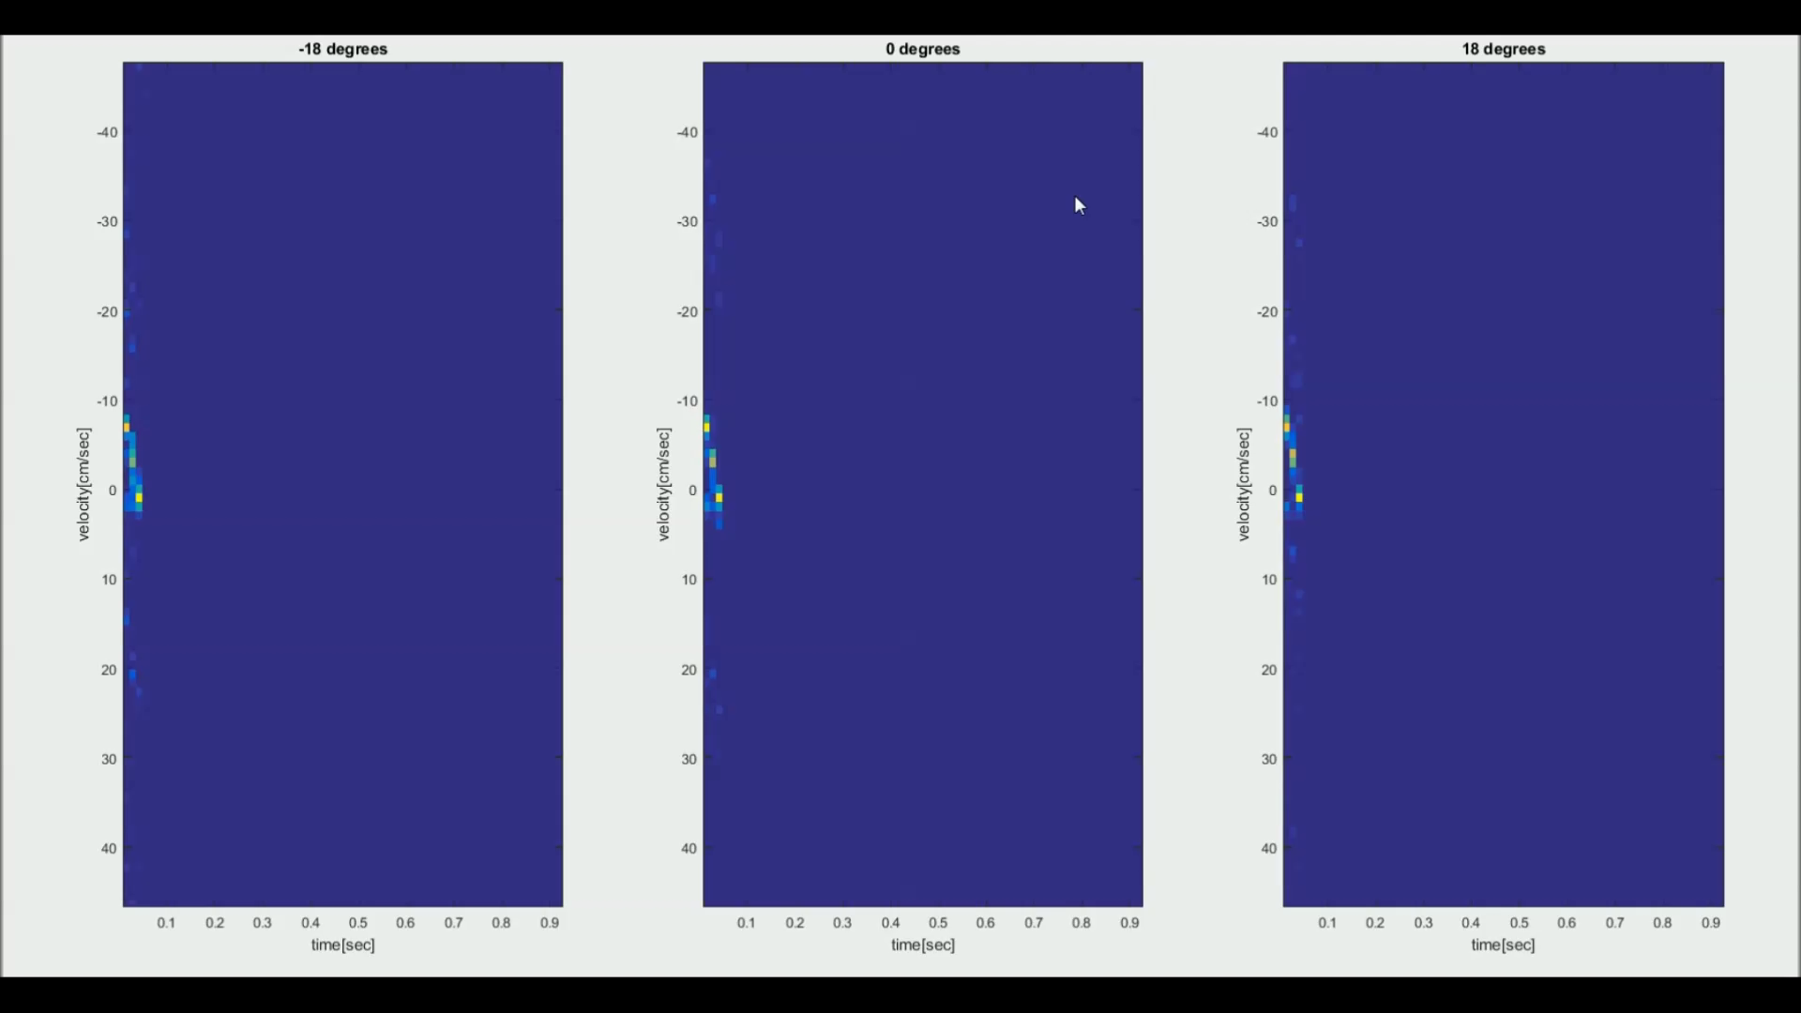

RESULTS: CS tdi dEMO
A demo version was implemented on
a Verasonics Vantage 256™ system

Slide 7
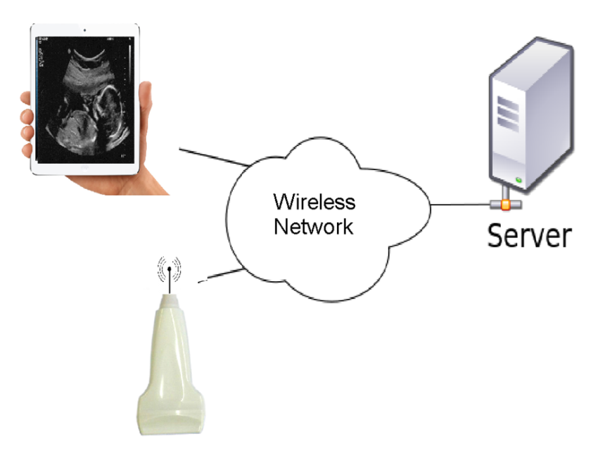
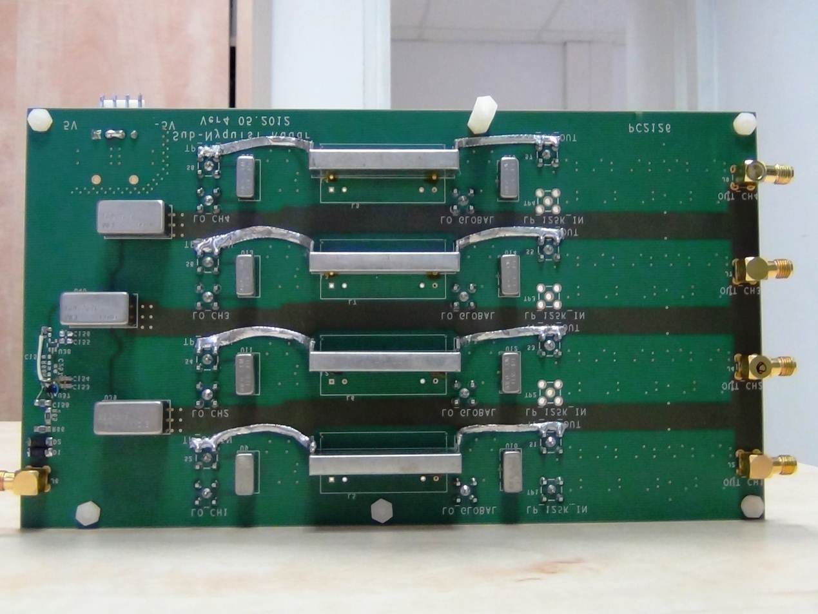
summary
TDI signals estimated from sub-Nyquist samples:
  Using a subset of the fast time frequencies
  Non-uniformly space stream of pulses
Facilitating increased imaged sector
Reduced data volumes -> hand-held / wireless systems
Xampling:
Sub Nyquist Sampling

Slide 8


Thank you
SAMPL Lab, Technion
Ido Cohen
Shai Yagil
Regev Cohen
Or Dicker
Tanya Chernyakova
Deborah Cohen
Dan Adam’s Lab, Technion
Amit Livneh
Hanan Khamis
Grigoriy Zurakhov
Verasonics
This project has received funding from the European Union's Horizon 2020 research and innovation programme under grant agreement No. 646804-ERC-COG-BNYQ0

