Slide 1

Bio-Inspired Materials for Electronic Applications
Technion – Israel Institute of Technology
Prof. N. Tessler (Electrical Engineering)
Prof. Y. Eichen (Chemistry)

Slide 2
N. Tessler, O. Globerman, N. Rappaport, Y. Preezant, Y. Roichman, O. Solomesch, et al., "Conjugated Polymer Electronics – Engineering Materials and Devices," in Handbook of Conducting Polymers, T. A. Skotheim and J. R. Reynolds, Eds., ed London: CRC, 2006.
O. Solomeshch, Y. J. Yu, V. Medvedev, A. Razin, B. Blumer-Ganon, Y. Eichen, et al., "Wide band gap cross-linkable semiconducting polymer LED," Synt. Met., vol. 157, pp. 841-845, 2007.
Y.-J. Yu, O. Solomeshch, H. Chechik, A. A. Goryunkov, R. F. Tuktarov, D. H. Choi, et al., "p-type doping in organic light emitting diodes based on fluorinated C60," Journal of Applied Physics, vol. 104, p. 124505, 2008.

Slide 3
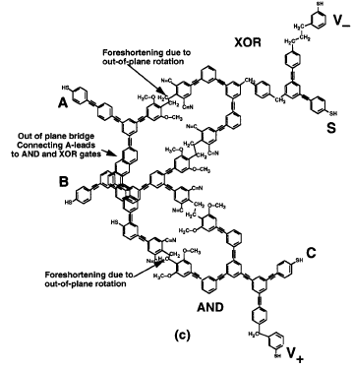
Organic Molecules as Semiconductors
Many structures with exciting electrical properties may be drawn on paper
But
Most of them are just too difficult to make.
J.C. ELLENBOGEN J.C. LOVE,
PROC. OF THE IEEE, 2000, 88(3), 386

Slide 4
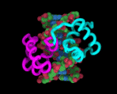
How is Complexity Achieved in Truly Complex Systems?

Slide 5
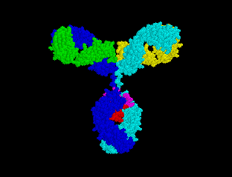
How is Complexity Achieved in Truly Complex Systems?
Antibodies
The molecular machinery (peptides) used to tackle
Unknown problems

Slide 6
How is Complexity Achieved in Truly Complex Systems?

Slide 7
Sequence Independent Syntheses - The Way Nature Deals with Complexity
Phospho(di)ester world
Peptide world
Notes:
The nature use this 20 amino acids as building blocks for almost infinite number of proteins that have different structures and functionalities. The question that we wanted to ask is whether we can use those building blocks to synthesize, using Merrifield synthesis or even enzymatic synthesis, an infinite number of organic conjugated polymers with different lengths, structures and sequences.

Slide 8
How is Complexity Achieved in Truly Complex Systems?
Very Simply in the case of peptides
-H₂O

Slide 9
Solid Phase Peptide Synthesis
H
O
X
X
N
OH
H
N
R
'
R
'
X
O
R
'
O
N
H
N
H
N
H
H
R
R
2
R
H
N
N
O
H
O
O
O
2
O
R
O
O
O
Deprotect
α amino
function
Linker
Linker
Couple
Linker
X= Amino protecting group
Repeat

Slide 10
Peptide bond – π-conjugated
What is its role in extended conjugation?
Notes:
One major question is whether there is conjugation through the peptide bond. We are used draw the peptide bond like this, but we must remember that there a contribution of this structure which is conjugated. So we have test the conjugation through the peptide bond.

Slide 11
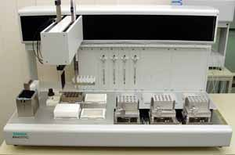
Electronic Peptides – The basic idea
The materials of organic displays
Of the shelf peptide synthesizer
O
R1
R2
O
The materials of Nature
Electronic Peptide
Electronic-grade
Tailor-made

Slide 12
Oligo- π-Conjugated Peptide-Like Systems
“Insulating” sp³
“Conductive” sp²
Notes:
For this we need a conjugated amino acid, like the thiophene amino acid.
In order to learn about the properties of this amino acid and the peptide that we can make of it, we made this protected amino acid, the dimer and the trimer.

Slide 13
Oligo- π-Conjugated Peptide-Like Systems

Slide 14
Can the Peptide Bond Serve As An Assembler for Electronic Materials ?
Peptide Bonds – π-Conjugated or Not?
Or – will the material remain a semiconductor
when such unit is used as a linker?

Slide 15
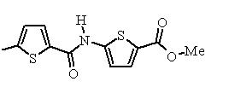

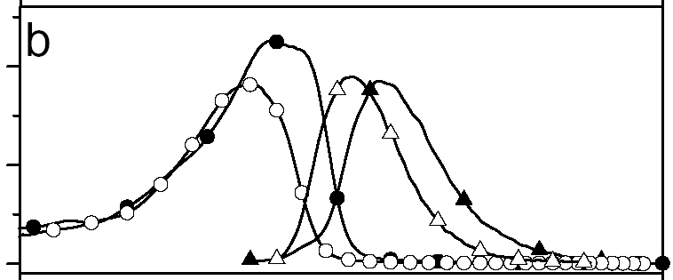
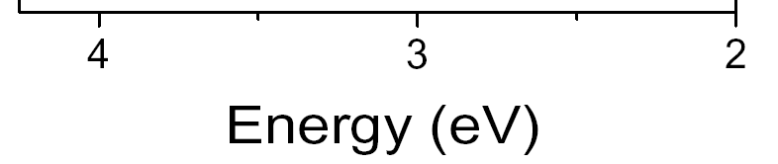
Electronic Continuity through the Peptide bond?
dipeptide
tripeptide
H₂N
H₂N
Absorption
Emission

Slide 16
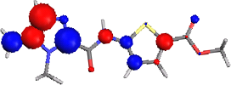

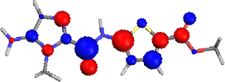

NH2-5I2-5T2-CO2Me
NO2-5T2-5T2-CO2Me
HOMO
LUMO
N
H
O
H
O
N
S
N
S
H
2
N
N
O
M
e
O
2
N
S
O
M
e
CH₃
O
O
The conjugation through the peptide bond is possible
Michelle Steel & Jerome Cornil, Mons Group

Slide 17
Can one successfully-introduce PPV analogs?
PL QE=25%
No quenching introduced by this bond despite its slight push-pull nature

Slide 18
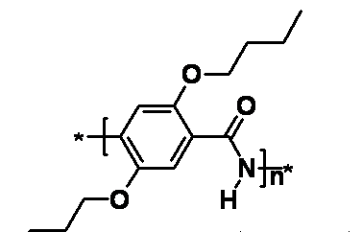
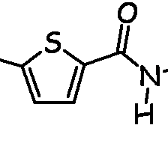
Of the shelf peptide synthesizer
H
O
*
N
*
10
O
N
O
N

