Slide 1

Generation and Recombination in Organic Solar Cells
Lior Tzabari, Dan Mendels, Nir Tessler
Nanoelectronic center, EE Dept., Technion

Slide 2
Outline
Macroscopic View of recombination P3HT:PCBM
- Exciton Annihilation as the bimolecular loss
Generalized Einstein Relation (one page)

Slide 3
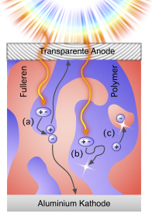
What about recombination in P3HT-PCBM Devices
Let’s take a macroscopic look and decide on the relevant processes.
What experimental technique would be best?
Picture taken from:
http://blog.disorderedmatter.eu/2008/06/05/picture-story-how-do-organic-solar-cells-function/ (Carsten Deibel)

Slide 4

Mobility Distribution Function or Spatially Dispersive Transport
Different time-scales
Different Populations
(PV is a CW device )
N. Rappaport et. al., APL, 88, 252117, 2006
N. Rappaport et. al., JAP, 99, 064507, 2006
N. Rappaport, et. al., Phys. Rev. B 76 (23), 235323 (2007).
L. S. C. Pingree, et.al., Nano Lett. 9 (8), 2946-2952 (2009).

Slide 5
QE as a function of excitation power
(If Undoped)
Only Loss Mechanism
Is
Exciton recombination
(Intra, Inter, “pairs”,…)
Free-Charge
Generation Efficiency
Cell Efficiency
HOMO
Other Losses Kick in
Al
Ca
Generating Power (mWcm⁻²)
PEDOT:PSS
N. Tessler and N. Rappaport, JAP, vol. 96, pp. 1083-1087, 2004.
N. Rappaport, et. al., JAP, vol. 98, p. 033714, 2005.
ITO
Glass

Slide 6
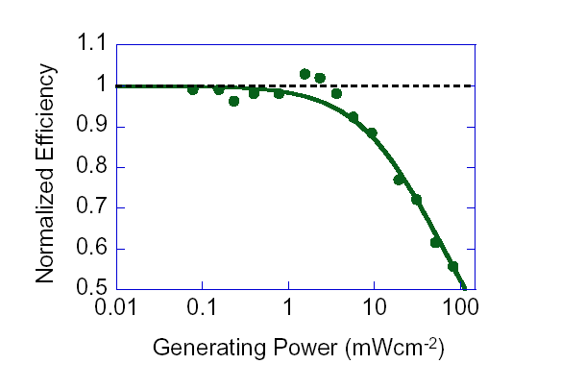
QE as a function of excitation power
Langevin /Bimolecular loss
Charge generation rate
Photo-current
Smaller Bimolecular Coefficient
No re-injection
Bimolecular recombination-current
Signature of
bi-molecular Loss
N. Tessler and N. Rappaport, Journal of Applied Physics, vol. 96, pp. 1083-1087, 2004.
N. Rappaport, et. al., Journal of Applied Physics, vol. 98, p. 033714, 2005.

Slide 7
QE as a function of excitation power
SRH (trap assisted recombination) loss
LUMO
dEt
Mid
gap
Bimolecular
HOMO
Monomol
Doped → Traps already filled
Intrinsic (traps are empty)
Nt – Density of traps.
dEt - Trap depth with respect to the mid-gap level.
Cn- Capture coefficient
L. Tzabari, and N. Tessler, Journal of Applied Physics 109, 064501 (2011)

Slide 8
QE as a function of excitation power
SRH (trap assisted recombination) loss
Fewer Traps
LUMO
Traps
Mid
gap
Deeper Traps
HOMO
L. Tzabari, and N. Tessler, Journal of Applied Physics 109, 064501 (2011)

Slide 9
What can we learn using simple measurements
(intensity dependence of the cell efficiency)
Bi- Molecular
SRH (trap assisted)
L. Tzabari, and N. Tessler, Journal of Applied Physics 109, 064501 (2011)

Slide 10

Recombination in P3HT-PCBM
4min
1.5e-12 | K_{b}[cm³/sec]
1
4 min
Anneal
0.95
0.9
K_{b} – Langevin bimolecular
recombination coefficient
In practice detach it from its physical origin and use it as an independent fitting parameter
0.85
0.8
Normalized QE
0.75
0.7
0.65
, - Experiment
, - Model
190nm of P3HT(Reike):PCBM (Nano-C)(1:1 ratio, 20mg/ml) in DCB
PCE ~ 2%
0.6
0.55
-2
0
2
10
10
10
Intensity [mW/cm²]
Notes:
צריך קבוע יותר גדול – הגיוני כי הניידות גדלה.
אבל!!! מצד שני שינוי הניידות בלבד יביא לתוצאות הפוכות מאחר והגדלת הניידות מגדילה גם את יכולת האיסוף – וברגע שיכולת האיסוף גדלה כמות נושאי המטען האפקטיבית בהתקן קטנה ומנגנוני האיבוד נכנסים מאוחר יותר.
=> יכול להיות שינוי תלוי מורפולוגיה בלבד.

Slide 11

Recombination in P3HT-PCBM
10min | 4min
8e-12 | 1.5e-12 | K_{b}[cm³/sec]
4 min
10 min
, - Experiment
, - Model
Notes:
צריך קבוע יותר גדול – הגיוני כי הניידות גדלה.
אבל!!! מצד שני שינוי הניידות בלבד יביא לתוצאות הפוכות מאחר והגדלת הניידות מגדילה גם את יכולת האיסוף – וברגע שיכולת האיסוף גדלה כמות נושאי המטען האפקטיבית בהתקן קטנה ומנגנוני האיבוד נכנסים מאוחר יותר.
=> יכול להיות שינוי תלוי מורפולוגיה בלבד.

Slide 12
Shockley-Read-Hall Recombination
LUMO
dEt
4 min
Mid gap
10 min
HOMO
Intrinsic (traps are empty)
, - Experiment
, - Model
I. Ravia and N. Tessler, JAPh, vol. 111, pp. 104510-7, 2012. (P doping < 10¹²cm⁻³)
L. Tzabari and N. Tessler, "JAP, vol. 109, p. 064501, 2011.

Slide 13
Shockley-Read-Hall + Langevin
The dynamics of recombination at the interface is both
SRH and Langevin
10min | 4min
1.2e17 | 1.9e17 | Nt [1/cm³]
0.371 | 0.435 | dEt [eV]
0.5e-12 | 0.5e-12 | Kb[cm³/sec]
4 min
10 min
, - Experiment
, - Model
LUMO
dEt
Mid
gap
HOMO

Slide 14
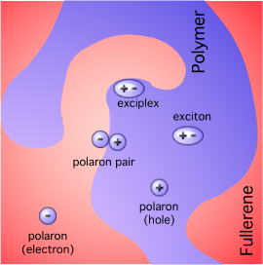
Exciton Polaron Recombination
M. Pope and C. E. Swenberg, Electronic Processes in Organic Crystals., 1982.
Neutrally excited molecule (exciton) may transfer its energy to a charged molecule (electron, hole, ion).
As in any energy transfer it requires overlap between the exciton emission spectrum and the “ion” absorption spectrum.

Slide 15
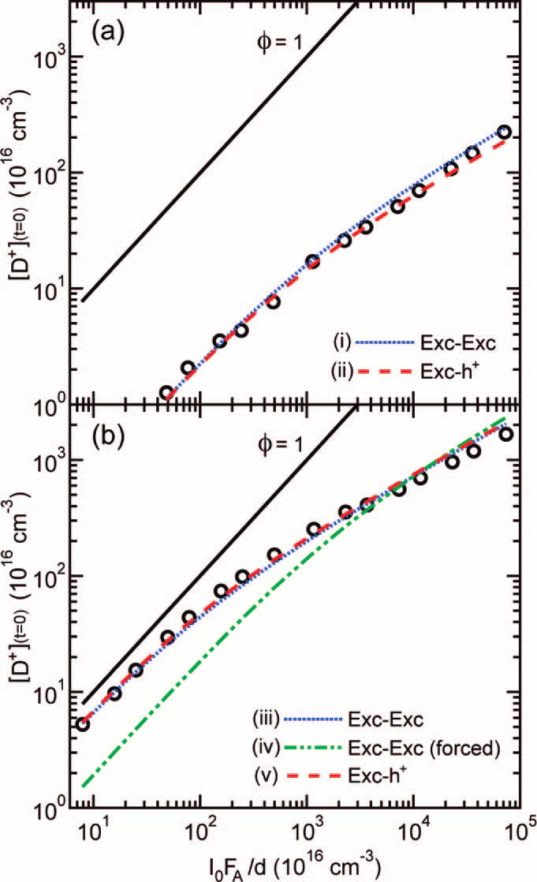
Quenching of Excitons by Holes in P3HT Films
A. J. Ferguson, N. Kopidakis, S. E. Shaheen and G. Rumbles, J Phys Chem C 112 (26), 9865, 2008
In neat P3HT ramping the excitation power results in exciton-exciton annihilation
Generated Charge Density (at t=0)
Add 1% PCBM and losses become dominated by Exciton-Polaron recombination.
Kep=3x10⁻⁸ cm³/s
Excitation Density

Slide 16

Exciton Polaron Recombination
Sensitivity | 10min | 4min
0 | 1.05e17 | 1.9e17 | Nt [1/cm^3]
0.015 | 0.365 | 0.435 | dEt [eV]
1.08e-8 | 1.6e-8 | 1.6e-8 | Kep[cm^3/sec]
4 minutes
10 minutes
Nt – Density of traps.
dEt - trap depth with respect to the mid-gap level.
Kep – Exciton polaron recombination rate.
Kd– dissociation rate
1e9-1e10 [1/sec]
, - Experiment
, - Model
A. J. Ferguson, et. al., J Phys Chem C, vol. 112, pp. 9865-9871, 2008 (Kep=3e-8)
J. M. Hodgkiss, et. al., Advanced Functional Materials, vol. 22, p. 1567, 2012. (Kep=1e-8)

Slide 17
Traps or CT states are stabilized during annealing
4 minutes
Sensitivity | 10min | 4min
0 | 1.05e17 | 1.9e17 | Nt [1/cm^3]
0.015 | 0.365 | 0.435 | dEt [eV]
1.08e-8 | 1.6e-8 | 1.6e-8 | Kep[cm^3/sec]
10 minutes
T. A. Clarke, M. Ballantyne, J. Nelson, D. D. C. Bradley, and J. R. Durrant, "Free Energy Control of Charge Photogeneration in Polythiophene/Fullerene Solar Cells: The Influence of Thermal Annealing on P3HT/PCBM Blends," Advanced Functional Materials, vol. 18, pp. 4029-4035, 2008. (~50meV stabilization)

Slide 18
Bias Dependence
10 minutes anneal
- Generation
- Recombination
- Mobility
Charge
Generation

Slide 19
What does it all mean
(summary, conclusions,…)
The “geminate” recombination occurs through “defect sites” and their availability limits the recombination.
“Defect sites” or “Traps” act like stabilized charge transfer states.
At high enough density (depending on morphology) a new channel opens up and Losses become Bi-molecular.
Bi-molecular = electron-hole or exciton-polaron?
Charge generation requires some field and this is observed at very low light intensities

Slide 20
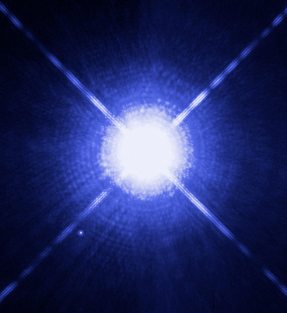
Disordered hopping systems
degenerate semiconductors
Y. Roichman and N. Tessler, APL, vol. 80, pp. 1948-1950, Mar 18 2002.
Degenerate
To describe the charge density/population one should use Fermi-Dirac statistics and not Boltzmann
Degenerate (gas)
Degenerate (gas) Pressure
∇ Pressure = Enhanced Diff.
White Dwarf
It’s effect is in basic thermodynamics texts.
Astronomy: Degenerate gas pressure.
Fluidics: Osmosis
Drift
Diffusion
Diffusion
Seebeck
Streaming
Streaming
Enhanced
Diffusion
In Semiconductors:
D. Mendels and N. Tessler, J. Phys. Chem. C 117 (7), 3287-3293 (2013).

Slide 21
Thank You
Ministry of Science, Tashtiyot program
Helmsley project on Alternative Energy of the Technion, Israel Institute of Technology, and the Weizmann Institute of Science
Israeli Nanothecnology Focal Technology Area on "Nanophotonics for Detection"

Slide 22
Charge recombination is activated

Slide 23
Why Generalized Einstein Relation does not affect the Ideality Factor of PN Diode
Long Diode [N. Tessler and Y. Roichman, Org. Electron. 6 (5-6), 200-210 (2005)]
In Amorphous semiconductors:
Exponential DOS
Short Diode
[Y. Vaynzof, Y. Preezant and N. Tessler, Journal of Applied Physics 106 (8), 6 (2009)]

