Slide 1

can we recover 0.2eV of open circuit voltage?
Nir Tessler, Lior Tzabari
Microelectronic and Nanoelectronic Centers,
Electrical Engineering Department,
Technion Israel Institute of Technology,
Haifa 32000, Israel

Slide 2
Outline
What we (slowly) learned over the years about BHJ
(Power dependent QE method)
Maybe the fault is in the device structure and not the materials
(Contact Engineering)

Slide 3
Some of the processes in
P3HT-ICBA Devices
Generation
Loss
+
-
Light
Light emission
Exciton
-
-
Charge recombination
+
-
Charge transfer
Exciton
Polaron-Exciton
annihilation
+
+
-
- +
Free charges
+
Anode (positive contact)

Slide 4
The Physical Framework we built
+
-
- +
+
+
-
-
+
-
- +
+
+
L. Tzabari, V. Zayats and N. Tessler; J. Appl. Phys. 114, 154514 (2013)

Slide 5
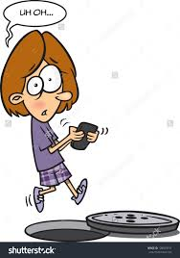
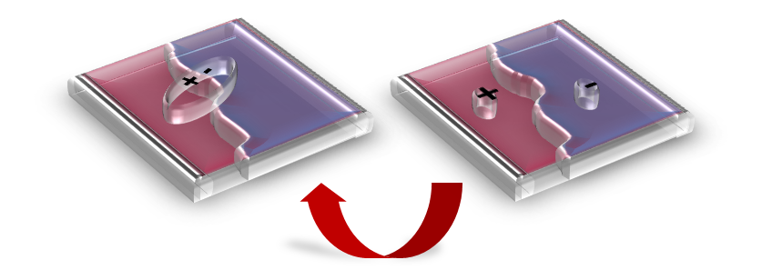
Shockley-Read-Hall (SRH) recombination
Capture cross section is as in Langevin recombination
Kuik, M., et. al. Physical Review Letters, 107(25), 256805, (2011).

Slide 6
3 Simplifications
1. Effective electronic band gap
2. CT states = charge recombination traps
3. CT (trap) of narrow energy band (1 level)
LUMO
LUMO
LUMO
Free polaron
Conduction band
E_{b}
E_{b}
Donor
Traps
Polaron pair (CT)
ΔE_{t}
+ Charge transfer state -
E_{Fi}
Acceptor
E_{CT}
Eg/2
HOMO
HOMO
Ground state
Valence band
HOMO
L. Tzabari, et. al., "The Role of Charge Transfer States …. ," J Phys Chem C, 2014.
R. A. Street, Advanced Functional Materials, 22(21), 4608–4619 2012

Slide 7
Model’s Equations
Notation:

Slide 8
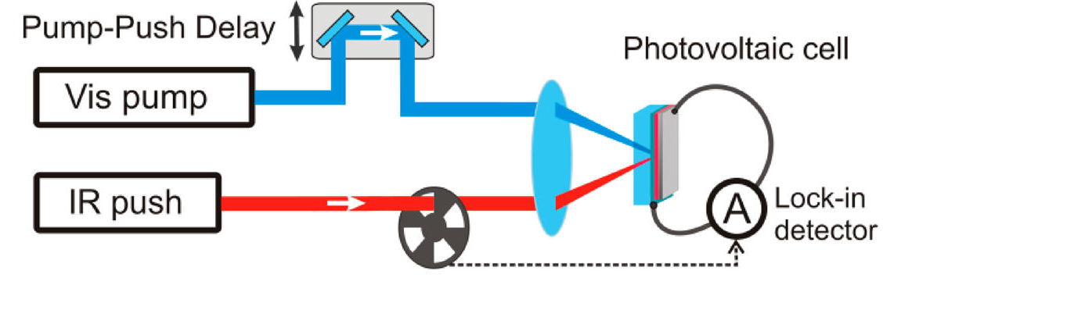
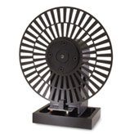
Time resolved pump-probe techniques
Typically all excitations are found to decay within a μs.
Log P
Log t
External quantum efficiency of solar cells
Sometimes excitations live up to milliseconds

Slide 9
Why CW ?
Equilibrium? Steady state?
Chain morphology?
Mobility
When we apply Electric field
Chain + 4 site conjugation
Charges go up in energy
Chain morphology
Effective temperature of e⁻
mobility
Cubic lattice
Polymers have higher tendency towards “quasi” equilibrium
D. Mendels & N. Tessler, Scientific reports , to be published.

Slide 10
Why CW ?
Efficient charge generation by relaxed charge-transfer states at organic interfaces.
Koen Vandewal,…., Alberto Salleo; Nature Mat, 2014, 13, 63-68.
There are lots of processes on the sub ns time scale. But by the time the device cares about it - all populations are at quasi equilibrium

Slide 11
QE as a function of excitation power @ V_{SC}
Free-Charge
Generation Efficiency
Cell Efficiency
Other Losses Kick in
HOMO
Al
Ca
Generating Power (mWcm⁻²)
N. Tessler and N. Rappaport, JAP, vol. 96, pp. 1083-1087, 2004.
N. Rappaport, et. al., JAP, vol. 98, p. 033714, 2005.
PEDOT:PSS
ITO
Glass

Slide 12
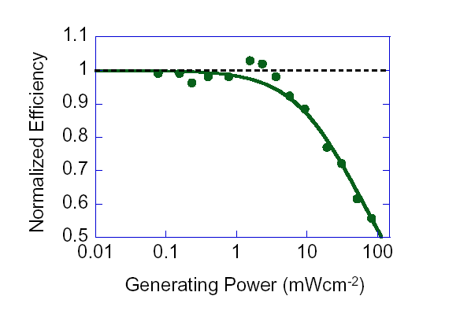
Signature of bi-molecular loss mechanism
Smaller Bimolecular Coefficient
Signature of
bi-molecular Loss
N. Tessler and N. Rappaport, Journal of Applied Physics, vol. 96, pp. 1083-1087, 2004.
N. Rappaport, et. al., Journal of Applied Physics, vol. 98, p. 033714, 2005.

Slide 13
SRH Recombination
- QE as a Function of Light Intensity
Fewer Traps
LUMO
dEt
HOMO
Deeper Traps
L. Tzabari, and N. Tessler, J Appl Phys 109, 064501 (2011)
L. Tzabari, et. al., J Appl Phys, vol. 114, p. 154514, 2013.
Notes:
The SRH recombination in the context of blends describes the fact that in a BHJ an electron-hole recombination can occur only at specific spatial location (the interface between the two phases) and through certain energy levels (CT states). Those sites will be treated as the SRH recombination centers (the "traps"). Their density will reflect the interface density, and their depth will follow the system energetic levels. This process starts as a bimolecular process (hence the drop) and as the recombination centers are filled it becomes monomolecular and its effect on the QE saturates. Therefore the clear signature of SRH is mainly visible at the low excitation regime.

Slide 14
Fitting procedure
Normalization is done to the absolute value at the low intensity regime of the V_{app}=0V curve.
SRH
Bimolecular
V_{app}

Slide 15
Fitting procedure
(a)
(b)
6.5e15cm⁻³
CT density
9.5e15cm⁻³
(c)
(d)
9.5e14cm⁻³
7.5e14cm⁻³
3.5e14cm⁻³
Dark carrier density
(e)
(f)
3e³
3e⁴

Slide 16
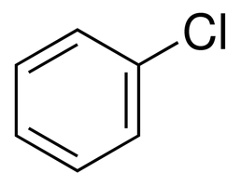
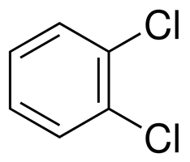
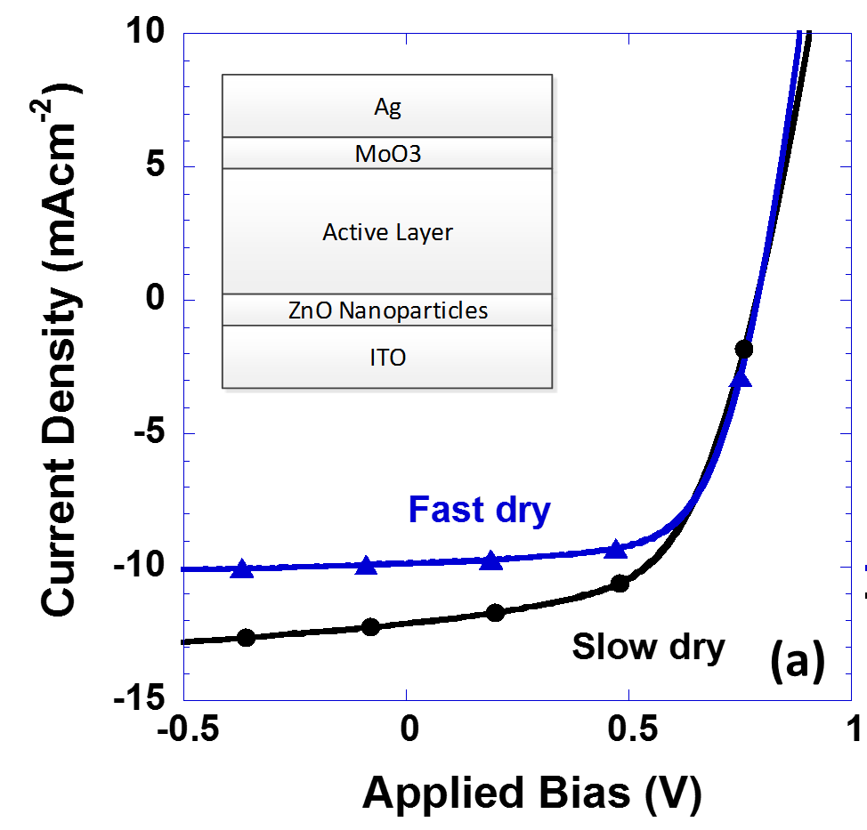
Fast Dry vs. Slow Dry (CB vs. DCB)
.
What else is there?
Traps are FULL
Electrochemical potential difference should be high
L. Tzabari, et. al., J. Phys. Chem. C, 120(19), 10146–10155, 2016..
Notes:
Examining the results we suggest that the SRH recombination centers are the Charge Transfer States (CT's) at the interface between the different phases. The CT's are used at the same time as a generation center for exciton dissociation, and as a recombination pathway for free carriers. As the CT's density is a function of the phase segregation in the active layer, we claim that our findings indicate that using the slow dry process results in finer phase segregation.
It is important to note that although exhibiting more SRH loss, the slow dry devices are more efficient than the fast dry ones due to their higher generation efficiency which results from the same CT's that cause the recombination loss. The relative overall generation efficiency can be extracted from the plateau in the not normalized QE graph

Slide 17

Electrochemical Pot. Diff.?
Molecular Picture
V_{OC}=0.8 V
CT binding energy = Trap
0.2 eV ?
Acceptor LUMO
Δμ ≥ 1.0 eV
Donor HOMO

Slide 18
Semiconductor Device Model
What happens @ V_{OC}?
It is not just a possibility the device is actually doing it!
V=V_{OC}
0.16V at the Contact + 0.04V in the Bulk = 0.2 V
L. Tzabari, et. al., J Phys Chem C, 118(48), 27681–27689 (2014).
V. D Mihailetchi et. al. Journal of Applied Physics, 94(10), 6849–6854. (2003).
T. Kirchartz, et. al., Journal of Physical Chemistry Letters, 4(14), 2371–2376. (2013).

Slide 19
The effect of pinned electrodes
V_{bi} limits V_{OC}
Liu, B., (2014). Advanced Energy Materials, 4(4), 1200972.

Slide 20
Move to full device model
(making sure it reproduces real device data)
Short Circuit
Open Circuit
0.81+0.037*ln(S)
P3HT-ICBA
P3HT-PCBM
0.60+0.040*ln(S)
Tessler, N. “Experimental techniques and…” J. Poly. Sc. B, 52(17), 1119–1152. (2014).
Tessler, N. “Adding 0.2 V to….” Journal of Applied Physics, 118(21), 215501. (2015).

Slide 21
Can we add %% to PCE
LUMO
LUMO
HOMO
HOMO
ICBA
Bis-PCBM
PCBM
Higher Built-in Potential
LUMO
LUMO
HOMO
HOMO

Slide 22
We often observe that improving materials affects only FF
Reducing bulk losses x 10

Slide 23
LUMO, Conduction
P3HT:ICBA
HOMO, Valence
Standard, 0eV
+ 0.1V
25% increase in PCE
0.2eV
C_{n}N_{t}=3.3x10⁴s⁻¹
0.3eV

Slide 24
Something slightly better than P3HT
Standard, 0eV
+ 0.2V in V_{OC}
48% increase in PCE
0.2eV
C_{n}N_{t}=3.3x10³s⁻¹
0.3eV

Slide 25

Comparing Materials ?
Can’t always just blame the chemist
Standard
Structure
Band gap enhanced
structure

Slide 26
Full Device Model
-
E_{G} =1.36
V_{bi}=1.56
V_{OC}=1V
E_{Fe}
E_{Fh}
+

Slide 27

Thank You
Summary
Intensity dependent QE is a powerful tool & simple model
Contact Engineering can recover FF, I_{SC}, & 0.2V of V_{OC}
Collaborations
  Prof Julia WP Hsu (University of Texas at Dallas)
  Jian Wang
  Yun-Ju Lee
Israel Science Foundation
INNI Focal Technical Area on Nano-Photonics
The fabrication was performed at the Micro-Nano Fabrication Unit (MNFU), Technion.

