Slide 1
Dan Mendels, Nir Tessler
Mobility and Diffusion under the Premise of Solar Cells
The Role of Energy-Transport
Sara & Moshe Zisapel Nanoelectronic Center
Electrical Engineering Dept.
Haifa 32000
Israel
www.ee.technion.ac.il/nir

Slide 2
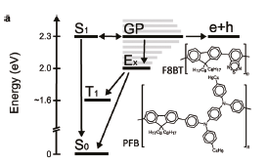

The operation of Solar Cells is all about balancing nergy
Think “high density” or “many charges” NOT “single charge”
There is extra energy embedded in the ensemble
If you came from session P.
There is also pseudo band like behavior

Slide 3
The Physical Framework
Steady State I-V measurements
Steady State → Qausi Equilibrium (Incl. Traps)
[1] K. C. Kao and W. Hwang, Electrical transport in solids vol. 14. New York: Pergamon press, 1981.
[2] H. T. Nicolai, M. M. Mandoc, and P. W. M. Blom, "Electron traps in semiconducting polymers…" PRB, 83, 195204, 2011.
Not the transient, possibly dispersive, transport where D/μ may be VERY HIGH
R. Richert, L. Pautmeier, and H. Bassler, "Diffusion and drift of charge-carriers in a random potential - deviation from Einstein law," Phys. Rev. Lett., vol. 63, pp. 547-550, 1989.

Slide 4
Original Motivation
Measure Diodes I-V
Extract the ideality factor
Y. Vaynzof et. al. JAP, vol. 106, p. 6, Oct 2009.
The ideality factor
Is the Generalized Einstein Relation
The Generalized Einstein Relation is NOT valid for
organic semiconductors
G. A. H. Wetzelaer, et. al., "Validity of the Einstein Relation in Disordered Organic Semiconductors," PRL, 107, p. 066605, 2011.

Slide 5
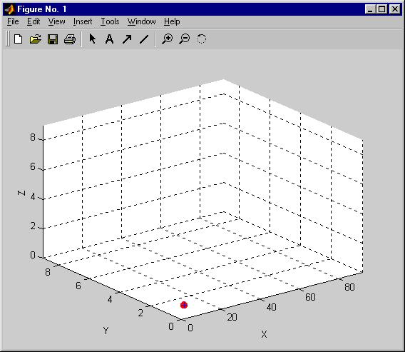
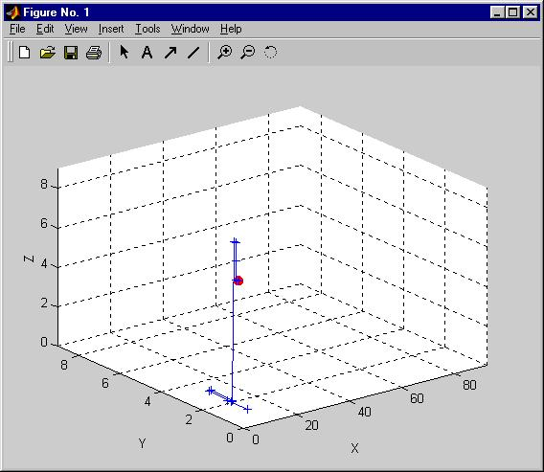
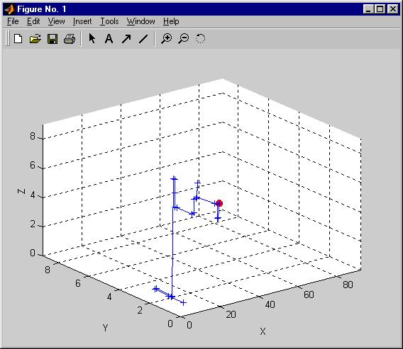
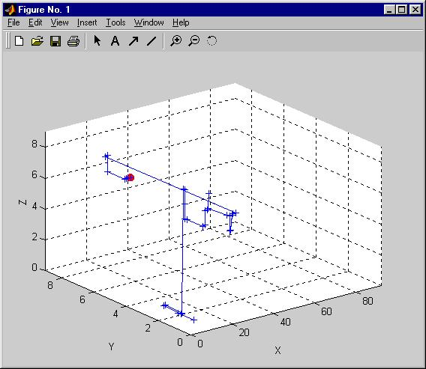
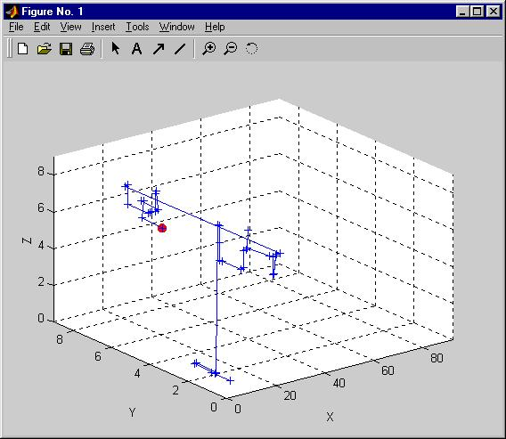
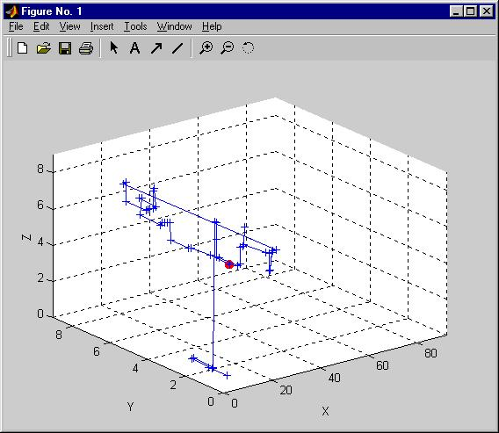
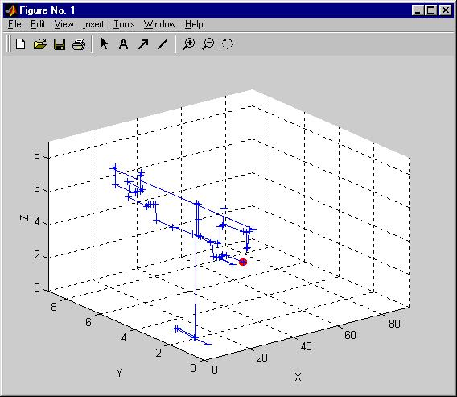
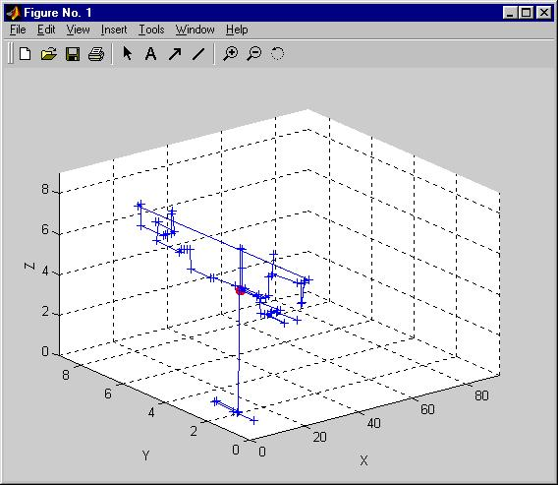

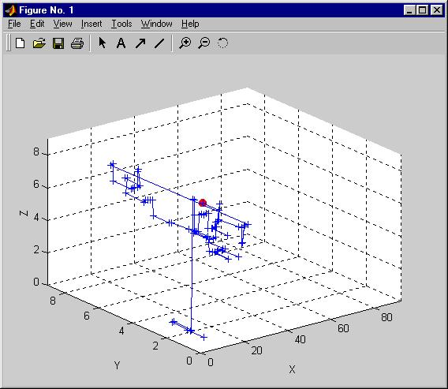
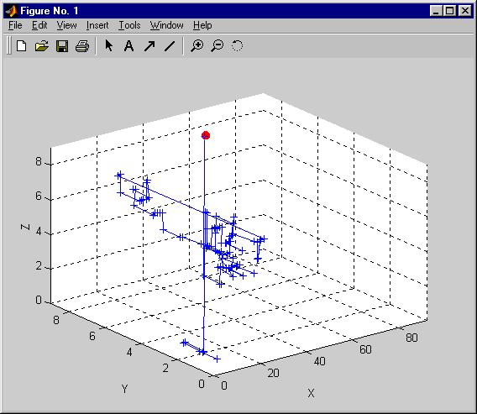
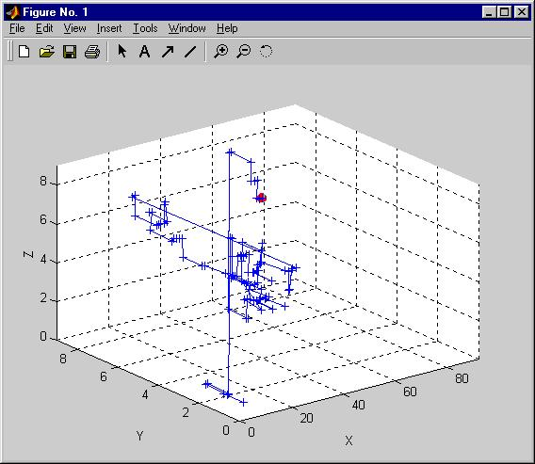

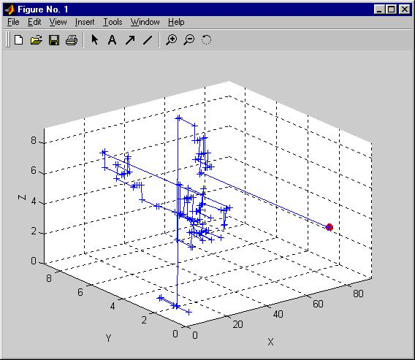
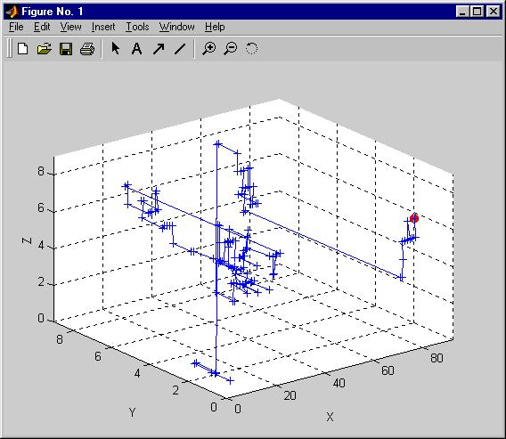
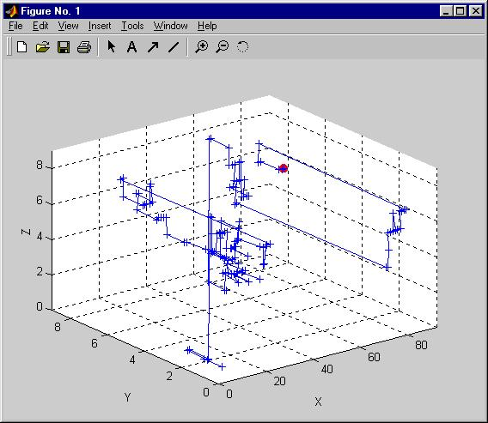
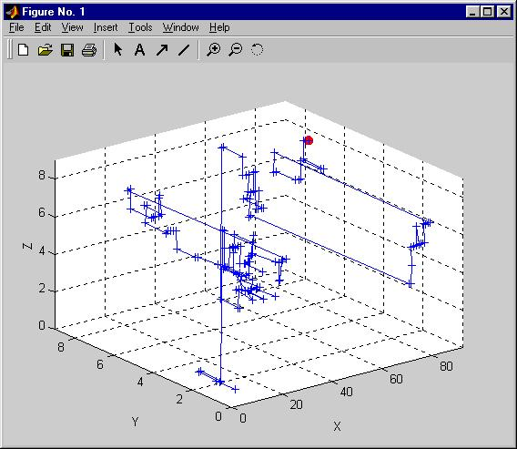
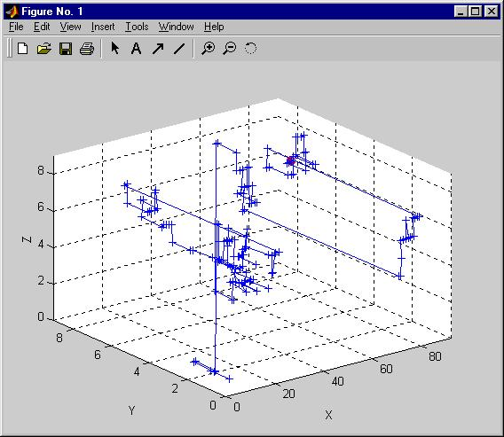
Monte-Carlo simulation of transport
Standard M.C. means uniform density
G.E.R.
Monte-Carlo
Y. Roichman and N. Tessler, "Generalized Einstein relation for disordered semiconductors - Implications for device performance," APL, 80, 1948, 2002.

Slide 6
Comparing Monte-Carlo to
Drift-Diffusion & Generalized Einstein Relation
Implement contacts as in real Devices
qE
qE
GER Holds for real device Monte-Carlo Simulation

Slide 7
Where does most of the confusion come from
D →The intuitive Random Walk
The coefficient describing
Generalized Einstein Relation is defined ONLY for
J. Bisquert, Physical Chemistry Chemical Physics, vol. 10, pp. 3175-3194, 2008.

Slide 8
What is Hiding behind
E
E
There is an Energy Transport
X
X
Charges move from high density region to low density region
Charges with High Energy move from high density region to low density

Slide 9
The Energy Balance Equation
The operation of Solar Cells is all about balancing nergy
R
ΔE

Slide 10
How much “Excess” energy is there?
150meV
σ=3kT
DOS = 10²¹cm⁻³
N=5x10¹⁷cm⁻³=5x10⁻⁴ DOS
Low Electric Field
B. Hartenstein and H. Bassler, Journal of Non - Crystalline Solids 190, 112 (1995).

Slide 11
The High Density Picture
Mobile and Immobile Carriers
Jumps distribution
Is it a BAND?
σ=3kT
DOS = 10²¹cm⁻³
N=5x10¹⁷cm⁻³=5x10⁻⁴ DOS
Low Electric Field
Mobile Carriers
Transport is carried by high energy carriers

Slide 12
Summary
Thank You
Transport: Many Charges ≠ Single Charge
  Mobile and Immobile (“trapped”, “Band”) charges
Transport of energy!
  There is “excess” energy in the system.
Where do the carriers hop in energy
  Not around E_{F}.
Ideality factor Einstein relation?
Recombination
Seebeck
Effect

Slide 13
Mott’s Variable Range Hopping
E
r
r and ΔE are determined so as to maximize the hopping rate
For a constant density of states:
For a shaped density of states:
ε
Transport Energy (E_{t}=?)
Effective intermediate energy
ΔE
Effective initial energy

Slide 14
1. Mobility is charge density dependent
2.
Transport Energy
3. is
K_{B}T
There is transport of energy even in the absence of Temperature gradients
Effective Initial Energy
(a)

Slide 15
What if we analyze the standard (uniform density) Monte-Carlo
GER
Monte-Carlo

Slide 16
e⁻ & E

Slide 17
Does the Generalized Einstein Apply
Does your system obey the laws
of Thermodynamics

