Slide 1
Dan Mendels, Ariel Ben Sasson, Michael Greenman, Nir Yaacobi-Gross, Ariel Epstein, Nir Tessler
Electrical Engineering Perspective of a Material Driven Field
Sara & Moshe Zisapel Nanoelectronic Center
Electrical Engineering Dept.
Haifa 32000
Israel
www.ee.technion.ac.il/nir

Slide 2
Outline
Transport (do we know it all?)
Material manipulations by EE
Engineering tool for OLED analysis
Engineering FET structure (VOFET)

Slide 3

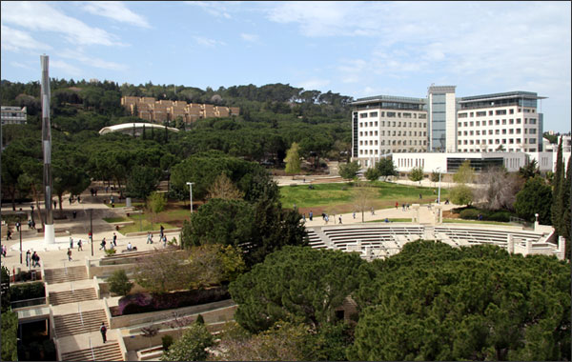
Technion Campus

Slide 4
Lab to FAB
Large size companies got seriously involved at around 1997
Today, 15 years later, there are still some basics we don’t know
In the context of amorphous organic semiconductors

Slide 5
Trivia
Chemical potential
Fermi level
Equilibrium
Drift Diffusion
Warning: each topic is dealt by at least two different communities (disciplines) that have developed their own “obvious” meaning of the terminology.

Slide 6
Chemical Potential
Equilibrium
Vacuum Level
E
E_{c}
Conduction
Eg
E_{v}
Valence
Chemical potential is the energy to be added to the system if an electron is added. Electron can reside either in Valence or Conduction band according to Fermi Dirac statistics. Under equilibrium it equals the parameter in the FD statistics (E_{F}).
We consider the following reaction:

Slide 7
Quasi Chemical Potential
Non-Equilibrium
Vacuum Level
Vacuum Level
E
E
QCP_{e}
Generally:
Quasi Chemical potential
≠
E_{F} in the FD statistics (quasi - E_{F}).
(for ideal gas they are equal)
QCP_{h}
E_{c}
E_{c}
Conduction
E_{Fe}
E_{Fh}
E_{v}
E_{v}
Valence
Quasi Chemical potential is the energy to be added to the system if an electron is added. Electron can reside only in the band the quasi chemical potential refers to. In the respective band it will reside according to Fermi Dirac statistics with the respective quasi - E_{F}.

Slide 8
Disorder and Anderson Localization
E
High Order
E
Band
x
Density of states
Low disorder
E
E
Band
Tail states (traps)
x
Density of states
High disorder
E
E
Density of localized states
x
Density of states

Slide 9
Transport
R
ΔE
R
ΔE
InGaAs
InP
PFOBT
PFO
When considering many
molecules or sites one uses a variant of
Mott’s Variable Range Hopping

Slide 10
Mott’s Variable Range Hopping
E
r
r and ΔE are determined so as to maximize the hopping rate
For a constant density of states:
For a shaped density of states:
ε
Transport Energy (E_{t}=?)
Effective intermediate energy
ΔE
Effective initial energy

Slide 11
Transport Energy
K_{B}T
J. O. Oelerich et. al. APL, 97, 143302, 2010.
Effective Initial Energy (QCP)
D. Mendels & N. Tessler, Submitted.

Slide 12
1. Mobility is charge density dependent
2.
Transport Energy
3. is
K_{B}T
There is transport of energy even in the absence of Temperature gradients
Effective Initial Energy
(a)

Slide 13
If
Seebeck effect
BUT
For most practical scenarios the GER is a very good approximation
G.E.R.
The effect is linked to charge density gradients.
Let’s examine a case where current flows and there is
no charge gradient
D/μ = Einstein relation
Monte-Carlo
new formalism

Slide 14
Engineers’
Engineering of Materials
Creating building blocks
to allow for device engineering

Slide 15
Building Electronic Materials with LEGO bricks

Slide 16
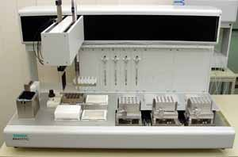
Electronic Peptides
The basic idea
The materials of organic displays
Of the shelf peptide synthesizer
O
R1
R2
O
The materials of Nature
Electronic Peptide
Electronic-grade
Tailor-made
Yoav Eichen, Chemistry, Technion

Slide 17
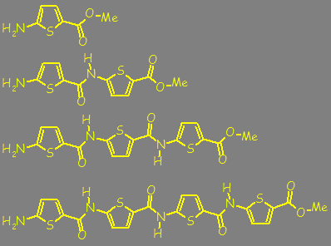
Works like a charm but for:
Amide bond is only slightly conjugated
Film morphology is difficult to control
(probably H bonds)
N. Tessler et. al., "Conjugated Polymer Electronics – Engineering Materials and Devices," in Handbook of Conducting Polymers, CRC, 2006

Slide 18
  Colloidal nanocrystals (NCs)
Organic capping layer (Ligands)
8-18 aliphatic carbon chain
Allows solubility
Stabilizes the QDs
Act as a barrier for charge transfer
core
Greenham, N. et al. Phys Rev B, 1996, 54, 17628
Notes:
Up until recently the capping layer was underestimated and was mostly looked at as to:
Allow solubility
Stabilizes the QDs
Act as a barrier for charge transfer

Slide 19
Ligands Exchange
Y
Y
InAs
X
Y
Y
X
Y
Y
X
X
Y
X
TOP
(trioctylphosphine)
X
X
Free dipole
Y
NH₂
SH
X
OCH₃
CH₃
NO₂
Michal Soreni-Harari, et. al., Nano Lett. 8, 678-684, (2008).
Notes:
Ligands exchange in order to examine the effect of the ligands dipole
We expose the NCs to high excess of competing ligands
were incubated for at least 72 h and then precipitated with methanol. After separation by centrifugation, excess ligand was removed by redispersion in toluene and precipitation with methanol

Slide 20
HOMO level shifting
(Differential Pulsed Voltammetry)
InAs
4.4 nm
SH
NH₂
Surface ligands
CH₃
H
TOP (original)
MTP
aniline
Vacuum level
-4.7eV
-4.95eV
-5.05eV

Slide 21
Size Matters
4.4nm diameter
Sub 2nm diameter
Why ?

Slide 22
Partial Ligands Exchange
CH₂(CH₂)₁₄CH₃
CdSe
NH₂
Are we polarizing
SH
CH₃
N. Yaacobi-Gross et. al. , "Molecular control of quantum-dot internal electric field …." Nat Mater, vol. 10, pp. 974-979, 2011.
Notes:
Ligands exchange in order to examine the effect of the ligands dipole
were incubated for at least 72 h and then precipitated with methanol. After separation by centrifugation, excess ligand was removed by redispersion in toluene and precipitation with methanol

Slide 23
Adding small fractions of free MTP ligands.
Mixed Ligands CdSe
CH₃
Mixed Ligands
→ Stark Shift
SH
NH₂
HDA
CdSe
Nir Yaacobi-Gross et. al., Nature Materials 10, 974-979 doi:10.1038/nmat3133

Slide 24
Ligands induced bulk heterojunction in near IR active all nanocrystals solar cells
Results:
Stark shift helps to dissociate charges

Slide 25
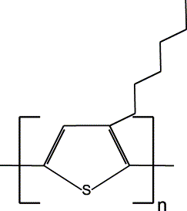
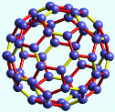
Formulations
Wide gap x-linkable conjugated matrix
Emitter (green PPV)
Triarylamine
m=3% n=48.5% o=48.5%
Transport (P3HT)
PVK-Cin
Dopant (C60Fxx)
O. Solomeshch et. al, "Electronic formulations…” Adv. Func. Mat, 16, 2095, 2006.

Slide 26


Formulations
Patterning
Stable Hole injection layer
(PVK-Cin + P3HT + C60F36)
or
(PVK-Cin+ PolyTPD+C60F48)
110c in Vacuum
Single pixel
two-Color OLED
(no loss of efficiency during processing)
X-Linking → Stability
O. Solomeshch et. al., "Electronic formulations - Photopatterning of luminescent conjugated polymers," Advanced Functional Materials, vol. 16, pp. 2095-2102, Oct 2006.
O. Solomeshch, et. al., “…Electrical Doping of Fluorinated C-60 in Conjugated Polymers," Advanced Materials, vol. 21, pp. 4456-+, Nov 2009.

Slide 27
Engineering Tool
Simple method to extract recombination zone parameters in OLEDs

Slide 28
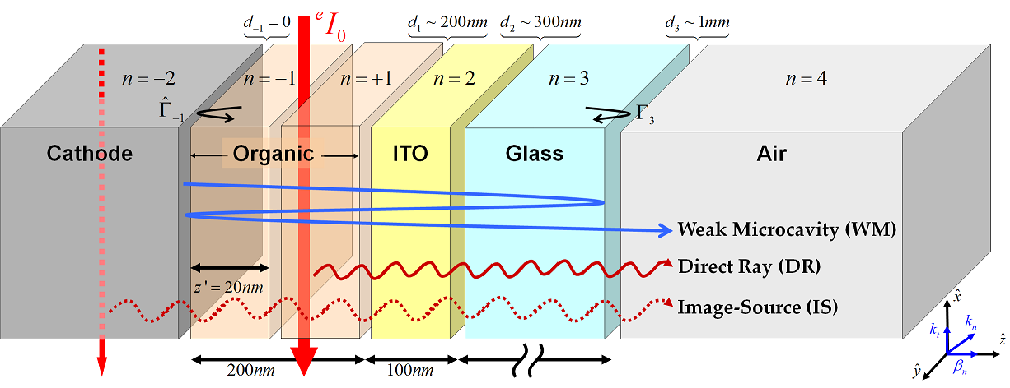
Closed-form solution
Cathode
ITO
Image-Source
Spatial broadening factor
Direct-Ray
A. Epstein, N. Tessler, and P. D. Einziger,
IEEE J. Quantum Elect., 46, 9, pp. 1388-1395 (2010).
Weak-microcavity
Spectral broadening

Slide 29
Emission zone (EZ) location effect
Very narrow emission zone
Different positions ↔
Emission pattern extrema
Origin: Image-Source interference (reflecting cathode)
Cathode
ITO

Slide 30
Emission zone (EZ) width effect
Symmetrical distribution
Different widths ↔
“Fringe visibility” (ratio)
Origin: Image-Source interference averaged
Cathode
ITO
A. Epstein, N. Tessler, and P. D. Einziger, Opt. Lett., 35, 20, pp. 3366-3368 (2010).

Slide 31
Blue P-OLED (CDT OLED)
Angular spectra
Device under test
Aluminium
LEP 130nm
IL 15nm
HIL 35nm
ITO 45nm
Glass Substrate 0.7mm
Angle [°]
Glass hemisphere (centre is at emissive area)
‘p’ pol (TM)
‘s’ pol (TE)
M. Roberts, K. Asada, M. Cass, C. Coward, S. King, A. Lee, M. Pintani, M. Ramon, and C. Foden, Proc. SPIE Photonics 7722, 77220C, Brussels (2010)

Slide 32
Emission zone location
Maxima angles

Slide 33
Engineering Device Structures

Slide 34
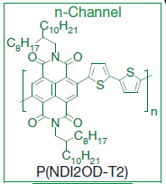
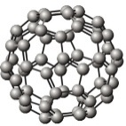
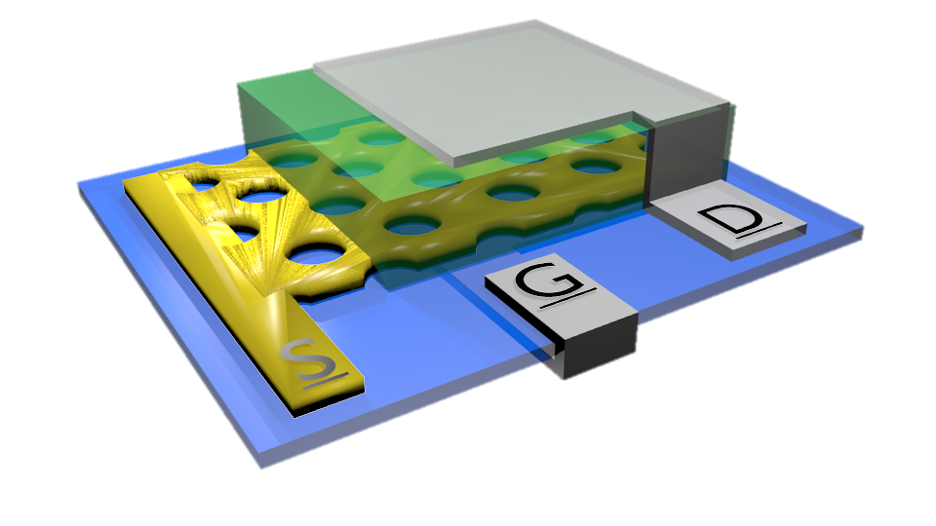
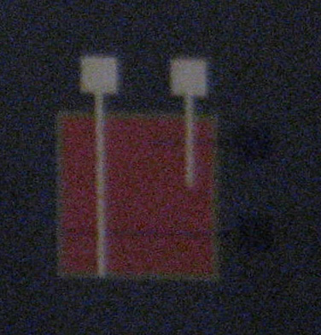
Device architecture
3D Illustration
Macro scale top view
500μm
100μm
100μm
Fundamental parameters
Gate – Al
L - Channel length - active layer thickness
D - Perforations’ diameter (~80nm)
FF - perforations area ratio
t_{d} & t_{s}
Drain – Al
Dielectric – t_{d}
Active layer
Patterned source – t_{s} 100Å Au
O. Globerman, "Lateral And Vertical Organic Field Effect Transistors," M.Sc., Electrical Engineering, Technion Israel Institute of Technology, Israel, 2006.

Slide 35
How does it work?
Drain
Patterned source
Gate Insulator
Gate
V_{G} > 0

Slide 36
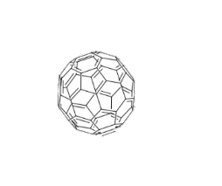
The effect of the perforations’ aspect ratio
Measurements
Simulations
Drain
(a)
V_{DS}=1V
(b)
V_{DS}=1V
h_{S}[nm]
ON
7
9
13
I_{G}[A]
φ_{b0}=0.68eV.
S
e⁻
SC
D
h_{S}
D=80nm
Φ_{b0}
h⁺
Gate Insulator
C₆₀
Au
Al
Gate
“Thick” source → Tunnel effect
A. J. Ben-Sasson, E. Avnon, E. Ploshnik, O. Globerman, R. Shenhar, G. L. Frey, and N. Tessler, "Patterned electrode vertical field effect transistor fabricated using block copolymer nanotemplates," Applied Physics Letters, vol. 95, p. 213301, 2009.
A. J. Ben-Sasson and N. Tessler, "Patterned electrode vertical field effect transistor: Theory and experiment," Journal of Applied Physics, vol. 110, p. 12, Aug 2011.
A. J. Ben-Sasson, Z. Chen, A. Facchetti, and N. Tessler, "Solution-processed ambipolar vertical organic field effect transistor," Applied Physics Letters, vol. 100, pp. 263306-4, 2012.

Slide 37
“Fast” Switching
(L~170nm)
Reducing stray serial resistance.
Stray Capacitance area 1X0.5mm.
V_{DS}=10V
V_{GS}=-10V → 10V
Better than 100kHz BW.

Slide 38
Summary
In degenerate semiconductors part of the current is due to energy flow
(similar to the case of energy flow due to thermal gradient)
It is possible to have some level of “post-synthesis” manipulation of materials with the aim to provide “building blocks” for device engineering
Reducing the OLED’s micro-cavity emission to a simple expression allows for physical insight but more importantly – provides an engineering too.
Vertical Field Effect Transistors – low voltage , high current & fast

Slide 39
In Collaboration with:
Uri Banin, Asaf Aharoni
Hebrew Univ., Jerusalem
Funding
NCs
Israel Science Foundation
Israel Ministry of Science
Minerva Center
Yoav Eichen, Shai Tal
Technion
Peptides
Jung Il Jin, Yang Jun Yu,
Korea Univ,
Wide gap x-link
Antonio Facchetti, Zhihua Chen,
Polyera Corporation
Ntype (VOFET)
Thank You

Slide 40
Thomson effect, the evolution or absorption of heat when electric current passes through a circuit composed of a single material that has a temperature difference along its length. This transfer of heat is superimposed on the common production of heat associated with the electrical resistance to currents in conductors. If a copper wire carrying a steady electric current is subjected to external heating at a short section while the rest remains cooler, heat is absorbed from the copper as the conventional current approaches the hot point, and heat is transferred to the copper just beyond the hot point. This effect was discovered (1854) by the British physicist William Thomson (Lord Kelvin)
When carriers move from cold to hot they need to gain energy in order to be distributed in energy according to the new temperature. For that they absorb phonons (heat) and the conductor cools.

