Slide 1
VFET – A Transistor Structure for Amorphous semiconductors
Michael Greenman, Ariel Ben-Sasson, Nir Tessler
Sara and Moshe Zisapel Nano-Electronic Center, EE Dept., Technion Israel Institute of Technology, Haifa, Israel

Slide 2
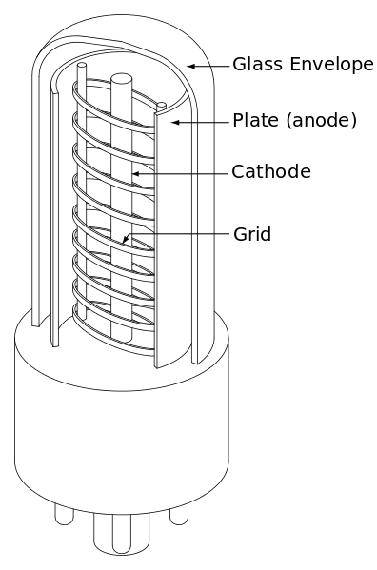
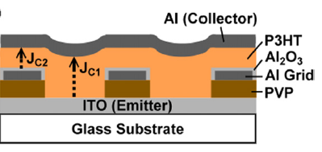
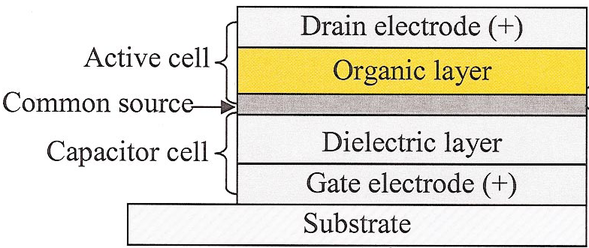
III
Vertical Transistors
Vacuum tube triode
Solid state triode
(AKA SCLT)
Vertical-junction field-effect transistor
Vertical Organic FET
Patent US841387 from 10/25/1906
D. C. Mayer, N. A. Masnari, and R. J. Lomax, Ieee Transactions on Electron Devices 27, 956-961 (1980).
Yang, Y.; Heeger, A. J. Nature 1994, 372, (6504), 344-346.
L. P. Ma and Y. Yang, Appl. Phys. Lett. 85 (21), 5084 (2004).

Slide 3
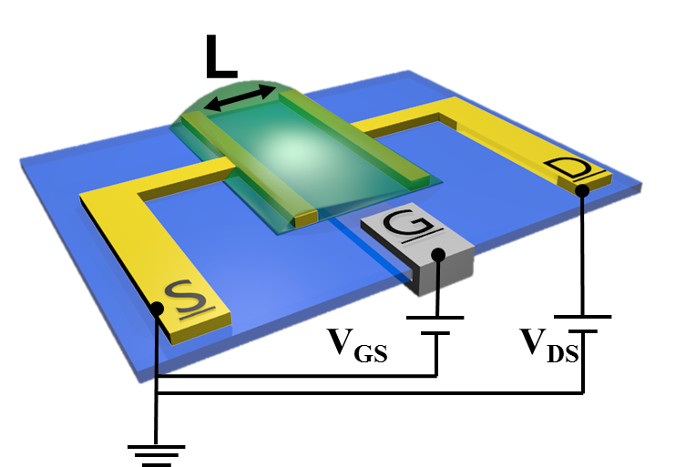
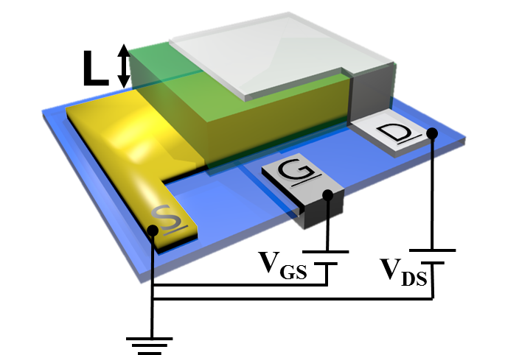
Lateral Goes Vertical
L
L
Source
Drain
Source
Drain
Drain
Semiconductor
SiO2
Source
SiO2
Si++
Gate
Si++
Gate
Lateral
FET:
Vertical
FET:
Channel Length
Direction
Location
Ma, L. & Yang, Y. Applied Physics APL 85, 5084 (2004).

Slide 4
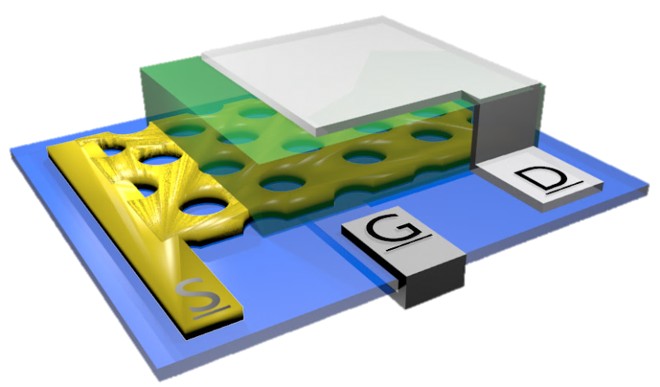
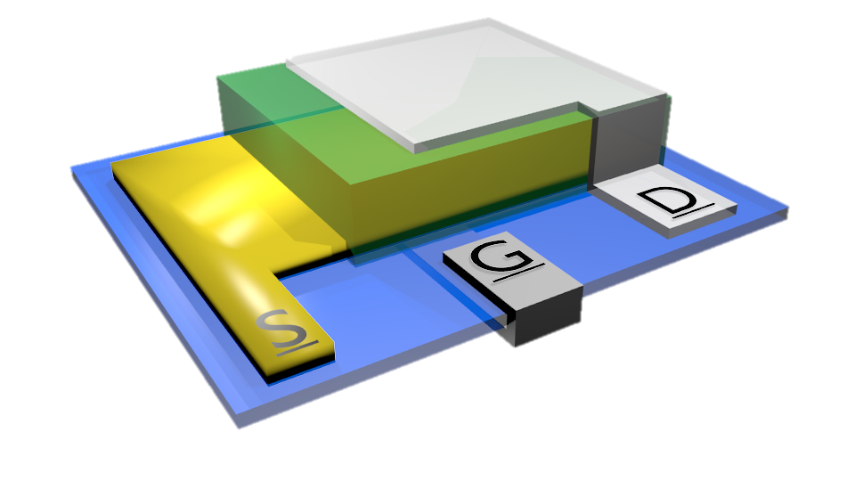
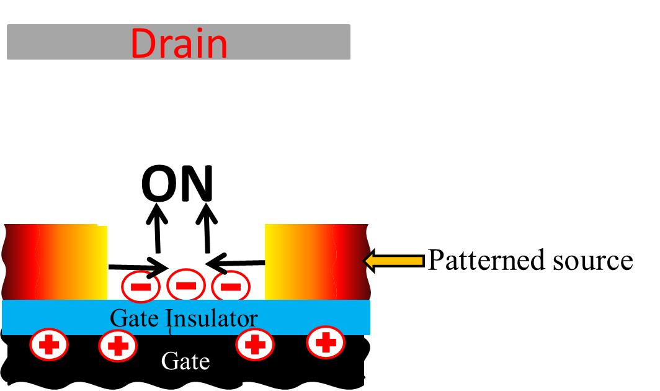
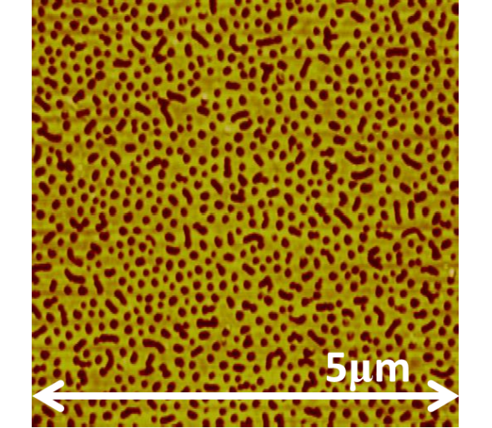
III
VOFET Architecture
Patterned source electrode
A. J. Ben-Sasson et al., Applied Physics Letters 95, 213301 (2009).
Source electrode characteristics
L
Conductive; Transparent
Perforated conductive layer
Virtual electrode

Slide 5
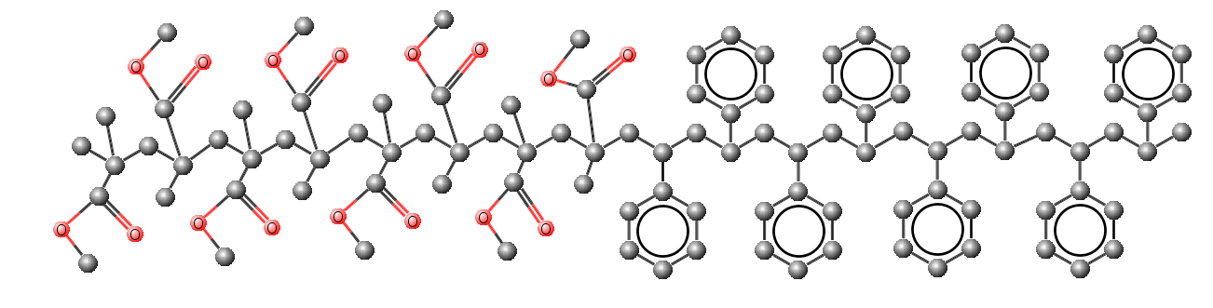
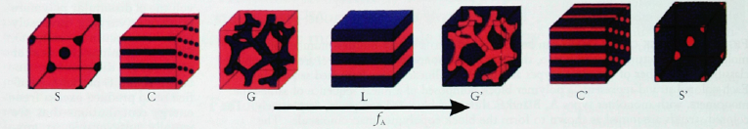
Processes:
Block-copolymers
Di-block copolymer self-assembly
f_{PMMA}
f_{PS}

Slide 6
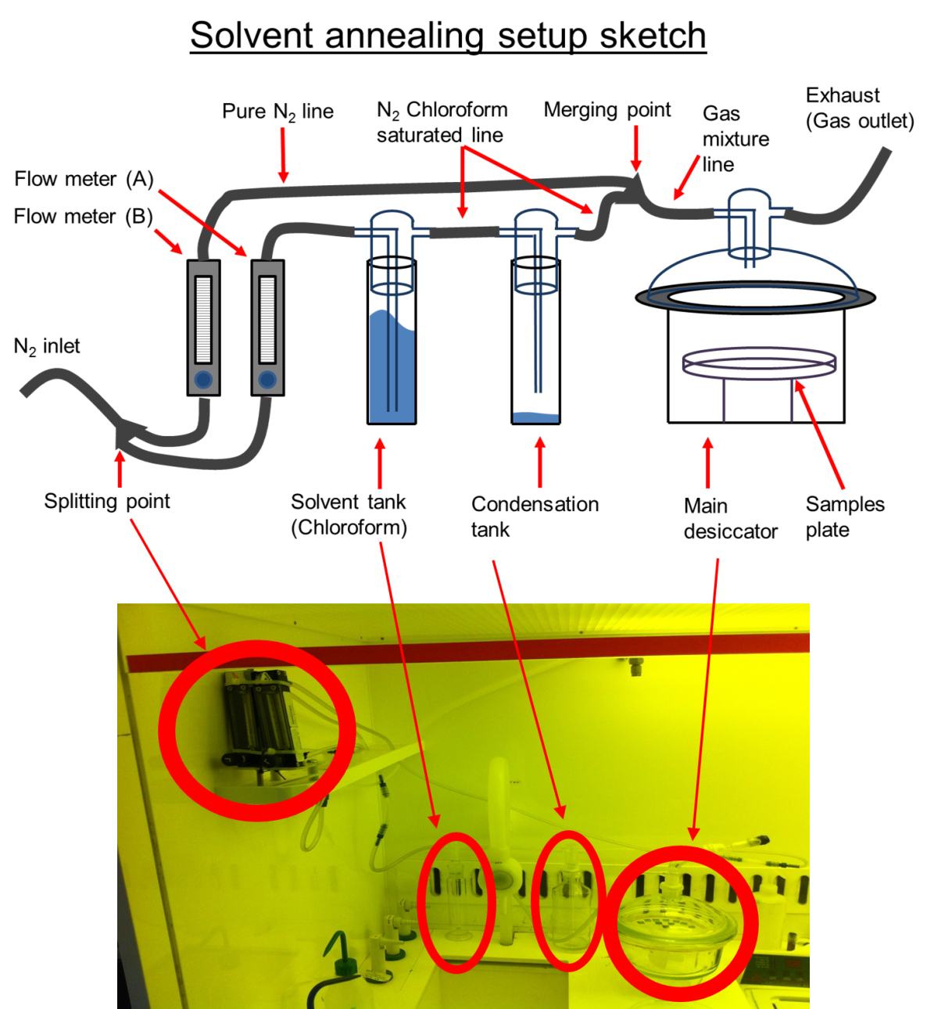
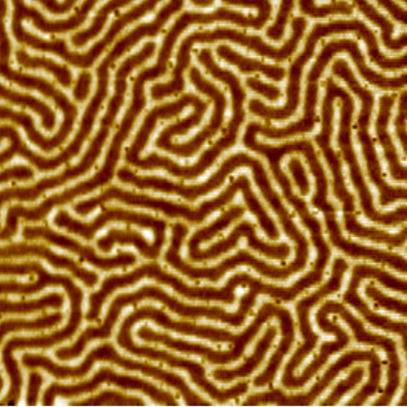
Processes - Block-copolymers
Annealing
Disordered to molecularly organized
Thermal annealing
[T↑, T_{G} const.]
Solvent annealing
[T const., T_{G}↓]
3µm

Slide 7
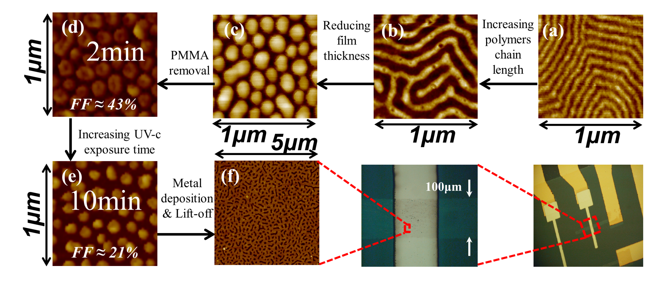
IV
Processes:
Block-copolymers
Block-copolymers as photolithography masks
Design tools:
Chemistry
Dimensions
Process

Slide 8
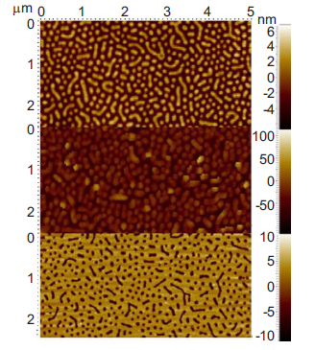
Creating patterned source electrode using block co-polymers (BCP) lithography.
PS
PMMA
PMMA
Au
PS
PS
Au
Works on cm scale samples
Ben-Sasson, A. J. et al. Patterned electrode vertical field effect transistor fabricated using block copolymer nanotemplates. Applied Physics Letters 95, 213301 (2009).
Notes:
Ariel ben sasson devloped a self assmblend block copolymer process to fabricate a pattrernd source electrode. This method is based on a phase-sepration between the 2 differ block in the polymer which aquirs under certain annealing process. A differ sencebility to UV light is used to remove the PMMA matrix leaving a standing cyclnders of PS. Then a thin ti/au is evperate on the PS cylders. Using lift-off process the PS cylnders is removed leaving the desire pattern electrode. The patterned electorde is not only transperte to DC electric field but also for a visible light there for is hard to seen on the samples. Keep in mind the resistance of this electrode is not neglebal becouse the relativly high sheet resistance.

Slide 9
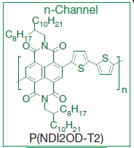
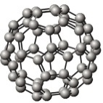
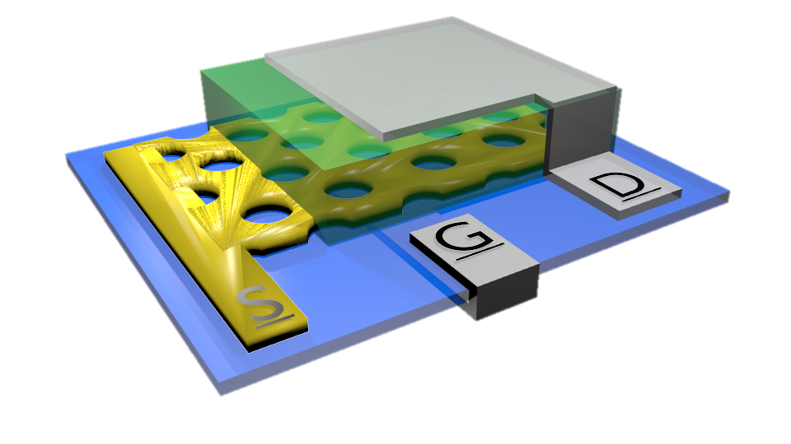
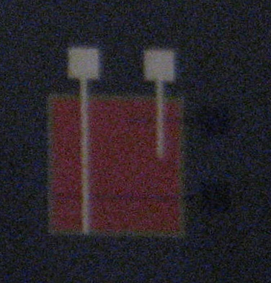
Device architecture
3D Illustration
Macro scale top view
500μm
100μm
100μm
Fundamental parameters
Gate – Al
L - Channel length - active layer thickness
D - Perforations’ diameter (~80nm)
FF - perforations area ratio
t_{d} & t_{s}
Drain – Al
Dielectric – t_{d}
Active layer
Patterned source – t_{s} 100Å Au
O. Globerman, M.Sc. Thesis, Electrical Engineering, Technion, Israel, 2006
A. J. Ben-Sasson and N. Tessler, Nano Letters, vol. 12, pp. 4729-4733, 2012/09/12 2012.

Slide 10
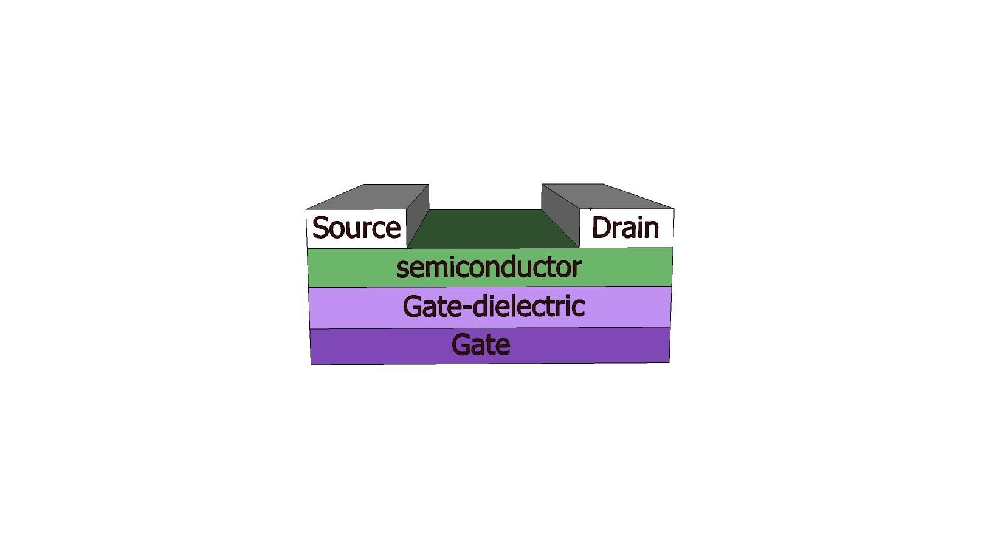
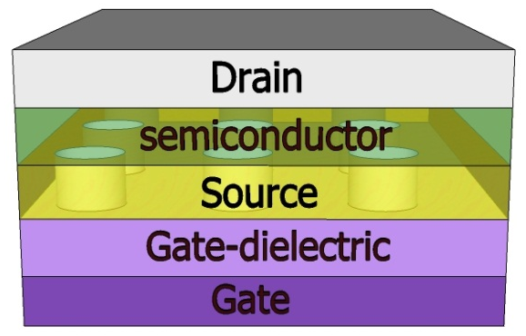
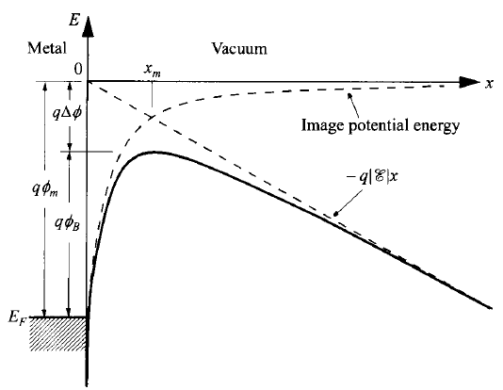
How VOFET works?
Our approach – patterned source electrode:
Sze, S. & Ng, K. Physics of semiconductor devices. (2006).

Slide 11
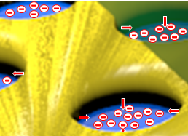
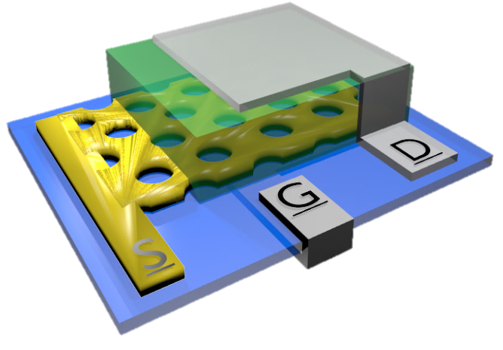
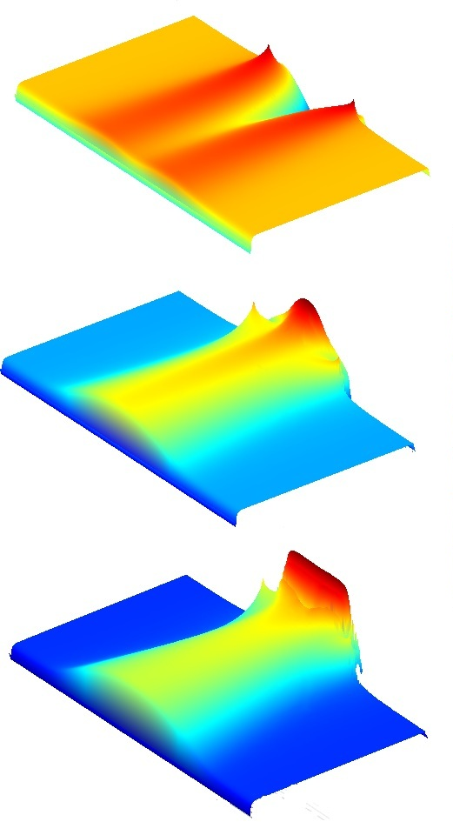
How VOFET works?
Charge density in the Semiconductor layer for
Unbiased gate
Virtual contact
Formation
Drain
OFF
ON
OFF
Off state – Contact Limited due to Schottky barrier
Saturated virtual contact
Patterned source
Gate dielectric
On state – Virtual contact, Space Charged Limited Current
Gate

Slide 12
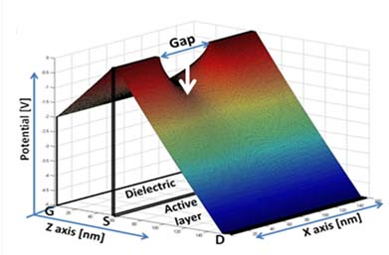
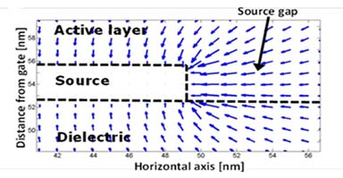
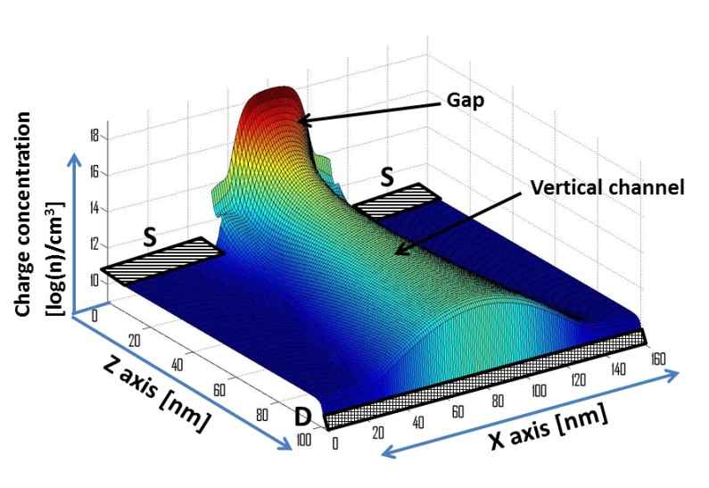
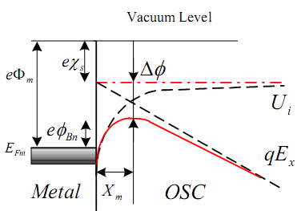
Design: Schottky (On current)
Potential surface
Electric field
Charge distribution
Virtual contact
Vertical Channel

Slide 13
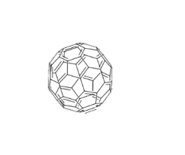
The effect of the perforations’ aspect ratio
Measurements
Simulations
(a)
V_{DS}=1V
(b)
V_{DS}=1V
h_{S}[nm]
7
9
13
I_{G}[A]
S
e⁻
SC
D
Φ_{b0}
h⁺
Drain
ON
Au
C₆₀
Al
Patterned source
Gate dielectric
“Thick” source → Tunnel effect
Gate

Slide 14
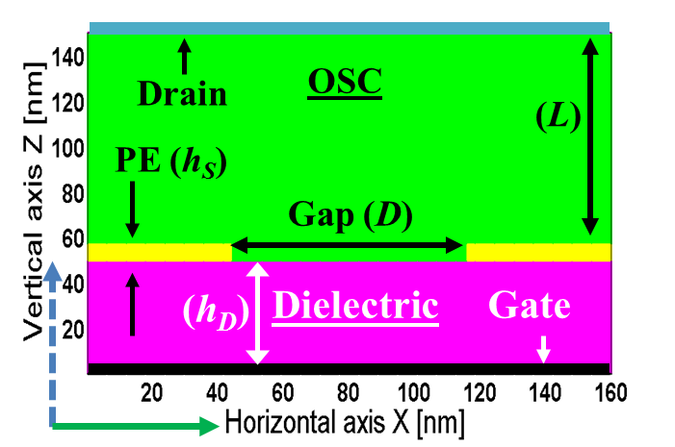
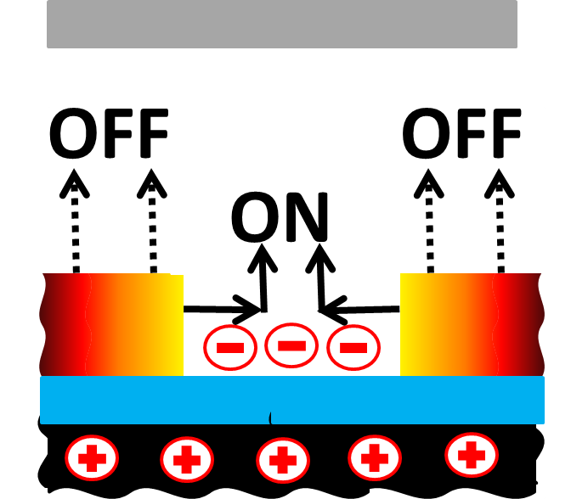
The Electrode Barrier
Φ_{b}
High barrier → High On/Off
High barrier → High V_{TO}
On and Off channel spatial origin is different
V_{On}
A. J. Ben-Sasson, N. Tessler, Journal of Applied Physics 110, 044501 (2011).

Slide 15
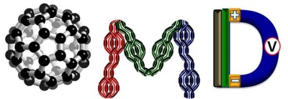

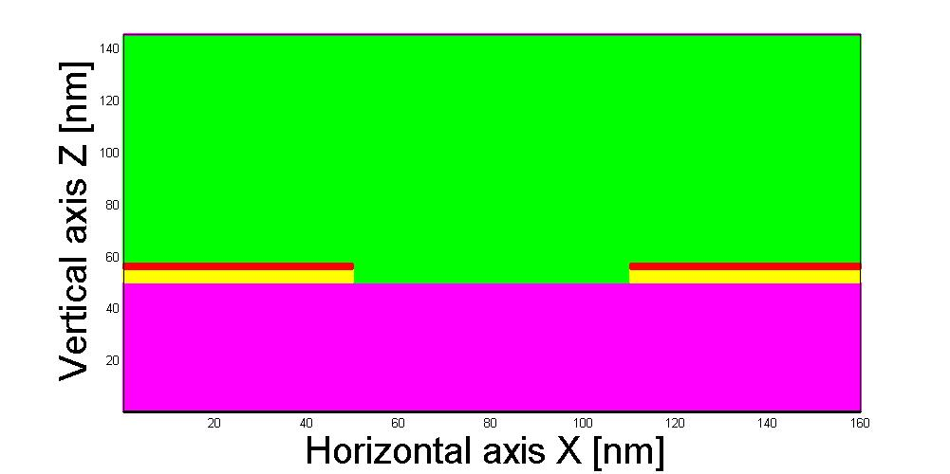

V.B
Stractured electrode
Non-uniform structure
J_{On}
J_{Off}
V_{On}
V_{On}
J_{Off}

Slide 16
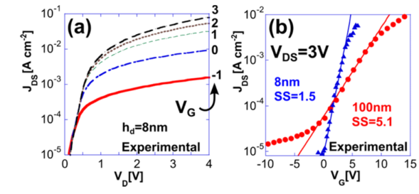
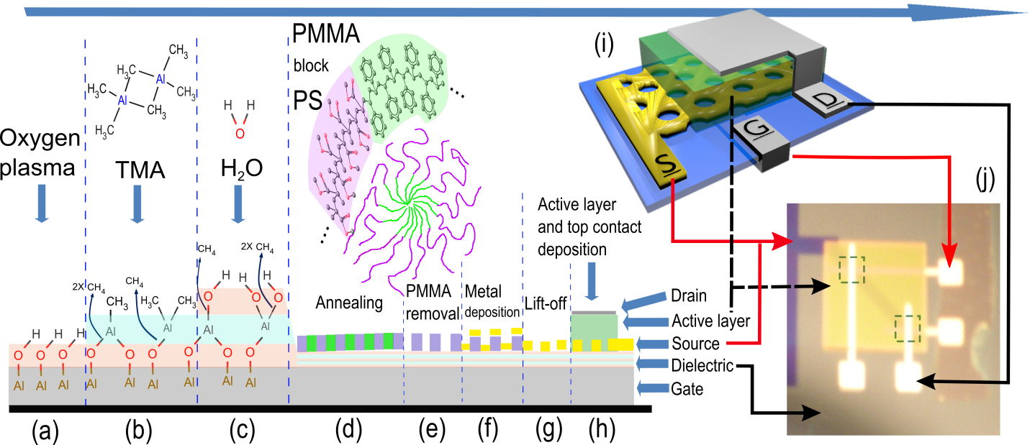
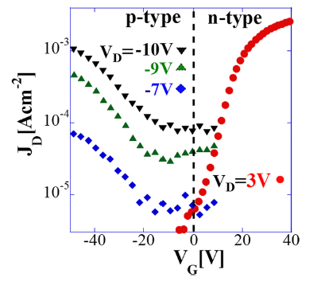
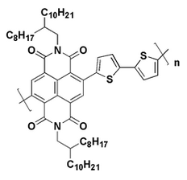
DC characteristics
Reducing Vg:
Gate
Source
Active
Drain
A. Ben-Sasson, G. Ankonina, M. Greenman , M. T. Grimes and N. Tessler , Low-temperature molecular vapor deposition of ultra-thin metal oxide dielectric for low-voltage vertical organic field effect transistors, ACS Appl Mater Interfaces (2013)
Solution processed active layer:
Drain (Al)
N2200
Source(Au)
4.08 eV
4.0 eV
5.1 eV
5.6 eV
Ben-Sasson, A. J., Chen, Z., Facchetti, A. & Tessler, N. Solution-processed ambipolar vertical organic field effect transistor. Applied Physics Letters 100, 263306 (2012).

Slide 17
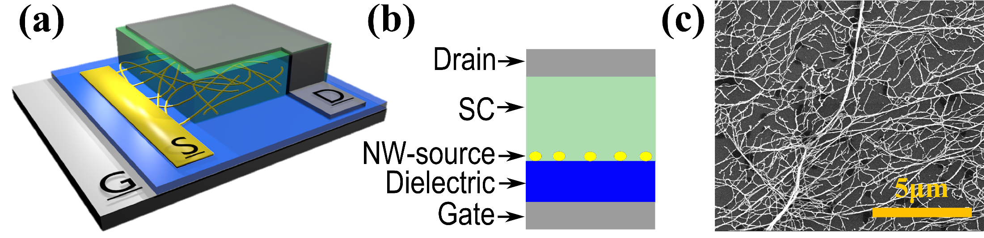
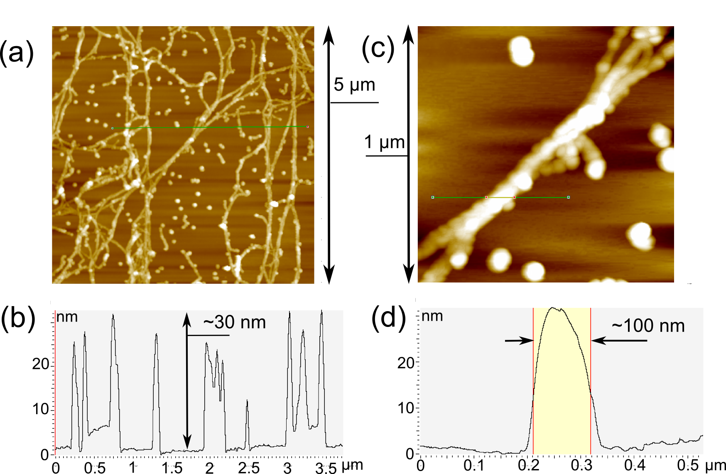
Silver Nanowire Based Electrode

Slide 18
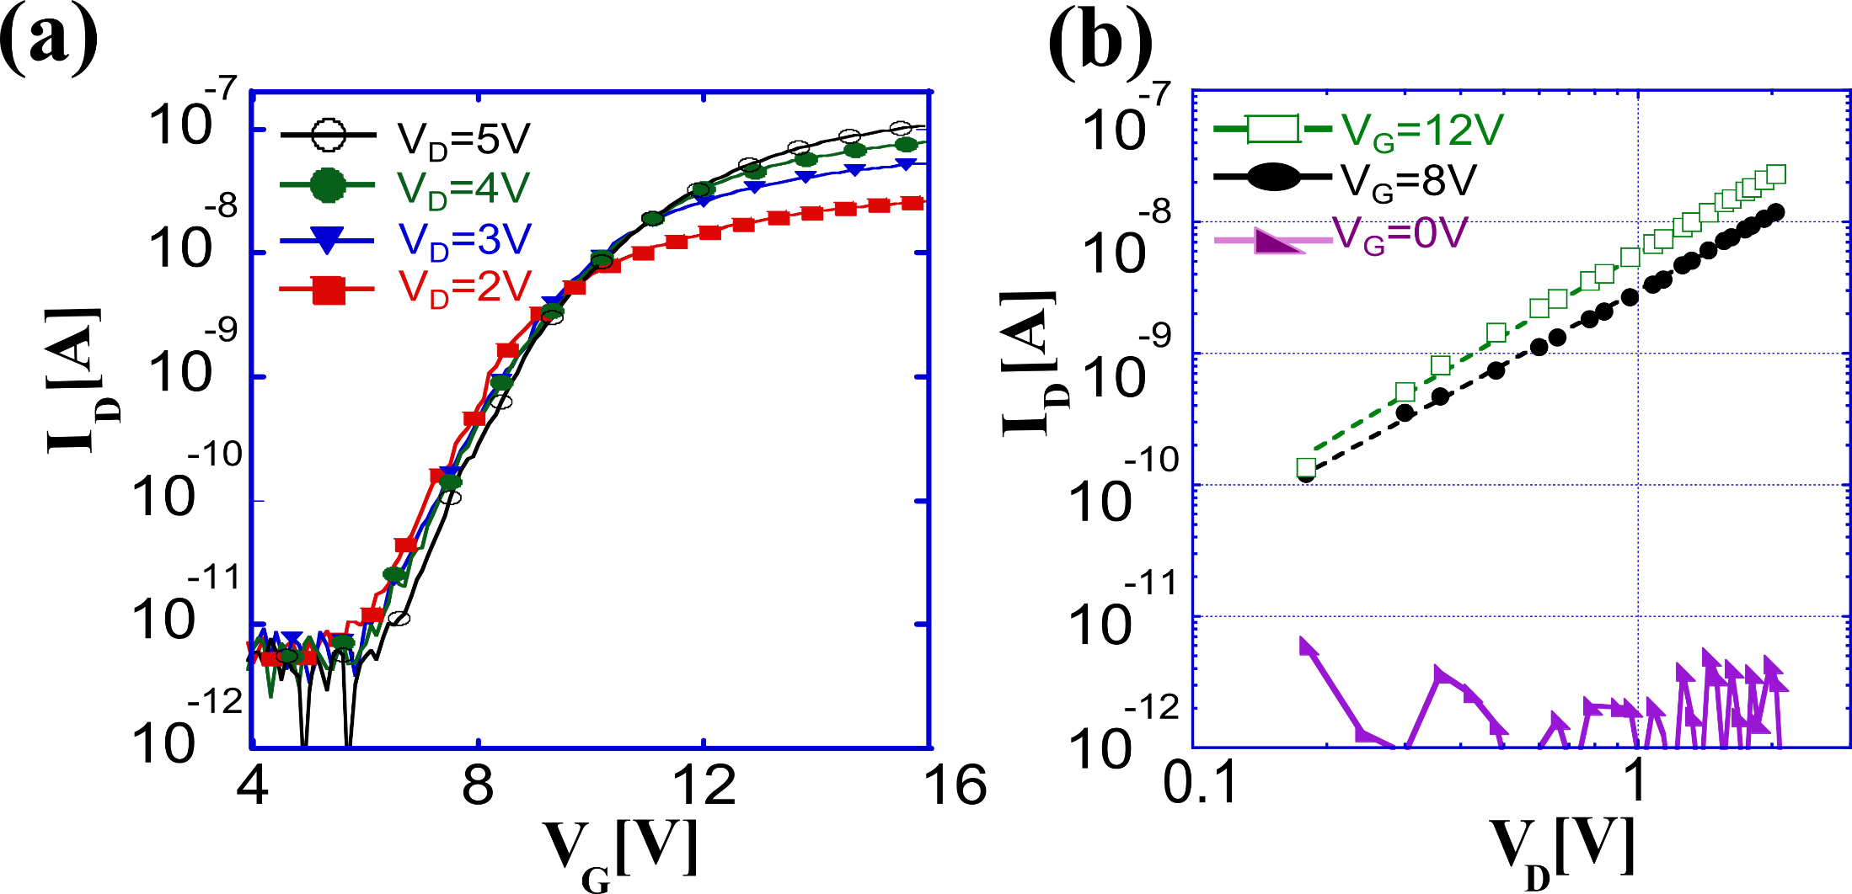
Silver Nanowire Based Electrode

Slide 19
Time resolved measurement
Assembling time-resolved setup
reducing source resistance
VFET
Scope
ch1
Voltage Amplifier
Scope
ch2
Greenman, M., Ben-Sasson, A. J., Chen, Z., Facchetti, A. & Tessler, N. Fast switching characteristics in vertical organic field effect transistors. Appl. Phys. Lett. 103, 073502 (2013).
Notes:
So whwn we minimize the area of the patterned source only to the device area we could reveal a much fater response of 2 micro-sec. This time the limiting pramter was the ringing effect in the setup. We had use some low pass filter to analize the result which increase the result of the turn on time. But still almost 2 orders of magnetude faster the the privace measurment.

Slide 20
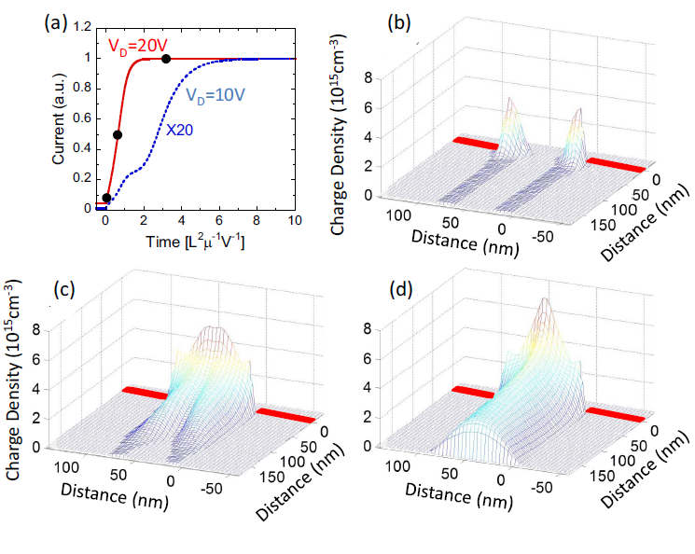
Time resolved measurement
Time-resolved simulation
μ=10⁻³cm²V⁻¹s⁻¹
μ=10⁺¹cm²V⁻¹s⁻¹
ns turns into ps
Greenman, M., Ben-Sasson, A. J., Chen, Z., Facchetti, A. & Tessler, N. Fast switching characteristics in vertical organic field effect transistors. Appl. Phys. Lett. 103, 073502 (2013).
Notes:
Usng time resolved numrical simulation we thinks the intrinsic turn on time of the device is faster. Somewhere between 2-5 TOF depending on the ds voltage. Placing the device pramters in the TOF formola leads to 16-32 ns meaning a much better turn on time should be revlead but is hiden due to setup and overlap technicals problems

Slide 21
Silver Nanowire Based Electrode

Slide 22
Silver Nanowire Based Electrode
A. J. Ben-Sasson et al., Self-Assembled Metallic Nanowire-Based Vertical Organic Field-Effect Transistor. ACS Appl. Mater. Interfaces 7, 2149-2152 (2015)

Slide 23
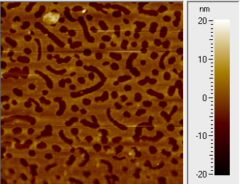
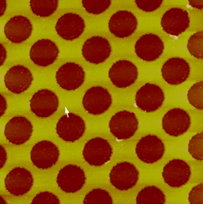
Standard photo-lithography
Replacing BCP technic with basic lithography:
Fits for metric scale substrates. (matches for standard FAB lines)
Enables more complex lift-off or etching process.
Holes diameter:

Slide 24
Standard photo-lithography
Unit cell
Holes diameter effect
Diameter
Fill Factor
Perimeter per unit cell
Perimeter per device area
Perimeter Area = Injection Area

Slide 25
Conventional photo-lithography
Connecting VOFET’s to invertor:
The first VOFET invertor!
Not good but still invert the signal.
Low performance due to P-VOFET strong off current.

Slide 26

Thank You
The fabrication was performed at the Micro-Nano Fabrication Unit (MNFU), Technion.

