Slide 1
Multimodal Audio Inpainting
Yuval Bahat
Yoav Schechner
Michael Elad

Slide 2
Video Conferencing
Broadly used
Uses an Internet protocol
http://www.thecorneroffice.co/2013/01/video-conference-interview-tips-for-new-year/

Slide 3
Video Conferencing
Broadly used
Uses an Internet protocol
http://www.thecorneroffice.co/2013/01/video-conference-interview-tips-for-new-year/

Slide 4
Packet Dropping
WWW

Slide 5
Packet Dropping
Packet Loss Concealment
(PLC)
WWW

Slide 6
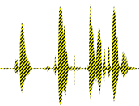
Previous Approaches
Packet Loss Concealment (PLC):
Sender based:
Forward Error Correction (Bandwidth consuming)
WWW

Slide 7
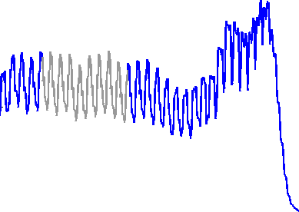
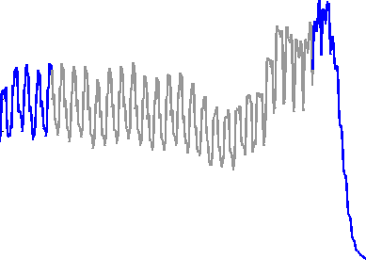
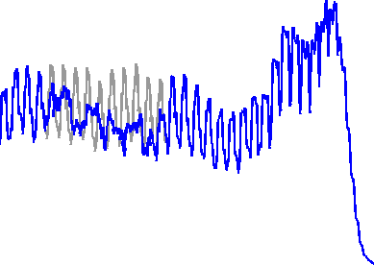
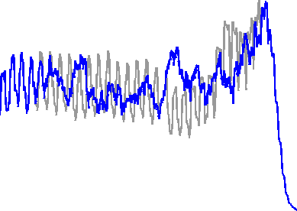
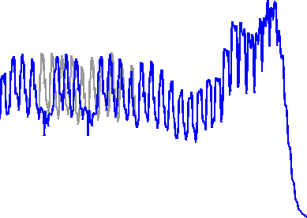
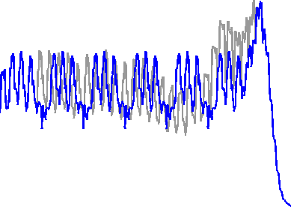
Previous Approaches
Packet Loss Concealment (PLC):
Receiver based: (No dedicated bandwidth)
Silence (Trivial)
White noise
Repetition
Audio energy,
smoothed
gap
Original audio
Heard audio
Short
Long
Notes:
Say that this graph is what we hear

Slide 8
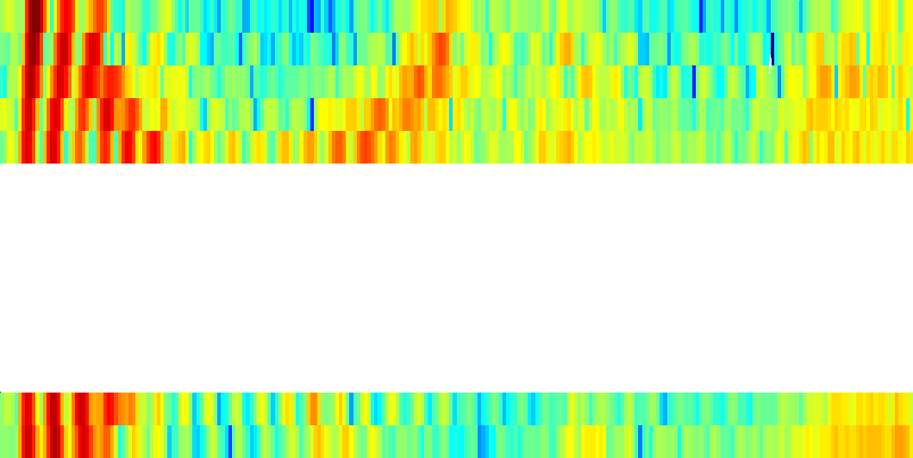
Previous Approaches
Packet Loss Concealment (PLC):
Receiver based: (No dedicated bandwidth)
Frequency domain interpolation
(Lindblom et al. 2002 , Lee et al. 2005, Ofir et al. 2007)
spectrogram
$$f$$
STFFT
STFFT⁻¹
$$t$$
$$t$$
$$t$$
Notes:
ask Yoav for Zohar slide about spectrogram, find a good explenation to why not these methods, take Zohar’s slide “advanced”, “higher quality results”

Slide 9
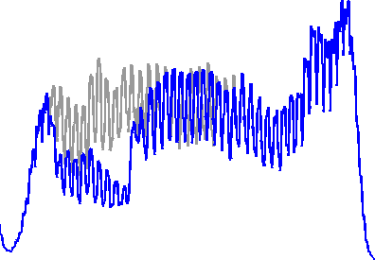
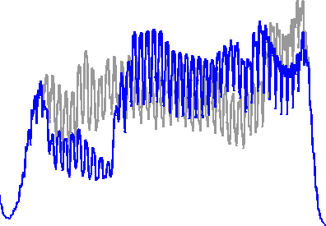
Our Result
Original audio
Heard audio
Ours
Short
Long
Pierced
Notes:
“visibly different but perceptually similar” making the waveform similar is unneccessary. Our purpose is to make it perceptually good! OUR RESULTS!!!!!!

Slide 10
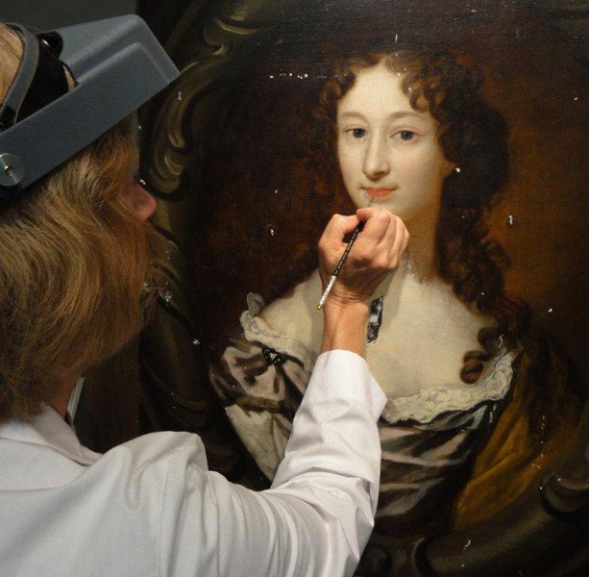
Image Inpainting
Filling-in missing image segments
Intact image information
and
Prior knowledge
http://www.oldworldrestorations.com/painting-restoration.aspx
Notes:
“Our problem is similar to a problem in…” – introduction to this slide

Slide 11
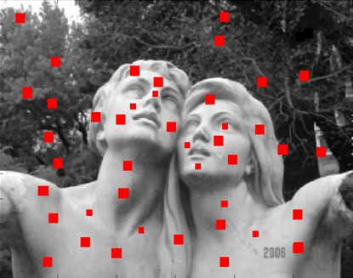
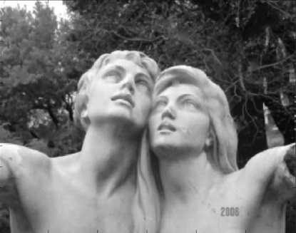
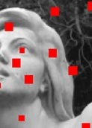
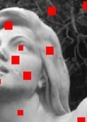
Image Inpainting
Thoroughly researched (Elad et al. 2005, Xu et al. 2010…)
Example Based
http://www.mathworks.com/company/newsletters/articles/applying-modern-pde-techniques-to-digital-image-restoration.html
Notes:
“fill” and not “fill in”

Slide 12
Back to Audio: Proposed Solution
od
“…I’m in a bad mood…
…That’s a go-- idea!”
Receiver based
Example based
Audio inpainting (Adler et al.)
Handles long gaps – 40ms-240ms
Notes:
“Now lets talk about OUR solution”

Slide 13
Algorithm Sketch
$$e_{1}$$
$$e_{2}$$
$$e_{3}$$
$$q_{n−1}$$
$$e_{4}$$
$$q_{n}$$
$$q_{n+1}$$
$$e_{1}$$
$$q_{n−1}$$
$$e_{2}$$
~0.3 sec.
$$q_{n}$$
$$e_{3}$$
$$q_{n+1}$$
$$e_{4}$$

Slide 14
Algorithm Sketch
$$e_{1}$$
$$e_{2}$$
$$e_{3}$$
$$q_{n−1}$$
$$e_{4}$$
$$q_{n}$$
$$q_{n+1}$$
$$e_{1}$$
$$q_{n−1}$$
$$e_{2}$$
Best match
$$q_{n}$$
$$e_{3}$$
$$q_{n+1}$$
$$e_{4}$$
Notes:
“first stage…..”, “second stage..”

Slide 15
Algorithm Sketch
$$e_{1}$$
$$e_{2}$$
$$e_{3}$$
$$q_{n−1}$$
$$e_{4}$$
$$q_{n}$$
$$q_{n+1}$$
Best match
$$q_{n+1}$$
$$e_{1}$$

Slide 16
Algorithm Sketch
$$e_{1}$$
$$e_{2}$$
$$e_{3}$$
$$e_{4}$$
$$q_{n}$$
$$q_{n+1}$$
Features Extraction
$${\tilde{e}}_{1}$$
$${\tilde{e}}_{1}$$
$$e_{1}$$
$${\tilde{e}}_{2}$$
$${\tilde{q}}_{n−1}$$
$$e_{2}$$
Best match
$$e_{3}$$
$${\tilde{e}}_{3}$$
$${\tilde{q}}_{n}$$
$${\tilde{e}}_{4}$$
$$e_{4}$$
$${\tilde{q}}_{n+1}$$

Slide 17
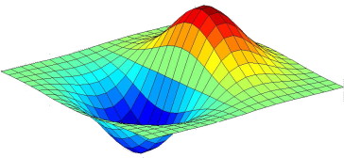
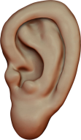
Three Layers Method
Statistical prior
Visual Features
Audio features

Slide 18
Feature Extraction
Using data intact
Audiodata

Slide 19
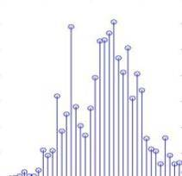
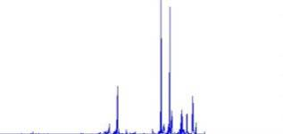
Audio Features
MFCCs – Mel-frequency Cepstral Coefficients
Signal spectrum
Audio signal
Mel-frequency filter bank
log(.)
Well represent human perception
13 frequency bands for each 40ms packet
Normalization
Concatenation of MFCCs of 7 packets
MFCCs
Courtesy of Segev, Schechner, Elad, Cross-Modal Denoising

Slide 20
Examples & queries
While audio intact
Example collection
Feature extraction
Once an audio gap appears
Form queries
Extract features
$$q_{1}$$
$$q_{2}$$
$$q_{3}$$
$${\tilde{q}}_{1}$$
$${\tilde{q}}_{2}$$
$${\tilde{q}}_{3}$$

Slide 21
Features Distance Minimization
Feature-space
Mahalanobis distance
$${\tilde{e}}_{103}$$
$${\tilde{e}}_{45}$$
$${\tilde{e}}_{2546}$$
$${\tilde{e}}_{33}$$
$${\tilde{e}}_{54}$$
$${\tilde{e}}_{87}$$
$${\tilde{e}}_{639}$$
$${\tilde{e}}_{4}$$
$${\tilde{e}}_{342}$$
$$D\left({\tilde{q}}_{1},{\tilde{e}}_{32}\right)$$
$${\tilde{q}}_{1}$$
$${\tilde{e}}_{12}$$
$${\tilde{e}}_{1056}$$
$${\tilde{e}}_{32}$$
Notes:
Have an explanation on Mahalanobis

Slide 22
Features Distance Minimization
Feature-space
$$\underset{\left\{q_{n},e_{k} \right\}}{argmin}\left\{D\left({\tilde{q}}_{n},{\tilde{e}}_{k}\right)\right\}$$
$${\tilde{e}}_{103}$$
$${\tilde{e}}_{45}$$
$${\tilde{e}}_{2546}$$
$${\tilde{e}}_{33}$$
$$\left\{q_{1},e_{4} \right\}$$
Best match
$${\tilde{e}}_{54}$$
$${\tilde{e}}_{87}$$
$${\tilde{e}}_{639}$$
$${\tilde{e}}_{4}$$
$${\tilde{e}}_{342}$$
$$D\left({\tilde{q}}_{1},{\tilde{e}}_{32}\right)$$
$${\tilde{q}}_{1}$$
$${\tilde{e}}_{12}$$
$${\tilde{e}}_{1056}$$
$${\tilde{e}}_{32}$$

Slide 23
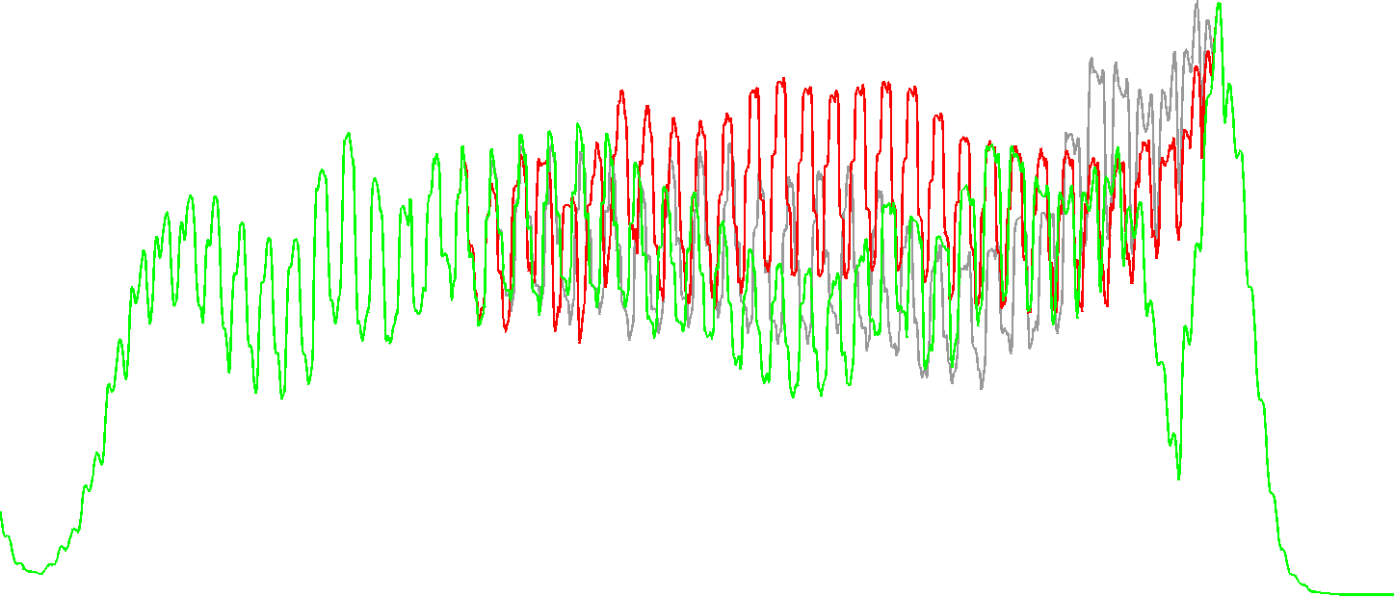
Rendering the Inpainted Audio
Pitch & Gain modification
Filled with higher pitch
Filled with correct pitch
Original waveform

Slide 24
Rendering the Inpainted Audio
Pitch cycle
Pitch & Gain modification
The same syllable can be said differently
Match process insensitive to pitch & gain
We modify pitch and gain (Seo, 2008)
Pitch cycle
$$q_{1}$$

Slide 25
Rendering Inpainted Audio
Pitch & Gain modification
Temporal fine tuning – waveform correlation
Optimal coupling – minimal spectrogram diff.
Inlaying
$$e_{4}$$
$$q_{1}$$

Slide 26
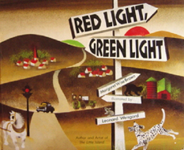
An Experiment
“Red light, green light” – a children story - ~5 minutes
Pierced according to Gilbert model (Hasslinger et al. 2008)
30 seconds pierced - 20% loss
Average hole length – 200ms
Notes:
say it, that we still have video and HMM ahead. Correct video stream. “now I’ll demonstrate what the pierced audio sounds like. Red columns indicate audio gap”.

Slide 27
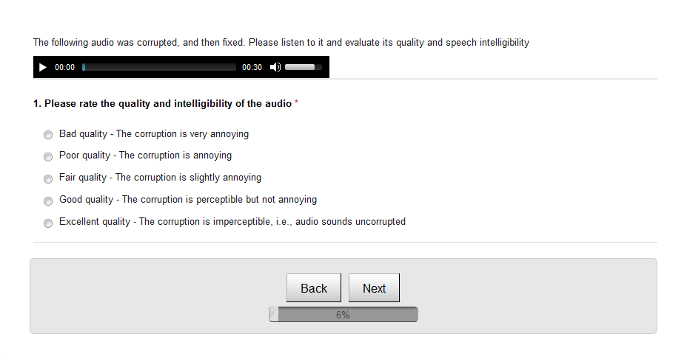
Survey
1
2
3
4
5

Slide 28
Mean Opinion Score
Audio features matching
Silence
Original
Repeat last
White noise
Notes:
Make clear what are mine. “Let’s see if it gets better using Visual features”

Slide 29
Audio-Visual Audio Analysis
Recognition - Lips reading
(Dupont & Luettin, 1998)
Source localization
(Barzelay & Schechner, 2007)
Example-based denoising
(Segev et al. 2012)
Our purpose – Audio inpainting

Slide 30
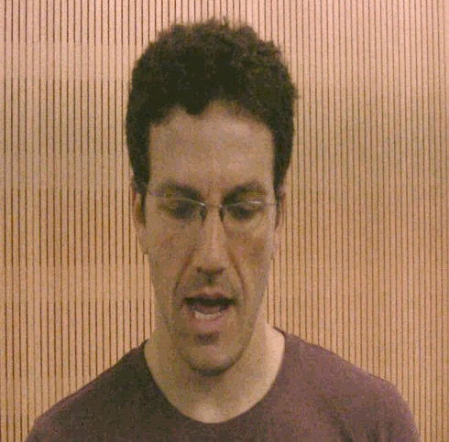
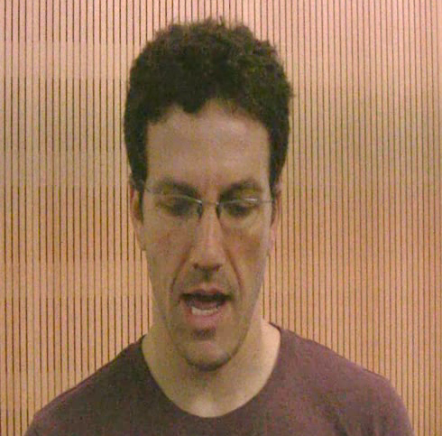
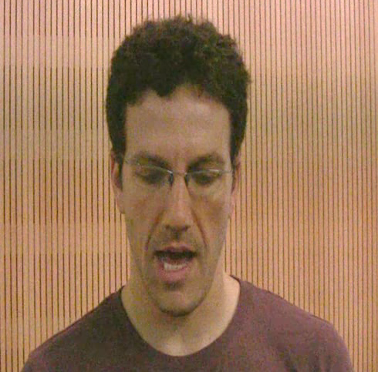
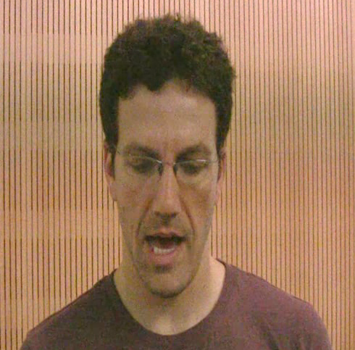
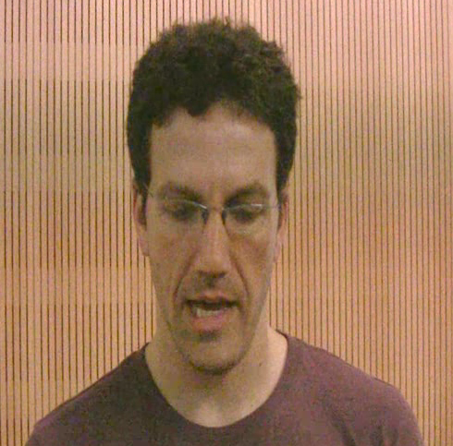
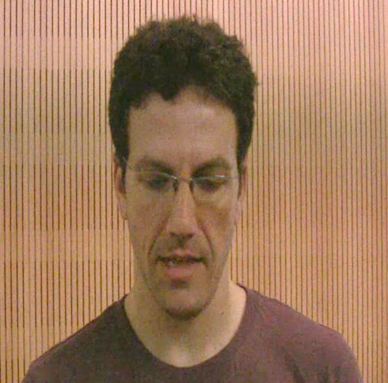
Feature Extraction
Using data intact
Assuming video intact
Audiodata
Video data
Notes:
Add another slide on AV audio analysis in different applications (Dana…). “Now we want to use video for inpainting…”. Emphesize that the video exist while the audio is missing, and why

Slide 31
Video Features – 1st trial
3D - Discrete Cosine Transform:
Video stabilization & cropping
3D DCT over 7 consecutive frames
Coeffs. pruning
Notes:
Correct video stream

Slide 32
Video Features – 2nd trial
Lips 3D coordinates:
(Saragih et al. 2010, Python wrapping by Amit Aides)
Vertical aperture
Horizontal aperture
Lips perimeter
Lips area
Lips roundness
Concatenating features of 7 frames

Slide 33
Audio-Visual Features Results
Audio is reconstructed using Audio & Video features:
Red flash indicates a gap in received signal

Slide 34
Mean Opinion Score
Audio
Audio
Video
Silence
Original
Repeat last
White noise

Slide 35
Feature Statistics as a Prior
Feature-space
Clustering feature space
$${\tilde{e}}_{103}$$
$${\tilde{e}}_{45}$$
$${\tilde{e}}_{2546}$$
$${\tilde{e}}_{33}$$
$${\tilde{e}}_{54}$$
$${\tilde{e}}_{87}$$
$${\tilde{e}}_{639}$$
$${\tilde{e}}_{4}$$
$${\tilde{e}}_{342}$$
$${\tilde{e}}_{1056}$$
$${\tilde{e}}_{32}$$
Courtesy of Segev, Schechner, Elad, Cross-Modal Denoising
Notes:
Emphesize the differenc in sound between the two before playing
“Our time division roughly corresponds to the length of a sylable”

Slide 36
Feature Statistics as a Prior
Counting cluster transitions
“red-lai-t-__-grin-lai-t”
Feature-space
$${\tilde{e}}_{103}$$
Cluster at $t+1$
lai
grin
 | 1 | 2 | 3 | 4 | 5
1
2
3
4
5
$${\tilde{e}}_{45}$$
$$c_{5}$$
$$c_{3}$$
1
Cluster at $t$
1
$${\tilde{e}}_{2546}$$
$${\tilde{e}}_{33}$$
1
red
$${\tilde{e}}_{54}$$
$$c_{2}$$
$${\tilde{e}}_{87}$$
$${\tilde{e}}_{639}$$
$${\tilde{e}}_{4}$$
$${\tilde{e}}_{342}$$
1
__
2
$${\tilde{e}}_{1056}$$
1
$${\tilde{e}}_{32}$$
$$c_{1}$$
$$c_{4}$$
t
Notes:
“for each of the possible cluster transition, we count the number of occurances”

Slide 37
Feature Statistics as a Prior
Creating cluster transition matrix P
Cluster at $t+1$
Cluster at $t+1$
 | 1 | 2 | 3 | 4 | 5
1
2
3
4
5
 | 1 | 2 | 3 | 4 | 5
1 |  |  | $$1/6$$
2 |  |  |  |  | $$1/6$$
3 |  |  |  |  | $$1/6$$
4 | $$1/6$$
5 |  |  |  | $$1/3$$
 | 1 | 2 | 3 | 4 | 5
1
2
3
4
5
1
Cluster at $t$
1
Cluster at $t$
1
1
2
P
Number of collected examples
Assuming a Hidden Markov Model generates audio

Slide 38
Cost function minimization
$e_{k}$ - Example
$q_{n}$ - Query
$$C\left({\tilde{q}}_{n},{\tilde{e}}_{k}\right)=D\left({\tilde{q}}_{n},{\tilde{e}}_{k}\right)+λR\left({\tilde{q}}_{n},{\tilde{e}}_{k}\right)$$
$$D\left({\tilde{q}}_{n},{\tilde{e}}_{k}\right)$$
Data
term
Regularization
term

Slide 39
Regularization term
$$q_{1}$$
Hidden Markov Model
$$e_{1}$$
$$e_{54}?$$
$$e_{3}$$
Cluster at $t+1$
$$e_{?}$$
 | 1 | 2 | 3 | 4 | 5
1 |  |  | $$1/6$$
2 |  |  |  |  | $$1/6$$
3 |  |  |  |  | $$1/6$$
4 | $$1/6$$
5 |  |  |  | $$1/3$$
$$c_{3}$$
$$c_{5}$$
$$c_{4}$$
Cluster at $t$
$$p\left(c_{3},c_{5},c_{4}\right)$$
$$=$$
$$p\left(c_{3},c_{5}\right)$$
$$∙$$
$$p\left(c_{5},c_{4}\right)$$
$$∙$$
$$1/6$$
$$1/3$$
$$R\left(q_{1},e_{54}\right)=$$
$$−log\left[p\left(c_{3},c_{5},c_{4}\right)\right]=$$
P
$$=−log\left[p\left(c_{3},c_{5}\right)∙p\left(c_{5},c_{4}\right)\right]$$
Notes:
Be ready for “why log?”
“This is the PRIOR probability for tranisition between clusters”
Change e54

Slide 40
Cost Function Minimization
Keep the few closest examples
Calculate $R$ for all candidates
Best match:
$$\underset{\left\{{\tilde{q}}_{n},{\tilde{e}}_{k} \right\}}{argmin}\left\{D\left(q_{n},e_{k}\right)+λR\left(q_{n},e_{k}\right)\right\}$$
Feature-space
$${\tilde{e}}_{103}$$
$${\tilde{e}}_{103}$$
$${\tilde{e}}_{45}$$
$${\tilde{e}}_{45}$$
$${\tilde{q}}_{2}$$
$$\left\{{\tilde{q}}_{1},{\tilde{e}}_{1056} \right\}$$
Best match
$${\tilde{e}}_{33}$$
$${\tilde{e}}_{2546}$$
$${\tilde{e}}_{33}$$
$${\tilde{e}}_{54}$$
$${\tilde{e}}_{87}$$
$${\tilde{e}}_{639}$$
$${\tilde{e}}_{4}$$
$${\tilde{e}}_{342}$$
$${\tilde{q}}_{1}$$
$${\tilde{e}}_{12}$$
$${\tilde{e}}_{1056}$$
$${\tilde{e}}_{32}$$

Slide 41
Mean Opinion Score
Audio
Audio
HMM
Pitch
Audio
Video
Audio
Video
HMM
Audio
HMM
Silence
Original
Repeat last
White noise

Slide 42
Mean Opinion Score
Insights:
Statistical prior improved
Pitch mod. degraded
Effect of prior knowledge
Audio
Audio
HMM
Pitch
Audio
Video
Audio
Video
HMM
Audio
HMM
Silence
Original
Repeat last
White noise
Notes:
Emphesize the error bar issue – “When adding HMM, there is no longer statistical significance” “The left 3 are difficult to differ”

Slide 43
An (Inpainted) Children story
Audio reconstructed using Audio & Statistical prior:
Mean Opinion Score: 3.79
Red flash indicates a gap in received signal

Slide 44
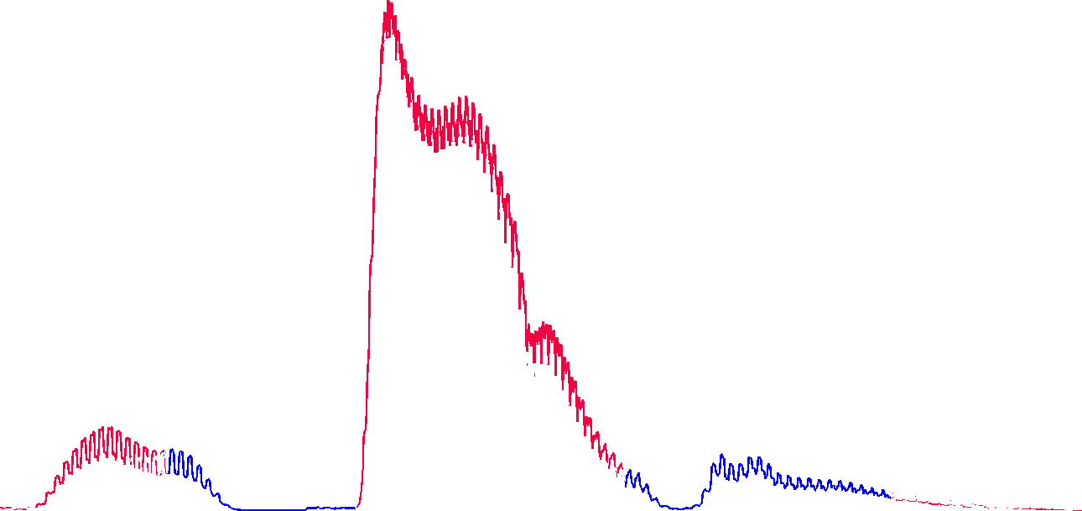
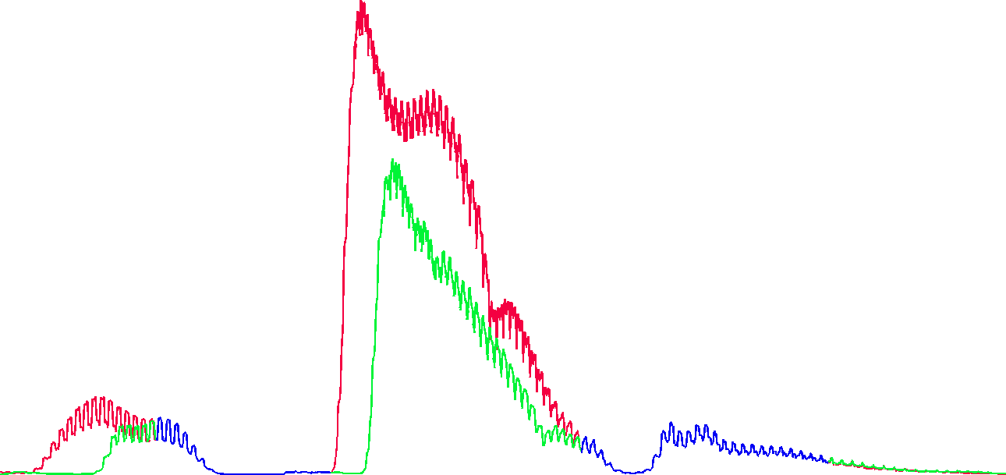
Conclusion
Example based packet loss concealment
Aiming for perceptual quality (MOS)
Different algorithm layers:
Audio features
Audio & Video features
Incorporating statistical prior
___y c__ go
They can go
44

