Slide 1


Multiplexed
Fluorescence Unmixing
Marina Alterman, Yoav Schechner
Technion, Israel
Aryeh Weiss
Bar-Ilan, Israel

Slide 2
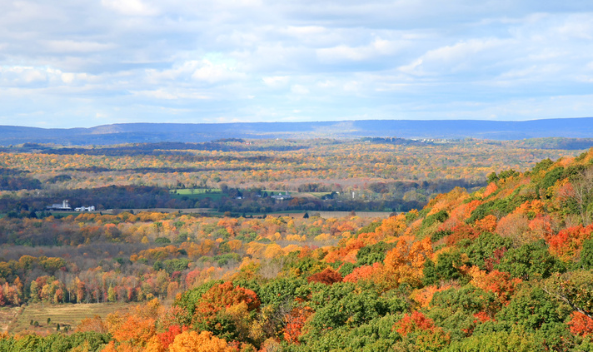
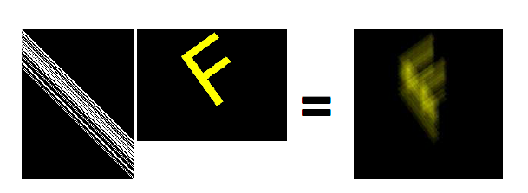

Natural Linear Mixing
i
c
i
c
Raskar et al. 2006.
i
c
ImageJ image sample
collection.

Slide 3
Natural Linear Mixing
?
+ noise
i
c
i
+ noise
c
Raskar et al. 2006.
i
+ noise
How do you measure i?
c
ImageJ image sample
collection.

Slide 4

Single Source Excitation
demultiplex
Multiplexed Excitation
i₁
₂
₁
a₁
Beam
combiner
₁
i₂
₃
a 1 1 0 i
₂
1
1
a₂
a = 0 1 1 i
2
2
a 1 0 1 i
3
3
₁
₃
i₃
₃
a₃
₂

Slide 5
Why Multiplexing?
Trivial
Measurements
Multiplexed Measurements
i
+
noise
SNR
SNR
Intensity vector
Same acquisition time

Slide 6
Multiplexing - Look closer
i – single source intensities
η - noise
Estimate c not i
Xc
i
acquisition
estimation
Minimum → W=?

Slide 7
Multiplexing: a=Wi, Mixing: i=Xc
Common Approach
This Work
Acquired multiplexed
intensities
Single source
intensities
Concentrations
a
ˆ
ˆ
ˆ
ˆ
i
c
a
i
c
W_{i}≠W_{c}
W_{i}
W_{c}
N_{dyes}=3
N_{sources}=7
N_{measure}=3
size(i)=7
efficient acquisition
N_{measure}=7
Alterman, Schechner & Weiss, Multiplexed Fluorescence Unmixing

Slide 8
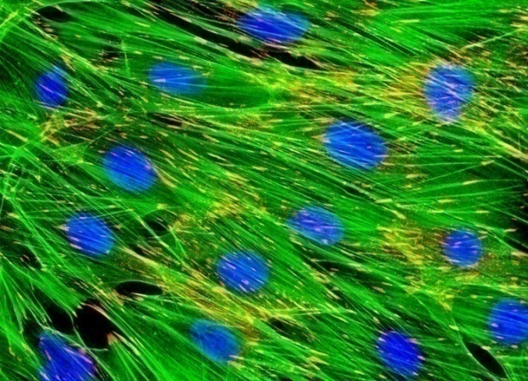
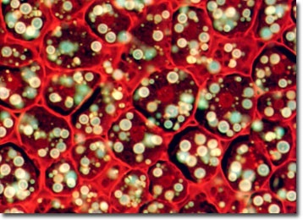
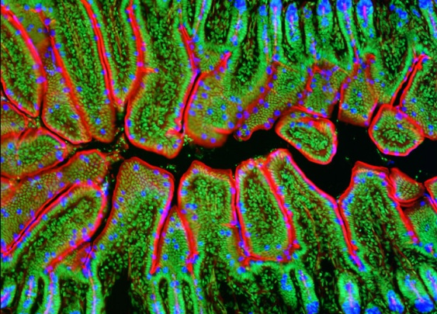
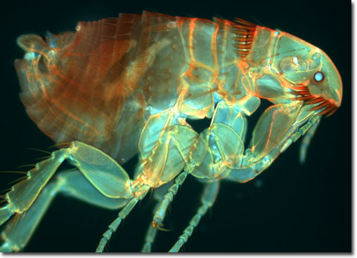
Fluorescence
Cell structure and processes
Fluorescent Specimen
Horse Dermal Fibroblast Cells
Corn Grain
Intestine Tissue
Flea
http://www.microscopyu.com/galleries/fluorescence, http://www.microscopy.fsu.edu/primer/techniques/fluorescence/fluorogallery.html

Slide 9
Linear Mixing
i
More molecules per pixel
Brighter pixel
c
Molecules per pixel
i = x∙c
i c
Alterman, Schechner & Weiss, Multiplexed Fluorescence Unmixing

Slide 10
Linear Mixing
i
{c_{d}}
For each pixel:
i = x x ∙ ∙ ∙ x
c
c
∙
∙
∙
c
1 2 N_{dyes}
1
2
N_{dyes}
vector of concentrations (spatial distribution)
Alterman, Schechner & Weiss, Multiplexed Fluorescence Unmixing

Slide 11
Linear Mixing
i
i
1
2
s=1
s=2
{c_{d}}
{c_{d}}
For each pixel:
i = x x ∙ ∙ ∙ x
c
c
∙
∙
∙
c
1
1,1 1,2 1,N_{dyes}
1
2
N_{dyes}
i = x x ∙ ∙ ∙ x
2
2,1 2,2 2,N_{dyes}
∙
∙
∙
i = x x ∙ ∙ ∙ x
s
s,1 s,2 s,N_{dyes}
vector of intensities
vector of concentrations (spatial distribution)
Mixing matrix

Slide 12
Linear Mixing
i
i
1
2
s=1
s=2
{c_{d}}
{c_{d}}
For each pixel:
vector of intensities
vector of concentrations (spatial distribution)
Mixing matrix

Slide 13

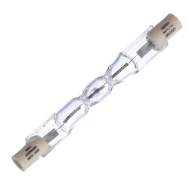
Fluorescent Microscope
Intensity image
e(λ)
300 400 500 600 700
λ
Emission
Filter
s
=
1
s
=
2
s
=
3
e(λ)
s
=
4
Dichroic
Mirror
L₂(λ)
s
=
5
300 400 500 600 700
λ
Excitation
Excitation
Filter
Sources
Fluorescent
s: illumination sources
Specimen
Blue
α(λ)
300 400 500 600 700
λ

Slide 14
Fluorescent Microscope
Intensity image
(mixed)
Intensity image
e(λ)
Unmixing required
300 400 500 600 700
λ
Emission
Filter
s
=
1
s
=
2
Cross-talk
s
=
3
e(λ)
s
=
4
Dichroic
Mirror
L₂(λ)
s
=
5
300 400 500 600 700
λ
Excitation
Excitation
Filter
Sources
Fluorescent
s: illumination sources
Specimen
Green
Blue
α(λ)
Cross-talk
300 400 500 600 700
λ

Slide 15
Problem Definition
Fluorescent specimen
Intensity image (mixed)
+ noise
noise
Unmix
How to multiplex for least noisy unmixing?
Alterman, Schechner & Weiss, Multiplexed Fluorescence Unmixing

Slide 16
Sum up the concepts
Man made
Nature
Acquired multiplexed
image intensities
Single source
Image intensities
W
X
a
i
Concentrations
multiplexing
mixing
c
demultiplexing
unmixing
W⁻¹
X⁻¹
multiplexed unmixing
Alterman, Schechner & Weiss, Multiplexed Fluorescence Unmixing

Slide 17
Look closer - again
i – single source intensities
η - noise
Xc
i
Estimate c not i
Alterman, Schechner & Weiss, Multiplexed Fluorescence Unmixing

Slide 18
Multiplexed Unmixing
acquired measurements
i
acquisition
noise
a
W
X
c
For each pixel
=
+
multiplexing
matrix
mixing
matrix
estimation
WX is not square
Weighted Least Squares
Other estimators
OR
OR
Minimum Variance in c → W=?

Slide 19
Generalizations
Minimum Var → W=?
η - noise
Image intensities
i =?
var(η) = constant
Details in the paper
concentrations
c =?
var(η) = constant
c =?
var(η) ≠ constant
Alterman, Schechner & Weiss, Multiplexed Fluorescence Unmixing

Slide 20
Generalized Multiplex Gain
What is the SNR gain for unmixing?
Only Unmixing
VS.
Unmixing
+ Multiplexing
Alterman, Schechner & Weiss, Multiplexed Fluorescence Unmixing

Slide 21
Significance of the Model
W_{i}≠W_{c}
GAIN_{c}
2.2
a
ˆ
ˆ
i
c
2
1.8
W_{c}
VS.
1.6
a
ˆ
ˆ
1.4
i
c
1.2
W_{i}
1
3
4
5
6
7
Nsources=Nmeasure
Alterman, Schechner & Weiss, Multiplexed Fluorescence Unmixing

Slide 22
Significance of the Model
a
ˆ
ˆ
GAIN_{c}
2.2
i
c
2
W_{c}
1.8
1.6
1.4
1.2
1
3
4
5
6
7
Nsources=Nmeasure
Alterman, Schechner & Weiss, Multiplexed Fluorescence Unmixing

Slide 23
Significance of the Model
a
ˆ
ˆ
GAIN_{c}
2.2
i
c
2
W_{c}
1.8
a
ˆ
ˆ
i
c
1.6
1.4
W_{i}
1.2
1
3
4
5
6
7
GAIN < 1
Nsources=Nmeasure
For specific 3 dyes, camera and filter characteristics

Slide 24
Natural Linear Mixing
?
+ noise
i
c
i
+ noise
c
Raskar et al. 2006.
i
+ noise
c
ImageJ image sample
collection.

Slide 25
Multiplexed
Unmixing
Xc
i
Generalization of multiplexing theory
The goal is unmixing
SNR improvement
Efficient Acquisition
Exploit all available sources
a
X
W
c
η
=
+
Alterman, Schechner & Weiss, Multiplexed Fluorescence Unmixing

