Slide 1
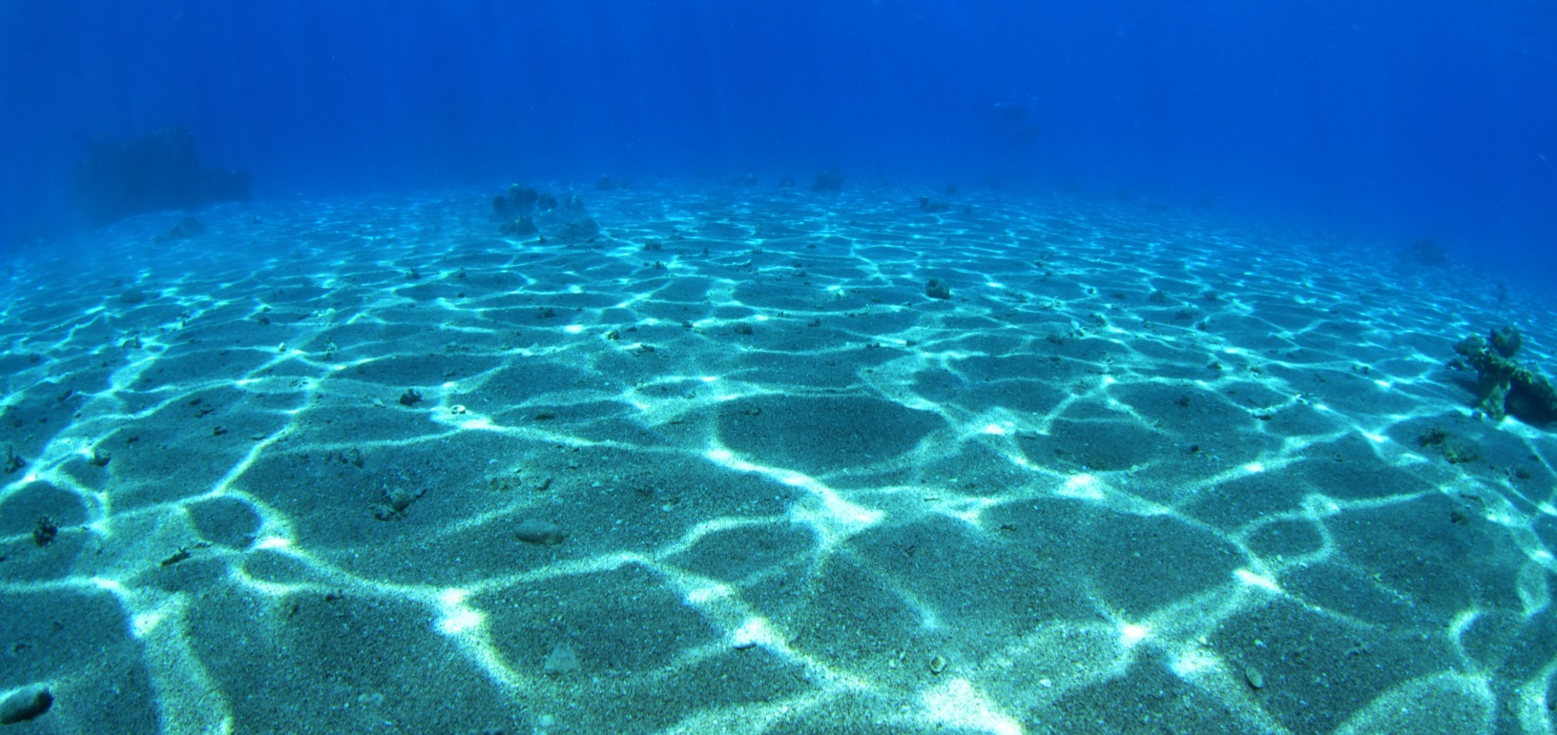



Stereo from Flickering Caustics
© I. Yogev
Yohay Swirski, Yoav Y. Schechner, Ben Herzberg
Elect. Eng. Dept.
Technion
Shahriar Negahdaripour
Elect. and Comp. Eng. Dept.
University of Miami

Slide 2
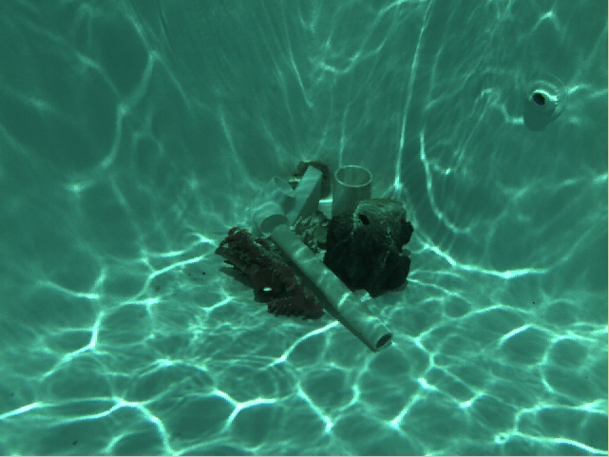
Flickering caustics
Ack: Amin Sarafraz and Ali Taatian
Swirski, Schechner, Herzberg, Negahdaripour

Slide 3
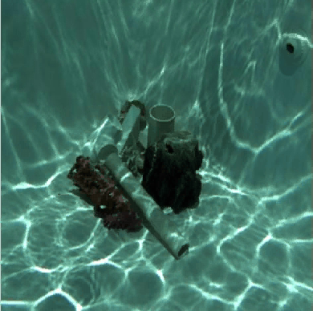
3D Recovery (inverse disparity)
Swirski, Schechner, Herzberg, Negahdaripour

Slide 4
Flickering caustic pattern
4
Walker, 1994.
Fraser et al, 1980.
Fournier and Reeves, 1986.
Swirski, Schechner

Slide 5
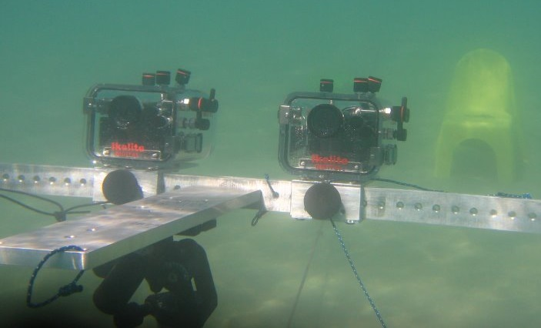
Contribution
5
Image formation model.
  Scattering media.
  Flickering illumination.
  Stereo.
Correspondence from flickering caustics.
  Accurate.
  Dense and point-wise.
  Simple.
  Reliable.
Swirski, Schechner, Herzberg, Negahdaripour

Slide 6
Underwater challenges
*Kahanov and Royal
Backscatter
Strong attenuation
Color distortion
Non-uniform and flickering illumination
Swirski, Schechner, Herzberg, Negahdaripour

Slide 7
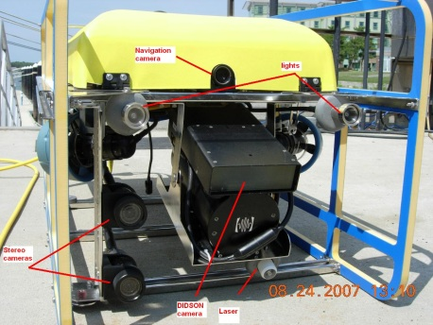
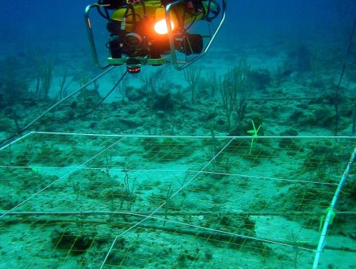
Related works
7
We exploit flicker
Flicker removal.
Karpel & Schechner, 2004.
Gracias et al, 2008.
Underwater stereo.
We focus on correspondence
under flicker
Bryant et al, 2000.
Negahdaripour & Firoozfam, 2005
Chari & Sturm, 2009.
Queiroz-Neto et al, 2004.
Structured light stereo (space-time stereo).
Zhang et al, 2003.
Davis et al, 2005.
We use unstructured,
Uncontrollable, natural light

Slide 8
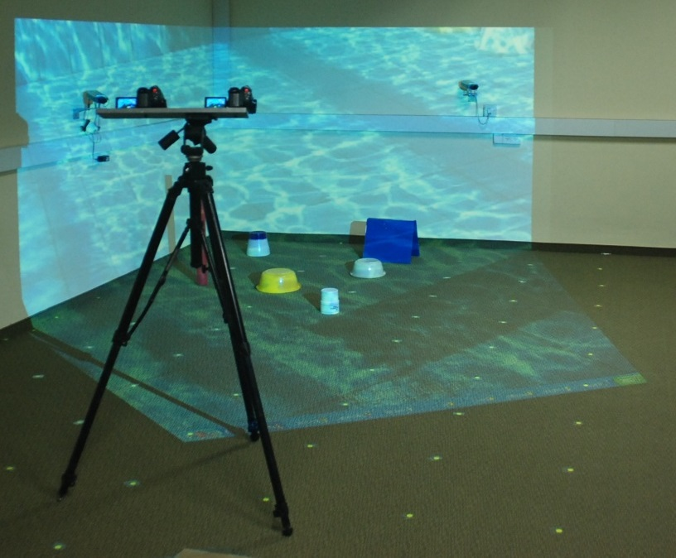
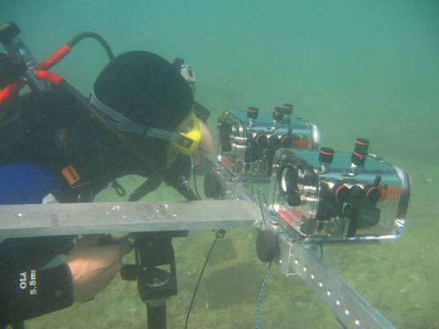
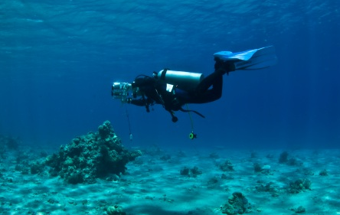
Experimental Setup
Ack: Tali Treibitz, Itchak Yogev
Swirski, Schechner, Herzberg, Negahdaripour

Slide 9
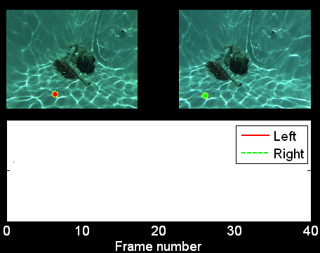
Correspondence by temporal flicker
Intensity
Swirski et al, ICCV 2009

Slide 10


Strong Disambiguation
Shift
of just
5 pixels.
Intensity
Swirski et al, ICCV 2009

Slide 11
Strong Disambiguation
Shift
of just
5 pixels.
Intensity
Swirski et al, ICCV 2009

Slide 12
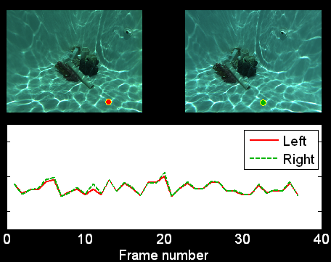
Correspondence by temporal flicker
Unambiguous temporal signature
Intensity
Swirski et al, ICCV 2009

Slide 13
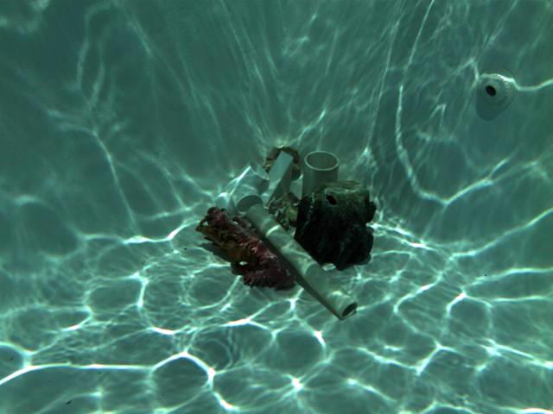
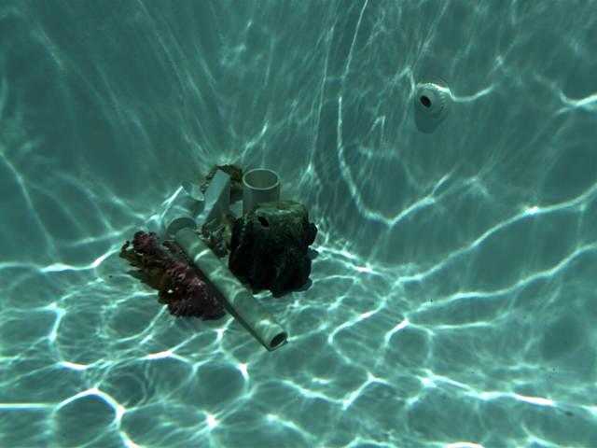
Pointwise (temporal) algorithm
Intensity
Find best match of all candidates in the second viewpoint.
Swirski, Schechner, Herzberg, Negahdaripour

Slide 14
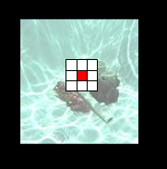
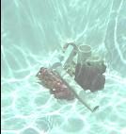
Using spatial information
t
t
Temporal
information
Spatial
information
Spatio-temporal
information
Swirski, Schechner, Herzberg, Negahdaripour

Slide 15
15
88%,
35 frames
80%,
15 frames
96%!
35 frames
86%,
10 frames!
100
4x4 support
80
3x3 support
60
% of correct correspondence
Temporal match:
  Point-wise and accurate.
  Requires more frames.
40
Spatio-temporal support:
  Less frames.
  Less accuracy.
Temporal only
20
0
5
10
15
20
25
30
35
Number of frames
Swirski, Schechner, Herzberg, Negahdaripour

Slide 16
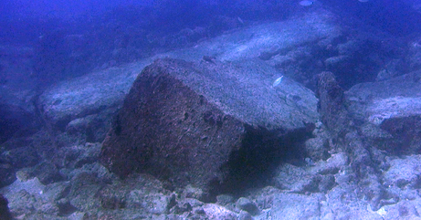
Caesarea:
Underwater archeological site
Swirski, Schechner, Herzberg, Negahdaripour

Slide 17
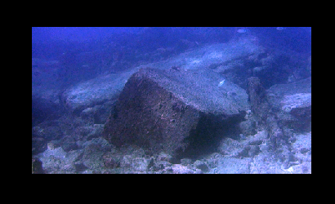
Caesarea:
Underwater archeological site
Swirski, Schechner, Herzberg, Negahdaripour

Slide 18
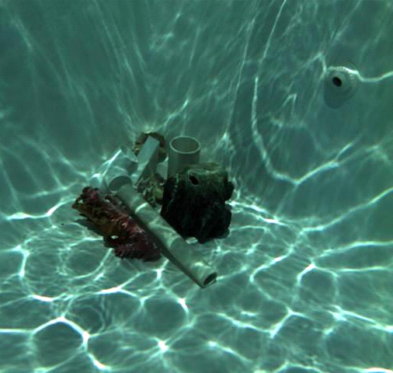
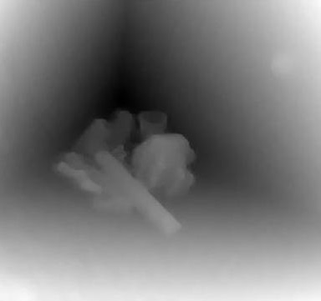
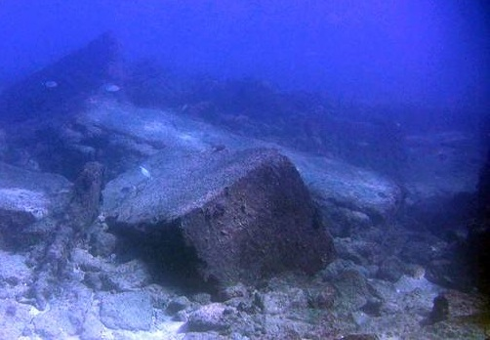

Space-time variational stereo
18
3 pairs of frames
Swirski, Schechner, Nir

Slide 19
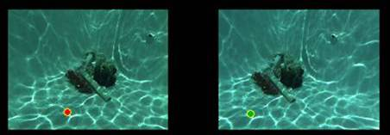
Space-time variational stereo
19
Using flicker as additional temporal information.
Flicker solves the aperture problem!
Other possible cost functions:
  Epipolar constraint.
  Different functional for data and smoothness terms
Data term
Smoothness term
Swirski, Schechner, Nir

Slide 20
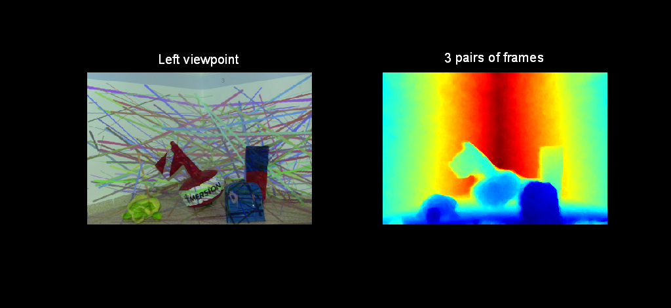
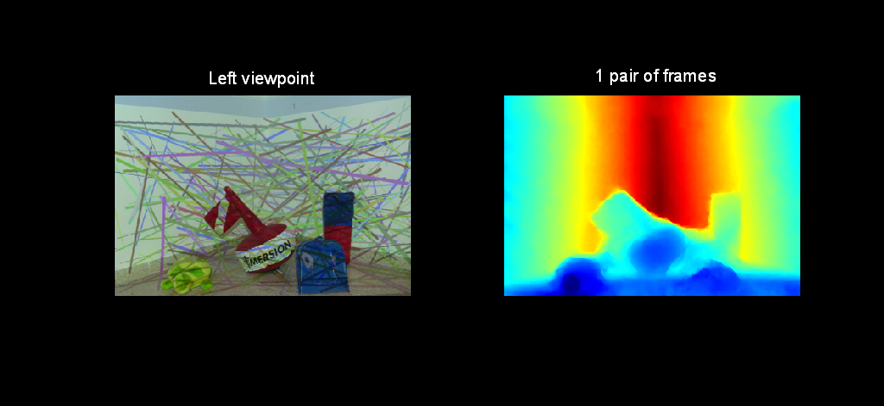
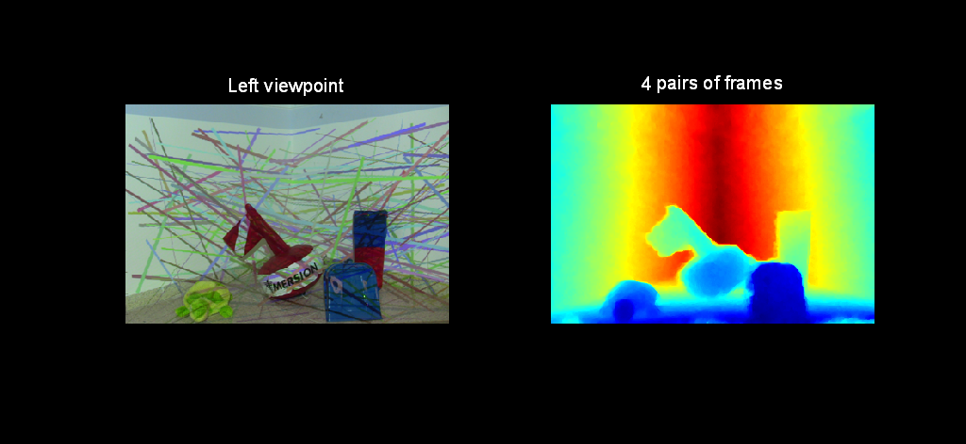

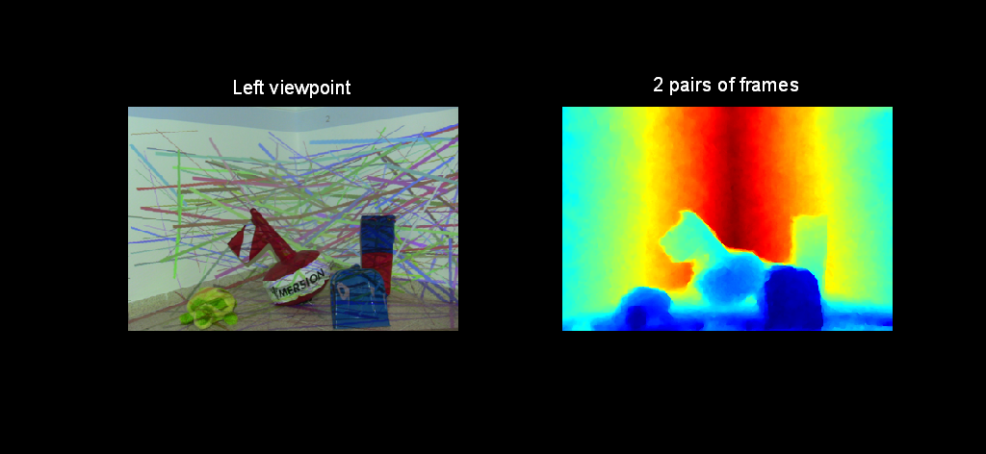
Structured light
Fast and accurate results
Swirski, Schechner, Nir

Slide 21
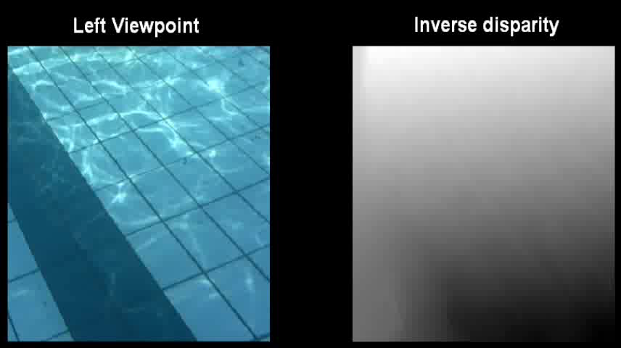
Dynamic results
Swirski, Schechner, Nir

Slide 22






Image formation
22
Backscatter
B
signal
scattering
S
Signal attenuation.
Spatio-temporal varying backscatter.
Swirski, Schechner, Herzberg, Negahdaripour

Slide 23




Image formation model
23
SIGNAL
+
BACKSCATTER
Two viewpoints
different backscatter
Swirski, Schechner, Herzberg, Negahdaripour

Slide 24
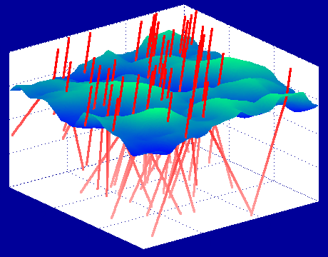
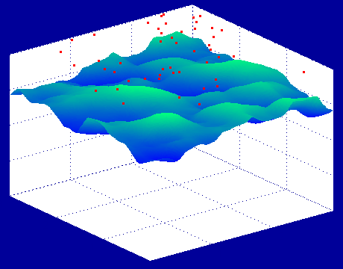
Image formation model
24
Backscatter
Signal
Backscatter
Water Surface
Intensity
Z
R
Signal
Assumption:
  Backscatter variations << Signal variations
Backscatter variations averaged by line-of-sight integral.
Validation by ray-trace simulation.
Swirski, Schechner, Herzberg, Negahdaripour

Slide 25
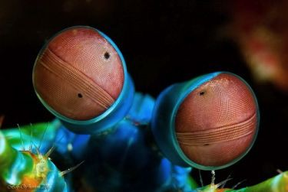
Potential Biological Mechanism?
25
Mantis Shrimp
© Webexhibits
Potential stereo vision capability
Very small brain (trouble for spatial-only stereo)
Shallow water (flickering habitat)
Swirski, Schechner, Herzberg, Negahdaripour

Slide 26

Correspondence from flicker
Accurate.
Dense.
Point-wise.
Simple.
Caustrereo
Swirski, Schechner, Herzberg, Negahdaripour

Slide 27
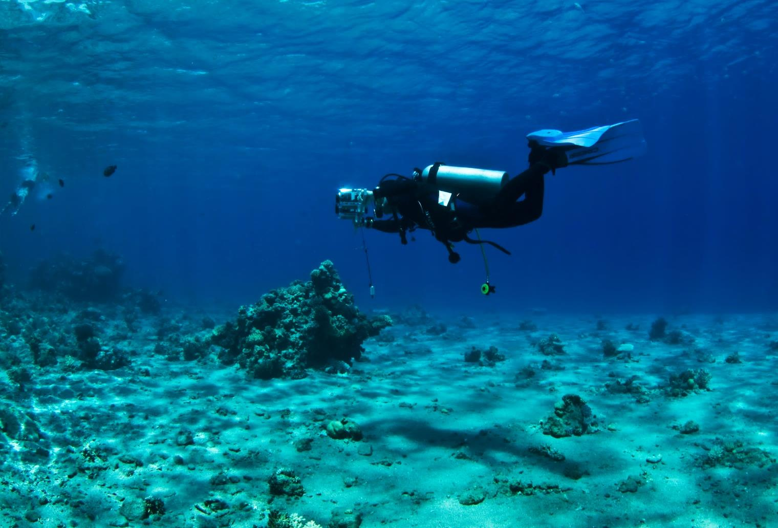
3Deflicker from Motion
Stereo video
Motion
3D structure
Scattering
© I. Yogev
Flickering illumination
Yohay Swirski and Yoav Y. Schechner
Elect. Eng. Dept.
Technion – Israel Institute of Technology

Slide 28
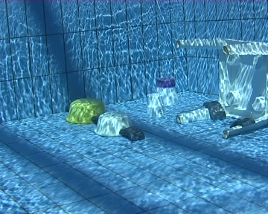
Flickering caustics in a free-moving camera
Ack: Marina Alterman, Hani Swirski, Yuval Bahat
Swirski, Schechner

Slide 29
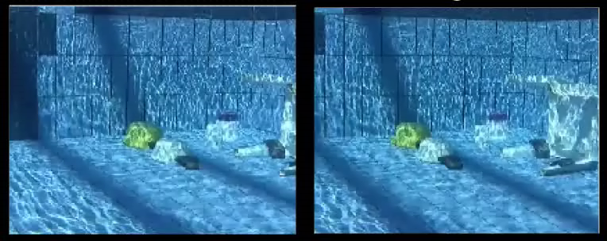
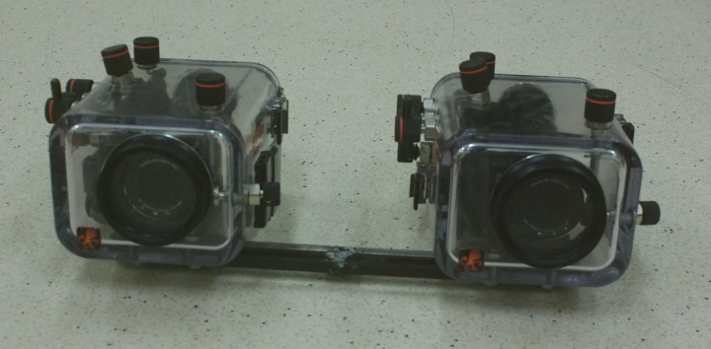
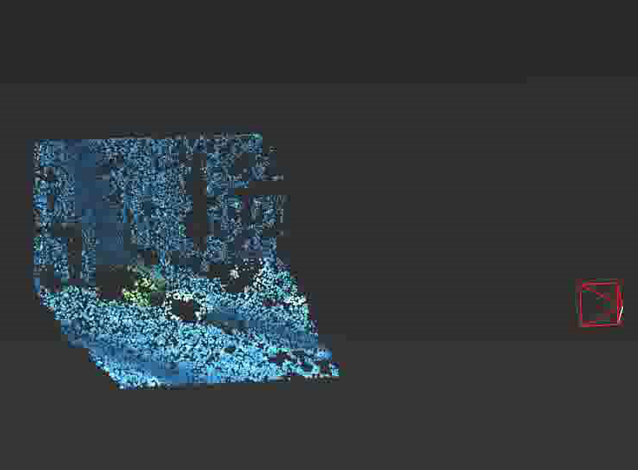
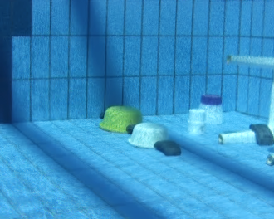
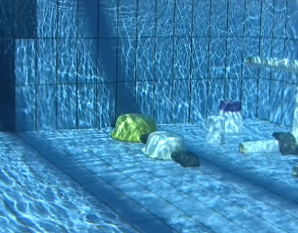
Structure, motion and deflicker from moving stereo
Left
Right
Render a deflickered image
Swirski, Schechner
Ack: Amit Aides

Slide 30
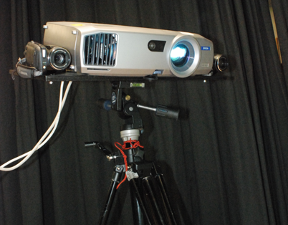
Structured light setups
Video cameras
Swirski, Schechner

Slide 31
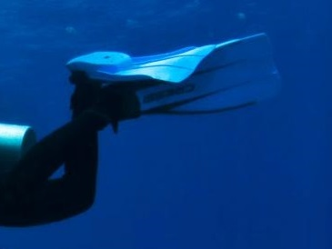
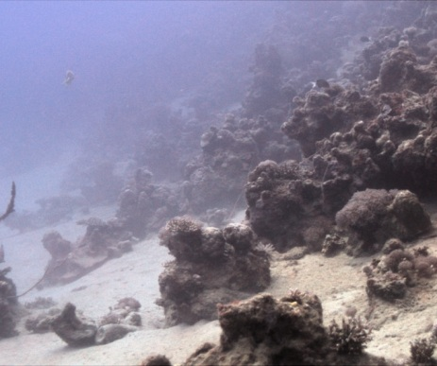
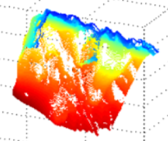
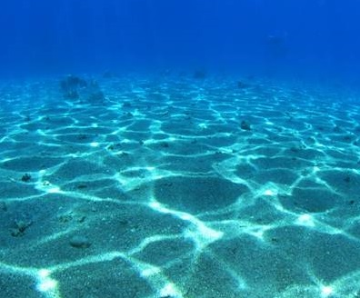
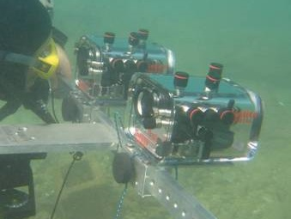
31
31
Motion estimation
Motion
estimation
Scattering and
attenuation
3D structure
Flickering
Caustics
Stereoscopic
Vision

Slide 32
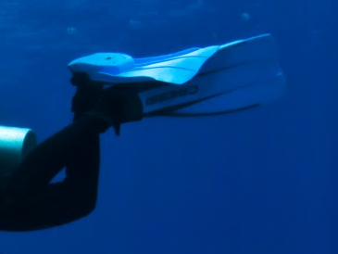
32
32
Stereo from flicker (CauStereo)
Swirski et al, 2009.
Swirski, Schechner and Nir, 2011.
Motion estimation
Motion
estimation
Space-time stereo.
Zhang et al, 2003.
Davis et al, 2005.
Scattering and
attenuation
3D structure
Structured light
We generalize CauStereo for
free-moving cameras.
Flickering
Caustics
Stereoscopic
Vision

Slide 33
33
33
Motion estimation
Flicker removal (Deflicker)
Motion
estimation
Karpel & Schechner, 2004.
Gracias et al, 2008.
Scattering and
attenuation
3D structure
We deflicker
free-moving video sequences.
Flickering
Caustics
Stereoscopic
Vision

Slide 34
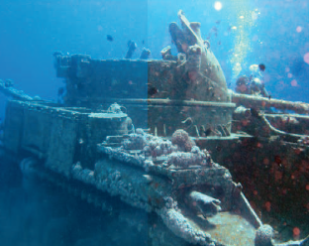
34
34
Dehazing & Descattering
Motion estimation
Nayar & Narasimhan, 1999.
Schechner & Karpel, 2004.
Treibitz & Schechner, 2006.
Fattal, 2008.
He et al, 2009.
Joshi & Cohen, 2010.
Motion
estimation
Scattering and
attenuation
3D structure
We descatter using moving stereo videos.
Flickering
Caustics
Stereoscopic
Vision

Slide 35
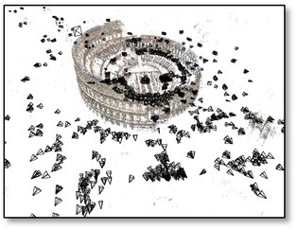
35
35
Motion estimation
Structure from motion
Motion
estimation
Hartley and Zisserman, 2000
Snavely et al, 2006.
And many more…
Scattering and
attenuation
3D structure
We focus on SfM under very strong illumination variations.
Flickering
Caustics
Stereoscopic
Vision

Slide 36
36
36
3Deficker from motion:
3D structure
Motion estimation
Deflicker
Descatter
Motion estimation
Motion
estimation
Scattering and
attenuation
3D structure
Our work
Coupled problems solved together!
Flickering
Caustics
Stereoscopic
Vision

Slide 37
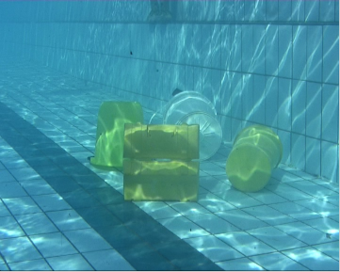
Swirski, Schechner

Slide 38
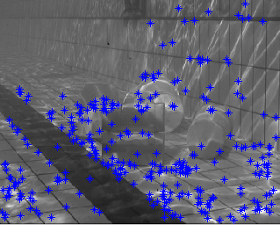
SIFT feature points
A static sequence :
almost no temporally static feature points
Swirski, Schechner
Lowe, IJCV 2004

Slide 39
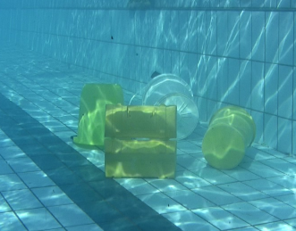
Rendering vibrations
Swirski, Schechner

Slide 40
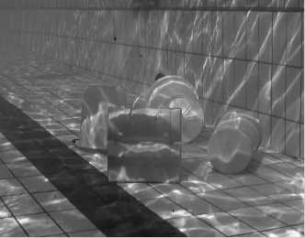
Stabilization using SIFT
Erroneous stabilization result using SIFT and RANSAC
Swirski, Schechner

Slide 41
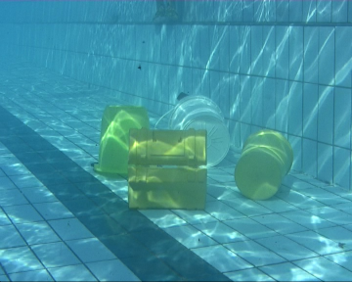








Principle: stabilization using stereo
Left viewpoint
Right viewpoint
Range maps
3D shape is illumination invariant!
time
Swirski, Schechner

Slide 42
Stabilization using Stereo
Stabilized sequence using disparity maps
Comparison to SIFT and ground truth
Displacement [pixels]
Frame number
Swirski, Schechner

Slide 43










43
Instantaneous
Stereo
Instantaneous
Stereo
Instantaneous
Stereo
Point-cloud 1
Point-cloud 2
Point-cloud 3
ICP
ICP
Rusinkiewicz & Levoy, 2001
Segal et al, 2009
Model
point-cloud
Updated Model
Point-cloud
Swirski, Schechner

Slide 44







44
Single-pair
stereo
Single-pair
stereo
Single-pair
stereo
Static video
rendering
Aligned stereo pair 1
Aligned stereo pair 2
Aligned stereo pair 3
Swirski, Schechner

Slide 45


45
Aligned stereo pair 1
Aligned stereo pair 2
Aligned stereo pair 3
Space-time stereo – Higher accuracy
Swirski, Schechner

Slide 46




46
Aligned frame 1
Aligned frame 2
Aligned frame 3
Point-wise
temporal median
Deflickered
sequence
Swirski, Schechner

Slide 47


Structured light
Left viewpoint
Projected varying flicker pattern.
Unconstrained motion of the stereo rig.
Swirski, Schechner

Slide 48


Structured light results
Left
Right
Ack: Amit Aides
Swirski, Schechner

Slide 49



Sea experiment
Gain correction
target
Structure and motion estimation
Left viewpoint
Reduced contrast
due to scattering
Ack: Amit Aides
Swirski, Schechner

Slide 50
Descattering - Image formation
50
Backscatter
Object
B
O
scattering
Swirski, Schechner

Slide 51
After deflickering
51
Backscatter
Object
B
O
scattering
Swirski, Schechner

Slide 52


Descattering – Object recovery
52
Deflicker
Range
Attenuation coefficient:
Needs to be estimated
Descattered
Image
Measured intensity
Backscatter at infinity:
Estimated by observing the horizon
Range map:
Yielded by 3D shape
Swirski, Schechner

Slide 53


Attenuation coefficient (η) estimation
53
53
Scattering is modulated by Cameras motion
Same object, different intensity between viewpoints
Swirski, Schechner

Slide 54

Attenuation coefficient (η) estimation
54
54
Estimation of η Using
a cost function Minimization
Estimation of η
for each color
Swirski, Schechner

Slide 55

Descattering results
Original image (left viewpoint)
Deflickered
Deflickered + descattered
Swirski, Schechner

Slide 56
Future research
Improved alignment for
stabilization and deflickering.
Generalization to non-rigid
scene motion.
Swirski, Schechner

Slide 57



3Deflicker from Motion
Moving stereo
under flickering
illumination
Dense structure & motion
Deflicker
Descatter
Swirski, Schechner

