Slide 1
Wine glass sound excitation by mechanical coupling to plucked strings
Lior Arbel¹
Yoav Y. Schechner²
Noam Amir³
¹Faculty of Architecture and Town Planning, Technion - Israel Institute of Technology ²Viterbi Faculty of Electrical Engineering, Technion - Israel Institute of Technology ³Department of Communication Disorders, Sackler Faculty of Medicine, Tel-Aviv University, Tel-Aviv, Israel

Slide 2
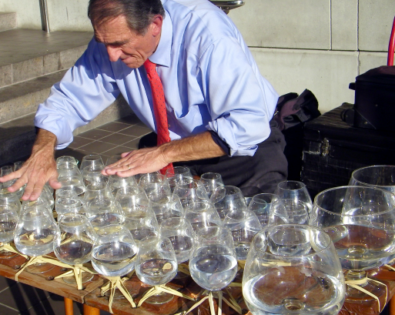
Introduction Musical Wine Glasses
Wine glasses have been used for music production for centuries.
Wine glass sounds are produced by rubbing, bowing or striking.
Several variations of wine glass instruments exist.
Glass Harp by Alan Kotok / CC BY

Slide 3
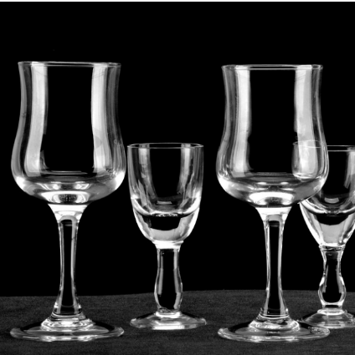
Introduction Musical Wine Glasses
In this research a new method for producing wine glass sounds is developed-
By coupling the wine glass to a vibrating string.

Slide 4
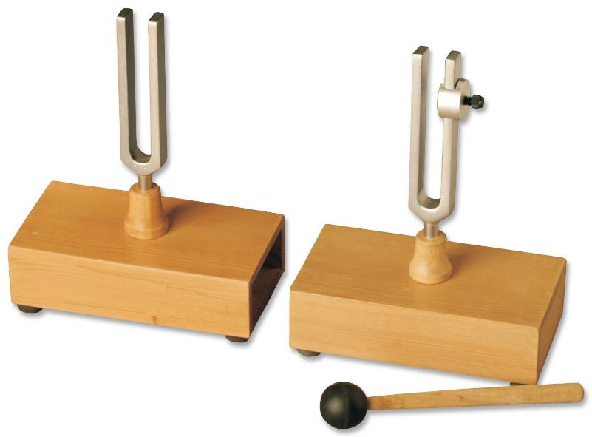
Introduction Sympathetic resonance
Development of string-glass coupling is inspired by the principle of sympathetic resonance, demonstrated here by two tuning forks.
Second tuning fork vibrates
First tuning fork is struck
Vibration transmitted through coupling
Frey Scientific Sympathetic-Differential Forks

Slide 5
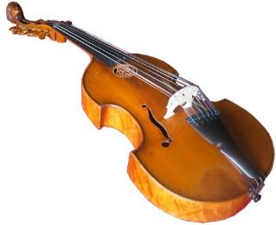
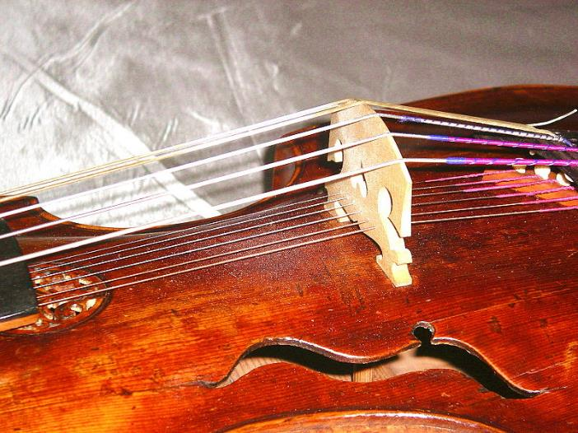
Introduction Sympathetic resonance
Sympathetic resonance is used between sets of strings in many musical instruments, such as the Viola d’amore.
Strings are played
Viola d'amore
by Frinck51/ CC BY
Vibration transmitted through bridge
Sympathetic strings react
by Aviad2001/ CC BY

Slide 6
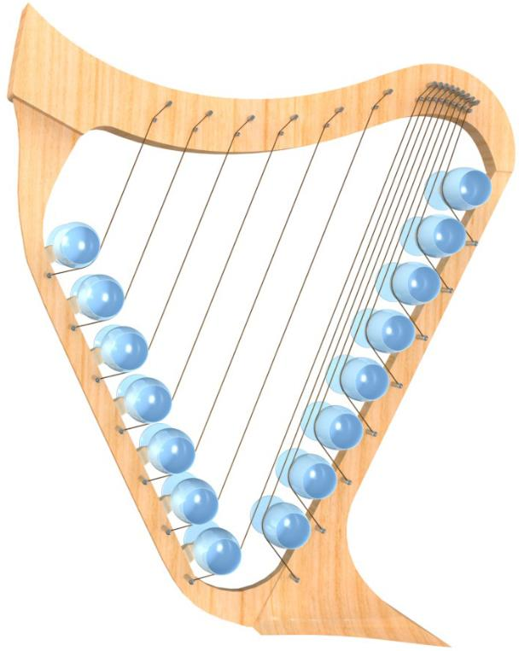
Instrument concept The Direct Contact method
A concept of a string-wine glass
instrument, based on a shape of a harp.
The string-glass coupling is achieved by direct contact.
The instrument contains 15 strings, each
coupled to a different wine glass.

Slide 7
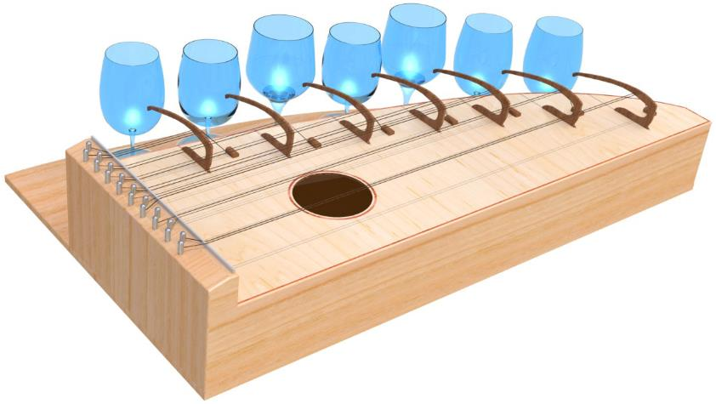
Instrument concept Coupling Component
A concept of a string-wine glass instrument, based on the shape of a dulcimer.
The string-glass coupling is achieved by a coupling component.
The instrument contains 7 glasses, each coupled to several strings.

Slide 8
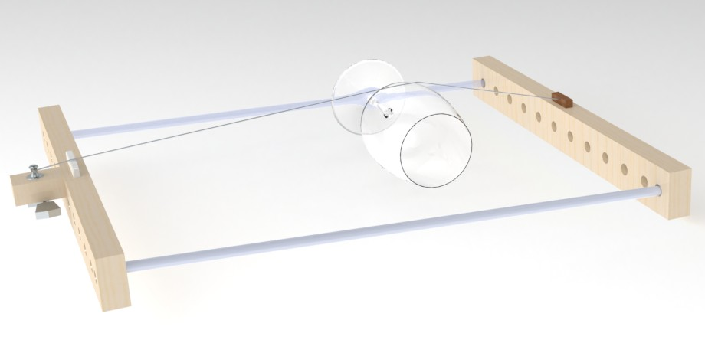
Coupling The Direct Contact method
String-glass coupling is first achieved by creating direct contact between the glass surface to the vibrating string.
Pluck
Transmit
React

Slide 9
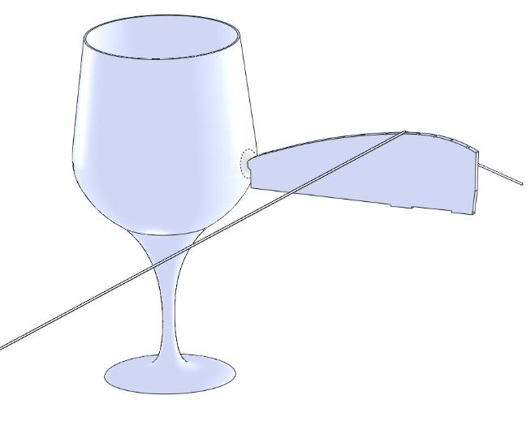
Coupling Coupling component
A coupling component (‘bridge’) is used
to create a physical distance between
glass and string.
The magnitude of the mechanical
impedance of the bridge affects the
produced glass sounds.
Simulations show that wine glass sound
intensity is increased when bridge and
glass impedances are of the same order
of magnitude.

Slide 10
Optimization Need for optimization
10⁸
10⁶
10⁴
10²
10⁰
Impedance of initial bridge prototypes is several orders of
magnitude higher than glass impedance.
A quantitative design process is used to optimize the coupling
component performance by lowering its impedance.

Slide 11
Optimization Phase I: Material Distribution Method
New coupling component boundary, Ω.
String excitation point – top (circled).
Glass contact point – left (circled).
Material Distribution Method is used to generate a new
structure within the boundary Ω.

Slide 12
Optimization Phase I: Material Distribution Method
Solid Isotropic Material with Penalization (SIMP) is used to
discourage intermediate values.
Design variable: α(x,y), with values [0,1].
Material Young’s modulus: E= α(x,y)^{p}E₀
P=5 (SIMP penalization parameter).

Slide 13
Optimization Phase I: Material Distribution Method
Design variable is defined
$$CSTR=\iint_{Ω}{α\left(x,y\right)dΩ;} x,y∈Ω$$
An upper limit was imposed:
$$CSTR≤{CSTR}_{limit}=0.5\iint_{Ω}{dΩ;} x,y∈Ω$$

Slide 14
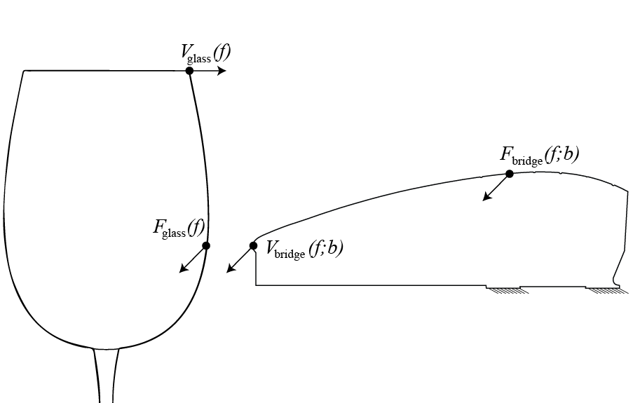
Optimization Phase I: Material Distribution Method
Defining
$b∈B$ : a bridge layout.
B : all possible bridge layouts.
F_{bridge}(f;b) : Force measured on the string excitation point.
V_{bridge}(f;b) : Velocity measured on the bridge, at the glass contact point.
F_{glass}(f;b) : Force measured on the glass contact point.
V_{glass}(f;b) : Velocity measured on a point at the glass rim.
$Z_{bridge}\left(f;b\right)=\frac{F_{bridge}(f;b)}{V_{bridge}(f;b)}$ : bridge transfer impedance
${\overline{Z}}_{glass}\left(b\right)=\frac{F_{glass}(f;b)}{V_{glass}(f;b)}$ : average glass transfer impedance.

Slide 15
Optimization Phase I: Material Distribution Method
Z_{bridge}(f;b) – bridge transfer impedance
${\overline{Z}}_{glass}$(f) – average glass transfer impedance.
The difference in magnitudes is given as:
$${Z(f;b) }_{diff}=\left|Z_{bridge}(f;b)\right|−\left|{\overline{Z}}_{glass}\right|$$
Averaging the magnitude difference over a set F of discrete frequencies, F = {100; 200…1000}:
$${\overline{Z}}_{diff}\left(b\right)=\frac{1}{\left|F\right|}\sum_{f∈F}{Z_{diff}}(f;b)$$
The optimization goal is defined as finding $\hat{b}$ that minimizes ${\overline{Z}}_{diff}(b)$: $\hat{b}=\arg{ min{\overline{Z}}_{diff}(b)}$
b∈B

Slide 16
Optimization Phase II: Shape Optimization Method
1
0
Optimization results in a two dimensional layout
for a new prototype of a coupling component.

Slide 17
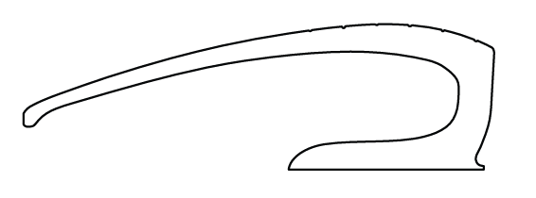
Optimization Phase II: Shape Optimization Method
A coupling component is extracted from the layout.

Slide 18
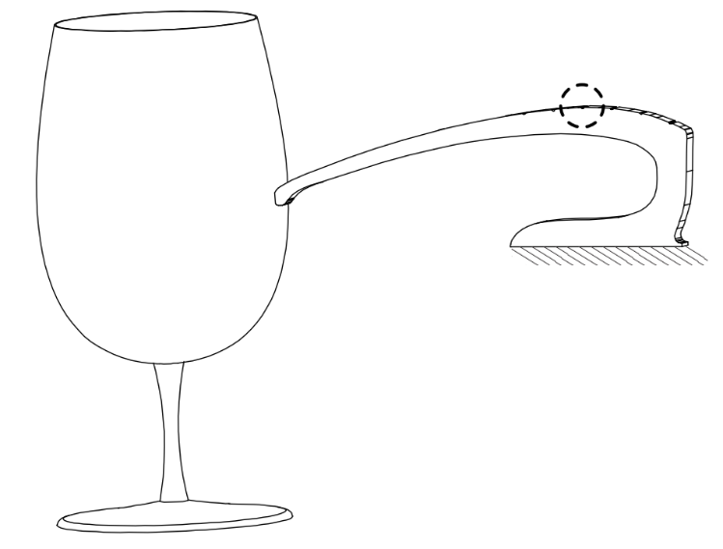
Optimization Phase II: Shape Optimization Method
The coupling component is achieved by extruding
the 2 dimensional layout generated by the Material Distribution Method.
The shape optimization method uses a coupled
wine glass/coupling component model.

Slide 19
Optimization Phase II: Shape Optimization Method
The new shape is parameterized:
N fixed anchor points are added on the outer contour, Õ.
From each point, a ray is projected towards the inner contour, Ĩ,
creating intersection points ${x_{i}}^{int}$.
The distances d_{i} are the design variables.
The algorithm changes the distances d_{i}, thus moving ${x_{i}}^{int}$.
The inner contour is replaced by a spline connecting ${x_{i}}^{int}$ at the new positions,
thus tuning the bridge shape.

Slide 20
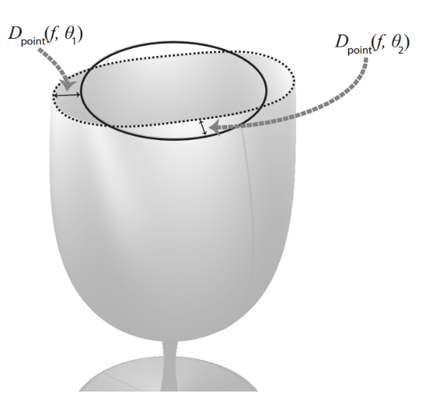
Optimization Phase II: Shape Optimization Method
β - A shape of a bridge defined by a set {d₁…d_{N}}
Β – The domain of all possible bridge shapes
that can be obtained by small perturbations.
D_{point}(f,θ;β) – frequency dependent glass displacement
at a point on the rim.
Defining a closed-line integral:
$D_{rim}\left(f;β\right)=\oint_{0}^{2π}{\left|D_{point}(f,θ;β)\right|dθ}$
Average D_{rim}(f) over a set of discrete frequencies, F₂={100,150…1000}Hz:
$\overline{D}\left(β\right)=\frac{1}{\left|F_{2}\right|}\sum_{f∈F_{2}}{D_{rim}}(f;β)$
The optimization seeks a set of {d₁…d_{N}} which defines a new bridge $\hat{β}$ that maximizes $\overline{D}\left(β\right):$
$\hat{β}=\arg{ max\overline{D}(β)}$
$$β∈β$$

Slide 21
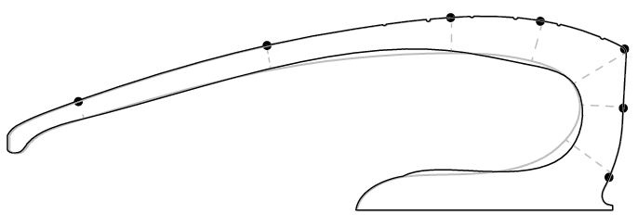
Optimization Phase II: Results
The optimization stage results in a new set of values,
defining a new optimized bridge.

Slide 22
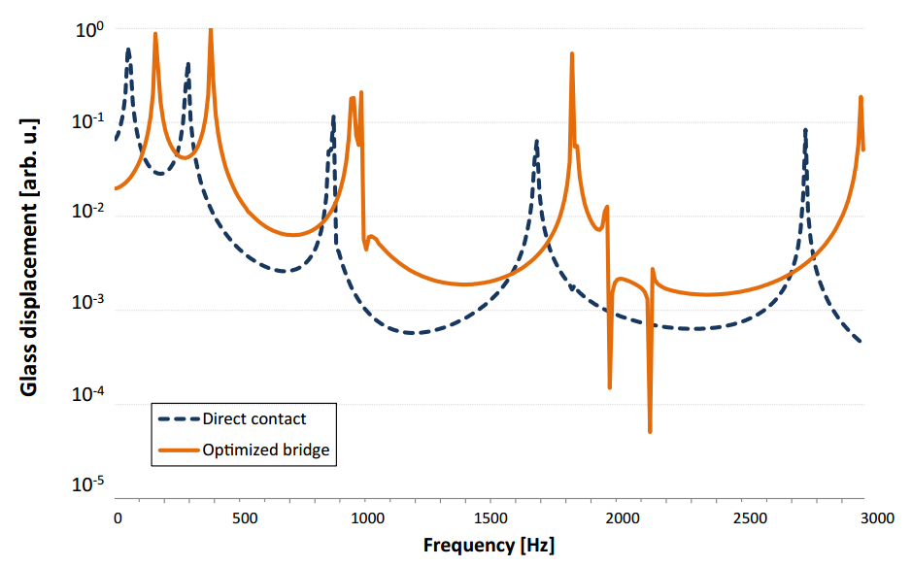
Optimization Simulation
The optimized bridge was tested by simulations.
The optimized bridge produced higher glass displacements
than the direct contact method.

Slide 23
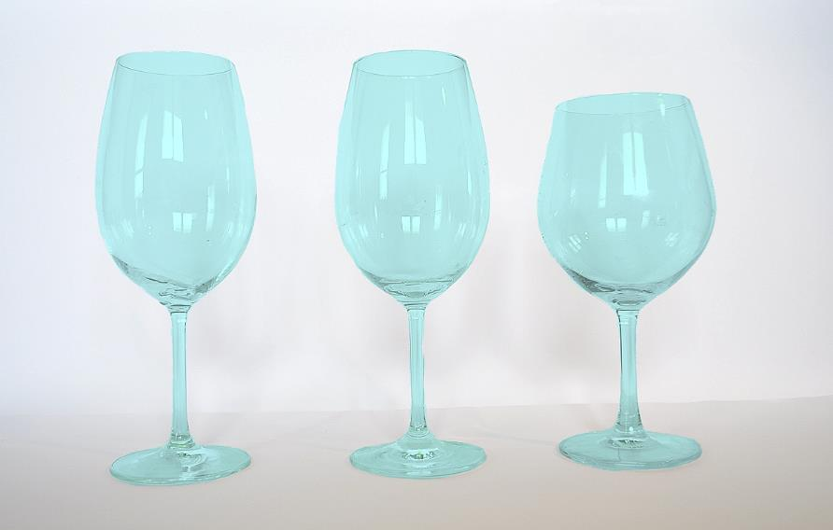
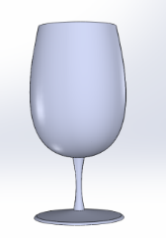
Experiment Setup
Simulation
model
glass
437Hz
(A4) Glass1a
550Hz
(C#5) Glass1b
435Hz
(A4) Glass2
The optimized bridge was compared to direct-coupling by experiment.
3 glasses were used, 2 of which are identical to the simulation model.

Slide 24
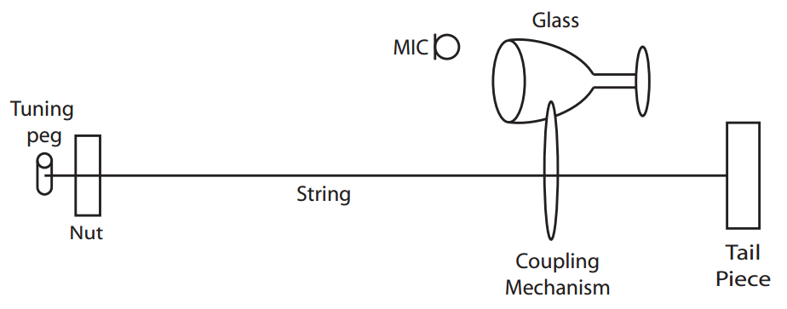
Experiment Setup
Glass sound intensity produced by each coupling method was measured.
Measurements were performed across a discrete frequency range of musical notes.

Slide 25
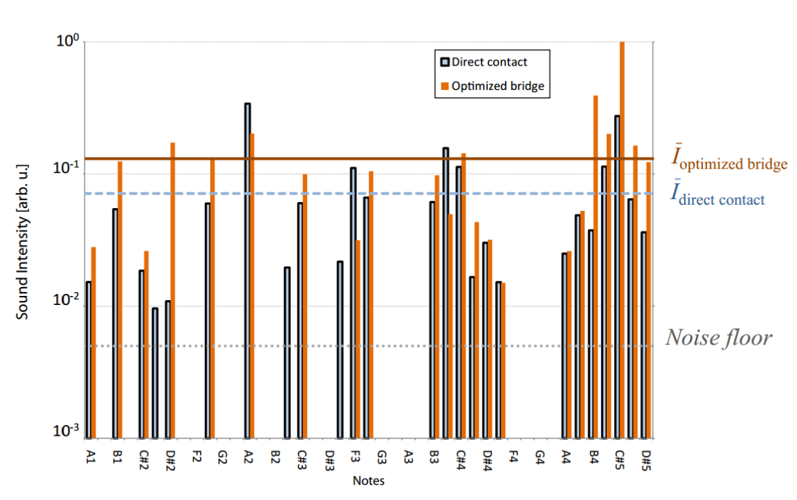
Experiment Results
Glass1a intensity measurements
Glass1a and Glass1b:
The optimized bridge generated higher intensity glass responses (average and median).
Glass2 (different from the model glass):
The optimized bridge generated lower intensity glass responses (average and median).

Slide 26
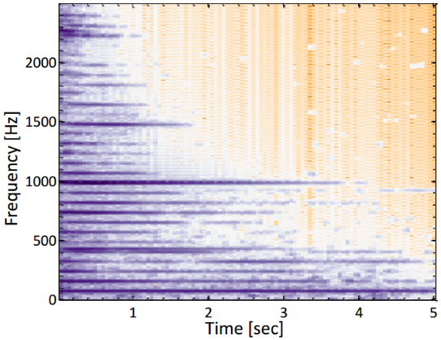
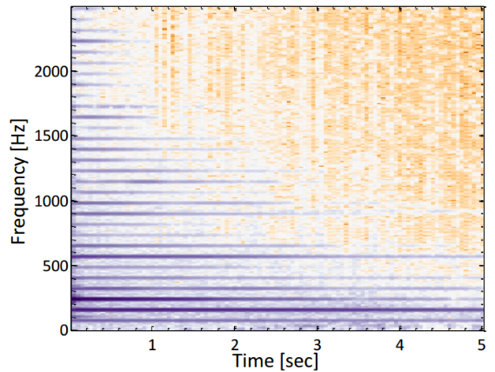
Experiment Results
Coupled string and glass (Glass2a)
Classical guitar
The coupled string-wine glass spectrum contains more high harmonies,
in comparison with a classical guitar spectrum.

