Slide 1


1
Resolution Loss without Optical Blur
Tali Treibitz
Alex Golts
Yoav Y. Schechner
Technion , Israel
Notes:
Good afternoon. Our work deals with analysis of cross-modal signals. Specifically, with audio-visual signals.

Slide 2
14
total intensity
object radiance
L
airlight
object
I
A
D
scattering
direct transmission
1
0
z
0
z
Schechner, Narasimhan, Nayar

Slide 3
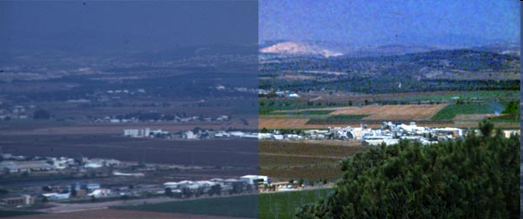
Haze
15
object
transmittance
airlight
Schechner et al., Applied Optics ‘03
Notes:
haze

Slide 4
Pointwise Degradations
17
noise
object
pointwise attenuation:
vignetting
atmosphere attenuation
additive component:
reflection
glare
path radiance
Treibitz & Schechner, Recovery Limits in Pointwise Degradations
Notes:
What is the relation of all this to computer vision?
There are many works that were done by people in this room where the common property is that there is no blur,
Where the degradation is pointwise.
Major part is: estimate t and A, compensate to get L.
Thus, the limits are effective

Slide 5
Pointwise Degradations
18
reduce SNR even if known
noise
object
pointwise attenuation
additive (positive) bias
Treibitz & Schechner, Recovery Limits in Pointwise Degradations
Notes:
5
Note that because of signal dependent photon noise the additive component reduces the input SNR So even if your reconstruction method precisely estimates that degradation terms, the reconstruction is still limited.
This analysis is not only theoretical. It has practical implications.
Now, we can tell if any reconstruction method can detect an object in a certain size, with a certain contrast under given noise levels. I am going to demonstrate it in the case of haze.

Slide 6
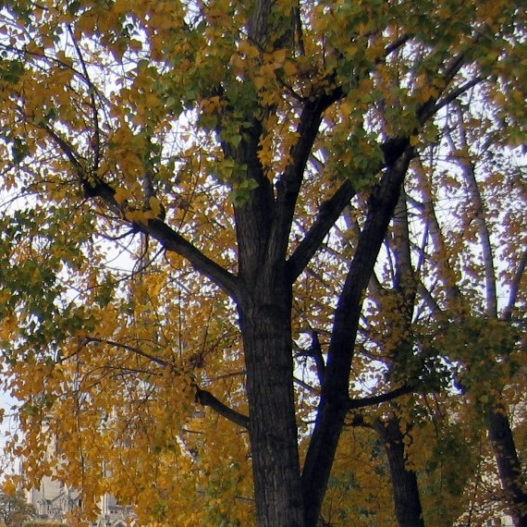
Noise: Object size matters?
19
Notes:
Let’s see what happens when we add noise.
Small details disappear

Slide 7
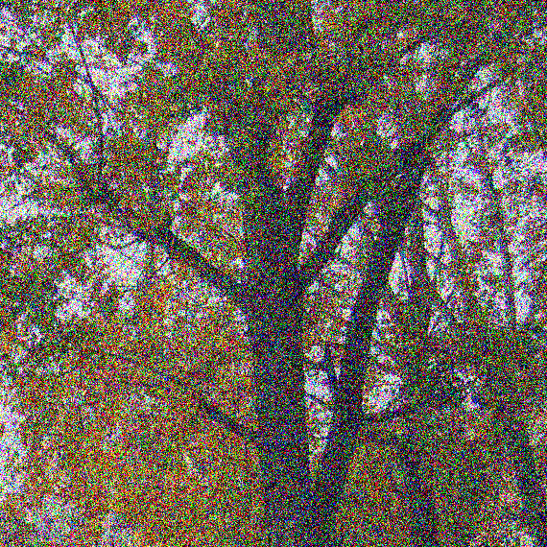
Noise: Object size matters?
20
Notes:
As we add noise the smaller objects like this branch start to disappear, while the larger ones stay

Slide 8
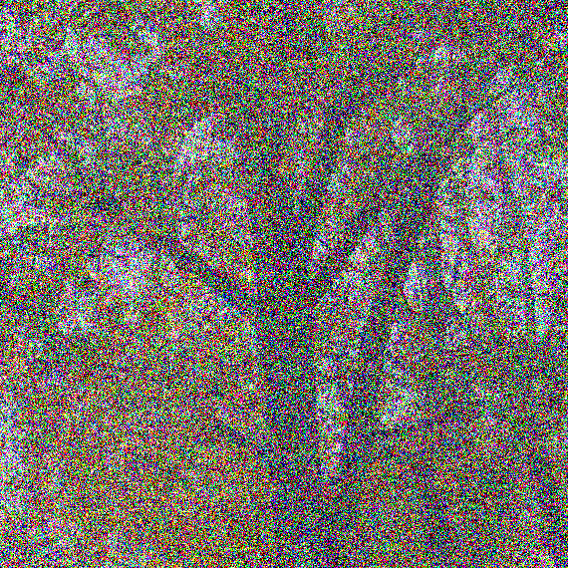
Noise: Object size matters?
21

Slide 9
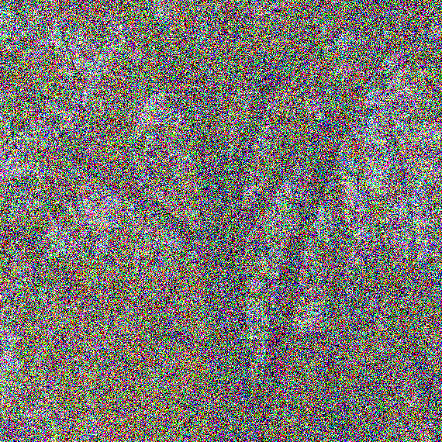
Noise: Object size matters?
22
Notes:
Branch disappears as noise increases
There is no blur- but details still disappear
How can it be- there is no LPF, and still small details disppear
Noise induces a LPF- this is what the work is about

Slide 10
Visibility Under Noise
23
depends on:
noise level
object  background intensity difference
object size
quantify this dependency !
Prior art: resolution limits due to optical blur
here: no optical blur
Notes:
10
So, visibility under noise depends of course on the noise level,
Obviously, it also depends on the intensity differences between the signal and the background
(same intensity-can’t see),
And- it also depends on the object size! and in this work we quantify this dependency
I want to emphasize that previous works have analyzed how noise affects resolution under blur, for example, when doing a deconvolution
But- here we assume no blur

Slide 11





Previous criteria
Is there something there?
Is it a tank?
What type is it?
Johnson charts:
identification | recognition | orientation | detection
7 | 3.5 | 1.2 | 0.75 | tank
minimum line pairs for 50% success

Slide 12
NIIRS- National Image Interpretability Rating Scales
Interpretability of the imagery is precluded by obscuration, degradation, or very poor resolution
0
Detect a medium-sized port facility and/or distinguish between taxi-ways and runways at a large airfield.
1
2
Detect large hangars at airfields. Detect large static radars (e.g., AN/FPS-85, COBRA DANE, PECHORA, HENHOUSE), Detect military training areas...
Identify the wing configuration (e.g., straight, swept, delta) of all large aircraft (e.g., 707, CONCORD, BEAR, BLACKJACK). ..
3
Identify small light-toned ceramic insulators that connect wires of an antenna.
Identify vehicle registration numbers (VRN) on trucks.
Identify screws and bolts on missile components. ..
9

Slide 13
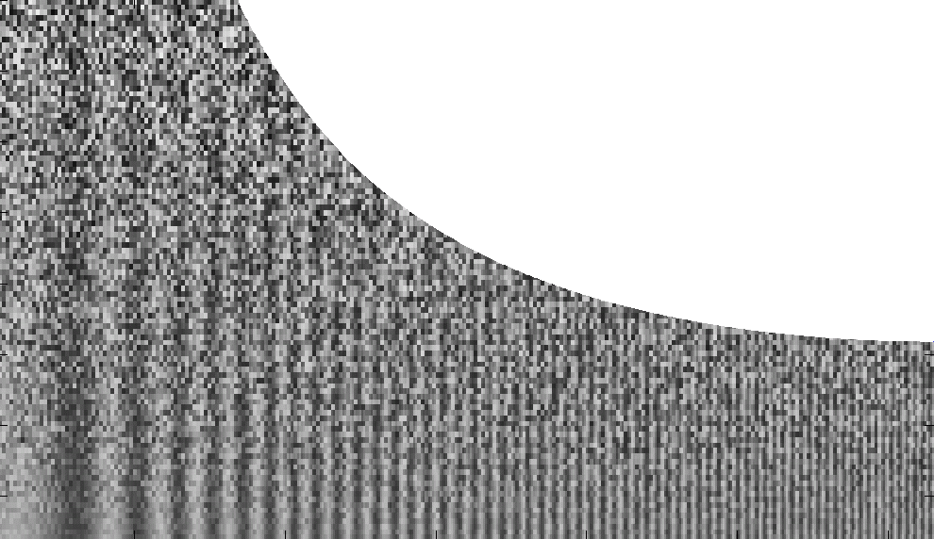

24
pattern visible
Treibitz & Schechner, Recovery Limits in Pointwise Degradations

Slide 14
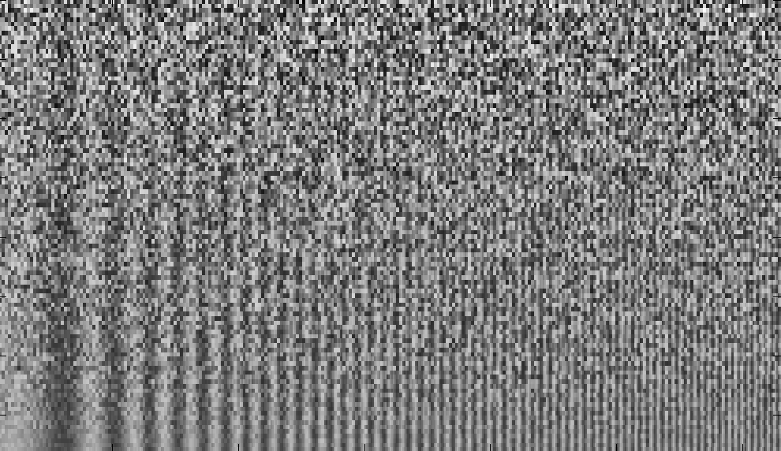
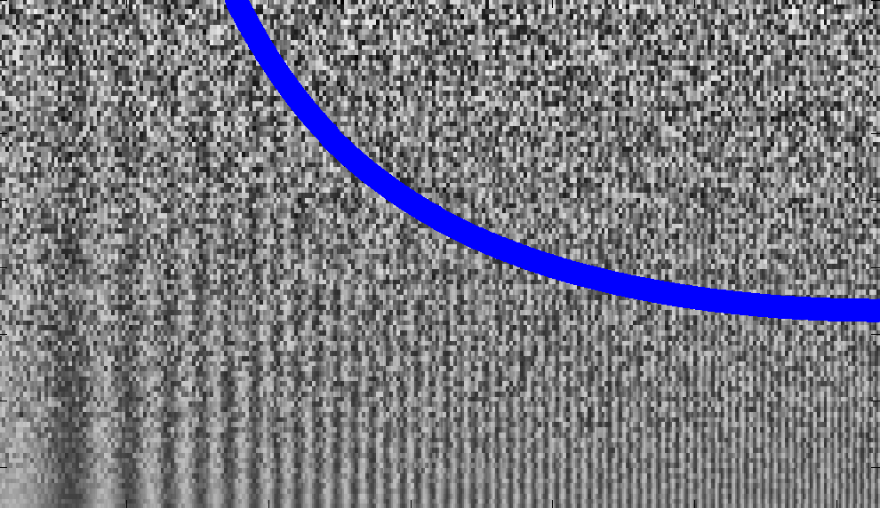
Where is the Cutoff?
25
pattern invisible
pattern visible
calculated analytically!
Input SNR
(frequency)
Treibitz & Schechner, Recovery Limits in Pointwise Degradations
Notes:
14
This is the whole image
We took a signal with increasing frequency and added noise with decreasing variance
Signal to noise ratio (SNR) increases
In high frequencies even relatively low noise hides the pattern
Low frequencies- even under high noise the pattern is visible
In the same SNR- low freqs are visible, high are not
We can draw a line (try to) that separates the areas where the pattern is visible from the areas where it’s not
If I’d draw it manually, this is where I’ll do it
This line was calculated analytically- I’ll explain how

Slide 15
Cutoff Per Success Rate
26
success rate 50%
Input SNR
(frequency)
Treibitz & Schechner, Recovery Limits in Pointwise Degradations
Notes:
15
This is the whole image
We took a signal with increasing frequency and added noise with decreasing variance
Signal to noise ratio (SNR) increases
In high frequencies even relatively low noise hides the pattern
Low frequencies- even under high noise the pattern is visible
In the same SNR- low freqs are visible, high are not
We can draw a line (try to) that separates the areas where the pattern is visible from the areas where it’s not
If I’d draw it manually, this is where I’ll do it
This line was calculated analytically- I’ll explain how

Slide 16
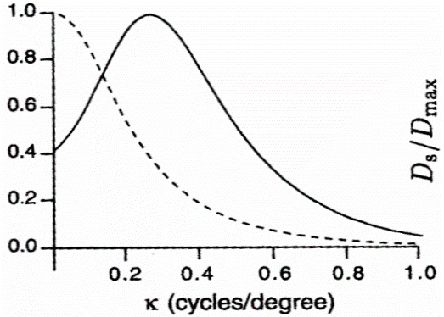
Noise Suppression in the HVS
28
response of receptive field
low noise
Theoretical Neuroscience, Dayan & Abbott
high noise
frequency (cycles/degree)
We derive: fundamental analytical model
Model: simple linear denoising
not a denoising method
Notes:
The human visual system suppresses noise and demonstrates this behavior
In this curve you can see that under high noise, high frequencies are suppressed more
That’s why you managed to see, the eye is doing an averaging action
We do not analyze the HVS, but we want to know the limits of every system
We use tools of simple linear systems- that allow us to analyze frequency response
We calculate the limits of optimal linear systems- will apply also to suboptimal

Slide 17


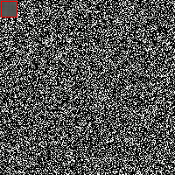

SNR Improvement by Averaging
29
signal
- SNR change after averaging
noise
Treibitz & Schechner, Recovery Limits in Pointwise Degradations
Notes:
Linear systems-> fourier decomposition
As we work with linear systems, we can look at each frequency separately.
I want to stress that I don’t suggest here a denoising method, I just want to know the limits of an optimal linear LPF.
Linear operation on a sinus- the frequency does not change, only its amplitude changes, in the factor of the system’s response
On noise- decreases the noise
so there is a change in SNR
So averaging with a window affects both the signal and the noise, therefore we understand there is a change in SNR

Slide 18
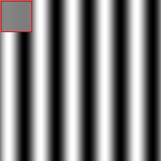
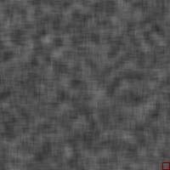
Different Sizes of Windows
30
too big for signal
too small for noise
Treibitz & Schechner, Recovery Limits in Pointwise Degradations
Notes:
18
What size of a window should we take?
If the window is too big for the frequency- it averages it out
If it’s too small- we could average more noise
So we understand the SNR change depends on the frequency and the window size

Slide 19
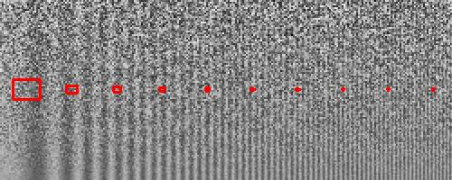
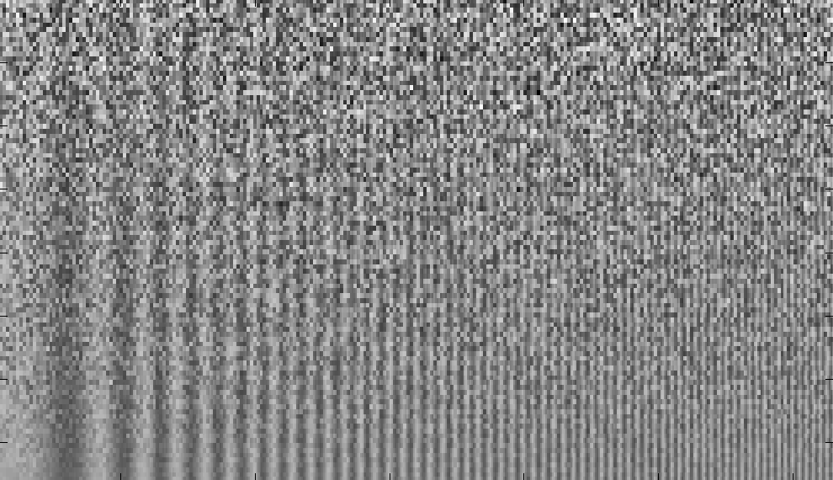
Averaging by Optimal Window
31
Treibitz & Schechner, Recovery Limits in Pointwise Degradations
Notes:
For each frequency, there is an optimal window size- suppresses as much noise without averaging out the frequency
So the ability to improve the SNR depends on the frequency

Slide 20

SNR Improvement by Averaging
32
depends on frequency!
same plot for a Gaussian filter
Treibitz & Schechner, Recovery Limits in Pointwise Degradations
Notes:
Plugging in the expression for reduction in signal and reduction in noise results in the following function for SNR improvement
In the highest frequency- C equals 1: no change
In low frequencies- big improvement

Slide 21
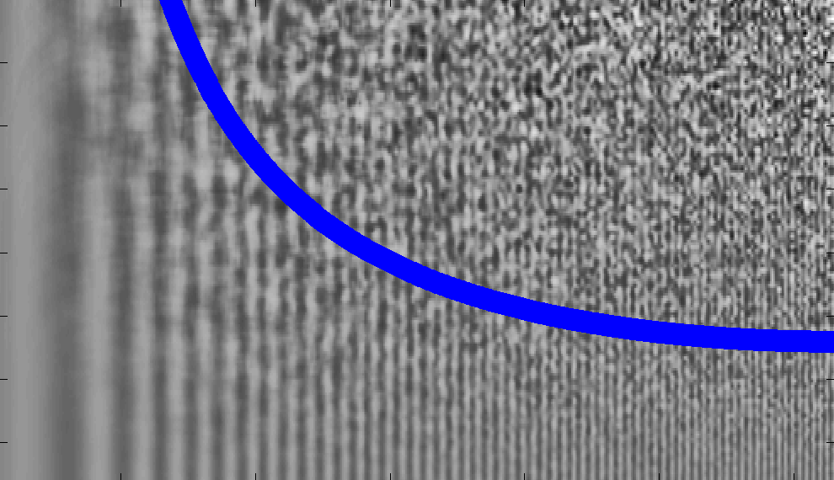
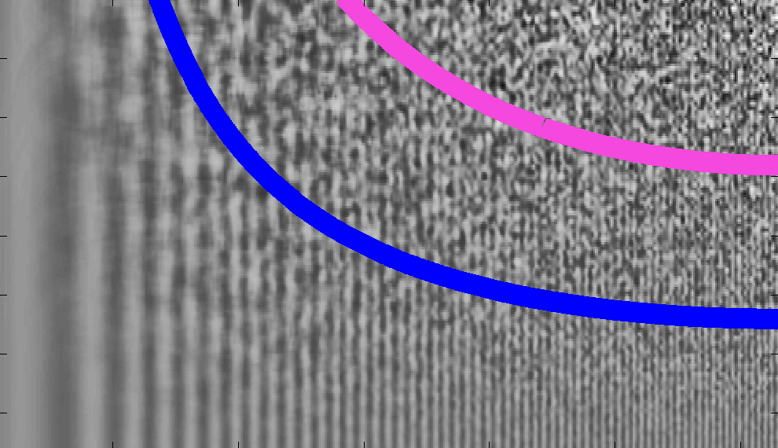
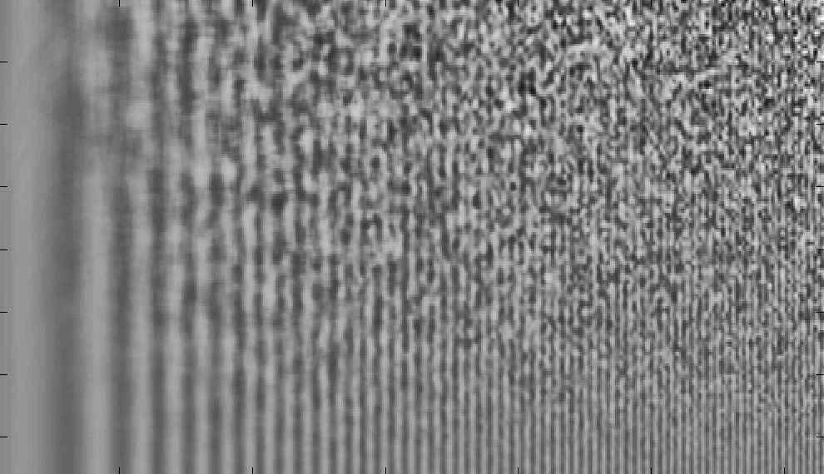
Output SNR
33
Input SNR
(frequency)
Treibitz & Schechner, Recovery Limits in Pointwise Degradations
Notes:
21
This is how our pattern looks after optimal averaging- we can see that the averaging made the pattern clearer, but no new details are revealed
This is the row were the input SNR was 1, now after averaging the location where the output SNR is 1 depends on the frequency, as you can see in the plot- and this is how we got the previous cutoff curve.
Now, if we know our vision system requires an SNR of 1- and we know the input SNR, we can determine the cutoff frequency using this plot. If the input SNR is higher- the cutoff is higher, if we require a lower SNR, also the cutoff is higher.
But how can we determine what is the output SNR that we need?

Slide 22
Cutoff Per Success Rate
34
success rate 70%
success rate 40%
Input SNR
(frequency)
Treibitz & Schechner, Recovery Limits in Pointwise Degradations
Notes:
22
So now we can convert the SNR values in the previous plot to success rate.
So now we established a general framework for relating a desired success rate and input SNR to the cutoff frequency.
This is a general framework that does not depend on the imaging model. The imaging model only determines the input SNR. Our only assumption here was that there is no blur

Slide 23


Vision Success is Probabilistic
35
visible
invisible
SNR=2/3
SNR determines chances of visibility
Treibitz & Schechner, Recovery Limits in Pointwise Degradations
Notes:
For example, here we have an image of a dark square on a bright background
With a lower SNR- we still see the coarse details, but the fine details disappear
one side is visible, and the other is not!
But the same SNR- conclusion: SNR influences chances

Slide 24
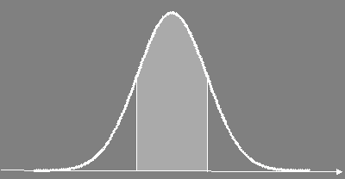


Success within a Confidence Interval
36
Object is visible if
…depends on SNR and..
- success rate
SNR
Treibitz & Schechner, Recovery Limits in Pointwise Degradations
Notes:
24
Say we have a signal in a field of noise.
The signal is visible if the noise field does not overwhelm the signal.
Say we have a signal in a field of noise.
The signal is visible if the noise field does not overwhelm the signal.
But- the noise is a random variable, so under the same distribution, it can sometimes be smaller than the signal and sometimes higher.
What is the probability that the noise is smaller than the signal? Of course it depends on the SNR
And on the distribution.
The probability for a random variable to be lower than a certain threshold is termed the confidence interval.
For a gaussian noise, the probability of the noise to be smaller than it’s STD is 68%.
This leads us to this plot that shows the relation between success rate and SNR. An SNR of 1 gives a 68% success rate in detection, lower SNR gives us higher success rate. We see that we gain a lot by improving low SNR values, and less as the input SNR increases.

Slide 25

Success within a Confidence Interval
25
visibility is kept if edge keeps sign
clear
noisy
depends on SNR
background pixel
object pixel
what is the probability for correct detection?
- success rate
%(sign kept) - %(wrong sign)
SNR
Treibitz & Schechner, Recovery Limits in Pointwise Degradations
Notes:
25
The signal is visible if the noise field does not overwhelm the signal.
Is the noise greater than the signal? Of course it depends on the SNR
And on the distribution.
N is a random variable, what is the chance that is lower than a certain threshold?
This is expressed as a confidence interval
For example here for a white gaussian noise
Increasing above 1.5 doesn’t give much
More details in the paper

Slide 26

Determining Resolution Limits
37
cutoff for ρ=70% success
system input SNR
frequency
Treibitz & Schechner, Recovery Limits in Pointwise Degradations
Notes:
Now we can use the curve we plotted for 70% success to determine the cutoff frequency
This is a fundamental result- depending on the system input SNR and the desired success rate- we can determine the cutoff frequency
Note that there is a cutoff even if there is no blur! This fundamental result does not depend on the type of degradation

Slide 27
Pointwise Degradations
38
noise
pointwise attenuation:
vignetting
atmosphere attenuation
additive component:
reflection
glare
haze
Treibitz & Schechner, Recovery Limits in Pointwise Degradations
Notes:
What is the relation of all this to computer vision?
There are many works that were done by people in this room where the common property is that there is no blur,
Where the degradation is pointwise.
Major part is: estimate t and A, compensate to get L.
Thus, the limits are effective

Slide 28
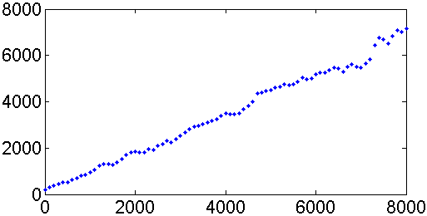
Noise Model
39
Nikon D100
photon noise dominates
Treibitz & Schechner, Recovery Limits in Pointwise Degradations
Notes:
what is the noise model?
it has a signal independent component, and photon noise- which is signal dependent
as you can see from the example calibration of our camera- because of photon noise, the noise variance increases with the signal
This can also be seen in this demo.

Slide 29
Photon (shot) Noise
9
Detector (pixel)
Electrons
{
Photon
e
either
or
nothing
50% quantum efficiency
Schechner

Slide 30
Photon (shot) Noise
10
Electrons
{
e
e
Photons
either
e
nothing
50% quantum efficiency
Schechner

Slide 31
SNR per size (frequency)
41
Treibitz & Schechner, Recovery Limits in Pointwise Degradations
Notes:
We found a connection between the SNR to detection.
Now, how do we calculate the SNR?
We showed a model for the noise
How do we define the signal?
The signal- depends on the application
We look at the difference between the object and its background
This can vary according to size
And is attenuated

Slide 32
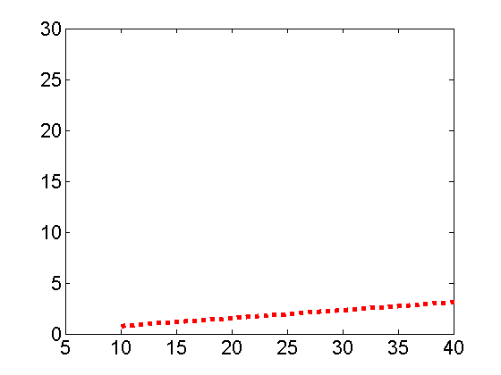
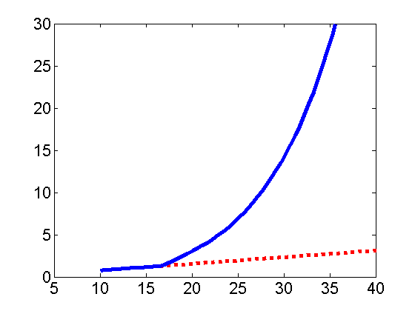
Resolution Limits in Haze
42
minimal visible object size[m]
reciprocal to
limit due to atmosphere
limit due to pixel size
distance [km]
Treibitz & Schechner, Recovery Limits in Pointwise Degradations
Notes:
We’ll calculate the limits of dehazing- does not matter which dehazing method
The red is the geometrical limit, and our analysis yielded the blue limit- details in the paper

Slide 33
Cutoff Per Success Rate
43
success rate 50%
Input SNR
(frequency)
Treibitz & Schechner, Recovery Limits in Pointwise Degradations
Notes:
33
This is the whole image
We took a signal with increasing frequency and added noise with decreasing variance
Signal to noise ratio (SNR) increases
In high frequencies even relatively low noise hides the pattern
Low frequencies- even under high noise the pattern is visible
In the same SNR- low freqs are visible, high are not
We can draw a line (try to) that separates the areas where the pattern is visible from the areas where it’s not
If I’d draw it manually, this is where I’ll do it
This line was calculated analytically- I’ll explain how

Slide 34
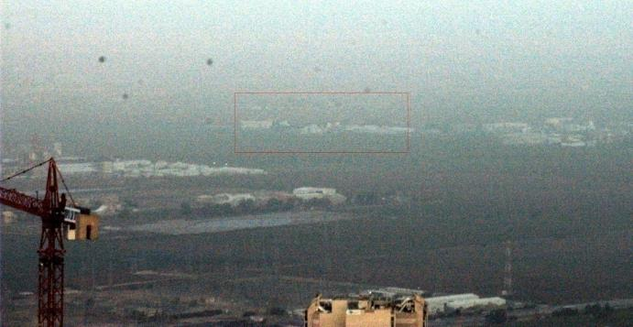
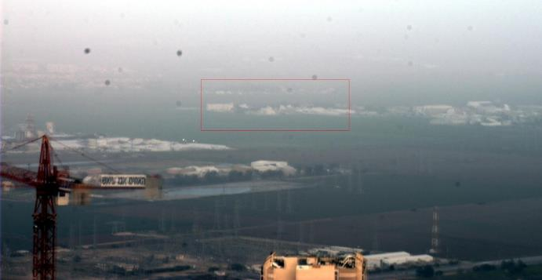
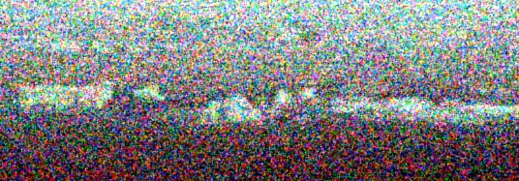
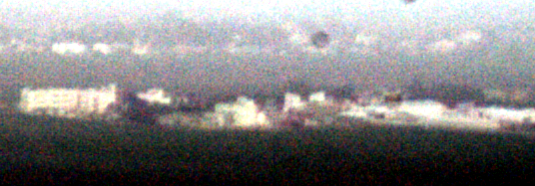
Haze in the Galilee
44
raw frame
average of 50 frames
limit due to noise and not blur
Treibitz & Schechner, Recovery Limits in Pointwise Degradations
Notes:
We demonstrate that in a real life example
Here we see big details but the small ones are lost.
You might argue that this is because of atmospheric blur or blur in the imaging system.
To show you that it’s not due to blur, I averaged 50 images- this only reduced noise, and now the objects are visible
34

Slide 35
What now?
45
What are the reconstruction limits?
What is the minimal detectable object size?
What camera noise properties are acceptable for detection?
…
Notes:
You did works about glare, separation, reconstruction, in this conference there are new works
With this analysis you can calculate which object size you can recover, which camera you need

Slide 36

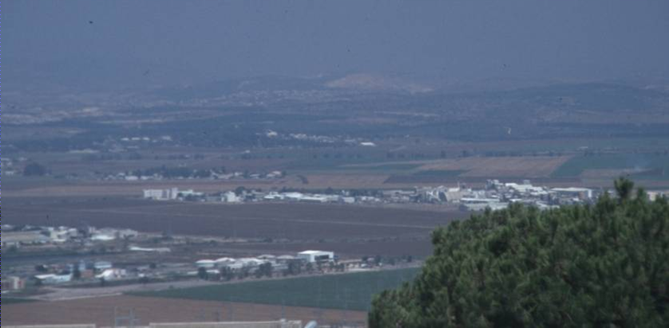
Imaging in Haze
46
Treibitz & Schechner, Polarization- Beneficial for Visibility Enhancement?
Notes:
Haze deteriorates visibility in images- as you can see in this example.
The haze is partially polarized- this means that is you look at the vector of the electrical field- it has one direction that is more dominant than others.
How can we exploit that?

Slide 37
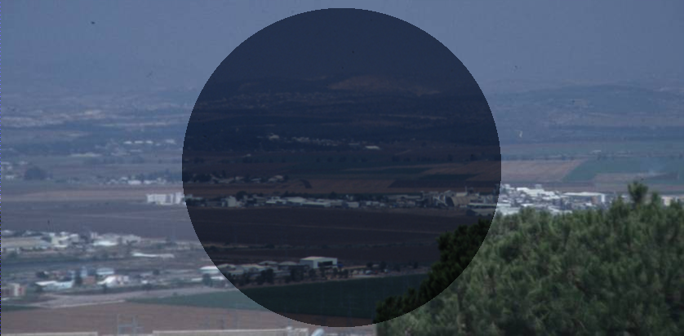
Haze Through a Polarizer
47
best polarized image
Treibitz & Schechner, Polarization- Beneficial for Visibility Enhancement?
Notes:
We can mount a polarizer such that it’ll block the dominant angle
What happens then?
The polarizer blocks part of the light- so the image darker

Slide 38
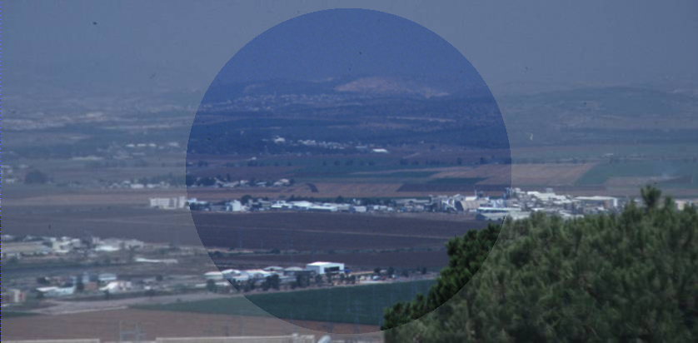
Haze Through a Polarizer
48
best polarized image
increased exposure time
single frame- used by photographers
Treibitz & Schechner, Polarization- Beneficial for Visibility Enhancement?
Notes:
But it blocks more airlight than signal
Thus, if the exposure time is increased, the result is an image with a better contrast.

Slide 39
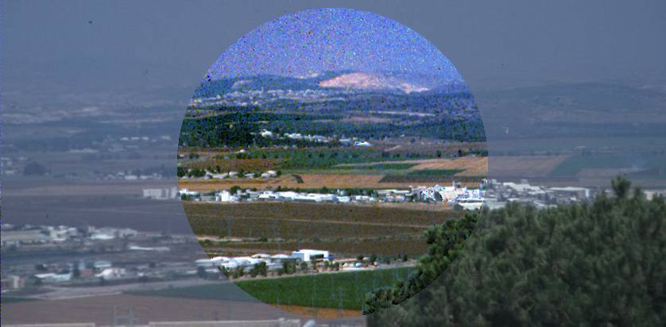
Dehazing using a Polarizer
49
best polarized image
worst polarized image
post-processing 2 frames
two frames- Schechner et al.
Treibitz & Schechner, Polarization- Beneficial for Visibility Enhancement?
Notes:
Another option is to acquire 2 polarized frames and post process them.
This is the result. The visibility seems to be much better and seems that the problem is solved. This method requires extra hardware and effort.
The question is, how much does it help? is it worth it?
This is a general question- each of the results I showed you here might be further post processed- using
I want to emphasize that we ask this question in the context of detection- i.e., where can we detect more objects?

Slide 40
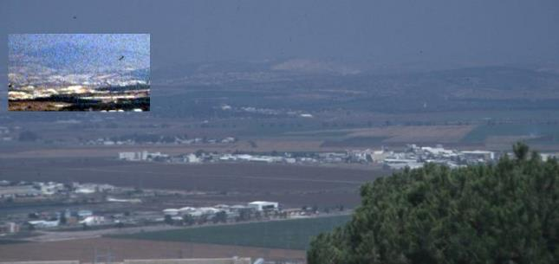
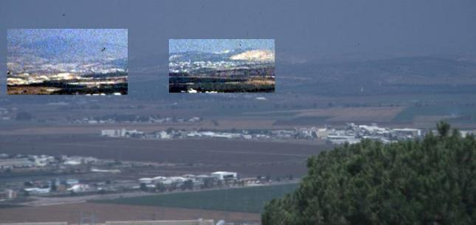
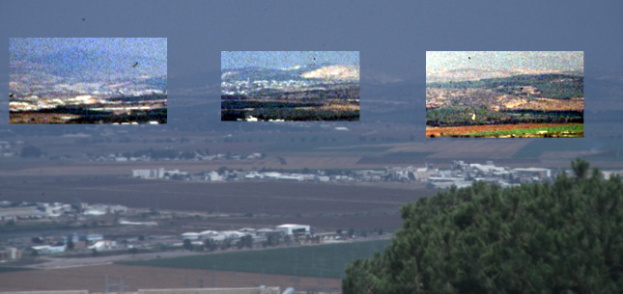
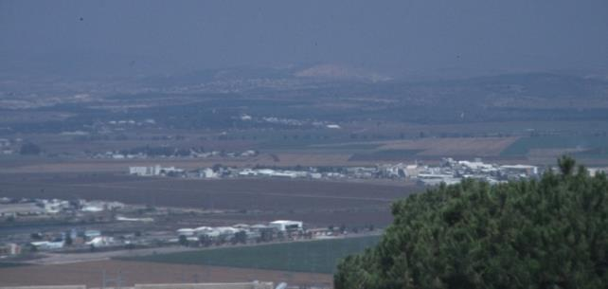
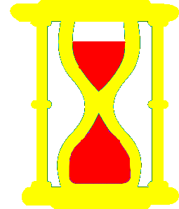

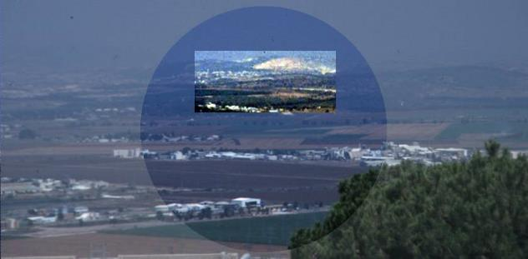

Is it worth using a polarizer?
50
rarely!
under the constraint of equal acquisition time
unpolarized image
best polarized image
goal: object detection
local contrast stretch- OK
post-processing 2 frames
Treibitz & Schechner, Polarization- Beneficial for Visibility Enhancement?
Notes:
40
To look for the objects we can zoom in and do local contrast stretch in areas with uniform distances
So how can we give an decisive answer for that question?

Slide 41
Using a Single Polarized Image
51
I
min
Best polarized image
degree of polarization
Treibitz & Schechner, Polarization- Beneficial for Visibility Enhancement?
Notes:
Haze in the atmosphere is partially polarized
therefore, mounting a polarizer, reduces the airlight relative to the signal in the image
There is one angle of the polarizer where the airlight is minimal, so this is the best image that can be captured with a single polarizer
Larger p means that the polarizer reduces more airlight

Slide 42
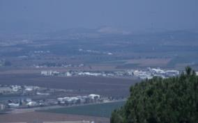
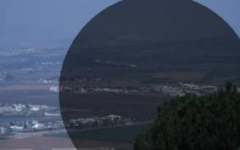
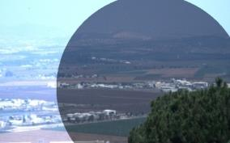
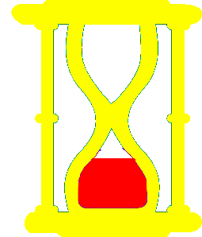
SNR Comparison
52
✓
Treibitz & Schechner, Polarization- Beneficial for Visibility Enhancement?
Notes:
42
so if we compare SNR in the unpolarized frame and the polarized frame- the SNR is the polarized frame is higher (uniform distances)
but- we pay for that with increased exposure time
so the fair comparison is to compare images taken under the same acquisition time. If we just increase exposure time, the image will be saturated. so we can use the available time to take a few frames and average them. It is easy show that the best strategy is dividing the time equally between the frames- and then the SNR increases by root of the number of frames. Then, the SNR in the unpolarized image is higher

Slide 43
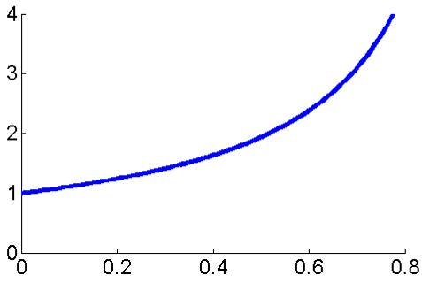
53
A Single Saturated Frame
SNR^{polarized}
SNR^{unpolarized}
maximal value in nature
Treibitz & Schechner, Polarization- Beneficial for Visibility Enhancement?
Notes:
43
P is the dop
We see there is an improvement, but this is under the assumption that the whole image has uniform distances
i.e., the exposure time of the polarized image is adjusted according to the area we want to detect

Slide 44
SNR Comparison
54
technical details in the paper
✓
✓
equal acquisition time
acquisition time = exposure time X number of frames
Notes:
44
so if we compare SNR in the unpolarized frame and the polarized frame- the SNR is the polarized frame is higher (uniform distances)
but- we pay for that with increased exposure time
so the fair comparison is to compare images taken under the same acquisition time. If we just increase exposure time, the image will be saturated. so we can use the available time to take a few frames and average them. It is easy show that the best strategy is dividing the time equally between the frames- and then the SNR increases by root of the number of frames. Then, the SNR in the unpolarized image is higher

Slide 45
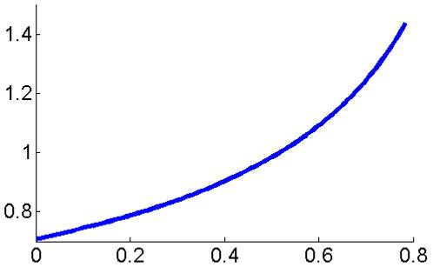
55
Same Total Acquisition Time
SNR^{polarized}
SNR^{unpolarized}
p<0.4
in our experiments
maximal value in nature
Treibitz & Schechner, Polarization- Beneficial for Visibility Enhancement?
Notes:
45
This is the plot for 2 different optical distances
We see there is an improvement, but this is under the assumption that the whole image has uniform distances
i.e., the exposure time of the polarized image is adjusted according to the area we want to detect

Slide 46
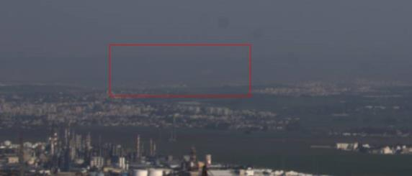


Experiment
56
Wide field of view
average of 2 frames
same total acquisition time
Treibitz & Schechner, Polarization- Beneficial for Visibility Enhancement?
Notes:
46
Here are some example
Imin is noisier even in the single case as the exposure time is not adjusted

Slide 47
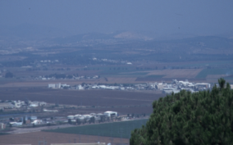
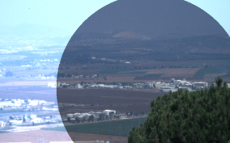
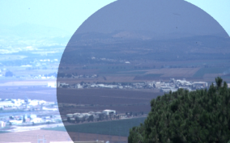
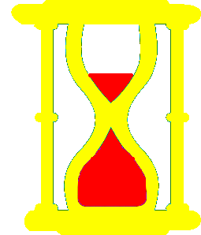
SNR Comparison
57
technical details in the paper
dehazing
✓
equal acquisition time
optimal exposures
Notes:
47
now we compare the SNR with an unpolarized image taken under the same total acquisition time
The 2 polarized images are linearly combined with weights that depend on the degree of polarization

Slide 48
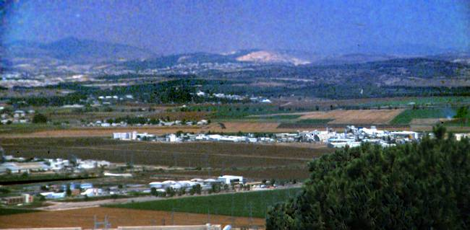
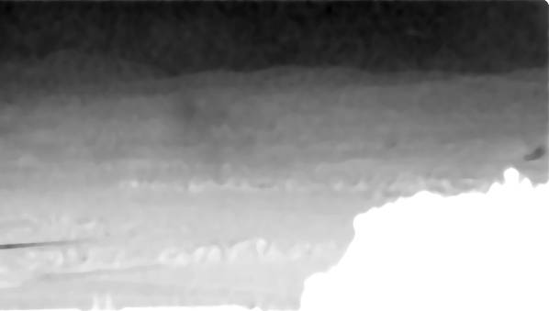
Advantages of Polarization
58
contrast stretch in non-uniform distances
restoring color
compensating for attenuation
distance map
Notes:
This result seems to contradict previous results- some of them done in our lab about polarization based dehazing
But it doesn’t. No polarization based dehazing method have shown to reveal objects that were otherwise invisible
Our analysis assumed that we do a very local contrast stretch and look for objects. Dehazing performs on the whole image, restores color and compensates for attenuation
It also provides a distance map

Slide 49
59
Limits in Pointwise Degradations
Freq cutoff – due to noise – without imaging blur
Relation between cutoff and success rate
Application: limits in pointwise degradations
Case study of performance trade-offs
Notes:
To conclude- we saw that noise imposes a frequency cutoff even with no blur
We gave the relation between cutoff and success rate
And showed how to apply it for cv applications
Now, that we established the relation between SNR and visibility, we can analyze what is the SNR benefit in a certain reconstruction scheme
Once we have the SNR benefit, we can know what was the visibility improvement due to this reconstruction method

Slide 50
Cutoff frequency in color imaging
What is the smallest recoverable object size (maximum cutoff frequency) per success rate ρ and a given scenario?
Performance prediction
System design
Understanding the benefit of color
Motivation:

Slide 51




Linear, space-invariant imaging systems
$$MTF(u)∙cos⁡(2πux)$$
$$cos⁡(2πux)$$
Modulation transfer function
LSI system
$$MRC ,MRTD ∝ \frac{1}{MTF @ u_{cutoff}}$$
Limiting frequency
(Object size)
Minimum resolvable Contrast / Temperature Difference
$$SNR∝MTF$$

Slide 52
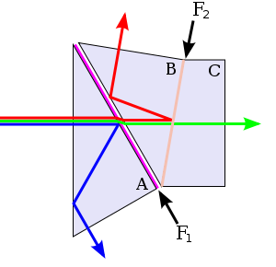
Frequency response and Сutoff
Optical blur
Pointwise effects
Color
Single channel
G | R | G | R
B | G | B | G
G | R | G | R
B | G | B | G
Bayer
Full field
3-CCD
Wikipedia
A. Golts and Y. Y. Schechner – “Spatial frequency response of Bayer color image formation” – In review, JOSA A.
A. Golts and Y. Y. Schechner – “Cutoff due to pointwise degradations in color images” – In review, JOSA A.

Slide 53
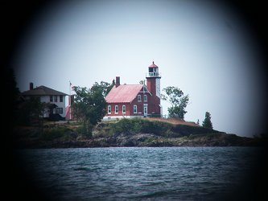





Pointwise degradations
Object
Random noise
Multiplicative component
Additive component
Atmosphere attenuation
Reflection
Vignetting
Haze
I
Bayer sampling
I
T
Schechner et al, ICCV 99
http://elynxsdk.free.fr/API/html/convert_bayer.html
Bobrov & Schechner
Schechner et al, Applied Optics ‘03
http://www.bokashii.com/vignette/

Slide 54
Bayer color sensors
R | R | R
R | R | R
R | R | R
Sampling
(Space-Variant)
Color
Scene
G | R | G | R
B | G | B | G
G | R | G | R
B | G | B | G
G | G | G
G | G | G
G | G | G
Interpolation/ Demosaicking
B | B | B
B | B | B
B | B | B
How to quantify the frequency response due to
Bayer sampling and interpolation?

Slide 55

Linear, space-invariant imaging systems
$$MTF(u)∙cos⁡(2πux)$$
$$cos⁡(2πux)$$
LSI system
Bayer is not LSI
We assume linear interpolation
How to assign MTF for such system?

Slide 56
Previous work
Y. Elor, E. Pinsky, and A. Yaacobi – “MTF for bayer pattern color detector”.
In Proc. SPIE, volume 6567, 2007
Sampling
(Space-Variant)
B/W
Scene
G | R | G | R
B | G | B | G
G | R | G | R
B | G | B | G
Interpolation/ Demosaicking
White balance
Analysis in 1D, Assumed integration in the vertical direction
We perform a full 2D analysis, and verify by simulation

Slide 57






















































Color signal representation
A test on ~1000 natural images shows high correlation
between the RGB Fourier phase components
L.G. Shapiro
Associated Press
Input to Bayer system:

Slide 58



Bayer simulation
Color signal:
Bi-linear interpolation

Slide 59
Bayer simulation
DTFT

Slide 60



Bayer simulation

Slide 62
Bayer color sensors
Extension of MTF to space-variant systems:
Variant
For an LSI system, this definition coincides with the MTF
Spurious response
Elor et. Al - 2007

Slide 63
Bayer sampling frequency response
Spurious response

Slide 64
Total frequency response

Slide 65
Bayer sampling
Raw Bayer signal
G | R | G | R
B | G | B | G
G | R | G | R
B | G | B | G
Ideal signal

Slide 66
Bayer sampling
Spurious Response

Slide 67
Bayer linear interpolation
Interpolated signal
Raw Bayer signal
Interpolation/ Demosaicking

Slide 68
Bayer linear interpolation
4 pixel types
R
G1
G2
B
B | G | B
G | R | G
B | G | B
G | R | G
B | G | B
G | R | G
G | B | G
R | G | R
G | B | G
R | G | R
G | B | G
R | G | R
Interpolation kernels
Example -
Bi-linear:
…

Slide 69
Bayer linear interpolation

Slide 70
Total frequency response

Slide 71
Bayer simulation
DTFT

Slide 73
Bayer spatial frequency response
- Summary
Analytical expressions for Bayer SFR – VMTF and parasitic SR
2D analysis
Account for color input
Account for both Bayer sampling and interpolation.
Verified by simulation.

Slide 74


Full-field color systems
Several full sensors
No spatial resolution compromise
3-CCD / N-CCD
FOVEON technology
Wikipedia
Time multiplexing
www.foveon.com
Optec Inc.

Slide 75


Previous work
T. Treibitz and Y. Y. Schechner – “Resolution loss without imaging blur”
JOSA A, 2012
Found limits for single-channel signals
Visible pattern
(frequency)

Slide 76

Previous work
T. Treibitz and Y. Y. Schechner – “Resolution loss without imaging blur”
JOSA A, 2012
Found limits for single-channel signals
Input SNR
(frequency)

Slide 77


Full field color systems
Background level $B_{c}$

Slide 78
Filtering in the color domain
How can we account for color while using results of previous work (pan-chromatic)?
Spectral filtering (fusion)
T. Wang, C. C. Shaw and C-C. Li– “Pixelwise fusion for optimizing SNR in multiple-plate computed radiography imaging”.
IEEE Trans. on Medical Imaging, 1999
We seek α which maximizes the SNR:
Noise
Panchromatic case with enhanced SNR
Signal amplitude

Slide 79
Resolution improvement due to color fusion
The optimal SNR (after fusion) satisfies:
We quantify resolution improvement by comparing the following
1
2
3
Detector
4
N
…

Slide 80



Limitation of the improvement
$s_{1}^{}=…=s_{N}^{}$
$n_{1}^{}=…=n_{N}^{}$ ➔
${SNR}_{p}^{}≫{SNR}_{q}^{}$
$n_{p}≪n_{q}$ ➔
$D_{max}=1$
Low variability SNR
$D_{max}≫1$
High variability SNR

Slide 81
Hyperspectral image example
A. Chakrabarti and T. Zickler. Statistics of real-world hyperspectral images.
IEEE CVPR, pages 193–200, 2011
31 spectral channels
We added synthetic noise
Signal estimation:

Slide 82








Hyperspectral image example
Low variability SNR
High variability SNR
Panchromatic
Color
Optimal color fusion
Color
Optimal color fusion
Panchromatic

Slide 83




Simulation
Dominant photon noise
$A_{c}=[0,15,0]$, $B_{c}=[150,150,150]$
Panchromatic
Optimal color fusion
Color

Slide 84
Full-field sensors - Summary
Color fusion for optimal SNR
Analytical expression for the optimal SNR and enhancement factor.
Limiting cutoff frequency in color

Slide 85
Summary
Modeling of Bayer 2D spatial frequency response accounting for sampling and linear demosaicking.
Spectral filtering for optimal SNR.
Quantify object recovery limits in full-field color systems.

Slide 86
Further directions
Account for noise and limiting cutoff frequency in Bayer imaging systems .
G | R | G | R
B | G | B | G
G | R | G | R
B | G | B | G

Slide 87

Further directions
Study resolution limits and possible enhancement in other domains where low SNR and resolution is a common problem:
Medical imaging, thermal, THz, MMW…
S. Bobrov and Y. Y. Schechner
Ratheon Company

Slide 88


Further directions
Extend our model for non white Gaussian noise.
Dominant fixed-pattern noise in thermal imaging.
A. Averbuch et. al.

Slide 89
Further directions
New demosaicking algorithms based on our Bayer spatial frequency response model.

Slide 90


Further directions
Design CFAs other than Bayer based on a desired frequency domain performance.
Consider unified design of CFA + interpolation kernels.
Fujifilm
Yasuma et. al.

