Slide 1
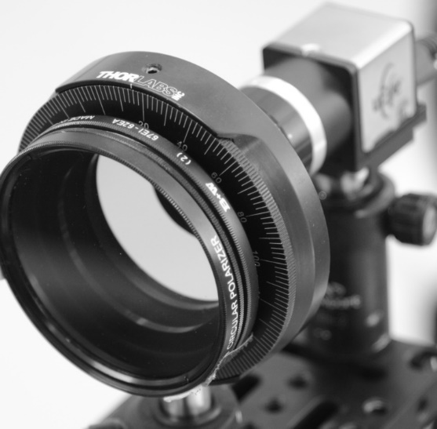


Self-Calibrating Imaging Polarimetry
1
Yoav Y. Schechner
EE, Technion , Israel
camera
lens
polarizer (analyzer)
protractor

Slide 2
2
Self-calibration
in other imaging problems
Y. Schechner, self-calibrating polarimetry

Slide 3
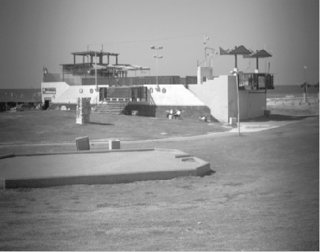
3
Self-calibration of radiometric properties
Spatial non-uniformity Time-varying gain Response nonlinearity
Debevec; Malik (98)
spatial non-uniformity
Mitsunaga; Nayar (99)
light intensity
Schechner; Nayar (01)
Kim; Pollefeys (04)
electronic readout
pixel
A. Litvinov & Y. Schechner, radiometric nonidealities

Slide 4







4
Structure from Motion (SfM)
$${{2N}_{m}N}_{o} \text{data}$$
$$≥$$
$${6N}_{m}+{3N}_{o} \text{unknowns}$$
$$N_{o} \text{object} \text{points}$$
Unknown${3N}_{o} \text{coordinates}$
$$N_{m} \text{images}$$
Unknown${6N}_{m} \text{pose} \text{DOF}$
Schechner

Slide 5
5
Polarization
Y. Schechner, self-calibrating polarimetry

Slide 6
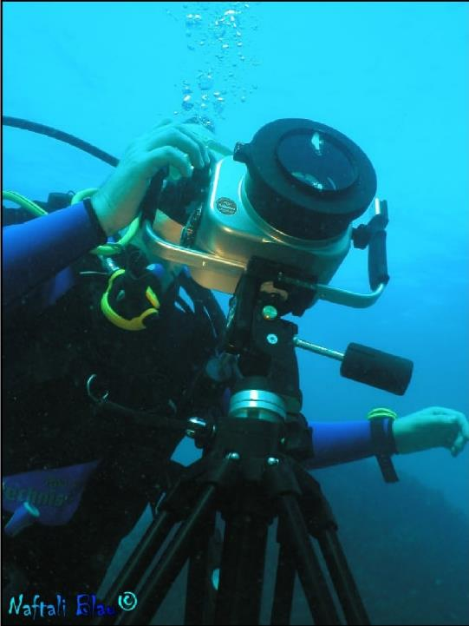
Tedious, inaccurate control
6
polarizer
protractor
N. Karpel & Y. Schechner, underwater imaging

Slide 7
7
Polarization vector determination
polarizer
camera
3 general measurements suffice,
at known orientations
o
180
Y. Schechner, self-calibrating polarimetry

Slide 8
8
Polarization vector determination
polarizer
camera
What about
unknown orientations ?
o
180
Y. Schechner, self-calibrating polarimetry

Slide 9
9
Self-calibration would allow
Easy polarimetry-based methods, by lay person
(SLR? Smartphone?)
Scientific exploration by the lay person
Less hassle for experimentalists (lab and field)
Increase tolerance in scientific-grade specs
Biological understanding
Y. Schechner, self-calibrating polarimetry

Slide 10





10
$$I_{m,o}=c_{o}$$
$$c_{o}p_{o}$$
$$c_{o}$$
camera
$$c_{o} unpolarized constant$$
$$p_{o} degree of linear polarization$$
$$angle of polarization$$
$$θ_{o}$$
Y. Schechner, self-calibrating polarimetry

Slide 11

11
$$I_{m,o}=1/2\left[c_{o}+c_{o}p_{o}\text{cos}2{(α}_{m}\text{−}θ_{o}) \right]$$
$$c_{o}p_{o}$$
polarizer
$$c_{o}$$
camera
$$α_{m}$$
$$c_{o} unpolarized constant$$
$$p_{o} degree of linear polarization$$
$$angle of polarization$$
$$θ_{o}$$
Y. Schechner, self-calibrating polarimetry

Slide 12


12
$$q_{o}$$
$$u_{o}$$
$$I_{m,o}=1/2\left[c_{o}+c_{o}p_{o}\text{cos}2θ_{o}\text{cos}2α_{m}\text{+}c_{o}p_{o}\text{sin}2θ_{o}\text{sin}2α_{m}\right]$$
$$c_{o}p_{o}$$
polarizer
$$c_{o}$$
camera
$$α_{m}$$
$$c_{o} unpolarized constant$$
$$p_{o} degree of linear polarization$$
$$angle of polarization$$
$$θ_{o}$$
Y. Schechner, self-calibrating polarimetry

Slide 13
13
$$2I_{m,o}=\left[1 \text{cos}2α_{m} \text{sin}2α_{m}\right]∙[c_{o}{ q}_{o}{ u}_{o}]$$
Y. Schechner, self-calibrating polarimetry

Slide 14











14
$$2I_{m,o}=\left[1 \text{cos}2α_{m} \text{sin}2α_{m}\right]∙[c_{o}{ q}_{o}{ u}_{o}]$$
$$I_{1,o}$$
$$1 \text{cos}2α_{1} \text{sin}2α_{1}$$
$$c_{o}$$
$${ q}_{o}$$
$$I_{2,o}$$
$$1 \text{cos}2α_{2} \text{sin}2α_{2}$$
$${ u}_{o}$$
=
2
$$I_{m,o}$$
$$1 \text{cos}2α_{m} \text{sin}2α_{m}$$
$$I_{N_{m},o}$$
$$1 \text{cos}2α_{N_{m}} \text{sin}2α_{N_{m}}$$
Y. Schechner, self-calibrating polarimetry

Slide 15


15
$$2I_{m,o}=\left[1 \text{cos}2α_{m} \text{sin}2α_{m}\right]∙[c_{o}{ q}_{o}{ u}_{o}]$$
$$I_{1,o}$$
$$1 1 0$$
$$c_{o}$$
$${ q}_{o}$$
$$I_{2,o}$$
$$1 \text{cos}2α_{2} \text{sin}2α_{2}$$
$${ u}_{o}$$
=
2
$$I_{m,o}$$
$$1 \text{cos}2α_{m} \text{sin}2α_{m}$$
$$I_{N_{m},o}$$
$$1 \text{cos}2α_{N_{m}} \text{sin}2α_{N_{m}}$$
$${(N}_{m}−1) \text{unknowns}$$
Y. Schechner, self-calibrating polarimetry

Slide 16
16
$$2I_{m,o}=\left[1 \text{cos}2α_{m} \text{sin}2α_{m}\right]∙[c_{o}{ q}_{o}{ u}_{o}]$$
$$I_{1,o}$$
$$1 1 0$$
$$c_{o}$$
P
$${ q}_{o}$$
$$I_{2,o}$$
$$1 \text{cos}2α_{2} \text{sin}2α_{2}$$
$${ u}_{o}$$
=
2
$$I_{m,o}$$
$$1 \text{cos}2α_{m} \text{sin}2α_{m}$$
$$I_{N_{m},o}$$
$$1 \text{cos}2α_{N_{m}} \text{sin}2α_{N_{m}}$$
$${(N}_{m}−1) \text{unknowns}$$
Y. Schechner, self-calibrating polarimetry

Slide 17







17
$$2I_{m,o}=\left[1 \text{cos}2α_{m} \text{sin}2α_{m}\right]∙[c_{o}{ q}_{o}{ u}_{o}]$$
P
$$I_{1,o}$$
$$c_{o}$$
$$I_{2,o}$$
=
$${ q}_{o}$$
2
$${ u}_{o}$$
$$I_{m,o}$$
$$I_{N_{m},o}$$
Y. Schechner, self-calibrating polarimetry

Slide 18
























18
$$2I_{m,o}=\left[1 \text{cos}2α_{m} \text{sin}2α_{m}\right]∙[c_{o}{ q}_{o}{ u}_{o}]$$
P
$$I_{1,1}$$
$$I_{1,2}$$
$$I_{1,o}$$
=
$$c_{1}$$
$$c_{2}$$
$$c_{o}$$
$$c_{N_{o}}$$
$$I_{2, 1}$$
$$I_{2,2}$$
$$I_{2,o}$$
$${ q}_{1}$$
$${ q}_{2}$$
$${ q}_{o}$$
$$q_{N_{o}}$$
2
$${ u}_{1}$$
$${ u}_{2}$$
$${ u}_{o}$$
$$u_{N_{o}}$$
$$I_{m,1}$$
$$I_{m,2}$$
$$I_{m,o}$$
$$I_{N_{m},1}$$
$$I_{N_{m},2}$$
$$I_{m,o}$$
Y. Schechner, self-calibrating polarimetry

Slide 19

19
$$2I_{m,o}=\left[1 \text{cos}2α_{m} \text{sin}2α_{m}\right]∙[c_{o}{ q}_{o}{ u}_{o}]$$
D
P
$$I_{1,1}$$
$$I_{1,2}$$
$$I_{1,o}$$
=
$$c_{1}$$
$$c_{2}$$
$$c_{o}$$
$$c_{N_{o}}$$
$$I_{2, 1}$$
$$I_{2,2}$$
$$I_{2,o}$$
$${ q}_{1}$$
$${ q}_{2}$$
$${ q}_{o}$$
$$q_{N_{o}}$$
2
$${ u}_{1}$$
$${ u}_{2}$$
$${ u}_{o}$$
$$u_{N_{o}}$$
$$I_{m,1}$$
$$I_{m,2}$$
$$I_{m,o}$$
$$I_{N_{m},1}$$
$$I_{N_{m},2}$$
$$I_{m,o}$$
$${N_{m}N}_{o} \text{data}$$
Y. Schechner, self-calibrating polarimetry

Slide 20

20
$$2I_{m,o}=\left[1 \text{cos}2α_{m} \text{sin}2α_{m}\right]∙[c_{o}{ q}_{o}{ u}_{o}]$$
D
P
O
$$I_{1,1}$$
$$I_{1,2}$$
$$I_{1,o}$$
=
$$c_{1}$$
$$c_{2}$$
$$c_{o}$$
$$c_{N_{o}}$$
$$I_{2, 1}$$
$$I_{2,2}$$
$$I_{2,o}$$
$${ q}_{1}$$
$${ q}_{2}$$
$${ q}_{o}$$
$$q_{N_{o}}$$
2
$${ u}_{1}$$
$${ u}_{2}$$
$${ u}_{o}$$
$$u_{N_{o}}$$
$$I_{m,1}$$
$$I_{m,2}$$
$$I_{m,o}$$
$${3N}_{o} \text{unknowns}$$
$$I_{N_{m},1}$$
$$I_{N_{m},2}$$
$$I_{m,o}$$
$${N_{m}N}_{o} \text{data}$$
Y. Schechner, self-calibrating polarimetry

Slide 21

21
$$2I_{m,o}=\left[1 \text{cos}2α_{m} \text{sin}2α_{m}\right]∙[c_{o}{ q}_{o}{ u}_{o}]$$
D
P
O
$$I_{1,1}$$
$$I_{1,2}$$
$$I_{1,o}$$
=
$$c_{1}$$
$$c_{2}$$
$$c_{o}$$
$$c_{N_{o}}$$
$$I_{2, 1}$$
$$I_{2,2}$$
$$I_{2,o}$$
$${ q}_{1}$$
$${ q}_{2}$$
$${ q}_{o}$$
$$q_{N_{o}}$$
2
$${ u}_{1}$$
$${ u}_{2}$$
$${ u}_{o}$$
$$u_{N_{o}}$$
$$I_{m,1}$$
$$I_{m,2}$$
$$I_{m,o}$$
$${3N}_{o} \text{unknowns}$$
$$I_{N_{m},1}$$
$$I_{N_{m},2}$$
$$I_{m,o}$$
$${(N}_{m}−1) \text{unknowns}$$
$${N_{m}N}_{o} \text{data}$$
Y. Schechner, self-calibrating polarimetry

Slide 22


22
D=PO
$${N_{m}N}_{o} \text{data}$$
$$≥$$
$${[(N}_{m}−1)+{3N}_{o}] \text{unknowns}$$
At least 3 object points and 4 images
At least 2 object points and 5 images
Y. Schechner, self-calibrating polarimetry

Slide 23
23
$$1 1 0$$
D=PO
$$1 \text{cos}2α_{2} \text{sin}2α_{2}$$
arg min || D-PO ||
$$1 \text{cos}2α_{m} \text{sin}2α_{m}$$
$$1 \text{cos}2α_{N_{m}} \text{sin}2α_{N_{m}}$$
P
Y. Schechner, self-calibrating polarimetry

Slide 24




24
$$1 1 0$$
$$1 \text{cos}2α_{2} \text{sin}2α_{2}$$
arg min || D-PO ||
$$1 \text{cos}2α_{m} \text{sin}2α_{m}$$
O,
$$α_{2}$$
$$α_{3}$$
$$1 \text{cos}2α_{N_{m}} \text{sin}2α_{N_{m}}$$
$$α_{m}$$
P
$$α_{N_{m}}$$
Y. Schechner, self-calibrating polarimetry

Slide 25
25
Given P (standard polarimetry)
O = arg min || D-PO ||
O
Y. Schechner, self-calibrating polarimetry

Slide 26
26
$$1 1 0$$
$$1 \text{cos}2α_{2} \text{sin}2α_{2}$$
arg min || D-PO ||
$$1 \text{cos}2α_{m} \text{sin}2α_{m}$$
O,
$$α_{2}$$
$$α_{3}$$
$$1 \text{cos}2α_{N_{m}} \text{sin}2α_{N_{m}}$$
$$α_{m}$$
P
$$α_{N_{m}}$$
Y. Schechner, self-calibrating polarimetry

Slide 27



Given O
27
$$\text{cos}2α_{2} \text{sin}2α_{2}$$
arg min || D-PO ||
$$\text{cos}2α_{m} \text{sin}2α_{m}$$
~
P
$$\text{cos}2α_{N_{m}} \text{sin}2α_{N_{m}}$$
~
T
P
T
Y. Schechner, self-calibrating polarimetry

Slide 28
Given O
28
~
~
~
arg min || - ||
D
O
P
T
T
T
~
r
P
~
P
Result:
T
Y. Schechner, self-calibrating polarimetry

Slide 29



29
$$\text{cos}2α_{2} \text{sin}2α_{2}$$
$$v_{2}$$
$$\text{cos}2α_{m} \text{sin}2α_{m}$$
$$v_{m}$$
$$\text{cos}2α_{N_{m}} \text{sin}2α_{N_{m}}$$
$$v_{N_{m}}$$
~
P
T
~
P
Result:
T
Y. Schechner, self-calibrating polarimetry

Slide 30
30
$$\text{cos}2α_{2} \text{sin}2α_{2}$$
$$v_{2}$$
Normalize rows
$$\text{cos}2α_{m} \text{sin}2α_{m}$$
$$v_{m}$$
$$\text{cos}2α_{N_{m}} \text{sin}2α_{N_{m}}$$
$$v_{N_{m}}$$
~
P
Result:
T
Y. Schechner, self-calibrating polarimetry

Slide 31
31
Roughly guessed
O = arg min || D-PO ||
O
~
~
~
~
P
= arg min || - ||
T
D
O
P
T
T
T
~
r
P
Angle estimates
Y. Schechner, self-calibrating polarimetry

Slide 32
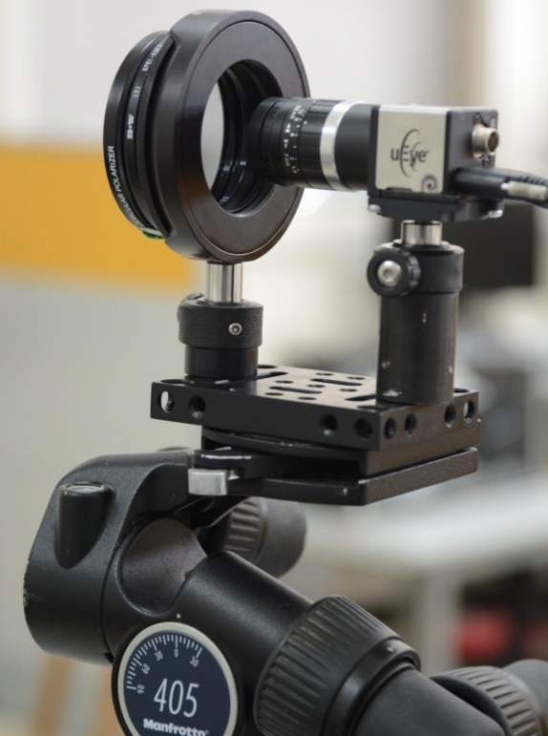

polarizer (analyzer)
32
lens
camera
$$±1°$$
rotating mount
camera
rotating mount
lens
polarizer (analyzer)
Tripod-head
protractor
Y. Schechner, self-calibrating polarimetry

Slide 33
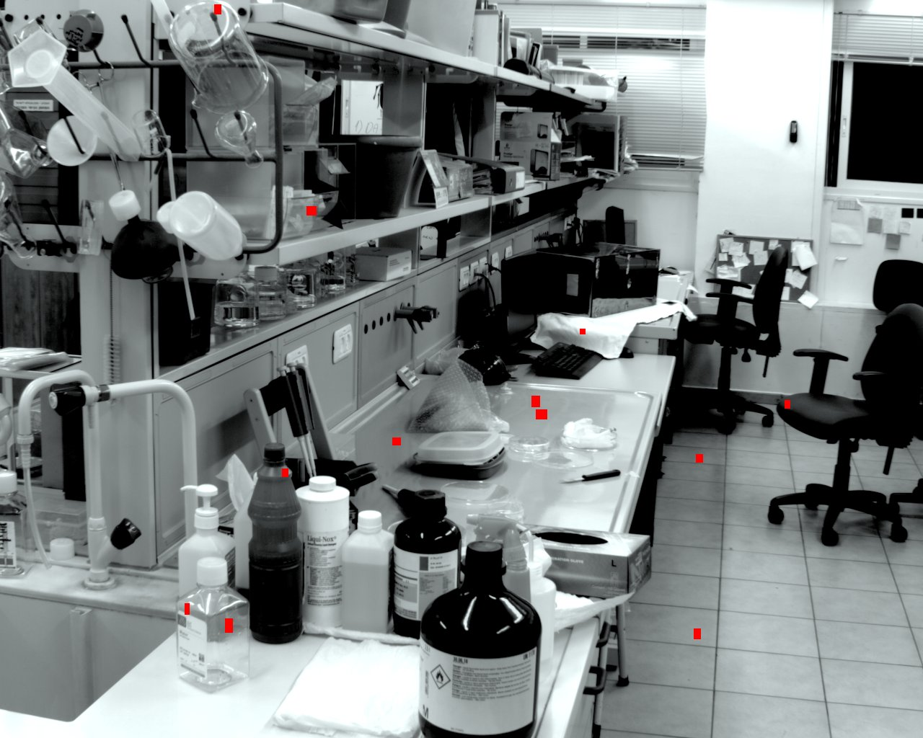
33
Y. Schechner, self-calibrating polarimetry

Slide 34
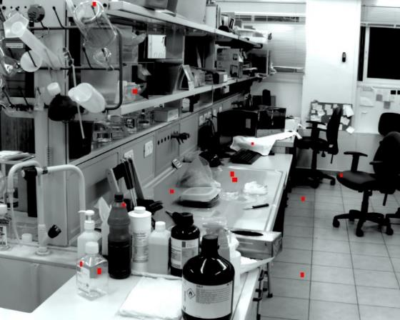

















200
34
hundred iterations
first guess
true
170
$$0°$$
$$0°$$
$$0°$$
$$48°$$
$$48.5°$$
$$60°$$
140
$$79°$$
$$79.8°$$
$$68°$$
$$119°$$
$$120.0°$$
$$146°$$
110
$$144°$$
$$145.3°$$
$$116°$$
$$±1°$$
$$±30°$$
80
50
20
0
45
90
135
Y. Schechner, self-calibrating polarimetry

Slide 35

180
35
120
90
60
30
0.8
0
30
60
90
120
150
0.6
0.4
0.2
Y. Schechner, self-calibrating polarimetry
0
0.2
0.4
0.6
0.8

Slide 36
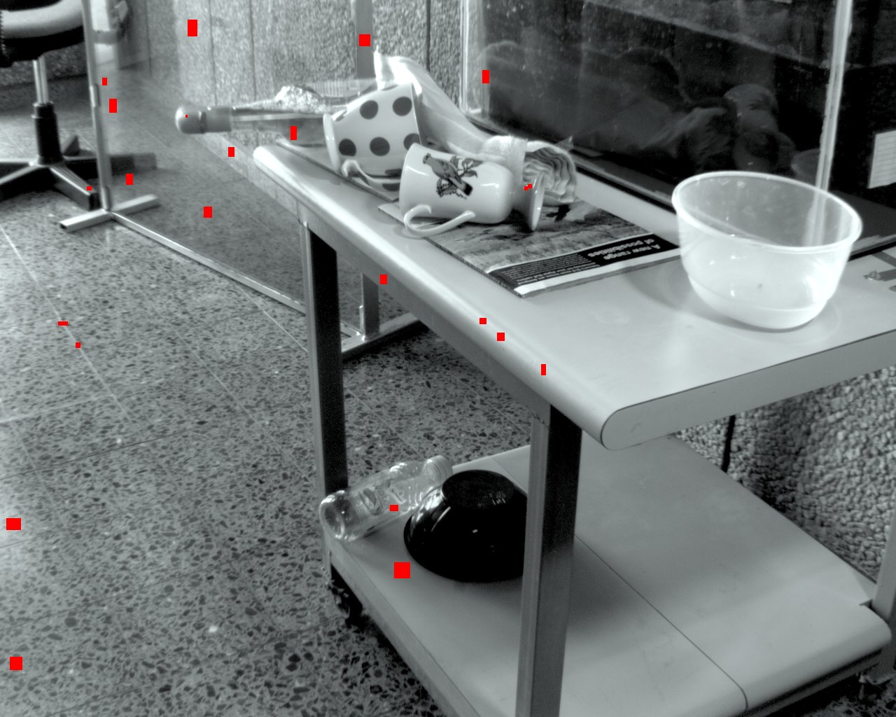
36
Y. Schechner, self-calibrating polarimetry

Slide 37
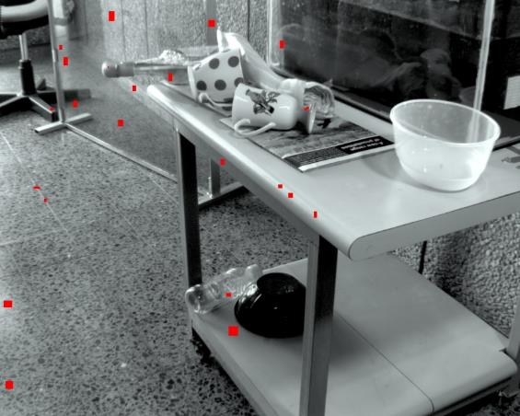












37
hundred iterations
first guess
150
true
120
$$0°$$
$$0°$$
$$0°$$
90
$$40°$$
$$39.5°$$
$$64°$$
60
$$80°$$
$$79.6°$$
$$58°$$
30
$$120°$$
$$119.1°$$
$$145°$$
$$140°$$
$$139.6°$$
$$148°$$
0
45
90
135
180
$$±1°$$
$$±30°$$
200
140
110
80
50
20
0
45
90
135
180
Y. Schechner, self-calibrating polarimetry

Slide 38
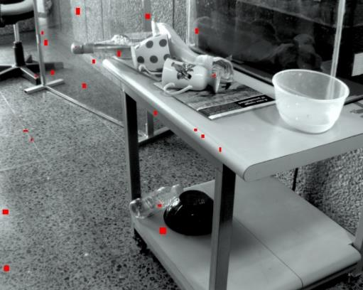
180
38
120
90
60
30
0.8
0
30
60
90
120
150
0.6
0.4
0.2
Y. Schechner, self-calibrating polarimetry
0
0.2
0.4
0.6
0.8

Slide 39
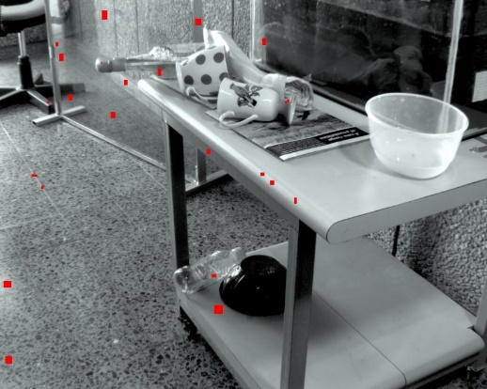
|| D-PO ||
39
2
e =
|| D-P O ||
true
true
2
1,000
100
10
1
1
10
iteration
100
Schechner

Slide 40
40
Code available online:
webee.technion.ac.il/~yoav/research/polar-self-calib
Polarimetric imaging has a
self-calibration capacity !!
Y. Schechner, self-calibrating polarimetry

