Slide 1
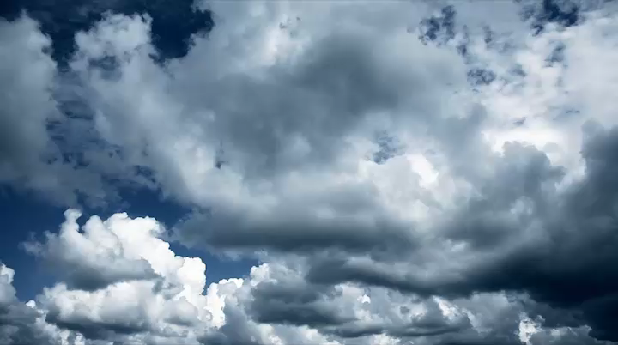

3D volumetric Scattering Tomography
Yoav Schechner, Amit Aides, Aviad Levis, Anthony Davis,
Vadim Holodovsky, Anat Levin
EE, Technion

Slide 2


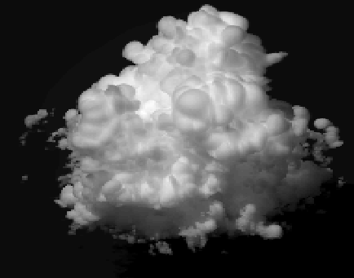


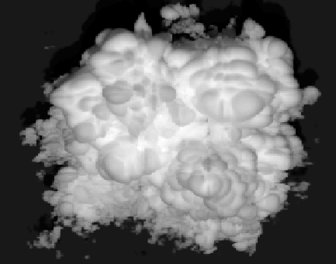
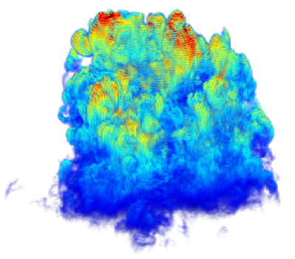

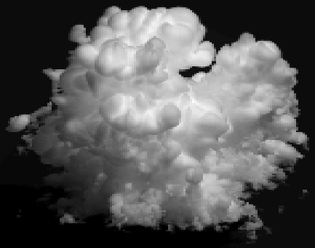
Tomography of scatterers
inverse scattering
recovered
scatterer density
Multi-angular images
Levis, Schechner, Aides, Davis
ICCV’15
Notes:
We, on the other hand, seek inverse scattering:
using multiple images to recover the distribution of scatterers.

Slide 3
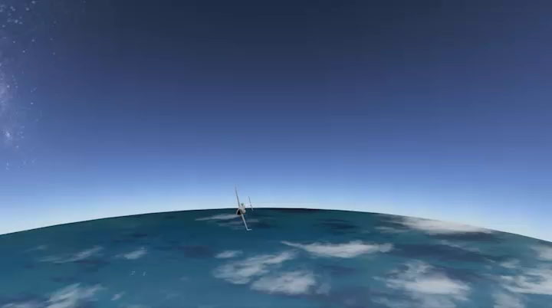

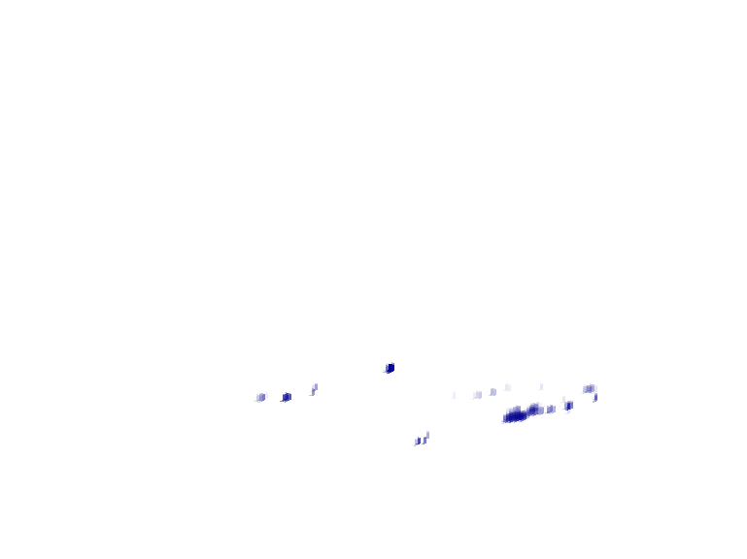


Scattering Tomography: passive, large scale
Scatter distribution within a cloud
: 315,000 unknowns
High-altitude flight
Levis, Schechner, Aides, Davis
ICCV’15
Notes:
We do it in a huge outdoor field, acquiring multi-view images from high-altitude.
With these images we recover the scatterer distribution within a cloud.
Lets put this problem into context

Slide 4
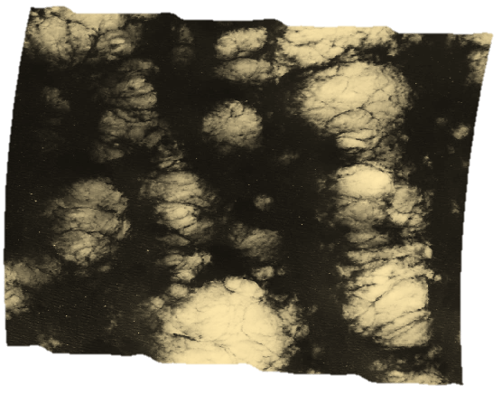
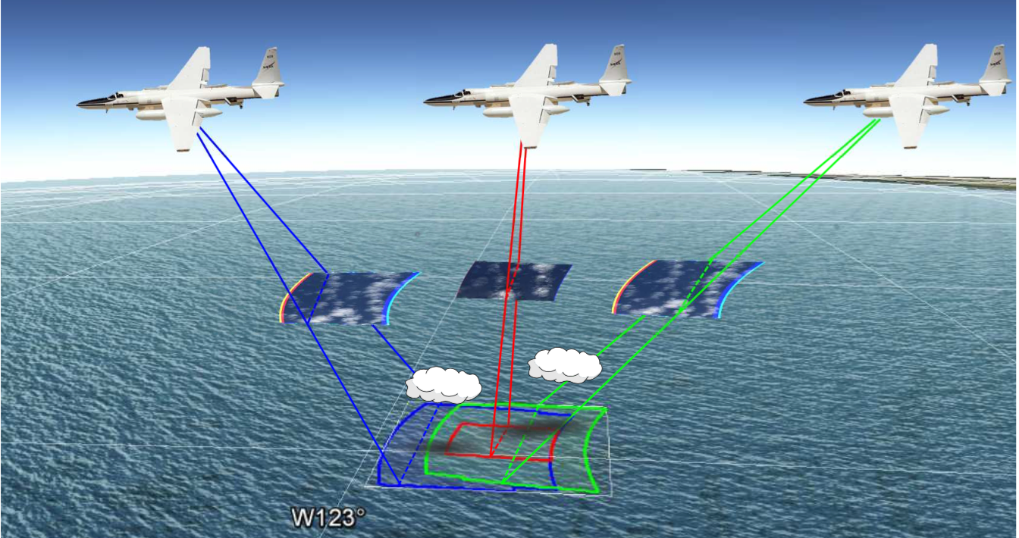
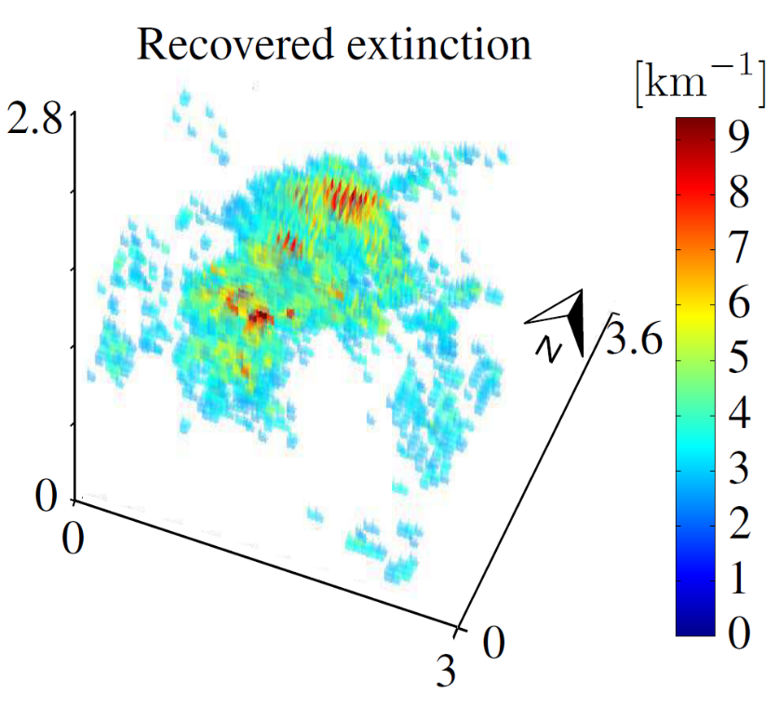

  Airborne experiment
JPL’s AirMSPI on board NASA’s ER-2
Nadir image
Airborne Multiangle SpectroPolarimetric Imager
84,380 unknowns
Dave Diner‘s team at JPL
Levis, Schechner, Aides, Davis
ICCV’15
Notes:
In this work we use a high-altitude aircraft to acquire multi-view images.
On the left you can see how the nadir image looks like.
We focused on this cloud to recover 85,000 unknowns.
But how do we validate our recovery?

Slide 5
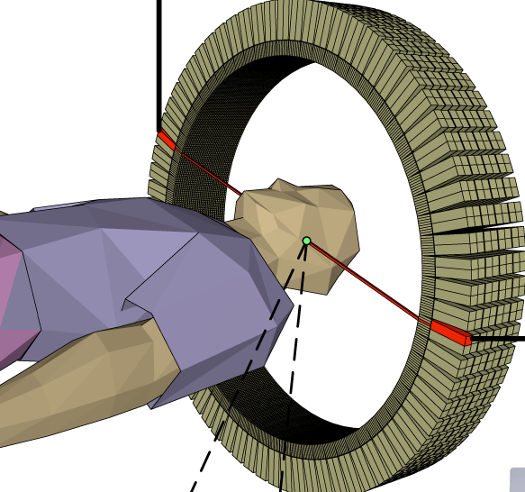

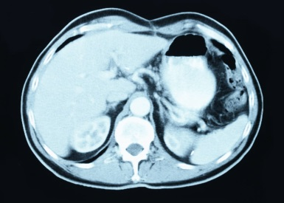
Medical Computed Tomography (CT)
direct transmission
We use multiple-scatter
as a source of information
β
uncontrolled radiation
LARGE scale
ICCV’15
Notes:
In medical CT, small-scale and controlled rotatable radiation, enable a simple, direct transmission model.
We deal with a generalized problem having multiple-scattering, uncontrolled radiation, and a large scale.
Now this is an important note. We don't “deal” with multiple-scattering, but rather use it as the main signal component.

Slide 6


Image Formation
line of sight
Levis, Schechner, Aides, Davis
ICCV’15
Notes:
In single-scattering, sunlight scatters into a line of sight.
However in multiple-scattering, not only sunlight scatters into the line of sight, but also light traveling around the 3D domain.

Slide 7



Image Formation
Notes:
For a given atmosphere, beta, the image model F forms the images as viewed by the imaging system, in this case the satellite.

Slide 8
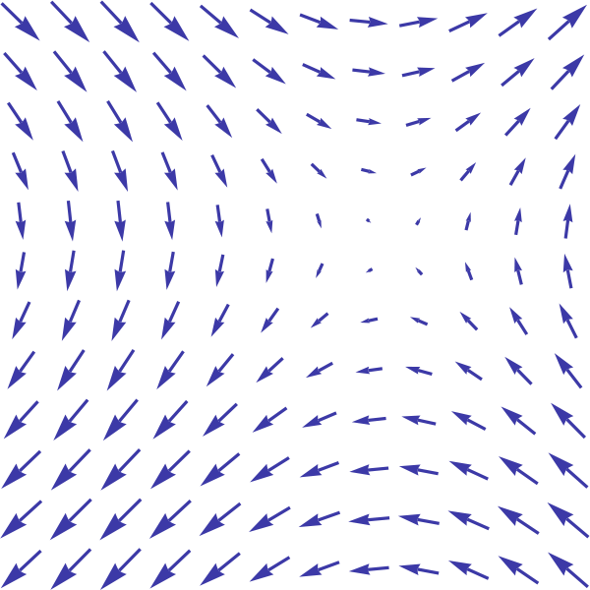

Light Field
light field:
how much light
at every point and angle
Levis, Schechner, Aides, Davis
ICCV’15
Notes:
The notion of light traveling around is captured by the 5D light field

Slide 9






In-Scatter Light Field
Light scattered into line of sight
=
Levis, Schechner, Aides, Davis
Notes:
So how much light is there at this point and direction?
… The optical density at this point…
… The fraction of light scattered to this direction…
… and the attenuation from x’ to x.

Slide 10








Radiative Transfer Equation
Chandrasekhar, 1950
light field
direct component
scattered component
=
+
scatter field
Radiative transfer by
=
SHDOM
or
Monte Carlo
recursive relation of &
Levis, Schechner, Aides, Davis
ICCV’15
Notes:
The relation between these two field I and J is recursive: depends on J and J depends on I.
This is the radiative transfer equation, which was derived decades ago. It is solved numerically, however this recursion is computationally expensive.
This is the image formation model that we use.

Slide 11

Radiative Transfer Equation
Chandrasekhar, 1950
light field
direct component
scattered component
=
+
scatter field
Image formation model
=
subset of
recursive relation of &
Levis, Schechner, Aides, Davis
Notes:
The relation between these two field I and J is recursive: depends on J and J depends on I.
This is the radiative transfer equation, which was derived decades ago. It is solved numerically, however this recursion is computationally expensive.
This is the image formation model that we use.

Slide 12
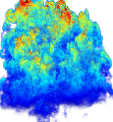



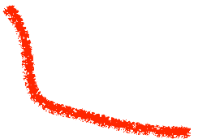

Computing
too complex for many unknowns
how to solve this minimization?
gradient based
method
Gkioulekas et al. Inverse Volume Rendering with Material Dictionaries, SIGGRAPH (2013): uniform with hundreds of unknowns
Levis, Schechner, Aides, Davis
ICCV’15
Notes:
Now, we are back to the inverse problem. The question is how to solve this minimization?
Suppose we try a gradient-based method. A previous work tried this, to recover a homogeneous medium having a few hundred unknowns.
However, computing the gradient is too complex for many unknowns.

Slide 13
39
light field
direct component
scattered component
=
+
scatter field
=
:fixed
No longer recursive
Levis, Schechner, Aides, Davis
ICCV’15
Notes:
If we look back at the image formation model…
… we can see that for a fixed J…
… the image formation model is no longer recursive. and has a simple dependency on beta

Slide 14

40
light field
direct component
scattered component
=
+
simple function of
Fast to compute
Levis, Schechner, Aides, Davis
ICCV’15
Notes:
… This makes this minimization fast to compute

Slide 15
41
Iterative Approach
Notes:
With this in mind we devise the following iterative approach

Slide 16
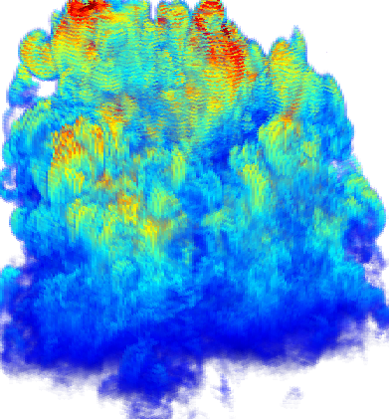


42
Initial guess
compute
Radiative transfer by
SHDOM
or
Monte Carlo
Forward (recursive) problem
Notes:
Starting with an initial guess beta_zero to compute compute J_zero, solving a forward recursive problem.
I remind you that this part is time consuming.

Slide 17

43
Initial guess
compute
Inverse (non-recursive) problem
Notes:
With this fixed J_zero we update beta solving an inverse, non-recursive problem. which is fast to compute.

Slide 18


44
Initial guess
compute
compute
Iterated until convergence
Notes:
Using the newly estimated beta we can re-update J, and iterate until convergence

Slide 19
Controlled Test
Simulated cloud field
Matheou, Chung
Large Eddy Simulator (LES)
simulation of turbulent flows
With noise
[Chang, Matheu]
Levis, Schechner, Aides, Davis
ICCV’15
Notes:
To test this approach in a realistic setting we used a large eddy simulated cloud field, which produces physically realistic cloud distributions.

Slide 20
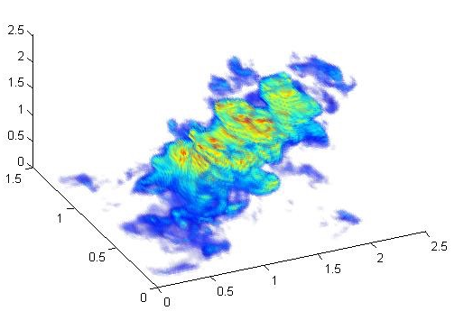
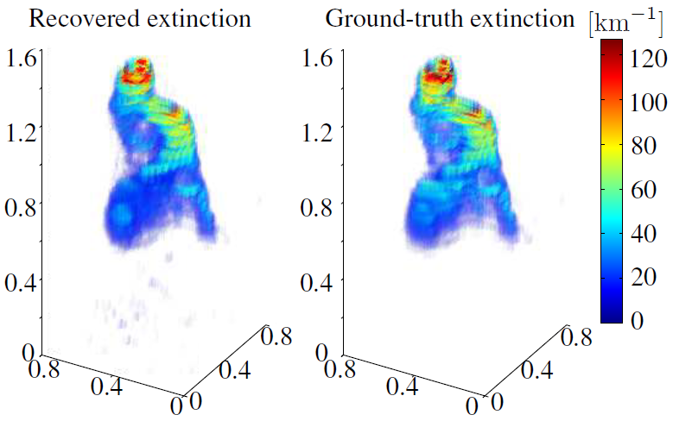

LES Ground truth
Simulated cloud field
[km]
315,000 unknowns
1.3x2.2x2.2 km
3
[km]
[km]
0.7x0.7x1.5 km
3
45,000 unknowns
[km]
[Chang, Matheu]
[km]
[km]
Levis, Schechner, Aides, Davis
ICCV’15
Notes:
On the left you can see the ground truth distribution as generated with the LES.

Slide 21
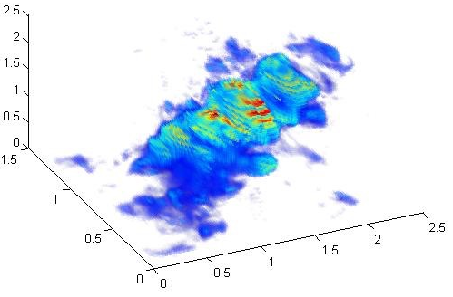
Recovery
Simulated cloud field
[km]
315,000 unknowns
1.3x2.2x2.2 km
3
[km]
[km]
[km]
0.7x0.7x1.5 km
3
45,000 unknowns
[km]
[Chang, Matheu]
[km]
[km]
Levis, Schechner, Aides, Davis
ICCV’15
Notes:
Here you can see the recovery using our approach.

Slide 22
First time: multiple-scattering tomography
[km]
315,000 unknowns
Initialized both with zero cloud
shape
values in the ball park
[km]
[km]
[km]
Limitations
depends on initial guess
very large optical depth
45,000 unknowns
[km]
[km]
[km]
Levis, Schechner, Aides, Davis
ICCV’15
Notes:
I want to point out this is a first large-scale multiple-scatter tomographic recovery.
In both cases we used and initial guess of zero cloud. The recovered solution was able to get the correct shape and magnitude.
The limitations are that the covered solution depends on the initial condition. As evident in the top reconstruction we cannot recover extremely thick clouds since there is almost no signal coming from within the cloud.

Slide 23
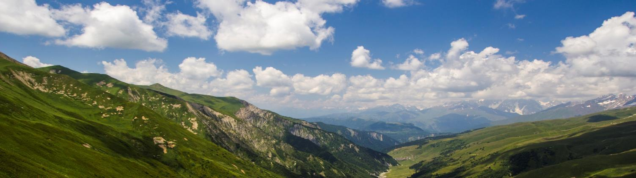

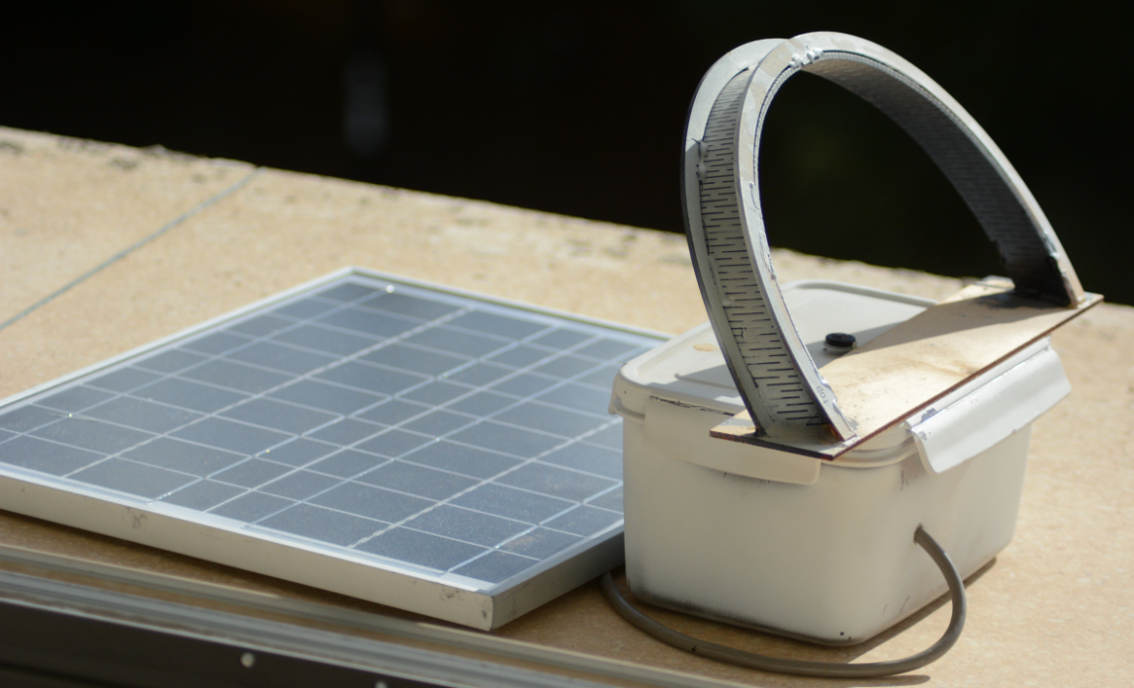
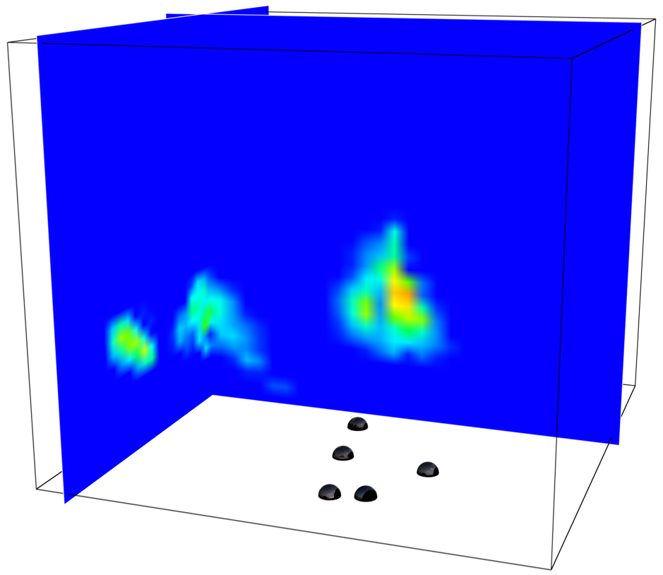
Clouds in The Cloud
3
Static sun
blocker
Camera
Veikherman, Aides, Schechner , Levis, ACCV (2014).

Slide 24

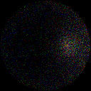

Forward monte carlo radiative transfer
or
Rare event!
Notes:
A photon packet is shot from the sun with an initial intensity. The distance it propagates is randomly sampled according to the density of the medium.
Once it collides with a particle, the particle type is randomly sampled. The photon packet intensity is updated by the single scattering albedo, that determines
a probability for scattering by the sampled particle. Then, the angle of scattering is randomly sampled according to the phase function of the particle. This process continues until one of two things occurs -
Either the photon packet leaves the atmosphere. or the packet reaches the sensor and contributes its intensity to a pixel.
Another method is the Backward MC method, which we mention in our paper. The paper describes why we prefer FMC over BMC.
What is the problem here?
The problem with this technique is that a photon reaching the sensor is a rare event, Resulting in sparse noisy image estimates.

Slide 25

Forward monte carlo radiative transfer
with local estimation
Explodes
for small R
Notes:
A known method to tackle this problem is Local Estimation.
Here, whenever a scattering event occurs, the scattering contributes to the image. This contribution expresses the probability that a photon scatters towards the
camera and reaches the camera without any more interactions.
Since we have only one source and multiple sensors, forward MC estimates all images at once, Per scattering.
But yet using LE, this method is unstable for in-situ.
The problem is that the LE contribution is proportional to one over the distance squared. Since the cameras are in situ, this distance could be very small causing the LE contribution to explode.
Here you can see a noisy image as a result of this singularity.

Slide 26
Efficient method
Stable & efficient solution for multi-view
Forward
Monte Carlo
expected
26
Notes:
We succeeded to solve this problem and produce stable renderings using FMC, with it’s computational benefits. So how do we get it ?

Slide 27
Voxelization of
projected scattered radiance
J(x,ω) in camera direction
Notes:
here, we do voxelization of the radiance that scatters toward the cameras.
Instead of scattering points we talk about scattering voxel, contributing to an image.
For each voxel we summarize all the intensities of the in-scatterings.
We are inspired by volumetric photon mapping.
Voxelization compromis the MC accuracy in order to get improved stability.

Slide 28
Voxelization
voxel
Spot size
increases with
voxel
No spike of
pixel intensity
Image plane
Notes:
A voxel projectes, to a spot in the image plane.
A nearby voxel creates a larger spot, whose size increases with 1/R^2, but the intensity does not spike.

Slide 29



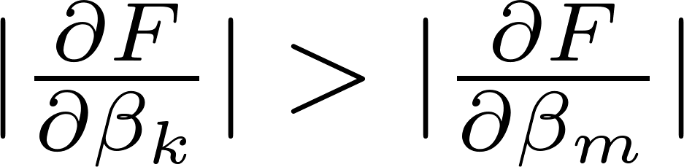
Conditioning
Rendering, Fitting gradient
cone of sight
increase with
Notes:
Note the following.
Generally In-situ, voxel k contributes to the camera more than voxel m.
The same phenomenon occures in the gradient:
The Gradient at voxel k prone to be higher than at voxel m.
Thus, near the cameras, voxels are unstable. This problem is
comparable to ill-conditioned linear optimization.
For example here *this is the cloud that we want to recover.
*This is an iteration of the cloud recovery: we can see that bogus clouds develop in voxels near the cameras.
To counter this we introduce a weighting Q, which is increase with distance square. It compensates for the distance dependent imbalance of the grasient.
*this is the same iteration using the weighting. The minimization here converges faster.

Slide 30
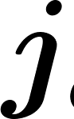

Scattered radiance voxelization
Discrete scattered
radiance toward cameras
Transmittance
Projection
element-wise
Notes:
The result is j, a discrete scattered radiance relating voxels to camera, pixels.
Now computing each pixel is simply a matter of integration over the discrete scattered radiance times optical extinction times the transmittance.
By generalize this to multi-view we get the discrete scattered radiance field from each voxel toward each camera.
But what happened to the 1/R^2 factor?

Slide 31

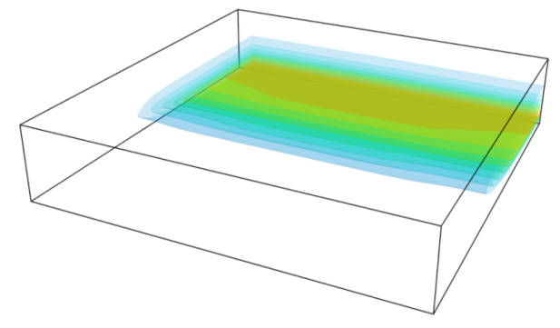
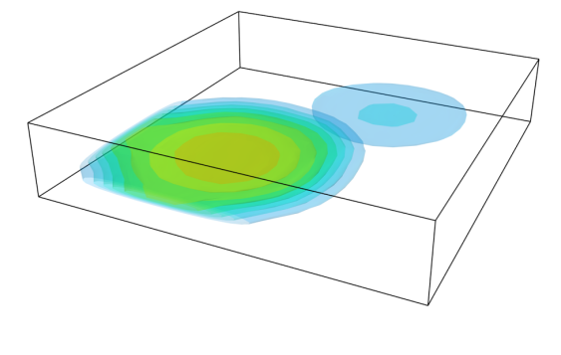



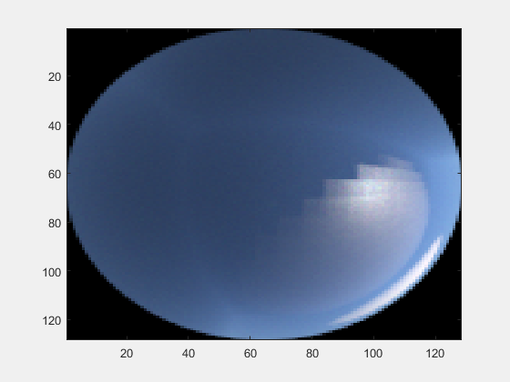
20x20x40 voxel grid
Aides et al. 2013
16000 unknowns
Single scattering
approximation
0
2.3
4.5
0
23
45
Including
Poissonian noise
Camera noise
Quantization
Notes:
We tested Haze front and Haze blobs scenes, with aerosols density ranging between low density to 10 times higher.
Optical domain has 16 thousand voxels, whose beta values are unknown.

Slide 32
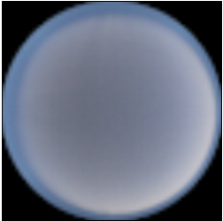
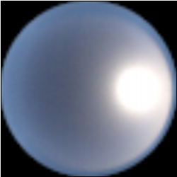
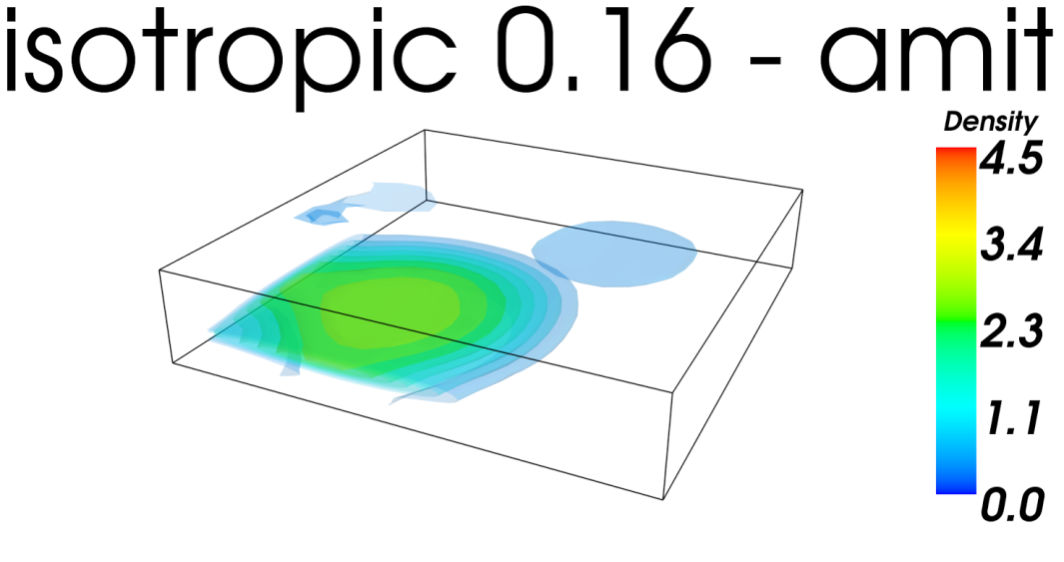
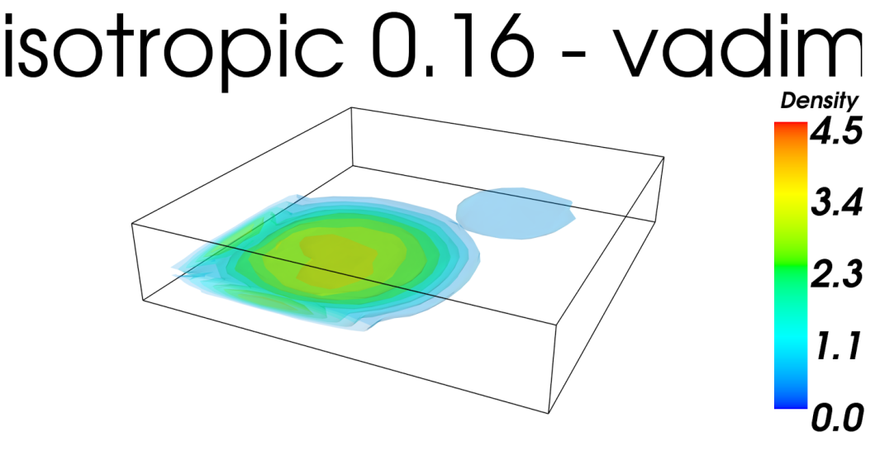
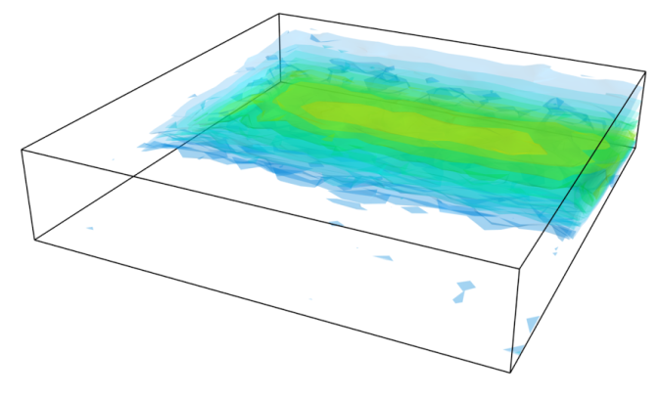

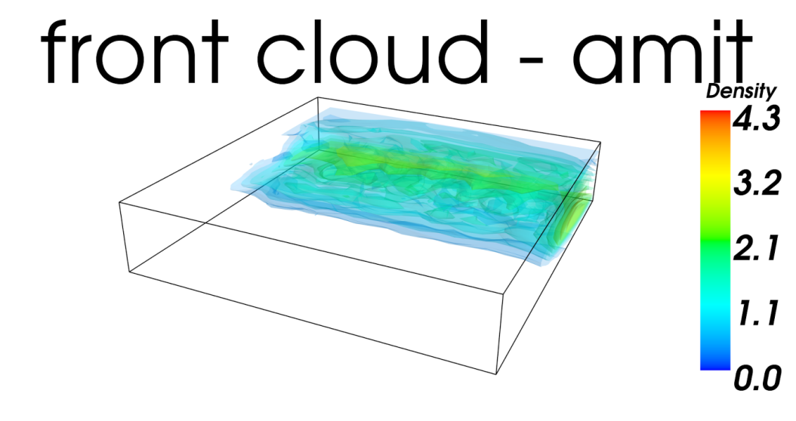
Isotropic phase-func
anisotropic phase-func
Ground truth
Our results
Ground truth
Single scat. approx.
density
Ground truth
Single scat. approx.
Ground truth
Our results
Notes:
Lets see a few recoveries. The upper corner shows Haze blobs with low density aerosols have an isotropic phase function. The Lower corner shows a Haze front with a non isotropic phase function.
This is the ground truth distribution. Single scattering approximation result, the ground truth, our result.
You can see Visually that our results are better.

Slide 33

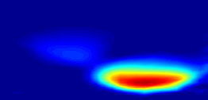
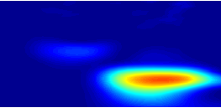
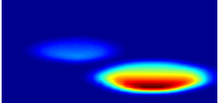
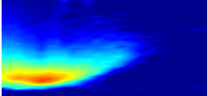
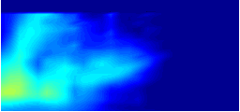
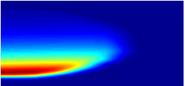
Results: diagonal slice
Diagonal slice
Diagonal slice
Our results
Our results
Ground truth
Single scat. approx.
Single scat. approx.
Ground truth
Ground truth
Ground truth
Notes:
Lets also see the diagonal slice of the results
the ground truth distribution. Single scattering results, the ground truth, our results.

Slide 34


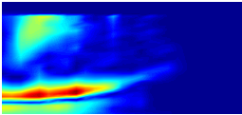
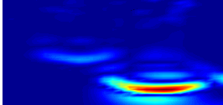
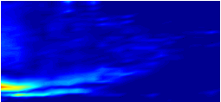
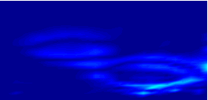
Errors: diagonal slice
Diagonal slice
Diagonal slice
Error
Our
Our
Single scat. approx.
Single scat. approx.
Error measure down by 0.5
Notes:
Lets also see the diagonal slice of the errors. Single scattering errors, our errors.
Our recovery has less error.
Our Average Error Measure is down by half. More information about the Error Measure is in the paper.
More recoveries are in the paper.

