Slide 1


Passive Tomography of Turbulence Strength
ECCV 2014
Turbulence Statistics Field
Marina Alterman, Yoav Schechner, Minh Vo, Srinivas Narasimhan

Slide 2
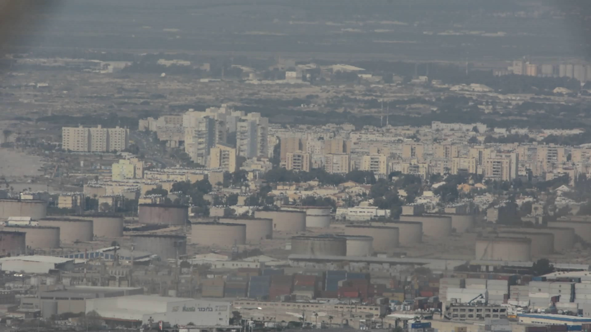

Imaging Through Turbulence
In the air
Passive Tomography of Turbulence Strength, M. Alterman, Y. Schechner, M. Vo, S. Narasimhan, ECCV 2014

Slide 3
Air Turbulence
Complex
Alterman, Schechner, Vo, Narasimhan, ECCV 2014

Slide 4
Air Turbulence
Random Temperature
fluctuations
Alterman, Schechner, Vo, Narasimhan, ECCV 2014

Slide 5

Air Turbulence
Refractive index random fluctuations
Alterman, Schechner, Vo, Narasimhan, ECCV 2014

Slide 6
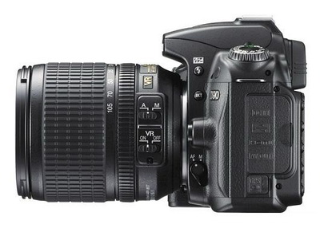

Imaging Through Turbulence
Spatio-temporal random refraction
Spatio-temporal random distortion
Alterman, Schechner, Vo, Narasimhan, ECCV 2014

Slide 7
Imaging Through Turbulence
Spatio-temporal random refraction
Spatio-temporal random distortion
Refractive perturbations to light
Random distortions when imaging background objects
Alterman, Schechner, Vo, Narasimhan, ECCV 2014

Slide 8
Imaging Through Turbulence
Spatio-temporal random refraction
Spatio-temporal random distortion
Refractive perturbations to light
Random distortions when imaging background objects
Alterman, Schechner, Vo, Narasimhan, ECCV 2014

Slide 9
Imaging Through Turbulence
Spatio-temporal random refraction
Spatio-temporal random distortion
Refractive perturbations to light
Random distortions when imaging background objects
Alterman, Schechner, Vo, Narasimhan, ECCV 2014

Slide 10
Imaging Through Turbulence
Spatio-temporal random refraction
Spatio-temporal random distortion
Refractive perturbations to light
Random distortions when imaging background objects
Alterman, Schechner, Vo, Narasimhan, ECCV 2014

Slide 11
Imaging Through Turbulence
Spatio-temporal random refraction
Spatio-temporal random distortion
Refractive perturbations to light
Random distortions when imaging background objects
Alterman, Schechner, Vo, Narasimhan, ECCV 2014

Slide 12
Imaging Through Turbulence
Spatio-temporal random refraction
Spatio-temporal random distortion
Refractive perturbations to light
Random distortions when imaging background objects
Alterman, Schechner, Vo, Narasimhan, ECCV 2014

Slide 13
Imaging Through Turbulence
Spatio-temporal random refraction
Spatio-temporal random distortion
Refractive perturbations to light
Random distortions when imaging background objects
Alterman, Schechner, Vo, Narasimhan, ECCV 2014

Slide 14
Imaging Through Turbulence
Spatio-temporal random refraction
Spatio-temporal random distortion
Refractive perturbations to light
Random distortions when imaging background objects
Alterman, Schechner, Vo, Narasimhan, ECCV 2014

Slide 15
Imaging Through Turbulence
Spatio-temporal random refraction
Spatio-temporal random distortion
Refractive perturbations to light
Random distortions when imaging background objects
Alterman, Schechner, Vo, Narasimhan, ECCV 2014

Slide 16
Imaging Through Turbulence
Spatio-temporal random refraction
Spatio-temporal random distortion
Refractive perturbations to light
Random distortions when imaging background objects
Alterman, Schechner, Vo, Narasimhan, ECCV 2014

Slide 17
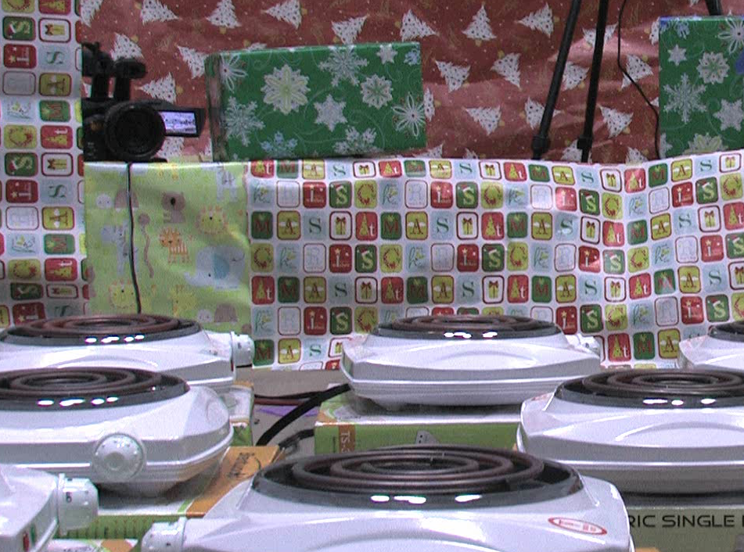
Where the turbulence is stronger?
Alterman, Schechner, Vo, Narasimhan, ECCV 2014

Slide 18
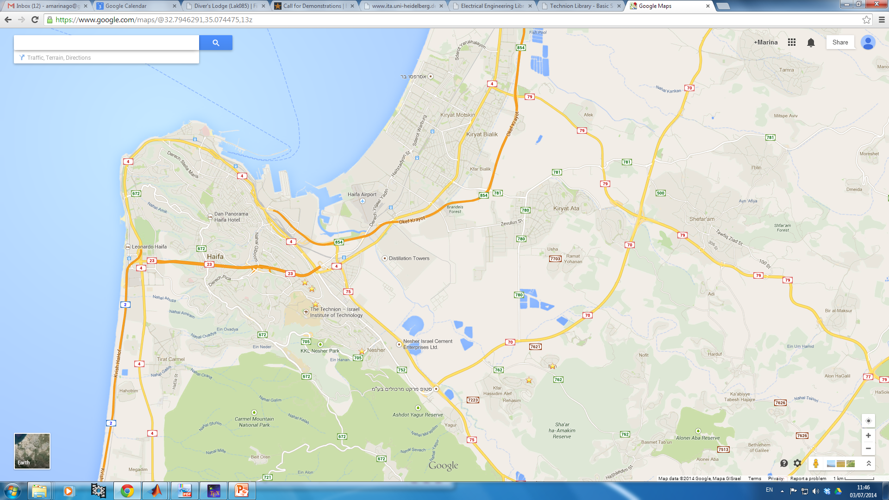
Outdoor Experiment – Result
power
station
Haifa Port
Power Station
Haifa Airport
town
Refineries
refineries
Technion
Nesher
Ibtin
viewpoints
Rechasim
viewpoints
maps.google.com
Alterman, Schechner, Vo, Narasimhan, ECCV 2014

Slide 19
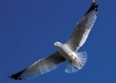
Turbulence Strength: Many Implications
meteorology
Free space communications
Wind turbines
Tethered balloons
convection
Alterman, Schechner, Vo, Narasimhan, ECCV 2014

Slide 20
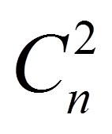
Strength of Turbulence
exploit random image distortions
Statistics Field
statistical measure of local variations in the medium
Estimate
Alterman, Schechner, Vo, Narasimhan, ECCV 2014

Slide 21
Imaging Though Turbulence
Passive Tomography of Turbulence Strength, M. Alterman, Y. Schechner, M. Vo, S. Narasimhan, ECCV 2014

Slide 22
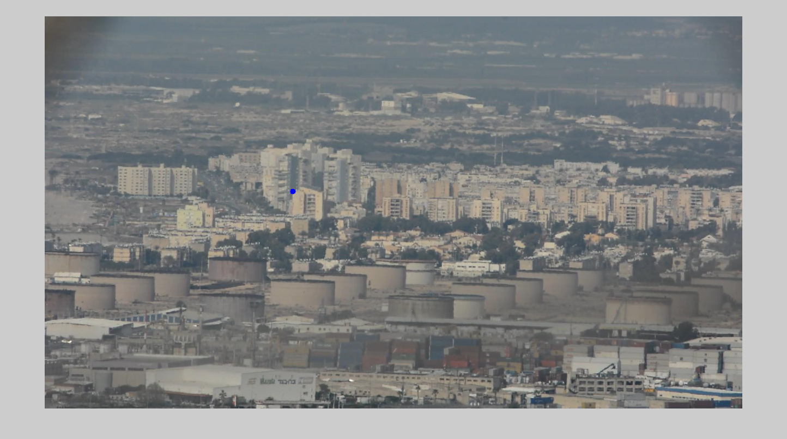
Imaging Though Turbulence
variance
Passive Tomography of Turbulence Strength, M. Alterman, Y. Schechner, M. Vo, S. Narasimhan, ECCV 2014

Slide 23
Distortion Statistics
Displacement variance
Passive Tomography of Turbulence Strength, M. Alterman, Y. Schechner, M. Vo, S. Narasimhan, ECCV 2014

Slide 24


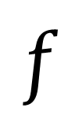
What caused high variance?
Alterman, Schechner, Vo, Narasimhan
Distortion
Variance
$$f$$
Turbulence Strength
Distance ,
Large source of turbulence
Small strong source
Location on line-of-sight of turbulence
Small strong source

Slide 25
Estimating Turbulence Strength
Turbulence Statistics Field
Measure
Pixel Shift Variance
Linear Tomography Problem
Alterman, Schechner, Vo, Narasimhan

Slide 26
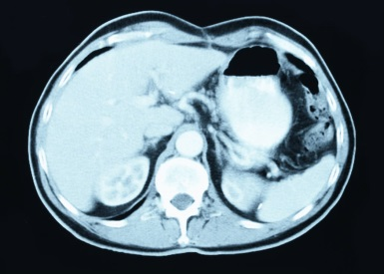
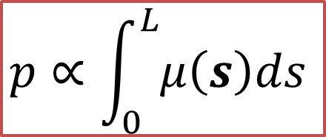
Computed Tomography (CT)
Rotating x-ray source
Measure the exit beam intensity integrated along a line between x-ray source and detector
$$p∝\int_{0}^{L}{μ\left(s\right)ds }$$
attenuation
Estimate
Rotating detector
Alterman, Schechner, Vo, Narasimhan, ECCV 2014

Slide 27



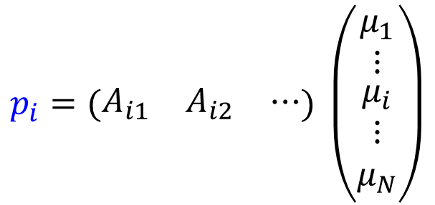
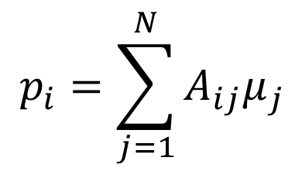
Reconstruction
Discretization of the object into voxels
$$p_{i}=\sum_{j=1}^{N}{A_{ij}μ_{j}}$$
voxel $j$
$$μ_{j}$$
body attenuation
$$p_{i}=(\begin{matrix}A_{i1} & A_{i2} & ⋯\end{matrix}) \left(\begin{matrix}μ_{1} \\ ⋮ \\ \begin{aligned}μ_{i} \\ ⋮ \\ μ_{N}\end{aligned}\end{matrix}\right)$$
measured pixel intensity
$$A_{ij}$$
projection $p_{i}$
Alterman, Schechner, Vo, Narasimhan, ECCV 2014

Slide 28



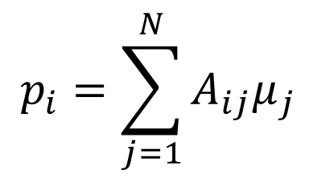




Reconstruction
28
$$p_{i}=\sum_{j=1}^{N}{A_{ij}μ_{j}}$$
$$p_{1}$$
$$(\begin{matrix}A_{11} & A_{12} & ⋯\end{matrix})$$
$$p_{2}$$
$$(\begin{matrix}A_{21} & A_{22} & ⋯\end{matrix})$$
$$\left(\begin{matrix}μ_{1} \\ ⋮ \\ \begin{aligned}μ_{i} \\ ⋮ \\ μ_{N}\end{aligned}\end{matrix}\right)$$
$$p_{i}$$
$$(\begin{matrix}A_{i1} & A_{i2} & ⋯\end{matrix})$$
=
body attenuation
measured pixel intensity

Slide 29
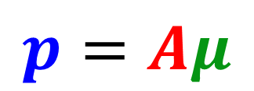
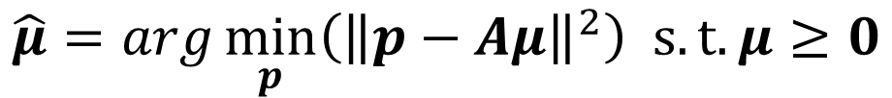
Reconstruction
29
measured pixel intensity
body attenuation
$$p=Aμ$$
$$\hat{μ}=arg\min_{p}\left({\left\|p−Aμ\right\|}^{2}\right) s.t.μ≥0$$

Slide 30
Measuring Displacement Variance
Passive Tomography
variance
Passive Tomography of Turbulence Strength, M. Alterman, Y. Schechner, M. Vo, S. Narasimhan, ECCV 2014

Slide 31

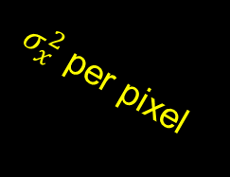

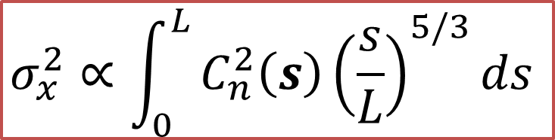


Turbulence Statistics
$σ_{x}^{2}$ per pixel
$$L$$
$$s=L$$
Pinhole
Image distortion statistics
Statistics Field
$$s=0$$
Estimate
Turbulence
Strength
$$σ_{x}^{2}∝\int_{0}^{L}{C_{n}^{2}\left(s\right){\left(\frac{s}{L}\right)}^{5/3}ds }$$
[Kolmogorov 1941]
variance
Alterman, Schechner, Vo, Narasimhan, ECCV 2014

Slide 32
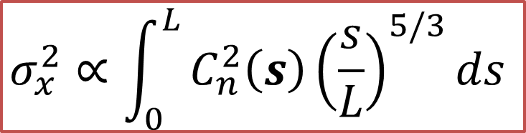

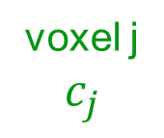

Estimating Turbulence Strength
$$σ_{x}^{2}∝\int_{0}^{L}{C_{n}^{2}\left(s\right){\left(\frac{s}{L}\right)}^{5/3}ds }$$
Partition of space into voxels
$$σ_{i}^{2}=\sum_{j=1}^{N}{A_{ij}c_{j}}$$
Turbulence Statistics Field
voxel j
$$c_{j}$$
$$A_{ij}$$
Including
weighting
factor
variance $σ_{i}^{2}$
Alterman, Schechner, Vo, Narasimhan, ECCV 2014

Slide 33
Estimating Turbulence Strength
measured pixel shift variance
Partition of space into voxels
turbulence strength
Turbulence Statistics Field
Measure
Pixel Shift Variance
Alterman, Schechner, Vo, Narasimhan, ECCV 2014

Slide 34
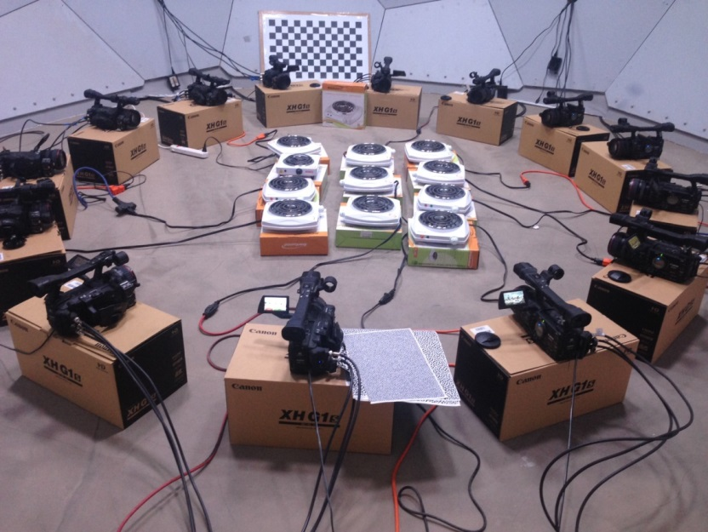
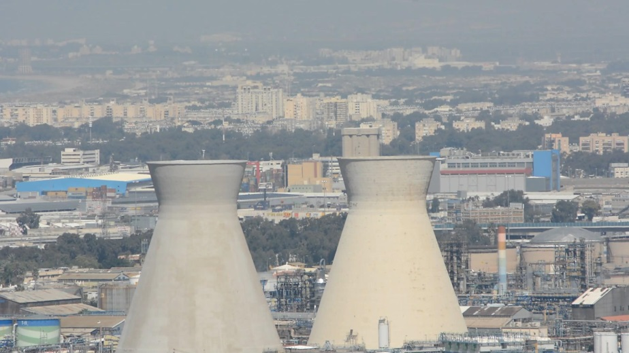
Alterman, Schechner, Vo, Narasimhan, ECCV 2014
Experiments
indoors
Outdoors

Slide 35
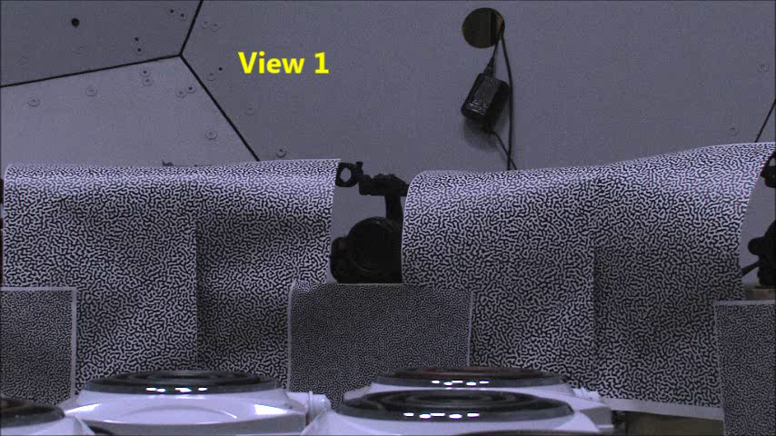
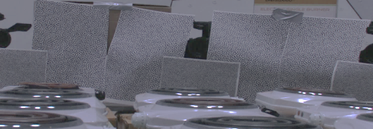
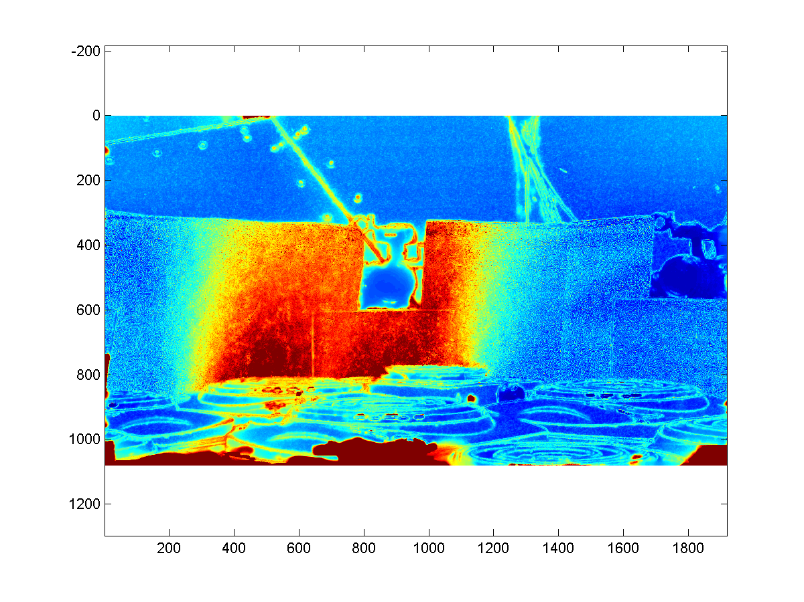
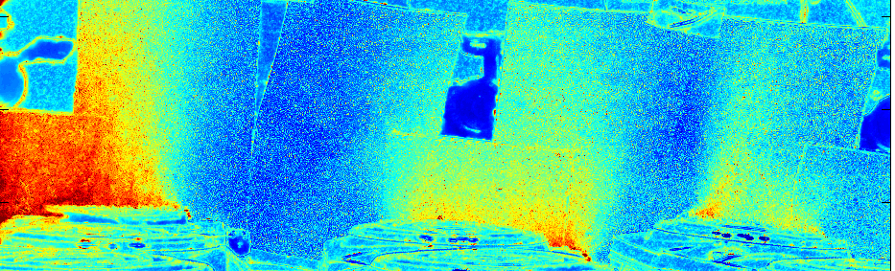
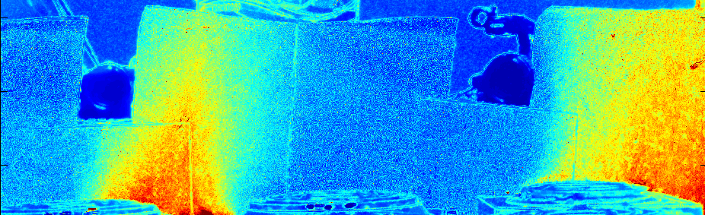
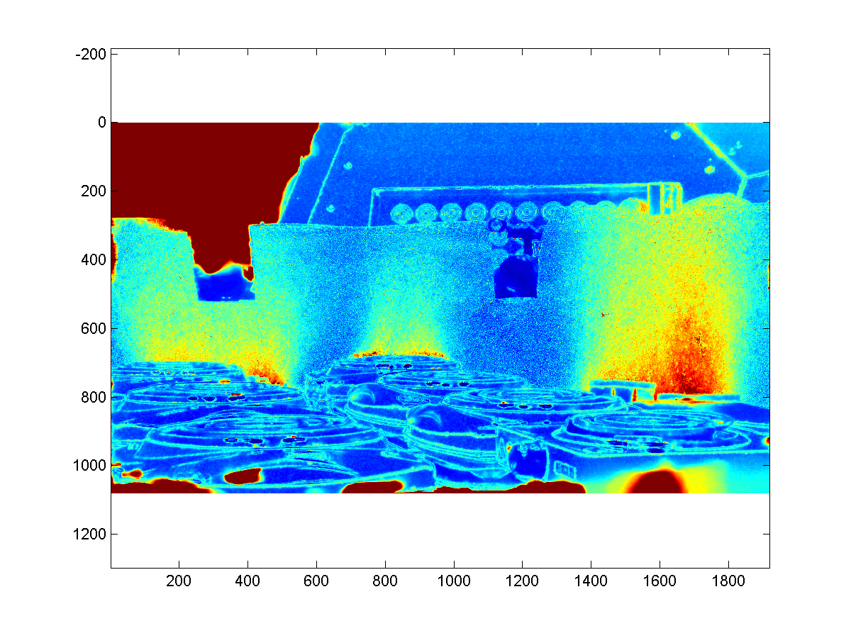
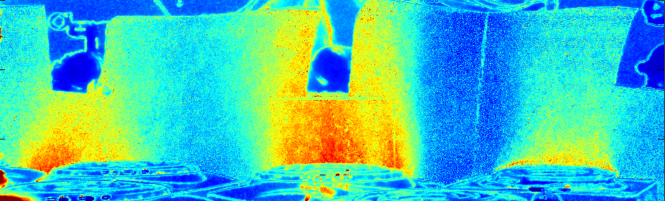
Indoor Lab Experiment
At Robotics Institute at Carnegie Mellon
hot stoves
stoves
Experimental Setup
3
1
5
Variance Images
8
6
Alterman, Schechner, Vo, Narasimhan, ECCV 2014

Slide 36
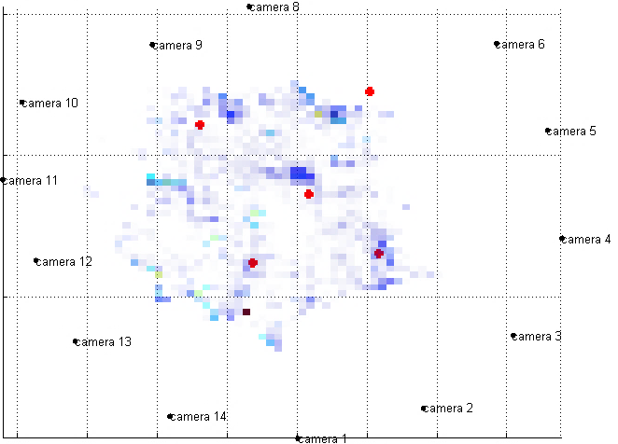
Indoor Lab Experiment
griddles
hot griddles
top view
camera 7
camera 8
camera 6
camera 9
camera 5
camera 10
camera 4
Experimental Setup
camera 11
camera 3
camera 12
camera 13
camera 2
camera 1
Estimated Turbulence
Alterman, Schechner, Vo, Narasimhan, ECCV 2014

Slide 37
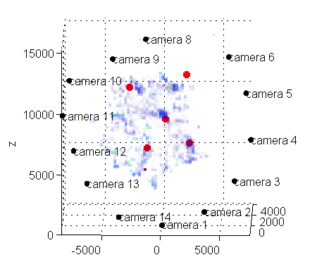
Indoor Lab Experiment
griddles
hot griddles
Experimental Setup
Alterman, Schechner, Vo, Narasimhan, ECCV 2014

Slide 38
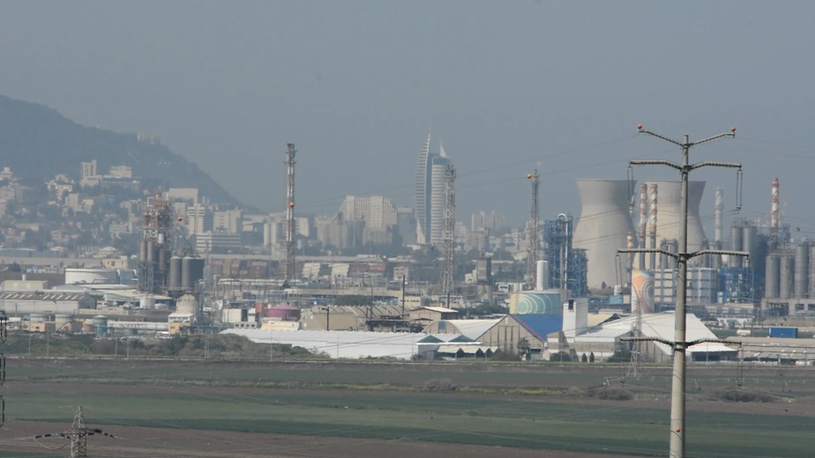
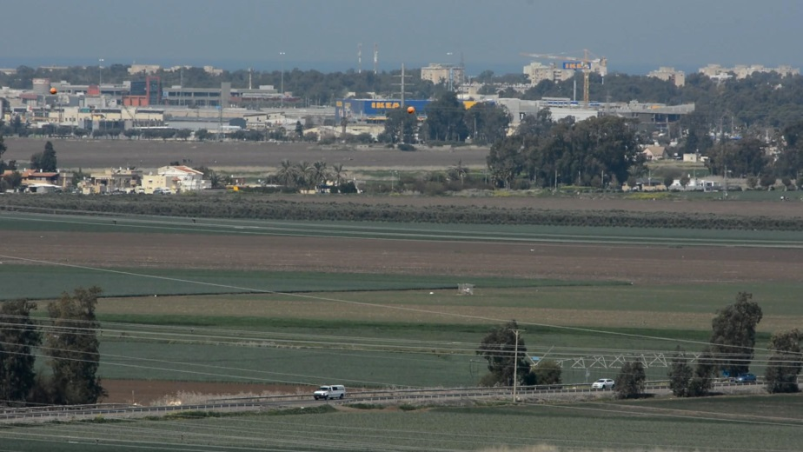
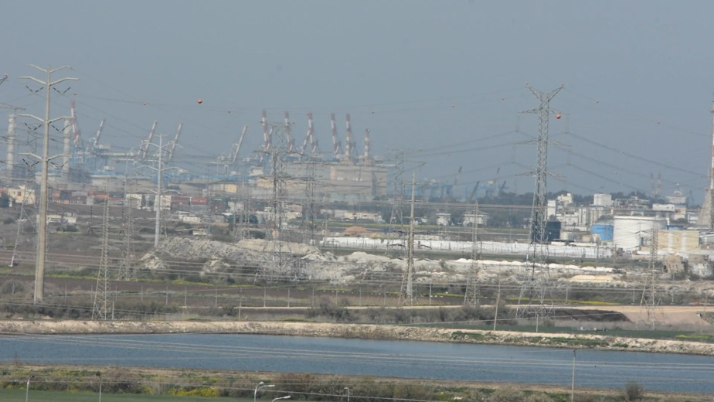
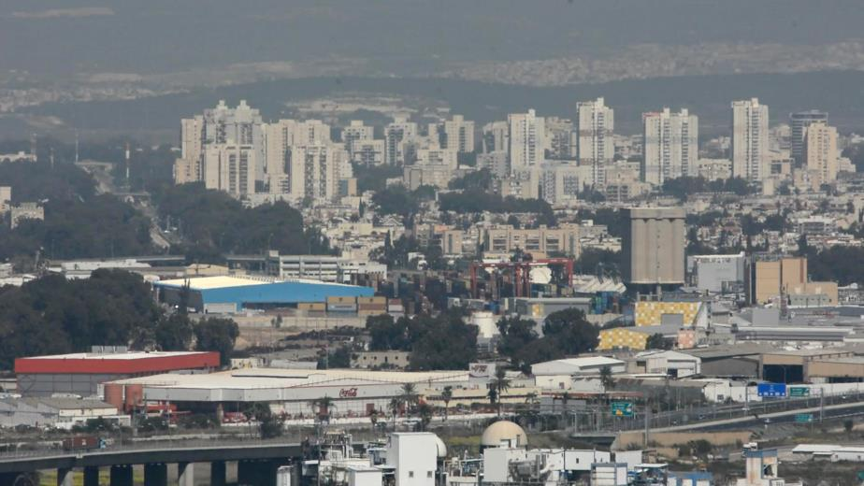
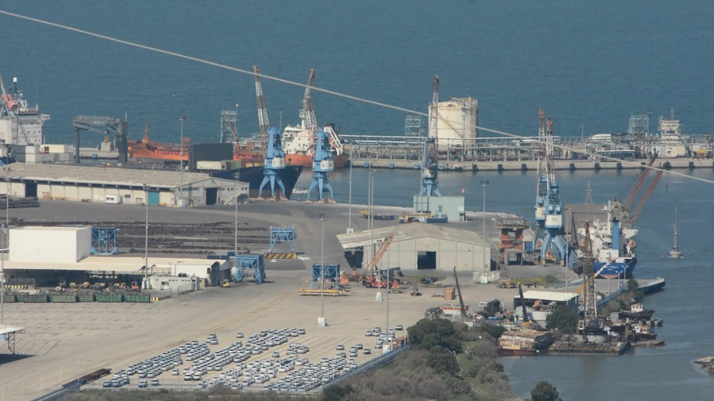
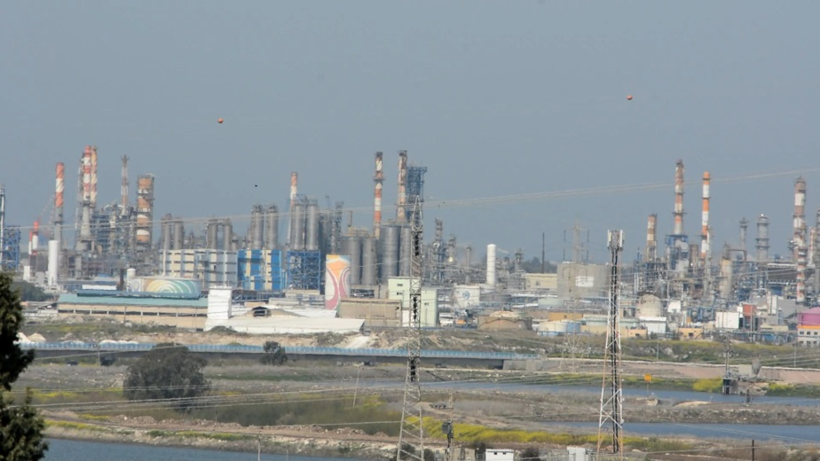
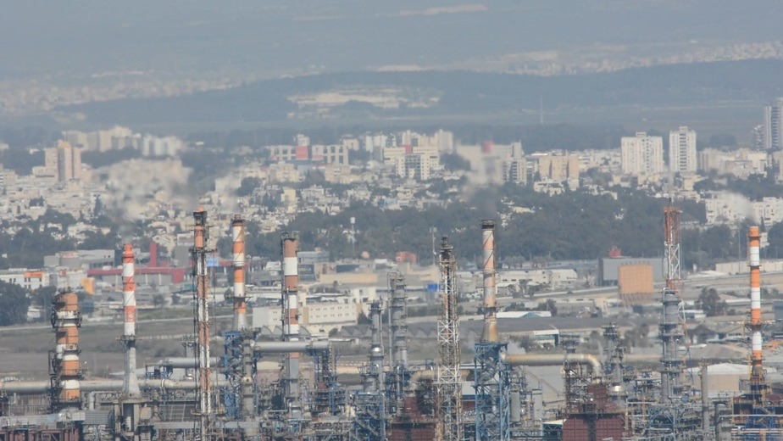
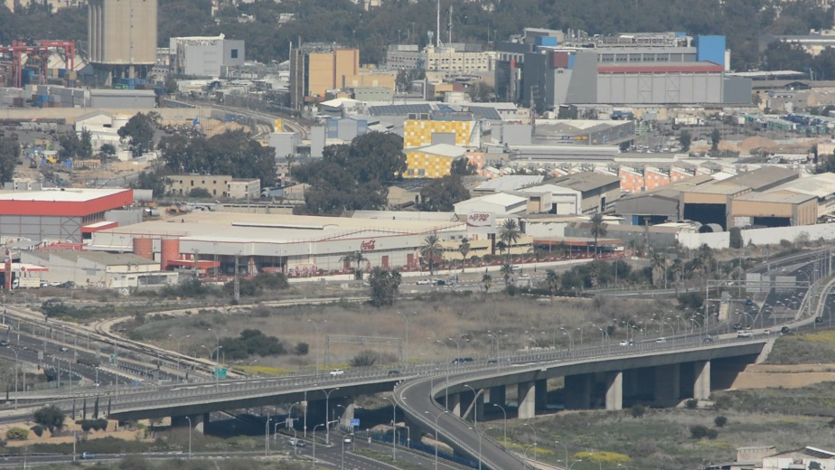
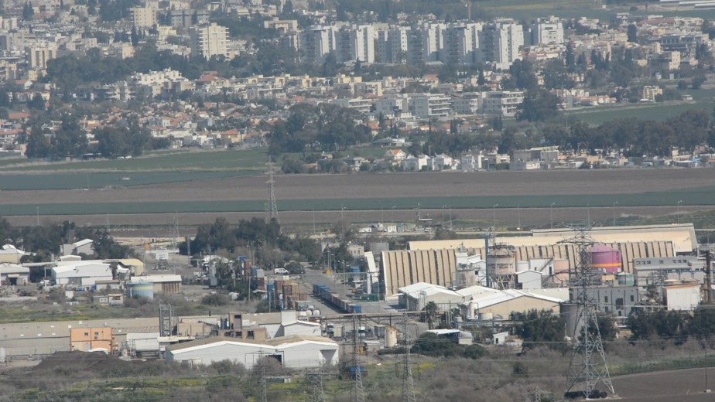
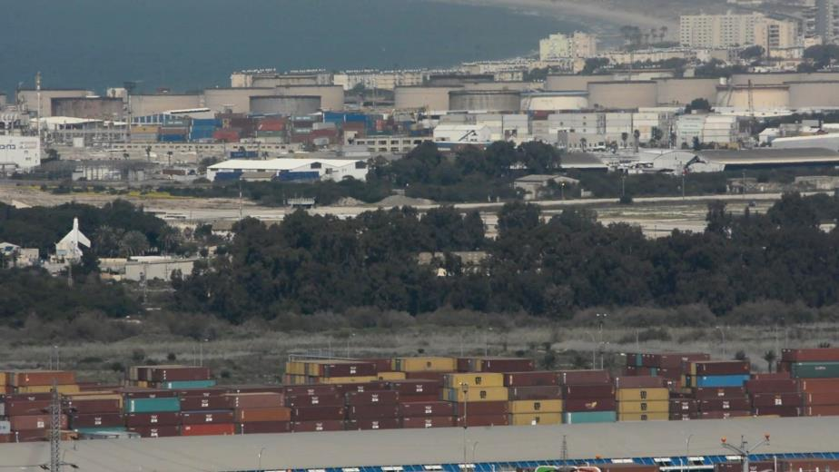
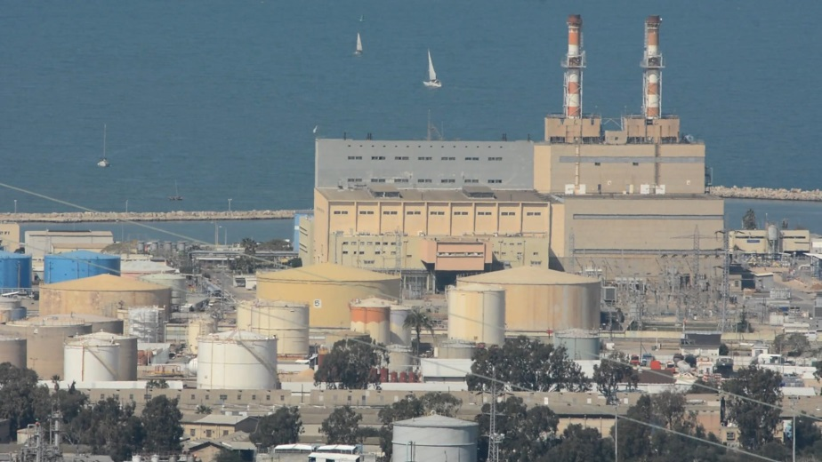
Outdoor Experiment
Haifa Experiment

Slide 39
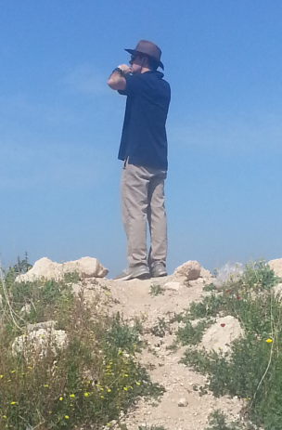
Outdoor Experiment
Haifa Port
Haifa Airport
Power Station
Refineries
Technion
Nesher
Ibtin
Rechasim
maps.google.com
Alterman, Schechner, Vo, Narasimhan, ECCV 2014

Slide 40
Imaging Though Turbulence
variance
Passive Tomography of Turbulence Strength, M. Alterman, Y. Schechner, M. Vo, S. Narasimhan, ECCV 2014

Slide 41
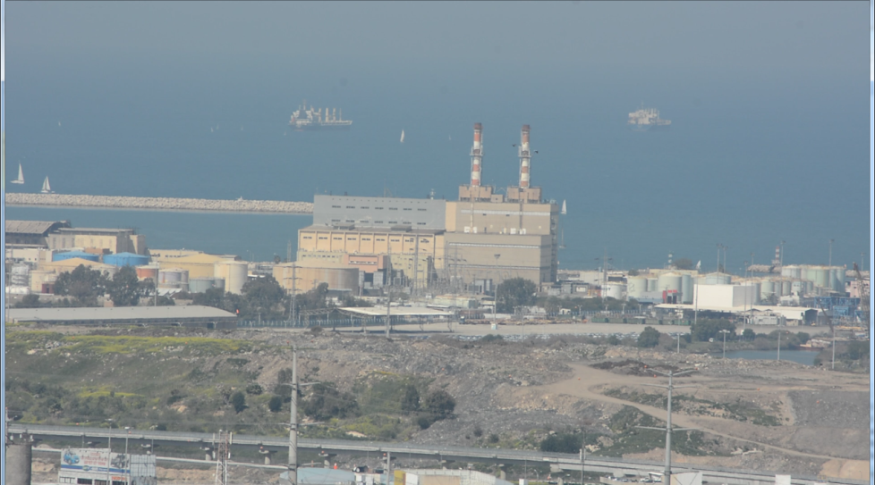

Outdoor Experiment
Refineries
Technion
Nesher
Ibtin
Rechasim
maps.google.com
Alterman, Schechner, Vo, Narasimhan, ECCV 2014

Slide 42
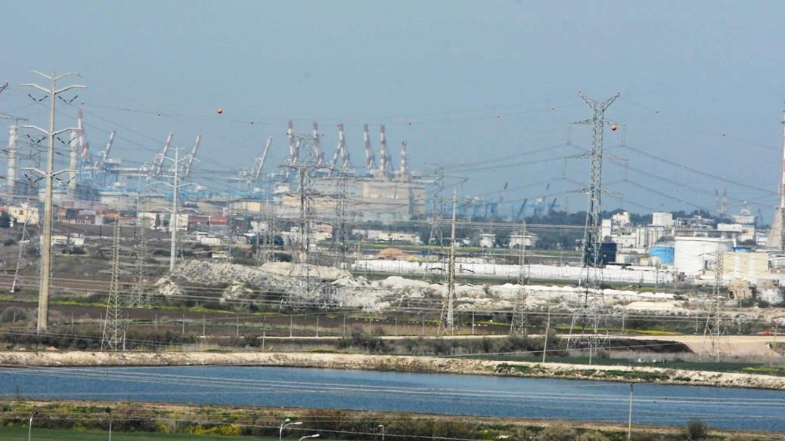
Outdoor Experiment
Haifa Port
Haifa Airport
Power Station
Refineries
Technion
Nesher
Ibtin
Rechasim
maps.google.com
Alterman, Schechner, Vo, Narasimhan, ECCV 2014

Slide 43
Outdoor Experiment
Haifa Port
Haifa Airport
Power Station
Refineries
Technion
Nesher
Ibtin
Rechasim
maps.google.com
Alterman, Schechner, Vo, Narasimhan, ECCV 2014

Slide 44
Outdoor Experiment
measured pixel shift variance
turbulence strength
view 6
view 5
Technion
view 4
Nesher
view 3
view 1
Ack:
Vadim Holodovsky
view 2
Alterman, Schechner, Vo, Narasimhan, ECCV 2014

Slide 45
Outdoor Experiment – Result
power
station
Haifa Port
Haifa Airport
Power Station
town
Refineries
refineries
Technion
viewpoints
Nesher
Ibtin
viewpoints
Rechasim
Alterman, Schechner, Vo, Narasimhan, ECCV 2014

Slide 46
Outdoor Experiment – Result
Haifa Port
Haifa Airport
Power Station
Refineries
Technion
Nesher
Ibtin
Rechasim
maps.google.com
Alterman, Schechner, Vo, Narasimhan, ECCV 2014

Slide 47
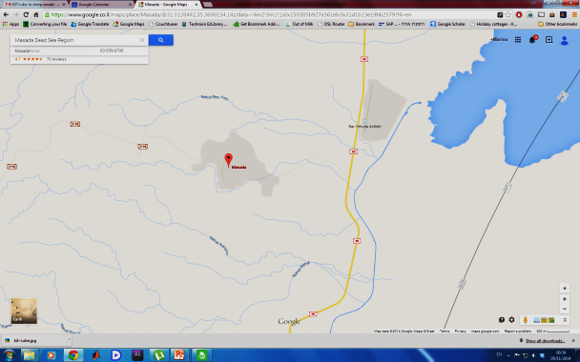
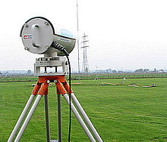
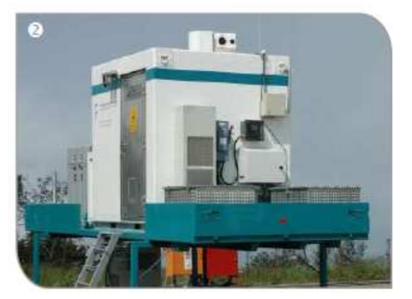
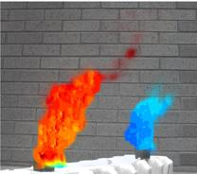

Related Work
Alterman, Schechner, Vo, Narasimhan, ECCV 2014
receiver
?
?
?
Active measurement instruments
Estimation of path averaged $C_{n}^{2}$
Measuring flow of refractive fluids
transmitter
Passive approach
Ordinary cameras
No frame synchronization
http://en.wikipedia.org/wiki/Scintillometer
[Zamek & Yitzhaky 2006]
Doppler Lidar
http://www.imk-tro.kit.edu
[Xue et.al. 2014]

Slide 48
Passive Tomography of Turbulence Strength
ECCV 2014
Turbulence Statistics Field
Visit our website:
http://webee.technion.ac.il/~yoav/research/turbulence_tomography.html
Marina Alterman, Yoav Schechner, Minh Vo, Srinivas Narasimhan

Slide 49
Acknowledgements
Joseph Shamir
Johanan Erez, Ina Talmon and Dani Yagodin
Vadim Holodovsky and Mark Sheinin
Yaser Sheikh
Taub Foundation.
Israel Science Foundation (ISF Grant 1467/12)
Asher Space Research Fund.
NSF grants (IIS-1317749 ,IIS-0964562)
Tonbo Imaging Gift.

