Slide 1
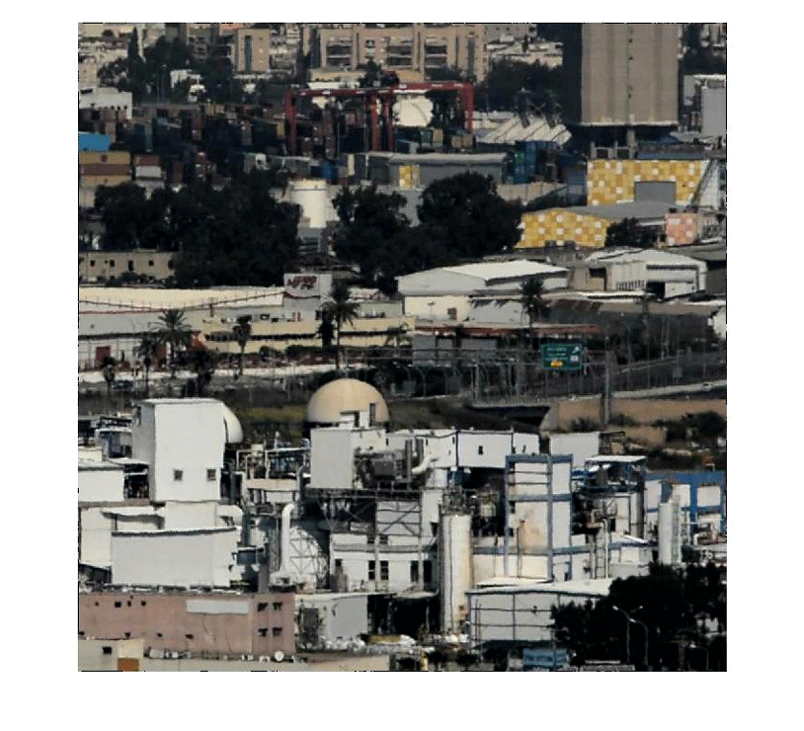
Turbulence-Induced 2D Correlated Image Distortion
Armin Schwartzman
UC San Diego
Marina Alterman
Northwestern University
Rotem Zamir
Yoav Schechner
Technion - Israel Inst. Technology
ICCP Conference , 2017

Slide 2
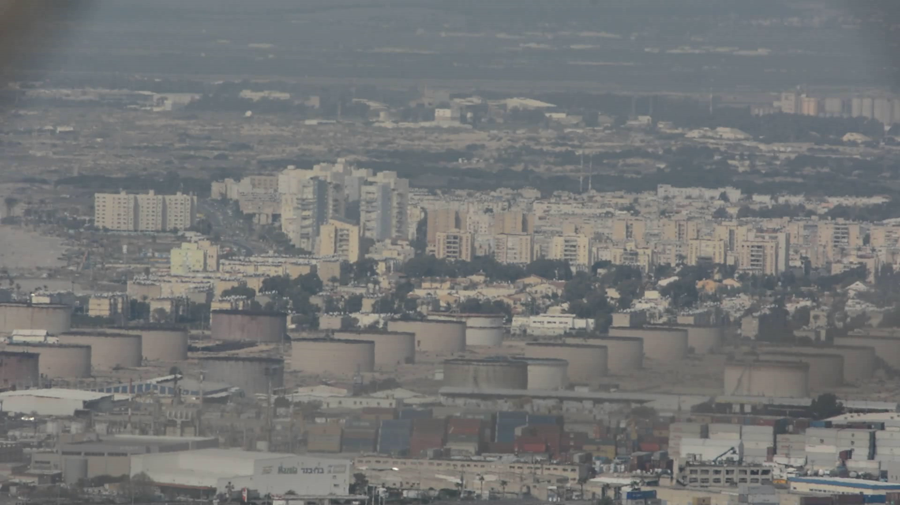
Imaging Through Turbulence
Goal: Render Turbulence Induced Distorted Image
Schwartzman, Alterman, Zamir , Schechner , Turbulence-Induced 2D Correlated Image Distortion, ICCP17
Notes:
This is a real video taken on a hot day through turbulent atmosphere.
Atmospheric turbulence randomly changes the refractive index along the line of sight. This creates refractive perturbations to light passing through a scene, generating geometric distortions such as you see here.
Our goal in this work is to render turbulence induced image distortions which are physically accurate.
This is a valuable tool in the development of imaging systems and image correction algorithms.

Slide 3

Motivation
Ray tracing in 3D
Object
3D Turbulence Field
2D distorted image
Scale of millimeters
Computationally complex
Scale of kilometers
Schwartzman, Alterman, Zamir, Schechner , Turbulence-Induced 2D Correlated Image Distortion, ICCP17
Notes:
Rendering should include these steps:
1. Simulate a huge 3D turbulent random ﬁeld (scale of kilometers)
2. ray-trace through this 3D refractive medium, from an object point to the camera of millimeter scale
3. Repeat this process for ALL points in the ﬁeld of view to obtain the distorted image.
This is computationally complex

Slide 4
Motivation
Image Transformation in 2D
Closed-form model of
distortion covariance
2D clear image
2D distorted image
Simple 2D operations
Schwartzman, Alterman, Zamir, Schechner , Turbulence-Induced 2D Correlated Image Distortion, ICCP17
Notes:
We believe that for some applications, there is no need for 3D simulations.
Basically, image distortion is an operation in just two dimensions.
The input is a 2D distortion free image. The output is a 2D distorted image.

Slide 5
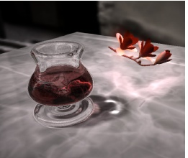
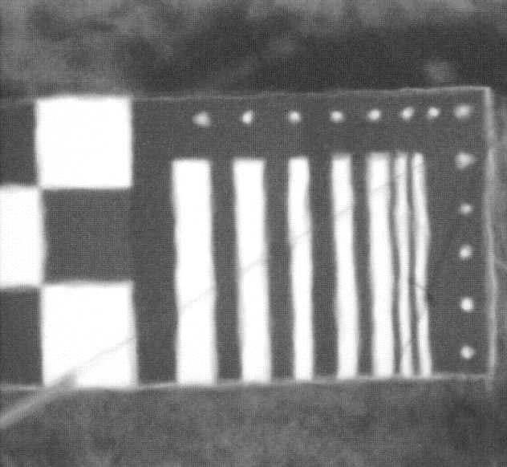
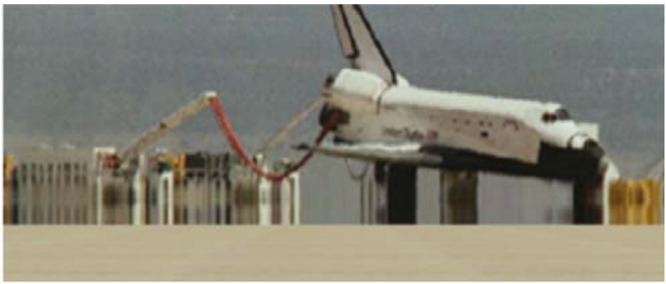
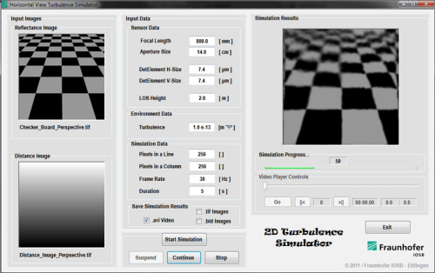
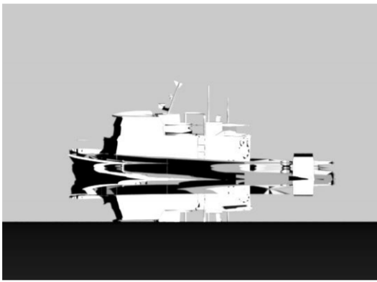
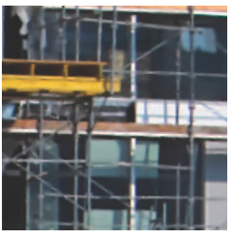
Related Work
Ray tracing in 3D
Image Transformation in 2D
Ihrke et al. Eikonal rendering: Efﬁcient light transport in refractive objects ,2007.
Potvin et al. A parametric model for simulating turbulence effects on imaging systems., 2007.
Empirical Parametric Models or
Gaussian Random Models
Repasi et al. Computer simulation of image degradations by atmospheric turbulence for horizontal views. 2011
Computationally complex
Gutierrez et al. Simulation of atmospheric phenomena, 2006.
Reinhardt et al.
Efficient physics-based predictive 3D modeling and image simulation of optical atmospheric refraction phenomena, 2017
Zhu et al.. Removing atmospheric turbulence via space-invariant deconvolution. IEEE T. PAMI, 35(1):157–170, 2013.
Schwartzman, Alterman, Zamir, Schechner , Turbulence-Induced 2D Correlated Image Distortion, ICCP17
Notes:
There are works in graphics on 3D ray tracing to render, for example, refractive objects and atmospheric phenomena, but as I mentioned this could be computationally complex.
Image simulation in 2D employs empirical parametric models or simple Gaussian random functions to generate distortion ﬁelds.
However, these methods are not set to have physically consistent spatial correlations.

Slide 6



What Affects Turbulence Image Distortions?
Object
Turbulence
camera
$$O$$
$$p$$
D
$$p+e(p)$$
Angle of Arrival (AA)
L
f
Schwartzman, Alterman, Zamir, Schechner , Turbulence-Induced 2D Correlated Image Distortion, ICCP17
Notes:
What affects turbulence induced image distortions?
A camera having focal length f observes an object point O at distance L.
Without turbulence, the line of sight is straight and an object point O is imaged at pixel p.
With turbulence, due to refractive index ﬂuctuations, the light from the same object point arrives at the camera at a random angle of arrival (AA) and is imaged at a distorted pixel p+e(p)

Slide 7

What Affects Turbulence Image Distortions?
Image plane view
pixels move randomly
p
e(p)
$$σ_{AA}^{2}∝C_{n}^{2}LD^{−1/3}$$
7
Schwartzman, Alterman, Zamir, Schechner , Turbulence-Induced 2D Correlated Image Distortion, ICCP17
Notes:
At the image plane it looks like this. This is the original pixel p and e(p) is the random distortion vector.
Then, according to the theory, the variance of the angle-of-arrival is proportional to the product of turbulence strength, distance and camera aperture.

Slide 8



What Affects Turbulence Image Distortions?
Object
Turbulence
camera
$$O$$
$$p+v$$
$$p$$
$$θ$$
$$O′$$
L
f
8
Schwartzman, Alterman, Zamir, Schechner , Turbulence-Induced 2D Correlated Image Distortion, ICCP17
Notes:
What happens if we have another object point?
Turbulence causes each of these lines of sight to deviate, by random angles of arrival.

Slide 9
What Affects Turbulence Image Distortions?
Image plane view
pixels move randomly but affect each other
The direction is affected by neighbors
p
v
p+v
e(p)
e(p+v)
9
Schwartzman, Alterman, Zamir, Schechner , Turbulence-Induced 2D Correlated Image Distortion, ICCP17
Notes:
As seen here at the image plane view. These are the two pixels separated by a vector v, related to angle theta from before.
The distortion is correlated and the direction is affected by neighbors.
This correlation is not trivial and I will get to it.

Slide 10

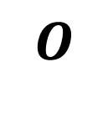


Pair-wise Distortion Correlation
Correlation depends on the arrival direction
$$Π$$
$$O$$
$$θ$$
$$O′$$
Perturbation Parallel within the plane
Schwartzman, Alterman, Zamir, Schechner , Turbulence-Induced 2D Correlated Image Distortion, ICCP17
Notes:
There is a correlation between AA(O) and AA(O’).
As you can see these lines form a plane Π.
The correlation actually depends on the directions of the AAs, relative to this plane Π. Let us define two terms now.
Suppose an AA perturbation is within the plane Π. Then, this perturbation is termed parallel.

Slide 11
Pair-wise Distortion Correlation
Correlation depends on the arrival direction
$$Π$$
$$O$$
$$θ$$
$$O′$$
Perturbation Perpendicular to the plane
Schwartzman, Alterman, Zamir, Schechner , Turbulence-Induced 2D Correlated Image Distortion, ICCP17
Notes:
AA perturbation is perpendicular if it is perpendicular to this plane PI.

Slide 12
Autocorrelation of a Stationary Vector Field
Image plane view
Perpendicular
perturbation
e┴ (p)
e(p)
p
e(p+v)
e║(p)
v
Parallel
perturbation
p+v
Schwartzman, Alterman, Zamir, Schechner , Turbulence-Induced 2D Correlated Image Distortion, ICCP17
Notes:
In the image plane these are the perpendicular and the parallel distortion projections.
In general, an distortion has both parallel and perpendicular components.

Slide 13
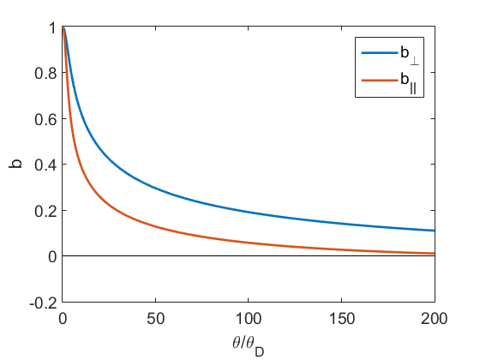
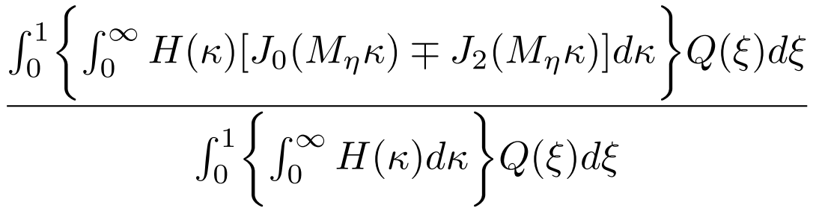









Pair-wise Distortion Correlation
$$L_{0}$$
$$O$$
$$θ$$
$$D$$
$$O′$$
$$L$$
Details in the paper
$$θ⋅L/D$$
$$b_{∥,⊥}\left(θ\right)=$$
$$=func(θ,D,L,L_{0})$$
Belen’kii, Stewart, Gillespie. Turbulence-induced edge image waviness: theory and experiment. Applied Optics, 2001.
Notes:
An expression for the correlation b(θ) for both parallel and perpendicular components was theoretically derived in this reference, and can be computed as you see in this plot.
Please refer to the paper for details on that.
Note that for a ﬁxed point O, the parallel and perpendicular axes and components are deﬁned depending on another point O’.

Slide 14
What Affects Turbulence Image Distortions?
find distortion with correct variance and correlation
Image plane view
Non Trivial Field
pixels move randomly but affect each other
The direction is affected by neighbors
14
Schwartzman, Alterman, Zamir, Schechner , Turbulence-Induced 2D Correlated Image Distortion, ICCP17
Notes:
So in reality we have multiple object points and thus non trivial correlation between multiple pixels. We deal, thus, with a non-trivial ﬁeld.
So, our goal is to find a distortion field with physically accurate variance and correlation.

Slide 15
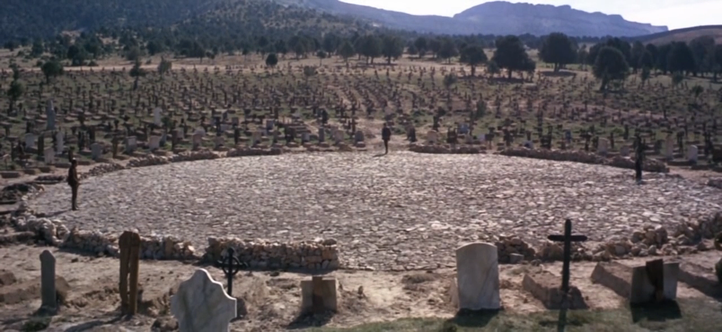

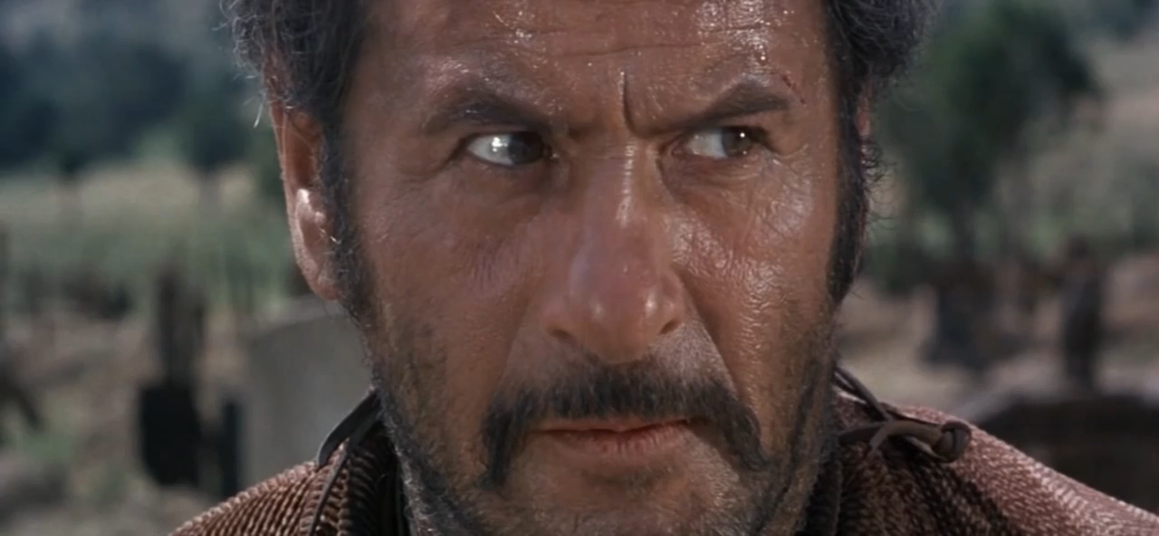

Directional Interdependence
directions they will point to are interdependent
The Good the Bad and the Ugly, directed by Sergio Leone, 1966
Notes:
This segment from “the good, bad and the ugly” demonstrates the kind of directional interdependence we are dealing with.
There is a truel (duel among three opponents). Their decisions and the directions they point to are interdependent.
Each ones decision to point the gun in a certain direction is affected by others.
This is directional interdependence.

Slide 16
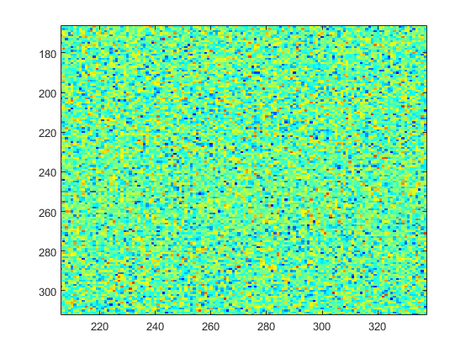
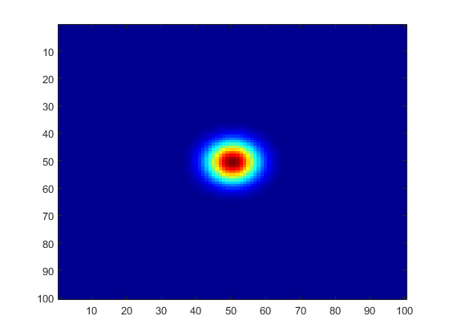
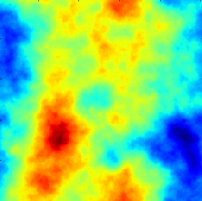
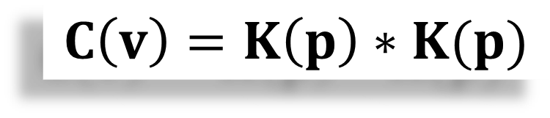
Create a Random Scalar Field
z(p)
K(p)
e(p)
*
white noise scalar ﬁeld
deterministic 2D kernel
correlated scalar ﬁeld
with autocorrelation C(v)
$$C\left(v\right)=K\left(p\right)∗K(p)$$
Schwartzman, Alterman, Zamir, Schechner , Turbulence-Induced 2D Correlated Image Distortion, ICCP17
Notes:
Let us first see how to create a random correlated scalar field.
Suppose we have a white 2D noise. To obtain a correlated noise, we need to convolve it with a 2D kernel such as this.
This kernel is directly related to the correlation function C(v), where C is a function of the pixel separation v.
This a correlated scalar field.

Slide 17
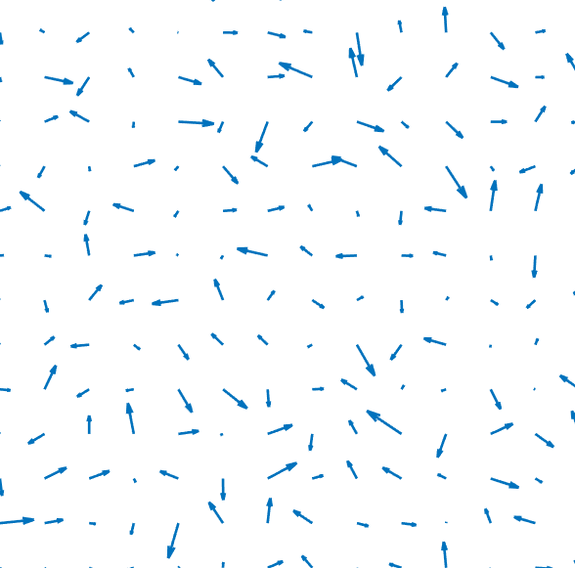
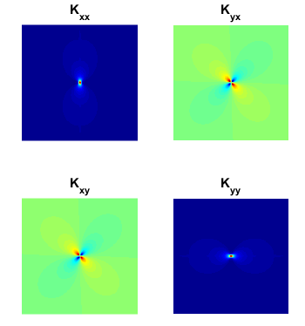
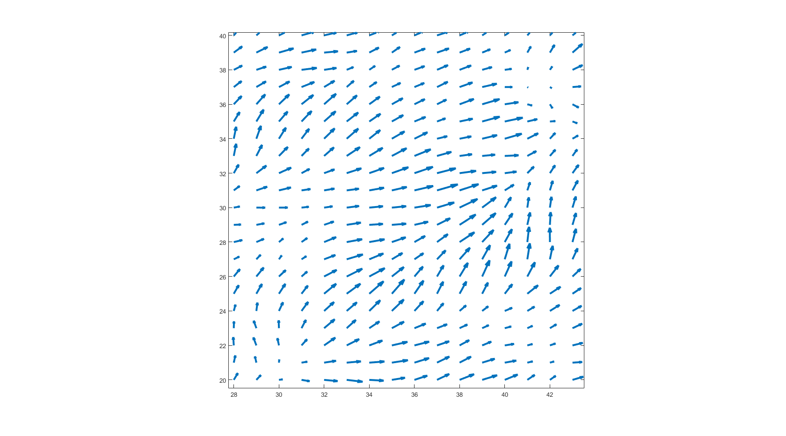

Create the Distortion Vector Field
z(p)
K(p)
e(p)
*
deterministic matrix-valued kernel
correlated vector ﬁeld
autocorrelation C(v)
white noise vector ﬁeld
$$C\left(v\right)=K\left(p\right)∗K(p)$$
Schwartzman, Alterman, Zamir, Schechner , Turbulence-Induced 2D Correlated Image Distortion, ICCP17
Notes:
This generalizes to vector fields.
To create a correlated vector field, we need to convolve a white noise vector field with a matrix-valued kernel / filter.
Here again this matrix-valued kernel is directly related to a matrix valued covariance function.
So next I will concentrate on the matrix valued covariance function C(v)

Slide 18
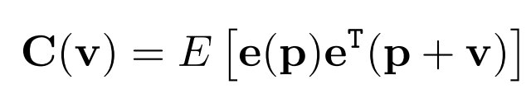
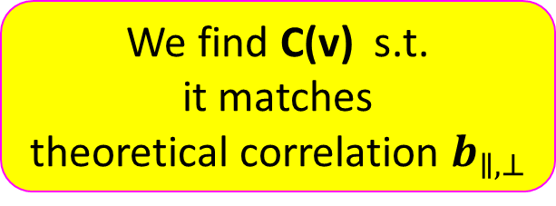

Autocorrelation of a Stationary Vector Field
Image plane view
We find C(v) s.t.
it matches
theoretical correlation $b_{∥,⊥}$
e(p)
p
e(p+v)
v
p+v
C(v) is Matrix Valued Function
$$θ⋅L/D$$
Schwartzman, Alterman, Zamir, Schechner , Turbulence-Induced 2D Correlated Image Distortion, ICCP17
Notes:
We wish to ﬁnd a correlation function C such that the induced parallel and perpendicular autocorrelation functions match the theoretical b.
C is a matrix valued function. Next I explain about this.

Slide 19
Autocorrelation of a Stationary Vector Field
Image plane view
v plane view
v₂
v₃
e(p)
v₂
e(p)
e(p+v₁)
v₁
e(p+v₁)
v₃
v₁
C_{xx}(v_{i})
C_{yx}(v_{i})
C_{xx}(v₁)
C_{yx}(v₁)
C(v_{i}) =
C(v₁) =
C_{xy}(v_{i})
C_{xy}(v₁)
C_{yy}(v_{i})
C_{yy}(v₁)
Schwartzman, Alterman, Zamir, Schechner , Turbulence-Induced 2D Correlated Image Distortion, ICCP17
Notes:
Now I explain in more detail about the matrix valued correlation function.
Let us look at the image plane. These are just some random pixels.
Let us look at these two pixels with separation v1.
Since, the correlation depends on the relative position of the pixels, which is v, let us look at the v plane here, and mark the position on v1.
The distortion vectors are random and correlated, so they have a correlation matrix of size 2x2.
Same thing happens for other pixels pairs and each one of them has its own correlation matrix of size 2x2.

Slide 20
Autocorrelation of a Stationary Vector Field
Image plane view
C_{xx}
C_{yx}
v₂
e(p)
C_{xy}
C_{yy}
v₁
e(p+v₁)
v₃
C_{xx}(v_{i})
C_{yx}(v_{i})
C_{xx}(v₁)
C_{yx}(v₁)
C(v₁) =
C(v_{i}) =
C_{xy}(v_{i})
C_{xy}(v₁)
C_{yy}(v_{i})
C_{yy}(v₁)
Notes:
Now let us look at each component of the correlation matrix, there are 4 components.
Each component depends on the relative separation v.
The components of the v1 are mapped here.

Slide 21
Autocorrelation of a Stationary Vector Field
Image plane view
C_{xx}
C_{yx}
v₂
C_{xx}(v₁)
C_{yx}(v₁)
e(p)
C_{xy}
C_{yy}
v₁
e(p+v₁)
v₃
C_{xy}(v₁)
C_{yy}(v₁)
C_{xx}(v₂)
C_{yx}(v₂)
C(v₂) =
C_{xy}(v₂)
C_{yy}(v₂)
Notes:
The components of the v2 are mapped here.

Slide 22
Autocorrelation of a Stationary Vector Field
Image plane view
C_{xx}
C_{yx}
v₂
C_{xx}(v₂)
C_{yx}(v₂)
C_{xx}(v₁)
C_{yx}(v₁)
e(p)
C_{xy}
C_{yy}
v₁
e(p+v₁)
v₃
C_{xy}(v₂)
C_{yy}(v₂)
C_{xy}(v₁)
C_{yy}(v₁)
C_{xx}(v₃)
C_{yx}(v₃)
Matrix Valued Function
C(v₃) =
C_{xy}(v₃)
C_{yy}(v₃)
Notes:
And the components of the v3 are mapped here.
And finally we get a matrix valued function.

Slide 23
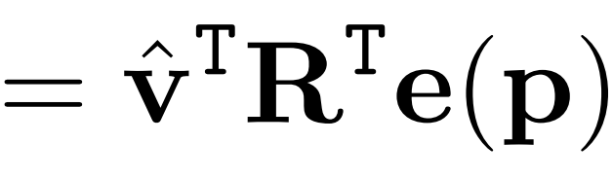
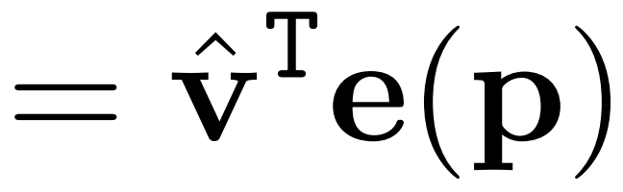
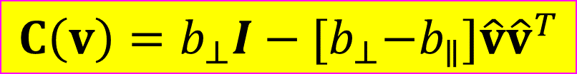

Autocorrelation of a Stationary Vector Field
Image plane view
A consistent C(v) is of a class:
e┴ (p)
$${C\left(v\right)=b_{⊥}I−{[b}_{⊥}−b}_{∥}]\hat{v}{\hat{v}}^{T}$$
e(p)
p
e(p+v)
e║(p)
v
p+v
C(v) is Matrix Valued Function
$$θ⋅L/D$$
Schwartzman, Alterman, Zamir, Schechner , Turbulence-Induced 2D Correlated Image Distortion, ICCP17
Notes:
Now, recall that the random distortion vectors have parallel and perpendicular projections.
In the paper, we show that this form of correlation function fulfills all the required properties, and the theoretic correlations b are used here.

Slide 24
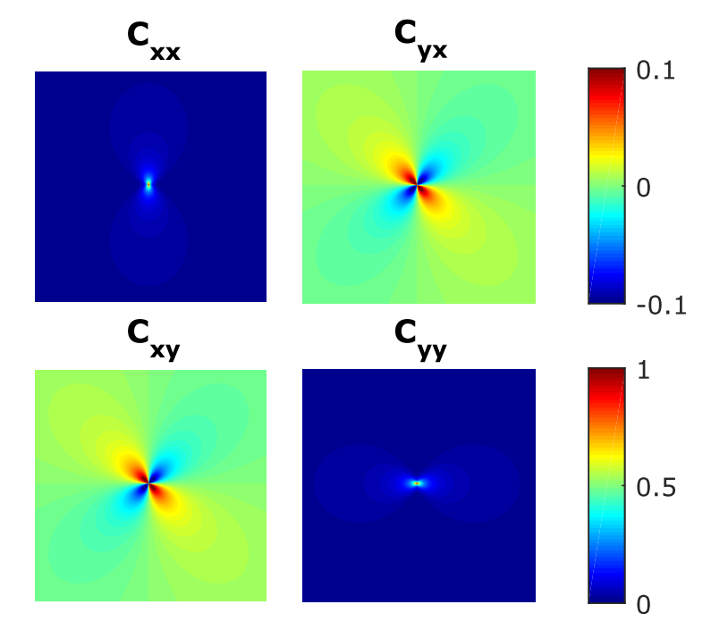
Autocorrelation of a Stationary Vector Field
Image plane view
A consistent C(v) is of a class:
e┴ (p)
$${C\left(v\right)=b_{⊥}I−{[b}_{⊥}−b}_{∥}]\hat{v}{\hat{v}}^{T}$$
e(p)
p
e(p+v)
e║(p)
v
p+v
C(v) is Matrix Valued Function
$$θ⋅L/D$$
Schwartzman, Alterman, Zamir, Schechner , Turbulence-Induced 2D Correlated Image Distortion, ICCP17
Notes:
Based on this formula and the theoretic correlations, we compute the matrix valued correlation function.

Slide 25
Create the Distortion Field
having
auto-correlation
Random distortion ﬁeld
e(p)
Auto-correlation
C(v)
Schwartzman, Alterman, Zamir, Schechner , Turbulence-Induced 2D Correlated Image Distortion, ICCP17
Notes:
Now, I present a recipe for creating a random distortion ﬁeld e(p), whose auto-correlation is consistent with C(v)

Slide 26
Create the Distortion Field
?
z(p)
K(p)
e(p)
*
deterministic matrix-valued kernel
correlated vector ﬁeld
autocorrelation C(v)
white noise vector ﬁeld
$$C\left(v\right)=K\left(p\right)∗K(p)$$
Schwartzman, Alterman, Zamir, Schechner , Turbulence-Induced 2D Correlated Image Distortion, ICCP17
Notes:
Recall that the correlated field is obtain by a convolution with a matrix valued kernel, and this kernel is directly related to the matrix valued correlation function.

Slide 27

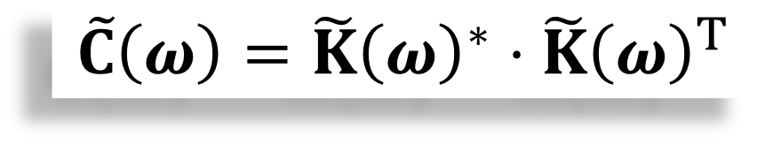

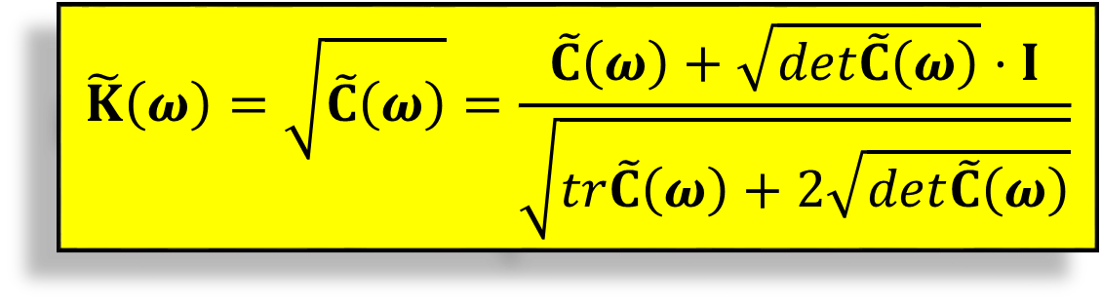
Create the Distortion Field
$$𝓕$$
matrix-valued spectral density function
$$C\left(v\right)=K\left(p\right)∗K(p)$$
$$\tilde{C}\left(ω\right)=\tilde{K}{\left(ω\right)}^{∗}⋅\tilde{K}{\left(ω\right)}^{T}$$
symmetric square root
$$\tilde{K}\left(ω\right)=\sqrt{\tilde{C}\left(ω\right)}=\frac{\tilde{C}\left(ω\right)+\sqrt{det\tilde{C}\left(ω\right)}⋅I}{\sqrt{tr\tilde{C}\left(ω\right)+2\sqrt{det\tilde{C}\left(ω\right)}}}$$
Schwartzman, Alterman, Zamir, Schechner , Turbulence-Induced 2D Correlated Image Distortion, ICCP17
Notes:
So this convolution is the relation between the correlation function and our required filter.
This can be solved in the Fourier domain.
While there are many 2×2 matrices K satisfying this relation, it is natural to choose the symmetric square root Of C(ω).
Given C(ω), its matrix square root can be computed per ω using this formula.

Slide 28

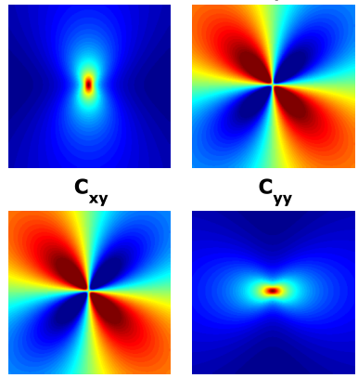
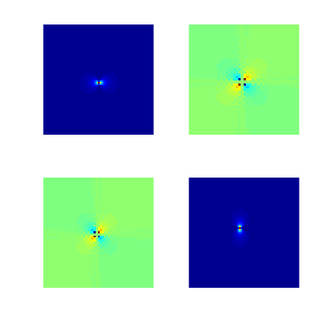
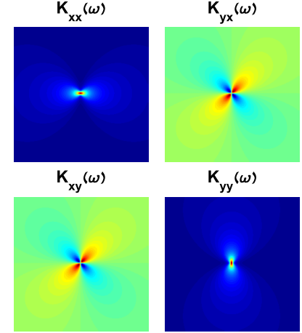
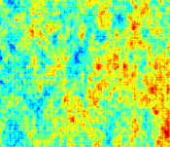
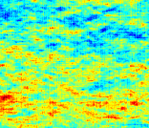





















Create the Distortion Field
recipe
Camera / turbulence parameters
$$C\left(v\right)$$
$$\tilde{C}\left(ω\right)$$
$$𝓕$$
$$\tilde{K}\left(ω\right)=\sqrt{\tilde{C}\left(ω\right)}$$
$$b_{⊥}$$
$C\left(v\right)=b_{⊥}$I
$${−{[b}_{⊥}−b}_{∥}]\hat{v}{\hat{v}}^{T}$$
$$b_{∥}$$
$$\tilde{K}\left(ω\right)$$
$$σ_{AA}^{2}∝C_{n}^{2}LD^{−1/3}$$
$σ_{AA}^{2}$
$$e\left(p\right)$$
$$\tilde{e}\left(ω\right)$$
$$𝓕^{−1}$$
$$e\left(p\right)$$
$$e_{x}$$
$$\tilde{z}\left(ω\right)$$
$$e_{y}$$
$$z\left(p\right)$$
$$z_{x}$$
$$𝓕$$
$$z_{y}$$
Schwartzman, Alterman, Zamir, Schechner , Turbulence-Induced 2D Correlated Image Distortion, ICCP17
Notes:
So our theoretical recipe is as follows:
Given camera and turbulence parameters, compute the theoretical correlations b
Then compute the matrix-valued correlation
Perform a Fourier transform of the correlation function
Do a square-root to obtain the matrix-valued kernel in the Fourier domain
Sample a Gaussian white noise vector field zx, zy
Perform a Fourier transform of the noise field and multiply with the kernel to get the Fourier transform of the distortion filed
Inverse Fourier transform to obtain the distortion vector field, but with variance 1
Using the camera and turbulence parameters, compute the required variance of the AA
Amplify the distortion field so that its variance is correct

Slide 29
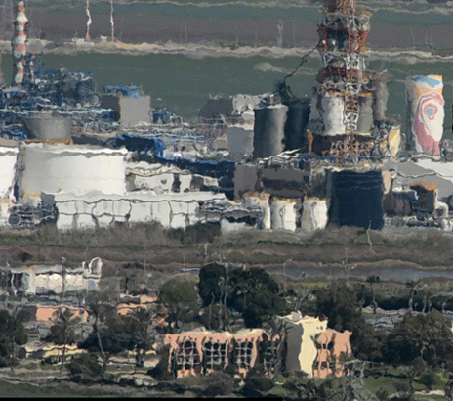
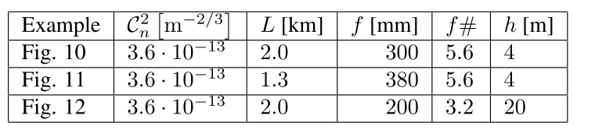
Simulate Turbulence Distorted Images
Schwartzman, Alterman, Zamir, Schechner , Turbulence-Induced 2D Correlated Image Distortion, ICCP17
Notes:
Now I show couple of examples.
We render the distorted image by warping it according to the obtained distortion vector field.

Slide 30
Simulate Turbulence Distorted Images
Schwartzman, Alterman, Zamir, Schechner , Turbulence-Induced 2D Correlated Image Distortion, ICCP17
Notes:
Another example

Slide 31
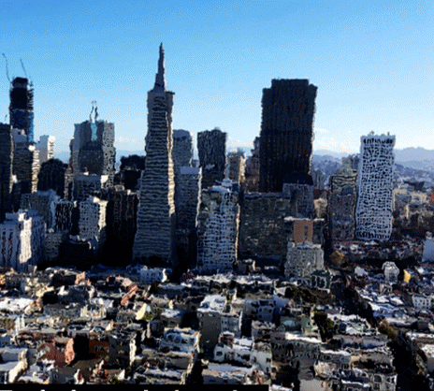
Simulate Turbulence Distorted Images
Schwartzman, Alterman, Zamir, Schechner , Turbulence-Induced 2D Correlated Image Distortion, ICCP17
Notes:
And another one

Slide 32

Verification
Verify that distortion statistics consistent with the theory
Image plane view
Select 100 random pixels
$$v$$
Schwartzman, Alterman, Zamir, Schechner , Turbulence-Induced 2D Correlated Image Distortion, ICCP17
Notes:
Finally, we empirically verified that our distortion statistics are consistent with the theory.
Let us choose a random subset of 100 pixels.

Slide 33
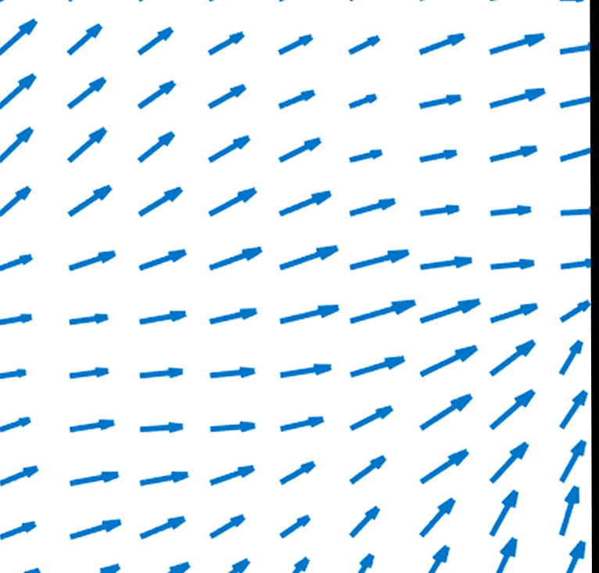
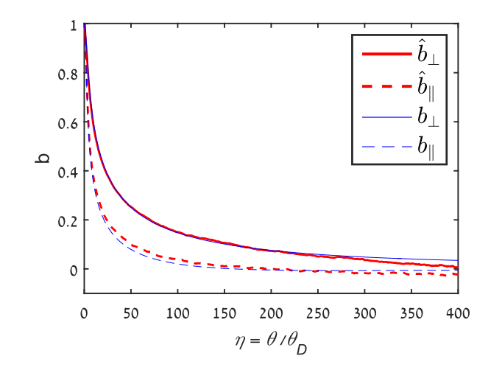

Verification
Verify that distortion statistics consistent with the theory
Image plane view
Generate 1500 distortion fields
Select 100 random pixels
Compute Correlation and compare to theory
$$v$$
$$θ⋅L/D$$
Schwartzman, Alterman, Zamir, Schechner , Turbulence-Induced 2D Correlated Image Distortion, ICCP17
Notes:
We then generate 1500 distortion fields, where each one is based on a different sampled white noise field. Then we compute the correlations for different pixels pairs and compare with the theory.
See that generally, there is very good consistency between the theoretical AA correlation and our
rendered ﬁelds.
FIRST SHOW ONLY ONE POINT ON GRAPH, THAN MANY AND WE GET THE PLOT

Slide 34
Future Directions
other turbulence-induced image effects
Blur
Scintillation
Dynamic Effects
Non-Stationary
Turbulence
Random fields
Have correlation between adjacent points
There are closed-form physical models
Incorporate a physics-based spatiotemporal correlation
Render videos
Extend to atmospheric layers with spatial variations of C_{n}²
(e.g. Astronomy)
Schwartzman, Alterman, Zamir, Schechner , Turbulence-Induced 2D Correlated Image Distortion, ICCP17
Notes:
In this work we focused on a particular turbulence-induced image effect: distortion in a 2D image. This may be extended, to express other turbulence-induced image effects:
Blur and Scintillation. They are both random correlated fields, and closed form physical models.
Turbulence is actually dynamic, and thus its image effects. The 2D distortion ﬁeld is actually correlated both in 2D space and in time. To render videos, this spatiotemporal correlation should be simulated correctly.
In some cases, the turbulence ﬁeld is not spatially stationary. Speciﬁcally, oblique views as in astronomy. Extending the approach to such cases is also important.

Slide 35
Summary
Render image distortions consistent with the theory
By-pass 3D numerical calculations and ray-tracing
Create 2D random correlated distortion vector ﬁelds
The correlations depend on the distortion directions relative to the orientation of all object pairs
v
Schwartzman, Alterman, Zamir, Schechner , Turbulence-Induced 2D Correlated Image Distortion, ICCP17
Notes:
To summarize, In this work, we show how to render image distortions consistent with turbulence theory.
We by-pass 3D numerical calculations and ray tracing by performing only 2D operations
We create 2D random correlated distortion vector fields with non trivial correlation.
This correlation depends on relative orientations of all object pairs.

Slide 36
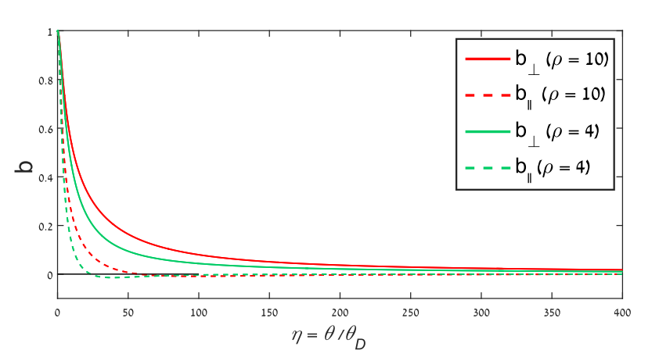


Dependence on Height h and L₀

Slide 37
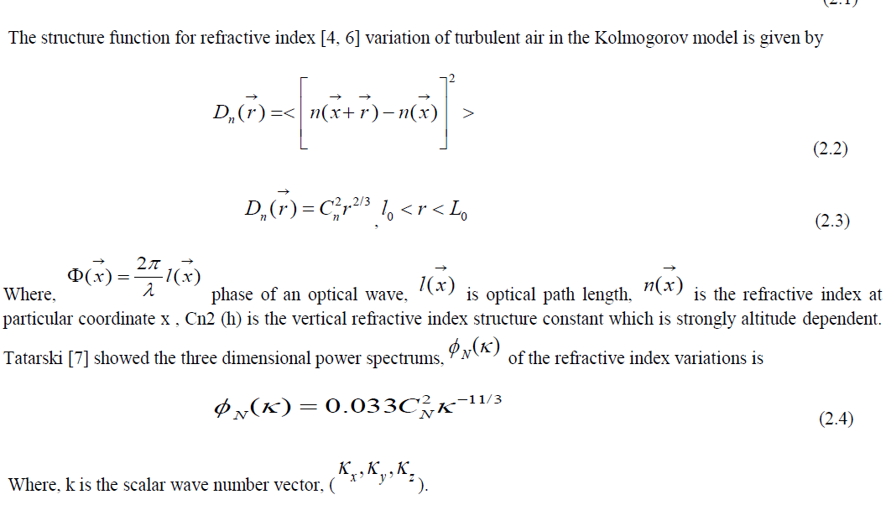
http://community.dur.ac.uk/james.osborn/thesis/thesisse3.html

Slide 38
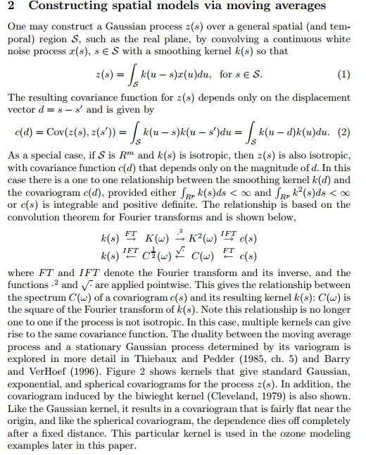
http://ftp.stat.duke.edu/WorkingPapers/01-03.pdf

