Slide 1
50th Annual Allerton Conference, 2012 On the Capacity of Bufferless Networks-on-Chip
Alex Shpiner, Erez Kantor, Pu Li, Israel Cidon and Isaac Keslassy
Faculty of Electrical Engineering,
Technion, Haifa, Israel

Slide 2
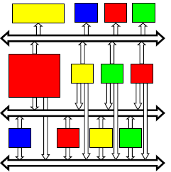
Network-on-Chip (NoC)
Buses and dedicated wires
Packet-based network infrastructure

Slide 3
Network-on-Chip (NoC)

Slide 4
Collision

Slide 5
Buffering
Drawbacks:
Dynamic and static energy.
Chip area.
Complexity of the design.

Slide 6
Deflecting
Drawbacks:
No latency guarantee.
No bandwidth guarantee.
Not the shortest path.

Slide 7
Scheduling

Slide 8
The Objective
Scheduling algorithm for bufferless network that maximizes throughput and guarantees QoS.

Slide 9
Complete-Exchange Periodic Traffic
In a period: Every node sends one unicast data packet to every other node.

Slide 10
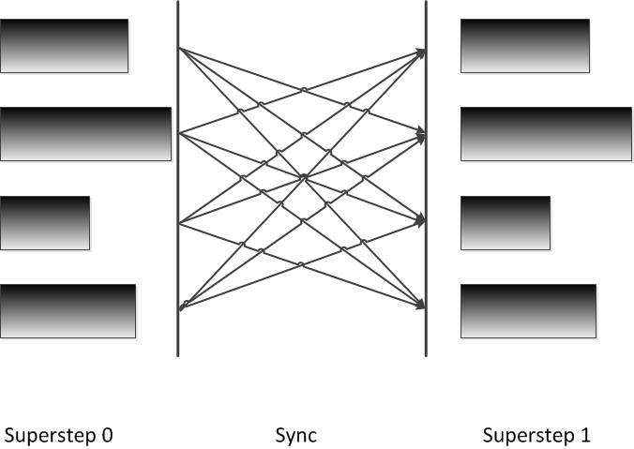
Complete-Exchange Periodic Traffic
Core 0
Computation step: autonomous processing.
Communication step: every core sends unicast data packet to every other core.
Applications:
Bulk Synchronous Parallel (BSP) programing.
Numerical parallel computing (FFT, matrix transpose, …).
End-to-end congestion control.
Core 1
Core 2
Core 3
time
computation
communication
computation

Slide 11
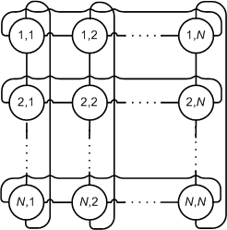
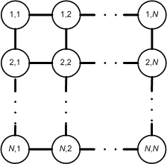
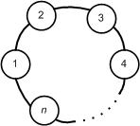
Contributions
Optimal scheduling algorithm for line and ring.
Optimal scheduling algorithm for torus.
Constant approximation and bounds for mesh.

Slide 12
Related Work
Bufferless NoCs designs
Deflecting [Moscibroda et al. ‘09]
Dropping [Gomez et al. ‘08]
TDM-based NoCs
Aethereal [Goosens et al. ‘05] – provides architecture, not scheduling.
Nostrum [Millberg et al. ‘04] – uses buffers.
Direct Routing
NP-hard for general traffic [Busch et al. ‘06]

Slide 13
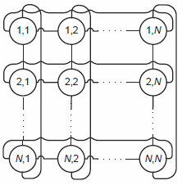
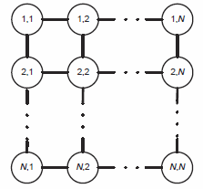
Problem Definition
Line, ring, torus or mesh network topology.
Complete-exchange periodic traffic pattern.
No buffering, deflecting or dropping packets.
Equal propagation times and capacity on links.
Equal packet sizes.
Shortest routing.

Slide 14
Problem Definition
Find a schedule that maximizes throughput
Minimizes the period time.

Slide 15
Degree-Two NoC Scheduling (DTNS) Algorithm
Each node i, at each time slot t, for each direction:
If at t-1 received a packet for retransmission, then retransmit it at t.
Else, inject packet to the farthest destination among all packets waiting to be sent from the node.
1→2
2→3
3→4
1→3
2→4
1→4

Slide 16
DTNS Period Length
n-Line:
$S_{L}\left(n\right)= \frac{n^{2}}{4}$ time slots.
Almost achieves capacity limit.
Impossible to spread traffic uniformly: central link is a bottleneck.
n-Ring:
$S_{R}\left(n\right)=\left\{\begin{matrix}\frac{n^{2}}{8} \\ \frac{\left(n−1\right)(n+1)}{8}\end{matrix} \right.$
Achieves capacity limit for odd n.
For even n achieves capacity with overlapping.
time slots
, if $n$ is even
, if $n$ is odd
time slots

Slide 17
Torus NoC Scheduling (TNS) Algorithm
Inject simultaneously in four directions.
Long-then-short routing.
Dist(x₁, x₂)=min{|x₁-x₂|, N-|x₁-x₂|}

Slide 18
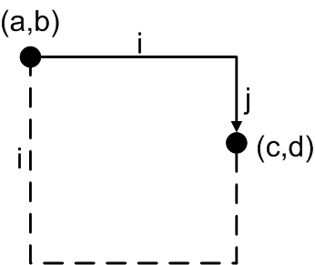
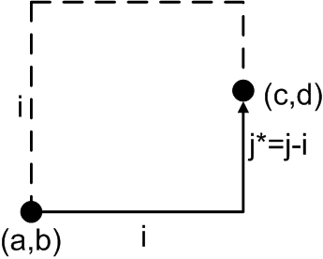
Torus NoC Scheduling (TNS) Algorithm
Period consists of phases.
Phase consists of epochs.
For packet from (a,b) to (c,d):
Phase $i∈ \{1,…,N/2\}$
i = max{Dist(a,c),Dist(b,d)}
Epoch $j∈ \{0,1,…,2i−1\}$
$j∈ \{0,1,…, i\}$for clockwise
j = min{Dist(a,c),Dist(b,d)}
$j∈ \{i+1,…,2i−1\}$ for counter-clockwise
j-i = min{Dist(a,c),Dist(b,d)}

Slide 19
TNS Period Length
$N∗N$-Torus:
$S_{T}\left(n=N∗N\right)=\left\{\begin{matrix}\frac{N^{3}−N}{8}=\frac{n\sqrt{n}−\sqrt{n}}{8} \\ \frac{N^{3}+2N}{8}=\frac{n\sqrt{n}+2\sqrt{n}}{8}\end{matrix} \right.$
Achieves capacity limit for odd N.
For even n achieves capacity limit with overlapping.
time slots
, if $N$ is odd
, if $N$ is even
time slots

Slide 20
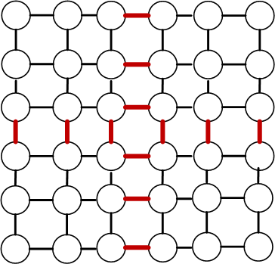
$N∗N$ Mesh
Lower bound for period length:
$S_{M}\left(n=N∗N\right)≥\left\{\begin{matrix}\frac{N^{3}}{4}=\frac{n\sqrt{n}}{4} \\ \frac{N^{3}−N}{4}=\frac{n\sqrt{n}−\sqrt{n}}{4}\end{matrix} \right.$
time slots
, if $N$ is even
, if $N$ is odd
time slots

Slide 21
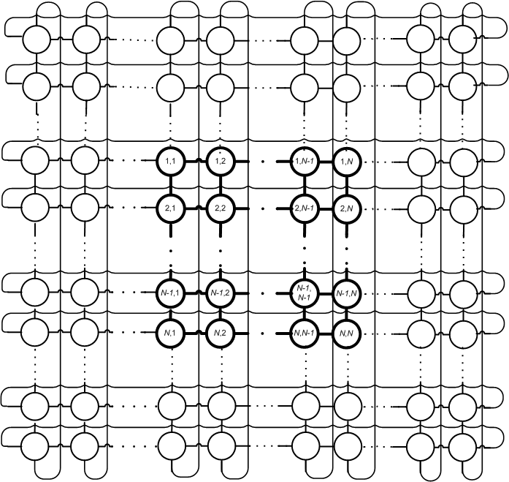
TNS Algorithm in Mesh
2N
N
2N
N
Upper bound for period length:
$S_{M}\left(n=N∗N\right)≤S_{T}\left(4n=2N∗2N\right)$ = $n\sqrt{n}+\frac{1}{2}\sqrt{n}$

Slide 22
Bounds for Mesh Scheduling Period Length
$$\frac{n\sqrt{n}}{4} ≤ S_{M}\left(n=N∗N\right) ≤n\sqrt{n}+\frac{1}{2}\sqrt{n}$$
$4+\frac{2}{n}$ -constant approximation.

Slide 23
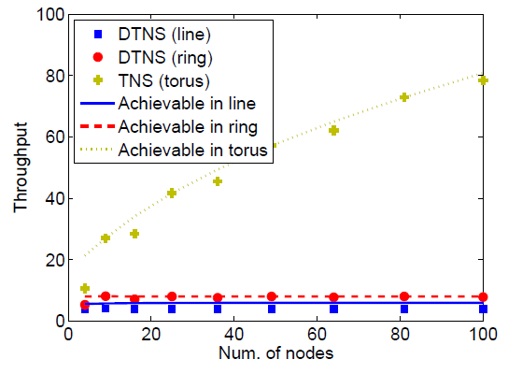
Evaluation
Throughput = num. of packets / period length

Slide 24
Summary
Use bufferless NoCs to reduce chip power and area consumption.
Rely on knowledge of periodic traffic for scheduling to increase capacity.
Complete-exchange traffic.
Line, Ring – DTNS optimal scheduling.
Torus – TNS optimal scheduling.
Mesh – bounds for TNS application.

Slide 25
Thank you.

