Slide 1
Distributed Adaptive Routing for Big-Data Applications
Running on Data Center Networks
Eitan Zahavi^{*+}
Isaac Keslassy⁺
Avinoam Kolodny⁺
ANCS 2012
* Mellanox Technologies LTD, ⁺ Technion - EE Department

Slide 2

Big Data – Larger Flows
Data-set sizes keep rising
  Web2 and Cloud Big-Data applications
Data Center Traffic changes to:
  Longer, Higher BW and Fewer Flows
Google

Slide 3
Static Routing of Big-Data = Low BW
Static Routing cannot balance a small number of flows
Congestion: when BW of link flows > link capacity
When longer and higher-BW flows contend:
  On lossy network: packet drop → BW drop
  On lossless network: congestion spreading → BW drop
Data flow
SR

Slide 4
Traffic Aware Load Balancing Systems
Adaptive Routing adjusts routing to network load
Centralized
  Flows are routed according to a “global” knowledge
Distributed
  Each flow is routed by its input switch with “local” knowledge
Central Routing Control
Self Routing
Unit
SR
SR
SR

Slide 5
Central vs. Distributed Adaptive Routing
Property | Central Adaptive Routing | Distributed Adaptive Routing
Scalability | Low | High
Knowledge | Global | Local (to keep scalability)
Non-Blocking | Yes | Unknown
Distributed Adaptive Routing is
either scalable or have global knowledge
It is Reactive

Slide 6
Research Question
Can a Scalable Distributed Adaptive Routing System perform like centralized system and produce non-blocking routing assignments in reasonable time?

Slide 7
Trial and Error
Is Fundamental to Distributed AR
Randomize output port – Trial 1
Send the traffic
Contention 1
Un-route contending flow
  Randomize new output port – Trial 2
Send the traffic
Contention 2
Un-route contending flow
  Randomize new output port – Trial 3
Send the traffic
Convergence!
SR
SR
SR

Slide 8
Routing Trials Cause BW Loss
Packet Simulation:
R1 is delivered followed by G1
R2 is stuck behind G1
Re-route
R3 arrives before R2
Out-of-Order Packets delivery!
Implications are significant drop in flow BW
  TCP* sees out-of-order as packet-drop and throttle the senders
  See “Incast” papers…
  * Or any other reliable transport
R1
R2
R3
SR
R1
SR
SR
G1

Slide 9
Research Plan
Given
Analyze Distributed Adaptive Routing systems
Find how many routing trials are required to converge
Find conditions that make the system reach a non-blocking
assignment in a reasonable time
events
New Traffic
No Contention
t
Trial 1
Trial 2
Trial N

Slide 10
A Simple Policy for Selecting a Flow to Re-Route
At each time step
  Each output switch
    Request re-route of a single worst contending flow
At t=0 New traffic pattern is applied
Randomize output-ports
and Send flows
At t=0.5 Request Re-Routes
Repeat for t=t+1 until no contention
1
1
r
1
SR
n
n
1
m
SR
SR
input
switch
output
switch

Slide 11
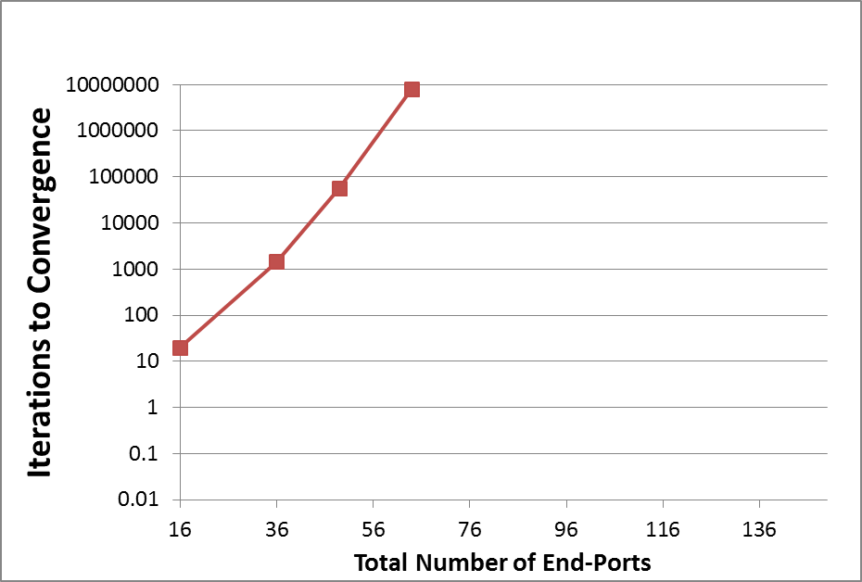
Evaluation
Measure average number of iterations I to convergence
I is exponential with system size !

Slide 12
A Balls and Bins Representation
Each output switch is a “balls and bins” system
Bins are the switch input links, balls are the link flows
Assume 1 ball (=flow) is allowed on each bin (=link)
  A “good” bin has ≤ 1 ball
  Bins are either “empty”, “good” or “bad”
Middle Switch
SR
empty
1
bad
SR
good
SR
m

Slide 13
System Dynamics
Two reasons of ball moves
  Improvement or Induced-move
Induced
SW1
SW2
SW3
3
Output switch 1
1
2
3
Middle Switch: 1 2 3 4
1
2
3
4
Improve
3
Output switch 2
1
2
3
2
1
3
Middle Switch: 1 2 3 4
Balls are numbered by their input switch number

Slide 14
The “Last” Step Governs Convergence
Estimated Markov chain models
  What is the probability of the required last Improvement to not cause a bad Induced move?
  Each one of the r output-switches must do that step
  Therefore convergence time is exponential with r
B
Absorbing – 1
Absorbing
Bad
Good
A
Output switch 1
D
1
0
C
Bad
B
Good
A
Output switch 2
D
1
0
C
Bad
B
Good
A
Output switch r
D
1
0
C

Slide 15
Introducing p
Assume a symmetrical system: flows have same BW
What if the Flow_BW < Link_BW?
The network load is Flow_BW/Link_BW
p = how many balls are allowed in one bin
p=2
p=1
SR
p=1
p=2
SR
SR

Slide 16
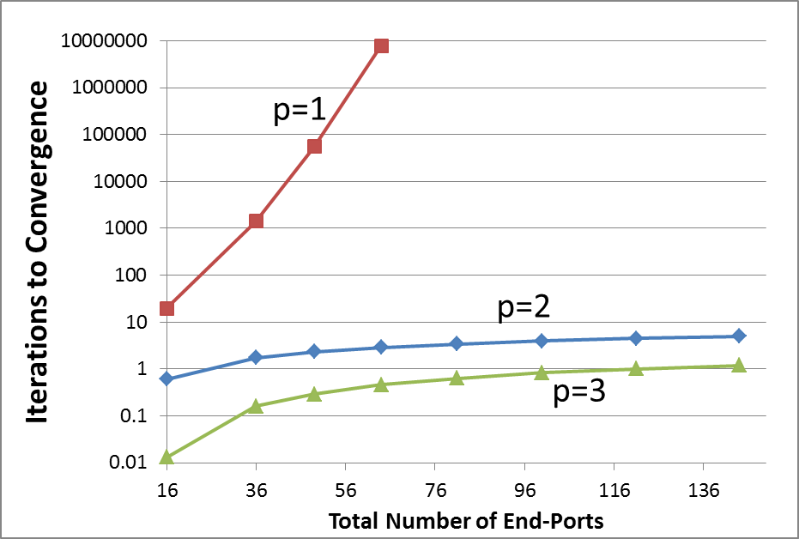
p has Great Impact on Convergence
Measure average number of iterations I to convergence
I shows very strong dependency on p

Slide 17
Implementable Distributed System
Replace congestion detection by flow-count with QCN
  Detected on middle switch output – not output switch input
Replace “worst flow selection” by congested flow sampling
Implement as extension to detailed InfiniBand flit level model

Slide 18
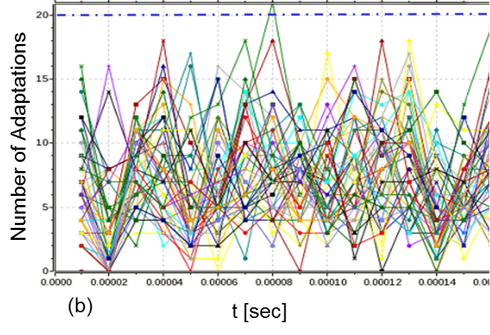
52% Load on 1152 nodes Fat-Tree
No change in number of adaptations over time !
No convergence

Slide 19
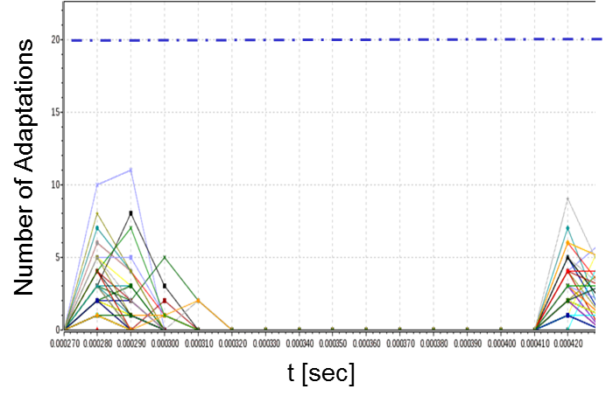
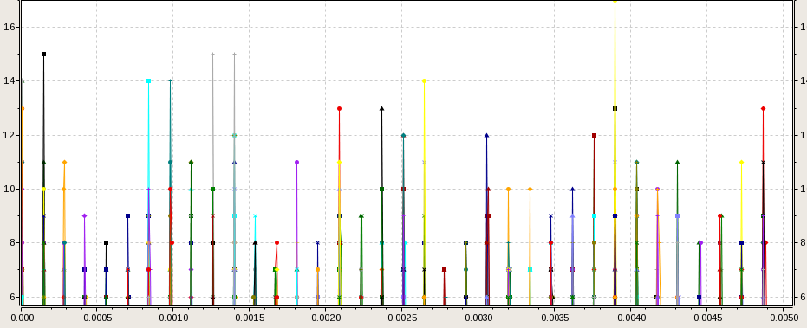
48% Load on 1152 nodes Fat-Tree
Switch Routing Adaptations/ 10usec
t [sec]

Slide 20
Conclusions
Study: Distributed Adaptive Routing of Big-Data flows
Focus on: Time to convergence to non-blocking routing
Learning: The cause for the slow convergence
Corollary: Half link BW flows converge in few iterations
Evaluation: 1152 nodes fat-tree simulation reproduce these results
  Distributed Adaptive Routing of Half Link_BW Flows
  is both Non-Blocking and Scalable

