Slide 1


Links as a Service:
Guaranteed Tenant Isolation in the Shared Cloud
Eitan Zahavi
Electrical Engineering, Technion,
Mellanox Technologies
Joint work with:
Isaac Keslassy (Technion),
Alex Shpiner (Mellanox),
Ori Rottenstreich (Princeton),
Avinoam Kolodny (Technion)

Slide 2

Losing Predictability in the Cloud
An organization can save a lot of money by moving its applications from a private cloud to a shared cloud
… But it often won’t because the applications of other tenants in the shared cloud can make the performance of its applications unstable
The performance of Tenant T₁ depends on the traffic of Tenant T₂
Tenant T₂ could attack Tenant T₁
by injecting high throughput traffic
tenant T₁
tenant T₁
tenant T₂
Tenant T₁ on private cloud
(or alone on shared cloud)
Tenants T₁ and T₂ sharing many links
on shared cloud

Slide 3
Sensitive Applications
Applications that depend on the weakest link
  MapReduce
  Any Bulk Synchronous Parallel programs
  Scientific computing
    Stencil Applications for example
Some mission critical applications can’t be late
  Bank customers rollup – must complete overnight
  Weather prediction – a new result every few hours
  …

Slide 4

Multi Tenant Experiment
Traffic is of MapReduce all-to-all exchange
MPI on 32 hosts 10Gbps InfiniBand Cluster
Compare to simulation model
Measure iteration runtime
1
m=4
Spines
Leaves
1
r=4
Hosts
1
n=8
32
Message Size:
25%
Map1,1
Map1,2
Map1,m
red
1,1
red
1,2
red
1,r
Measured
Simulated
Measured
Simulated
Measured
Simulated
Measured
Simulated
i₁
map₁
shuffle₁
red₁
o₁
1 Tenant
2 Tenants
3 Tenants
4 Tenants

Slide 5
Larger Networks
Simulated larger 3 level fat tree network of 1728 hosts
Either MapReduce or Stencil applications (traffic is +/-x,+/-y,+/-z)
Stencil application performance degrades by 60% @ 128KB messages when run with 31 others tenants
MapReduce shows smaller change as tenant suffers intra contention
Message Size:
60%
i₁
com_{1,1}
com_{1,2}
com_{1,k}
o₁
i₁
map₁
shuffle₁
red₁
o₁

Slide 6
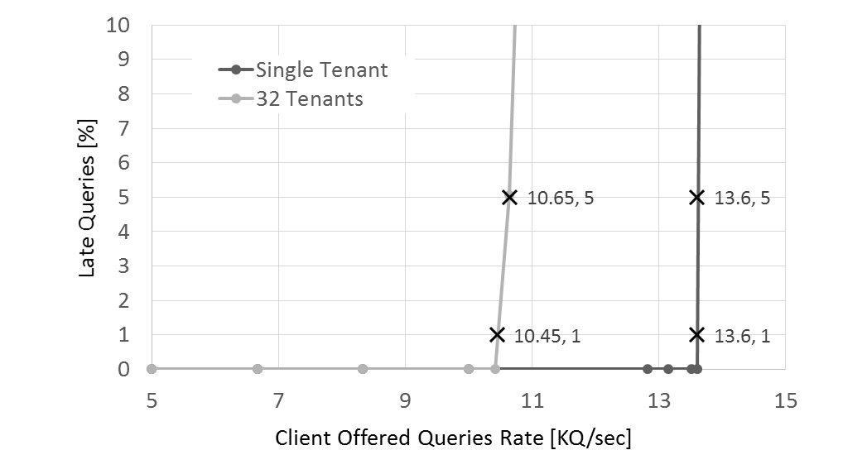
Distributed Database Queries
32 concurrent tenants performing distributed DB queries
  Half of the tenant hosts are servers and half clients
DB responses congest near the client
Measure query response time (last responses)
Inter-tenant interference reduces allowed query rate by ~30%
to maintain 10 msec response time
i_{n}
q_{n,1}
db 1
30%
web
r_{n,1}
o_{n}
q_{n,k}
r_{n,k}
db k=~1000
i₁
q_{1,1…k}
r_{1,1…k}
o₁

Slide 7
Main Related Work
Cloud Network performance of HPC and DCN was extensively studied
But only a few of the works deal directly with performance predictability
Some are:
  Isolation on 5D/6D Tori: On BG, TOFU – rely on extra D’s, low utilization
  [1] Y. Aridor, …, and E. Shmueli, “Resource allocation and utilization in the Blue Gene/L supercomputer,”
  [2] Y. Ajima, S. Sumimoto, and T. Shimizu, “Tofu: A 6D Mesh/Torus Interconnect for Exascale Computers,”
  Apply placement constraints: Quiet neighborhoods – partial
  [3] A. Jokanovic, … and J. Labarta, “Quiet Neighborhoods: Key to Protect Job Performance Predictability,”
  Virtual network embedding – specific traffic pattern, high computation time
  [4] M. Chowdhury, … and R. Boutaba, “ViNEYard: Virtual Network Embedding Algorithms with Coordinated Node and Link Mapping,”
  BW and burst allocation: Silo – worst case result in very low allocation
  [4] K. Jang, J. Sherry, H. Ballani, and T. Moncaster, “Silo: Predictable Message Latency in the Cloud,”

Slide 8
Related Work Analysis
Silo: Predictable message latency in the Cloud
  Proves that burst and bandwidth allocation are required to guarantee predictability when tenants utilize the same link
  But does not restrict tenant forwarding, so on the worst case all the hosts in a sub-tree may send traffic through one link.
  This leads to very low bandwidth and burst allocations
Virtual Network Embedding
  Satisfies a traffic matrix: thus ignores application temporal behavior;
  Or a Hose Model: Thus result in very low bandwidth allocation
  Is topology agnostic, thus very complex to compute
5/6D Tori Tenant Isolation
  Allocates 3D non-intersecting sub-tori to tenants, provides full links
  Allows tenant specific optimization of the network usage
  Topology specific

Slide 9
Links as a Service
Key idea: tenants get private links – no shared links!
  Requires switches to reserve resources per port
Today
LaaS
H₀
H₁
tenant T₁
tenant T₂
tenant T₁
tenant T₂
Many shared links
Unpredictable Performance
No shared links
Applications are Isolated

Slide 10


Support for Any Admissible Traffic
= Hose Model = Fat Tree RNB
How does a tenant feel when it is runs alone on the private cloud?
With proper forwarding it can utilize the entire network bandwidth
A full bisection network should support any admissible traffic pattern
  Admissible = sum of all flows leaving or reaching any host ≤ link bandwidth
  The term Hose Model is synonym to Admissible Traffic Pattern
For Fat-Trees it means the Rearrangable Non-Blocking (RNB) criterion
  Given a full permutation there exists a non contention forwarding iff $m≥n$
1
m
Spines
1
r
Leaves
Hosts
1
n
r x n

Slide 11
Dedicated Link Allocation
Is Not Enough!
Our target: Tenant should perform as if they run on a private cloud
Meaning: Isolate and susteain any admissible traffic pattern
Given: a placement and dedicated links to each tenant
  Are dedicated links enough to support all admissible traffic patterns?
  Answer: NO
    Tenant 1 requires 4 links from L1 missing 1 (and 3 from L2 and L3)
    Tenant 2 requires 2 links from L4 missing 1 (and 1 link from L2 and L3)
    No way to meet all requirements without extra links (Can you?)
L1
L2
L3
L4
H₀
H₁
tenant T₁
tenant T₂

Slide 12
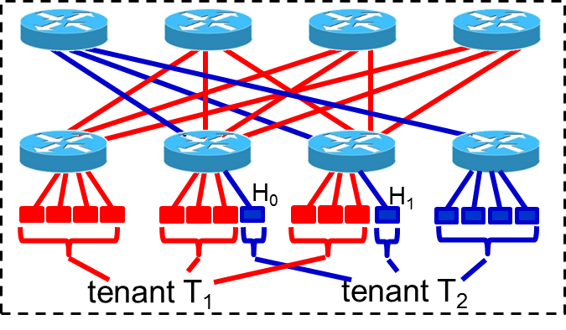
Supporting Admissible Traffic
Require Placement Constraints
Changing the placement, may allow for Link Isolation AND
support all possible admissible traffic patterns
tenant T₁
tenant T₂

Slide 13
Conditions for
LaaS with Hose Model
We limit our scope to:
  Fat Trees
  Symmetrical and Homogeneous
  Not allocating more links than hosts for each switch
We derive
  A necessary condition for placement
  A sufficient condition for link allocation
Based on these theorems
  An algorithm for 2 level fat trees
  An approximation for 3 level fat trees

Slide 14
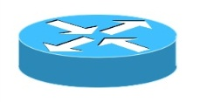
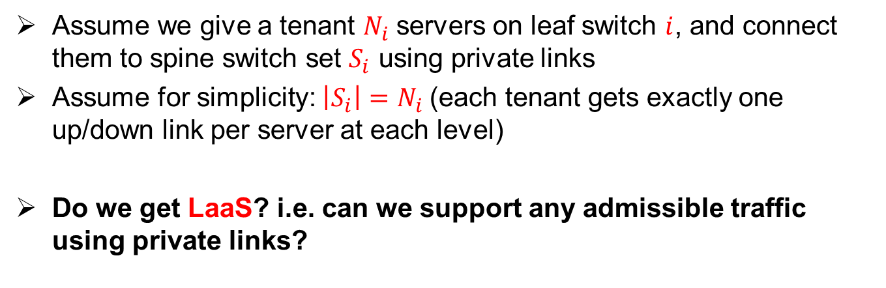
Analysis: how to get LaaS?
S₁=S₂
S₃
Spine
Leaf
1
2
3
4
N₁=3
N₂=3
N₃=2
Assume we give a tenant $N_{i}$ servers on leaf switch $i$, and connect them to spine switch set $S_{i}$ using private links
Assume for simplicity: $\left|S_{i}\right|=N_{i }$(each tenant gets exactly one up/down link per server at each level)
Do we get LaaS? i.e. can we support any admissible traffic using private links?

Slide 15
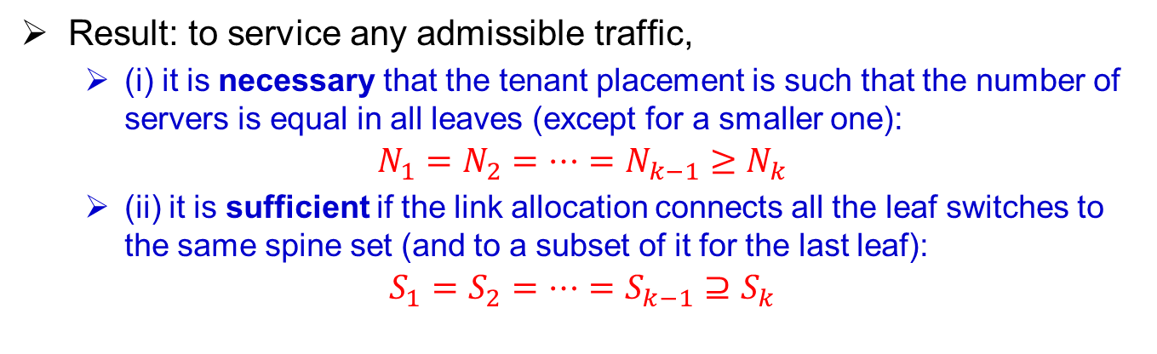
Analysis: how to get LaaS?
S₁=S₂
S₃
Spine
For a tenant with 8 servers: limited packing options:
    ✓ 8=3+3+2
    ✓ 8=4+4
    ✓ 8=2+2+2+2
    ✓ 8=5+3
    ✗ 8=4+3+1
    ✗ 8=4+2+2
    ✗ 8=6+1+1
Leaf
1
2
3
4
N₁=3
N₂=3
N₃=2
Result: to service any admissible traffic,
  (i) it is necessary that the tenant placement is such that the number of servers is equal in all leaves (except for a smaller one):
$$N_{1}=N_{2}=…=N_{k−1}{≥N}_{k}$$
  (ii) it is sufficient if the link allocation connects all the leaf switches to the same spine set (and to a subset of it for the last leaf):
$$S_{1}=S_{2}=…=S_{k−1}{⊇S}_{k}$$

Slide 16

How does LaaS work?
Placement done concurrently with link allocation
SDN controller routes the network accordingly
No change to existing tenants
Some tenant requests might be denied if can be placed isolated
Tenant
Requests
Cloud Manager
Tenant
Links
(a)
Tenants
Frontend
(b)
Host & Link Allocation Scheduler
Isolation Routing Engine
(c)
SDN
Controller
Hosts
LINKS
FWDING
Tenant
Hosts
Tenant
Requests
Hosts Provisioning

Slide 17
Simulating Cluster Utilization
Randomizer generates:
  A random list of tenant requests with # hosts and runtime
No bypassing – maintain request order
  This is worst case for cluster utilization since
  smaller jobs do not bypass the stalled ones
Keep track of each tenant start and end times
When all tenants are done
  Calculate total cluster utilization
We compare 3 different allocations
  Unconstrained – No link allocation – just fill
  Simple – Allocate complete sub-trees
  LaaS – Obey the placement and link
  allocation requirements
Tenant Randomizer
# Hosts,
Runtime
FIFO
Is empty?
LaaS Host & Link Allocation
Total Host Utilization Calculation
Tenant
Start / End

Slide 18
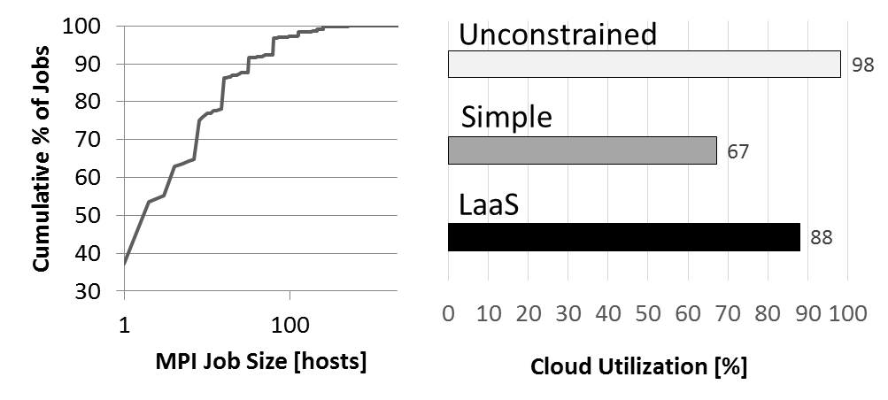
~10% Cluster Utilization Cost
10,000 requests placement on 11K nodes cluster
  Tenant runtime is Uniform in range of [20,3000] time units
Reproduced the job size statistics of JUROPA cluster
  Collected over a year and a half period
Compared LaaS with
  Unconstrained = fill as much as possible
  Simple = Complete sub-trees
P[s] ~exp(-xs)
JUROPA is a 2400 hosts HPC utility cluster

Slide 19
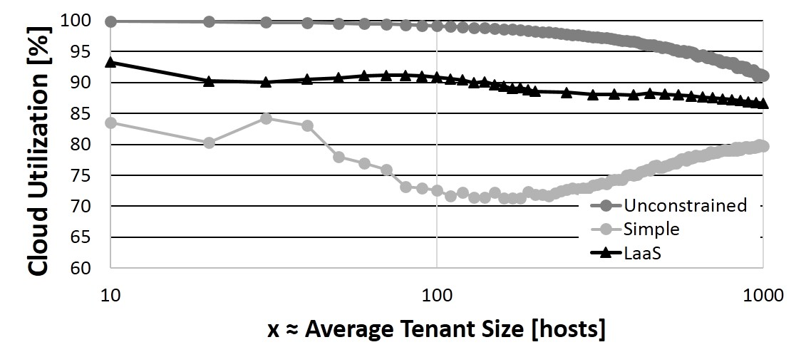
~10% Cluster Utilization Cost
10,000 requests placement on 11K nodes cluster
  Tenant runtime is Uniform [20,3000]
Randomly generate exponentially distributed tenants size
  Similar to JUROPA but variable average size
10%
x

Slide 20

Implementation
Provides a RESTFull service or Python binding
Placement on top of OpenStack Nova
  Utilizing Aggregates
Link Allocation and Routing of top of OpenSM
  Utilizing Hybrid Topologies feature:
    Splits the network and route each sub-topology
    separately
Tenant Requests
LaaS Service
Nova
commands
Port Groups
Topology
Routing
OpenStack
Nova
OpenSM
Routing Chains
PLACE
FWD

Slide 21
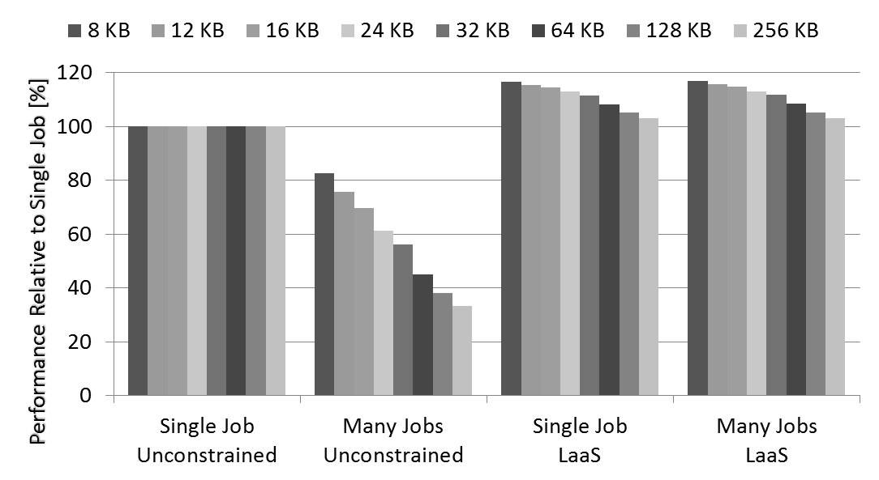
LaaS Removes any Variation
32 tenants run scientific computation on 1728 nodes cluster
Without LaaS tenants degrade one another by >50%
  At 64KB message
With LaaS no change in run time observed
58%

Slide 22
Enhancements
Slimmed Fat Trees (where bandwidth reduced closer to the roots)
  Fully described by our work
A mixed bare metal and shared resources environment
  Via pre-allocation of large “virtual tenant”
  Requires TDMA like allocation of link and switch resources to tenants
Heterogeneous clusters where node selection should minimize cost and adheres to node capabilities constraints
  Requires ordering the search and multiple iterations

Slide 23
LaaS Concluding Remarks
LaaS removes the cross tenant dependency
It is practical to implement even for very large cluster
It costs ~10% of cluster utilization even with FCFS scheduling
It unveils economic potential for Cloud customers and suppliers
Price
Performance
10%
200%

Slide 24
Questions

