Slide 1

CNSM 2014
SAL: Scaling Data Centers Using Smart Address Learning
Alex Shpiner (Technion / Mellanox)
Isaac Keslassy (Technion)
Carmi Arad (Marvell)
Tal Mizrachi (Marvell)
Yoram Revah (Marvell)

Slide 2
SAL: Scaling Data Centers Using Smart Address Learning
The Problem:
VM Address Resolution
in Multi-Tenant Data Centers

Slide 3
Data Center Network
Address Resolution
Where is VM X???
(Address Resolution)
Location | VM
… | …
… | …
… | X
… | …
… | …
… | …
VM X

Slide 4
Scalability Problem
Goal: Address resolution that supports VM migrations.
Two scalability bottlenecks:
Table size of resolution entries.
Network load (bandwidth and processing) of resolution packets.
Tradeoff between bottlenecks:
  Smaller tables lower hit-rate more resolution request packets

Slide 5
Address Resolution Methods
Conventional network implementation alternatives:
  Layer 2 Ethernet: single LAN.
    ARP broadcast flooding
    Large switching tables
    Spanning tree
  Layer 3 IP: subnet for each rack.
    No transparent VM migration between subnets (requires IP address change).
      Interrupts active connections.
      Affects user transparency/isolation/virtualization.
  Overlay Network (next slide)

Slide 6
Overlay Network
Assign for each VM:
  Application Address (AA)
    VM identity in the virtual tenant space
    Usually combined from tenant ID and VM ID
  Location Address (LA)
    VM identity in the physical network infrastructure
  Both can be MAC or IP addresses.
[VXLAN, NVGRE, VL2, Portland, SEATTLE, SecondNet, etc.]

Slide 7
Overlay Network
Encapsulation point:
  Encapsulate the packet with additional header or
  Rewrite existing header fields.
  ToR switch or hypervisor (server).
  We denote it as Edge Bridge (EB).
[VXLAN, NVGRE, VL2, Portland, SEATTLE, SecondNet, etc.]

Slide 8
Overlay Network
[VXLAN, NVGRE, VL2, Portland, SEATTLE, SecondNet, etc.]

Slide 9
Address Resolution Methods
(Related Work)
How to build the AA-LA resolution table?
Central DB
(VL2 [Greenberg et al., 2009], Portland [Niranjan Mysore et al., 2009], SEATTLE (DHT-based) [Kim et al., 2008])
Pull
(EtherProxy [Elmeleegy et al., 2009], Diverter [Edwards et al., 2009], SARP [Nachum et al., 2012])
Push
(Netlord [Mudigonda et al., 2011])

Slide 10

Central DB
e.g.: VL2 [Greenberg et al., 2009], Portland [Niranjan Mysore et al., 2009], SEATTLE (DHT-based) [Kim et al., 2008]
Drawbacks:
  Computation and communication hot-spot
  Data base consistency maintainence (fast updates, back-up)
  Additional latency to resolve the first packet
Learn LA(VM 2)
?
!
VM 1
VM 2

Slide 11
Pull (On-Demand Update)
e.g.: EtherProxy [Elmeleegy et al., 2009], Diverter [Edwards et al., 2009], SARP [Nachum et al., 2012]
Drawbacks:
  Broadcasts / flooding
  Additional latency to resolve the first packet
Learn LA(VM 2)
Learn LA(VM 1) ?
?
?
?
!
Learn LA(VM 1) ?
Learn LA(VM 1) ?
VM 1
VM 2

Slide 12

Push (On-Change Update)
e.g.: Netlord [Mudigonda et al., 2011]
Drawbacks:
  Unnecessary update messages.
  Large resolution tables in EBs.
    Combining with Pull is possible (but then adds drawbacks from Pull).
Learn LA(VM 2)
Learn LA(VM 2)
!
!
Learn LA(VM 2)
Learn LA(VM 2)

Slide 13
Scalability Problem
Existing algorithms do not solve the two scalability bottlenecks:
Table size of resolution entries.
Network load of resolution broadcasts.

Slide 14
Our suggestion for Multi-Tenant DC:
Smart Address Learning (SAL)
Selectively learn and update
based on the VM tenancy
  Main observation: VMs of different tenants do not communicate between each other.
In resolution table of EB, learn only the VMs of the tenants that run over the EB.
Pull and Push variants.
Benefits:
  Smaller resolution tables (or better hit rate)
  Less request/update broadcasts
  No hot-spots

Slide 15
SAL - Pull
Learn LA(VM 1)
?
?
?
!
Learn LA(VM 1)
Do NOT Learn LA(VM 1)
EBs do not learn unneeded addresses.
Improves table hit rate.
Three VMs of the tenant:
VM 1
VM 2
VM 3

Slide 16


SAL - Push
Update LA(VM 2)
Forget LA(VM 1)
!
No update message to here
Learn LA(VM 1)
Update broadcast replaced by unicasts.
Reduces network load.
Two VMs of the tenant:

Slide 17
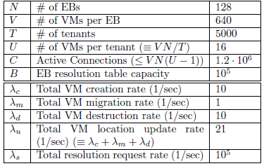
Simulation Settings: Typical Values
Sources: Amazon AWS, CloudNaas [T. Benson et al., 2011], SecondNet [C. Guo et al., 2010], [N. Ilyadis, 2012], [R. Katz, 2009], [J. & A. Meitzler, 2010/12], MS Azure, PAST [B. Stephens et al., 2012], Portland [R. Niranjan Mysore et al., 2009], Seawall [A. Shieh et al., 2010], VL2 [A. Greenberg et al., 2009], [Q. Zhang et al., 2010]

Slide 18
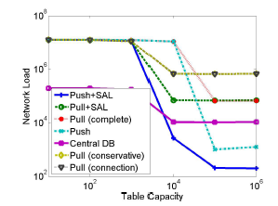
Simulation Results:
Network Load vs. Table Capacity
Rate of address resolution packets in the DCN core.
Broadcast packet to k EBs is counted as k packets.
For small tables, the Central DB is the best option, since the EBs do not have enough memory for any other option.
EB Table Capacity
For large tables, the Push approaches are better.
The addition of SAL to Push decreases the network load by order of magnitude.
The addition of SAL to Pull and to Push decreases the network load by order of magnitude.
Based on typical values.
Network load is in [pkts/sec]

Slide 19
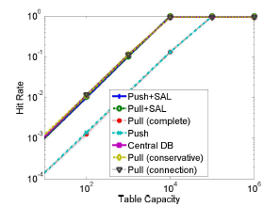
Simulation Results:
Hit Rate vs. Table Capacity
Percentage of hits in the EB resolution tables.
SAL improves the hit rate of the resolution tables.
EB Table Capacity
Based on typical values.

Slide 20
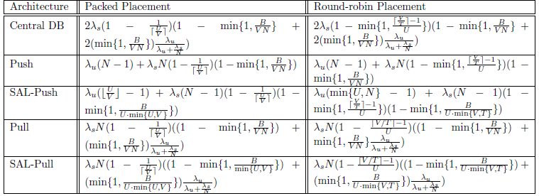
Analytical Model: Network Load
Rate of address resolution packets in the core.
Broadcast packet to k EBs is counted as k packets.

Slide 21
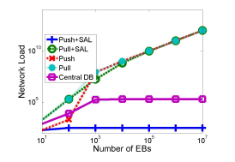
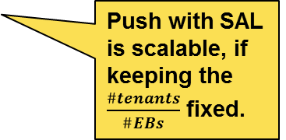
Analytical Model:
Network Load vs. Number EBs
Number of tenants and VMs scales with number of EBs
Round-robin placement
Push with SAL is scalable, if keeping the $\frac{\#tenants}{\#EBs}$ fixed.
Based on typical values.
Network load is in [pkts/sec]

Slide 22
Summary of Contributions
Smart Address Learning (SAL).
  Expands the scalability of address resolution mechanisms, for both the network load and the resolution table sizes.
  The key property: selectively learn the addresses in the resolution tables, based on the fact that the VMs of different tenants do not communicate.
Analytical model of the network load and resolution table sizes for the presented resolution methods.
  Evaluation of the network load and the resolution table size tradeoff using the model and simulations.
Both the network load and the resolution table sizes can be reduced by orders of magnitude.

Slide 23
Thank you.

