Slide 1

Per-CCA Queueing
Yara Mulla, Isaac Keslassy

Slide 2



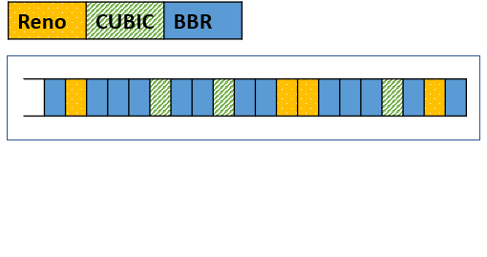

Problem: increasing CCA starvation
Cloud users can pick any Congestion Control Algorithm (CCA)
It is an arms race: they will tend to pick the most aggressive CCAs (like BBRv1) and can starve vanilla CCAs (like CUBIC) in their shared router buffers
How can cloud operators protect users with vanilla CCAs?

Slide 3
Related work
Fair queueing algorithms | Per-flow isolation | Hard to implement
Admission-control algorithms | Hits heavy hitters by dropping their packets | Assumes all CCAs respond equally to losing packets
Cebinae [1] | Hits heavy hitters in many ways | Large oscillations and hurting performance
P4air [2], Confucius [3], P4CCI [4] | Isolation per CCA family (e.g. loss-based, delay-based, etc.) | Unfairness within a CCA family
Fundamental problems:
1) In a shared buffer, each CCA impacts the others
2) Routers don’t know flow CCAs ⇒ no per-CCA congestion feedback (ECN, delay, loss, etc.)
[1] L. Yu et al., “Cebinae: scalable in-network fairness augmentation,” ACM SIGCOMM, 2022.
[2] B. Turkovic and F. Kuipers, “P4air: Increasing fairness among competing congestion control algorithms,” IEEE ICNP, 2020.
[3] Z. Meng et al., “Confucius queue management: Be fair but not too fast,” arXiv, 2023.
[4] E. Kfoury et al., “P4CCI: P4-based online TCP congestion control algorithm identification for traffic separation,” IEEE ICC, 2023.

Slide 4
ML-based CCA Classification
Independently: emergence of fast and accurate ML-based CCA classification algorithms, e.g.:
DeePCCI [1]
Seiðr [2]
Dragonfly [3]
[1] C. Sander et al., “DeePCCI: Deep learning-based passive congestion control identification,” Workshop on Network Meets AI & ML, pp. 37–43, 2019.
[2] K. A. Simpson, R. Cziva, and D. P. Pezaros, “Seiðr: Dataplane assisted flow classification using ML,” IEEE Globecom, pp. 1–6, 2020.
[3] D. Carmel and I. Keslassy, “Dragonfly: In-flight CCA identification,” IFIP Networking, 2023.

Slide 5
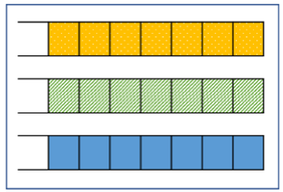
Per-CCA queueing
Naïve ideal view
Each queue is served proportionally to its estimated number of flows, so each CCA gets its fair share
Ideal classification
Ideal CCA isolation

Slide 6
Ideal per-CCA queueing: benefits
  Cloud users can use the CCA that best fits their application without caring about other users.
  CCA developers can design CCAs that better fit applications and that only need to be fair to themselves.
  Routers can apply the best feedback to each CCA (e.g. ECN or short buffer)

Slide 7
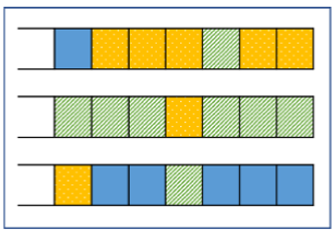
Per-CCA queueing with real-life classifiers

Slide 8

Per-CCA queueing: implementation challenges
  The CCA classifier should provide a classification after a few RTTs.
  It should automatically learn to classify CCAs without a need to define CCA protocols manually.
  It should do so while only locally examining the packets at the router buffer.
  It should be accurate enough to get a good queue isolation.
  It should classify dozens of CCAs.
  It should be able to separate elephants to classify urgently and mice that can stay in some unclassified queue.
  It should deal with re-classifications.
  It should deal with unknown CCAs.
  It should deal with different RTTs.
  It should be able to approximate the number of flows per queue for a fair service rate.
  It should remember classifier decisions.
What is the needed accuracy?

Slide 9
How classifier accuracy impacts performance
Model outline
Flow distribution
How many flows from each CCA in each queue
Classifier accuracy
(1)
Model uses fundamental results in classification theory
Packet distribution
Flow distribution
(2)
Simple aggressiveness model: the throughput ratio of a BBR flow to a CUBIC flow is constant
Advanced aggressiveness model: this ratio depends on the percentage of BBR and CUBIC flows
Packet distribution
Performance
Throughput of each CCA
(3)

Slide 10

Evaluations

Slide 11

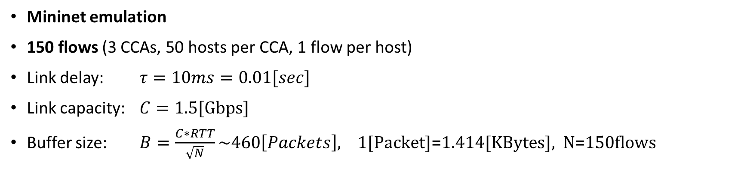




Parameters
Mininet emulation
150 flows (3 CCAs, 50 hosts per CCA, 1 flow per host)
Link delay: $τ=10ms=0.01[sec]$
Link capacity: $C=\text{1}\text{.}\text{5[}\text{Gbps}\text{]}$
Buffer size: $B=\frac{C∗RTT}{\sqrt{N}}\sim 460\left[Packets\right], \text{1[}\text{Packet}\text{]=1.414[}\text{KBytes}\text{], }\text{N}\text{=150}\text{flows}$
Reno
hosts
τ
$$C_{Reno}$$
CUBIC
hosts
$$C$$
server
$$C_{CUBIC}$$
ARBITER
switch
τ
$$B$$
τ
BBR
hosts
$$C_{BBR}$$
τ

Slide 12

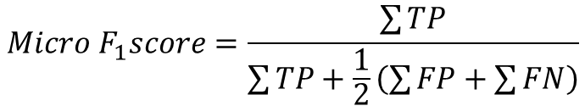
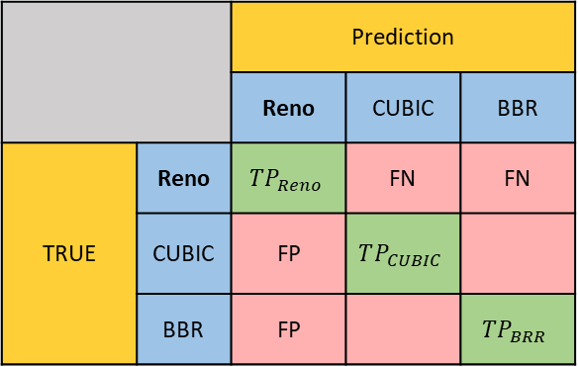


$F_{1}$ score
 |  | Prediction
 |  | Reno | CUBIC | BBR
TRUE | Reno | $$TP_{Reno}$$ | FN | FN
 | CUBIC | FP | $$TP_{CUBIC}$$
 | BBR | FP |  | $$TP_{BRR}$$
Classifier’s accuracy measured by F₁ score
$0≤F_{1}≤1 ,$ $F_{1}=1$for a perfect classifier
$$Precision=\frac{TP}{TP+FP}$$
$$Recall=\frac{TP}{FN+TP}$$
$$F_{1}=\frac{2∗Precision∗Recall}{Precision+Recall}=\frac{TP}{TP+\frac{1}{2}(FP+FN)}$$
$$Micro F_{1}score=\frac{\sum{TP}}{\sum{TP}+\frac{1}{2}\left(\sum{FP}+\sum{FN}\right)}$$

Slide 13
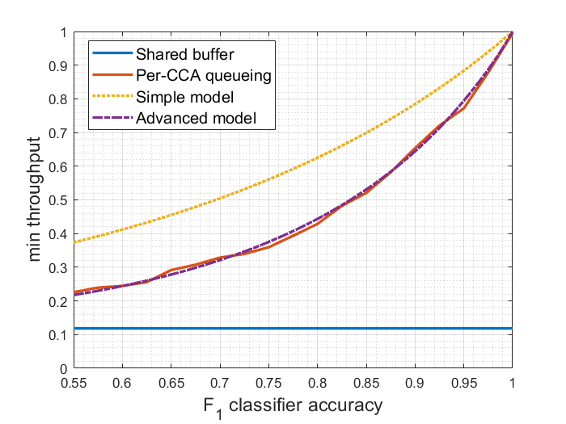

Throughput share of the most vulnerable CCA
We look at the throughput share of the most vulnerable CCA as a function of classifier accuracy: $\min_{i}{\frac{CCA_{i} throughput per flow}{fair share}}$
In a shared buffer (blue line) we can see how the most vulnerable CCA is starved
Per-CCA queueing reduces this starvation
The advanced aggressiveness model is accurate

Slide 14
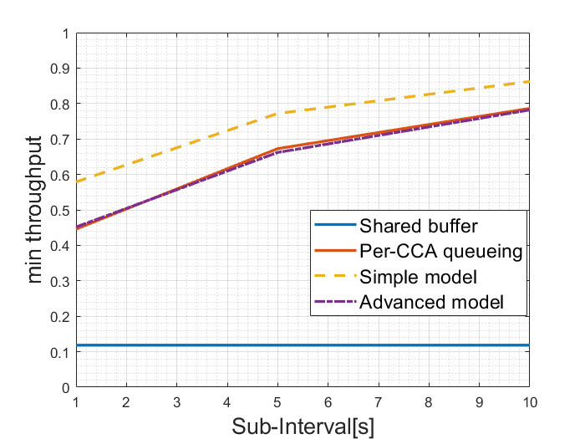
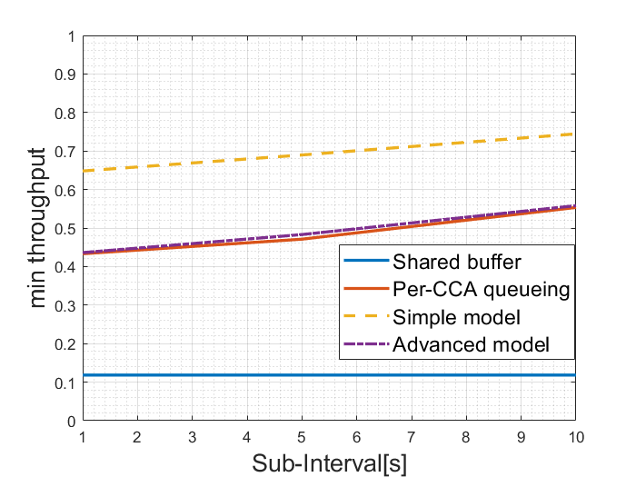
Classifiers from the literature
DeePCCI CCA classifier[1]
Dragonfly CCA classifier[2]
[1] C. Sander, J. Rüth, O. Hohlfeld, and K. Wehrle, “DeePCCI: Deep learning-based passive congestion control identification,” in Workshop on Network Meets AI & ML, 2019
[2] D. Carmel and I. Keslassy, “Dragonfly: In-flight CCA identification,” in IFIP Networking, 2023

Slide 15
Conclusion
Main idea: per-CCA queueing
With per-CCA queueing, we can design and use the best CCA for each application, without caring about CCAs of other users
Current CCA classifiers are already sufficiently accurate to strongly reduce starvation
Per-CCA queueing still needs to solve several implementation challenges to be widely used

