Slide 1



Composite-Path Switching
Shay Vargaftik, Katherine Barabash, Yaniv Ben-Itzhak,
Ofer Biran, Isaac Keslassy, Dean Lorenz, Ariel Orda.

Slide 2
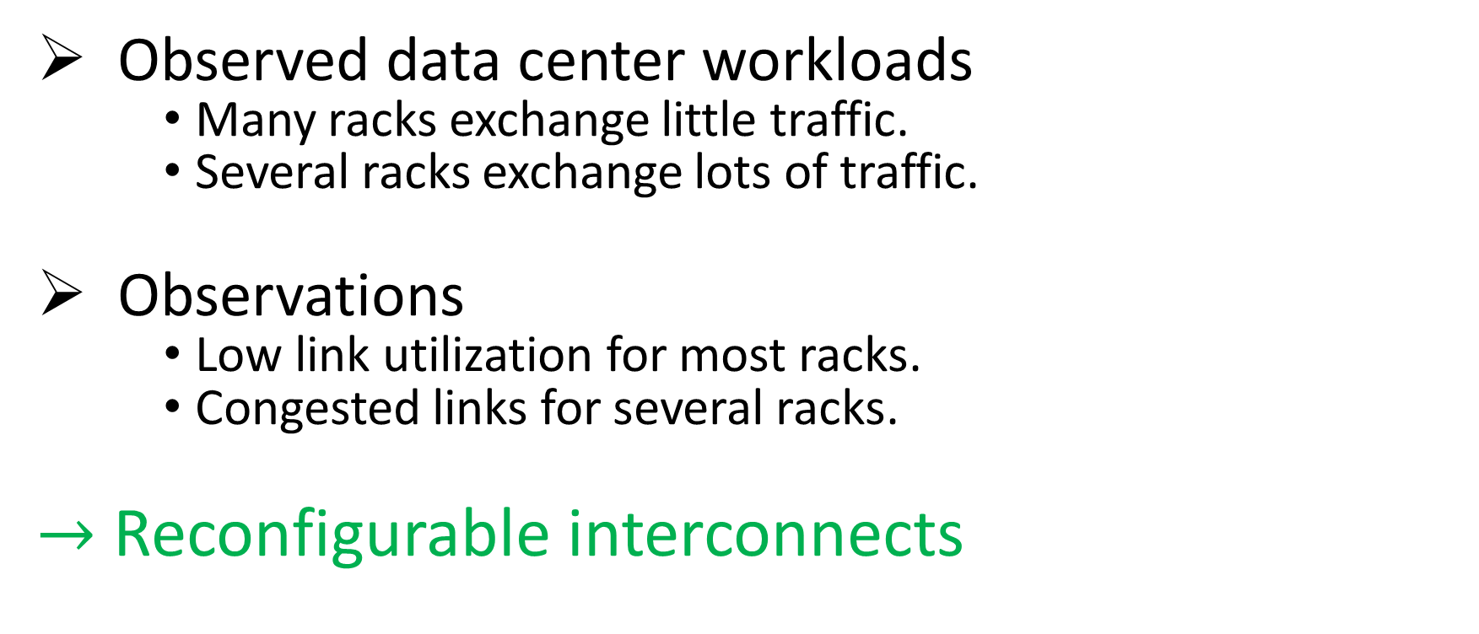
Background
Observed data center workloads
Many racks exchange little traffic.
Several racks exchange lots of traffic.
Observations
Low link utilization for most racks.
Congested links for several racks.
$→$ Reconfigurable interconnects

Slide 3
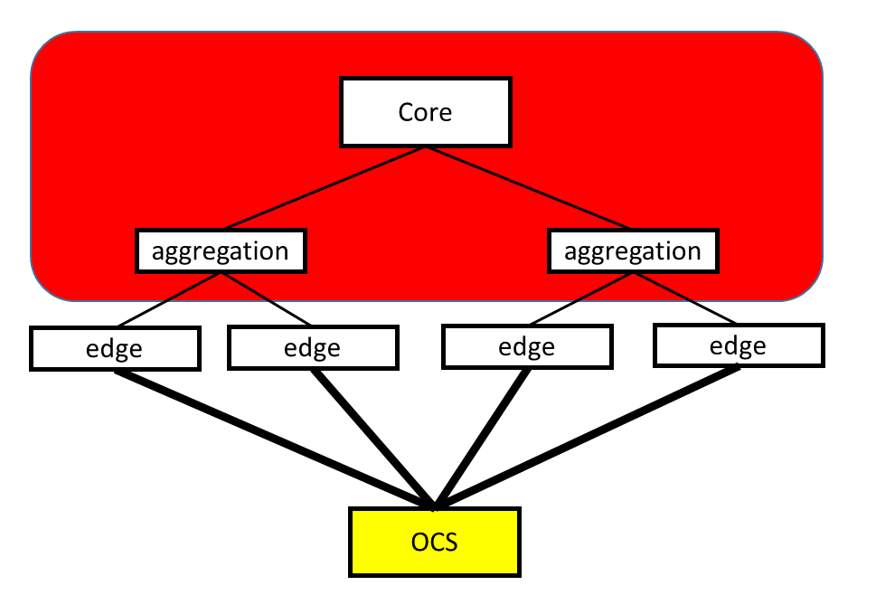
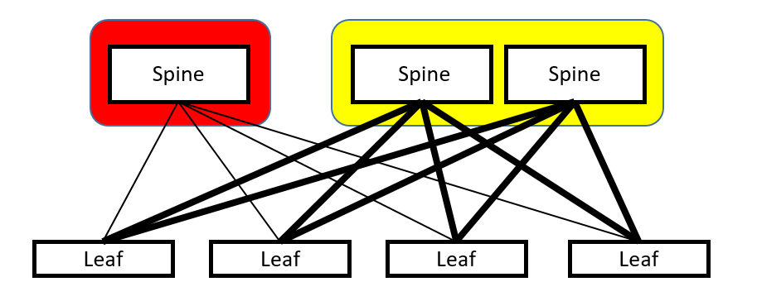
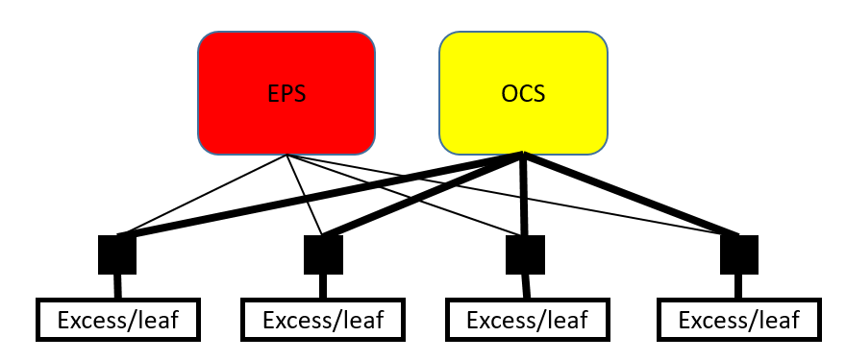
Hybrid Switching
c-Through - Wang et. al. SIGCOMM’10
Electrical Packet Switching (EPS)
Optical Circuit Switching (OCS)
EPS
Helios - Farrington et. al. SIGCOMM’10
EPS
OCS
REACToR - Liu et. al. NSDI’14

Slide 4
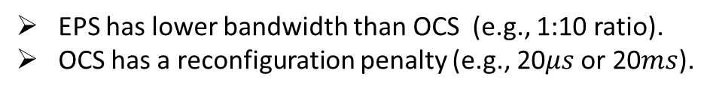
Hybrid Switch (h-Switch)
Solstice [CoNEXT ’15]
Eclipse [SIGMETRICS ‘16]
Sender 1
EPS
Receiver 1
⁞
⁞
Sender 2
Receiver 2
.
.
.
.
.
.
.
.
.
Receiver 3
Sender 3
.
.
OCS
.
Sender n
⁞
⁞
Receiver n
EPS has lower bandwidth than OCS (e.g., 1:10 ratio).
OCS has a reconfiguration penalty (e.g., 20$μs$ or 20$ms$).

Slide 5
DCN traffic patterns – Via the Coflow abstraction
many-to-many
one-to-one
one-to-many
many-to-one
Data parallel applications.
Dataflow pipelines.
Distributed file systems.
Backups.
MAP-Reduce
Partition-Aggregate (e.g., web search, content composition)

Slide 6
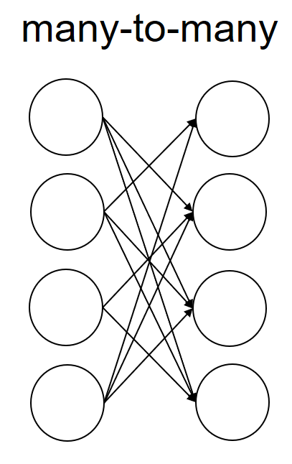
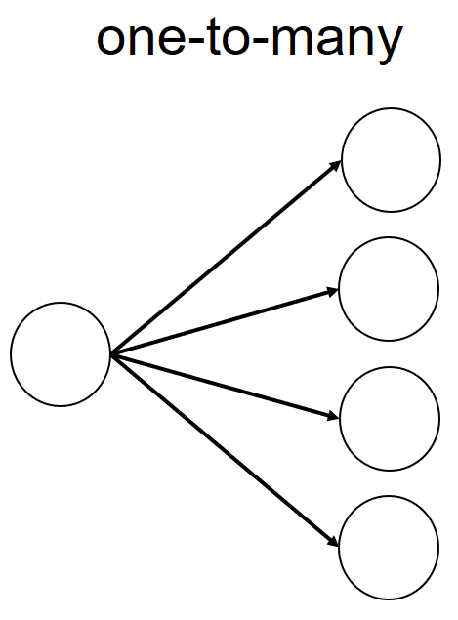
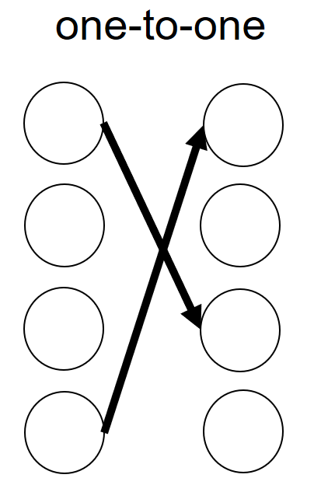
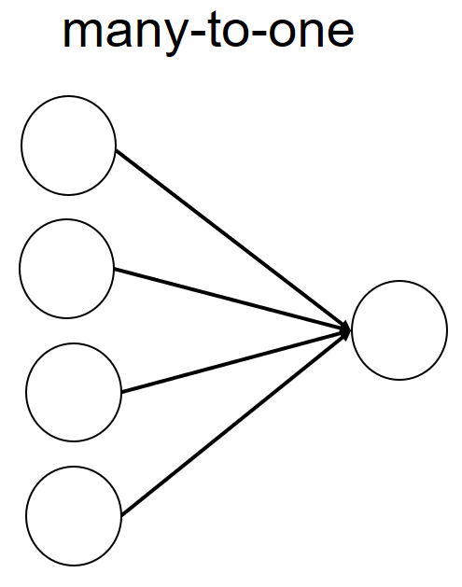
Hybrid Switch (h-Switch)
Sender 1
EPS
Receiver 1
⁞
⁞
Sender 2
Receiver 2
.
.
.
.
.
.
.
.
.
Receiver 3
Sender 3
.
.
OCS
.
Sender n
⁞
⁞
Receiver n

Slide 7
Hybrid Switch (h-Switch)
Sender 1
EPS
Receiver 1
⁞
⁞
Sender 2
Receiver 2
.
.
.
.
.
.
.
.
.
Receiver 3
Sender 3
.
.
OCS
.
Sender n
⁞
⁞
Receiver n
TDM
Constrained by the low bandwidth of the EPS
Constrained by the reconfiguration penalty of the OCS

Slide 8
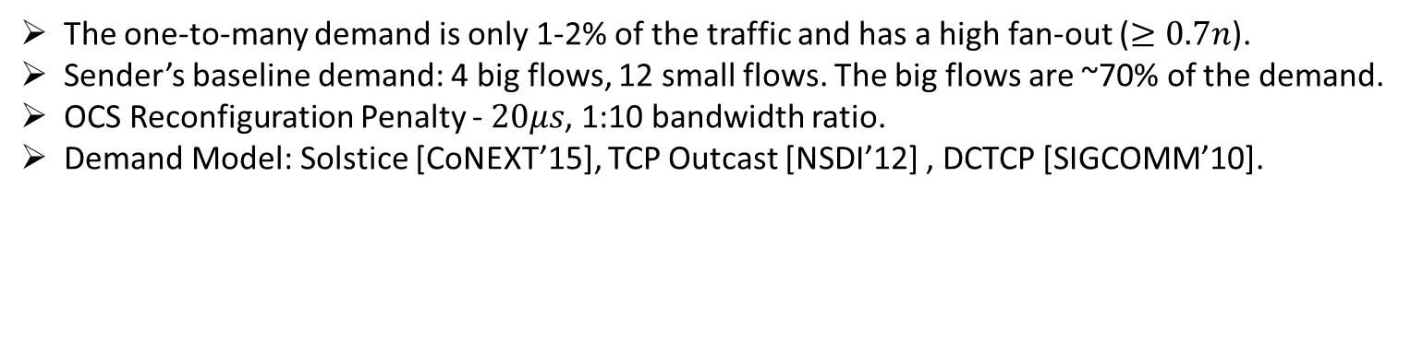
Evaluation
We take a baseline scenario from Solstice [CoNEXT’15].
Add one-to-many demand with 1-2% of traffic.
Baseline
Adding
one-to-many
one-to-many
Coflow
Number of ports
Number of ports
The one-to-many demand is only 1-2% of the traffic and has a high fan-out ($≥0.7n$).
Sender’s baseline demand: 4 big flows, 12 small flows. The big flows are ~70% of the demand.
OCS Reconfiguration Penalty - $20μs$, 1:10 bandwidth ratio.
Demand Model: Solstice [CoNEXT’15], TCP Outcast [NSDI’12] , DCTCP [SIGCOMM’10].

Slide 9
How to combine the benefits of both fabrics?
one-to-many composite-path
OCS
EPS
many-to-one composite-path
EPS
OCS

Slide 10
Composite-Path Switch (cp-Switch)
Sender 1
EPS
Receiver 1
⁞
⁞
Sender 2
Receiver 2
.
.
.
.
.
.
Receiver 3
Sender 3
.
.
OCS
.
Sender n
⁞
⁞
Receiver n

Slide 11
Composite-Path Switch (cp-Switch)
Sender 1
EPS
Receiver 1
⁞
⁞
Sender 2
Receiver 2
.
.
.
.
.
.
Receiver 3
Sender 3
.
.
OCS
.
Sender n
⁞
⁞
Receiver n

Slide 12
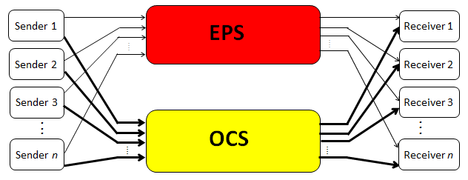




Scheduling?
h-Switch (e.g., Solstice [CoNEXT ’15], Eclipse [SIGMETRICS ‘16]):
OCS and EPS planes are independent.
Decide on permutation matrice(s) and their duration for the OCS.
Schedule the rest over the EPS.
Receivers
$$D:$$
Demand over the OCS
Demand over the EPS
 | 21 | 1
1 |  | 20 | 1
 | 1 |  | 21
 |  |  |  | 22
21 |  | 1
 | 1
 |  | 1
 |  |  | 1
 |  |  |  | 1
1
 | 1 | 1
1 |  |  | 1
 | 1 |  | 1
 |  |  |  | 2
1 |  | 1
$$=$$
$$+$$
$$20×$$
senders

Slide 13
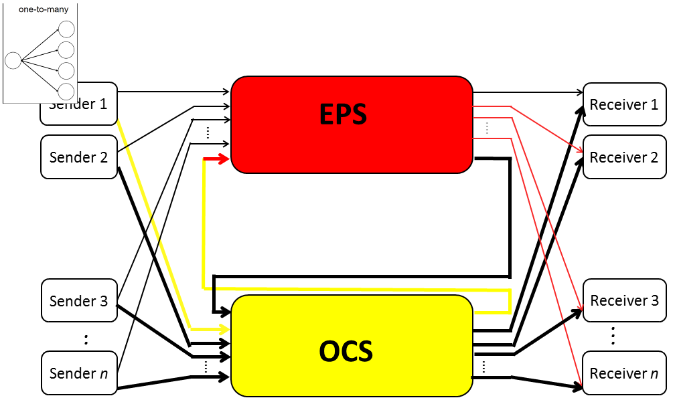
Scheduling for the cp-Switch?
The h-Switch scheduling approach cannot be directly applied.
Challenge 1: How to represent the composite paths?
Challenge 2: What to serve using the composite paths?
Receivers
 | 1 | 1 | 1 | 1
senders

Slide 14

cp-Switch Scheduling?
OUR IDEA: Efficiently translate h-Switch to cp-Switch scheduling
Leverage existing and future body of literature.
Make the problem more tractable.
How to represent the composite paths?
What to serve using the composite paths?
Receivers
 | 1 | 1 | 1 | 1
senders

Slide 15











Challenge 1: How to represent the composite paths?
Regular paths
3
1 | 1 |  | 1
 |  |  | 3 | 1
 |  | 3 |  | 1
 | 3 |  |  | 1
3
1 | 1 |  | 1
 |  |  | 3 | 1
 |  | 3 |  | 1
 | 3 |  |  | 1
 | 3
3 | 1 | 1 |  | 1
 |  |  |  | 3 | 1
 |  |  | 3 |  | 1
 |  | 3 |  |  | 1
 |  |  |  |  | 3
one-to-many composite-path
many-to-one composite-path
 | 3
3
 |  |  |  | 3
 |  |  | 3
 |  | 3
 |  |  |  |  | 3
 | 1
1
 |  |  |  | 1
 |  |  | 1
 |  | 1
 |  |  |  |  | 1
many-to-one
one-to-many
$$[1]$$
$$[1]$$
$$3×$$
$$[2]$$
$$[2]$$
$$[3]$$
$$[3]$$
$$[4]$$
$$[4]$$
$$[5]$$
$$[5]$$

Slide 16
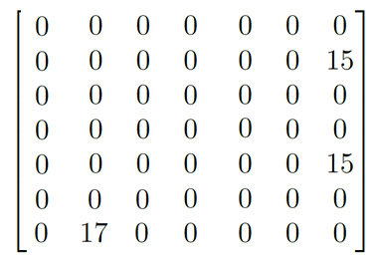
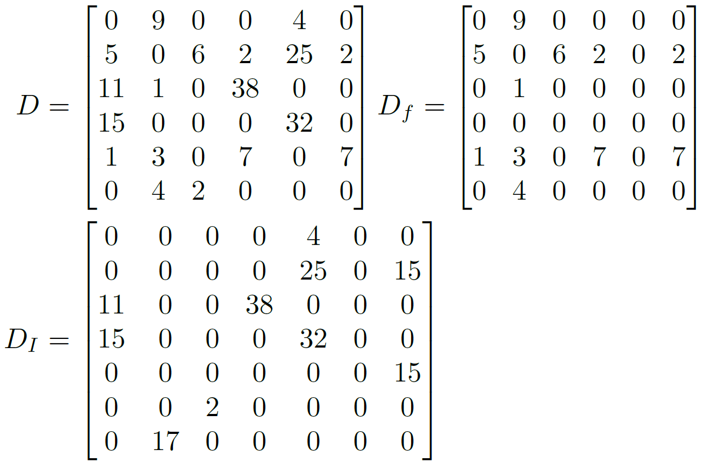
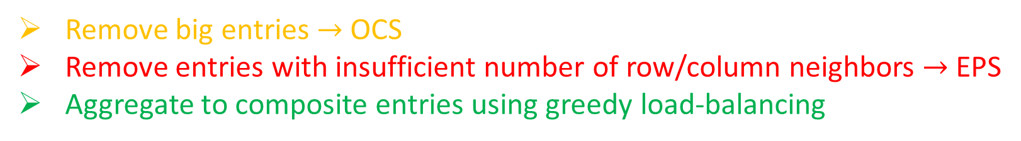
Challenge 2: What to serve using the composite paths?
Remove big entries $→$ OCS
Remove entries with insufficient number of row/column neighbors $→$ EPS
Aggregate to composite entries using greedy load-balancing

Slide 17
cp-Switch Scheduling?
Leverage existing and future body of literature.
Make the problem more tractable.
Bind the scheduling feasibility of both systems.
New Demand and corresponding h-Switch parameters
Reduction
Process
h-Switch scheduling
Scheduling for the corresponding h-Switch
Interpretation
Process
Demand and a cp-Switch parameters
Scheduling for cp-Switch
Eclipse [SIGMETRICS ‘16]
Solstice [CoNEXT ’15]
Run time is dominated by the used h-Switch scheduling algorithm (up to 99.9%).
Run time for cp-Switch is actually faster than for h-Switch due to the lower number of produced permutation matrices.

Slide 18
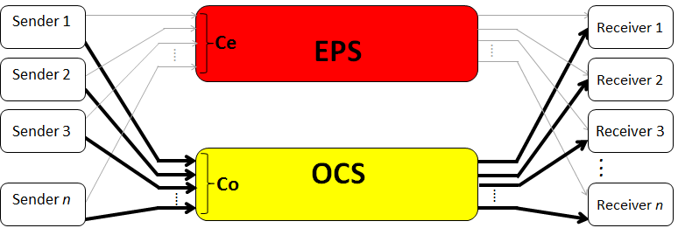
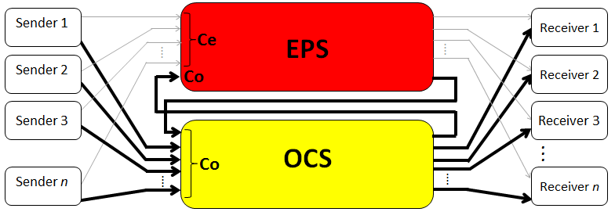


Baseline
h-Switch
Adding
one-to-many
$$1.57X$$
$$0.3X$$
cp-Switch
Adding
one-to-many
Number of ports
Number of ports

Slide 19


h-Switch
Adding
one-to-many
$$1.57X$$
$$2.36X$$
One-to-many Coflow
Adding
one-to-many
cp-Switch
One-to-many Coflow
Number of ports

Slide 20
Conclusions
A tighter integration leads to better performance.
cp-Switch can accommodate more traffic patterns.
Does not add scheduling complexity.

Slide 21

Thank you!
OCS
EPS

