Slide 1
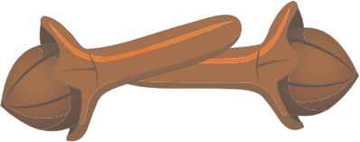




Congestion-Aware Load Balancing at the Virtual Edge
CLOVE
Aran Bergman
(Technion, VMware)
Naga Katta, Aditi Ghag, Mukesh Hira, Changhoon Kim, Isaac Keslassy, Jennifer Rexford

Slide 2


Data center load balancing today
Equal-Cost Multi-Path (ECMP) routing:
  Path(packet) = hash(packet’s 5-tuple)
src,dst IP + src,dst port + protocol
Spine
Switches
Coarse-grained
Elephant Hash collisions
Congestion-oblivious
Leaf
Switches
. . . . . .
…
…
…
Servers

Slide 3
Previously proposed load balancing schemes
vSwitch
vSwitch
Hypervisors

Slide 4
Previously proposed load balancing schemes
Centralized load balancing
Hedera, Fastpass, MicroTE, SWAN
Control-driven feedback
Slow reaction time
Routes computation overhead
Scalability Issues
Central Controller
vSwitch
vSwitch
Hypervisors

Slide 5
Previously proposed load balancing schemes
In-network load balancing
CONGA, HULA, LetFlow, DRILL
Needs custom ASIC data center fabric
High capital cost
Controller Involvement may still be required
vSwitch
vSwitch
Hypervisors

Slide 6
Previously proposed load balancing schemes
End-host load balancing
Presto
Congestion Oblivious
Controller intervention in case of topology asymmetry
MPTCP
Incast collapse
Guest VM network stack changes
Hermes (SIGCOMM’17)
Concurrent effort
vSwitch
vSwitch
Hypervisors

Slide 7
vSwitch as the sweet spot
Easy to implement
No Switch HW changes
No guest VM changes
Spine
switches
Leaf
switches
vSwitch
vSwitch

Slide 8
CLOVE assumptions
Clove operates over a DC Overlay – e.g., Stateless Transport Tunneling (STT)
Spine
switches
Network switches with ECMP using 5-tuple
Outer transport header is used for ECMP traffic distribution
Leaf
switches
Eth
IP
TCP
Overlay
vSwitch
vSwitch
Eth
IP
Payload

Slide 9
CLOVE in 1 slide
Path discovery using traceroute probes
Load-balancing flowlets [FLARE ‘05]
vSwitch switching between paths based on RTT-scale feedback
  Explicit Congestion Notification - ECN
  In-band Network Telemetry - INT

Slide 10
Path Discovery
Load balancing flowlets
vSwitch Load balancing
Outer transport source port (with ECMP) maps to network path
Standard ECMP in the physical network
H1 to H2
DPort: Fixed
SPort: P3
Overlay
Data
H1 to H2
DPort: Fixed
SPort: P2
Overlay
Data
H1 to H2
DPort: Fixed
SPort: P1
Overlay
Data
H1 to H2
DPort: Fixed
SPort: P4
Overlay
Data
Hypervisor learns source port to path mapping
Dst | SPort
H2 | P1
H2 | P2
H2 | P3
H2 | P4
vSwitch
ECMP-based source routing
vSwitch
H1
H2
Hypervisor H1
Hypervisor H2

Slide 11
Path Discovery
Load balancing flowlets
Scheme 1: Edge-Flowlet
vSwitch Load balancing
Eth
IP
TCP src
P3
Overlay
Data
Eth
IP
TCP src P2
Overlay
Data
Eth
IP
TCP src
P4
Overlay
Data
Eth
IP
TCP src P1
Overlay
Data
Dst | SPort
H2 | P1
H2 | P2
H2 | P3
H2 | P4
vSwitch
vSwitch
Flowlet gap
H1
H2

Slide 12
vSwitch Load balancing
Scheme2: CLOVE-ECN
Path Discovery
Load balancing flowlets
Congestion-aware balancing based on ECN feedback
2. Switches mark ECN on data packets
Data
Path weight table
1. Src vSwitch detects and forwards flowlets
4. Return packet carries ECN and src port for forward path
3. Dst vSwitch relays ECN and src port to src vSwitch
Dst | SPort | Wt
H2 | P1 | 0.1
H2 | P2 | 0.3
H2 | P3 | 0.3
H2 | P4 | 0.3
Dst | SPort | Wt
H2 | P1 | 0.25
H2 | P2 | 0.25
H2 | P3 | 0.25
H2 | P4 | 0.25
vSwitch
Hypervisor H1
Hypervisor H2
vSwitch
5. Src vSwitch adjusts path weights for the src port

Slide 13
vSwitch Load balancing
Scheme 3: CLOVE-INT
Path Discovery
Load balancing flowlets
Utilization-aware balancing based on INT feedback
2. Switches add requested link utilization
Data
1. Src vSwitch adds INT instructions to flowlets
4. Return packet carries path utilization for forward path
3. Dst vSwitch relays path utilization and src port to src vSwitch
Dst | SPort | Util
H2 | P1 | 40
H2 | P2 | 30
H2 | P3 | 50
H2 | P4 | 10
vSwitch
Hypervisor H1
Hypervisor H2
vSwitch
5. Src vSwitch updates path utilizations
6. Src vSwitch forwards flowlets on least utilized paths

Slide 14
Performance evaluation setup
Asymmetric Setup
Spine1
Spine2
2-tier leaf-spine symmetric topology
Web Search Workload
Client on Leaf1 <-> server on Leaf2
Measure Average Flow Completion Time (FCT)
Compare Edge-Flowlet and Clove-ECN to ECMP, MPTCP and Presto
4 x 40 Gbps
Leaf1
Leaf2
16 x 10 Gbps
…
…
16 Clients
16 Servers

Slide 15
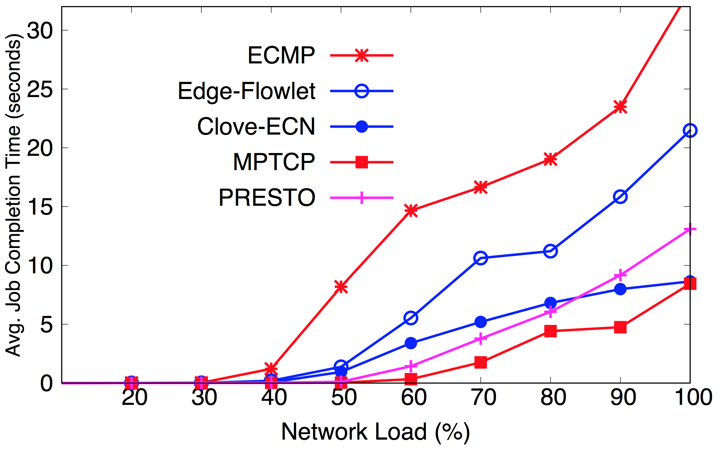
Symmetric topology
…
…
Better
1.8x
2.5x

Slide 16
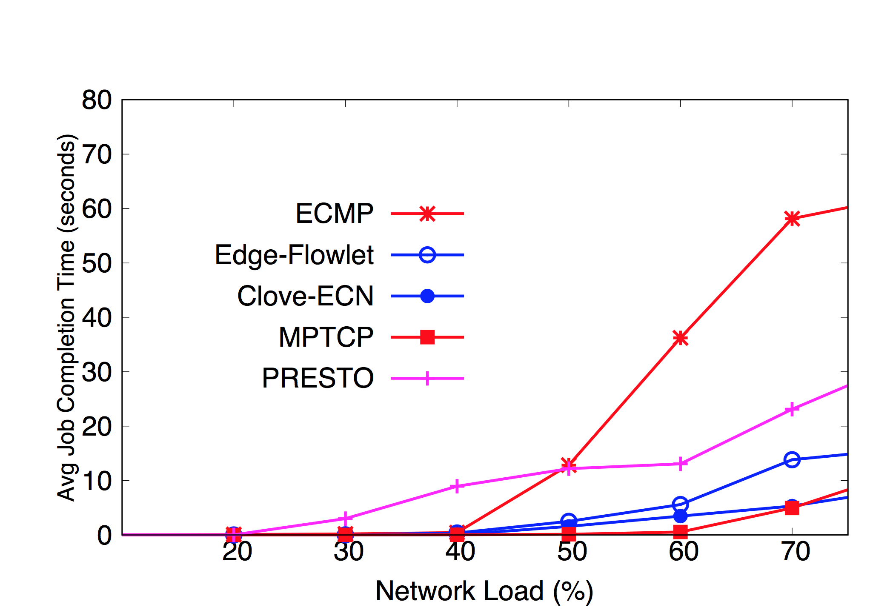
Asymmetric topology
…
…
Better
5x
12x

Slide 17
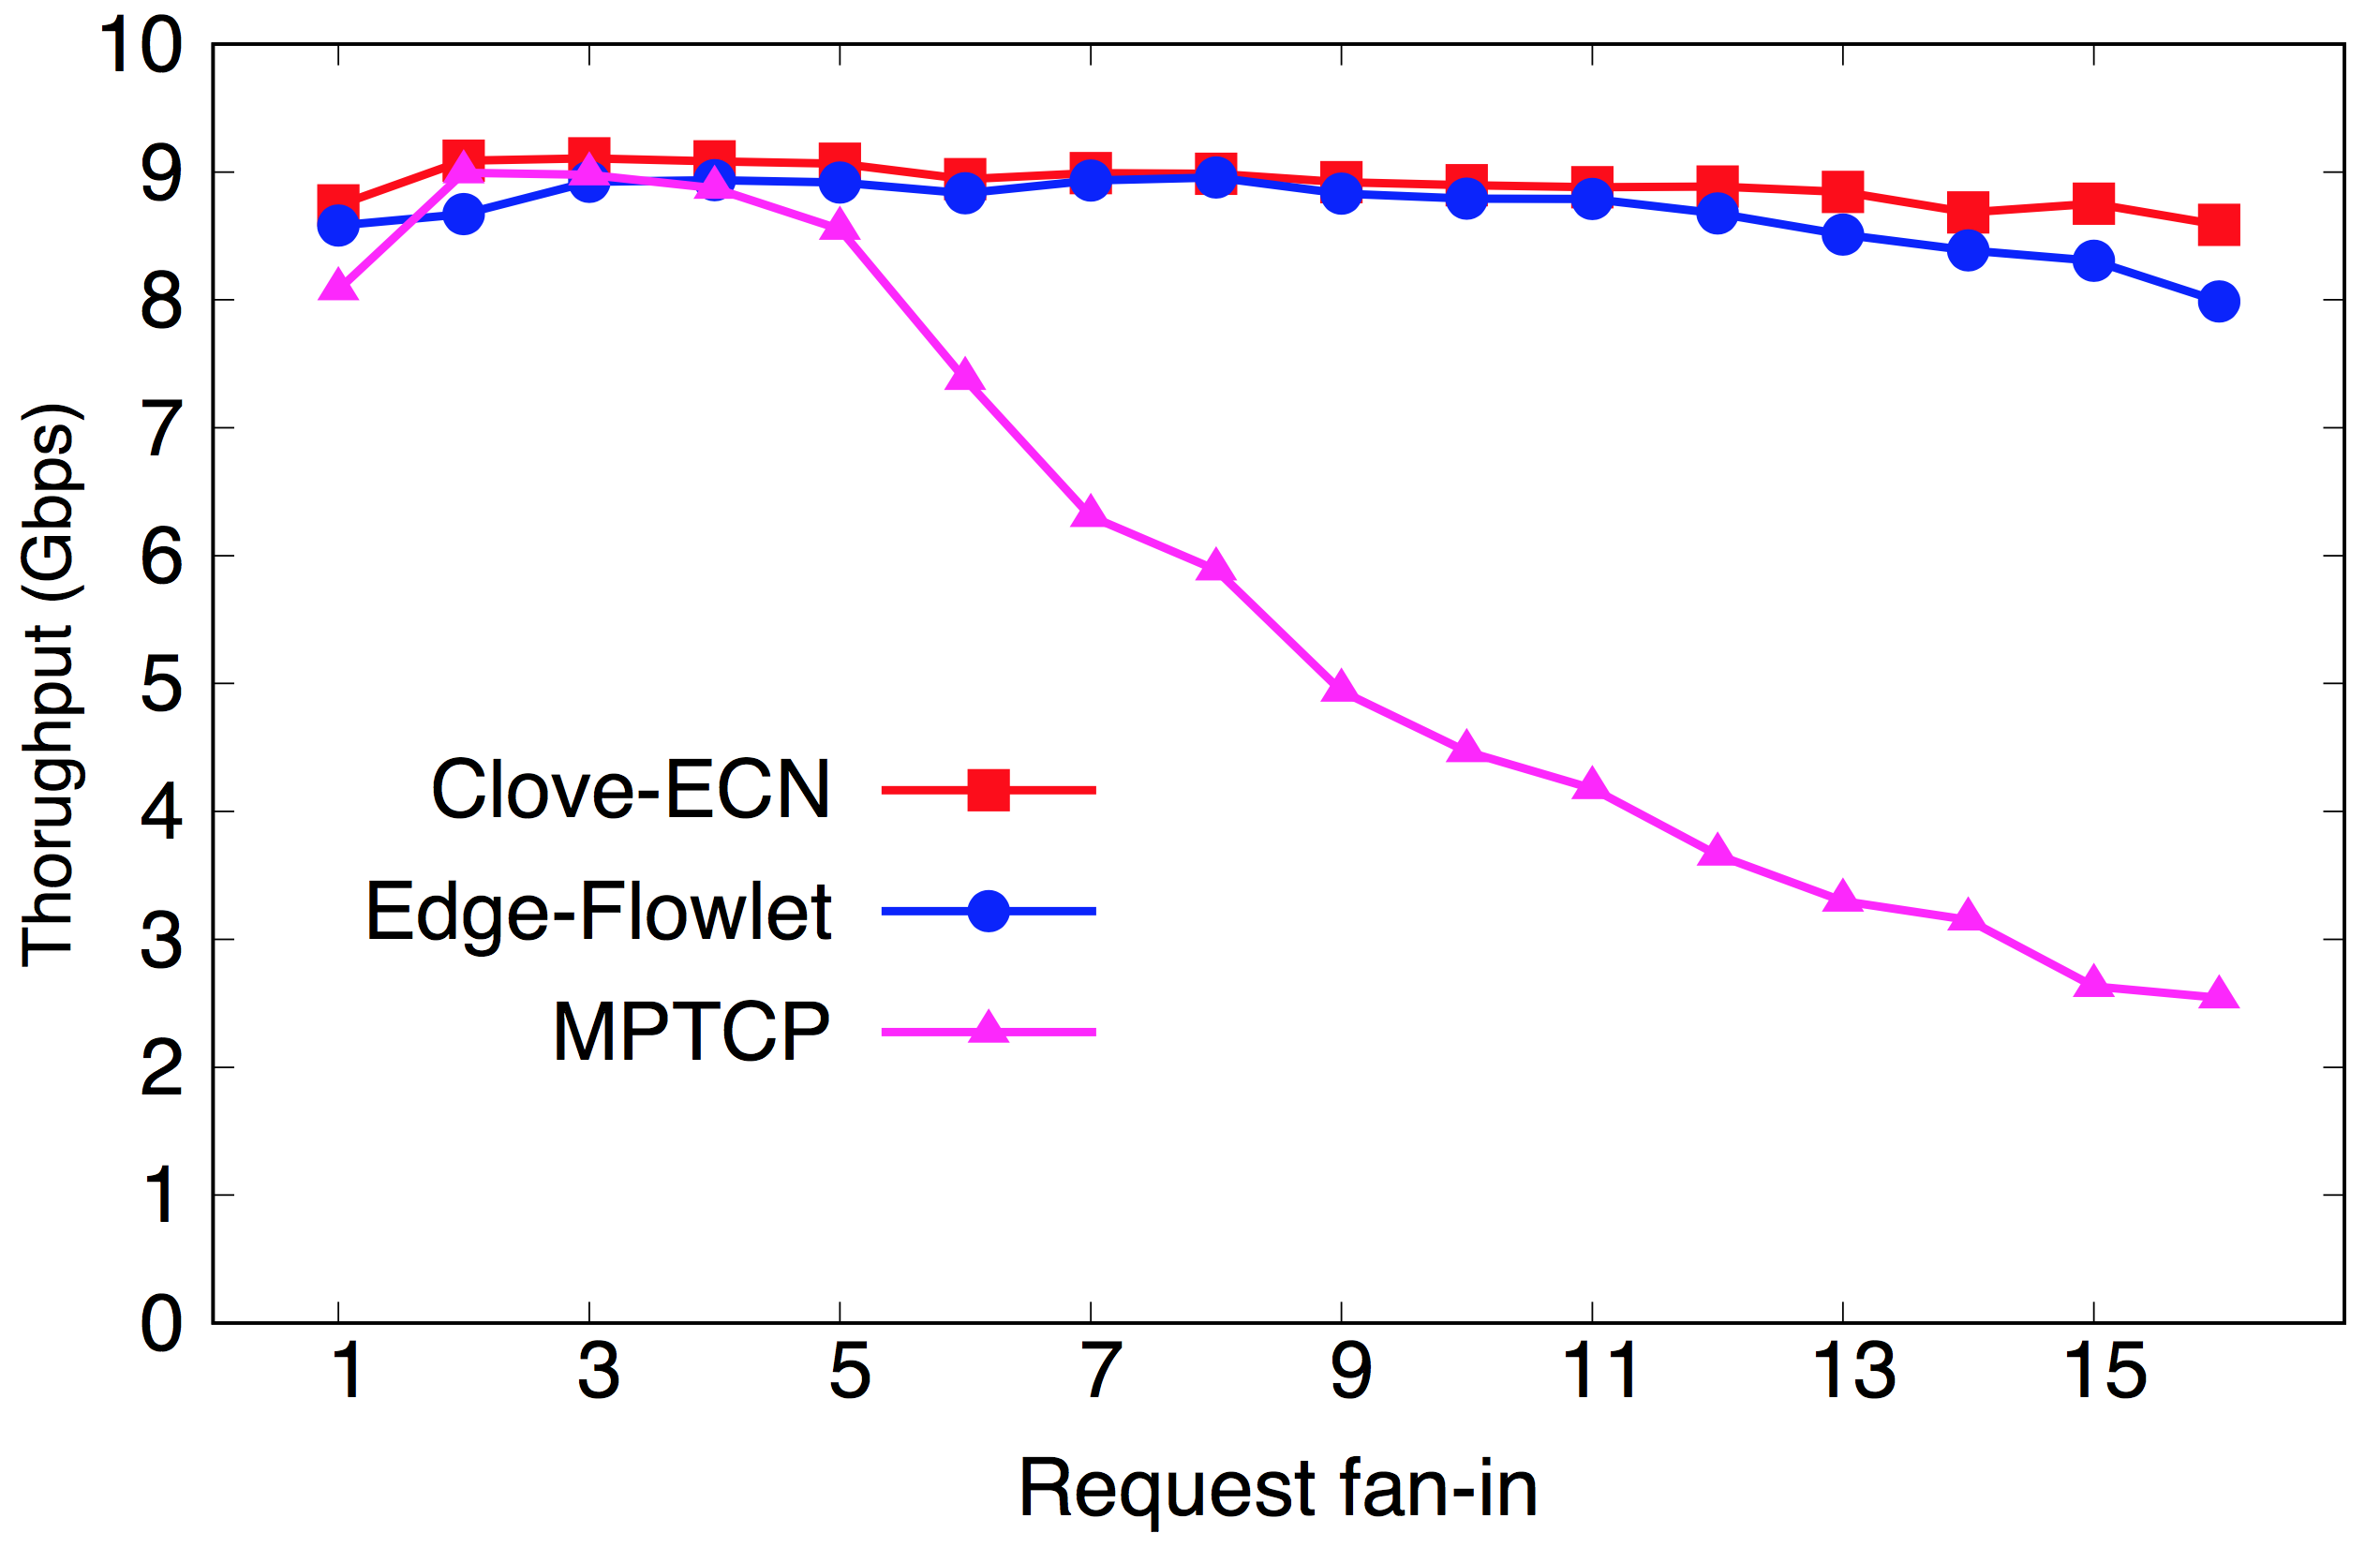
Incast Workload
Better
CLOVE-ECN outperforms MPTCP on Incast Workloads

Slide 18
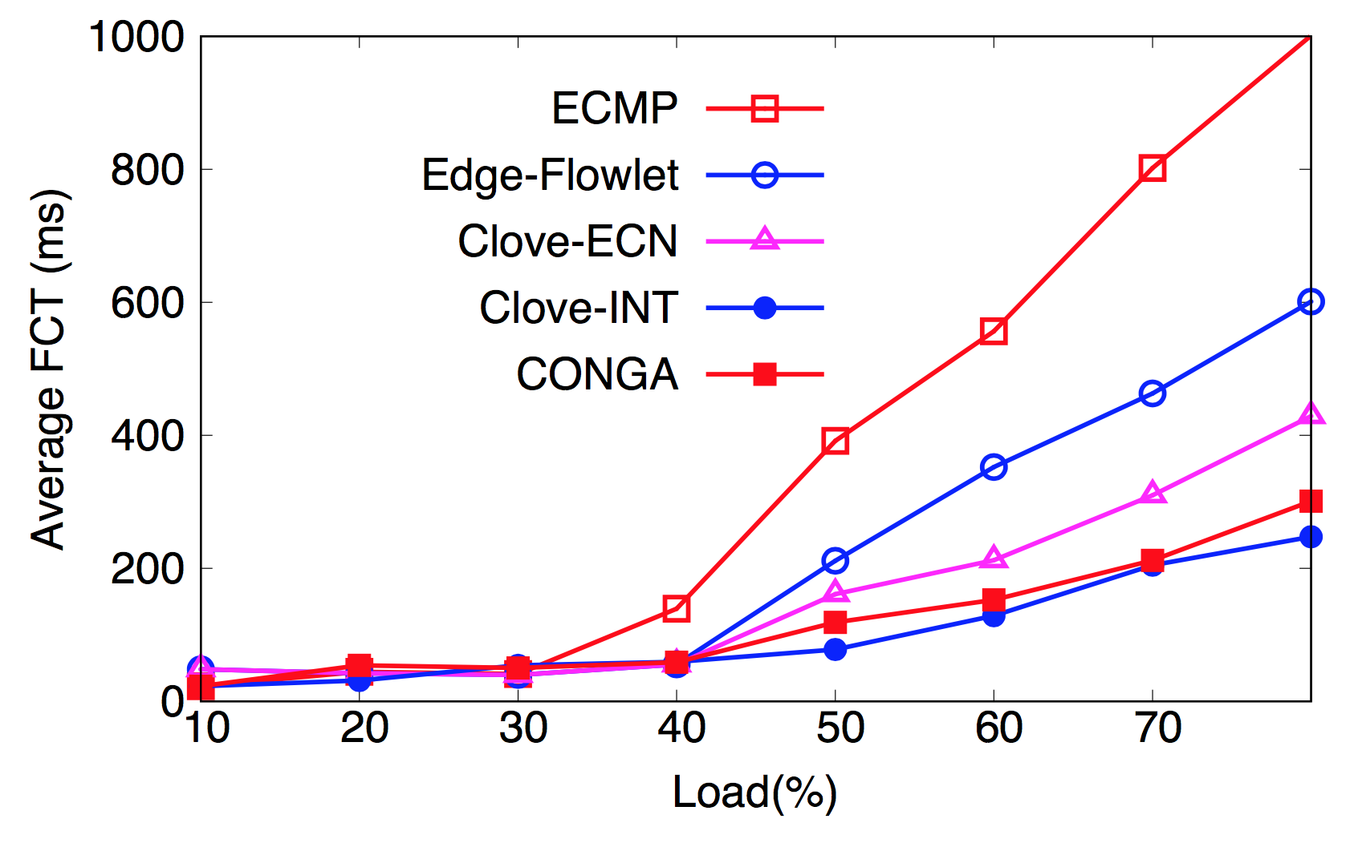
NS2 Simulation with CONGA – Asymmetric
…
…
3x lower FCT than ECMP
Better
1.2x higher FCT than CONGA
CLOVE-ECN captures 80% of the performance gain between ECMP and CONGA

Slide 19
CLOVE highlights
Captures 80% of the performance gain of CONGA
No changes to network hardware, VMs, applications
Adapts to asymmetry within the data plane
Scalable due to distributed state

Slide 20
THANK YOU
Questions?

Slide 22
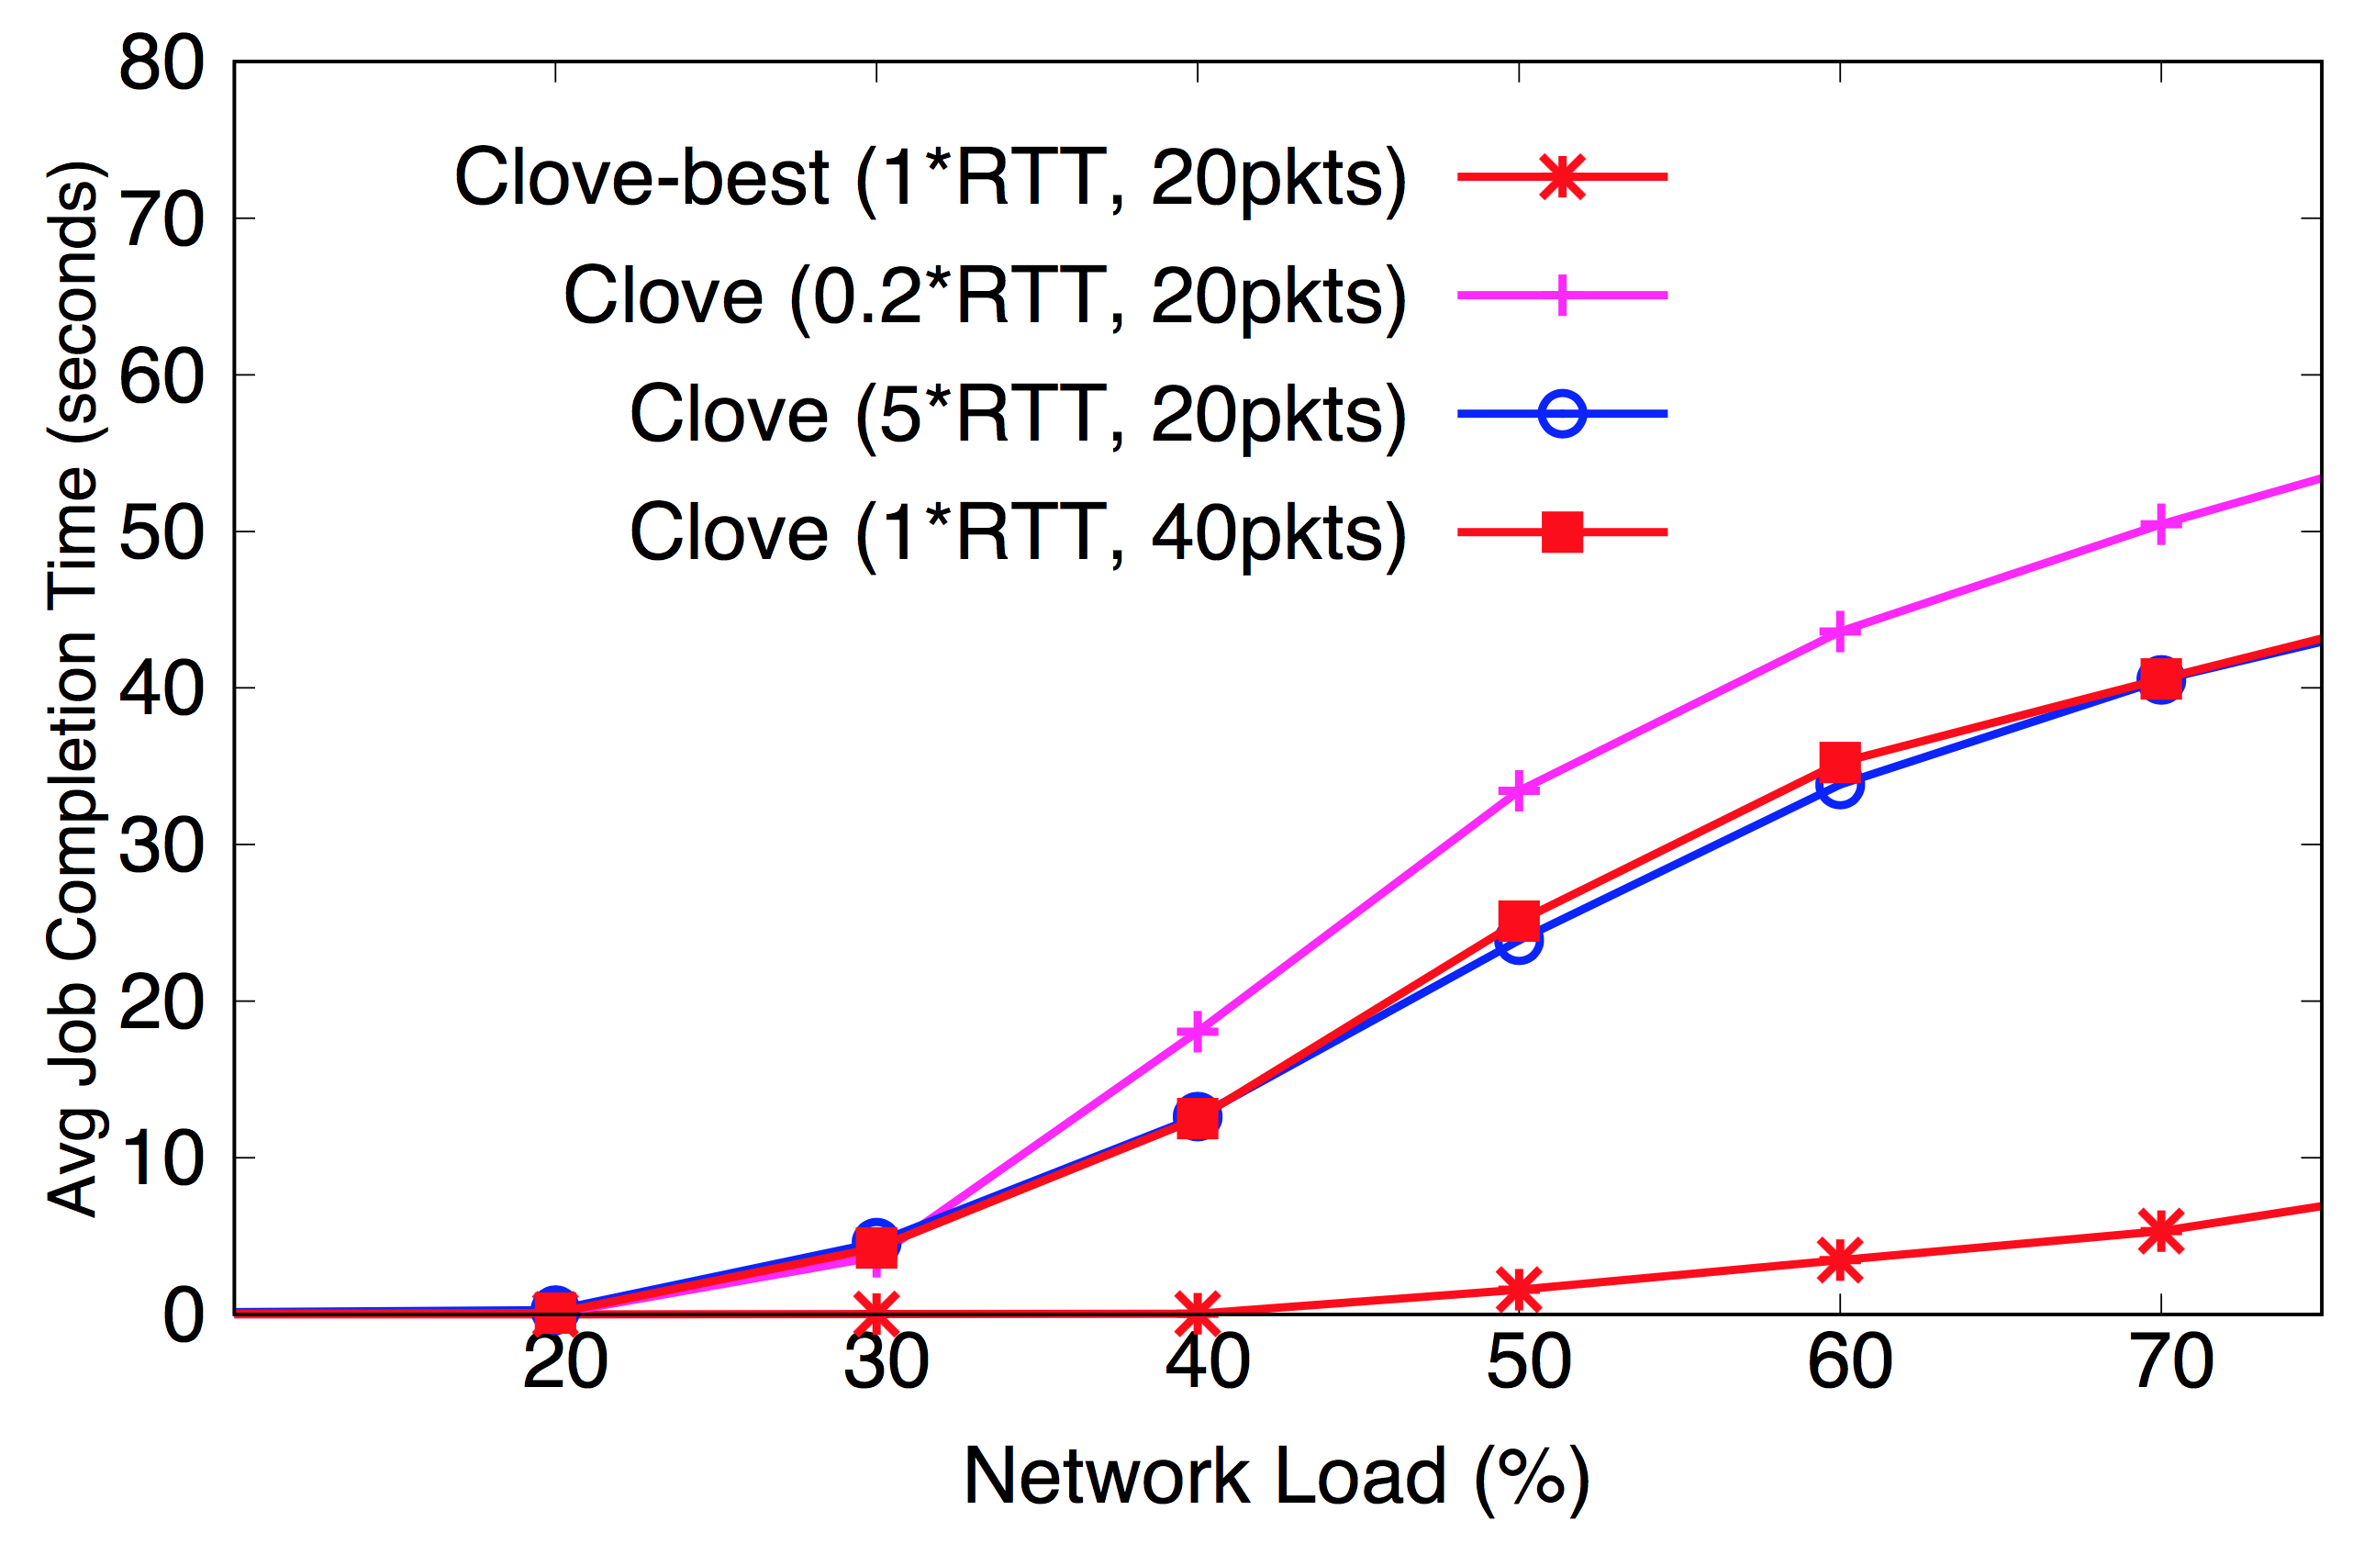
Parameter Sweeping
Empirical values for (flowlet-threshold, ECN-threshold) are 1RTT, 20pkts

