Slide 1
Memento: Making Sliding Windows Efficient for Heavy Hitters
Ran Ben Basat (Harvard University),
Gil Einziger (Ben Gurion University), Isaac Keslassy (VMWare and Technion), Ariel Orda and Shay Vargaftik (Technion), and Erez Waisbard (Nokia Bell Labs)

Slide 2
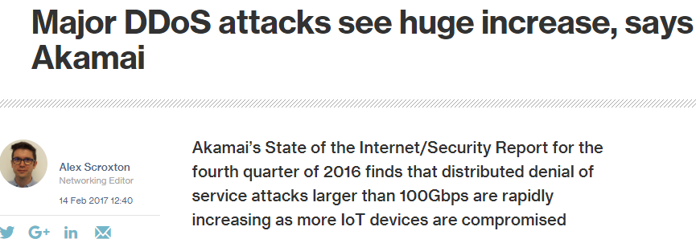
Distributed Denial of Service

Slide 3
Heavy Hitters
How many packets has sent?
Which flows are larger than $T$?
Traditionally – must fit in the SRAM
Year | 2012 | 2014 | 2016
SRAM (MB) | 10-20 | 30-60 | 50-100
7
8
8
7
3
5
1
0
7
2
8
7
3
4
1
0
7
8
8
7
3
5
1
0
7
2
8
7
3
4
1
0
7
3
4
1
0
7
8
8
7
3
5
1
0
7
2
8
7
3
4
1
0
7
2
8
7
3
4
1
0
7
3
4
1
0
7
8
8
7
3
5
1
0
7
2
8
7
3
4
1
0
(SilkRoad, SIGCOMM 2017)
Can’t allocate a counter for each flow!

Slide 4
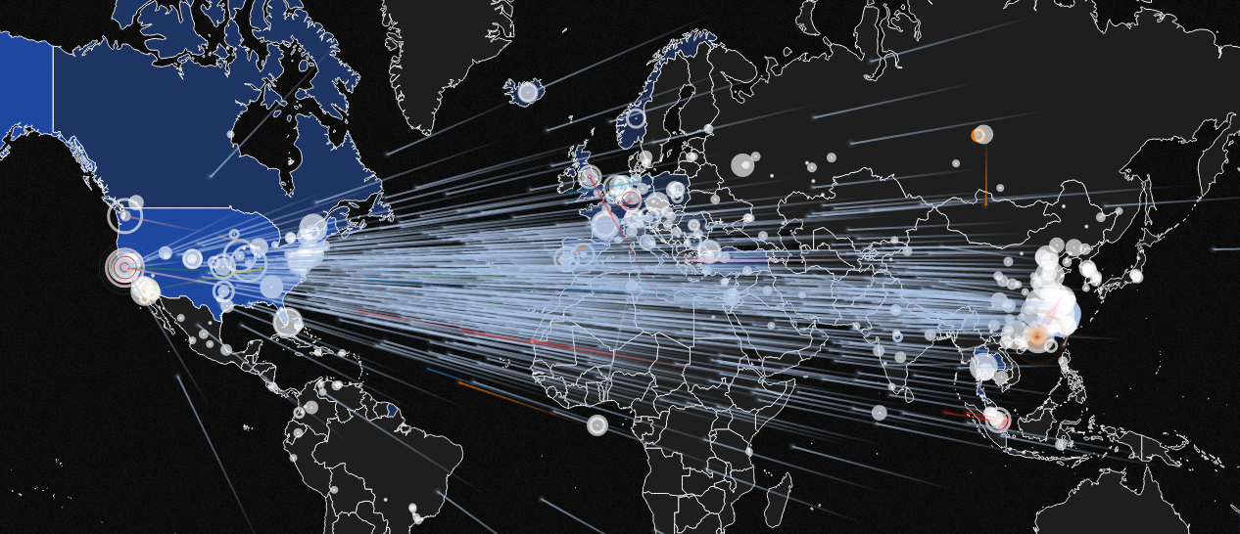
Hierarchical Heavy Hitters (HHH)
Hierarchical Heavy Hitters
identify traffic clusters.
If we find the attacking networks we can stop the attack!
DDoS attack (Aug. 2014)
DREAM: dynamic resource allocation for software-defined Counting.
ACM SIGCOMM 2014
LADS: Large-scale Automated DDoS Detection System.
USENIX ATC 2006
Automatically Inferring Patterns of Resource Consumption in Network Traffic.
ACM SIGCOMM 2003

Slide 5
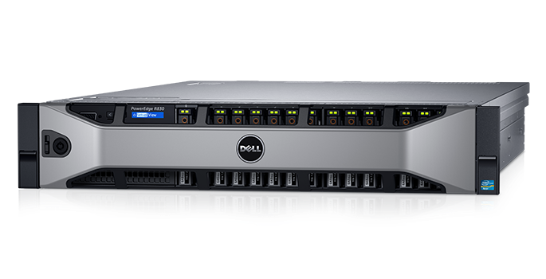
DDoS Mitigation
$$181.7.20.1$$
$$181.7.20.2$$
$$…$$
$$181.7.21.1$$
$$181.7.21.2$$
$$…$$
Can we block only the attacking devices?

Slide 6
Deterministic HHH
“Count each prefix independently.”
Level0 Counting
Level0 Counting
Level1 Counting
Level1 Counting
Compute all prefixes
181.7.20.6
181.7.20.*
Level2 Counting
Level2 Counting
181.7.20.6
181.7.*.*
181.*.*.*
Level3 Counting
Level3 Counting
*.*.*.*
Level4 Counting
Level4 Counting
Mitzenmacher et al., Hierarchical Heavy Hitters with the Space Saving Algorithm, ALENEX 2012

Slide 7
Randomized HHH
“Select a prefix at random and count it”
Level0 Counting
Level1 Counting
Level1 Counting
Compute a random prefix
Level2 Counting
181.7.20.6
181.7.20.*
Level3 Counting
Level4 Counting
Ben Basat et al., Constant Time Updates in Hierarchical Heavy Hitters, ACM SIGCOMM 2017

Slide 8
From Streams to Sliding Windows – the heavy hitters case
A stream of elements
How many times have 7 appeared within the last W items?
0
7
2
8
7
3
4
1
0
7
3
4
1
0
7
8
8
7
3
5
1
0
7
2
8
7
3
4
1
0
7
8
8
7
3
5
1
0
7
2
8
7
3
4
1
0
7
8
8
7
3
5
1
0
7
2
8
7
3
4
1
0
7
3
4
1
0
7
8
8
7
3
5
1
0
7
2
8
7
3
4
1
0
7
2
8
7
3
4
1
0
7
3
4
1
0
7
8
8
7
3
5
1
0
7
2
8
7
3
4
1
0
$W$ elements

Slide 9
Why Sliding Windows?
Often, we only care about the recent data.
Sliding windows detect new heavy hitters quicker.
They were considered in the past
“it may be desirable to compute HHHs over only a sliding window of the last n items” (Mitzenmacher et al., 2012)
And were dismissed as
“markedly slower and less space-efficient in practice”

Slide 10
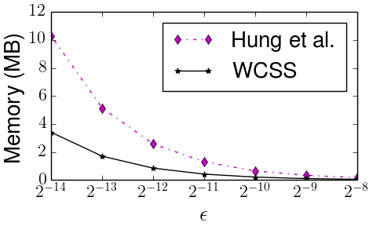
Sliding Windows Algorithms have Improved – the WCSS algorithm
$$O\left(\frac{1}{ε}\right)$$
$$O\left(1\right)$$
Ben Basat et al., Heavy Hitters in Streams and Sliding Windows, IEEE INFOCOM 2016

Slide 11
Markedly slower and less space-efficient in practice?
“Count each prefix independently.”
WCSS
Almost as fast as the (non-window) MST algorithm.
But far slower than RHHH.
WCSS
Compute all prefixes
181.7.20.6
181.7.20.6
181.7.20.*
WCSS
181.7.*.*
181.*.*.*
WCSS
*.*.*.*
WCSS
Mitzenmacher et al., Hierarchical Heavy Hitters with the Space Saving Algorithm, ALENEX 2012

Slide 12
Strawman #1
“Select a prefix at random and count it”
WCSS (W/5)
WCSS (W/5)
Problem:
The WCSS instances go out of sync
Compute a random prefix
WCSS (W/5)
181.7.20.6
181.7.20.*
WCSS (W/5)
WCSS (W/5)

Slide 13
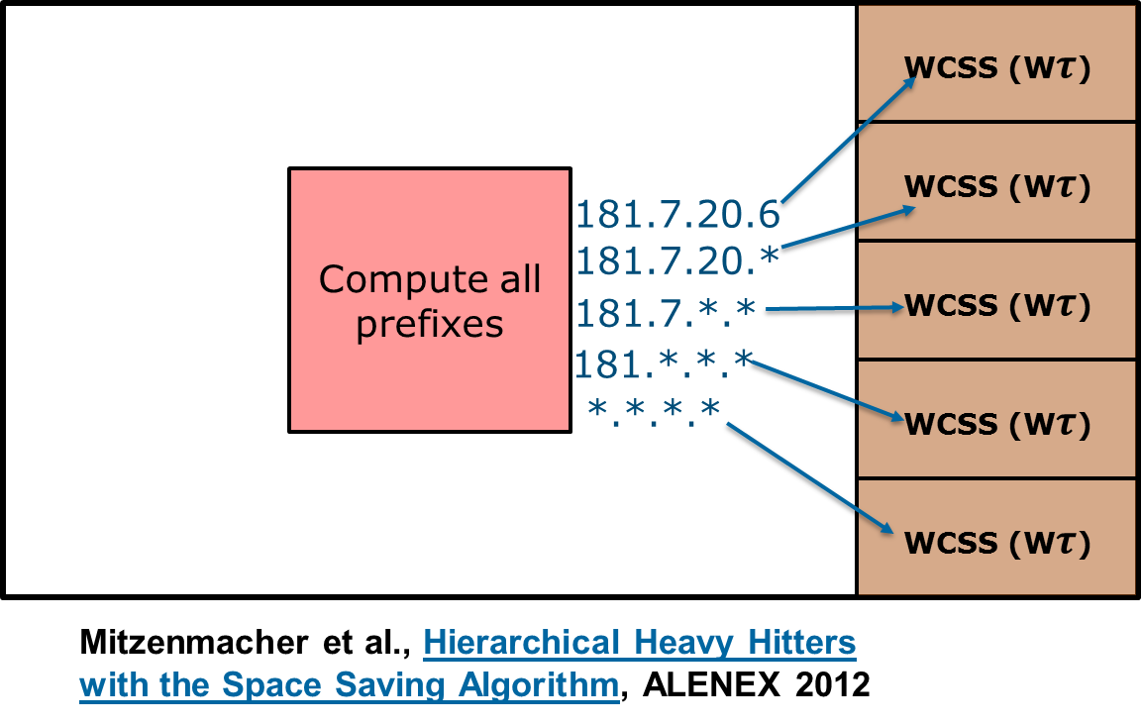
Strawman #2
“Flip a coin to choose if to update”
Add with probability $τ$
Problem:
Instead of looking at W packets this reflects $W±Θ\left(\sqrt{W}\right)$
181.7.20.6
Otherwise
discard

Slide 14
Challenges
How to apply sampling for accelerating sliding window algorithms?
How to keep synchronization and reflect exactly $W$packets?
In addition, we want extend the single-switch solution to network-wide monitoring.

Slide 15
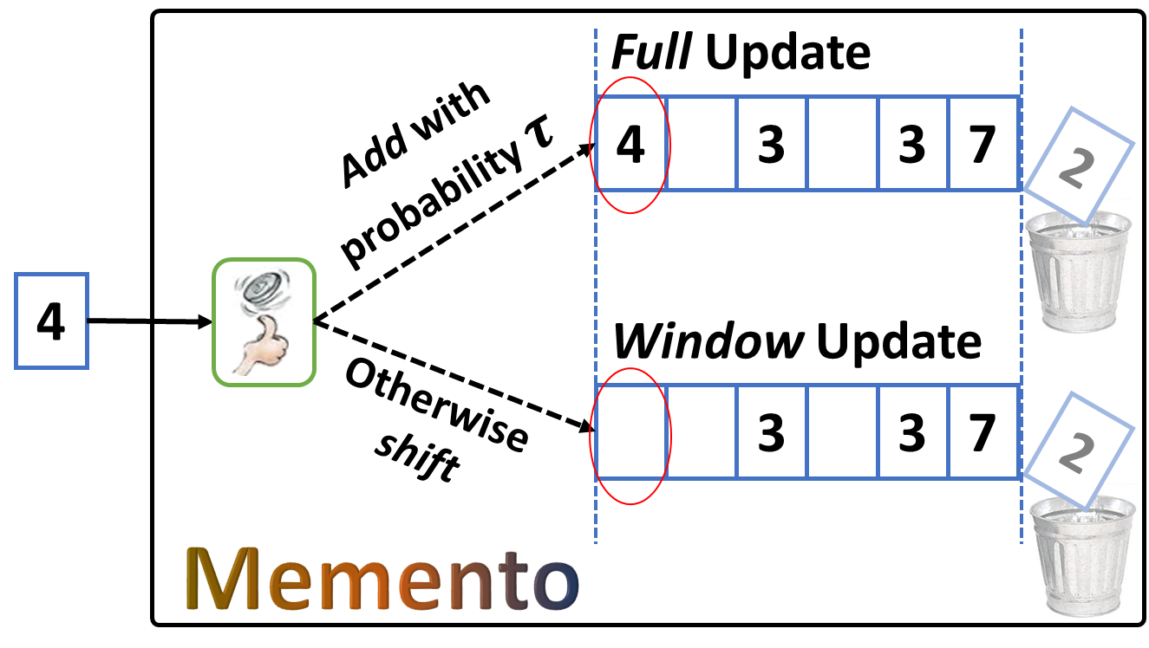
Memento – Efficient HH on Sliding Windows
Key idea: decouple the (lightweight) sliding operation from the (computationally expensive) counting step.

Slide 16
Performance Evaluation on Internet Traces
Ben Basat et al., Heavy Hitters in Streams and Sliding Windows, IEEE INFOCOM 2016

Slide 17
En route to HHH - Strawman #3
(but independently)
“Count each prefix efficiently .”
Memento
Still requires $O(H)$ update time
Memento
Compute all prefixes
181.7.20.6
181.7.20.*
Memento
181.7.20.6
181.7.*.*
181.*.*.*
Memento
*.*.*.*
Memento

Slide 18
H-Memento – HHH on Sliding Windows
“One prefix, one data structure.”
Random prefix
181.7.20.*
181.7.20.13
¥
Memento
H-Memento
¥
Same space as previous works, different structure

Slide 19
H-Memento – HHH on Sliding Windows

Slide 20
H-Memento – HHH on Sliding Windows (CoNEXT 2018)

Slide 21
D-Memento – From single node to network wide
Operators care about the entire network and require network-wide view.
port scans and superspreaders are not identifiable from a single node.
“Distributed Sliding Window”: reflect the last W packets that were measured anywhere in the network
No (direct) communication between measurement nodes
Minimal control bandwidth (configurable)
Different nodes may have different traffic rates

Slide 22
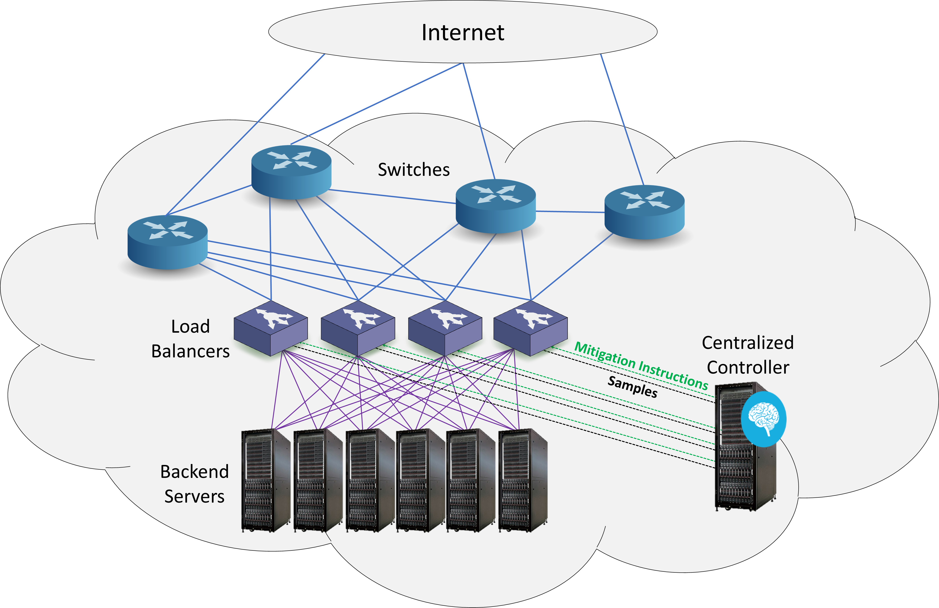
D-Memento – From single switch to network wide

Slide 23
D-Memento – From single switch to network wide
Aggregation: run a local algorithm at each point and sync with the controller as frequently as possible.
Sample: each measurement point samples each packet with probability $τ$ and sends samples to the controller that runs H-Memento.
Batch: collect samples before sending the report.
Increases the effective sampling rate.
Introduces reporting delay.

Slide 24
Evaluation: Distributed HTTP Flood attack using limited resources
How can we simulate O(10K) stateful connections from “distinct” IP addresses using a single attacking device?
$$srcip_{1}$$
$$srcip_{2}$$
$$srcip_{3}$$
$$srcip_{4}$$
$$srcip_{5}$$
$$srcip_{6}$$
$$srcip_{7}$$
$$…$$

Slide 25
Evaluation: Distributed HTTP Flood attack using limited resources
How can we simulate O(10K) stateful connections from “distinct” IP addresses using a single attacking device?
Attacker side:
Server side:
Create a mapping between port numbers and source IPs
Change IP tables to redirect all packets back to the attacker’s interface.
In egress, translate from port number to determine “source” IP
Make sure to compute checksum, etc.
At ingress, translate from destination IP to port number

Slide 26
Evaluation: Distributed HTTP Flood attack using limited resources
We use legitimate data and inject malicious traffic from 50 random 16-bit subnets which make up for 70% of the traffic.
We deployed 10 HAProxy load balancer instances that report to a centralized controller using 1 byte/request control bandwidth.
The attackers perform a TCP handshake and send an HTTP POST request.

Slide 27
Evaluation: Distributed HTTP Flood attack using limited resources

Slide 28
Conclusions
Sliding window solutions can be (nearly) as efficient as interval ones.
We extended HAProxy to network rate-limiting.
Open source: https://github.com/DHMementoz/Memento
Memento provides a measurement infrastructure for DDoS identification, mitigation, and evaluation.

Slide 29
Any Questions

Slide 30
Any Questions

Slide 31
Any Questions

Slide 32
Any Questions

Slide 33
Any Questions

Slide 34
Any Questions

Slide 35
Any Questions

