Slide 1
Quasi Fat Trees for HPC Clouds and their
Fault-Resilient Closed-Form Routing
Eitan Zahavi*
Isaac Keslassy
Avinoam Kolodny
HOTI 2014
Technion - EE Department; *and Mellanox Technologies

Slide 2



What is common to these Clusters?
They are all Utility Clusters
Their network topologies is Quasi Fat Tree

Slide 3
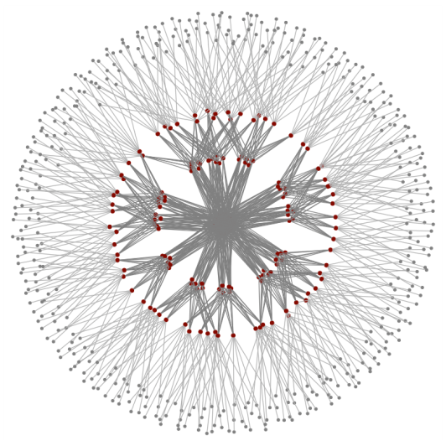
Fat Trees
Commonly used in HPC
Lately also in Data Centers
Why?
  Flexible tradeoff of BW vs. cost
  Superior in number of minimum paths
  Very shallow, very wide

Slide 4
The Fat Tree Evolution
A Tree
  Trivial forwarding
  Link capacity grows towards the root
    This ensures no contention for ALL permutations
1
2
M
1
2
N
1
2
N
1
2
N
[1] C. E. Leiserson, “Fat-trees: universal networks for hardware-efficient supercomputing,” IEEE Trans. Computing 1985.

Slide 5
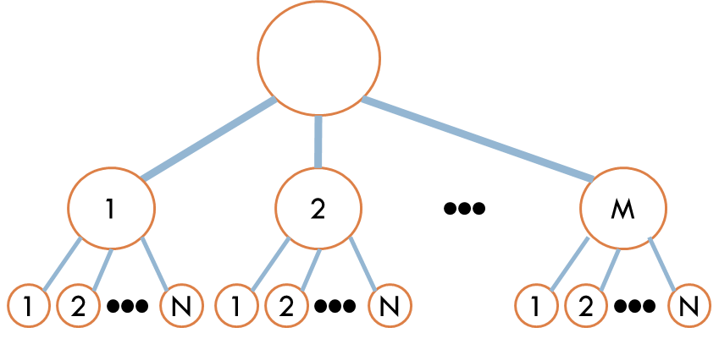
Multi Root Fat Trees
E.g. k-ary n-tree
  Scaleable since all switches/links are identical
  Static Routing = some permutations are contending
  The constant “k” – represents half the number of switch ports
    If same switch device is used for all levels, top switches utilize only half their ports
n
k
k
2
k
k
1
4-ary 3-tree
[2] F. Petrini and M. Vanneschi, “k-ary n-trees: high performance networks for massively parallel architectures,”
in Parallel Processing Symposium, 1997.

Slide 6


Extended Generalized Fat Tree - XGFT
Allows varying of “k” per level
Graph structure is formally defined
  Maintains: A single link between switches; Being collection of trees
Flexible Bisectional Bandwidth
$$XGFT(h; m1…mh; w1…wh)$$
n
m₃
h
k
k
w₃
2
2
k
m₂
k
w₂
1
m₁
1
w₁
4-ary 3-tree
$$XGFT(3;4,2,8;1,2,8)$$
[3] S. R. Ohring, et al., “On generalized fat trees,” in IPPS 1995

Slide 7
The 3 level XGFT of 8 port switches
This is the single and maximal constant bisectional bandwidth XGFT of 3 levels 8 ports switches !

Slide 8
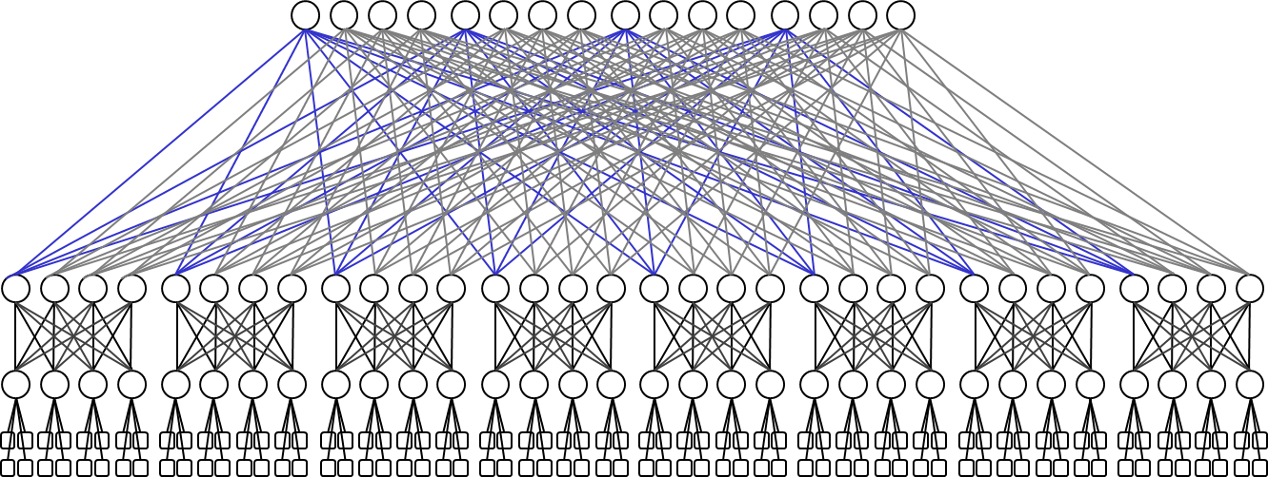
Building non-maximal topology
Given a switch device of 8 ports, build 64 nodes XGFT tree
  Remember only a single link is allowed between a pair of switches
2

Slide 9
Parallel Ports Generalized Fat Trees
Allow parallel ports (introduce port objects and numbering)
XGFT has dangling 2 ports for each levels 1 or 2 switches
PGFT allows parallel links – so now all ports being used
2
2
XGFT
PGFT

Slide 10
The Quasi Fat Tree
Provides better use for the extra links:
Connect to side branches and reduce average diameter
QFT is no longer a collection of trees
On Fat Tree there is a single path* from parent switch to any of its children. On QFT there are several such paths
Parent
Parent
XGFT
QFT
Child
Child

Slide 11
QFT reduces the Effective Diameter
Smaller jobs see higher impact on their effective diameter
If jobs fits into a sub-tree it gets lower latency and higher BW
QFT provides the maximal number of hosts in a sub-tree
  It is independent of cluster size
  PGFTs sub-tree size is reduced with the cluster size
sub tree
sub tree
2
2
PGFT
QFT

Slide 12
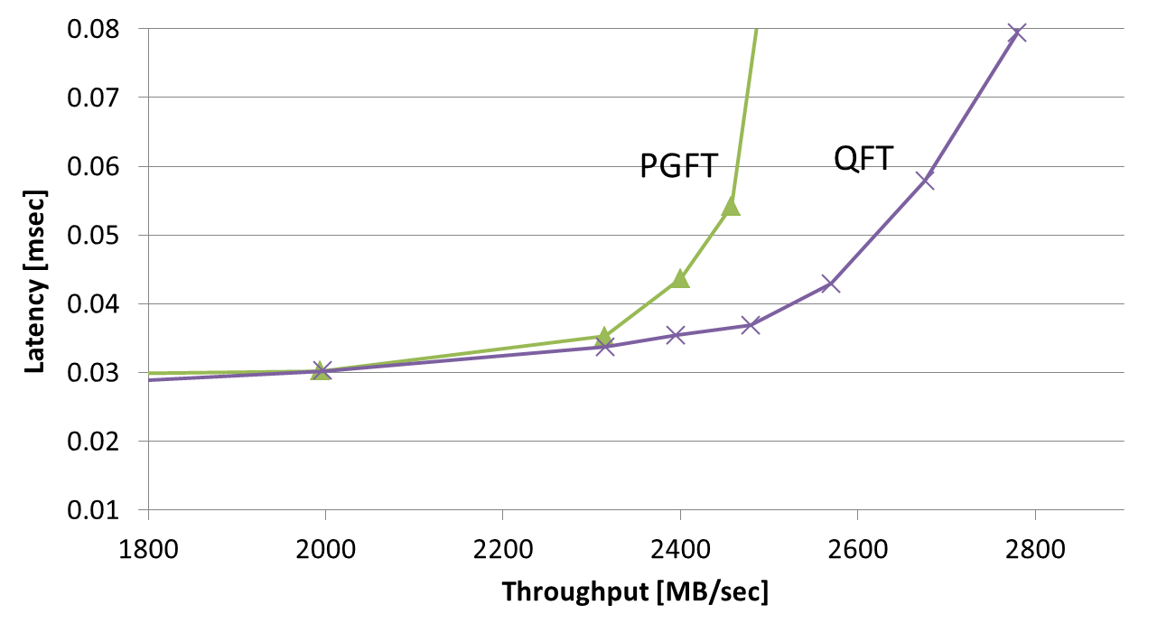
12 Jobs on PGFT/QFT
An experiment to show the impact of the larger QFT sub-trees
  A 4536 nodes 3 level PGFT and QFT Fat Trees
  12 jobs of job size Normal(300,20)
      Realistic placement of continuous fragments of TruncNormal(36,10)
      Traffic is random Shift Permutations
      MPI is sensitive to Max Latency / Min BW

Slide 13
From Many Small Jobs to Single Large Job
So far, we showed why QFT provides better
performance then other Fat Trees
for many concurrent small jobs
Can QFT compete with other Fat Trees
for single largest MPI job performance?

Slide 14
MPI Collectives mostly use Shifts
Collectives are used by most applications for best performance
Shift permutations are the traffic pattern of ALL the Collectives
  In most MPI implementations for medium and large messages
  In every distance “d” the permutation is: Dst = (Src + d) % N
0
1
2
3
4
5
6
d = 1
d = 2
d = 3
d = 4
[4] E. Zahavi, “Fat-Trees Routing and Node Ordering Providing Contention Free Traffic for MPI Global Collectives,”
IPDPS CASS, 2011

Slide 15
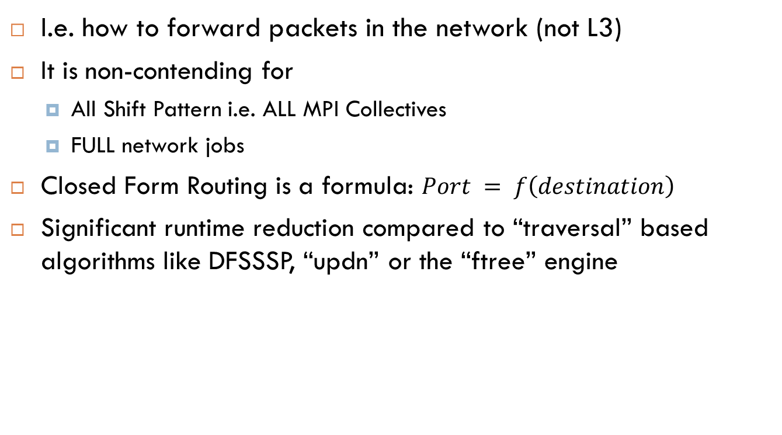
Routing for QFT
I.e. how to forward packets in the network (not L3)
It is non-contending for
  All Shift Pattern i.e. ALL MPI Collectives
  FULL network jobs
Closed Form Routing is a formula: $Port = f\left(destination\right)$
Significant runtime reduction compared to “traversal” based algorithms like DFSSSP, “updn” or the “ftree” engine

Slide 16
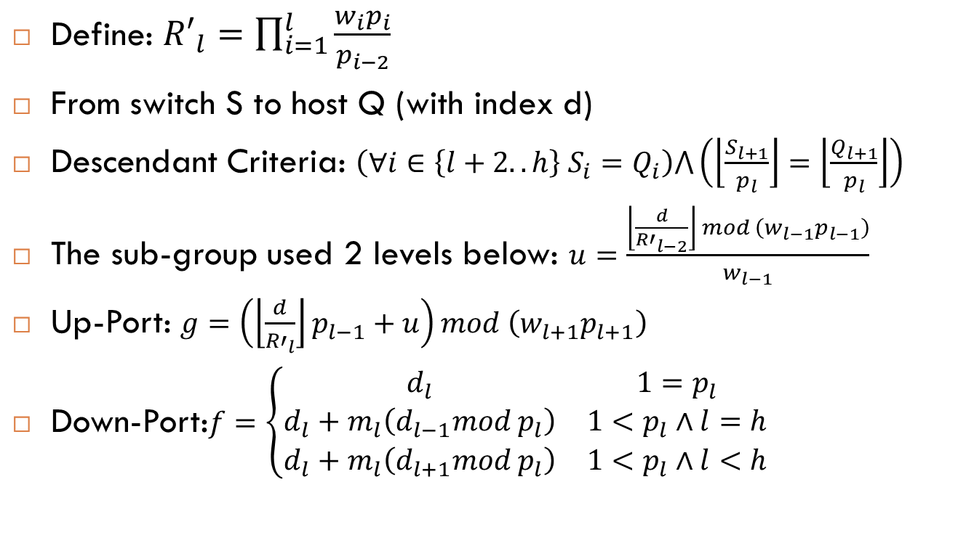
Routing is a Formula
Define: ${R′}_{l}=\prod_{i=1}^{l}{\frac{w_{i}p_{i}}{p_{i−2}}}$
From switch S to host Q (with index d)
Descendant Criteria: $\left(∀i∈\left\{l+2..h\right\} S_{i}=Q_{i}\right)⋀\left(\left\lfloor \frac{S_{l+1}}{p_{l}}\right\rfloor =\left\lfloor \frac{Q_{l+1}}{p_{l}}\right\rfloor \right)$
The sub-group used 2 levels below: $u=\frac{\left\lfloor \frac{d}{{R′}_{l−2}}\right\rfloor mod \left(w_{l−1}p_{l−1}\right)}{w_{l−1}}$
Up-Port: $g=\left(\left\lfloor \frac{d}{{R′}_{l}}\right\rfloor p_{l−1}+u\right)mod \left(w_{l+1}p_{l+1}\right)$
Down-Port:$f=\left\{\begin{matrix}d_{l} & 1=p_{l} \\ d_{l}+m_{l}\left(d_{l−1}mod p_{l}\right) & 1<p_{l}∧l=h \\ d_{l}+m_{l}\left(d_{l+1}mod p_{l}\right) & 1<p_{l}∧l<h\end{matrix}\right.$

Slide 17
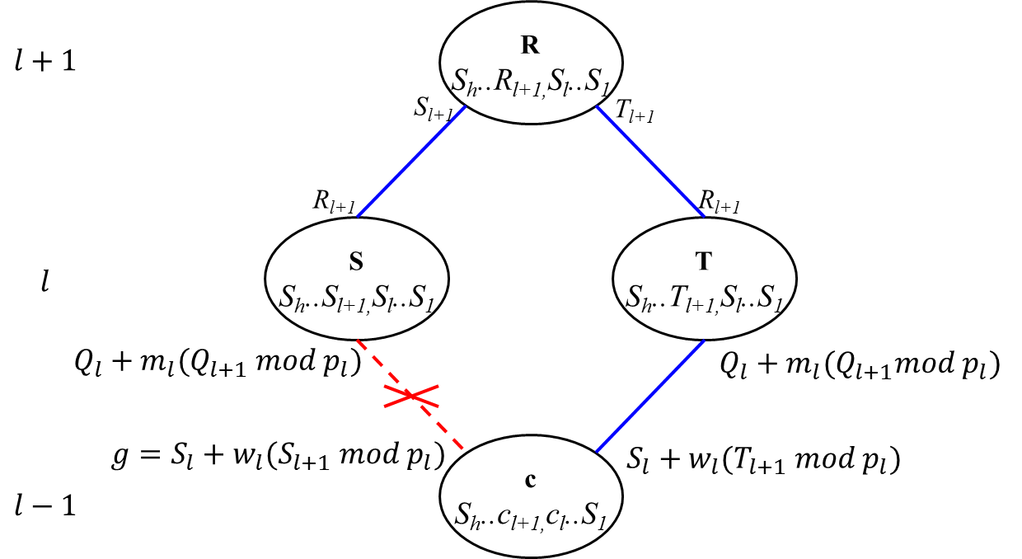
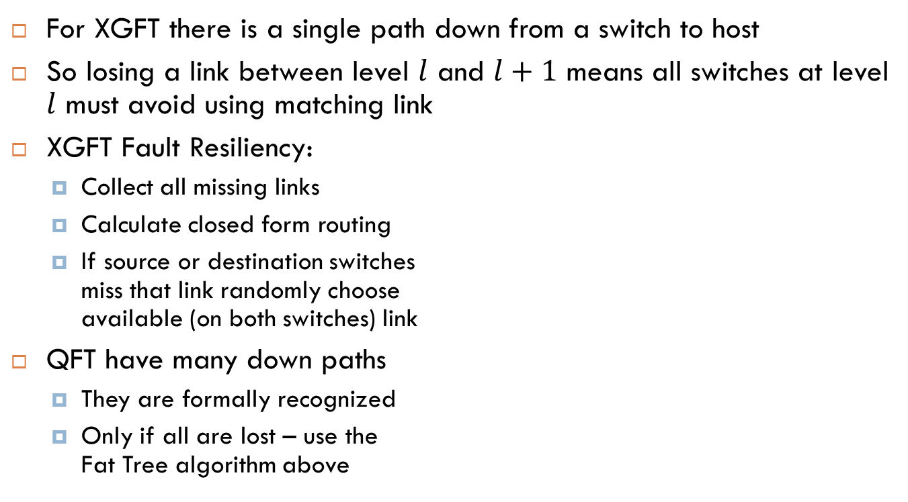
Fault Resiliency
For XGFT there is a single path down from a switch to host
So losing a link between level $l$ and $l+1$ means all switches at level $l$ must avoid using matching link
XGFT Fault Resiliency:
  Collect all missing links
  Calculate closed form routing
  If source or destination switches
  miss that link randomly choose
  available (on both switches) link
QFT have many down paths
  They are formally recognized
  Only if all are lost – use the
  Fat Tree algorithm above
[5] Zhu Ding,et al, “Level-wise Scheduling Algorithm for Fat Tree Interconnection Networks,” SC 2006

Slide 18
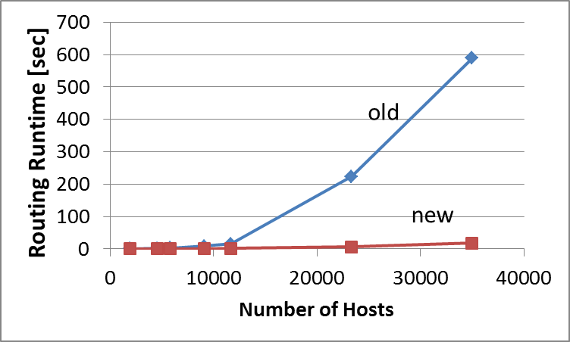
Evaluation
Correctness
  Proven as non contending [6]
  New algorithm coded as part of OpenSM “pqft” engine
  Verified to provide non-contention routing for all shift permutations
Runtime improvements (of single thread implementation)
Old “ftree”
New pqft
[6] http://technion.ac.il/~ezahavi/papers/qft_tr03_2014.pdf

Slide 19
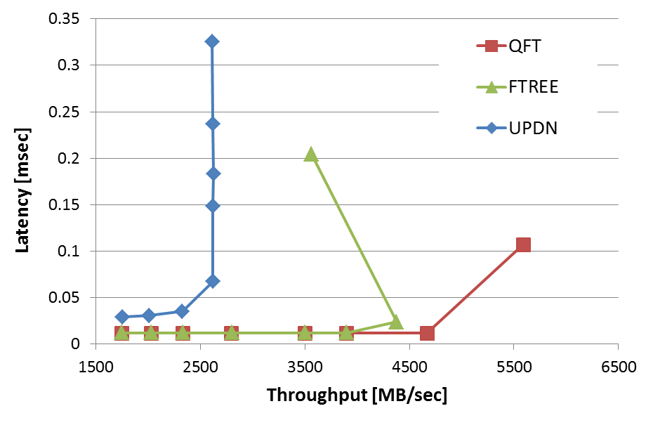

Single Job BW Saturation
A single MPI job random Shift permutations
Results show much higher saturation throughput for new “pqft” algorithm – throughput reaches the link BW – no contention
Old “updn”
Old “ftree”
New pqft
Random Shift permutations

Slide 20
Conclusions
We defined and formulate QFT
Non-Contention routing for global shifts
This routing is closed form and resilient
QFT outperforms other known Fat Tree flavors in both single job and multiple jobs scenarios

Slide 21

Thank you
Questions?

