Slide 1



Routing Keys
25th Annual Symposium of High-Performance Interconnects
Asaf Samuel, Eitan Zahavi,
Isaac Keslassy
Technion EE, Mellanox,
VMware

Slide 2

HPC and Datacenter Networks
Today’s datacenters and HPC networks consist of tens of thousands of nodes
Enable communication between each pair of nodes in the network
Network congestion can significantly impact application’s performance
Our Goal: Reduce completion time by reducing communication time

Slide 3
Introduction- Clos Topology
2- level Folded Clos

Slide 4
Introduction- Clos Topology
2- level Folded Clos

Slide 5
Routing Example

Slide 6
Intra-Application Contention

Slide 7
Inter-Application Contention

Slide 8
Application Lifetime
APP A
  Flow 1:
  Flow 2:
  Flow 3:
Time
Synchronization Barriers
Wasted Resources
Computation Communication

Slide 9
Inter Vs. Intra communication
Synchronization
APP A
APP B
  Flow 1:
  Flow 2:
  Flow 3:
  Flow 1:
  Flow 2:
  Flow 3:
Computation Communication

Slide 10
Inter Vs. Intra communication
Synchronization
APP A
APP B
  Flow 1:
  Flow 2:
  Flow 3:
  Flow 1:
  Flow 2:
  Flow 3:
Computation Communication

Slide 11
Inter-Intra Contention Decoupling
Routing
Problem
Decouple
Intra
Inter
Per Application
Greedy Optimization
App 1
App 2
…
App n
Optimal
ARK
NRK
At placement
At each communication phase

Slide 12
Eliminating Intra-Application Contention
Routing
Problem
Intra
Inter
App 1
App n
ARK
NRK

Slide 13
Reducing Inter-Application Contention
Routing
Problem
Intra
Inter
App 1
App n
ARK
NRK

Slide 14
Reducing Inter-Application Contention
Routing
Problem
Intra
Inter
App 1
App n
ARK
NRK

Slide 15

Contributions
New Concepts
  Routing Keys: a new routing paradigm
  Inter/intra contention decoupling
ARK (Application Routing Key)
  Intra-application contention free routing
  Proactive
  Scalable
NRK (Network Routing Keys)
  Enhanced ARK: keeps intra-application contention free routing
  Inter-application contention reduction
  Scalable

Slide 16

Related Work
Oblivious routing
  D-mod-K, Presto[’15]
    Easy implementation
    Scalable
    Poor load balancing for certain traffic patterns
Congestion-aware routing
  Conga[’14], Hula[’16]
    High performance at steady state
    Out-of-order arrivals
    High complexity
    Scalability issues

Slide 17
Related Work
Centralized routing
  Hedera[’10], MicroTE[’11], SWAN[’13], Fastpass[’14].
    High performance at small network
    Requires tracking global network state
    High complexity
    Scalability issues
Application-aware routing
  BSOR[’09], Transcom[’11], Rapier[’15]
    Exploit application information
    Complex (solving MILP/LP problems)
    Hard to scale

Slide 18
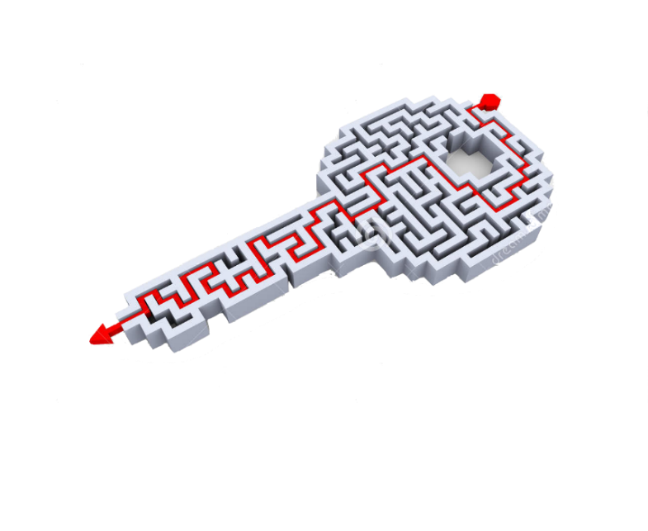
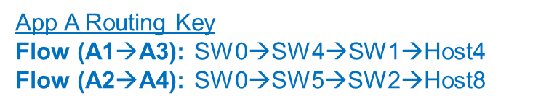
What is a Routing Key?
Routing key
  A key defines the routing of all flows across the network for a given application
Example
App A Routing Key
Flow (A1$→$A3): SW0→SW4→SW1→Host4
Flow (A2→A4): SW0→SW5→SW2→Host8

Slide 19
ARK (Application Routing Key)
Intra-application contention free
Application-aware routing
Each application on its own
Proactive approach: can be calculated offline at placement time (or during computation phase)

Slide 20
ARK Implementation Design
Configure
routing
Configure
routing
request
Application manager
Traffic pattern
information
Routing metadata
(e.g. LMC)
Notes:
GO SLOWLY
Before – motivation RKEY, next research, network arch.
How to create the keys to avoid intra-contention.
3 main components
Infiniband/ SDN
App manager
At placement time, traffic pattern information.
Inside the scheduler, we compute the routing keys, app aware.
“routing metadata” - only once!
Later, our suggestion.
Next, the scheduler requests the network controller according to keys.
Finally prepares the network
Controlling the route not trivial - LMC
leverage on LMC to implement the routing key.

Slide 21
Controlling the Route in Infiniband
LMC: LID (Local Identifier) Mask Control
Configure
routing
Configure
routing
request
Application manager
Traffic pattern
information
Placement +
Routing metadata
(e.g. LMC)

Slide 22
Controlling the Route in Infiniband
LMC: LID (Local Identifier) Mask Control
Link Layer Header:
No LMC
40
...…. |  | ...….
DLID
(dest. LID)
LID | Port
10 | 0
20 | 0
30 | 1
40 | 1
LID | Port
10 | 0
20 | 0
30 | 1
40 | 1
1
0
40 | 1
1
0 1
0 1
1 0
LID | Port
10 | 2
20 | 3
30 | 0
40 | 1
LID | Port
10 | 0
20 | 1
30 | 2
40 | 3
2 3 2 3
X Y
LID: (10) (20) (30) (40)

Slide 23
Controlling the Route in Infiniband
LMC: LID (Local Identifier) Mask Control
Link Layer Header:
No LMC
...…. |  | ...….
DLID
(dest. LID)
LID | Port
10 | 0
20 | 0
30 | 1
40 | 1
LID | Port
10 | 0
20 | 0
30 | 1
40 | 1
1
0
0 1
0 1
1 0
LID | Port
10 | 2
20 | 3
30 | 0
40 | 1
LID | Port
10 | 0
20 | 1
30 | 2
40 | 3
2 3 2 3
X Y
LID: (10) (20) (30) (40)
Sending to destination LID(30)

Slide 24
Controlling the Route in Infiniband
LMC: LID (Local Identifier) Mask Control
Link Layer Header:
No LMC
...…. | 30 | ...….
DLID
(dest. LID)
LID | Port
10 | 0
20 | 0
30 | 1
40 | 1
LID | Port
10 | 0
20 | 0
30 | 1
40 | 1
1
0
0 1
0 1
1 0
LID | Port
10 | 2
20 | 3
30 | 0
40 | 1
LID | Port
10 | 0
20 | 1
30 | 2
40 | 3
2 3 2 3
X Y
LID: (10) (20) (30) (40)
Sending to destination LID(30)

Slide 25
Controlling the Route in Infiniband
LMC: LID (Local Identifier) Mask Control
Link Layer Header:
With LMC (1 bit)
...…. | 30 | ...….
DLID
(dest. LID)
LID | Port | LID | Port
10 | 0 | 11 | 0
20 | 0 | 21 | 0
30 | 1 | 31 | 1
40 | 1 | 41 | 1
LID | Port | LID | Port
10 | 0 | 11 | 0
20 | 0 | 21 | 0
30 | 1 | 31 | 1
40 | 1 | 41 | 1
1
0
0 1
0 1
1 0
LID | Port | LID | Port
10 | 2 | 11 | 2
20 | 3 | 21 | 3
30 | 0 | 31 | 1
40 | 1 | 41 | 0
LID | Port | LID | Port
10 | 0 | 11 | 1
20 | 1 | 21 | 0
30 | 2 | 31 | 2
40 | 3 | 41 | 3
2 3 2 3
X Y
LID: (10,11) (20,21) (30,31) (40,41)
Sending to destination LID(30)
Sending to destination LID(31)

Slide 26
Controlling the Route in Infiniband
LMC: LID (Local Identifier) Mask Control
Link Layer Header:
With LMC (1 bit)
...…. | 30 | ...….
DLID
...…. | 31 | ...….
DLID (dest. LID)
LID | Port | LID | Port
10 | 0 | 11 | 0
20 | 0 | 21 | 0
30 | 1 | 31 | 1
40 | 1 | 41 | 1
LID | Port | LID | Port
10 | 0 | 11 | 0
20 | 0 | 21 | 0
30 | 1 | 31 | 1
40 | 1 | 41 | 1
1
0
0 1
0 1
1 0
LID | Port | LID | Port
10 | 2 | 11 | 2
20 | 3 | 21 | 3
30 | 0 | 31 | 1
40 | 1 | 41 | 0
LID | Port | LID | Port
10 | 0 | 11 | 1
20 | 1 | 21 | 0
30 | 2 | 31 | 2
40 | 3 | 41 | 3
2 3 2 3
X Y
LID: (10,11) (20,21) (30,31) (40,41)
Sending to destination LID(30)
Sending to destination LID(31)

Slide 27
Routing Keys with LMC
Link Layer Header:
KEY 1 – path bit 0
KEY 2 – path bit 1
...…. | 30 | ...….
...…. | 31 | ...….
DLID (dest. LID)
LID | Port | LID | Port
10 | 0 | 11 | 0
20 | 0 | 21 | 0
30 | 1 | 31 | 1
40 | 1 | 41 | 1
LID | Port | LID | Port
10 | 0 | 11 | 0
20 | 0 | 21 | 0
30 | 1 | 31 | 1
40 | 1 | 41 | 1
1
0
0 1
0 1
1 0
LID | Port | LID | Port
10 | 2 | 11 | 2
20 | 3 | 21 | 3
30 | 0 | 31 | 1
40 | 1 | 41 | 0
LID | Port | LID | Port
10 | 0 | 11 | 1
20 | 1 | 21 | 0
30 | 2 | 31 | 2
40 | 3 | 41 | 3
2 3 2 3
X Y
LID: (10,11) (20,21) (30,31) (40,41)

Slide 28
ARK Creation Algorithm
How to produce an intra-app contention-free routing key
Configure
routing
Configure
routing
request
Application manager
Traffic pattern
information
Placement +
Routing metadata
(e.g. LMC)

Slide 29
ARK Creation Algorithm
How to produce an intra-app contention-free routing key
ToR src Middle ToR dst
switches switches switches
0
1
2
3
4
5
6
7
8
9
10
11
12
13
14
15
0
1
2
3
4
5
6
7
8
9
10
11
12
13
14
15
0
1
2
3
4
5
6
7
8
9
10
11

Slide 30
ARK Creation Algorithm
How to produce an intra-app contention-free routing key
ToR src Middle ToR dst
switches switches switches
0
1
2
3
4
5
6
7
8
9
10
11
12
13
14
15
0
1
2
3
4
5
6
7
8
9
10
11
12
13
14
15
0
1
2
3
4
5
6
7
8
9
10
11

Slide 31
ARK Creation Algorithm
How to produce an intra-app contention-free routing key
ToR src Middle ToR dst
switches switches switches
0
1
2
3
4
5
6
7
8
9
10
11
12
13
14
15
0
1
2
3
4
5
6
7
8
9
10
11
12
13
14
15
Repeat until all flows mapped:
Solve Max Cardinality Matching (Hopcroft-Karp)
Map flows to middle switch
0
1
2
3
4
5
6
7
8
9
10
11

Slide 32
ARK Creation Algorithm
How to produce an intra-app contention-free routing key

Slide 33
ARK Creation Algorithm
How to produce an intra-app contention-free routing key
Repeat until all flows mapped:
Solve Max Cardinality Matching (Hopcroft-Karp)
Map flows to middle switch
Remove edges

Slide 34
ARK Creation Algorithm
How to produce an intra-app contention-free routing key

Slide 35
ARK Creation Algorithm
How to produce an intra-app contention-free routing key

Slide 36
ARK
0
1
2
3
4
5
6
7
8
9
10
11
12
13
14
15
0
1
2
3
4
5
6
7
8
9
10
11
12
13
14
15
0
1
2
3
4
5
6
7
8
9
10
11
0: SW0 → SW4 → SW10 →Host11
1: SW0 → SW5 → SW11 →Host12
2: SW1 → SW6 → SW10 →Host9
3: SW1 → SW4 → SW11 →Host13
4: SW2 → SW4 → SW9 →Host4
5: SW2 → SW6 → SW11 →Host14
6: SW3 → SW4 → SW8 →Host0
7: SW3 → SW5 → SW10 →Host8

Slide 37
NRK (Network Routing Keys)
ARK enhancement
⇒No intra-application contention
Reduction of inter-application contention
Run-time optimization with low complexity

Slide 38
NRK (Network Routing Keys)
Original ARK
Used link by another application

Slide 39
NRK (Network Routing Keys)
Original ARK
Used link by another application

Slide 40
NRK (Network Routing Keys)
Original ARK
Used link by another application

Slide 41
NRK (Network Routing Keys)
Original ARK
Used link by another application

Slide 42
NRK (Network Routing Keys)
Original ARK
Used link by another application

Slide 43
NRK Final Permutation
ARK
NRK

Slide 44

Simulator
Mellanox InfiniBand flit-level simulator based on OMNet++
  Credit propagation times
  Virtual-output-queue based switching
Forwarding database generated by OpenSM
New syntax for MPI collective applications
Support request for Routing Keys

Slide 45
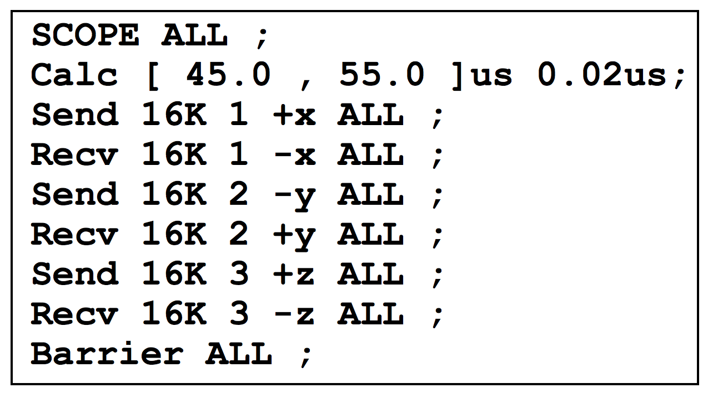
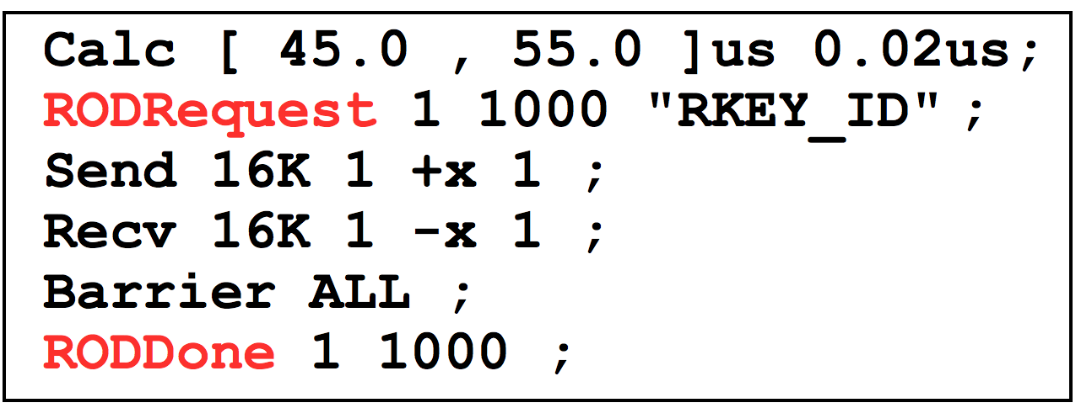
MPI Support +
Routing Key Support
MPI Collective Syntax
Route-on-Demand Request

Slide 46
Simulation Setup
Topology
  1728 nodes
  3-level fat-tree
Algorithms
  D-mod-K
  Conga
  ARK
  NRK
Workload
  N=1728 hosts
  M stencil applications
  N/M hosts per application
Mapping
  Random: avoids mapping optimization
Measure
  Max communication time
Utilization
  Utilization =

Slide 47
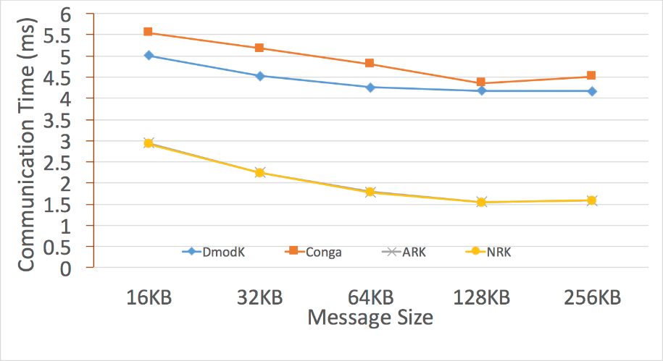
Simulations
Conga
D-mod-K
ARK
NRK
Lower is better
2 Applications – 864 hosts per application

Slide 48
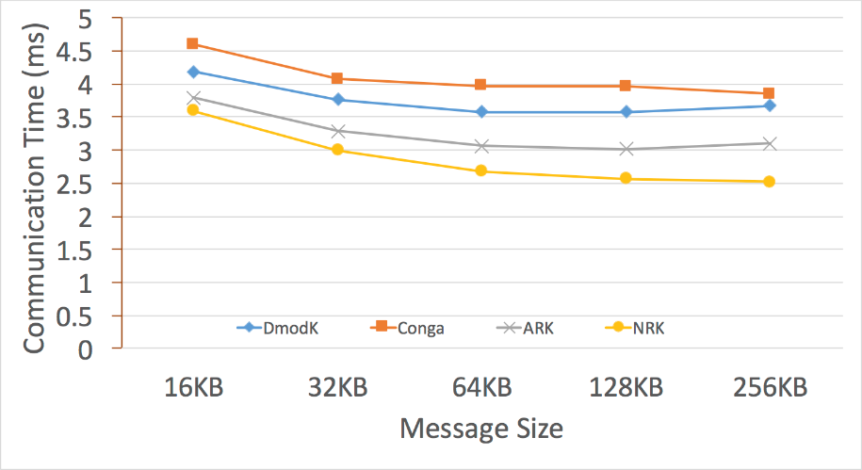
Simulations
Conga
D-mod-K
ARK
NRK
Lower is better
8 Applications – 216 hosts per application

Slide 49
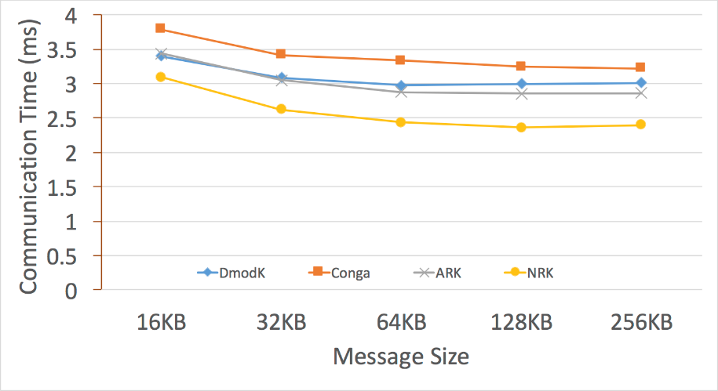
Simulations
Conga
D-mod-K
ARK
NRK
Lower is better
32 Applications – 54 hosts per application

Slide 50
Summary
Routing keys
  A new routing paradigm
  Application-aware
  Scalable
Decouple intra and inter contention
  Break the big routing problem into smaller problems
ARK (Application Routing Key)
  No intra-application contention
NRK (Network Routing Keys)
  Enhanced ARK
    No intra-application contention
    Inter-application contention reduction

Slide 51
Thank You!

