Slide 1



Petabit Router-in-a-Package: Rethinking Internet Routers in the Age of In-Packaged Optics and Heterogeneous Integration
Isaac Keslassy
Bill Lin

Slide 2


Computer Industry Undergoing a Radical Shift Due to Conventional Scaling Stalling
Raw gate delays improving < 1.2X every 2-3 years
3nm → 2nm → 18A → 14A
forecast
LLMs increasing 50X every 2 years!

Slide 3

Groundbreaking Scaling Transformations from the Computer Industry: In-Package Photonics and High-Bandwidth Memory
Single “Big Chip” in a Package
Chiplets and HBMs (high bandwidth memories)
TB-scale memory capacity possible via many HBM stacks
Fiber Arrays
Petabit-scale photonic I/O possible via fiber array attachments
Photonic Interposer
Substrate
500mm x 500mm panel-scale package coming

Slide 4

How to Rethink Internet Routers With These Groundbreaking Scaling Transformations?
We explored the challenges in designing a single-package petabit router, starting from an example with total I/O = 1.31 Pb/s (655 Tb/s in each direction).

Slide 5
Challenge 1: How to process, buffer, and switch at these high speeds?
Idea 1: Distribute load among H smaller electronic switches
Panel-Scale Interposer
Input
Fiber
Ribbons
Output
Fiber
Ribbons
H Electronic
Switches
F/H WDM
waveguides
F/H WDM
waveguides
F fibers
1
Incoming traffic
(optical fibers)
Outgoing traffic
(optical fibers)
…
…
…
H

Slide 6
Challenge 2: Optical/Electronic/Optical (OEO) Conversion
Traffic arrives on optical fibers. Existing solutions assume
Incoming optical fibers
Electronic per-packet load-balancing at inputs
Optical wires
Electronic buffering at the H switches
Optical wires
Electronic processing at outputs
Optical fibers
⇒ 3 OEO conversions
Input
Fiber
Ribbons
Panel-Scale Interposer
Output
Fiber
Ribbons
F/H WDM
waveguides
H Electronic
Switches
F/H WDM
waveguides
F fibers
1
…
…
…
H

Slide 7
Split-Parallel Switch (SPS)
Idea 2: Don’t do advanced per-packet load-balancing. Just split the fibers equally among the H smaller switches ⇒ 1 OEO
Panel-Scale Interposer
Input
Fiber
Ribbons
Output
Fiber
Ribbons
Ribbon
Arrays
H Switches
WDM waveguides
F/H WDM
waveguides
F/H WDM
waveguides
F fibers
1
Switch
F fibers
…
…
…
H
SPS Architecture
Packaging View on 2.5D Photonic Interposer

Slide 8
How to leverage HBMs to design a high-performance switch?
Challenge 3: Each of the H = 16 internal switches must handle 1/H = 81.92 Tb/s total I/O traffic. How to handle this?
Idea 3: Leverage HBM’s enormous memory bandwidth.
HBM4 provides 20.48 Tb/s of peak data rate via 32 channels and a 2048-bit ultra-wide interface.
4 HBMs can provide 81.92 Tb/s peak data rate via 128 channels.
HBM4
HBM4
DRAM
DRAM
HBM4
HBM4
base die
base die
DRAM
DRAM
base die
base die

Slide 9
Challenge 4: Peak rates only possible with complex timing rules for accessing channels, banks, and rows
Huge difference between worst-case vs. peak data rates if parallel channels are not utilized and there are bank conflicts.
Reconcile:
Arbitrary traffic patterns,
Complex HBM access rules, and
Goal of strong and predictable performance guarantees.

Slide 10








HBM Switch with Parallel Frame Interleaving (PFI)
Idea 4: Group packets into frames and write them into (and read them from) banks in a staggered interleaved way that reaches peak data rates.
Frame
Interleaving
Cycle 1
Frame
Interleaving
Cycle 2
Bank $ℓ$
ACT
WR
PRE
Bank $ℓ+1$
ACT
WR
PRE
Bank $ℓ+2$
ACT
WR
PRE
Bank $ℓ+3$
ACT
WR
PRE
Bank η
ACT
RD
PRE
Bank η $+1$
ACT
RD
PRE
Bank η $+2$
ACT
RD
PRE
Bank η $+3$
ACT
RD
PRE
Bank θ
ACT
WR
PRE
PFI algorithm ensures all parallel channels are fully used, all activation, precharge, refresh operations are fully hidden in the pipeline.
The devil is in the details. See paper.
Bank θ $+1$
ACT
WR
Frame Writing Phase
Frame Reading Phase

Slide 11
Impact on Networking Future
Capacity increase: What if router capacity increased by 1-2 orders of magnitude?
Buffer sizing and buffer management: What if buffer sizes could be much larger?
Designing datacenter switches: Can this apply to datacenter switches?
Road ahead: Power appears to be our key scaling bottleneck, in particular processing power. Could we simplify per-packet processing needs in the Internet?

Slide 12
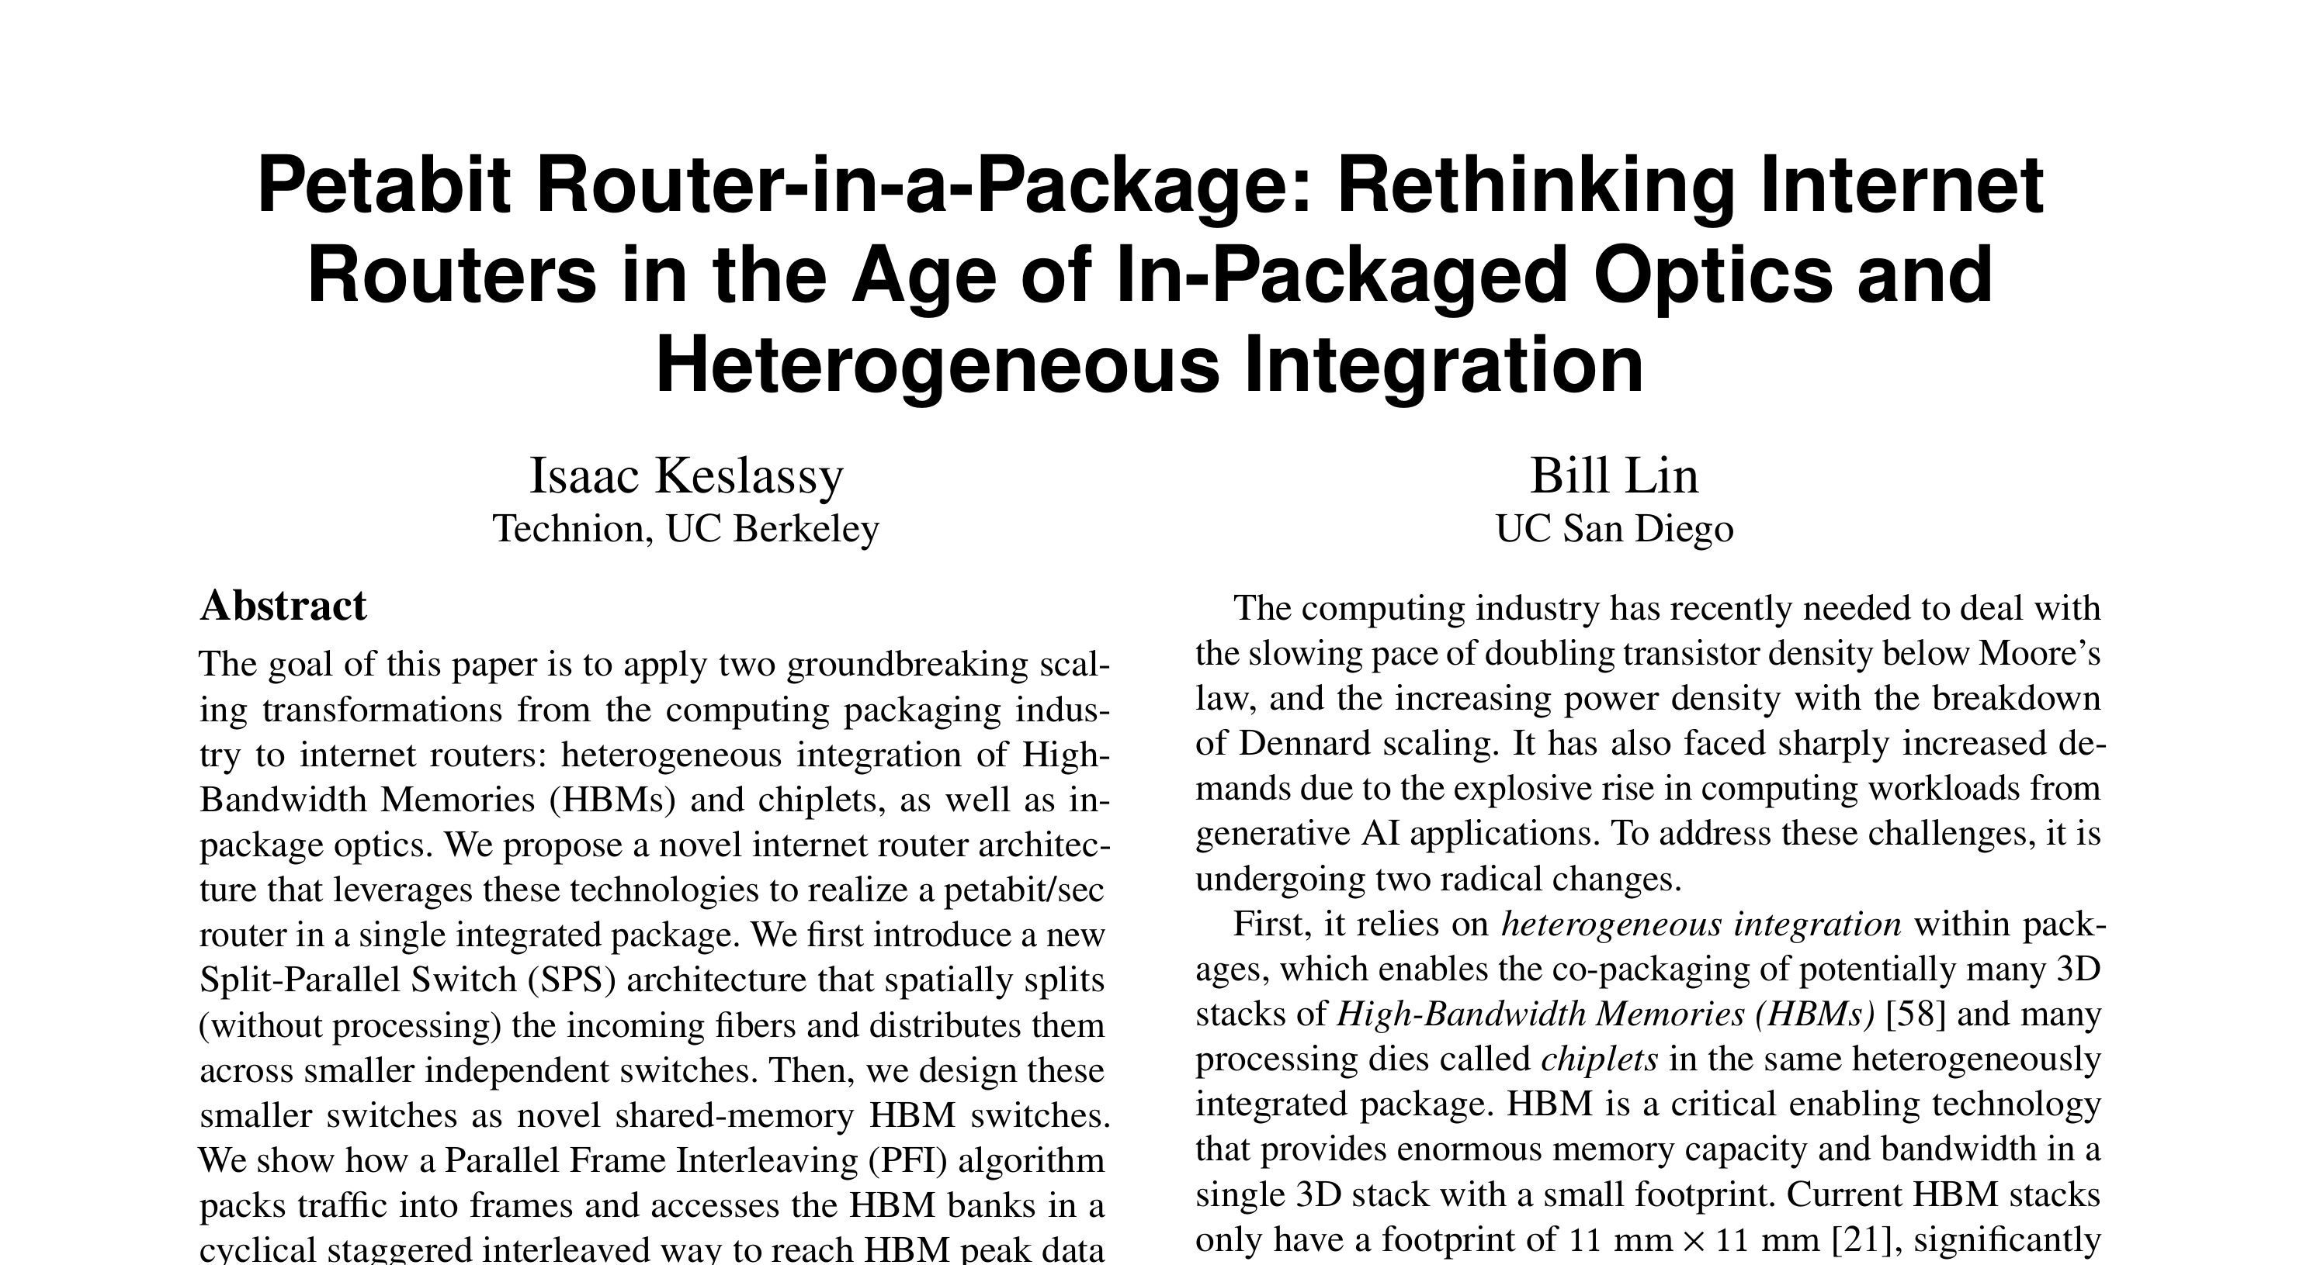
Thank You
Isaac Keslassy ✉ isaac@technion.ac.il
Bill Lin ✉ billlin@ucsd.edu

