Slide 1

IEEE HPSR 2014
Scaling Multi-Core Network Processors Without the Reordering Bottleneck
Alex Shpiner (Technion / Mellanox)
Isaac Keslassy (Technion)
Rami Cohen (IBM Research)

Slide 2
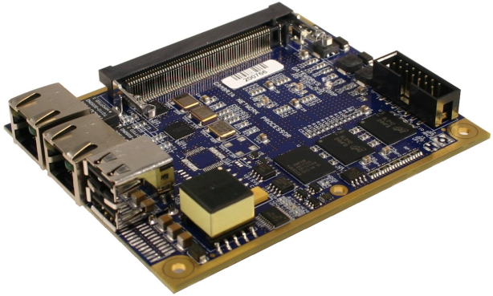
Network Processors (NPs)
NPs used in routers for almost everything
  Forwarding
  Classification
  Deep Packet Inspection (DPI)
  Firewalling
  Traffic engineering
  VPN encryption
  LZS decompression
  Advanced QoS
  …
  Increasingly heterogeneous processing demands.

Slide 3
Parallel Multi-Core NP Architecture
Each packet is assigned to a Processing Element (PE)
  Any per-packet load balancing scheme
E.g., Cavium CN68XX NP, EZChip NP-4

Slide 4
Packet Ordering in NP
NPs are required to avoid out-of-order packet transmission within a flow.
  TCP throughput, cross-packet DPI, statistics, etc.
Naïve solution is avoiding reordering at all.
  Heavy packets often delay light packets.
Can we reduce this reordering delay?
Stop!
2
1

Slide 5
The Problem
Reducing reordering delay
in parallel network processors

Slide 6
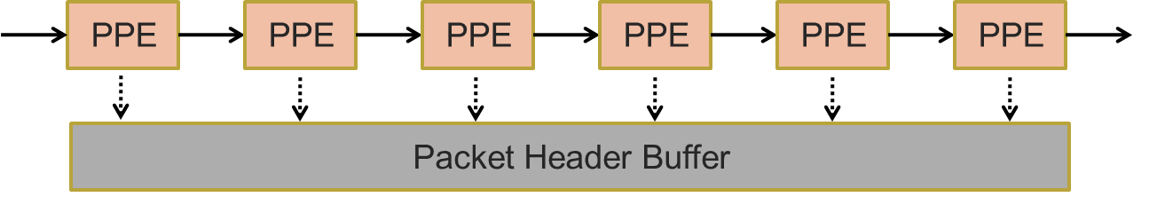
Multi-core Processing Alternatives
Static (hashed) mapping of flows to processing elements (PEs) [Cao et al., 2000], [Shi et al., 2005]
  Potential to insufficient utilization of the PEs.
Feedback-based adaptation of static mapping [Kencl et al., 2002], [He et al., 2010], [We et al., 2011]
  Causes packet reordering.
Pipeline without parallelism [Weng et al., 2004]
  Not scalable, due to heterogeneous requirements and commands granularity.

Slide 7

Single SN (Sequence Number) Approach
[Wu et al., 2005], [Govind et al., 2007]
SN (sequence number) generator.
Ordering unit - transmits only the oldest packet.
$⇒$Large reordering delay.
2
1

Slide 8
Per-flow Sequencing (Ideal)
Actually, we need to preserve order only within a flow.
[Khotimsky et al., 2002], [Wu et al., 2005], [Shi et al., 2007], [Cheng et al., 2008]
SN (sequence number) generator for each flow.
Ideal approach: minimal reordering delay.
Not scalable to a large number of flows [Meitinger et al., 2008]
13:1
47:1

Slide 9
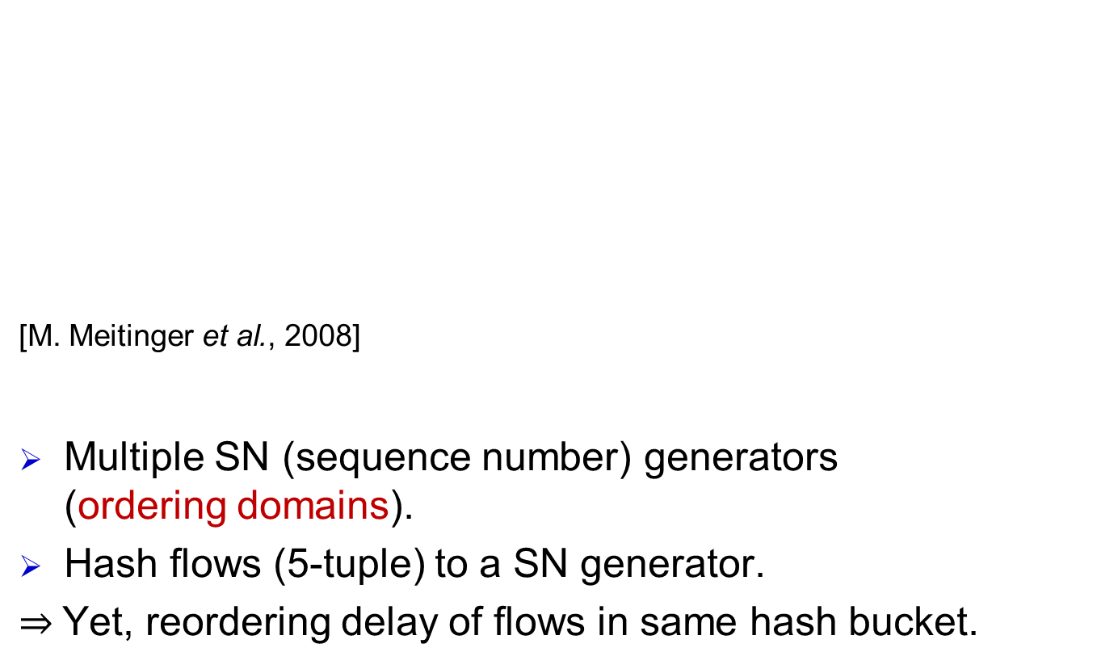
Hashed SN (Sequence Number) Approach
[M. Meitinger et al., 2008]
Multiple SN (sequence number) generators
(ordering domains).
Hash flows (5-tuple) to a SN generator.
$⇒$Yet, reordering delay of flows in same hash bucket.
7:1
1:2
1:1
Note: the flow is hashed to an SN generator, not to a PE

Slide 10
Our Proposal
Leverage estimation of packet processing delay.
Instead of arbitrary ordering domains created by a hash function, create ordering domains of packets with similar processing delay requirements.
  Heavy-processing packet does not delay light-processing packet in the ordering unit.
Assumption: All packets within a given flow have similar processing requirements.
  Reminder: required to preserve order only within the flow.

Slide 11
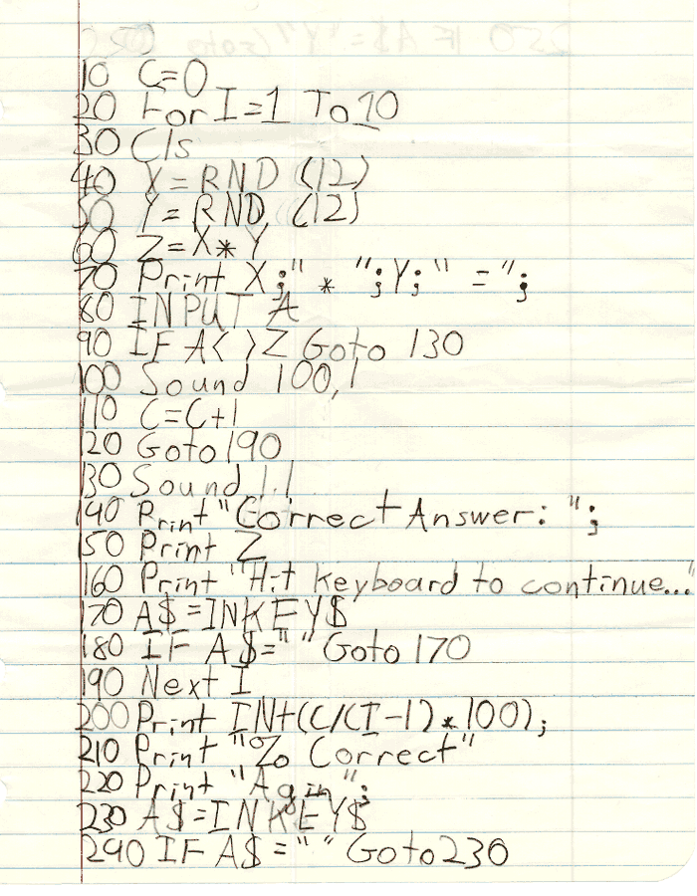
Processing Phases
E.g.:
IP Forwarding = 1 phase
Encryption = 10 phases
Processing phase #1
Processing phase #2
Disclaimer: it is not a real packet processing code
Processing phase #3
Processing phase #4
Processing phase #5

Slide 12
RP³ (Reordering Per Processing Phase) Algorithm
All the packets in the ordering domain have the same number of processing phases (up to K).
Lower similarity of processing delay affects the performance (reordering delay), but not the order!
7:1
7:2
1:1

Slide 13
Knowledge Frameworks
At what stage the packet processing requirements are known:
Known upon packet arrival.
Known only at the processing start.
Known only at the processing completion.
☑
1

Slide 14
RP³ Algorithm for Framework 3
Assumption: the packet processing requirements are known only when the processing completed.
Example: Packet that finished all its processing after 1 processing phase is not delayed by another currently processed packet in the 2nd phase.
  Because it means that they are from different flows
Theorem: Ideal partition into phases would minimize the reordering delay to 0.
Number of phases

Slide 15
RP³ Algorithm for Framework 3
But, in reality:

Slide 16
RP³ Algorithm for Framework 3
Each packet needs to go through several SN generators.
  After completing the φ-th processing phase it will ask for the next SN from the (φ+1)-th SN generator.
Next SN Generator

Slide 17
RP³ Algorithm for Framework 3
When a packet requests a new SN, it cannot always get it automatically immediately.
  The φ-th SN generator grants new SN to the oldest packet that finished processing of φ phases.
There is no processing preemption!
Request next SN
Granted next SN

Slide 18
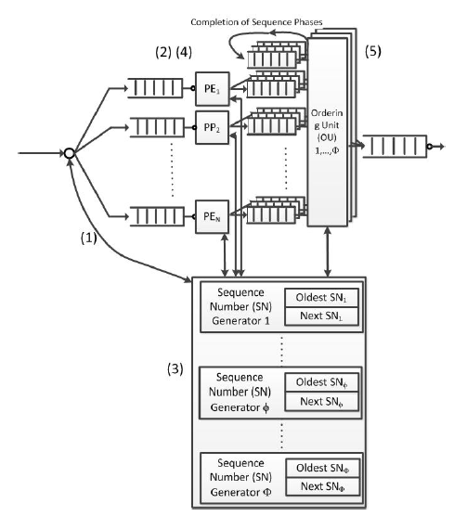
RP³ – Framework 3
(4) PE: When finish processing phases, send to OU
(1) A packet arrives and is assigned an SN₁
(5) OU: complete the SN grants
(2) At end of processing phase φ send request for SN_{φ+1}.
When granted increment SN.
(6) OU: When all SNs are granted– transmit to the output
(3) SN Generator φ:
Grant token when SN==oldestSN_{φ}
Increment oldestSN_{φ}, NextSN _{φ}

Slide 19
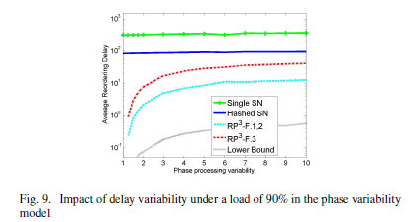
Simulations
Reordering Delay vs. Processing Variability
Synthetic traffic
  Poisson arrivals
  Uniform processing requirements distribution between [1,10] phases.
    For a fair comparison, 10 hash buckets in Hashed-SN algorithm.
  Zipf distribution of the packets between 300 flows.
Phase processing delay variability:
  Delay ~ U[min, max]. Variability = max/min.
  E[delay]=100 time units
Improvement in orders of magnitude
Improvement also with high phase processing delay variability
Improvement by an order of magnitude
Mean reordering delay
Improvement by an order of magnitude
Ideal conditions: no reordering delay.
Phase processing delay variability

Slide 20
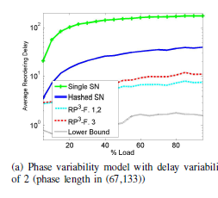
Simulations
Reordering Delay vs. Load
Real-life trace: CAIDA anonymized Internet traces
Note: reordering delay occurs even under low load.
Improvement by orders of magnitude
Improvement by orders of magnitude
Mean reordering delay
% Load

Slide 21
Summary
Novel reordering algorithms for parallel multi-core network processors
  reduce reordering delays
Rely on the fact that all packets of a given flow have similar required processing functions.
Three frameworks that define the stages at which the network processor knows about the packet processing requirements.
Analysis using simulations
  Reordering delays are negligible, both under synthetic traffic and real-life traces.
Analytical model (in the paper)

Slide 22
Thank you.

