Slide 1

Beyond the Ring: Quantized Heterogeneous Consistent Hashing
Yoav Levi, Isaac Keslassy
Department of Electrical & Computer Engineering
Technion

Slide 2
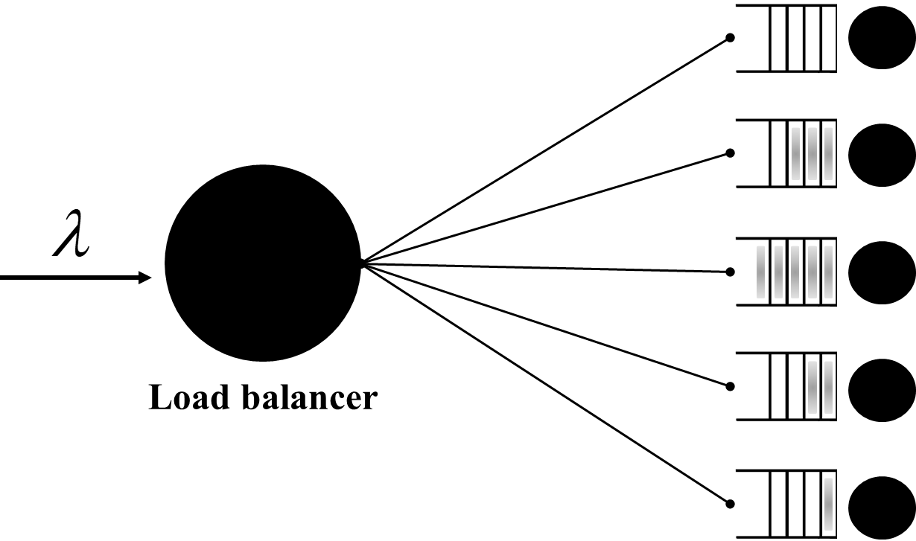
Consistent hashing
Load-balancer algorithm with:
  1) High throughput (⇒ good balance to exploit servers)
  2) Maximize persistent connections
    Mandatory for stateful computations
    Helpful for congestion control algorithms
Consistent hashing: two conditions:
  1) Balance
    Even load balancing of the flows across servers
    ⇒ High throughput
  2) Minimal disruption
    Minimum mapping changes as servers are arbitrarily removed or added
    ⇒ Maximize persistent connections
Many applications for consistent hashing:
  L4 load balancers (e.g. in datacenters)
  Distributed storage
  ECMP routing
Servers
Motivation
Related Work
H&M
Guarantees
Evaluations
Challenges
M3
Model

Slide 3
Why not hashing?
Why not naïve uniform hashing?
  Balanced (⇒ full throughput)
    Since hash is (reasonably) uniform
  Persistent & stateless
    Hash is deterministic
  Efficient
    Fast computation
    No memory footprint
Servers
Server = hash(flow ID) mod 5
flow ID = packet 5-tuple
Motivation
Related Work
H&M
Guarantees
Evaluations
Challenges
M3
Model

Slide 4
Why not hashing?
Problem: no minimal disruption
  Server failure or addition ⇒ most connections get a new server, no connection persistence
⇒ Does not satisfy consistent hashing
Servers
Server = hash(flow) mod 5
Server = hash(flow) mod 4
Motivation
Related Work
H&M
Guarantees
Evaluations
Challenges
M3
Model

Slide 5
Heterogeneous consistent hashing
We focus on heterogeneous consistent hashing with different traffic rates to different servers:
  Servers in datacenters may have vastly different strengths
    Different server generations
    Different hardware (CPU,GPU,FPGA)
    Different technologies (HDD,SSD)
  Difference may also be temporary
    “Slow start” when starting a new server
    Network conditions
    Spontaneous excess load
  Problem: no good solution in the literature
Motivation
Related Work
H&M
Guarantees
Evaluations
Challenges
M3
Model

Slide 6
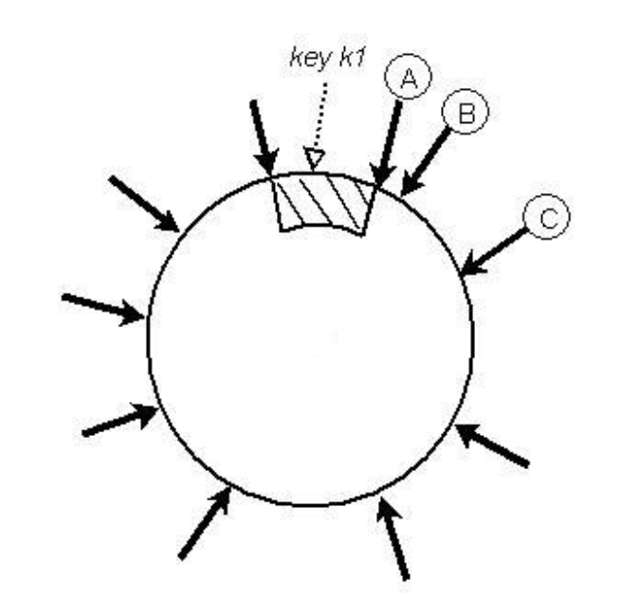
Related Work: heterogeneous CH
Ring-based algorithms
  Based on ring hashing [Karger et al., 1997]
    “Attributed Consistent Hashing (ACH)” [Zhou, Chen, and Wang, 2018]
    “Ketama” (used by NGINX)
  Problems of poor balance and scalability
Highest Random Weight
  [Thaler and Ravishankar, 1998]
  Good balance even for heterogenous systems
  Impractical
Motivation
Related Work
H&M
Guarantees
Evaluations
Challenges
M3
Model

Slide 7
Outline
H&M framework for heterogeneous consistent hashing
M3 mapping algorithm
Theoretical guarantees
Evaluations
Motivation
Related Work
H&M
Guarantees
Evaluations
Challenges
M3
Model

Slide 8
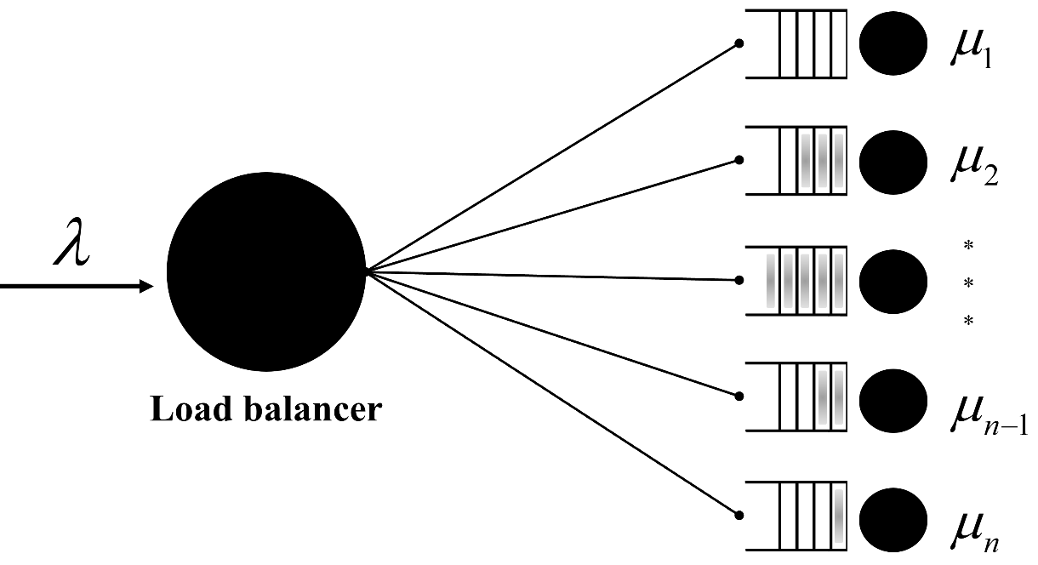

Model and Settings
Settings
Normalization
  $Total service rate μ=\sum_{i=1}^{n}{μ_{i}=1}$
  Load $ρ≡\frac{λ}{μ}=λ (arrival rate)$
Server arrival rates
  $\sum_{i=1}^{n}{λ_{i}=λ}$
Server load
  $ρ_{i}=\frac{λ_{i}}{μ_{i}}$
λ_{i}
ρ_{i}
μ_{i}
Motivation
Related Work
H&M
Guarantees
Evaluations
Challenges
M3
Model

Slide 9

Model and Settings
We assume admissibility
  $\sum_{i=1}^{n}{μ_{i}−λ=1}−λ>0$
⇒ We want to prove stability:
  $ρ_{i}<1 ∀i$
ρ₁
ρ_{i}
μ_{i}
ρ_{n}
Motivation
Related Work
H&M
Guarantees
Evaluations
Challenges
M3
Model

Slide 10
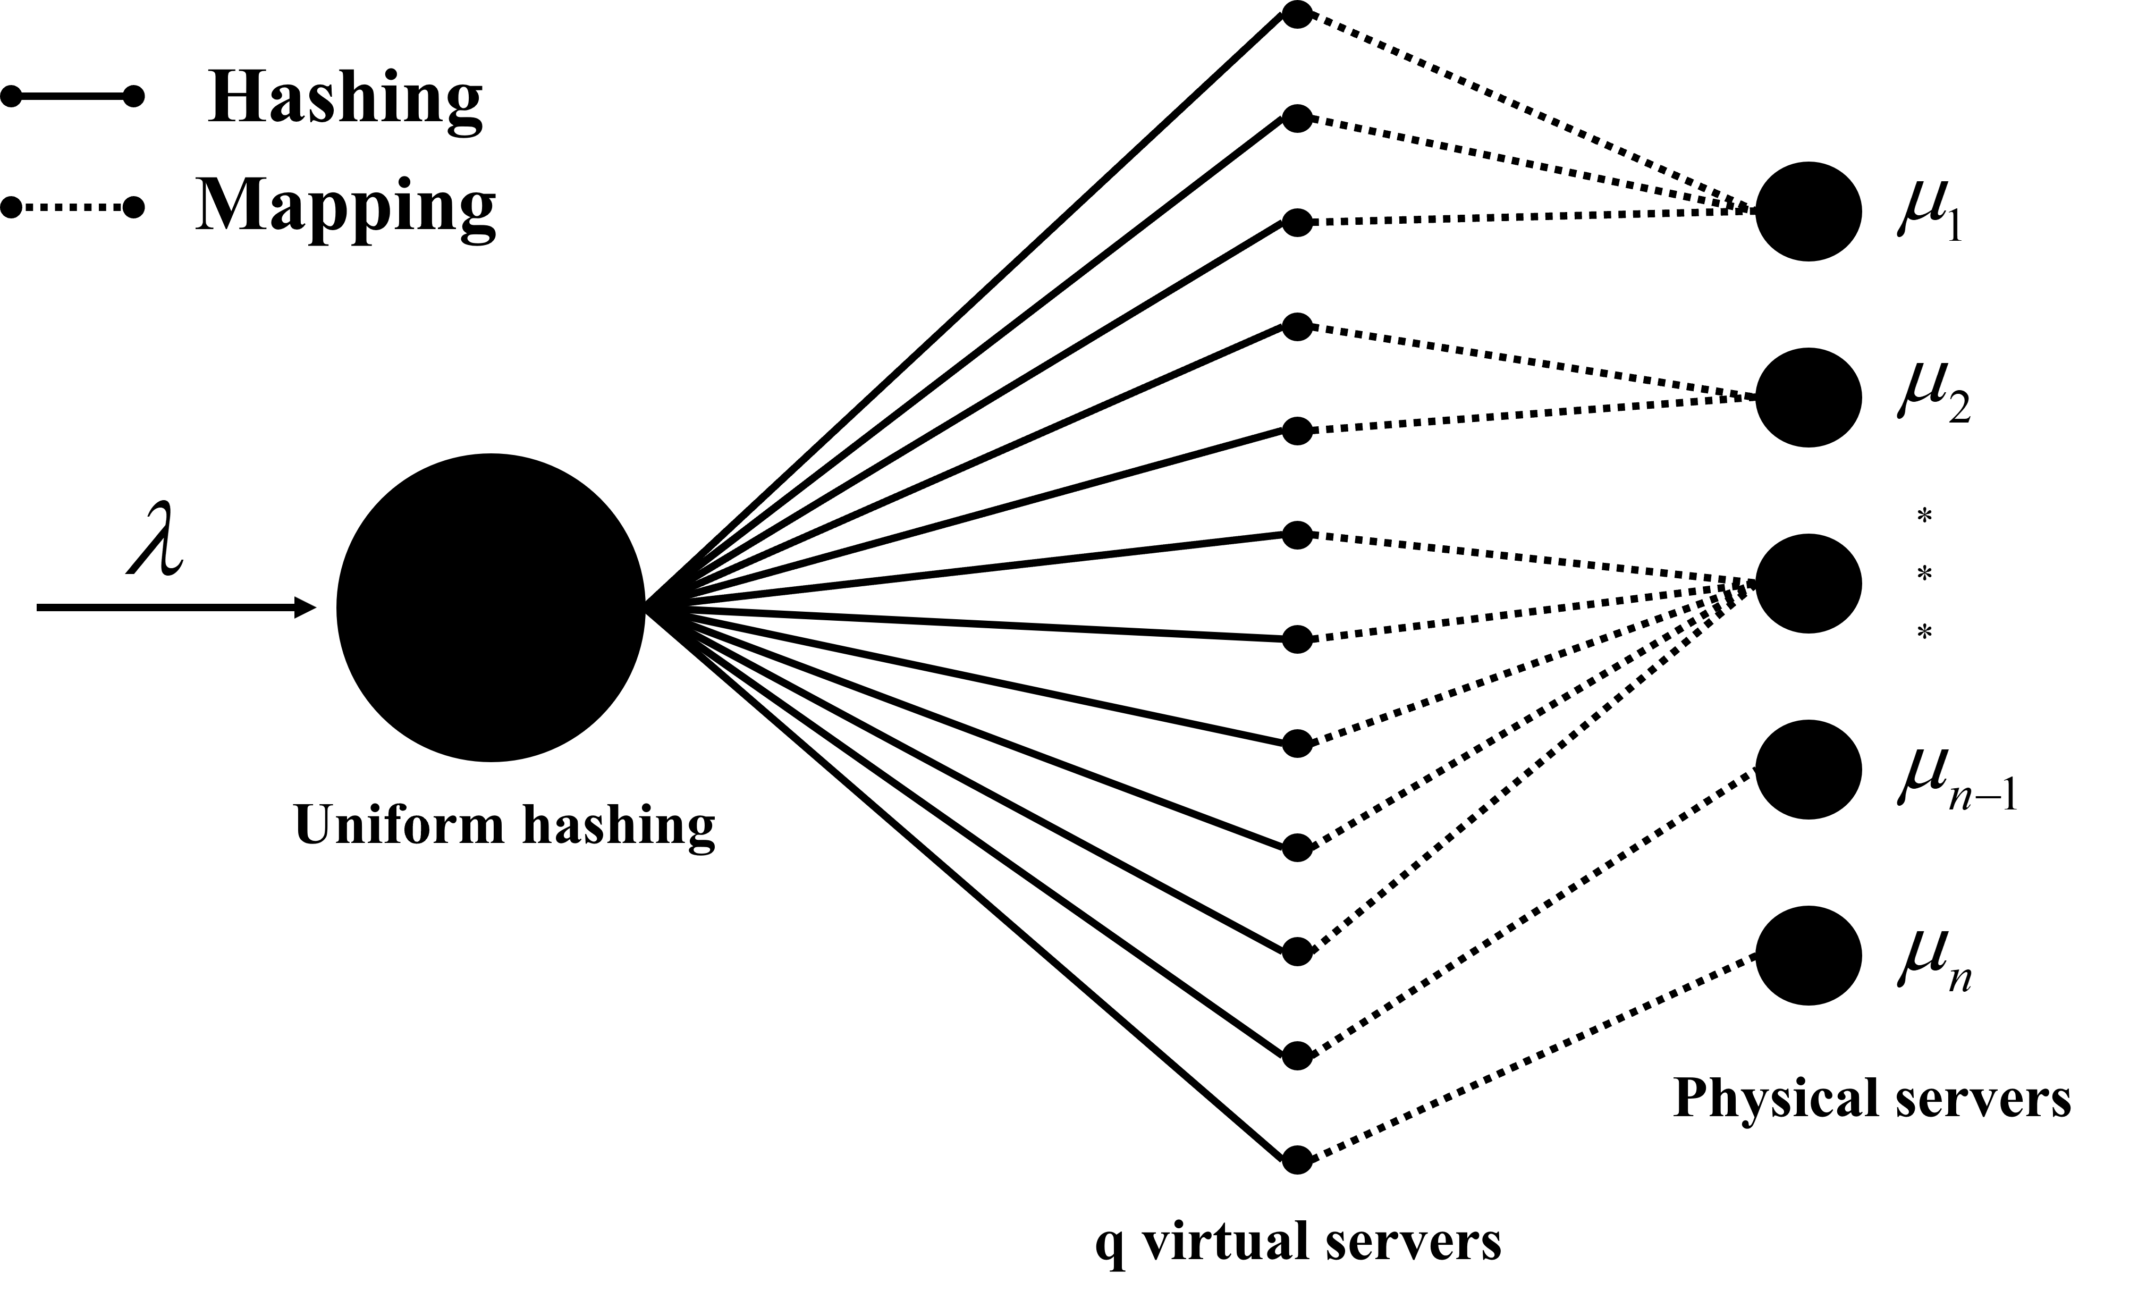
Hash & Map (H&M) Framework
Load balancer
Motivation
Related Work
H&M
Guarantees
Evaluations
Challenges
M3
Model

Slide 11
Hash & Map Framework
H&M properties:
  Scalability
    High key lookup rate: O(1) lookup cost
    Low memory footprint
  Heterogeneity
    By mapping different numbers of virtual servers onto the physical ones
  Stability?
Motivation
Related Work
H&M
Guarantees
Evaluations
Challenges
M3
Model

Slide 12
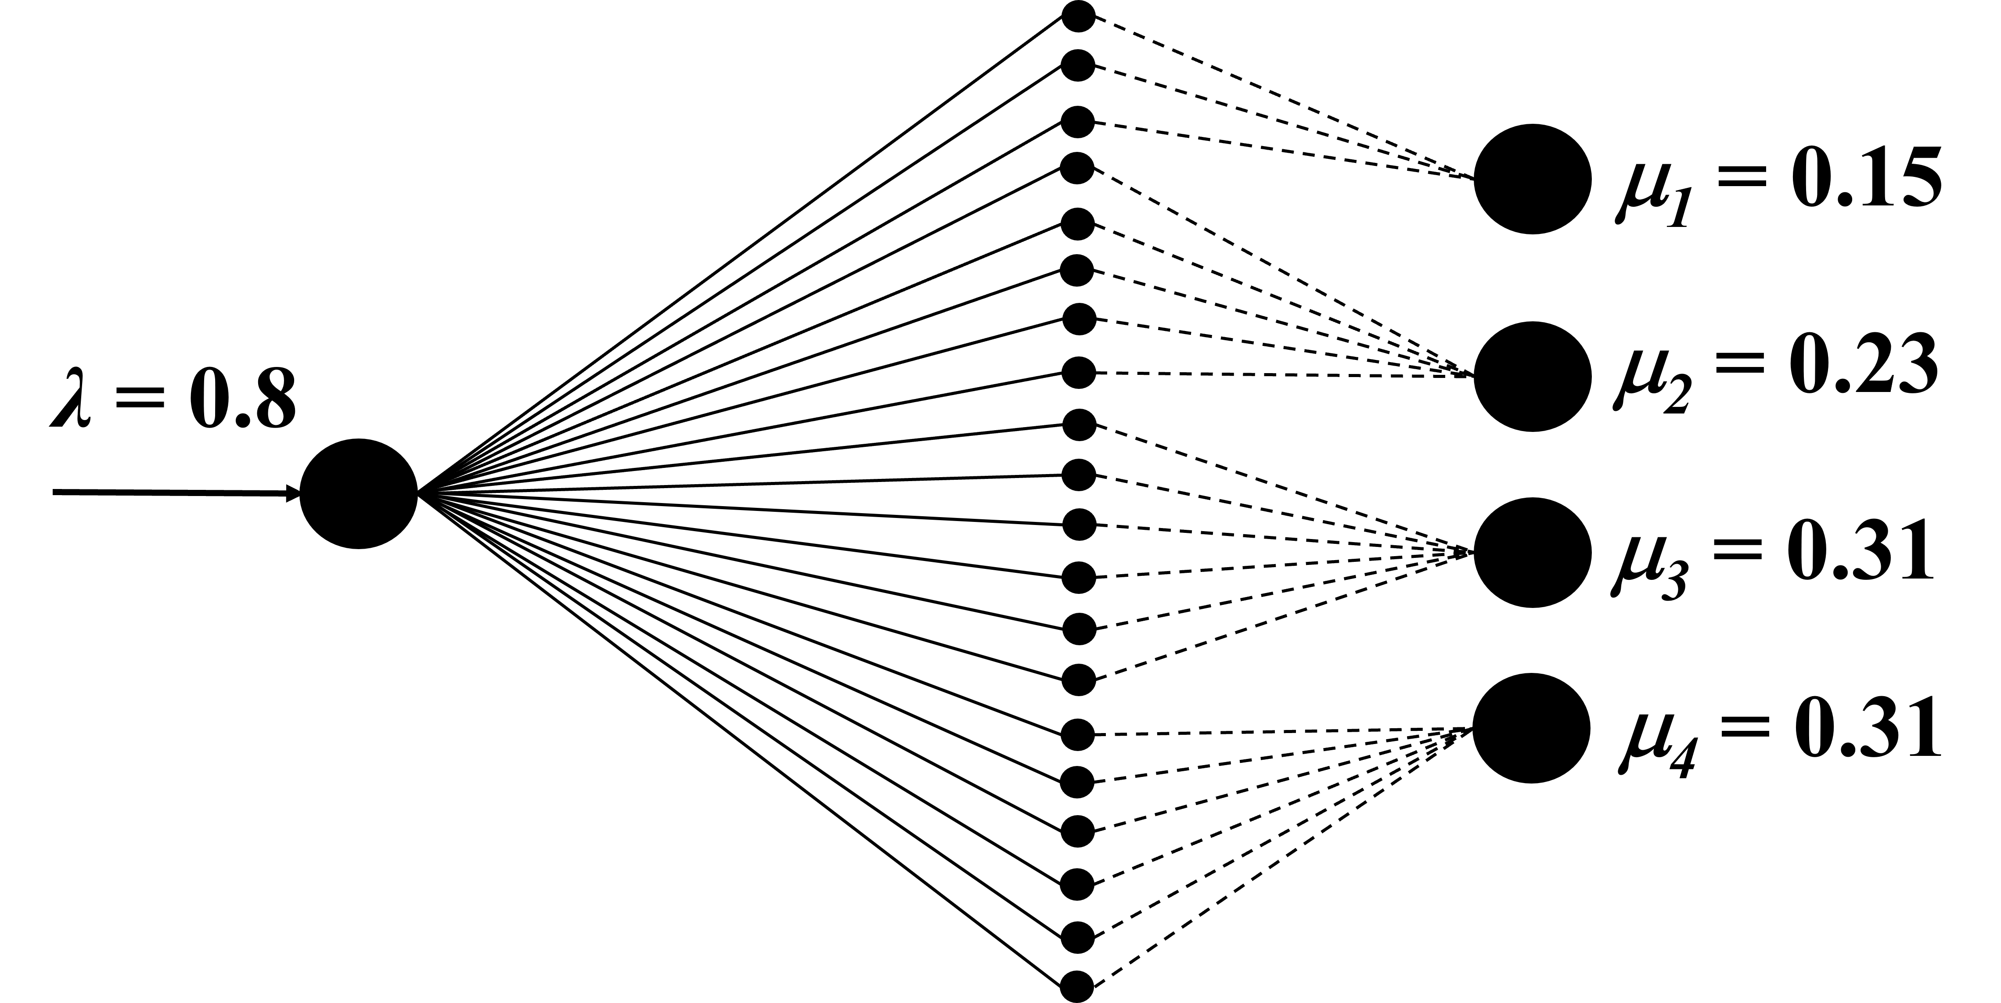
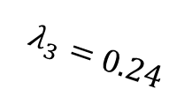
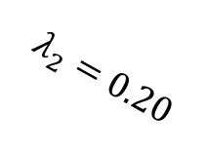
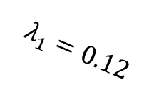

Example
Stable System
$$λ_{1}=0.12$$
$$λ_{2}=0.20$$
$$λ_{3}=0.24$$
$$λ_{4}=0.24$$
q=20
Motivation
Related Work
H&M
Guarantees
Evaluations
Challenges
M3
Model

Slide 13
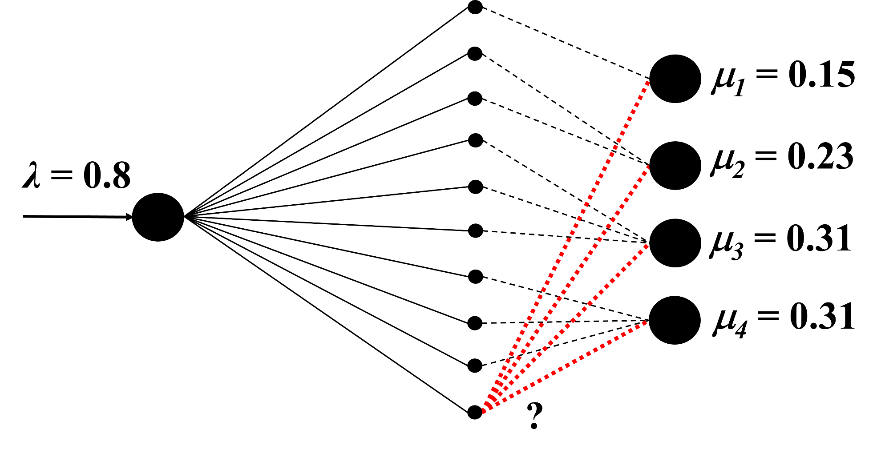
Example
Unstable System
q=10
Motivation
Related Work
H&M
Guarantees
Evaluations
Challenges
M3
Model

Slide 14
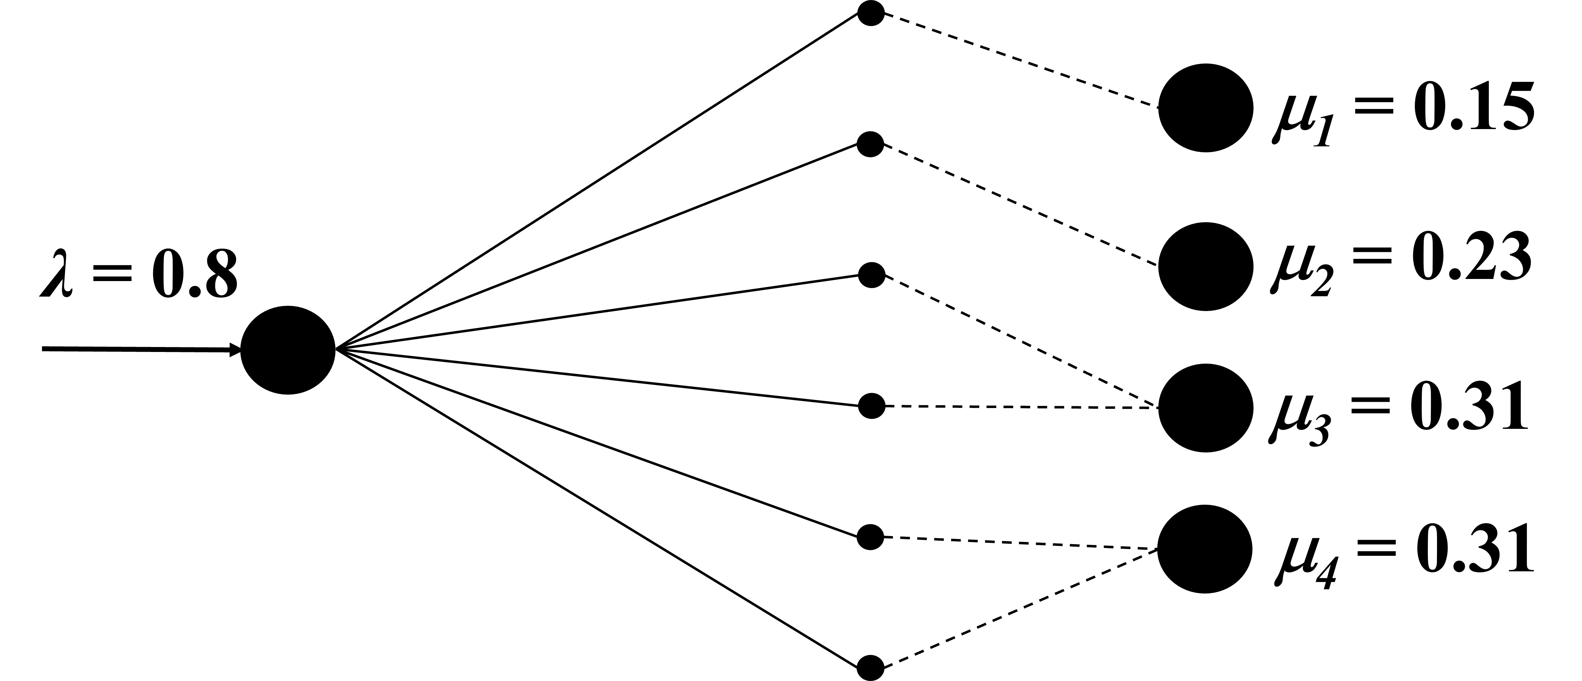
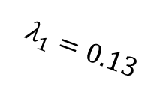

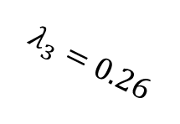
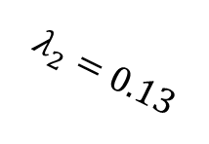
Example
Stable System
$$λ_{1}=0.13$$
$$λ_{2}=0.13$$
$$λ_{3}=0.26$$
$$λ_{4}=0.26$$
q=6
Motivation
Related Work
H&M
Guarantees
Evaluations
Challenges
M3
Model

Slide 15
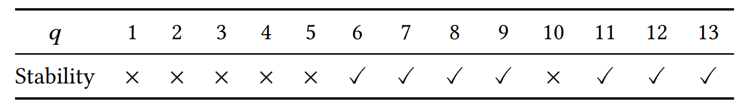

Challenges: Stability
Non-monotonicity of stability
Providing stability is not always possible in H&M for some values of q
Increasing or decreasing q does not always help
The stable q depends on the $$_{i}’s
Is there a q that guarantees stability for all possible $$_{i}’s?
Motivation
Related Work
H&M
Guarantees
Evaluations
Challenges
M3
Model

Slide 16
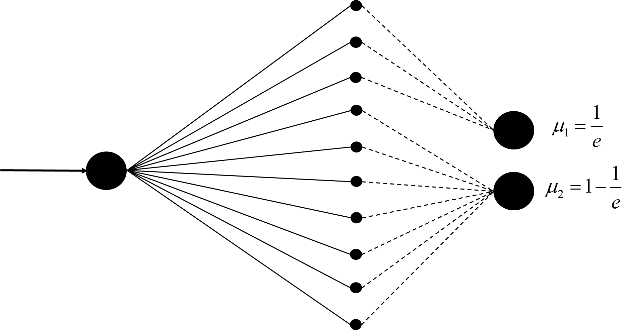
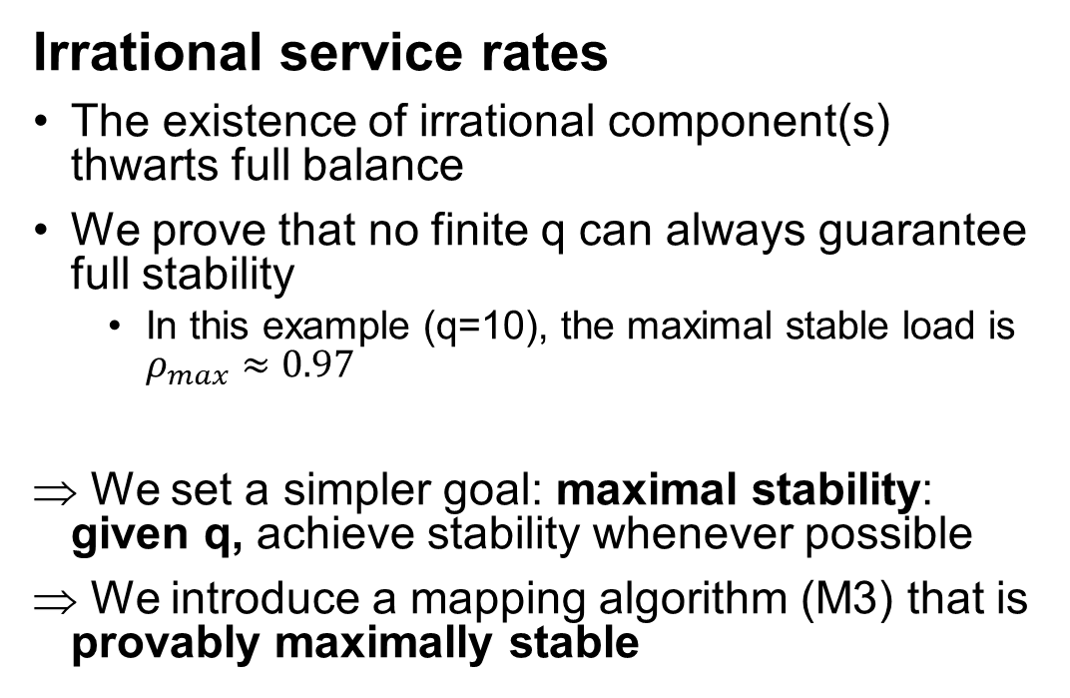
Challenges: Irrationality
Irrational service rates
The existence of irrational component(s) thwarts full balance
We prove that no finite q can always guarantee full stability
  In this example (q=10), the maximal stable load is $ρ_{max}≈0.97$
We set a simpler goal: maximal stability: given q, achieve stability whenever possible
We introduce a mapping algorithm (M3) that is provably maximally stable
q = 10
Motivation
Related Work
H&M
Guarantees
Evaluations
Challenges
M3
Model

Slide 17
Outline
H&M framework for heterogeneous consistent hashing
M3 mapping algorithm
Theoretical guarantees
Evaluations
Motivation
Related Work
H&M
Guarantees
Evaluations
Challenges
M3
Model

Slide 18
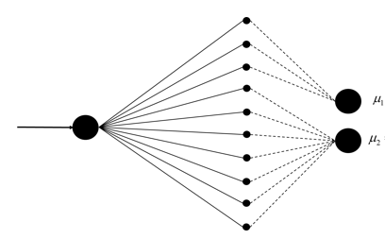
Min-Max Mapping (M3) Algorithm
Main idea: greedily add virtual servers to the mapping in a min-max fair manner
  At each step:
    Greedily minimize the maximal server load (max ρ_{i}) among all physical servers
q₁=3
ρ₁
μ₁
μ₂
ρ₂
q₂=7
Motivation
Related Work
H&M
Guarantees
Evaluations
Challenges
M3
Model

Slide 19
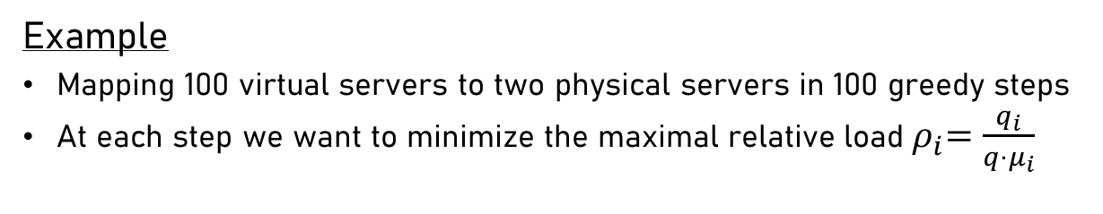
Min-Max Mapping (M3) Algorithm
?
q₁
Example
Mapping 100 virtual servers to two physical servers in 100 greedy steps
At each step we want to minimize the maximal relative load${ ρ}_{i}=\frac{q_{i}}{q⋅μ_{i}}$
ρ₁
μ₁=1/3
μ₂=2/3
ρ₂
q₂
Motivation
Related Work
H&M
Guarantees
Evaluations
Challenges
M3
Model

Slide 20
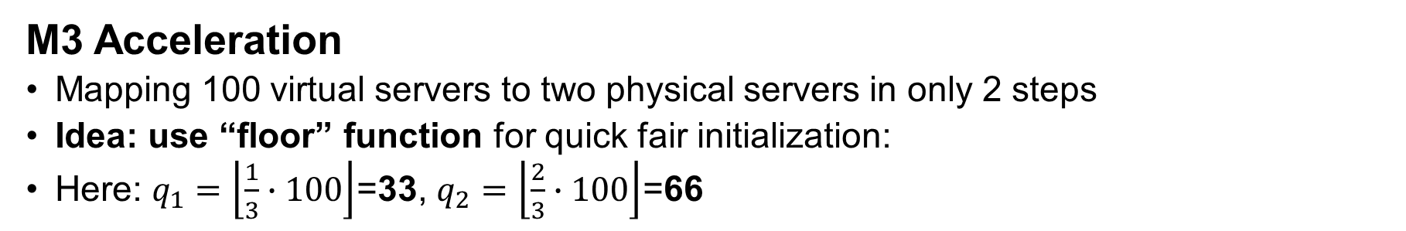
Min-Max Mapping Acceleration
M3 Acceleration
Mapping 100 virtual servers to two physical servers in only 2 steps
Idea: use “floor” function for quick fair initialization:
Here: $q_{1}=\left\lfloor \frac{1}{3}∙100\right\rfloor$=33, $q_{2}=\left\lfloor \frac{2}{3}∙100\right\rfloor$=66
Motivation
Related Work
H&M
Guarantees
Evaluations
Challenges
M3
Model

Slide 21
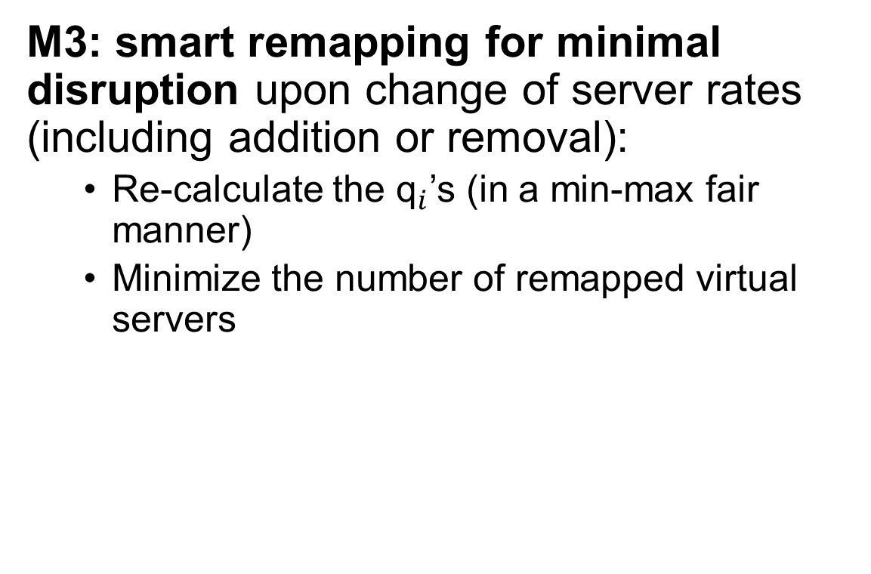
Min-Max Mapping (M3) Algorithm
M3: smart remapping for minimal disruption upon change of server rates (including addition or removal):
  Re-calculate the ${\text{q}}_{i}$’s (in a min-max fair manner)
  Minimize the number of remapped virtual servers
q₁=3
μ₁
μ₂
q₂=7
q₁=4
μ’₁
μ’₂
q₂=6
Motivation
Related Work
H&M
Guarantees
Evaluations
Challenges
M3
Model

Slide 22
Outline
H&M framework for heterogeneous consistent hashing
M3 mapping algorithm
Theoretical guarantees
Evaluations
Motivation
Related Work
H&M
Guarantees
Evaluations
Challenges
M3
Model

Slide 23

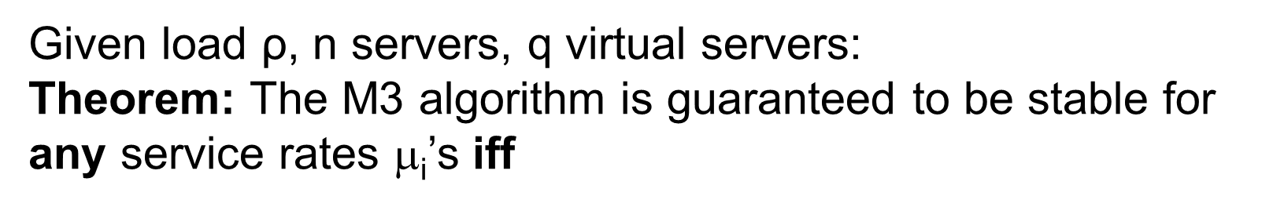

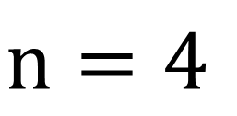
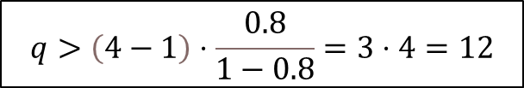
Main Theorem
Given load ρ, n servers, q virtual servers:
Theorem: The M3 algorithm is guaranteed to be stable for any service rates $$_{i}’s iff
n = 100 & ρ = 0.99 ⇒ q=9,802 is sufficient
$$q>\left(4−1\right)⋅\frac{0.8}{1−0.8}=3⋅4=12$$
$$n=4$$
$$ρ=λ=0.8$$
Motivation
Related Work
H&M
Guarantees
Evaluations
Challenges
M3
Model

Slide 24
Outline
H&M framework for heterogeneous consistent hashing
M3 mapping algorithm
Theoretical guarantees
Evaluations
Motivation
Related Work
H&M
Guarantees
Evaluations
Challenges
M3
Model

Slide 25
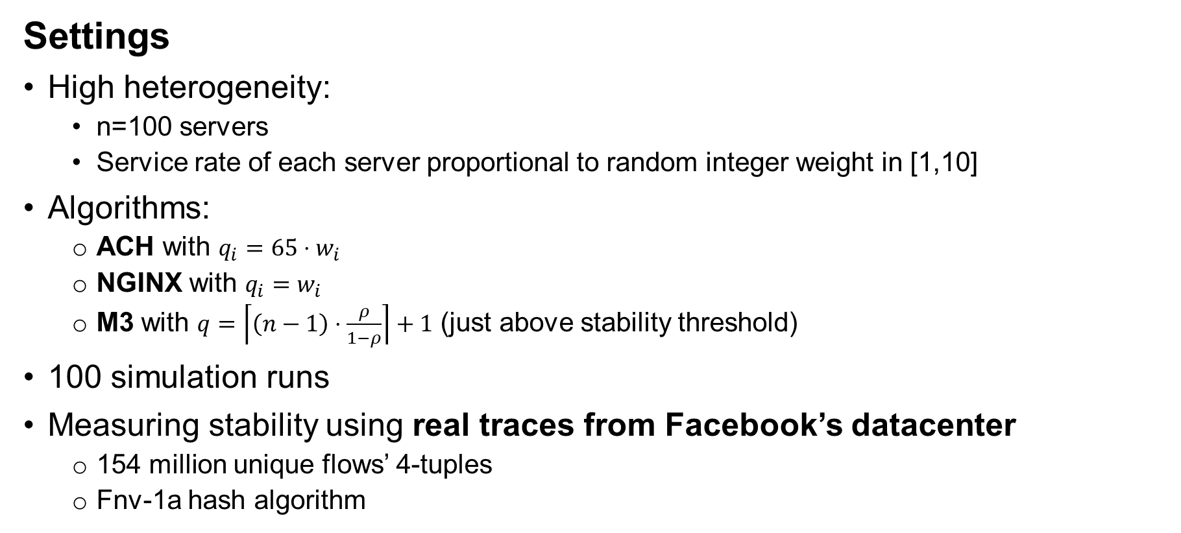
Evaluation: M3 vs. other algorithms
Settings
High heterogeneity:
  n=100 servers
  Service rate of each server proportional to random integer weight in [1,10]
Algorithms:
  ACH with $q_{i}=65⋅w_{i}$
  NGINX with $q_{i}=w_{i}$
  M3 with $q=\left\lceil \left(n−1\right)⋅\frac{ρ}{1−ρ}\right\rceil +1$ (just above stability threshold)
100 simulation runs
Measuring stability using real traces from Facebook’s datacenter
  154 million unique flows’ 4-tuples
  Fnv-1a hash algorithm
Motivation
Related Work
H&M
Guarantees
Evaluations
Challenges
M3
Model

Slide 26
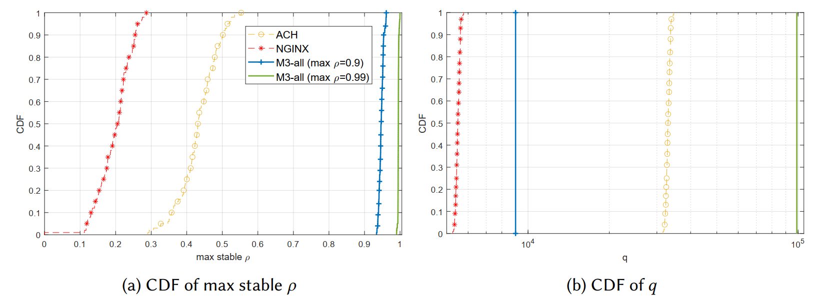
Evaluation: M3 vs. other algorithms
Theory bound for infinite traces
Simulation results
better
Motivation
Related Work
H&M
Guarantees
Evaluations
Challenges
M3
Model

Slide 27
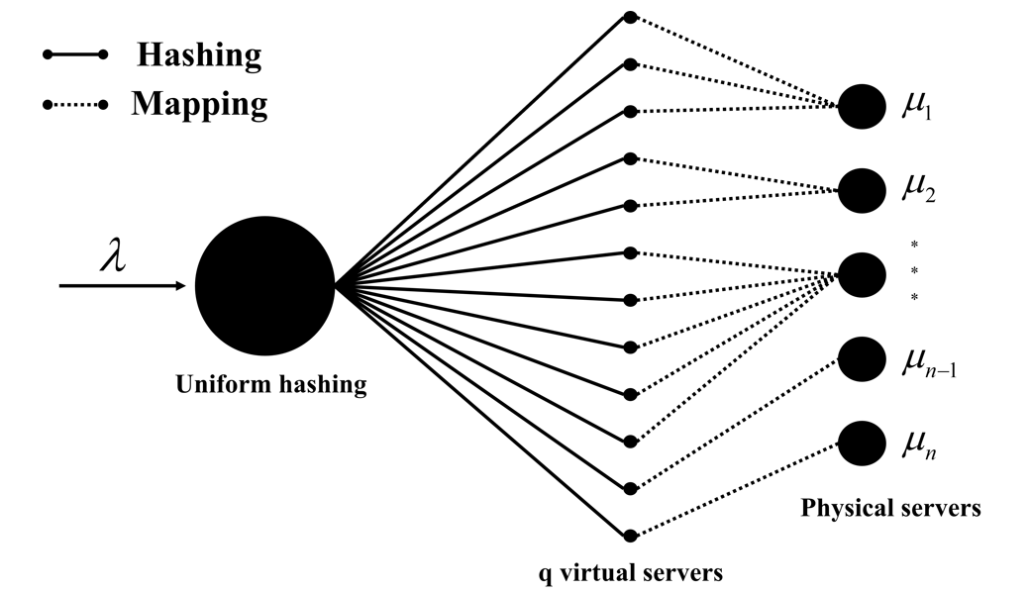

Summary
New scalable algorithms for heterogeneous consistent hashing
  H&M framework
  M3 mapping algorithm
Main theorem: stability for any $$_{i}’s iff:
Evaluations: higher guaranteed throughput
Motivation
Related Work
H&M
Guarantees
Evaluations
Challenges
M3
Model

Slide 28
Thank you!

