Slide 1
Providing Performance Guarantees in Multipass Network Processors
Isaac Keslassy | Kirill Kogan | Gabriel Scalosub | Michael Segal
Technion | Cisco & BGU (Ben-Gurion University) | BGU | BGU

Slide 2
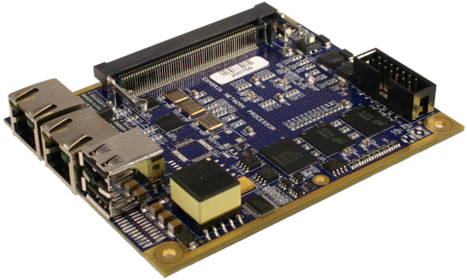
Network Processors (NPs)
NPs used in routers for almost everything
Forwarding
Classification
DPI
Firewalling
Traffic engineering
Classical NP architectures
✓Homogeneous tasks
✗ Increasingly heterogeneous demands
Examples: VPN encryption, LZS decompression, advanced QoS, …
What are “classical NP architectures”?

Slide 3
Pipelined NP Architecture
E.g., Xelerated X11 NP
Each packet gets processed by a pipeline of PPEs (packet processing engines)
each PPE in charge of a different task
✗ main issues: hard to scale, synchronous, packet header copy
PPE
PPE
PPE
PPE
PPE
PPE
Packet Header Buffer

Slide 4
Parallel/Multi-Core NP Architecture
E.g., Cavium CN68XX NP
Each packet is assigned to a single PPE
single PPE performs all processing, in “run-to-completion”
✗ main issue: run-to-completion ⇒ heavy packets can starve light ones
PPE
Hybrid Architecture:
Pipeline + Multi-core
PPE
PPE
E.g., EZChip NP-4 NP

Slide 5
Multipass NP Architecture
E.g., Cisco QuantumFlow NP
Packet processing divided into processing cycles
Packet headers recycled into the queue after each processing cycle
✓ Main benefits:
More scalable
Asynchronous
No run-to-completion (heavy packets do not necessarily starve light ones)
✗ Main issue : many degrees of freedom (more complex scheduling)
PPE
PPE
PPE
Packet Header Buffer

Slide 6
Scheduling in Multipass NP
Packets have heterogeneous demands
Each packet might require a different number of cycles
Designer objective: guarantee minimum throughput
Minimum number of processed packets per second
Problem: many degrees of freedom
Buffer management: FIFO, priority queueing, …? Preemption upon full buffer?
For each packet: what PPEs? In what order?
Fairness?
No reordering?
Heterogeneous PPEs?
PPE
PPE
PPE
Packet Header Buffer

Slide 7
Assumptions
Focusing on buffer management policy
Efficiently use the full buffer size (unit-size packets with slotted time)
Only 1 PPE
Complex enough!
Each packet needs up to k passes
Number of passes known for each packet
k used in analysis, not in algorithm
Our goal: competitive worst-case throughput guarantee
For any input sequence σ, show that Throughput(σ) ≥ OPT(σ) / c
Arbitrary arrival sequences (adversarial…)

Slide 8
Buffer Management Policies
PQ (Priority queueing)
less work = higher priority
FIFO
1
1
1
5
5
5
5
5
5
4
4
2
2
2
2
1
PPE
PPE
1
1

Slide 9
A Case for Preemption
(OR, how bad can non-preemption be when buffer overflows?)
Assume non-preemption
when a packet arrives to a full buffer, it is dropped
FIFO lower bound
simple traffic pattern: competitive ratio is Ω(k)
PQ lower bound
(much) more involved
also Ω(k)
Matching O(k) upper bounds for both

Slide 10
What If We Preempt?
Example:
3
5
5
5
4
2
2
PPE

Slide 11
What If We Preempt?
Preemption + PQ = Optimal
PQ can serve as a benchmark for optimality
Preemption + FIFO?
not optimal: Ω(log k) lower bound
sublinear(k) upper bound: still open

Slide 12
Are Preemptions Free?
New packets “cost” more than recycled packets
Example: costly memory access and system updates (pointers, data-structures)
Copying cost α
each new packet admitted incurs a cost of α∈[0,1)
Objective:
maximize ( Throughput – Cost )

Slide 13
Algorithm PQ_{β}
When buffer full, accept new packet if it needs less cycles than (worst packet / β)
Example: β =2
29
13
30
10
5
4
2
2
PPE

Slide 14
Algorithm PQ_{β}
Competitive ratio: f(k,α,β)
Gives some best β for each value of k and α
(1- α) (1 + log_{β/(β-1)}(k/2) + log_{β}(k))
1- α log_{β}(k)

Slide 15
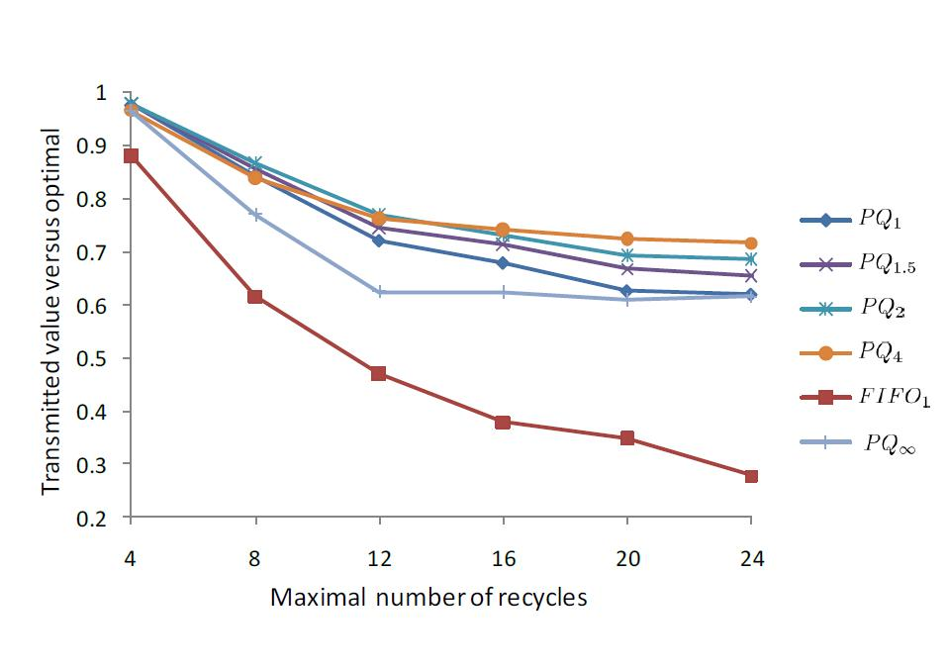
Simulation Results
Single PPE (C=1), copying cost α=0.4
ON-OFF bursty traffic
PQ is NOT optimal anymore!
k

Slide 16
Conclusion
Multipass NP architecture model
Preemptions help significantly
If preemptions are not free, schedule optimality gets complicated

Slide 17
Thank you.

