Slide 1

CEDAR
Counter-Estimation Decoupling for Approximate Rates
Erez Tsidon (Technion, Israel)
Joint work with Iddo Hanniel and Isaac Keslassy (Technion)

Slide 2
Network Flow Counters Usage
Network management applications require per-flow counters, for example:
  Congestion Control
  Detection of Denial of Service Attacks
  Detection of Traffic Anomalies
Counter types:
  Packet counting
  Byte counting
  Rate measurement

Slide 3
Switch Example
40MB memory
32nsec for single counter access
DRAM is too slow
SRAM is too expensive
SWITCH
10⁶ flows
Link Rate 10Gbps
Min packet size = 40B
per-flow counters
Total Packet Count
Total Byte Count
Packet Rate
Count event A
Count event B
64-bit width

Slide 4
Suggested Solutions
Hybrid SRAM-DRAM counters
[Shah, Iyer, Prabhakar and McKeown ’02]
  Cannot support fast reading
Counter Braids – compress counters into small SRAM [Y. Lu et al ’08]
  Cannot decompress in real time
Heavy Hitters – store only high counters [Estan and Varghese ’03]
  No records of small counter values

Slide 5
Counter Estimation Solutions
Intuitively we want counters to be as precise as possible, unbiased whenever possible, and scalable
SAC – R. Stanojevic, “Small Active Counters”, 2007
  Exponent-Magnitude representation
  Unbiased estimation
  Scalable
  Restricted to specific representation which prevents error optimization
DISCO – C. Hu et al, “DISCO: Memory Efficient and Accurate Flow Statistics for Network Measurement”, 2010
  Convex conversion function that reduces increment values
  Unbiased estimation
  Restricted to a close function representation. No scaling

Slide 6
Our Contributions
CEDAR – decoupling counters from estimators
Optimal estimators for the min-max relative error
Dynamic up-scale algorithm
Exponential-averaged rate estimation

Slide 7
Counter-Estimators Decoupling
Counter estimates
Flow pointers
F_{N-1}
995,784
F_{N-1}
p(L-2)
F_{N-2}
1.2
F_{N-2}
p(1)
Shared estimators
1,000,000
A_{L-1}
995,784
A_{L-2}
3.7
A₂
1.2
A₁
0
A₀
F₁
1,000,000
F₁
p(L-1)
q
F₀
1.2
F₀
p(1)
log₂ L

Slide 8
CEDAR Structure
Flow pointers
F_{N-1}
p(L-2)
N flows
L estimators
Flow array:
Estimation array:
Estimator differences:
F_{N-2}
p(1)
Shared estimators
1,000,000
A_{L-1}
995,784
A_{L-2}
3.7
A₂
1.2
A₁
0
A₀
F₁
p(L-1)
q
F₀
p(1)
log₂ L

Slide 9
CEDAR Increment Algorithm
Upon packet arrival: with probability
A₇
211
211
211
211
A₆
132
132
132
132
A₅
54.7
54.7
54.7
54.7
A₄
11
11
11
11
A₃
9
9
9
p=1/5
9
p=1/3
A₂
4
4
4
4
4
4
p=1
A₁
1
1
1
1
1
A₀
0
0
0
0
0
t=0
t=1
t=2
t=3
time

Slide 10
Performance Measures
Traffic Amount –
  - a random variable that represents the number of real counter increments in order for to hit estimator
Relative error – Coefficient of Variation:

Slide 11
Min-Max Relative Error
Problem: assuming L and AL-1 are given, find an estimation array that minimizes the guaranteed relative error δ such that
Solution: equal relative error
Estimation values

Slide 12
Equal Relative Error Example
Relative
Error
δ
A1
A2
A3
δ
A1
A2
A3
δ
A1
A2
A3
Estimation Values

Slide 13
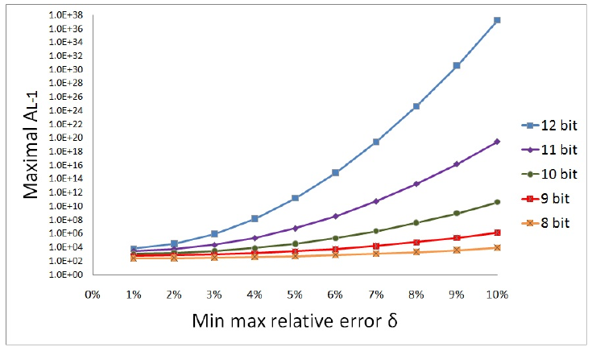
Capacity Region of Static CEDAR
Example:
10-bit counters
Max value 10^6
min-max relative error 8%

Slide 14
Up-Scale Procedure
A’
A’’
A₇
211
517
A₆
132
p=0.43
=(54-24)/(93-24)
314
upscale
threshold
A₅
54
54
156
A₄
11
11
93
93
A₃
4.5
24
A₂
3
5
A₁
1
1
2
A₀
0
p=0.5
0
0
Increase the relative error
δ0+ δstep
Initial relative error
δ0

Slide 15
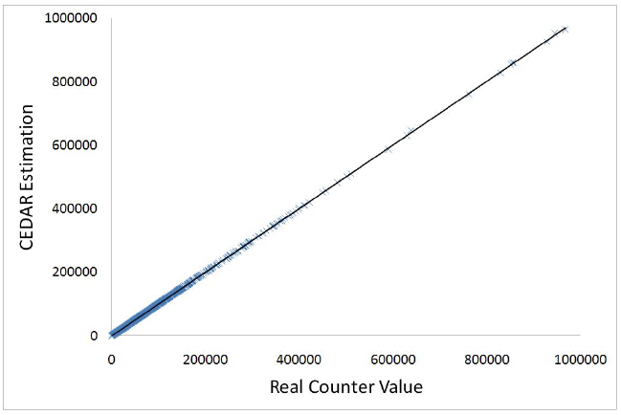
CEDAR Unbiasedness

Slide 16
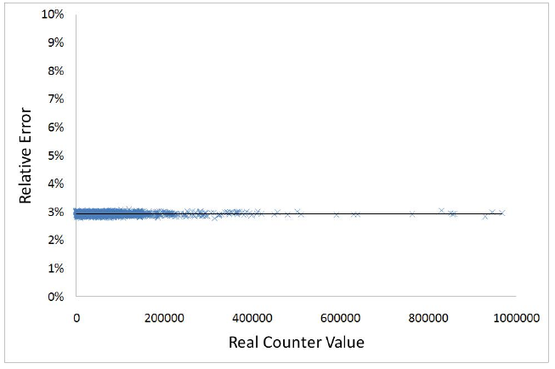
CEDAR Equal Error

Slide 17
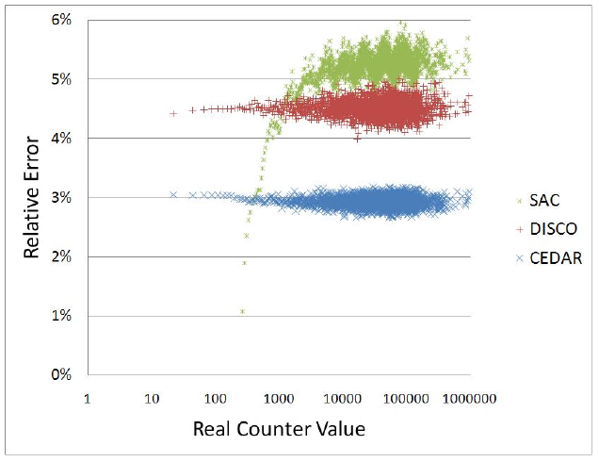
CEDAR Vs. SAC & DISCO 12-bit
4096 estimators

Slide 18
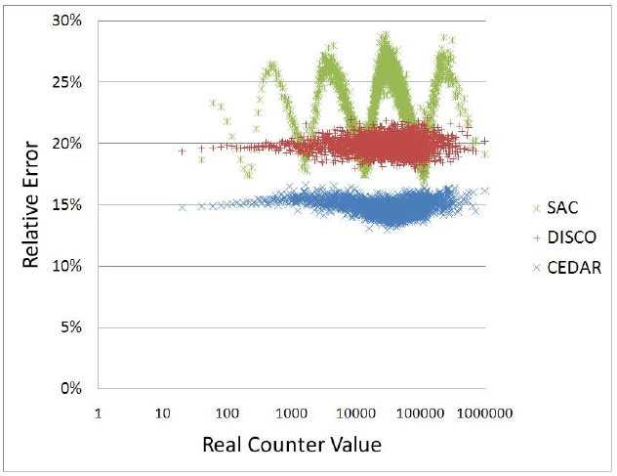
CEDAR Vs. SAC & DISCO 8-bit
256
estimators

Slide 19
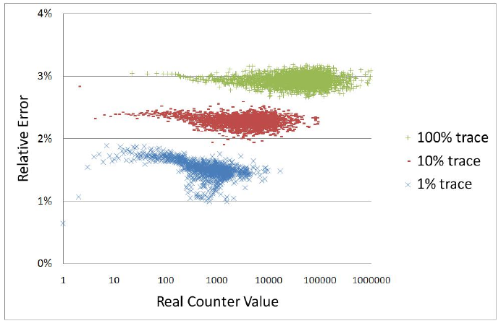
CEDAR Error Adjustment 12-bit

Slide 20
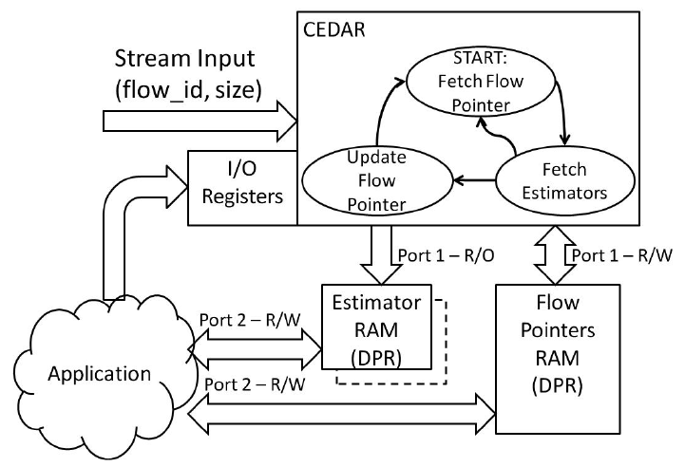
CEDAR Implementation on FPGA
12K gates
5.4 Gbps

Slide 21
Exponential-Average Rate Estimation
Incoming packet
x0.98 down-scale
x0.98 down-scale
A₇
122
122
119.5
117.1
A₆
102
P =
0.02x100/(85-68)
102
99.9
97.9
A₅
85
85
85
83.3
83.3
83.3
83.3
81.6
81.6
A₄
68
68
68
66.6
65.3
A₃
51
51
49.9
48.9
A₂
34
34
33.3
32.6
A₁
17
17
16.6
16.3
A₀
0
0
0
0
t0
t0 + 1
t0 + 2
time

Slide 22
Exponential-Average Rate Estimation
After 8 more down-scaling cycles
up-scaling
A₇
117.1
99.6
99.6
122
A₆
97.9
83.3
102
A₅
81.6
81.6
69.4
69.4
85
A₄
65.3
55.5
68
P =
(85-69.4)/(85-68)
68
A₃
48.9
41.6
51
A₂
32.6
27.7
34
A₁
16.3
13.8
17
A₀
0
0
0
t0 + 2
t0 + 10
time

Slide 23
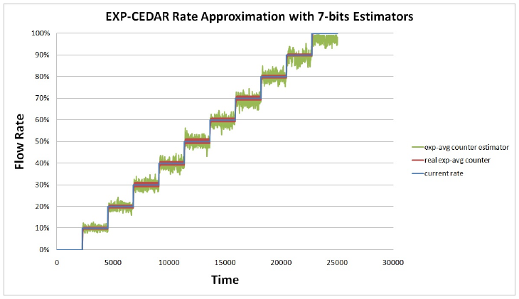
EXP-CEDAR 7-bit
Real exp-average with 64 bits
For 10^(-2) precision – 14 bits are required

Slide 24
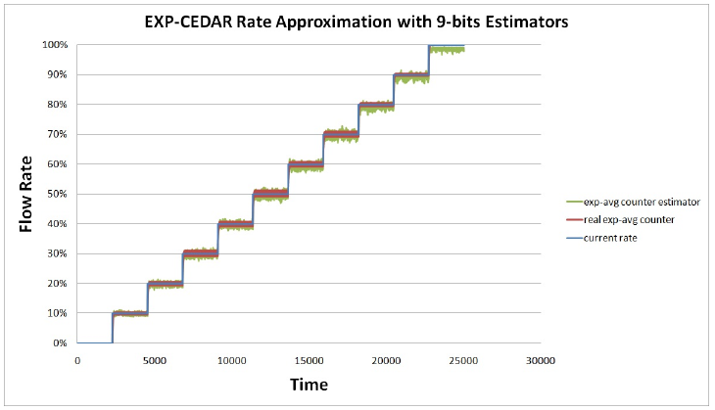
EXP-CEDAR 9-bit

Slide 25
CEDAR Summary
Decoupling - flexible estimators
Unbiased and scalable estimation
Attains the min-max relative error
FPGA supports link rate of 5.4Gbps and may increase to tens of Gbps on ASIC
Exponential-average rate estimation

Slide 26
Thank you.

