Slide 1

Palette: Distributing Tables in Software-Defined Networks
Yossi Kanizo (Technion, Israel)
Joint work with Isaac Keslassy (Technion, Israel) and David Hay (Hebrew Univ., Israel)

Slide 2
Software Defined Networks
[1] http://www.openflow.org/wp/switch-nec/
An abstraction of network devices and operations
Implemented through the network controller
  A single centralized device with a global view of the entire network
To implement a policy, it relies on the forwarding table in each network switch.
  Ternary content-addressable-memory (TCAM)
  Limited in size. E.g., 750 entries [1].
Example: access control.

Slide 3
Access Control Table
Switch
HEADER
Forwarding Engine
Access Control
Action
Policy Database (classifier)
Rule
Action
----
----
----
----
Incoming
Packet
----
----

Slide 4
TCAM Architecture
TCAM Array
0
deny
0
001110111111∗∗∗∗
Each entry is a word in {0,1,∗}^{W}
0
deny
1
1∗00∗0000110∗∗∗∗
10∗∗010110∗01000
0
accept
2
001110∗∗∗∗∗∗∗∗∗∗
1
row 3
deny
3
1110∗∗010∗0∗∗∗∗∗
0
accept
4
Encoder
0
deny
5
11∗∗10010∗01∗∗∗∗
∗∗∗∗∗∗∗∗∗0011100
1
deny
6
∗∗∗∗1010∗∗∗∗∗∗∗∗
1
accept
7
∗∗∗∗11111111111∗
0
deny
8
∗∗∗∗∗∗∗∗∗∗∗∗∗∗∗∗∗
1
accept
9
Match lines
Source Port
0011101000011100
Width W
Packet Header

Slide 5

Example: Access Control
Consider the following network.
  Access control table at each ingress point
Problem: Ingress points need
to hold large tables

Slide 6
Palette: Approach
Idea: Distribute the rules among all switches such that each packet goes through all rules along its path.
Implementation:
Decompose the large table into subtables.
  Each subtable is denoted by a different color
Distribute colors to switches
  Each path is a rainbow path, i.e. includes all the colors

Slide 7
Example
1. Split the rule table into subtables.

Slide 8
Example
2. Consider all (active) paths in the network
… and distribute the subtables.

Slide 9
Related Work
DIFANE (Yu et al.): Rule set is split into disjoint subsets and distributed to special switches.
  Ingress switches redirect packets to the relevant switch.
  If a rule is matched, it is stored in the ingress switch cache.
  Causes management and redirection overhead (it can change the paths).
CSAMP (Sekar et al.): Each switch along the path handles only a (disjoint) subset of the packets.
  Each switch still needs to hold the entire table.

Slide 10
Main Results
Table Decomposition
  Pivot Bit Decomposition
  Cut-Based Decomposition
Rainbow Path Problem
  A Single color case
  The multiple color case.
Evaluation

Slide 11
Table Decomposition
Dividing a large table into c subtables.
  Order-oblivious: The order in which the smaller tables are accessed does not matter
  Semantically-invariant: This global action of the network is the same as the one taken when using the initial single large table
Goal: minimize the largest subtable.

Slide 12
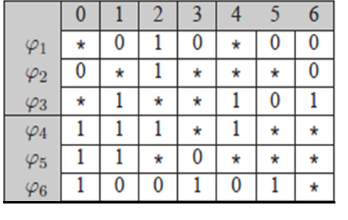
Pivot Bit Decomposition (PBD)
Basic Idea: At each iteration, decompose a table into two subtables.
Pick a column. All rules with ‘0’ go to the first subtable, while all rules with ‘1’ go to the second subtable.
Intuition: Any string
can match rule(s) in
at most one
subtable.
See also: Zheng et al., IEEE Trans. Computing, 2006.

Slide 13

PBD: Example
Rule φ₂ has ‘*’ in bit 1.
We replace it by two new rules by replacing the ‘*’ to ‘0’ and ‘1’:
  φ’₂ = 001***0, and
  φ’’₂ = 011***0.
Resulting subtables
consist of
  φ₁, φ’₂ and φ₆.
  (0’s in bit 1).
  φ’’₂, φ₃, φ₄ and φ₅.
  (1’s in bit 1).

Slide 14
PBD
Iteratively decomposing one subtable into two equivalent subtables.
At each iteration
  Choose the bit that upon decomposition minimizes the larger resulting subtable.
Repeat this on one of the subtables, until c subtables exist.

Slide 15
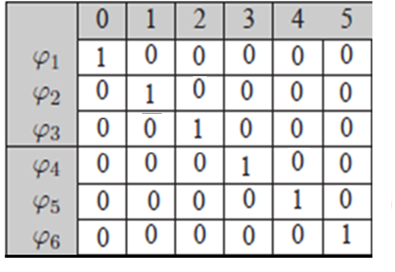
PBD Drawback
The following table is hard for PBD.
Choose any column, the resulting two subtables are of sizes 5 and 1.
However, it can be
easily divided into
equally sized
subtables (No
conflicts between
any of the rules).

Slide 16
  Cut-Based Decomposition (CBD)
Decomposition is based on representing the set of rules in a directed dependency graph.
  Nodes represent rules.
Edges represent dependency: an edge exists from u to v iff u has higher priority than v, and there is at least one key that matches both rules.
Goal: decompose the graph into c components (= subtables) with no edges between them.

Slide 17

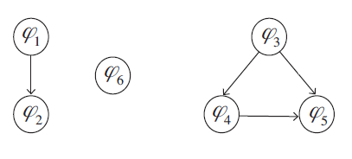

CBD Example

Slide 18
Cut-Based Decomposition (CBD)
Decomposing the graph into c equally sized components is usually impossible and hard to approximate.
Allow two operations:
  Breaking an edge between u and v: Replace v with a set of rules that have no conflict with u .
  Node expansion: Given a set of t ‘*’ bits, replace it with 2^{t} rules (like the duplication done in PBD).

Slide 19
Cut-Based Decomposition (CBD)
Iterative algorithm:
  Partition the graph to c (almost) equally sized partitions, subject to minimizing the number of crossing edges.
  NP-hard, use approximation (e.g., using METIS [2]).
  Break some edges or expand nodes.
Repeat until a (relatively balanced) partition with no crossing edges is found.
[2] http://glaros.dtc.umn.edu/gkhome/views/metis

Slide 20
Main Results
Table Decomposition
  Pivot Bit Decomposition
  Cut-Based Decomposition
Rainbow Path Problem
  A single color case
  The multiple color case.
Evaluation

Slide 21
Reminder
(Step 2.) Consider all (active) paths in the network … and distribute the subtables.

Slide 22
Rainbow Path Problem
Distribute the colors among switches (up to a single color for each switch), such that each path contains all colors.
Goal: maximize the number of colors c used.
  NP-hard problem
  Turn to greedy algorithms.

Slide 23
1-GREEDY
For each new color:
  Color the (yet uncolored) switch that maximizes the number of paths going through the switch and not yet containing the new color.
  Repeat this until all paths contain the new color.
Runs in time O(n²|P|), where n is the number of switches, and P is path set.

Slide 24
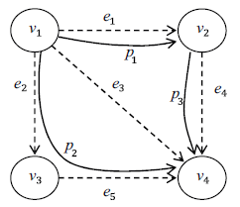
1-GREEDY: Example
First Iteration (first color):
  Switches v₁, v₂ and v₄ belong to two paths (each), while v₃ belongs only to one path.
    E.g., color v₁.
  Need also to color p₃.
  Color either v₂ or v₄.
Second iteration
(second color):
  Even by coloring both v₃
  and v₄, p₁ remains
  uncolored.
  Stop: only use first color.

Slide 25
q-GREEDY
In q-GREEDY, at each (sub-)iteration, pick up to q switches that maximize the number of paths going through the switches and not yet containing the new color.
  Runs in time O(n^{q+1}|P|), where n is the number of switches, and P is the path set.

Slide 26
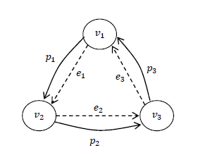
  The Multiple-Color Case
In the following network,
with 3 paths, there is no
solution with two colors.
Idea: assign more than one
color to each switch: v₁ with
colors 1 and 2, v₂ with colors
2 and 3 and v₃ with colors 1 and 3.
All paths contain all colors.
  Each switch holds approx. 2/3 of the table.
?

Slide 27
  The Multiple-Color Case
Goal: Maximize the number of colors used, subject to a maximum number d of colors allowed in each switch.
Problem is NP-hard.
Idea: Reduction to the single-color case:
  Split each switch into a chain of d switches.
  For each path that goes through a switch, make it go trough the entire chain.
d

Slide 28
Main Results
Table Decomposition
  Pivot Bit Decomposition
  Cut-Based Decomposition
Rainbow Path Problem
  A Single color case
  The multiple color case.
Evaluation

Slide 29
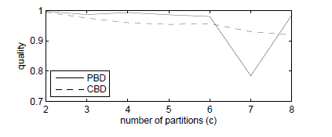
Table Decomposition: PBD and CBD
Define quality of the decomposition as:
original table size
max subtable size * number of subtables

Slide 30
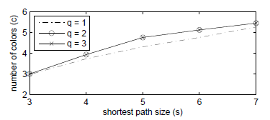
Table Distribution: q-GREEDY
Number of colors used cannot exceed
shortest path size.
Random network instances.
2-GREEDY performs better than 1-GREEDY.

Slide 31
Summary
Practical distributed way of implementing access control with small tables:
Cut into subtables
Distribute the subtables

Slide 32
Thank you.

