Slide 1

Tapping Into The Unutilized Router Processing Power
Marat Radan (Technion, Israel)
Joint work with
Isaac Keslassy (Technion, Israel)

Slide 2
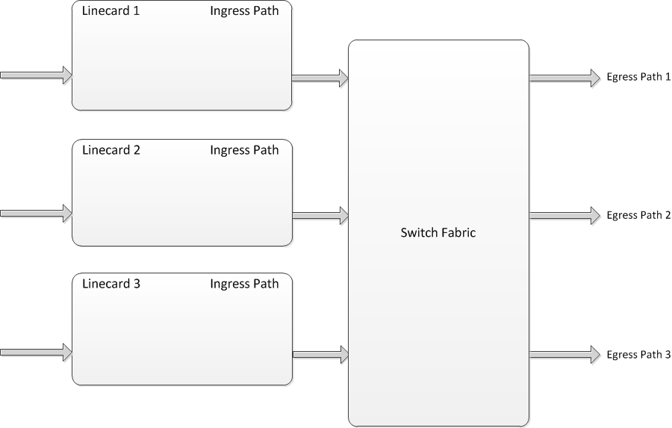
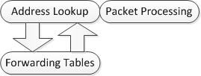
Introduction: Typical Router Architecture
2
Switching

Slide 3
The Processing Revolution
Routing (header processing)
Payload processing: payload encryption, intrusion detection, worm signature generation and more.
Network programmability
  Data centers and VMs (Virtual Machines)
  SDN (Software-Defined Networking)
  NFV (Network Function Virtualization)
  C-programmable applications
2 orders of magnitude
computational complexity
Nearly-unbounded
computational complexity
We need more processing power!

Slide 4
Outline
Model Assumptions and Valiant
The Infinite Switch Fabric Models
  Infinite capacity
  Single queue
  N-queues
Example
Simulation

Slide 5
Generic Router Model
Focus on the ingress path

Slide 6
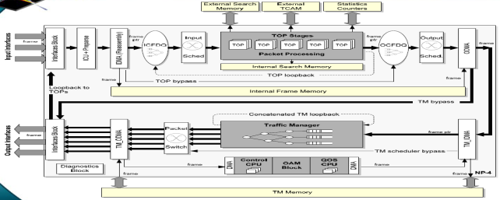
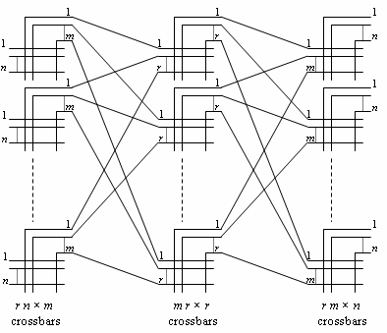
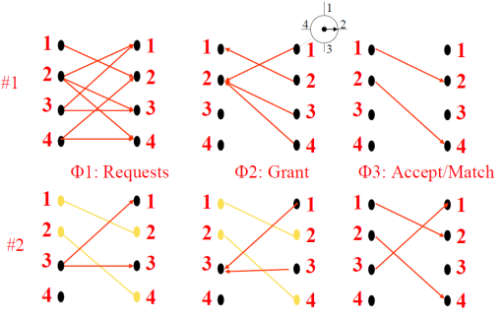
Generic Router Model

Slide 7
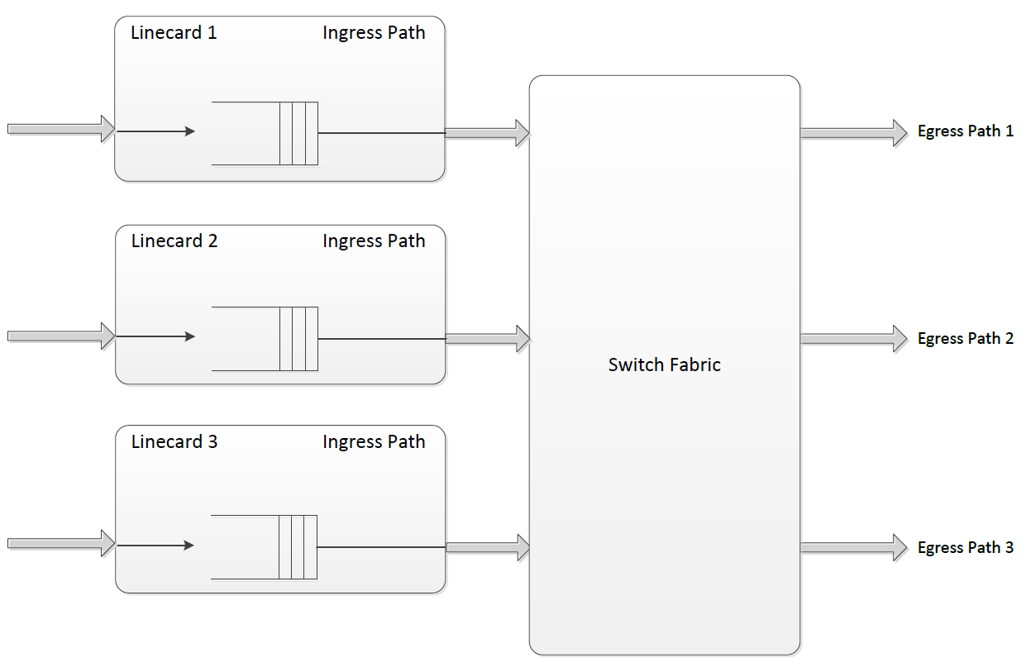
Generic Router Model
Simplify the ingress path
Processing

Slide 8
Generic Router Model
Drop packet
Congested
1
2
3
1
2
1
1
1
1
1
1
1

Slide 9
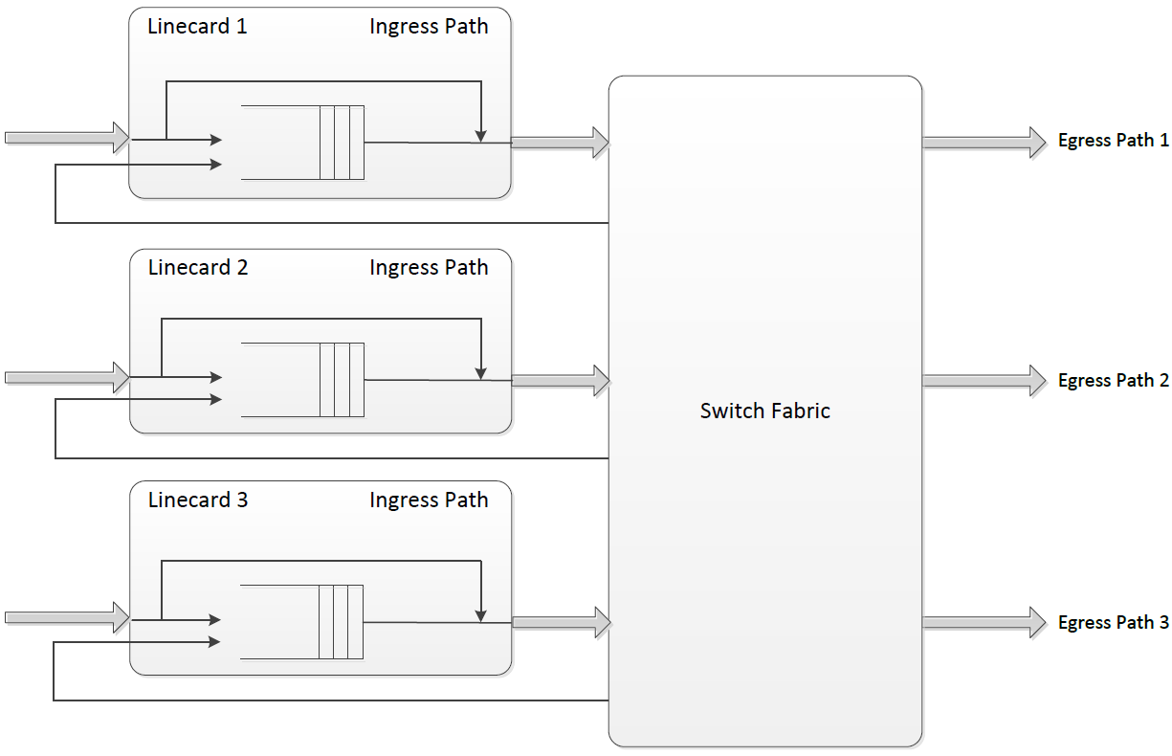
Our Proposal
Redirect part of the packets to a less congested linecard
Our proposal
Congested
1
2
3
1
2
1
1
1
1
1
1
3
Our idea: Tapping Into The Unutilized Router Processing Power
Unutilized processing power

Slide 10
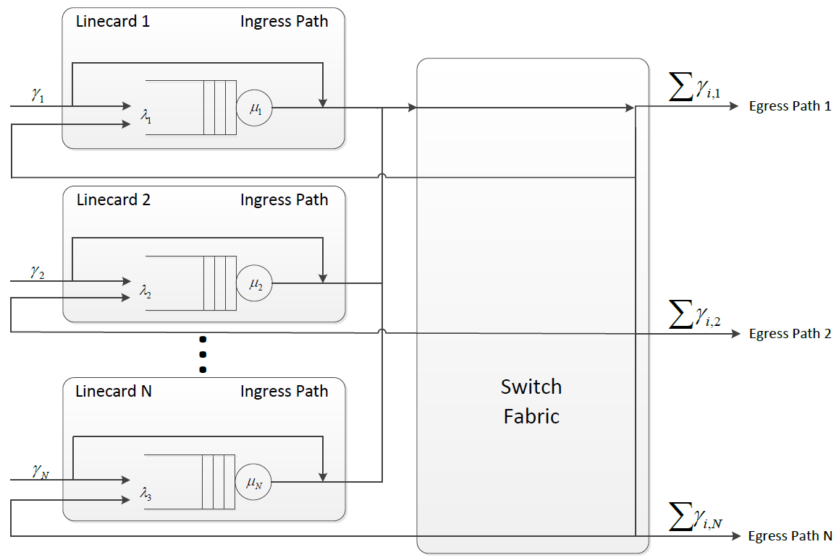






Model and Assumptions
Find optimal redirect probabilities

Slide 11
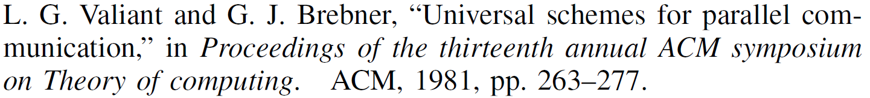
First idea: Valiant-based Algorithm
P=1/3
P=1/3
P=1/3
Inspired by:

Slide 12
First idea: Valiant-based Algorithm
2
P=1/3
1
P=1/3
3
P=1/3
Inspired by:

Slide 13
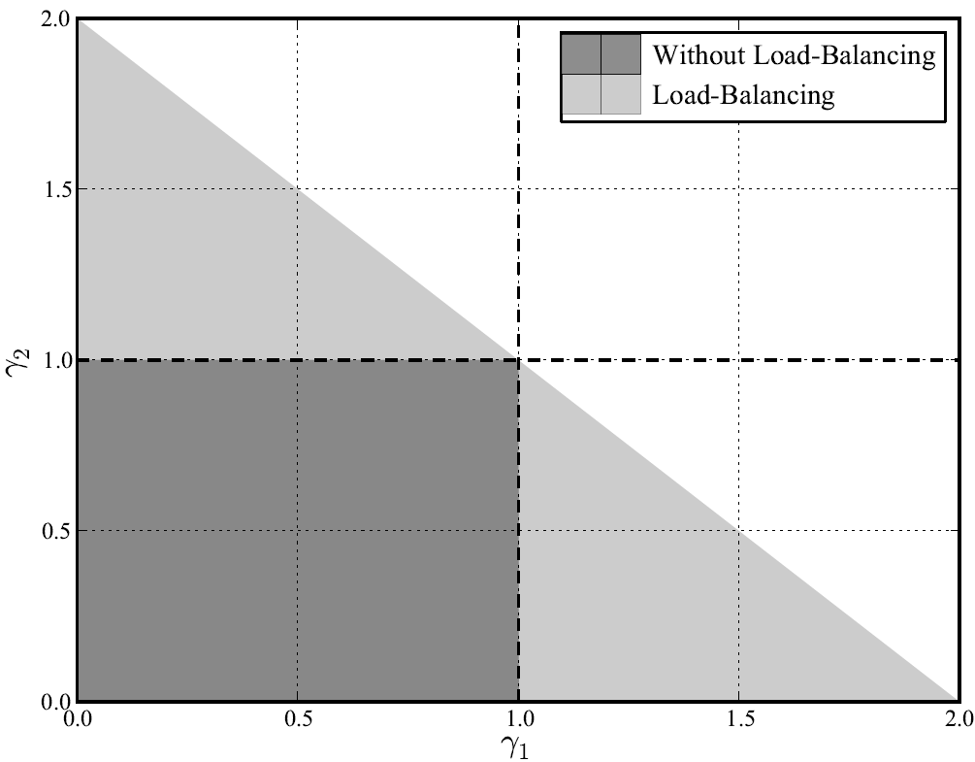
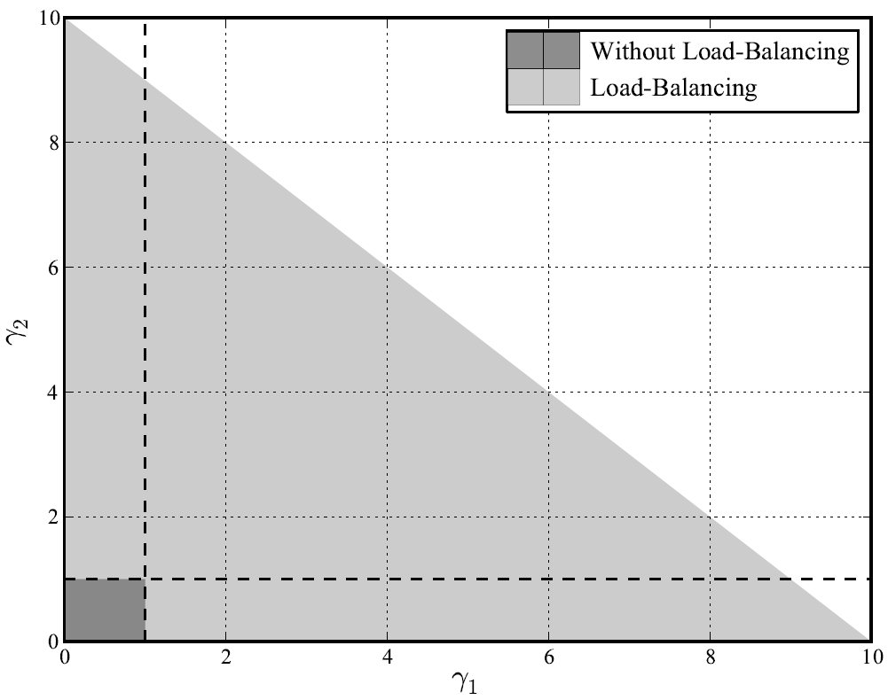


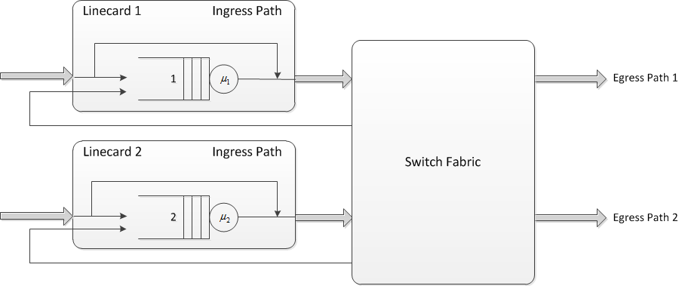


Capacity Region
N=2
N=10
N – Number of linecards

Slide 14
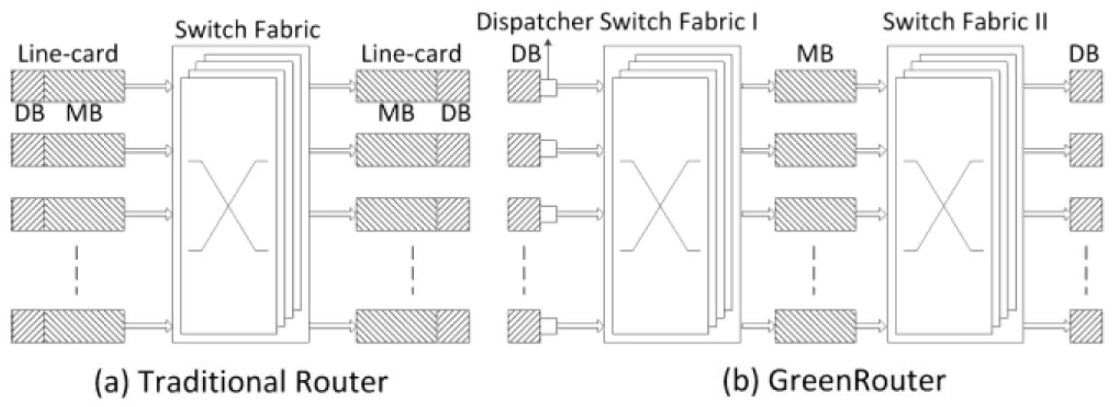
Related Work - GreenRouter
Change router architecture, two SF layers
Separate processing and interface in linecards
Y. Kai, Y. Wang and B. Liu, “GreenRouter: Reducing power by innovating router’s architecture”, 2013.

Slide 15
Outline
Model Assumptions and Valiant
The Infinite Switch Fabric Models
  Infinite capacity
  Single queue
  N-queues
Example
Simulation

Slide 16
The Infinite Switch Fabric Model

Slide 17
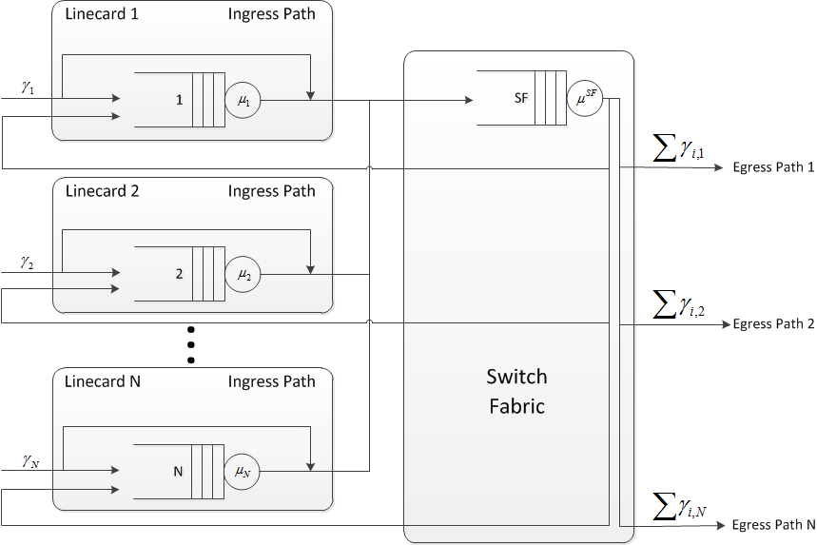
The Single Queue Switch Fabric Model
Shared Memory
Switching Delay

Slide 18
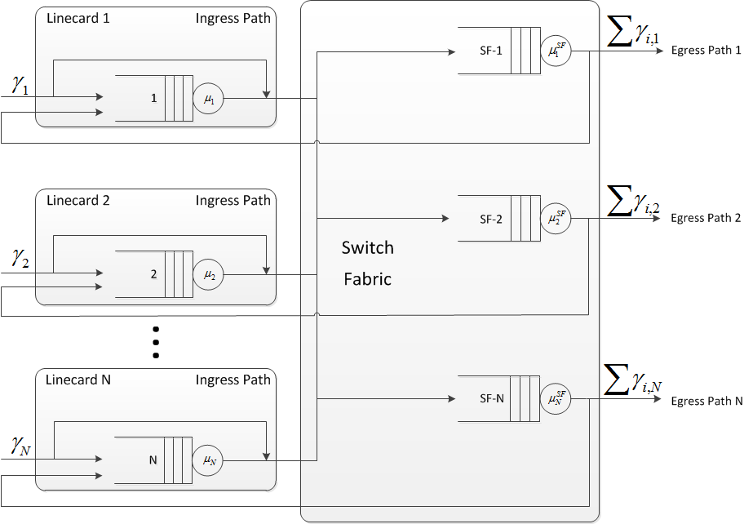
The N-Queues Switch Fabric Model
Output Queues

Slide 19
Outline
Model Assumptions and Valiant
The Infinite Switch Fabric Models
  Infinite capacity
  Single queue
  N-queues
Example
Simulation

Slide 20
The Single Queue Switch Fabric Model
Shared Memory
Switching Delay

Slide 21
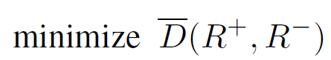
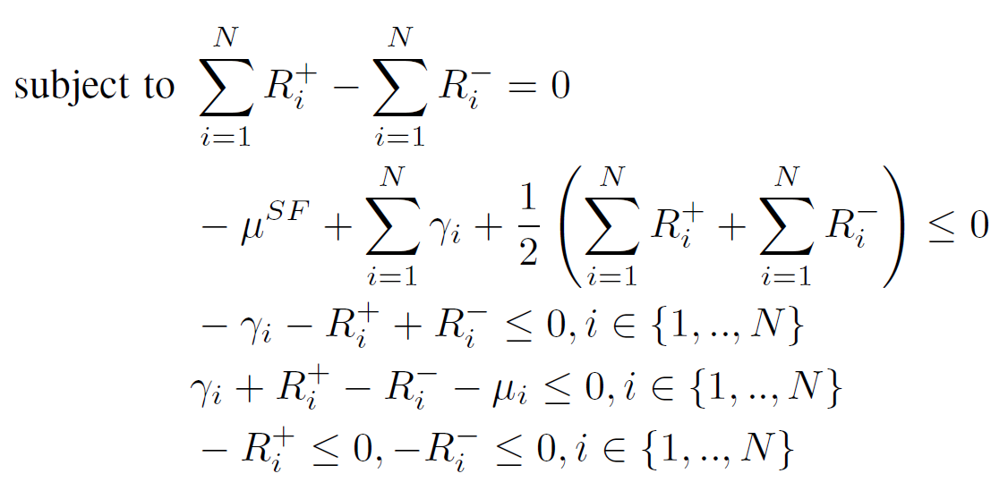
The Single Queue Switch Fabric Model - Optimization
Average delay
Flow conservation
Feasible SF flow
Positive flow
Feasible linecard flow
Positive variables

Slide 22
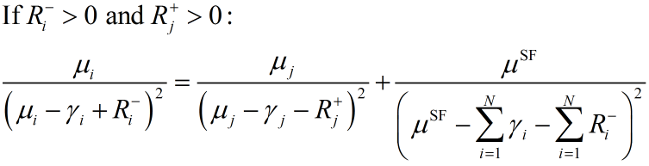
The Single Queue Switch Fabric Model - Intuition
1
3
1
2
1
Minimal average delay optimality conditions, redirect from i to j:
Linecard i weighted delay derivative
Linecard j weighted delay derivative
Switch fabric weighted delay derivative

Slide 23
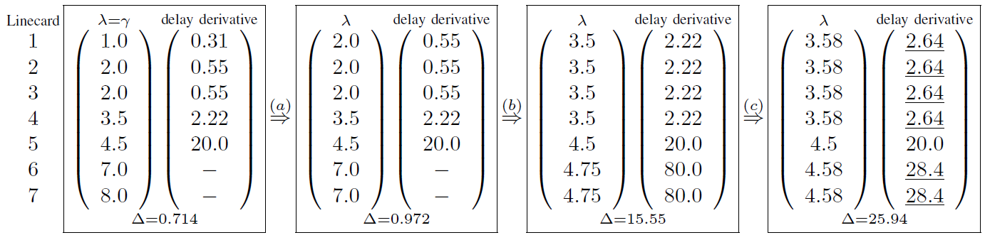


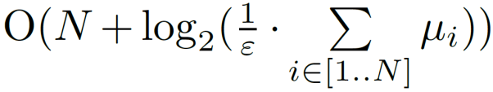
The Single Queue Switch Fabric Model - Example
Complexity:

Slide 24
Outline
Model Assumptions and Valiant
The Infinite Switch Fabric Models
  Infinite capacity
  Single queue
  N-queues
Example
Simulation

Slide 25
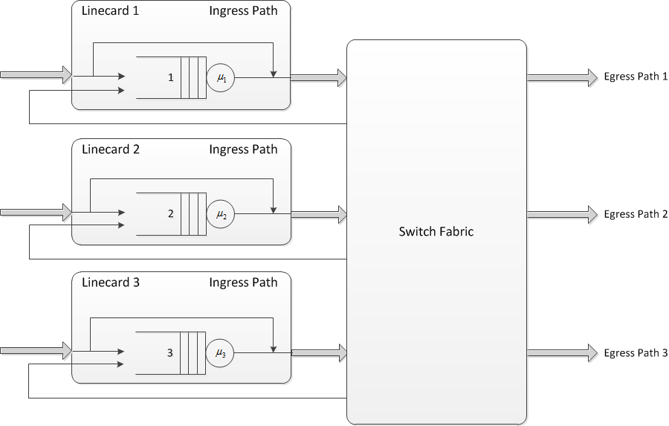

The Simulation Model
- Decision making algorithm
Real high-speed Internet backbone link traces from CAIDA.
Each input is associated with a different trace.
The processing time is calculated based on the packet size using the number of instructions and memory-accesses estimate of PacketBench for header and payload processing applications.
The architecture remains constant through the simulations.
Only the load-balancing algorithm changes.
Input-queued switch fabric with
VOQs and an implementation of
the iSLIP scheduling algorithm.

Slide 26
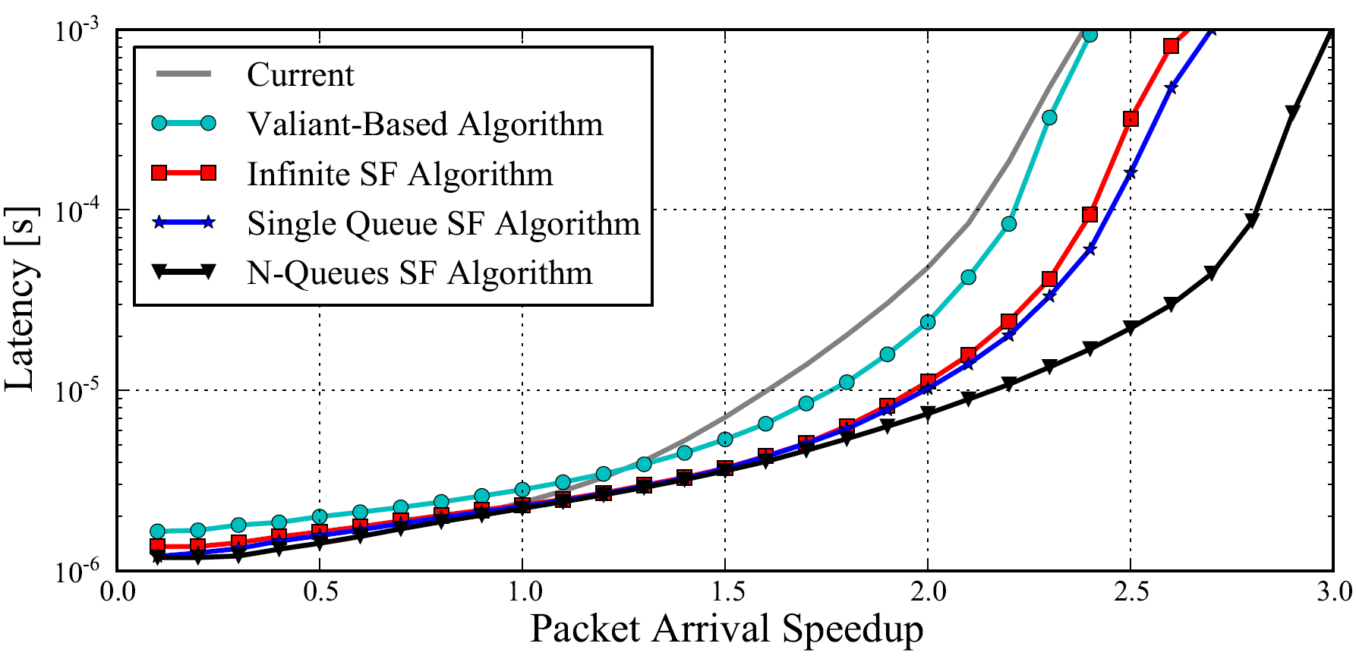
Real Traces, iSLIP, PacketBench
+25% capacity
Simulation settings: Five linecards with ~24% OC192 utilization, five with ~3%. Each linecard is associated with a different trace.
Note: Link utilization ≠ Processor utilization

Slide 27
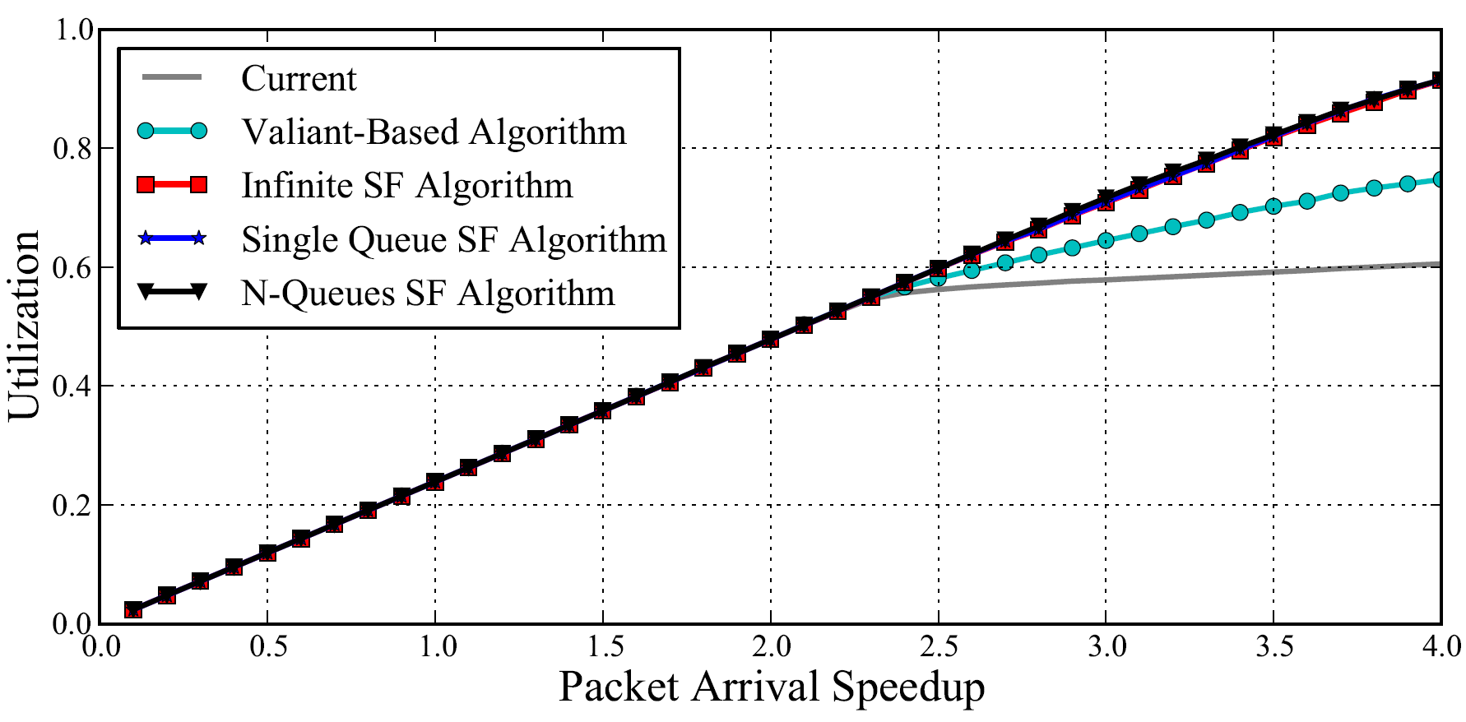
Real Traces, iSLIP, PacketBench
Simulation settings: Five linecards with ~24% OC192 utilization, five with ~3%. Each linecard is associated with a different trace.
Note: Link utilization ≠ Processor utilization

Slide 28
Concluding Remarks
Invented way of tapping into the unutilized router processing power
Significantly extended capacity region
Lower delay
  Reasonably higher complexity

Slide 29
Thank you!

