Slide 1

Stable User-Defined Priorities
Shay Vargaftik, Isaac Keslassy, Ariel Orda

Slide 2







Background
Giving users the ability to dynamically choose the priorities of their network flows.
My meeting was interrupted by your online games!
Internet
Best Effort

Slide 3

Background
Giving users the ability to dynamically choose the priorities of their network flows.
Internet
High priority
Low priority

Slide 4
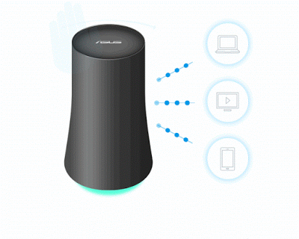
Academia
Industry
"Neutral Net Neutrality" Yiakoumis et al., SIGCOMM’16
Google OnHub
High priority

Slide 5


Our Focus:
Can networks maintain stability with user-defined priorities?
High priority
Best Effort
Low priority

Slide 6
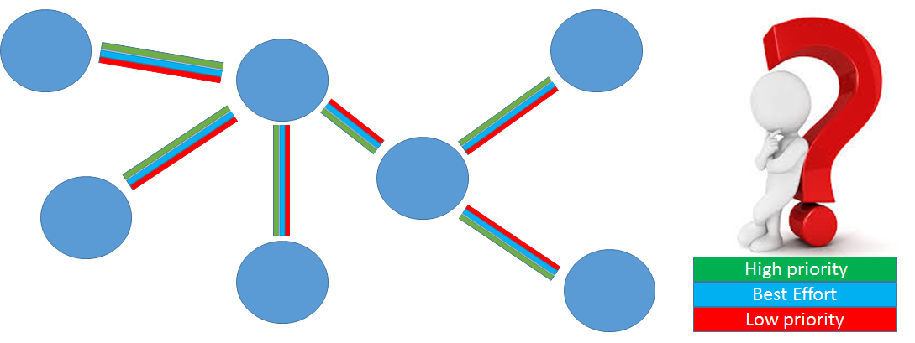
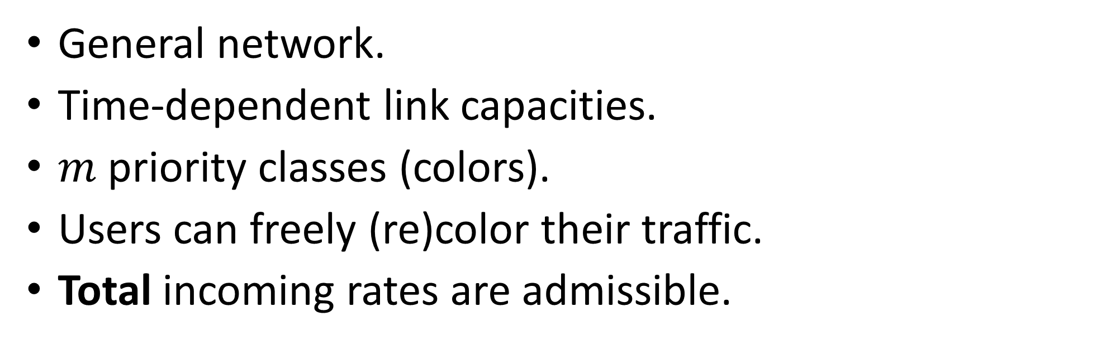
Model: User-defined priorities and rates
General network.
Time-dependent link capacities.
$m$ priority classes (colors).
Users can freely (re)color their traffic.
Total incoming rates are admissible.

Slide 7
Challenges
Challenge 1: Priority isolation
Challenge 2: Expected priority rates are not fixed
Challenge 3: Priorities are not fixed

Slide 8
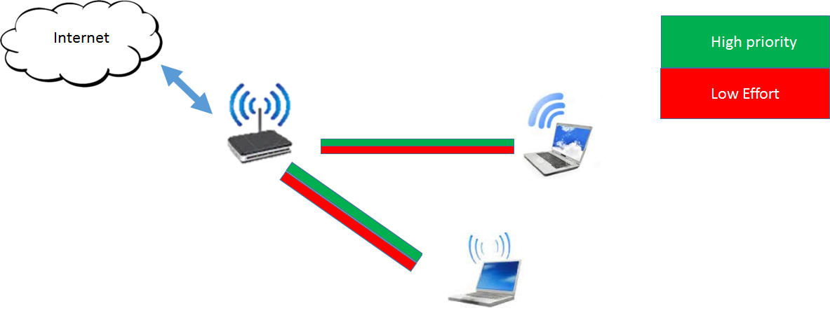
Challenge 1 – Priority isolation
PROBLEM:
S
D

Slide 9


Challenge 2 – Expected priority rates are not fixed
Internet
demand
High Priority
time
Low Priority

Slide 10


Challenge 3 - Priorities are not fixed
Internet
High Priority
demand
Low Priority
High Priority
Low Priority
time
On-the-fly change of priority to already submitted packets

Slide 11
Backpressure Background
Backpressure schemes stabilize a network with no user-defined priorities [Tassiulas and Ephremides, 1992].
  Scheduling decisions are based on:
    Congestion gradients (e.g., queue length differentials – Q-BP)
    Link capacities

Slide 12

Backpressure scheduling – Q-BP
Scheduling decisions are based on:
  Congestion gradients - queue length differentials
  Link capacities
Capacity = 1
Capacity = 1
Mutually exclusive links

Slide 13
Backpressure scheduling – Q-BP
Scheduling decisions are based on:
  Congestion gradients - queue length differentials
  Link capacities
Capacity = 1
Capacity = 2
Mutually exclusive links

Slide 14


Backpressure scheduling – Q-BP
  Congestion gradients - queue length differentials
  Link capacities
  Choose schedule to maximize the sum of products.
$$Q_{diff}=3−0=3$$
$$Q_{diff}=2−0=2$$
Capacity = 1
Capacity = 2
Mutually exclusive links
$$Q_{diff}⋅Capacity=3⋅1<2⋅2=Q_{diff}⋅Capacity$$

Slide 15
Backpressure and user defined priorities?
Natural approach – m-DRPC:
  Priority Isolation: Split each destination node to m virtual nodes.
  Priority Service: Use weighted congestion gradients [Neely et al., 2003 – “DRPC priority-service enhancement”].

Slide 16


m-DRPC - Priority isolation
PROBLEM:
S
D
$${ D}_{1}$$
Solution?
S
Mutual exclusion
$${ D}_{2}$$

Slide 17
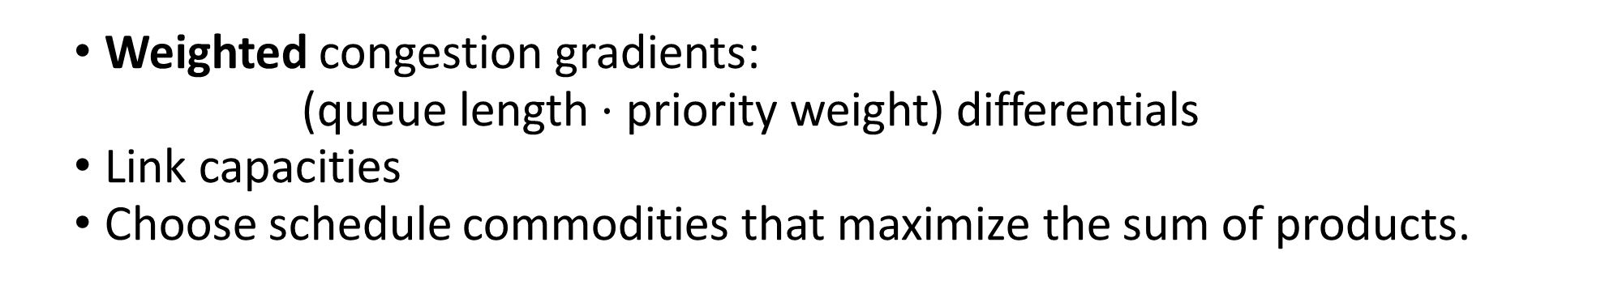


m-DRPC – Priority Service
  Weighted congestion gradients:
  (queue length $⋅$ priority weight) differentials
  Link capacities
  Choose schedule commodities that maximize the sum of products.
weight is 2
$${WQ}_{diff}=2⋅3−0=6$$
weight is 1
$${WQ}_{diff}=1⋅2−0=2$$
Capacity = 1
Capacity = 2
Mutually exclusive links
$${WQ}_{diff}⋅Capacity=6⋅1>2⋅2={WQ}_{diff}⋅Capacity$$

Slide 18
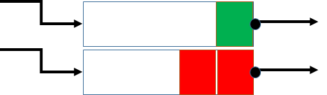
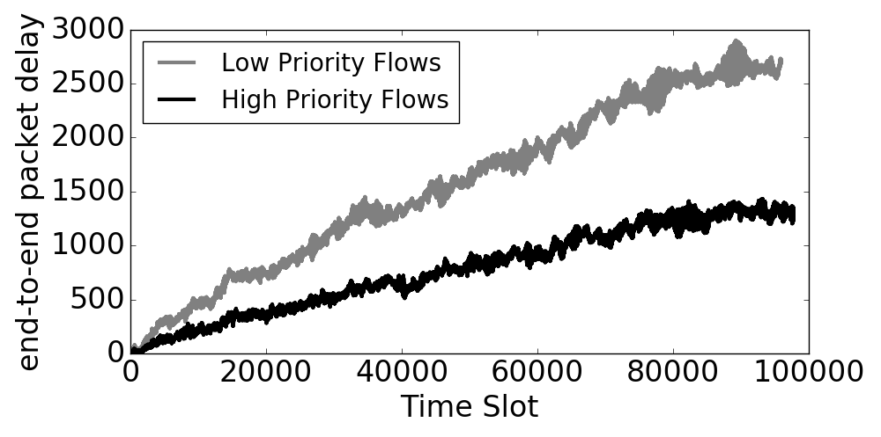
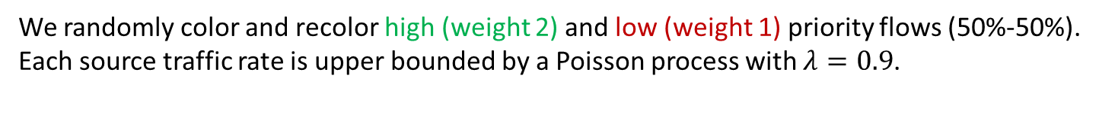



Backpressure schemes lose stability with user-defined priorities. Counter example based on [Neely et al., 2003].
m-DRPC - Unregulated priority jumps lead to instability
$$S_{1}$$
{1,2,3}
Mutual exclusion
$$D$$
$$S_{2}$$
{1,2,3}
We randomly color and recolor high (weight 2) and low (weight 1) priority flows (50%-50%).
Each source traffic rate is upper bounded by a Poisson process with $λ=0.9$.

Slide 19

Why do user-defined priorities cause instability?
Capacity = 2
Capacity = 1
User-defined priorities may force the scheduler not to take advantage of the better links whenever they are available!

Slide 20
Our Focus
Can networks maintain stability with user-defined priorities?

Slide 21
Challenges
Challenge 1: Priority isolation
Challenge 2: Expected priority rates are not fixed
Challenge 3: Priorities are not fixed

Slide 22
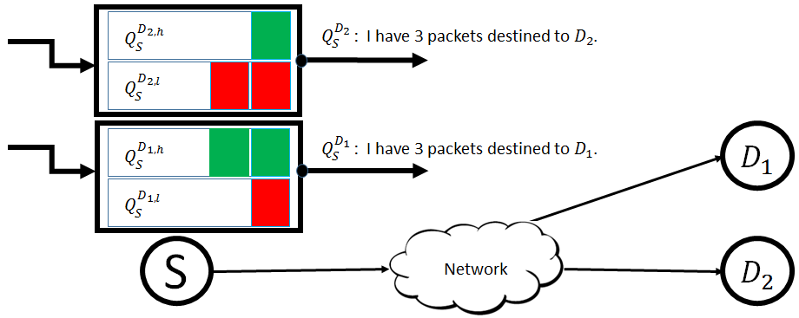
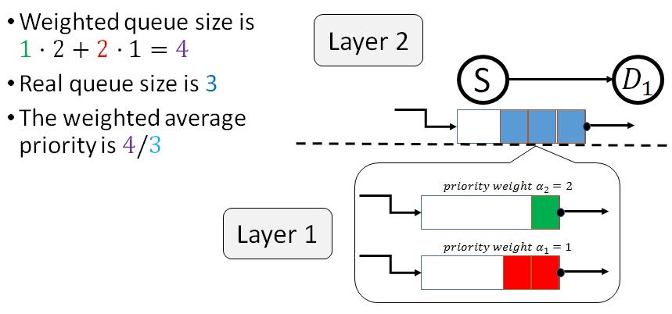
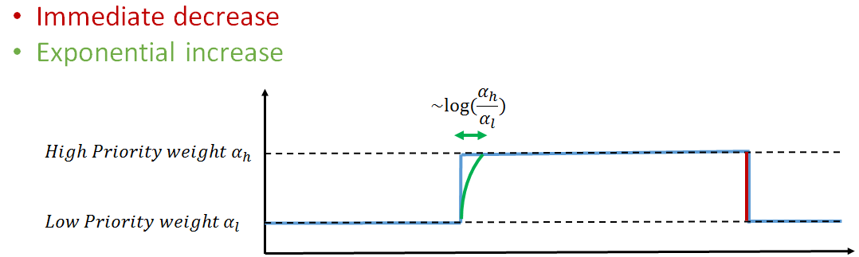
Our solution: User-defined Backpressure (U-BP)
  Step 1: Dual layer approach
  Step 2: Weighted average priorities
  Step 3: Gradual priority updates

Slide 23




  Current - No priority isolation
$$Q_{S}^{D_{1}}$$
$${ D}_{1}$$
$$Q_{S}^{D_{2}}$$
S
Network
$${ D}_{2}$$

Slide 24








Natural extension (m-DRPC)
$$Q_{S}^{D_{1,h}}$$
$${ D}_{1,h}$$
$$Q_{S}^{D_{1,l}}$$
$${ D}_{1,l}$$
$$Q_{S}^{D_{2,h}}$$
$$Q_{S}^{D_{2,l}}$$
$${ D}_{2,h}$$
S
Network
$${ D}_{2,l}$$
Increased delay (by a factor of m)

Slide 25








  U-BP - Step 1: Dual layer approach
Virtual queues handle the different priorities.
Inform the upper-layer backpressure scheme about the aggregated queue occupancy
$$Q_{S}^{D_{1,h}}$$
$Q_{S}^{D_{2} }$: I have 3 packets destined to${ D}_{2}$.
$$Q_{S}^{D_{1,l}}$$
$Q_{S}^{D_{1} }$: I have 3 packets destined to${ D}_{1}$.
$${ D}_{1}$$
$$Q_{S}^{D_{2,h}}$$
$$Q_{S}^{D_{2,l}}$$
S
$${ D}_{2}$$
Network

Slide 26

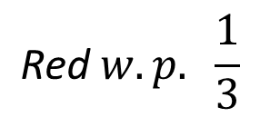
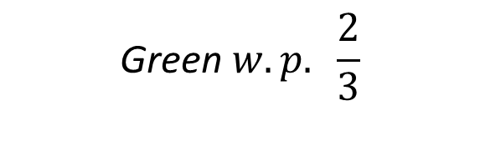


  U-BP - Step 1: Dual layer approach
S
$${ D}_{1}$$
Layer 2
Layer 1
$$priority weight 2$$
$$\text{Green} w.p. \frac{2}{3}$$
Inter-destination prioritization
$$priority weight 1$$
$$\text{Red} w.p. \frac{1}{3}$$

Slide 27
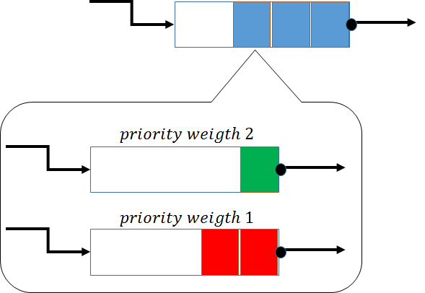



U-BP - Step 2: Weighted average priority
The dual-layer approach provides user defined priorities within a layer 2 queue.
How to favor higher priorities between different layer 2 queues?
$$S_{1}$$
{1,2,3}
$$D$$
Mutual exclusion
$$S_{2}$$
{1,2,3}

Slide 28
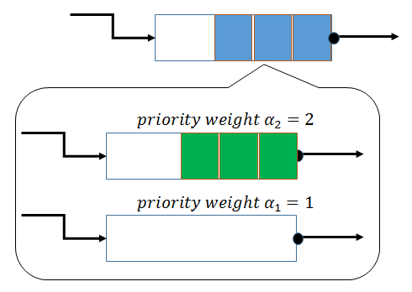
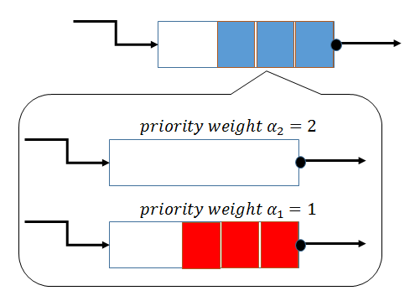



U-BP - Step 2: Weighted average priority
The dual-layer approach provides user defined priorities within a layer 2 queue.
How to favor higher priorities between different layer 2 queues?
$$S_{1}$$
{1,2,3}
$$D$$
Mutual exclusion
$$S_{2}$$
{1,2,3}

Slide 29

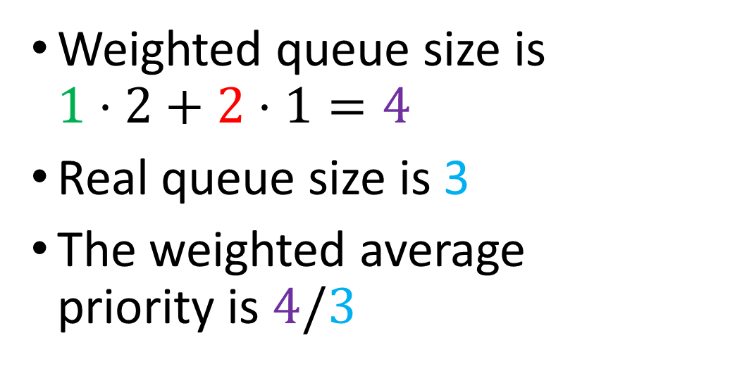


U-BP - Step 2: Weighted average priority
Weighted queue size is $1⋅2+2⋅1=4$
Real queue size is 3
The weighted average priority is $4/3$
Layer 2
S
$${ D}_{1}$$
Layer 1
$$priority weight α_{2}=2$$
$$priority weight α_{1}=1$$

Slide 30
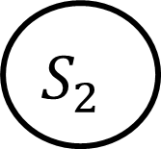


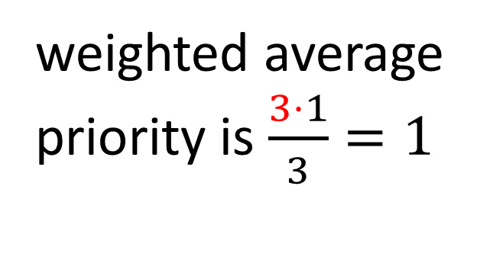
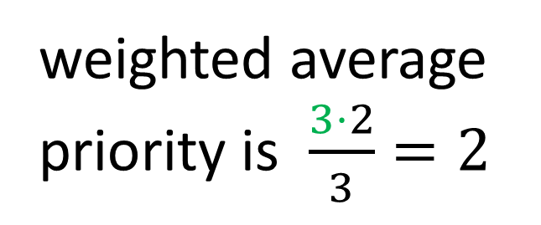
U-BP - Step 2: Weighted average priority
weighted average priority is $\frac{3⋅2}{3}=2$
Better service
$$S_{1}$$
{1,2,3}
$$D$$
Mutual exclusion
weighted average priority is $\frac{3⋅1}{3}=1$
$$S_{2}$$
{1,2,3}

Slide 31



  U-BP - Step 3: Gradual priority updates
Upon update of weighted average priority:
Exponential increase
$$\sim log⁡(\frac{H}{L})$$
Immediate decrease
$$weight H$$
$$weight L$$
time
Theorem: U-BP stabilizes a network with user-defined priorities

Slide 32
Evaluation
Q-BP
  Standard queue length based backpressure
m-DRPC
  Virtual destinations
  Priority service
U-BP
  Dual layer approach
  Weighted average priorities
  Gradual priority updates

Slide 33
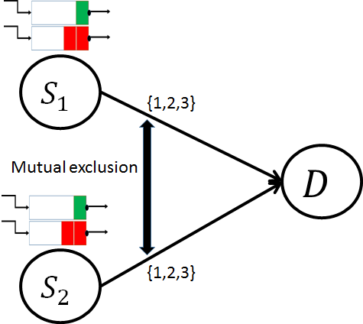
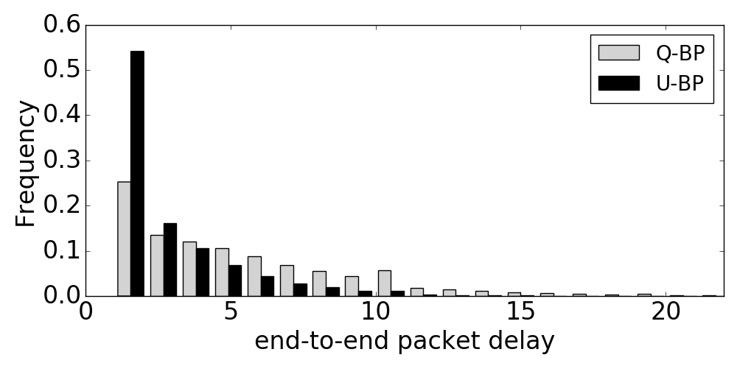
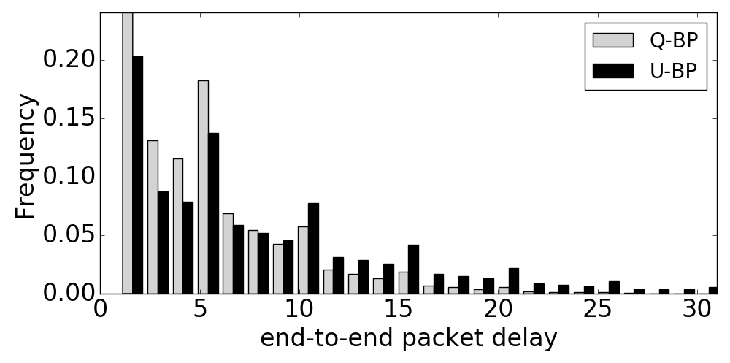
Evaluation – Previous counter example
High priority flows
mean
mean
Low priority flows
mean
mean
m-DRPC

Slide 34
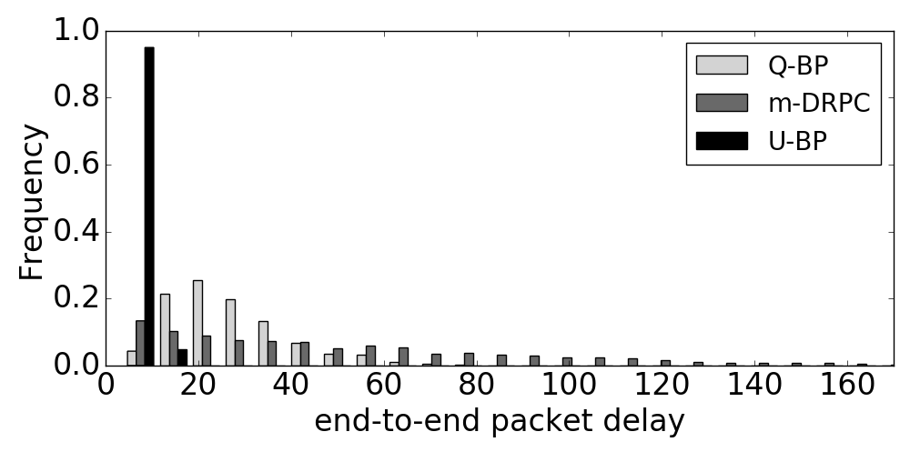
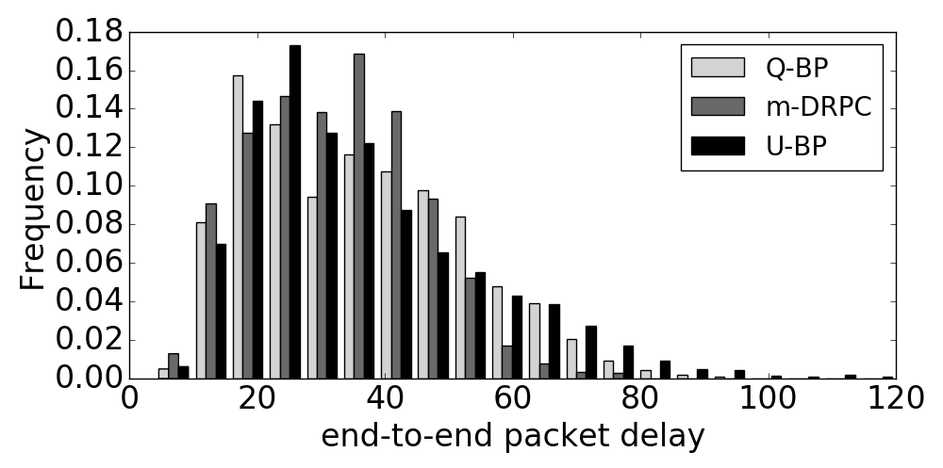
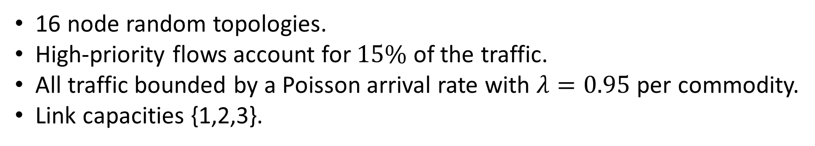
Evaluation
16 node random topologies.
High-priority flows account for $15\%$ of the traffic.
All traffic bounded by a Poisson arrival rate with $λ=0.95$ per commodity.
Link capacities {1,2,3}.
Arrows show the mean values
High priority flows
Low priority flows

Slide 35
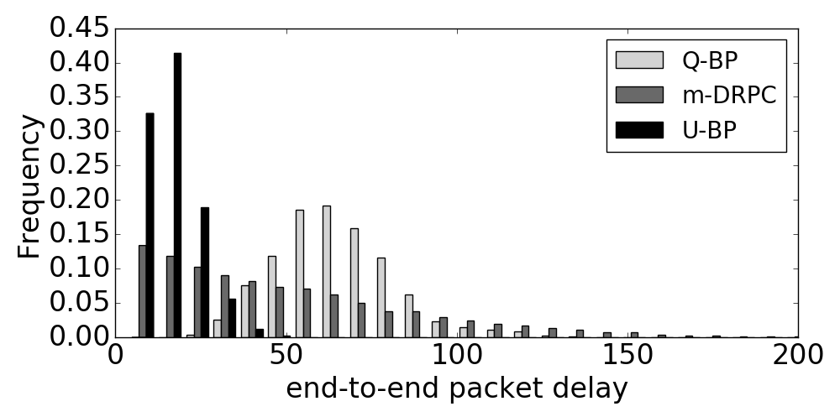
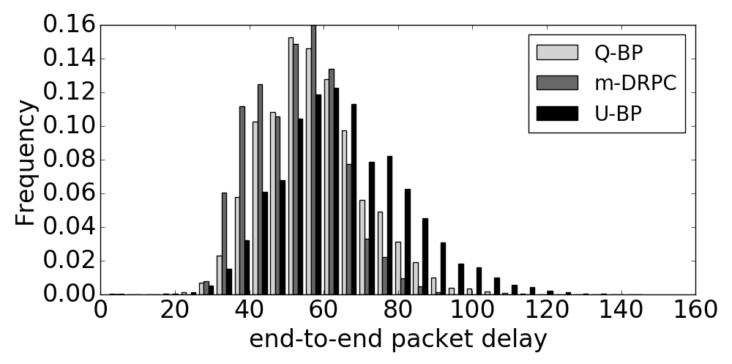
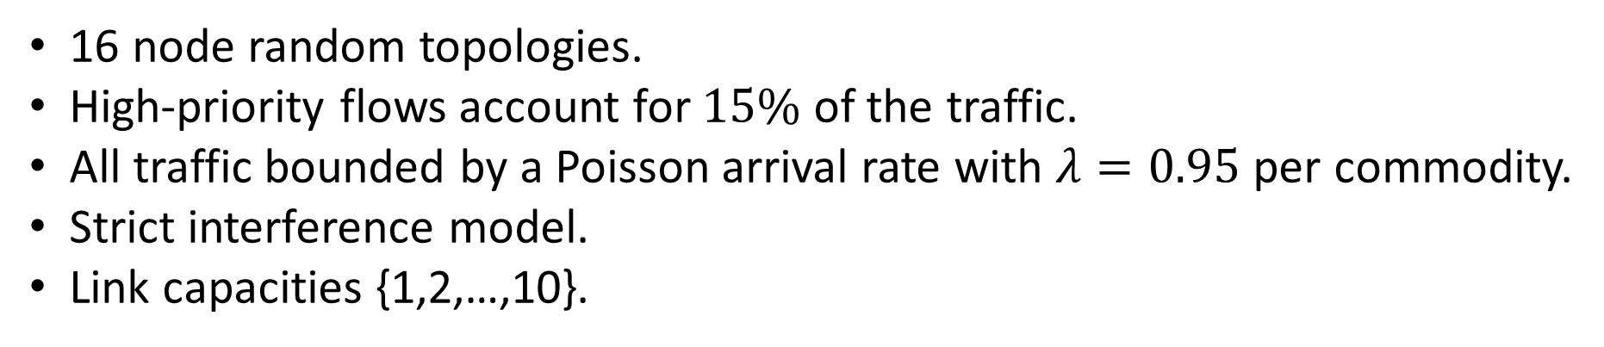
Evaluation
16 node random topologies.
High-priority flows account for $15\%$ of the traffic.
All traffic bounded by a Poisson arrival rate with $λ=0.95$ per commodity.
Strict interference model.
Link capacities {1,2,…,10}.
Arrows show the mean values
High priority flows
Low priority flows

Slide 36
Conclusions
Stability and user-defined priorities can coexist
U-BP provides user-defined priorities:
  Strong performance for high priority flows
  Maintains overall network performance

Slide 37
Thank you!

