Slide 1


QueuePilot: Reviving Small Buffers With a Learned AQM Policy
Micha Dery, Orr Krupnik, Isaac Keslassy
Department of Electrical & Computer Engineering
Technion

Slide 2
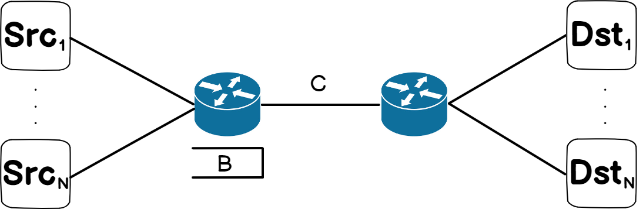
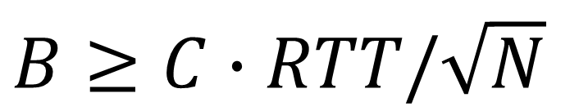
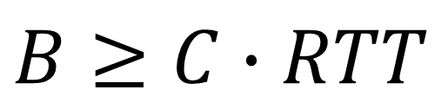

Background: Buffers in backbone routers
How much buffer do we need
for a high link utilization?
  B = Buffer size
  C = Link capacity
  RTT = Propagation round trip time
BDP rule-of-thumb¹:
  For 1 long-lived TCP flow
Small buffer rule²:
For $N$ long-lived TCP flows
$$B≥C∙RTT$$
$B≥C∙RTT/\sqrt{N}$
¹ V. Jacobson, “Modified TCP congestion avoidance algorithm,” Email to the end2end-interest mailing list, 1990
²G. Appenzeller, I. Keslassy, and N. McKeown, “Sizing router buffers,” ACM SIGCOMM CCR, vol. 34, no. 4, pp. 281–292, 2004
Motivation
Problem
Model
Evaluation

Slide 3


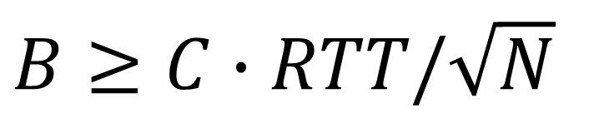
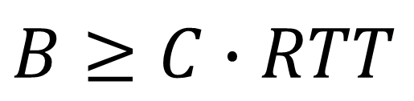

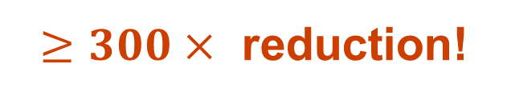
Background: Buffers in backbone routers
Example:
$C=400 Gb/s$
$RTT=60 ms$
$N=100K$
$$B≥C∙RTT$$
$$\sim 3 GB$$
$B≥C∙RTT/\sqrt{N}$
$$\sim 9 MB$$
$≥300×$ reduction!
Motivation
Problem
Model
Evaluation

Slide 4

Small buffers
Chip
Good for vendors – on-chip memory
Cheaper
Faster
Less power consumption
Good for users
Less delay
experiment¹:
traffic
traffic
Memory
“Once the buffer size becomes too large …, we see an increase in the number of rebuffers, increases in the amount of low quality video streamed, and an increase in the time it takes to start a video”
¹ B. Spang, B. Walsh, T.-Y. Huang, T. Rusnock, J. Lawrence, and N. McKeown, “Buffer sizing and video QoE measurements at Netflix,” Workshop on Buffer Sizing, 2019
Motivation
Problem
Model
Evaluation

Slide 5
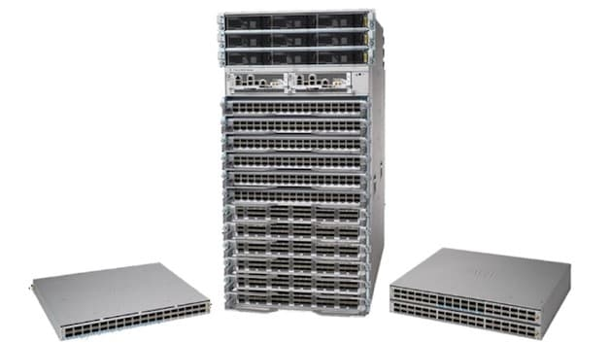
Current linecards for backbone routers
Vendors still follow a reduced version of BDP rule-of-thumb
Example: Cisco’s Q100-based linecards: 17ms buffer (32GB)
Why?
Motivation
Problem
Model
Evaluation

Slide 6
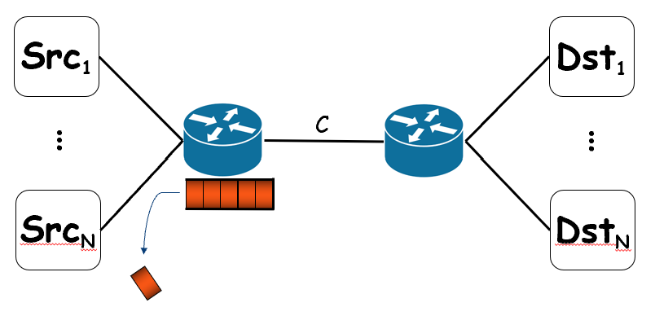
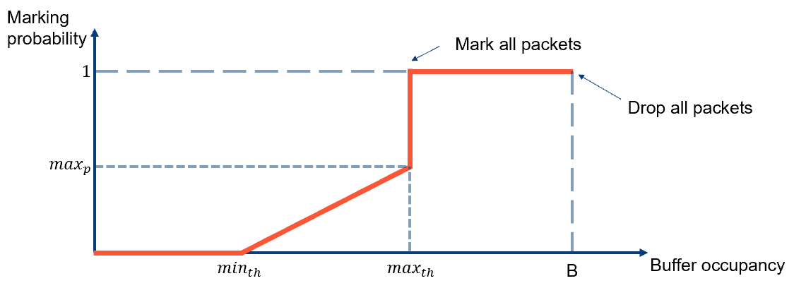
Small-buffer problems with existing AQM
Droptail
  Small buffers ⇒ high drop rate
  ⇒ service-level agreement (SLA) violation
RED¹ with ECN
  Sensitive to its parameters
ARED², CoDel³ and PIE⁴
  Adaptive or “No knobs” algorithms, but their default parameters do not deliver best results^{5,6}
¹ S. Floyd and V. Jacobson, “Random early detection gateways for congestion avoidance,” IEEE/ACM ToN, 1993
² S. Floyd, R. Gummadi, S. Shenker et al., “Adaptive RED: An algorithm for increasing the robustness of RED’s active queue management,” ICSI tech. report, 2001
³ K. Nichols and V. Jacobson, “Controlling queue delay,” Communications of the ACM, 2012
⁴ R. Pan et al., “PIE: A lightweight control scheme to address the bufferbloat problem,” IEEE HPSR, 2013
⁵ N. Kuhn, E. Lochin, and O. Mehani, “Revisiting old friends: is CoDel really achieving what RED cannot?” ACM SIGCOMM workshop on capacity sharing, 2014
⁶ N. Khademi, D. Ros, and M. Welzl, “The new AQM kids on the block: An experimental evaluation of CoDel and PIE,” in IEEE Infocom workshop, 2014
Motivation
Problem
Model
Evaluation

Slide 7






Recap
Vendors and users want small buffers
In small buffers:
  Droptail has high loss rate
  AQM policies do not achieve good results
One of the most significant open problems in networking: Dedicated workshop¹, vendor discussions², operator experiments, etc.
Operators cannot use
small buffers
¹ Workshop on buffer sizing, Stanford, 2019 http://buffer-workshop.stanford.edu/
² L. Wigley, “An update on router buffering,” Cisco White Paper, 2022.
Motivation
Problem
Model
Evaluation

Slide 8
Reinforcement learning (RL)-based AQMs
QRED¹: Chooses RED parameters for dropping
ACC²: Chooses RED parameters for ECN marking
RL-AQM³, DRL-AQM⁴ : Directly choose packet dropping probability
¹ Y. Su, L. Huang, and C. Feng, “QRED: A Q-learning-based active queue management scheme,” Journal of Internet Technology, 2018
² S. Yan, X. Wang, X. Zheng, Y. Xia, D. Liu, and W. Deng, “ACC: Automatic ECN tuning for high-speed datacenter networks,” ACM SIGCOMM, 2021
³ D. A. AlWahab, G. Gombos, and S. Laki, “On a deep Q-network-based approach for active queue management,” IEEE EuCNC, 2021
⁴ H. Ma, D. Xu, Y. Dai, and Q. Dong, “An intelligent scheme for congestion control: When active queue management meets deep reinforcement learning,” Computer Networks, 2021
Motivation
Problem
Model
Evaluation

Slide 9
Research question
Can we use RL-based AQM
to gain good performance
in small buffers?
Motivation
Problem
Model
Evaluation

Slide 10
QueuePilot: Key design choices
Simply replace current router AQM algorithms:
  Autonomous: Rely only on local router information
  Use ECN marking: To reduce drop rate
  Compatible and lightweight: Small model, no GPU
  Single policy: Valid for all buffer sizes and topology settings
Offline training: No online training to avoid catastrophic forgetting phenomenon
Motivation
Problem
Model
Evaluation

Slide 11
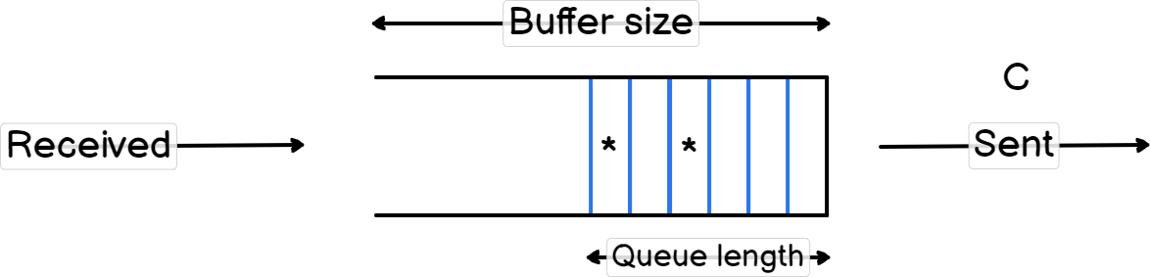
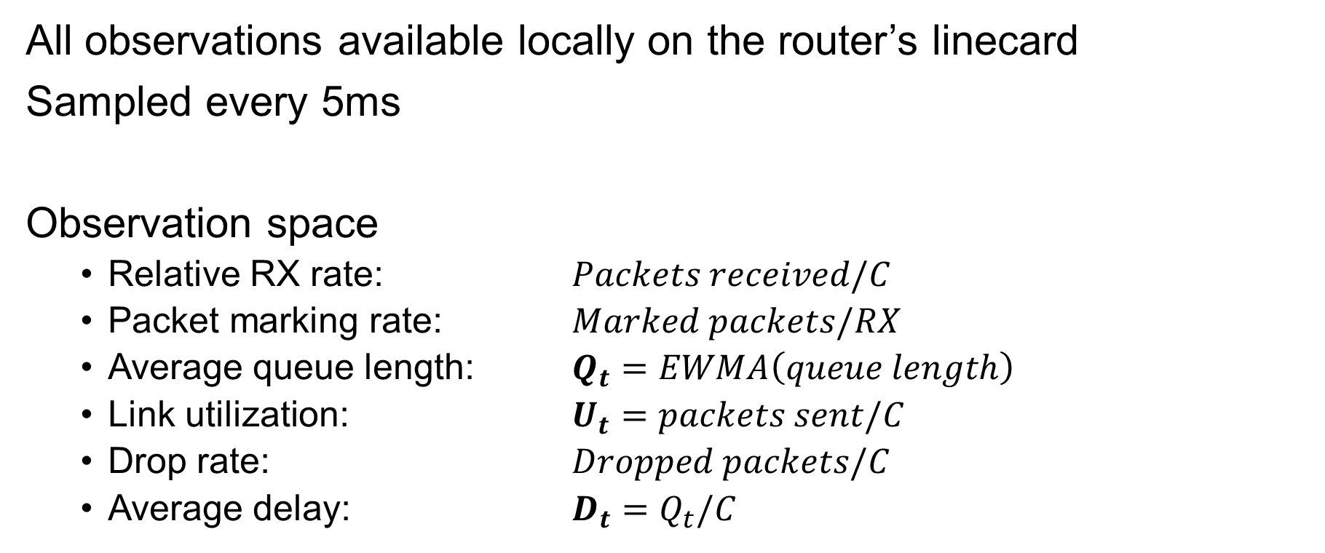
RL formulation
All observations available locally on the router’s linecard
Sampled every 5ms
Observation space
  Relative RX rate: $Packets received/C$
  Packet marking rate: $Marked packets/RX$
  Average queue length: $Q_{t}=EWMA\left(queue length\right)$
  Link utilization: $U_{t}=packets sent/C$
  Drop rate: $Dropped packets/C$
  Average delay: ${D_{t}=Q}_{t}/C$
Motivation
Problem
Model
Evaluation

Slide 12

RL formulation
Action space
  The action is the ECN marking probability of packets
$$a_{t}∈A=\left\{0, 0.01, 0.05, 0.1, 0.5, 1\right\}$$
Motivation
Problem
Model
Evaluation

Slide 13
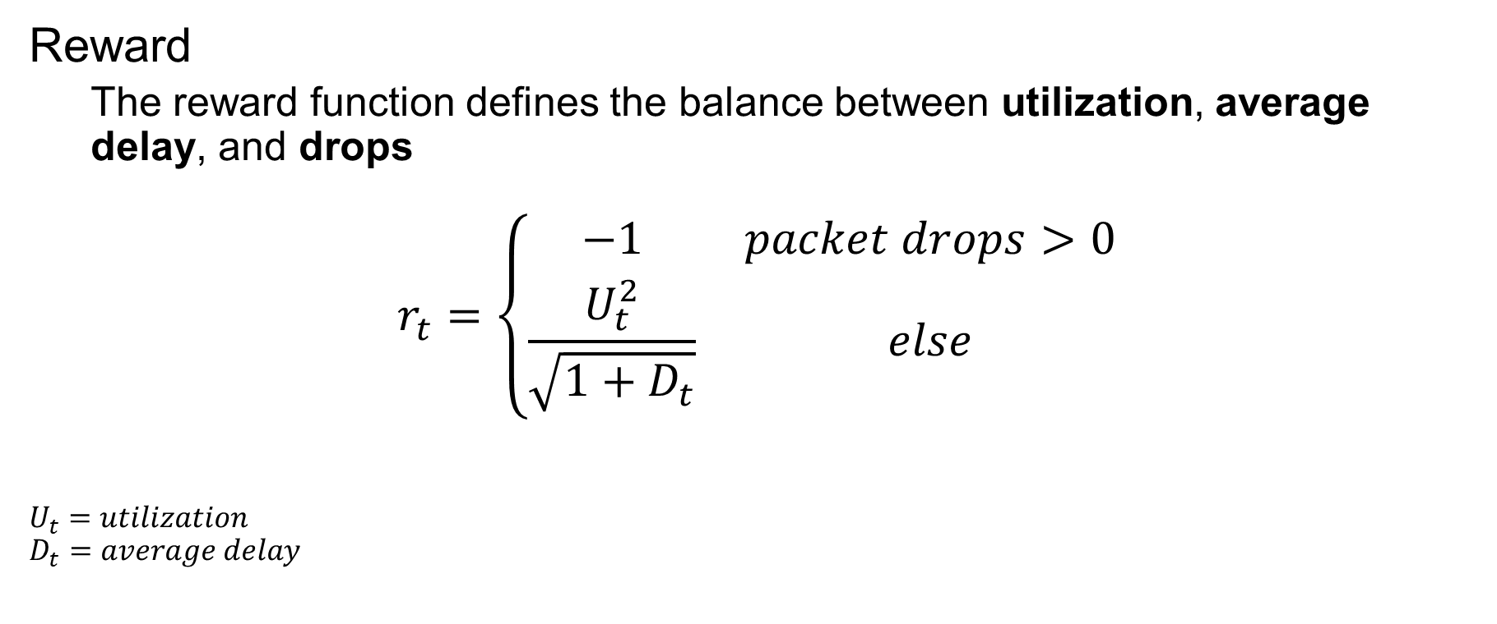
RL formulation
Reward
  The reward function defines the balance between utilization, average delay, and drops
$$r_{t}=\left\{\begin{matrix}−1 & packet drops>0 \\ \frac{U_{t}^{2}}{\sqrt{1+D_{t}}} & else\end{matrix}\right.$$
$U_{t}=$ $utilization$
$$D_{t}=average delay$$
Motivation
Problem
Model
Evaluation

Slide 14
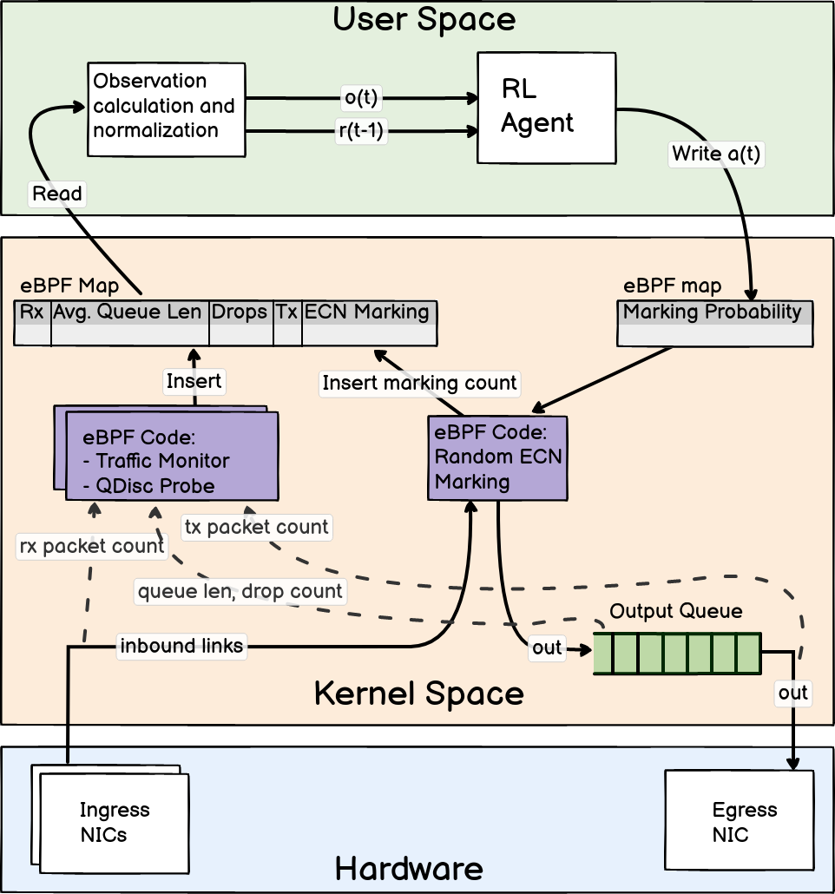
QueuePilot overview
Real packets
Motivation
Problem
Model
Evaluation

Slide 15
Experiments and Results

Slide 16
Questions about QueuePilot
Across several buffer sizes
How does it perform?
How does it trade off the various reward components?
In small buffers:
Does its better reward translate into a better FCT tail?
Can it generalize to a multi-router topology?
Motivation
Problem
Model
Evaluation

Slide 17
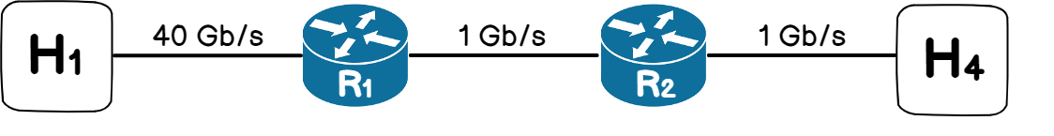
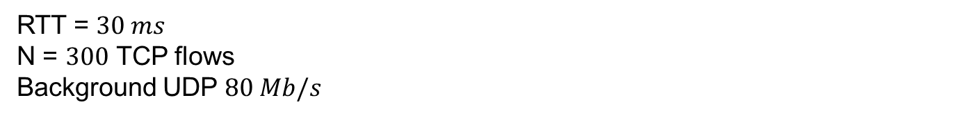
Testbed
...
...
QueuePilot
RTT = $30 ms$
N = $300$ TCP flows
Background UDP $80 Mb/s$
Motivation
Problem
Model
Evaluation

Slide 18
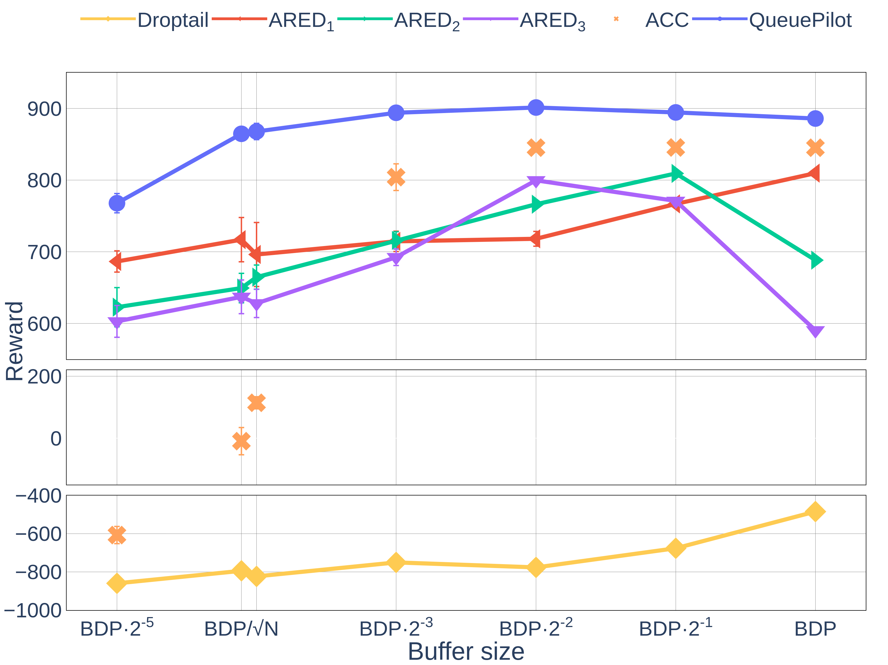
Buffer size sensitivity
Motivation
Problem
Model
Evaluation

Slide 19
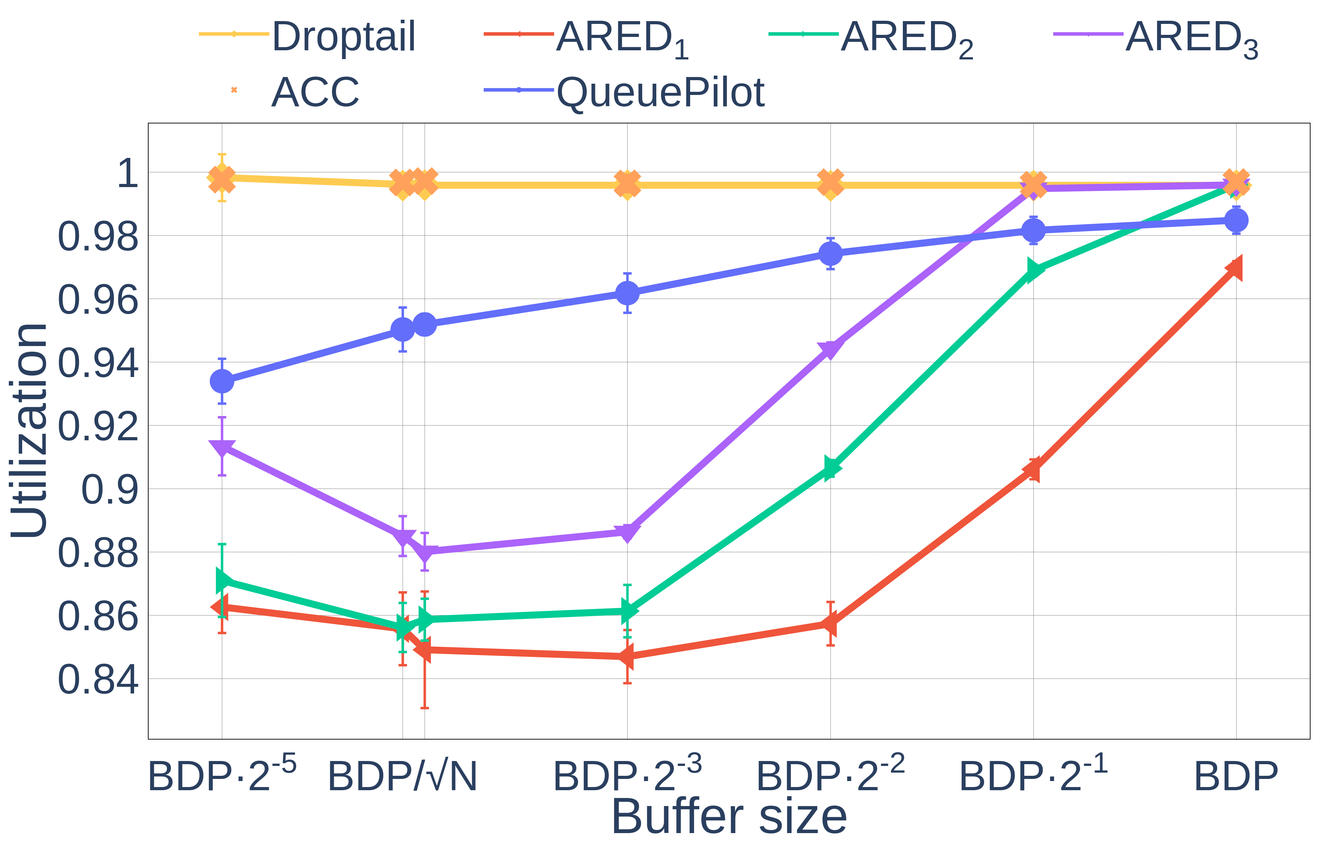
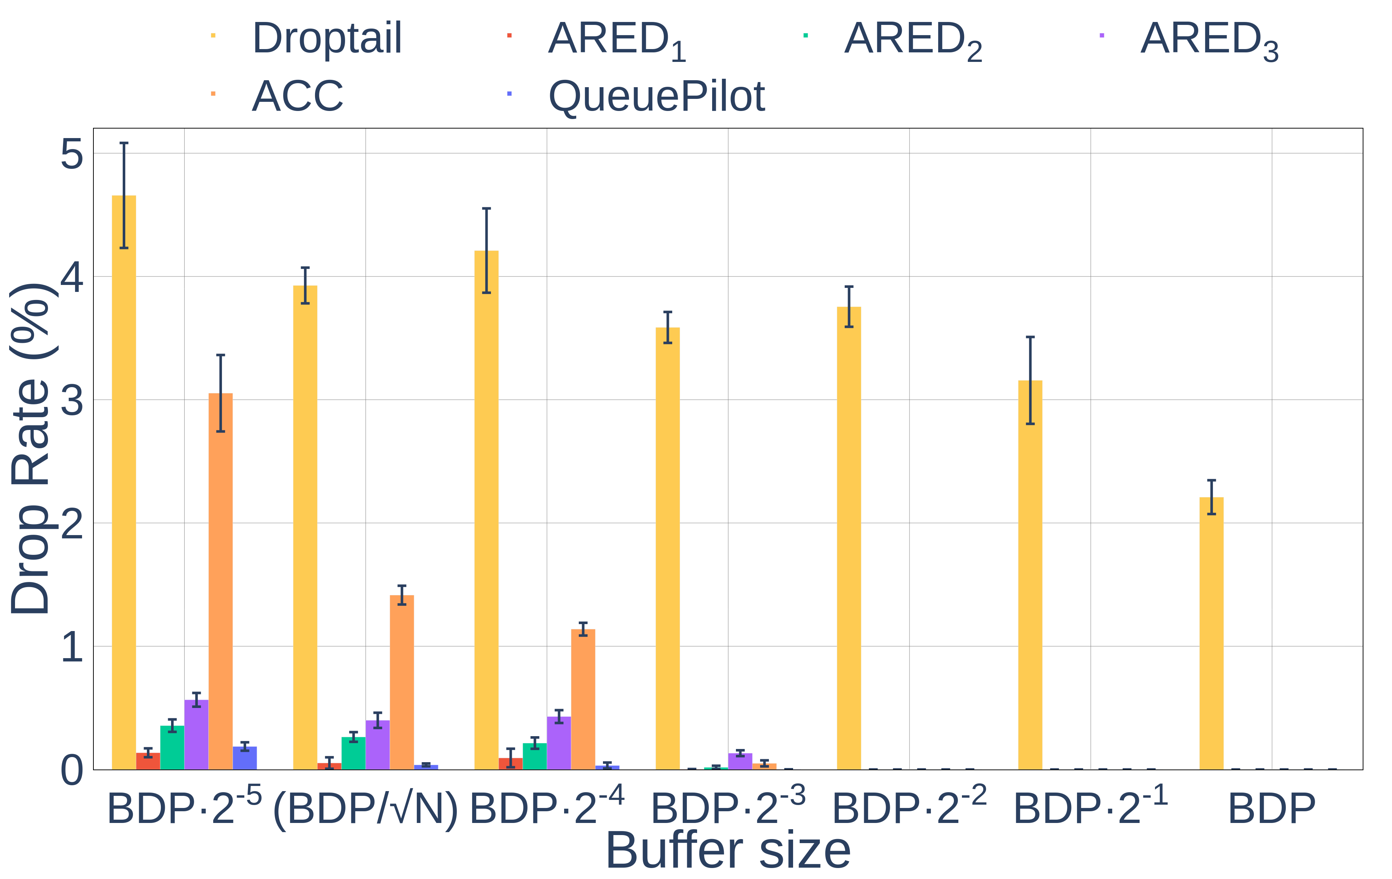
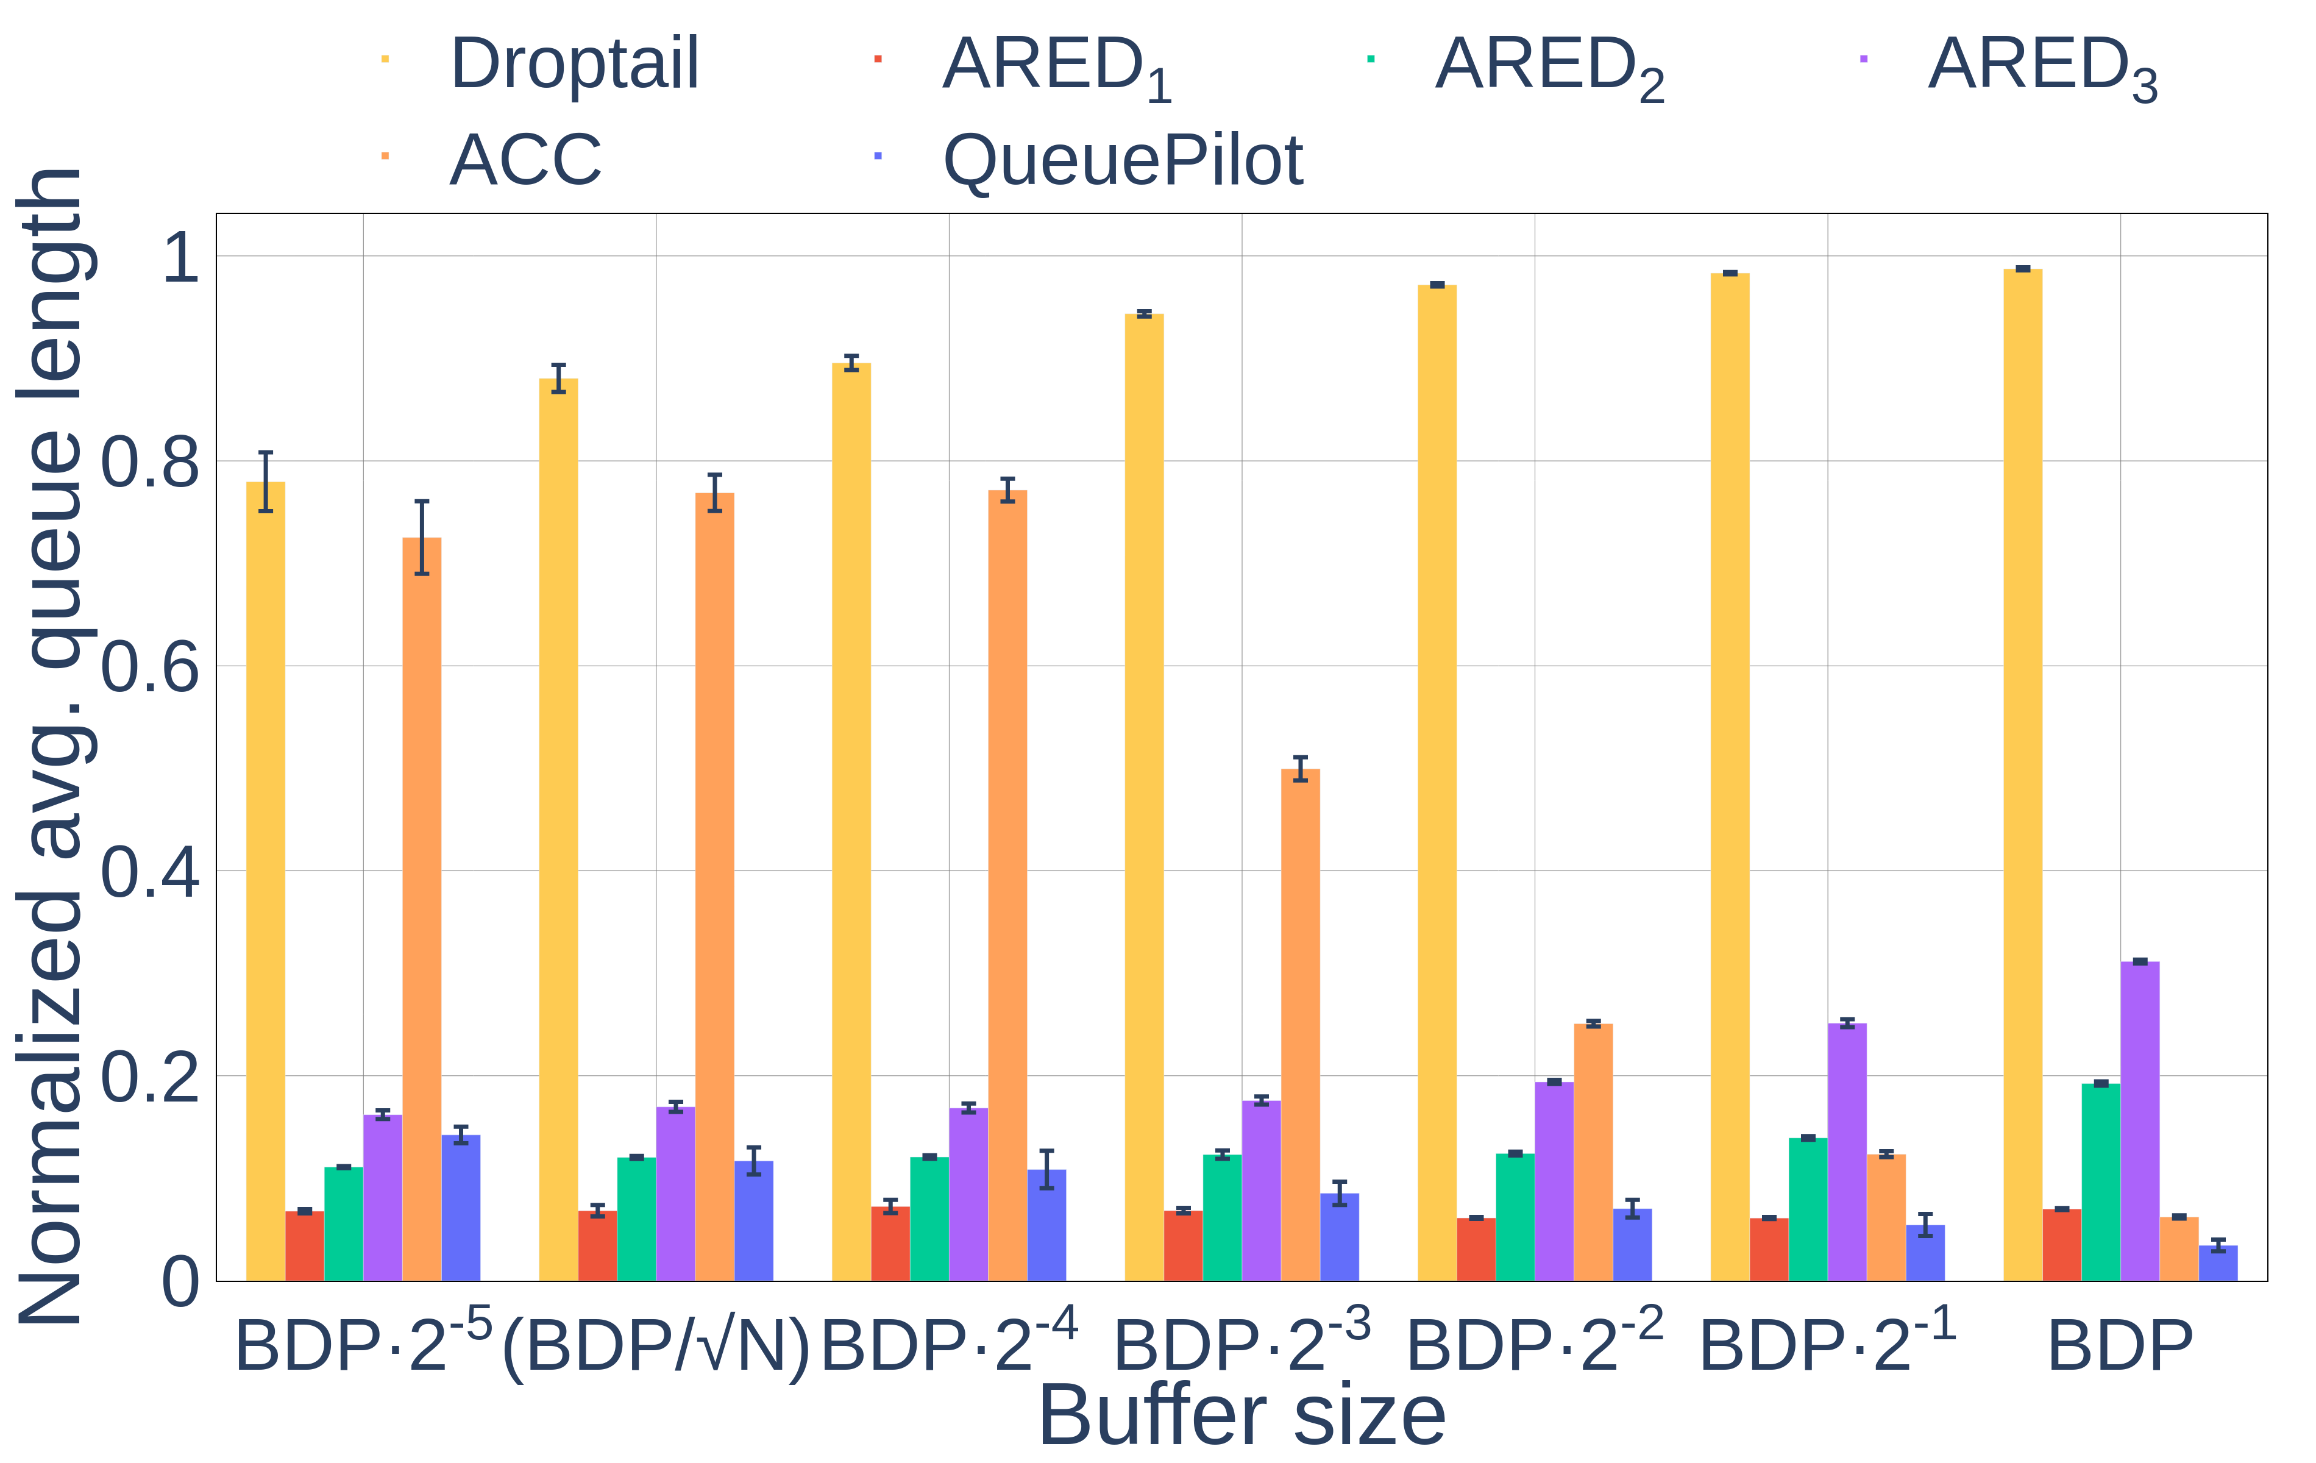
Zoom on the reward components: Utilization
①
②
③
Motivation
Problem
Model
Evaluation

Slide 20
Zoom on the reward components: Drop rate
①
②
③
Motivation
Problem
Model
Evaluation

Slide 21
Zoom on the reward components: Queue length
①
②
③
Motivation
Problem
Model
Evaluation

Slide 22
Questions about QueuePilot
Across several buffer sizes
How does it perform?
How does it trade off the various reward components?
In small buffers:
Does its better reward translate into a better FCT tail?
Can it generalize to a multi-router topology?
Motivation
Problem
Model
Evaluation

Slide 23
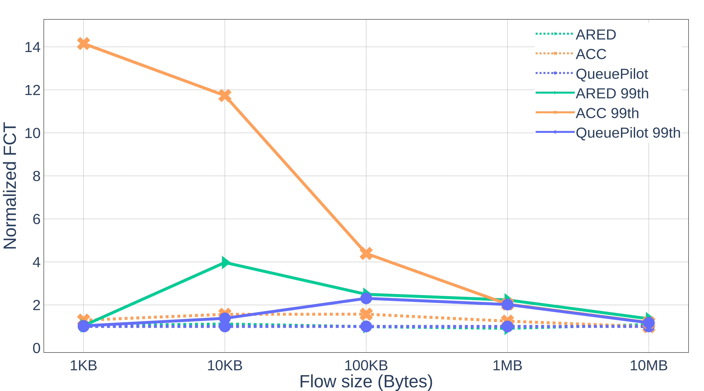

Flow Completion Time
$$B=BDP/\sqrt{N}$$
Motivation
Problem
Model
Evaluation

Slide 24
Questions about QueuePilot
Across several buffer sizes
How does it perform?
How does it trade off the various reward components?
In small buffers:
Does its better reward translate into a better FCT tail?
Can it generalize to a multi-router topology?
Motivation
Problem
Model
Evaluation

Slide 25
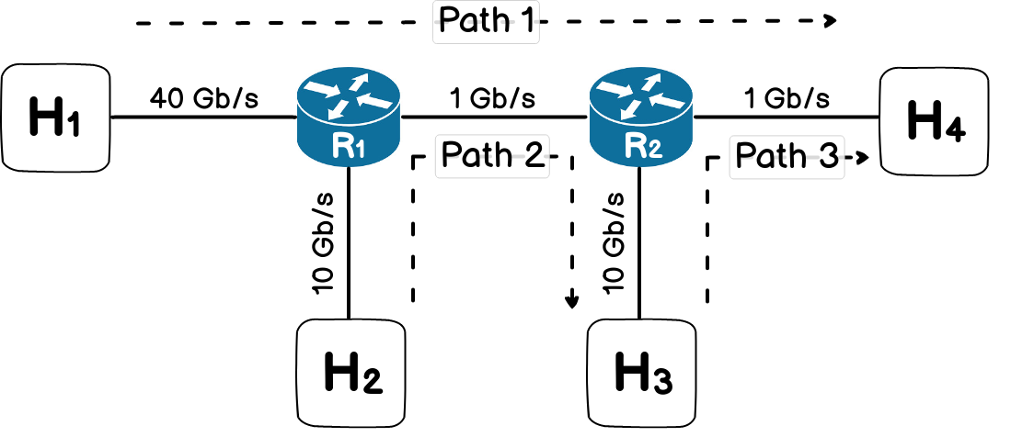
Parking lot topology
Path 1: 150 TCP flows + 50 Mbps UDP
Path 2: 100 TCP flows + 50 Mbps UDP
Path 3: 100 TCP flows + 50 Mbps UDP
Congestion is formed in both routers
QueuePilot uses the single-router policy
Motivation
Problem
Model
Evaluation

Slide 26
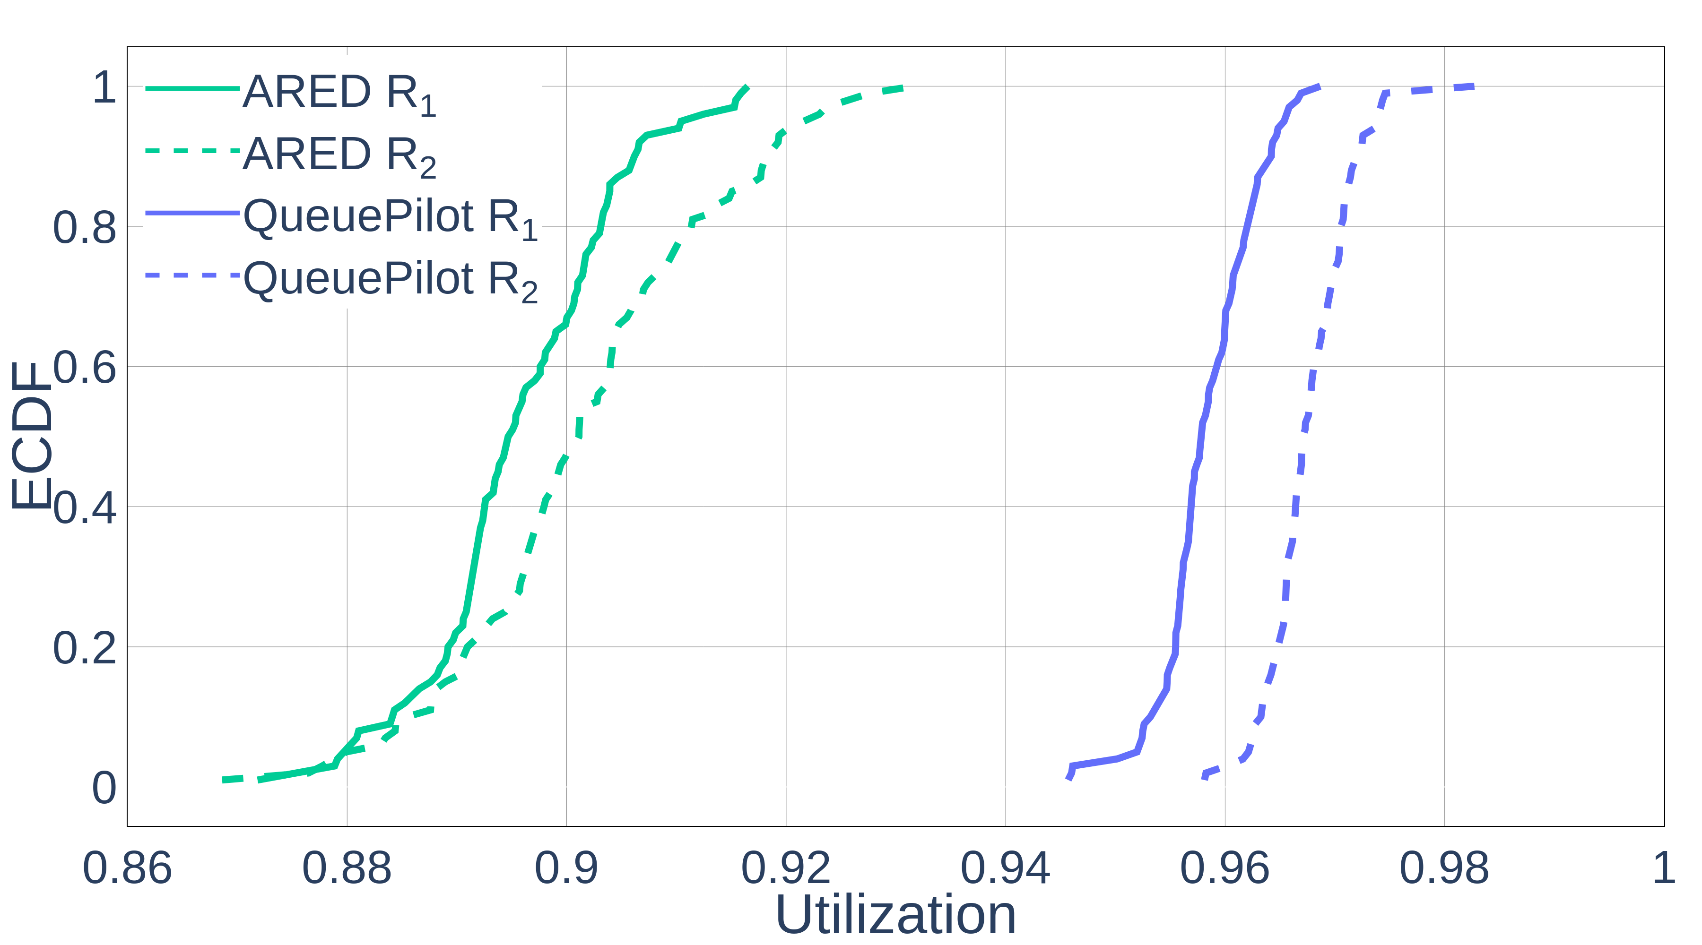
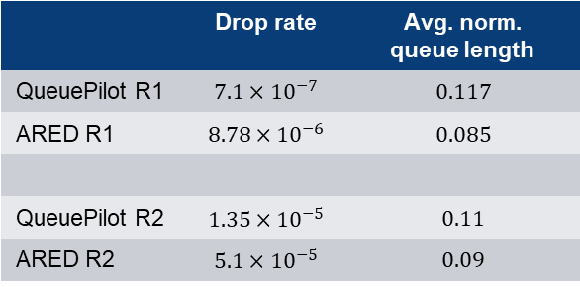
Utilization of 2 routers
 | Drop rate | Avg. norm. queue length
QueuePilot R1 | $$7.1×{10}^{−7}$$ | $$0.117$$
ARED R1 | $$8.78×{10}^{−6}$$ | $$0.085$$
QueuePilot R2 | $$1.35×{10}^{−5}$$ | $$0.11$$
ARED R2 | $$5.1×{10}^{−5}$$ | $$0.09$$
Motivation
Problem
Model
Evaluation

Slide 27
Conclusion
Small buffers are good for vendors and users
QueuePilot achieves a high performance with small buffers
⇒ learned AQMs look promising for using small buffers in routers

Slide 28
Thank You

