Slide 1
CloudPilot: Flow Acceleration in the Cloud
Kfir Toledo, David Breitgand,
Dean Lorenz and Isaac Keslassy
IFIP Networking 2022

Slide 2
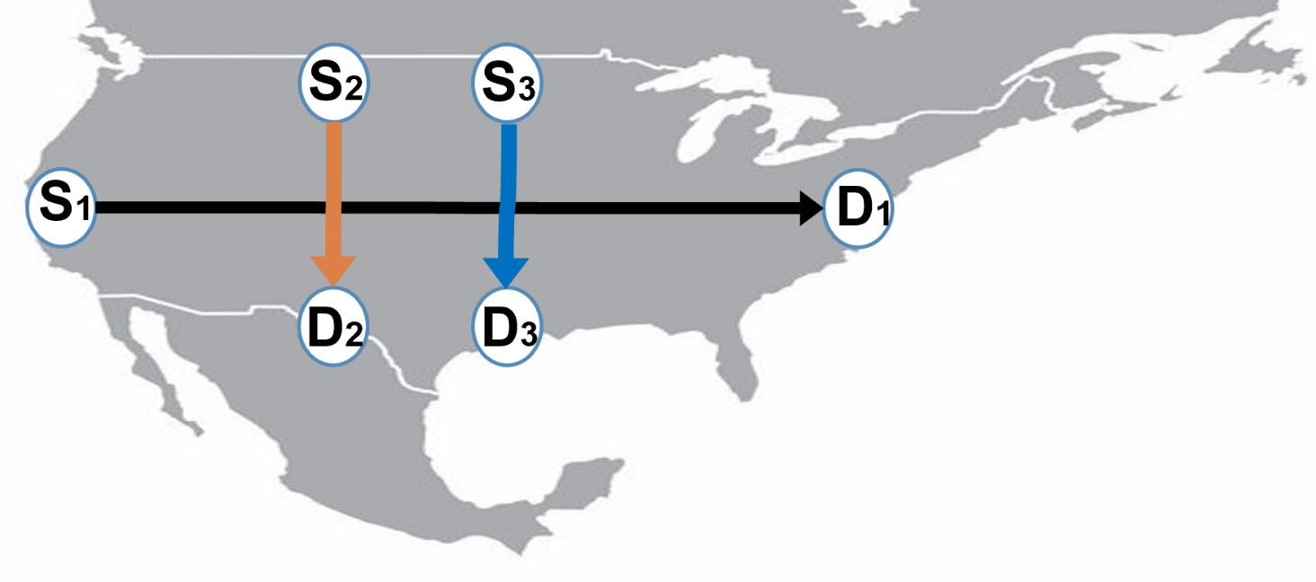
Motivation
Rise of applications with many flows:
Distributed databases
Batch file exchanges
VM migrations
CDNs
Our goal: How to accelerate a set of flows?
Motivation
Problem
Model
Algorithms
Evaluation

Slide 3
Today: Direct Connection Through Internet
Public
Internet
S
D
Motivation
Problem
Model
Algorithms
Evaluation

Slide 4
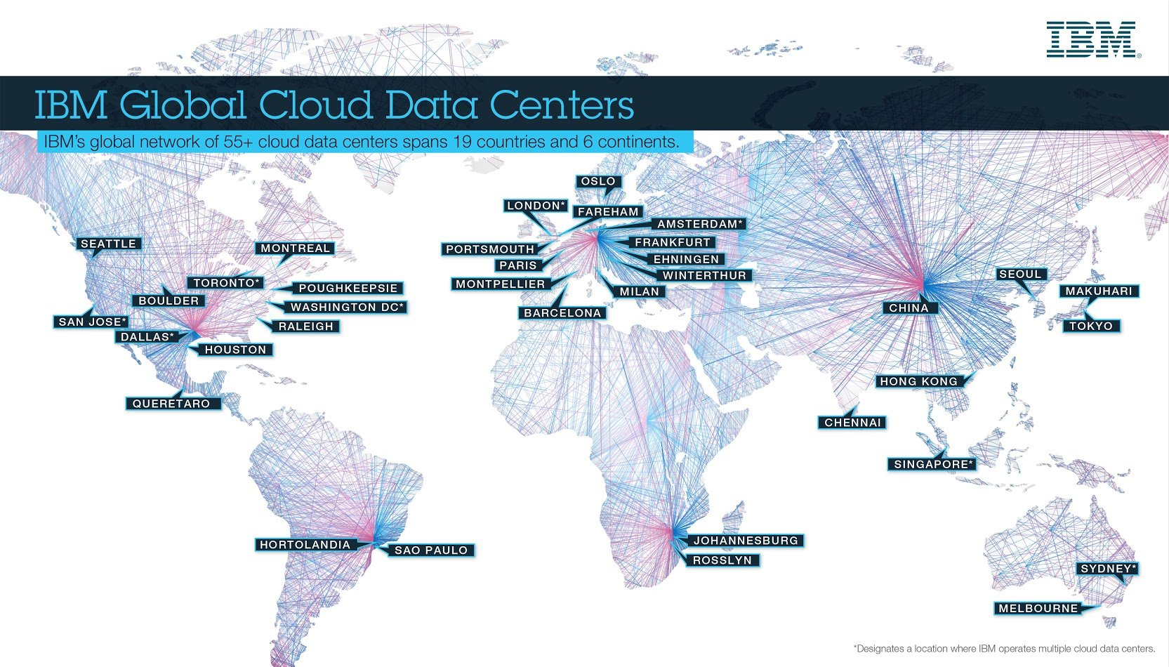
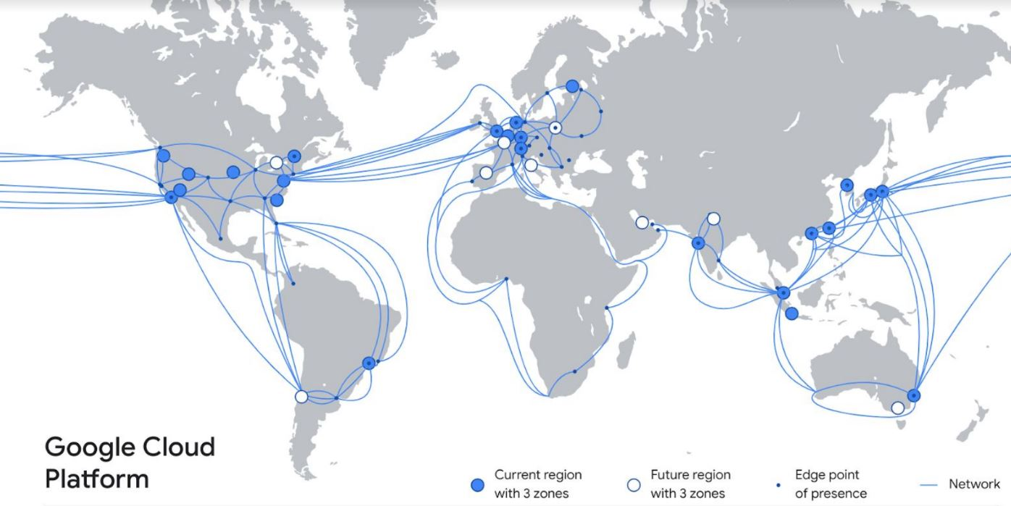
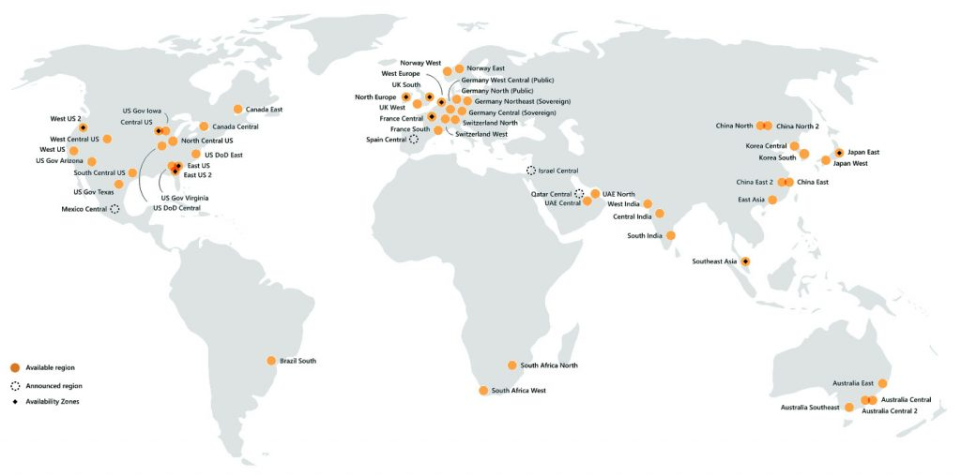
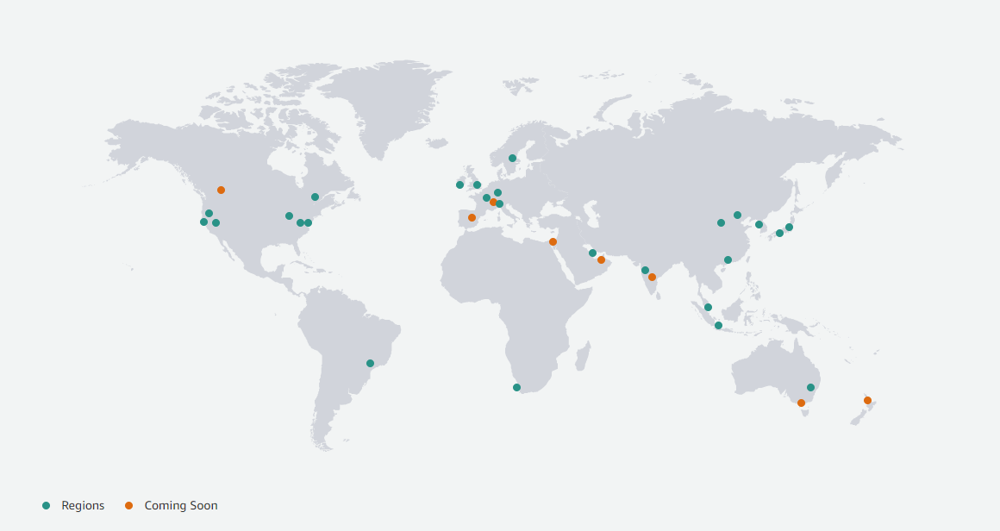
Clouds Are Everywhere
Motivation
Problem
Model
Algorithms
Evaluation

Slide 5
Cloud Forwarding
Public
Internet
Cloud
S
D
Motivation
Problem
Model
Algorithms
Evaluation

Slide 6
TCP-Split Acceleration
Public
Internet
Cloud
S
1
Proxy
2
D
Motivation
Problem
Model
Algorithms
Evaluation

Slide 7
2-Proxy TCP-Split Acceleration
Public
Internet
Cloud
Proxy
S
1
Proxy
2
3
D
Within cloud: Large maximum-window with large receive buffer
Motivation
Problem
Model
Algorithms
Evaluation

Slide 8
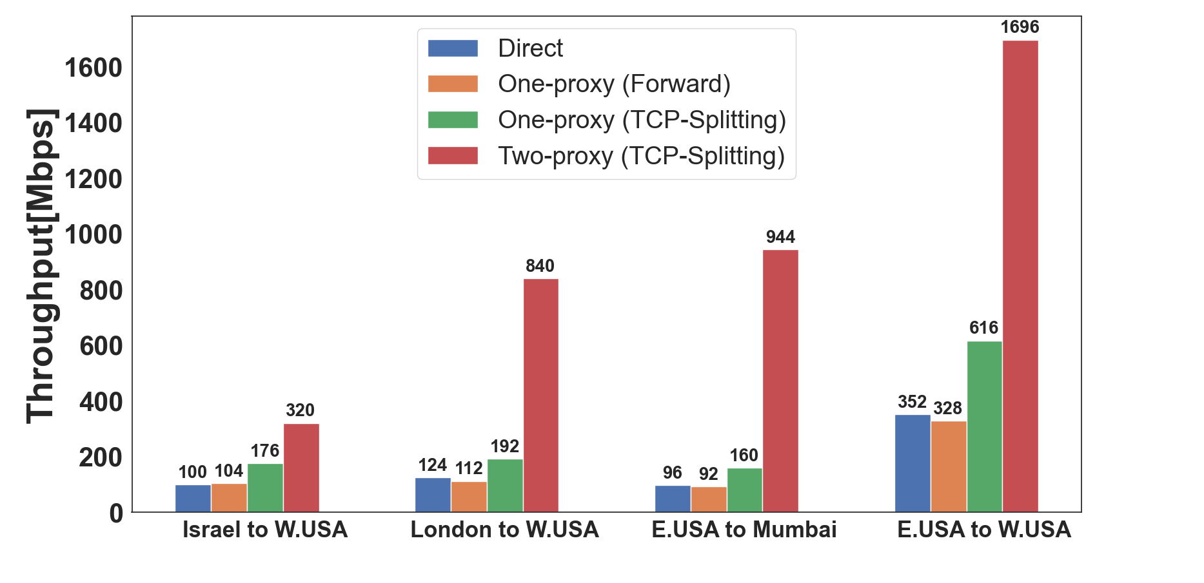
Sanity Check
Motivation
Problem
Model
Algorithms
Evaluation

Slide 9
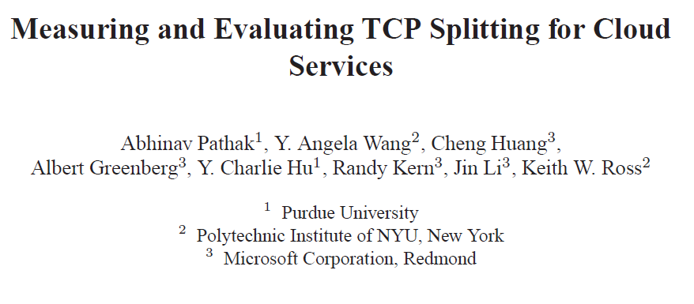
Related Work: Single Flows
Motivation
Problem
Model
Algorithms
Evaluation

Slide 10
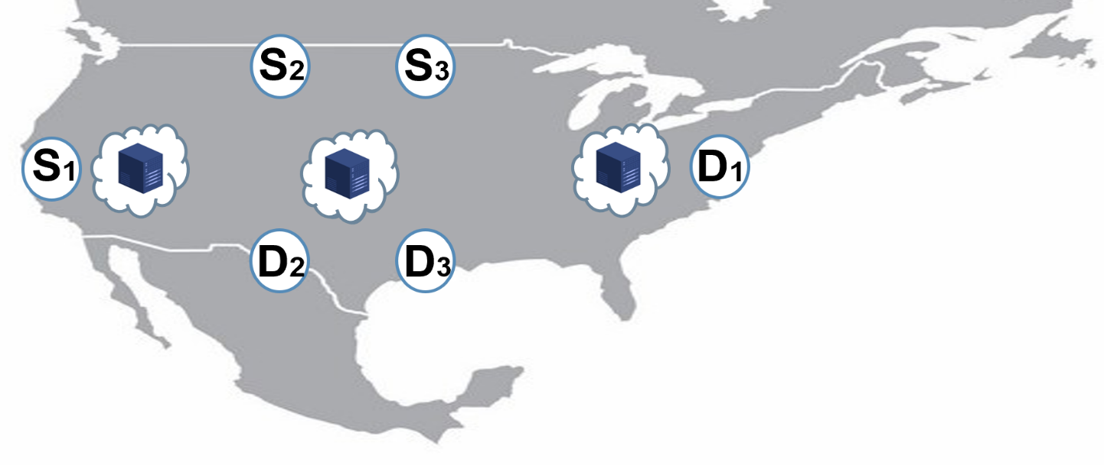
Cloud Proxy Placement Problem
Applications with many flows :
Distributed databases, batch file exchanges,
VM migrations and CDNs
Given application with multiple flows &
fixed budget
Find optimal cloud proxy placement
To minimize: Total Flow Completion Time = $\sum_{flows}{\text{(}\text{Flow} \text{Completion} \text{Times}\text{)}}$
Optimization goal
Motivation
Problem
Model
Algorithms
Evaluation

Slide 11
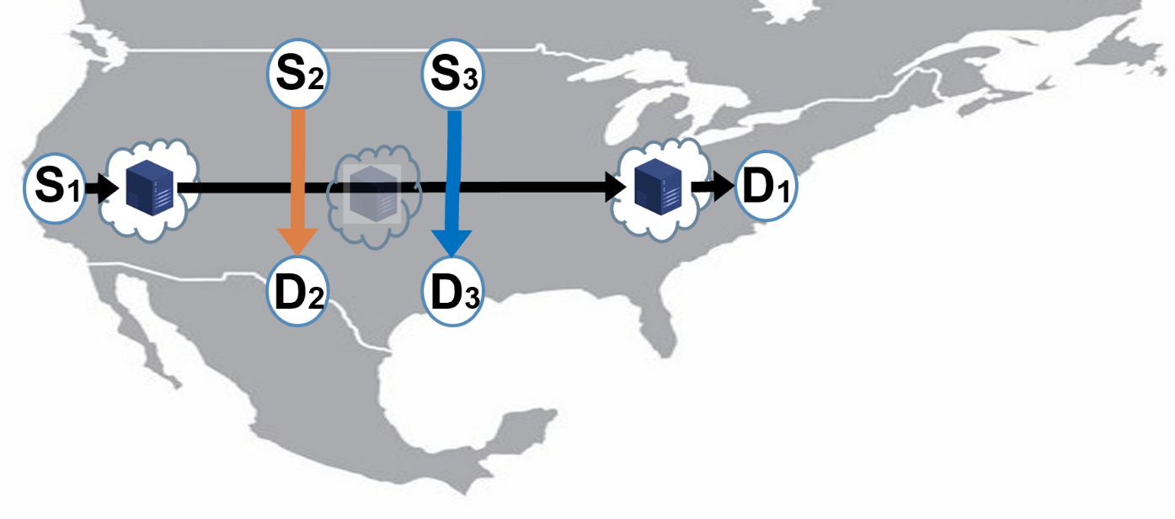
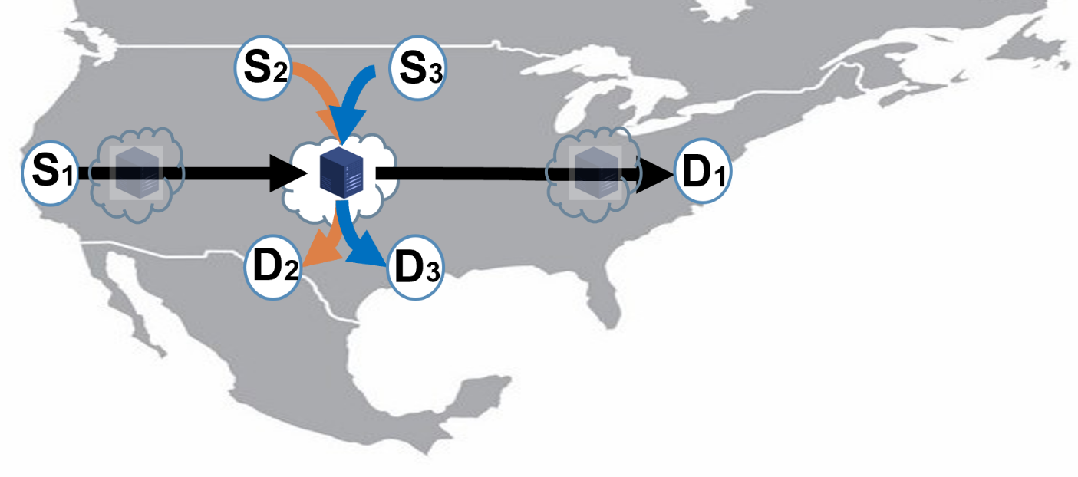
Cloud Proxy Placement Problem
Motivation
Problem
Model
Algorithms
Evaluation

Slide 12
Cloud Proxy Placement Problem
Constraints:
One type of connection per flow:
Direct connection
One-proxy acceleration (+ choose proxy)
Two-proxy acceleration (+ choose proxies)
Proxy capacity limitation
Budget limitation
Cost per proxy
Cost per GB
S2
S3
S4
S1
D1
D2
s
D4
D3
Motivation
Problem
Model
Algorithms
Evaluation

Slide 13
Cloud Proxy Placement Problem
Constraints:
One type of connection per flow:
Direct connection
One-proxy acceleration (+ choose proxy)
Two-proxy acceleration (+ choose proxies)
Proxy capacity limitation
Budget limitation
Cost per proxy
Cost per GB
S4
S3
S2
S1
D1
D2
s
D4
D3
Question 1: What acceleration does each type provide?
Question 2: Which proxies should we use?
Motivation
Problem
Model
Algorithms
Evaluation

Slide 14
Acceleration Model - Single Flow
Given fixed $Data Size$: Minimum $Flow Completion Time⇔$ Maximum $Rate$
$$Flow Completion Time≈\frac{Data Size}{Rate}$$
Motivation
Problem
Model
Algorithms
Evaluation

Slide 15
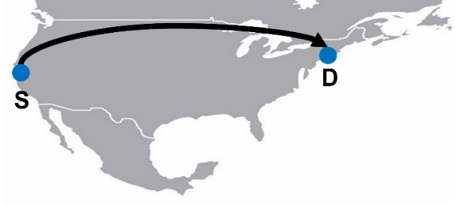
Acceleration Model - Single Flow
Direct Connection
$Maximum Rate=min⁡\left(Source Rate,Path Rate, Destination Rate\right)$
$=min⁡\left(BW_{source} , \frac{ max⁡_wnd}{RTT}, BW_{destination}\right)$
Motivation
Problem
Model
Algorithms
Evaluation

Slide 16
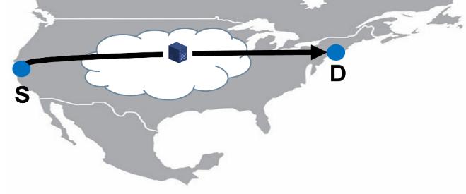
Acceleration Model - Single Flow
One-proxy acceleration:
$Maximum Rate=\min\left({Rate}_{1},{Rate}_{2}\right)$
= $min\left(BW_{source} , \frac{ max⁡_wnd_{1}}{RTT_{1}}, BW_{proxy_A} , \frac{ max⁡_wnd_{2}}{RTT_{2}}, BW_{destination}\right)$
1
2
A
Motivation
Problem
Model
Algorithms
Evaluation

Slide 17
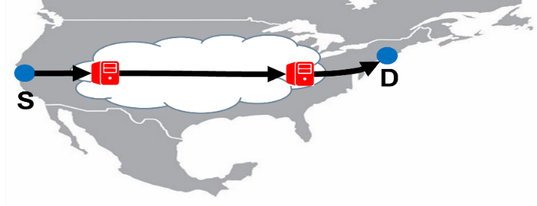
Acceleration Model - Single Flow
Two-proxy acceleration
$Maximum Rate=\min\left({Rate}_{ 1},{ Rate}_{2} , {Rate}_{3}\right)$
$$= min⁡({Rate}_{1}, { BW}_{proxy_A}, { BW}_{proxyB} , {Rate}_{3})$$
$$(BW_{Proxy_A}, \frac{max_wnd}{RTT}, BW_{Proxy_B})$$
1
2
3
A
B
Motivation
Problem
Model
Algorithms
Evaluation

Slide 18
Model Validation
Direct Connection
$$min⁡\left(BW_{source} , \frac{ max⁡_wnd}{RTT}, BW_{destination}\right)$$
Experiment setup:
Public internet: {S, D} connected to standard public internet, proxies in GCP
Single cloud: {S, D} in GCP , proxies in GCP
Multi cloud: {S, D} in IBM , proxies in GCP
Motivation
Problem
Model
Algorithms
Evaluation

Slide 19
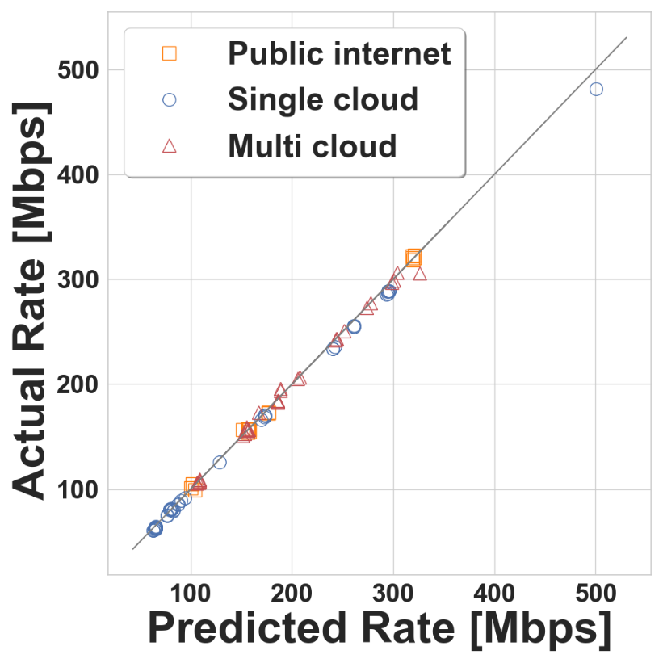
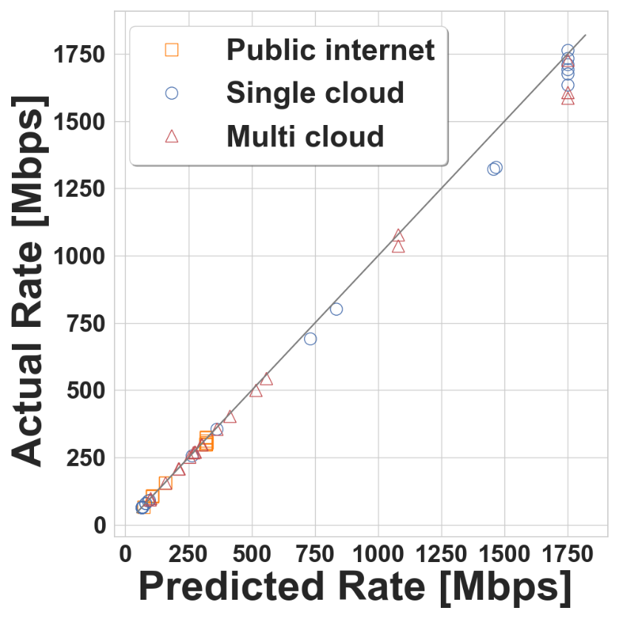
Model Validation
Direct Connection One-proxy acceleration Two-proxy acceleration
Experiment setup:
Public internet: Hosts connected to standard public internet, proxies in GCP
Single cloud: Hosts in GCP , proxies in GCP
Multi cloud: Hosts in IBM , proxies in GCP
Motivation
Problem
Model
Algorithms
Evaluation

Slide 20
Cloud Proxy Placement Problem
Constraints:
One type of connection per flow:
Direct connection
One-proxy acceleration (+ choose proxy)
Two-proxy acceleration (+ choose proxies)
Proxy capacity limitation
Budget limitation
Cost per proxy
Cost per GB
S2
S3
S4
S1
D1
D2
s
D4
D3
Question 1: What acceleration does each type provide?
Question 2: Which proxies should we use?
Motivation
Problem
Model
Algorithms
Evaluation

Slide 21
Approximation Algorithms
Greedily build set of used proxies out of potential ones until no budget remaining:
Flow Greedy Family
Choose first flow with most
FCT(Flow Completion Time)
improvement.
Proxy Greedy Family
Choose first proxy with most
total FCT improvement.
Motivation
Problem
Model
Algorithms
Evaluation

Slide 22
Flow Greedy Family
Flow greedy FCT algorithm (F-FCT)
Sort by Flow Completion Time improvement
Flow greedy FCT per cost algorithm (F-Cost)
Sort by Flow Completion Time improvement
per cost and bandwidth
Motivation
Problem
Model
Algorithms
Evaluation

Slide 23
Approximation Algorithms
Flow Greedy Family
Proxy Greedy Family
Motivation
Problem
Model
Algorithms
Evaluation

Slide 24
Approximation Algorithms
One proxy greedy (1-P)
Two-proxy greedy (2-P)
Two-proxy greedy
with rollback (2-P RB)
S
S
D
D
Motivation
Problem
Model
Algorithms
Evaluation

Slide 25
Approximation Algorithms
One proxy greedy (1-P)
Two-proxy greedy (2-P)
Two-proxy greedy
with rollback (2-P RB)
S
S
P
P
P
D
D
Motivation
Problem
Model
Algorithms
Evaluation

Slide 26
Approximation Algorithms
One proxy greedy (1-P)
Two-proxy greedy (2-P)
Two-proxy greedy
with rollback (2-P RB)
S
S
P
P
P
D
D
Motivation
Problem
Model
Algorithms
Evaluation

Slide 27
Approximation Algorithms
One proxy greedy (1-P)
Two-proxy greedy (2-P)
Two-proxy greedy
with rollback (2-P RB)
S
S
P
P
P
D
D
Motivation
Problem
Model
Algorithms
Evaluation

Slide 28
Approximation Algorithms
One proxy greedy (1-P)
Two-proxy greedy (2-P)
Two-proxy greedy
with rollback (2-P RB)
S
S
P
P
P
D
D
Motivation
Problem
Model
Algorithms
Evaluation
Notes:
We can be stuck with proxy we don’t need

Slide 29
Approximation Algorithms
S
One proxy greedy (1-P)
Two-proxy greedy (2-P)
Two-proxy greedy
with rollback (2-P RB)
S
P
S
P
P
P
D
P
D
D
Motivation
Problem
Model
Algorithms
Evaluation

Slide 30
Approximation Algorithms
S
One proxy greedy (1-P)
Two-proxy greedy (2-P)
Two-proxy greedy
with rollback (2-P RB)
S
P
S
P
P
P
D
P
D
D
Motivation
Problem
Model
Algorithms
Evaluation

Slide 31
Approximation Algorithms
S
One proxy greedy (1-P)
Two-proxy greedy (2-P)
Two-proxy greedy
with rollback (2-P RB)
S
P
S
P
P
P
D
P
D
D
Motivation
Problem
Model
Algorithms
Evaluation
Notes:
Add proxy I don’t use

Slide 32
Approximation Algorithms
One proxy greedy (1-P)
Two-proxy greedy (2-P)
Two-proxy greedy
with rollback (2-P RB)
S
S
S
P
P
P
P
D
D
D
Motivation
Problem
Model
Algorithms
Evaluation

Slide 33
Approximation Algorithms
One proxy greedy (1-P)
Two-proxy greedy (2-P)
Two-proxy greedy
with rollback (2-P RB)
S
S
S
P
P
P
P
D
D
D
Motivation
Problem
Model
Algorithms
Evaluation

Slide 34
Approximation Algorithms
One proxy greedy (1-P)
Two-proxy greedy (2-P)
Two-proxy greedy
with rollback (2-P RB)
S
S
S
P
P
P
P
D
D
D
Motivation
Problem
Model
Algorithms
Evaluation

Slide 35
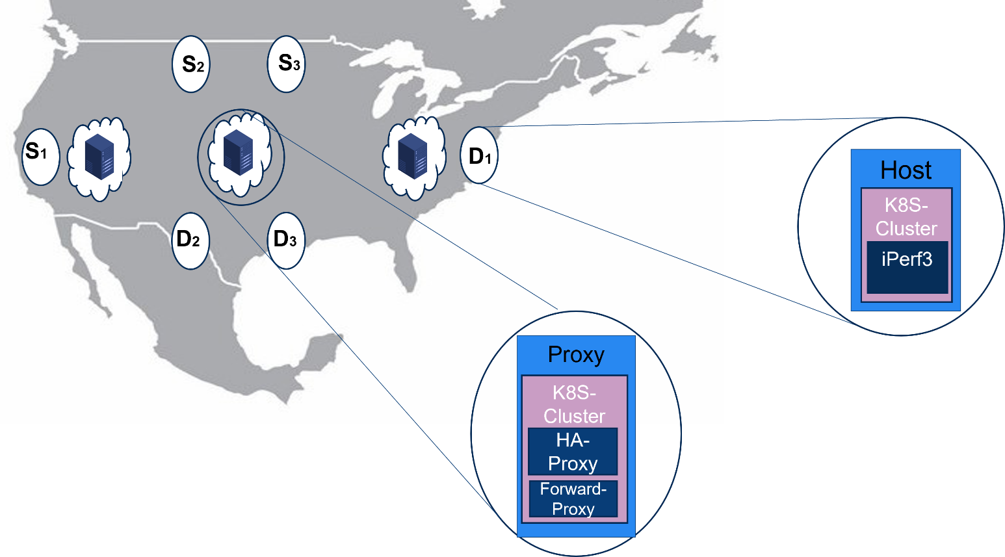
CloudPilot System
Kubernetes-based system
3 types of clusters:
Measurements (iPerf3)
Multi-cloud: AWS, GCP, IBM
TCP forwarding
Multi-cloud: GCP, IBM
TCP acceleration (HAProxy)
Multi-cloud: GCP, IBM
https://github.com/kfirtoledo/CloudPilot_Project
Motivation
Problem
Model
Algorithms
Evaluation

Slide 36
Use Cases for Evaluations Topologies for geo-distributed applications
One-to-many (Streaming) Many-to-many (Distributed-database)
Many one-to-one (Backup) Many localized one-to-many (CDN)
Motivation
Problem
Model
Algorithms
Evaluation

Slide 37
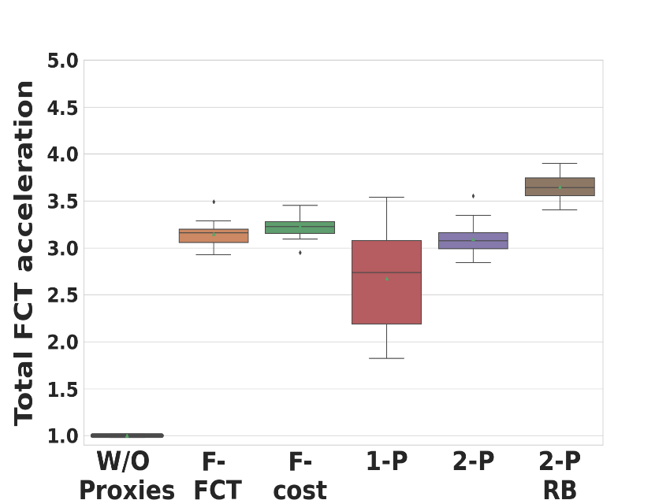
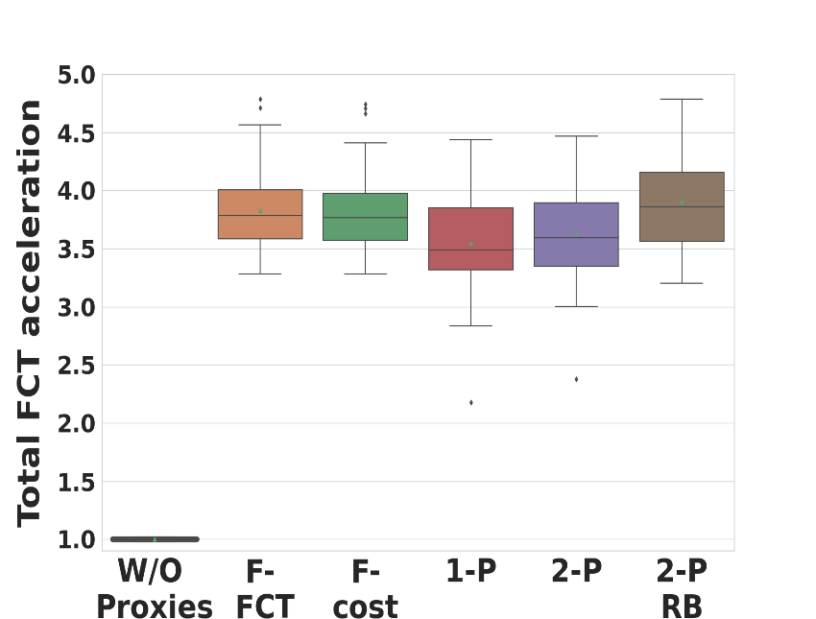
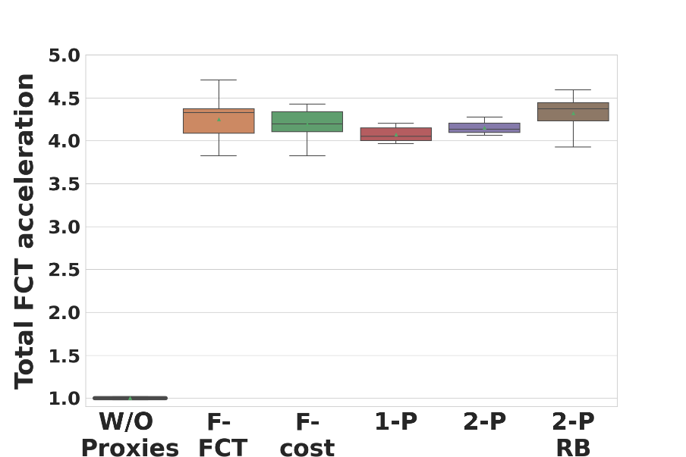
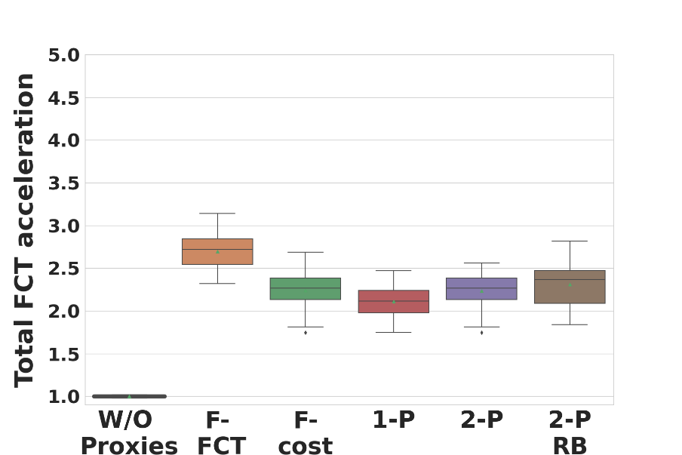
Evaluation: FCT Acceleration for Each Use-Case
Evaluation setup:
18 worldwide GCP proxies,
60 flows,
2 GB per flow,
0.50$ per-proxy cost,
0.08$/GB data cost,
fixed total budget
3.6x
3.9x
One to many (streaming)
Many to many (Distributed-database)
4.3x
2.7x
Many one to one (Backup)
Many localized one-to-many (CDN)
Motivation
Problem
Model
Algorithms
Evaluation

Slide 38
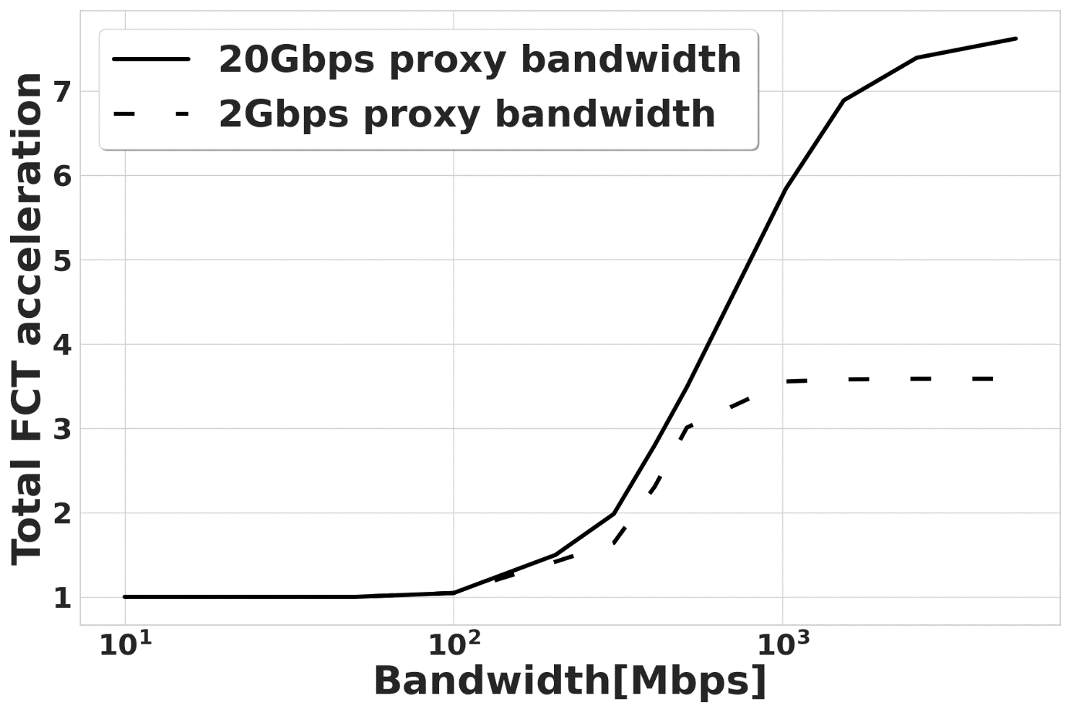
Evaluation: Impact of Last-Mile Bandwidth
Evaluation setup:
Simulation with 18 worldwide GCP proxies, One-to-many topology (hosts randomly picked within 40ms of random GCP
proxy) , 2 GB per flow, 60 flows, 0.50$ per-proxy cost, 0.08$/GB data cost, fixed total budget
DSL
Fiber optics
Last-mile bandwidth[Mbps]
Motivation
Problem
Model
Algorithms
Evaluation

Slide 39
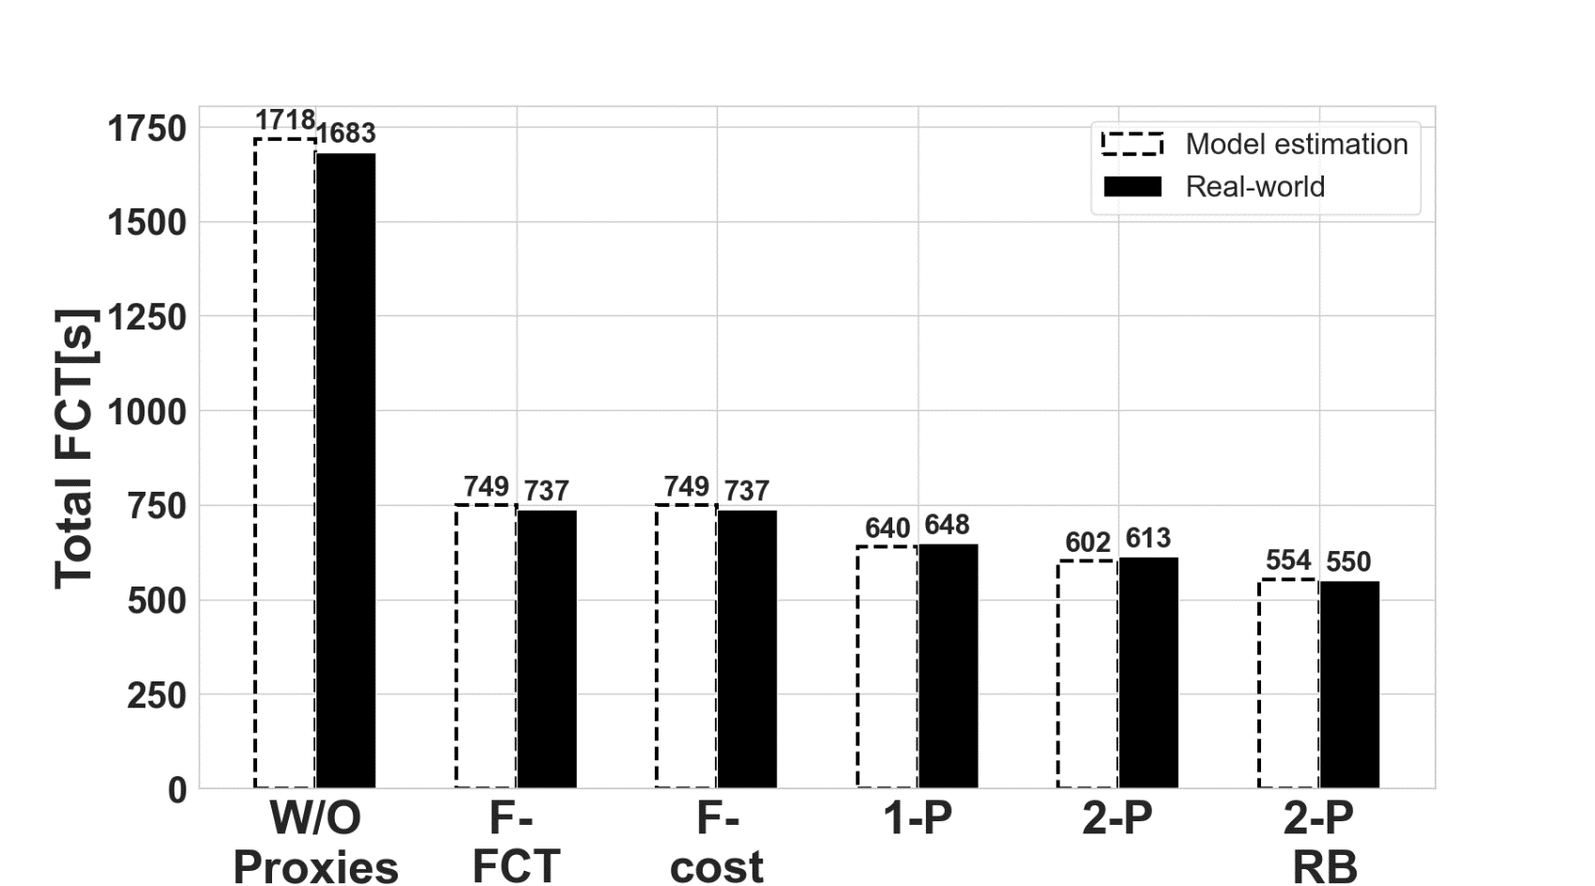
Real-World Cloud Experiment
Experiment setup:
Many-to-many topology (Brazil, England, Finland, and Japan), 2 GB per flow, 12 flows
0.50$ per-proxy cost, 0.08$/GB data cost, fixed total budget (total 6$, i.e. 0.50$ per flow)
3x
Motivation
Problem
Model
Algorithms
Evaluation

Slide 40
Conclusion
CloudPilot system https://github.com/kfirtoledo/CloudPilot_Project
Measurements
TCP acceleration
Multi-clouds
Future work: full automation, scalability, other clouds, setup-time
Cloud proxy placement problem
Problem and model
Heuristics algorithms
Evaluation
Future work: other acceleration
Motivation
Problem
Model
Algorithms
Evaluation
Conclusion

Slide 41
CloudPilot: Flow Acceleration in the Cloud
Thank you!
Contact: Kfir Toledo – skmt@campus.technion.ac.il
IFIP Networking 2022

