Slide 1
Dragonfly: In-Flight Congestion Control Identification
Dean Carmel, Isaac Keslassy
Department of Electrical & Computer Engineering Technion

Slide 2
Motivation: TCP Congestion
BBR
Ingress
Egress
CUBIC
Identify congestion control variant
RENO

Slide 3
Motivation: TCP Congestion
We need to classify. Why?
Flow classification is essential for identifying the causes of congestion that would otherwise remain unknown.
Through classification, we can select optimal congestion management techniques by considering the unique congestion control algorithms utilized by each flow.

Slide 4
Motivation: TCP Congestion
Flow classification is essential for identifying the causes of congestion that would otherwise remain unknown.
Through classification, we can select optimal congestion management techniques by considering the unique congestion control algorithms utilized by each flow.
CUBIC
CUBIC
BBR
BBR
RENO
RENO

Slide 5
Wishlist
1. We are allowed to inspect the ingress and egress of the buffer only.
2. Online: on-the-fly, starting from any point in time.
3. Scalable traffic collection: input computation complexity should be in 𝑂(1) for each slot.
4. Scalable classification: simple neural-network architecture.
5. Reliable classification: resilient to different settings.

Slide 6
Related Work
Programable dataplanes for fast classification.
Congestion control identification variants using packet arrival time information.

Slide 7
Dragonfly Algorithm
Inputs Per Packet
Aggregated inputs per (1ms) slot
Classification (CNN)
Output: classified CCA

Slide 8
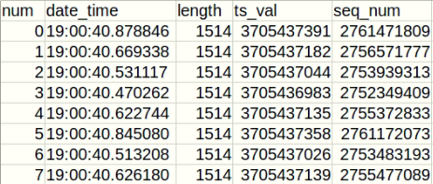
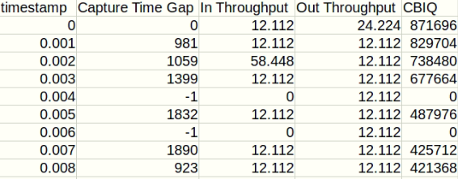
Dragonfly Algorithm
Per Packet
Dataframe
CBIQ=
congestion bytes in queue
Per Slot
Classification

Slide 9
Dragonfly Algorithm
CBIQ=
congestion bytes in queue
CBIQ = 1
CBIQ = 3
Ingress
Egress
Capture Time Gap
Out Throughput
In Throughput

Slide 10
Dragonfly Algorithm
Need for Built-in Memory: CBIQ “remembers" the past by measuring the queue size devoted to the analyzed flow, thus implicitly relying on an integral of the past throughput.
In addition, the built-in memory in CBIQ helps us because it can reduce the volatility of the input.
100ms
60s

Slide 11
Dragonfly Algorithm
CUBIC
BBR
RENO

Slide 12
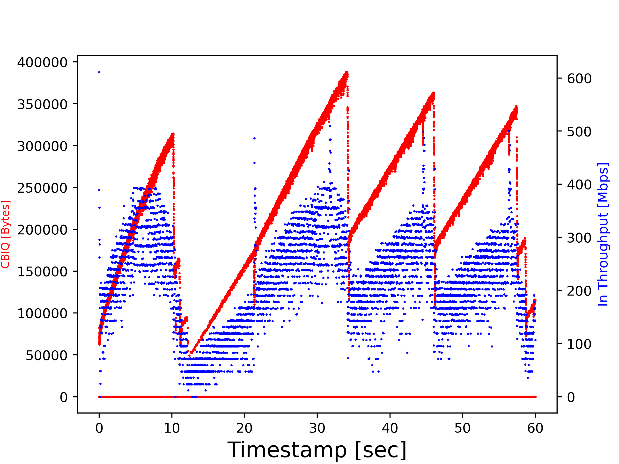
Dragonfly Algorithm
CBIQ
Throughput
A single TCP flow

Slide 13
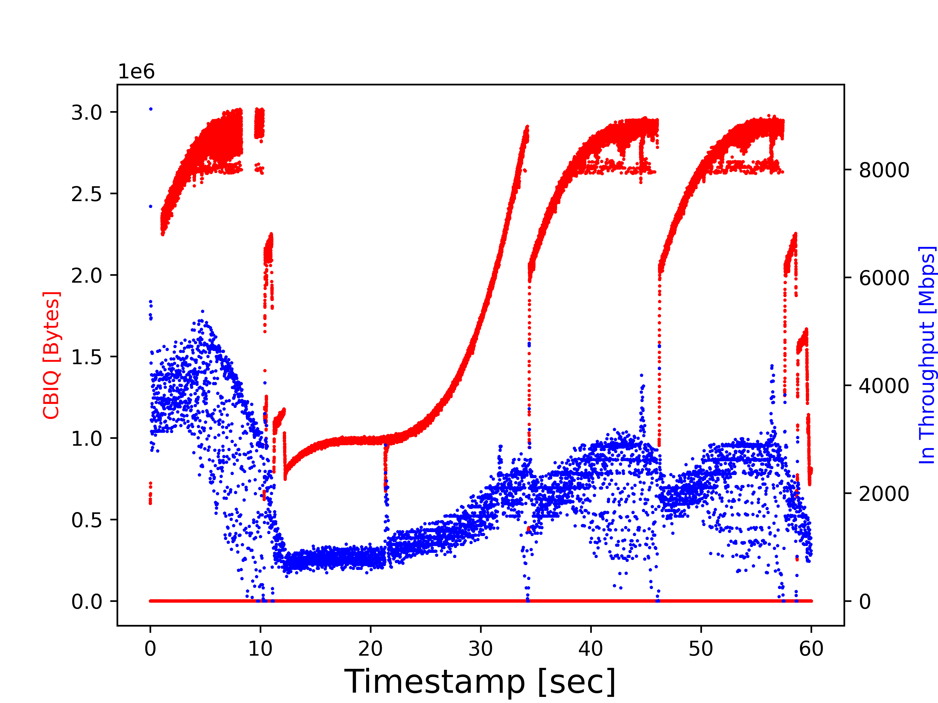
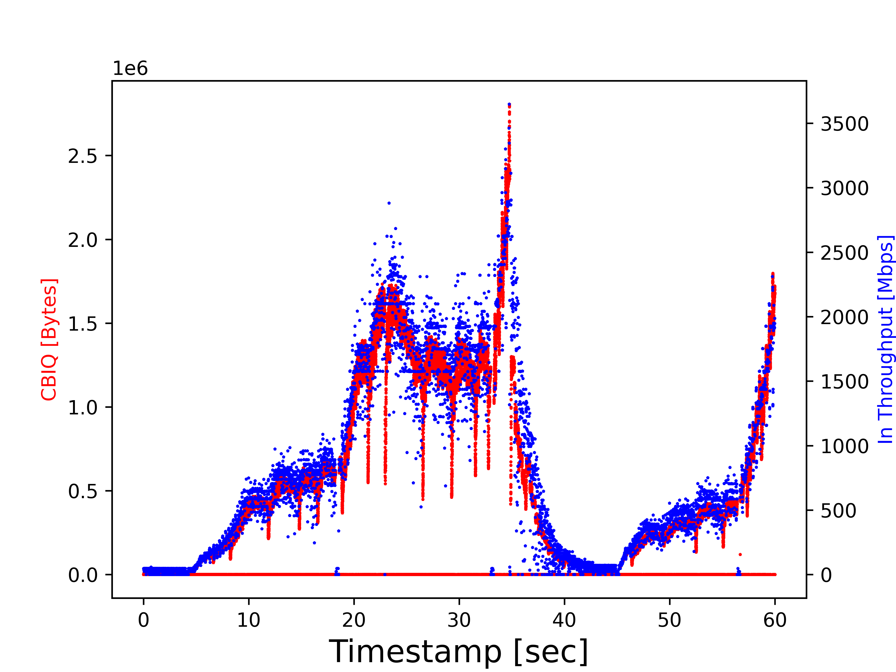
Dragonfly Algorithm
b. BBR
a. RENO
c. CUBIC

Slide 14
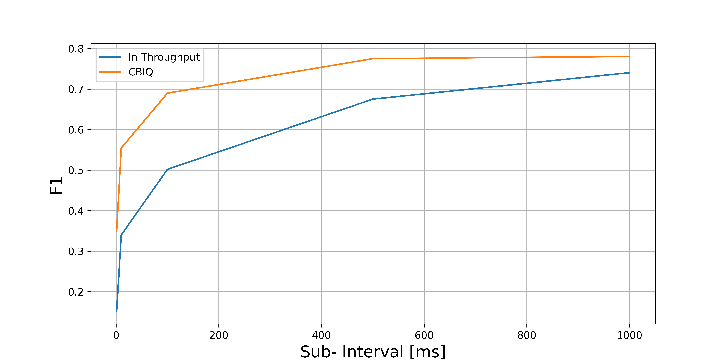
Classification
60 seconds session, 15 background flows

Slide 15
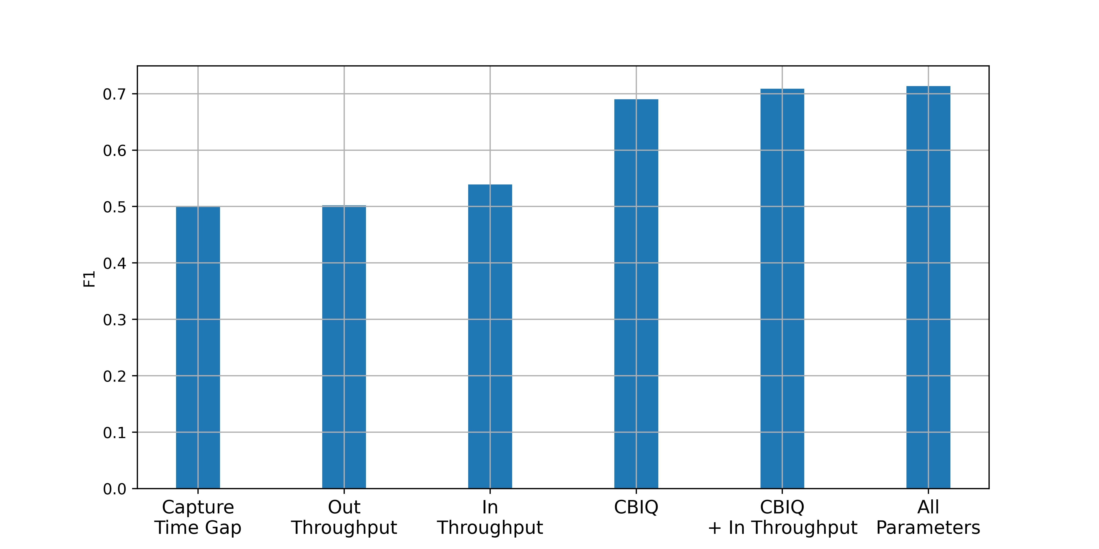
Classification
60 seconds session, random sub-interval of 100ms, 15 background flows

Slide 16
CNN
Dataframe
Input Size:
Interval Length X 2
init weights
{CBIQ, Throughput}
Inputs
conv2D
BN
X5
RelU
MaxPool
Output Size: 3
Classification
{BBR, Cubic, Reno}
Outputs

Slide 17
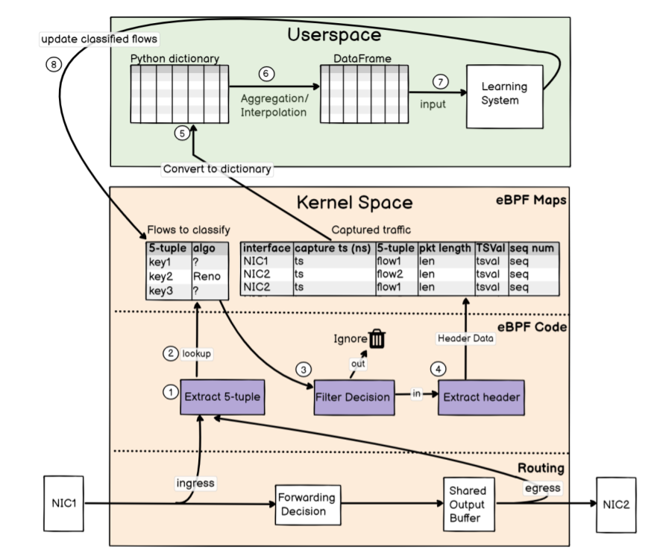
Dragonfly Algorithm
eBPF
1. Fast header extraction
2. Dynamic filtering decision

Slide 18
Dragonfly Algorithm

Slide 19
Sampling
First-packet sampling
For each flow, eBPF keeps the first packet of each time slot and drops the other packets.
Reducing both the raw- input dictionary size and the computation complexity.
5 MB table size

Slide 20
Simulations & Experiments
Linux- based router.
Buffer size of 2000- 16000 packets.
Queueing delay of 25- 200 ms.
$${flow}_{1}$$
$$2000−16000$$
$$Packets$$
$$1Gbps$$
rtr
$$1Gbps$$
$$1ms Rtt$$
$$1ms Rtt$$
server
{0, 15, 30, 60, 75}
Background flows
$$1Gbps$$
$${flow}_{3n+3}$$
Router

Slide 21
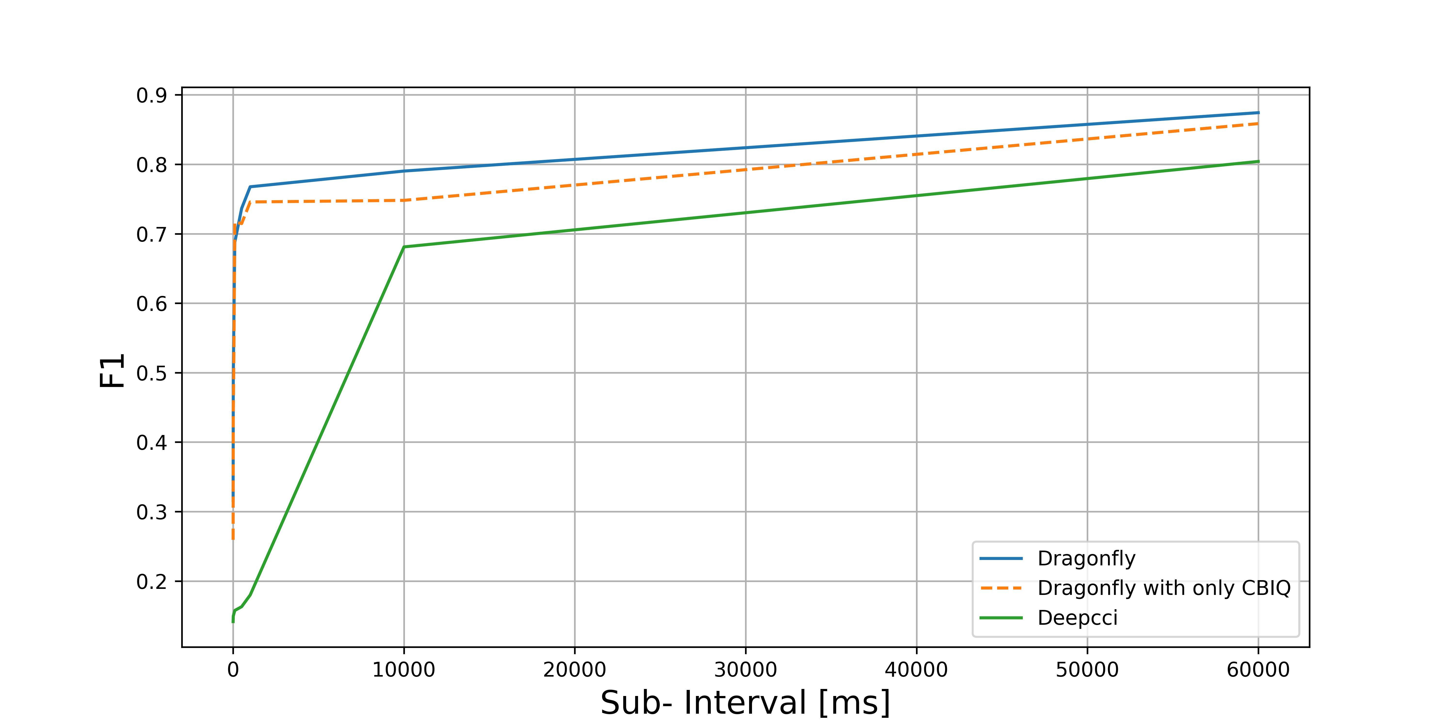
Impact of sub-interval duration
60 seconds session, 15 background flows

Slide 22
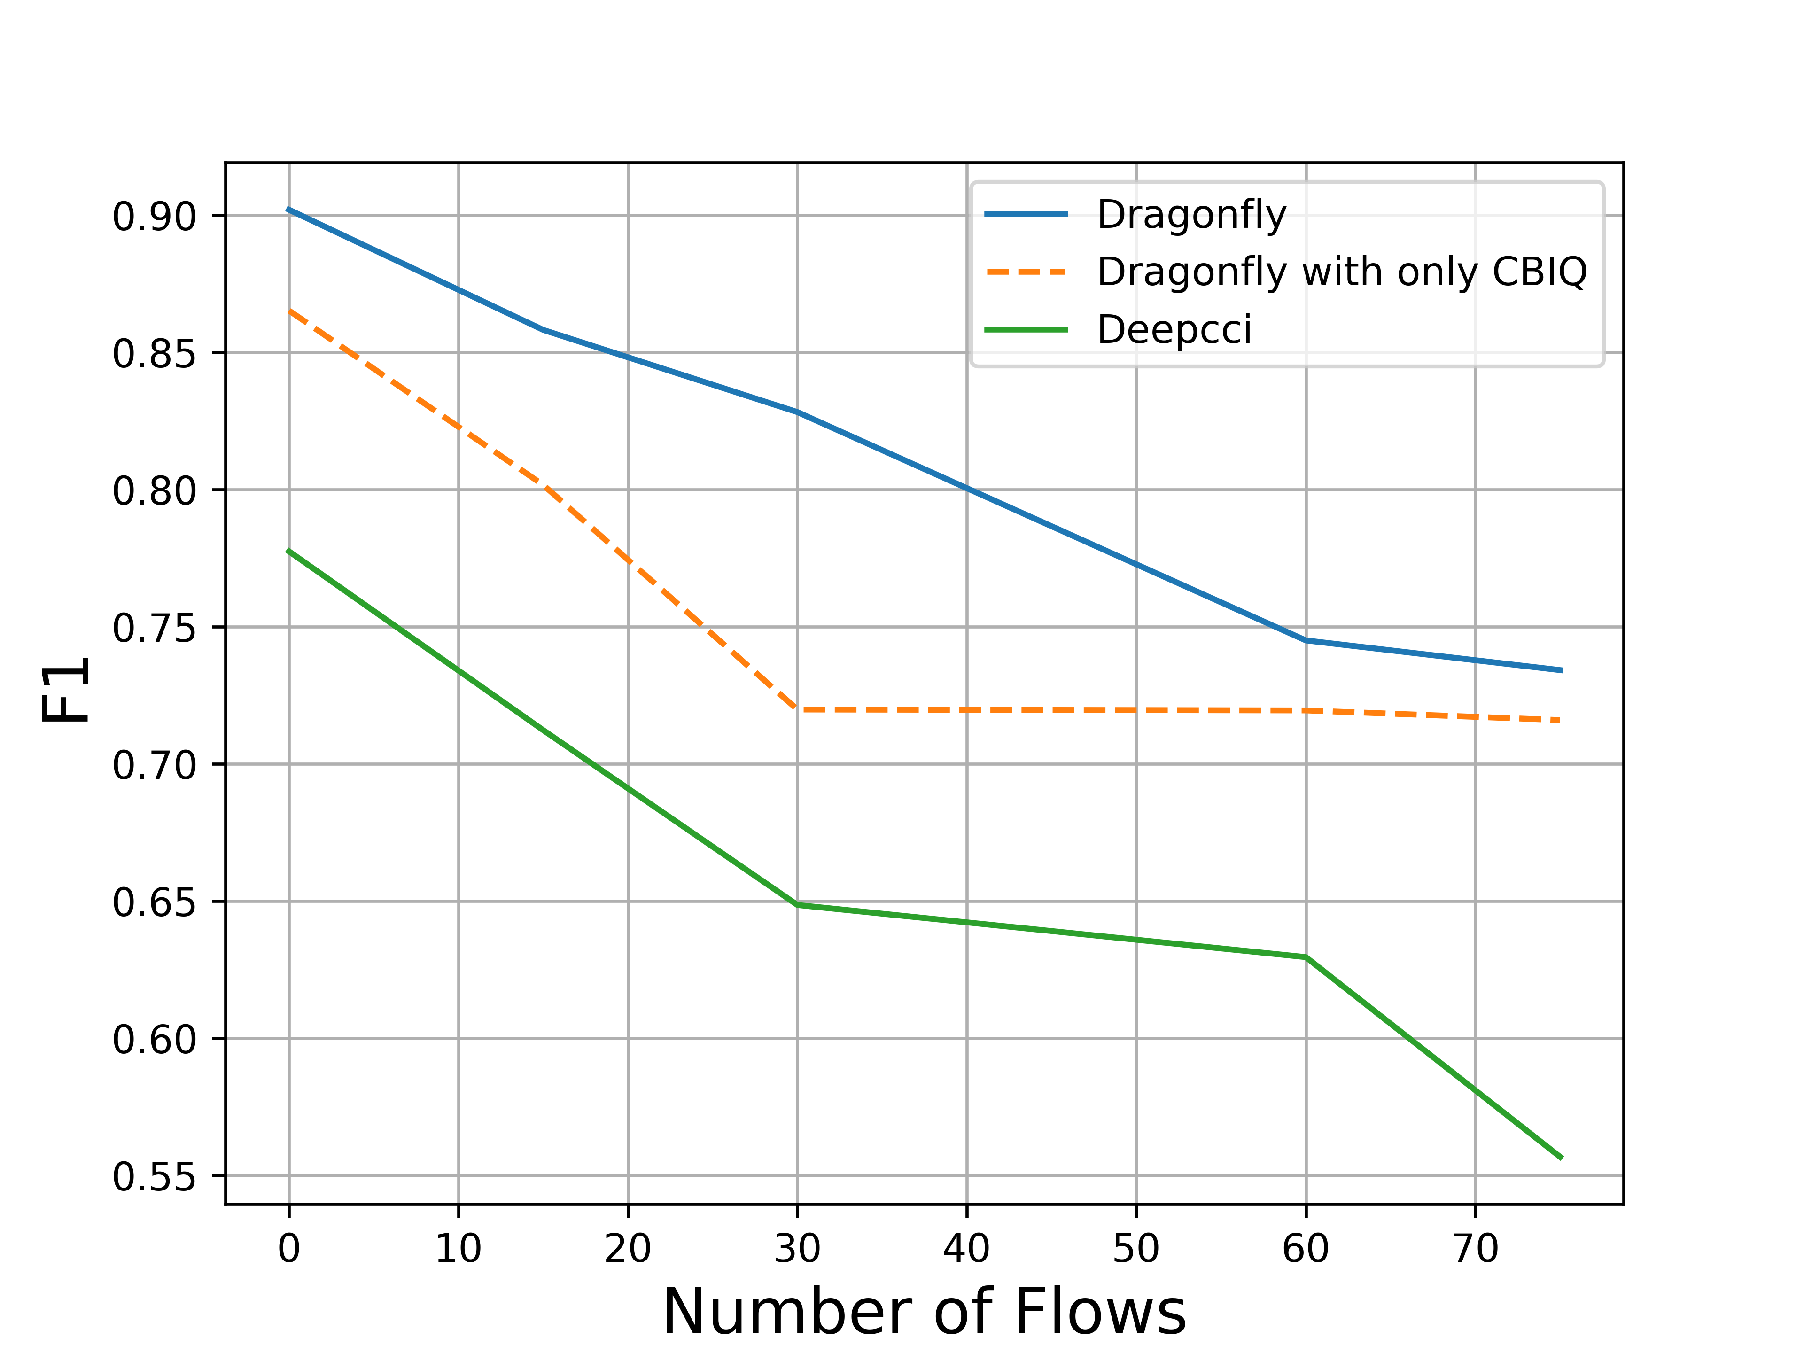
Impact of background traffic
60 seconds session

Slide 23
Running in the cloud
We first install 3 AWS servers in Tokyo, N. California and Frankfurt.
We use three clients as three flow sources:
Each client uses a distinct 10- Gbps line to connect to a shared router, which uses a 1- Gbps line to get to the Internet.
$${flow}_{1}$$
$$10Gbps$$
rtr
$$1Gbps$$
source
$$10Gbps$$
destination
$${flow}_{n}$$

Slide 24
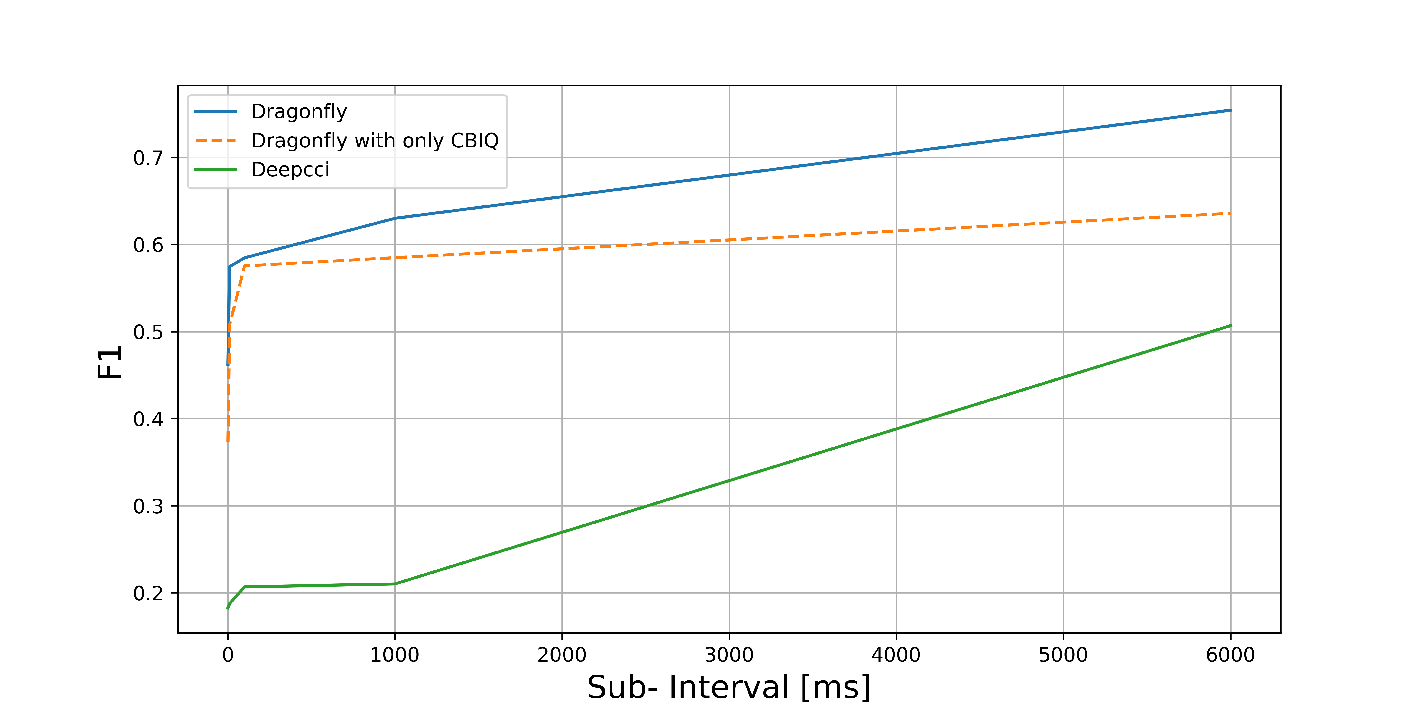
Impact of sub-interval duration in the cloud
60 seconds session, 15 background flows

Slide 25
Conclusion
We introduced CBIQ which contains a built- in intrinsic memory.
We further designed an eBPF- based scalable traffic collection.
We evaluated Dragonfly using a variety of platforms which has outperformed exiting works, including Deepcci.

