Slide 1



Simulate Before Sending:
Rethinking Transport in Datacenter Networks
Dan Straussman
Isaac Keslassy
Alexander Shpiner
Liran Liss

Slide 2


Motivation
Challenge: datacenters designed for AI training
AI training applications are very bursty
Mixture-of-experts (MoE) models exhibit unpredictable patterns
Worsen packets drops
Increase CCTs
Increase tail latency of RDMA
Motivation
DCSIM
Evaluation
Conclusion

Slide 3


Current Solutions
Per-packet load balancing
Random packet spraying (Alibaba Stellar), Adaptive packet spraying (STrack, REPS, Ultra Ethernet Consortium), Adaptive routing (NVIDIA’s Spectrum-X)
  Relies on commodity switches
  Vulnerable to losses
Credits
Receiver-driven credit-based scheme that attempts to avoid losses (ExpressPass, Homa, Aeolus, FlexPass)
  Handles incast
  No visibility into network
Motivation
DCSIM
Evaluation
Conclusion

Slide 4
Current Solutions
Scheduling-based approach
Shifts scheduling decisions to end hosts using matching (dcPIM, pHost)
  High utilization and scalability
  No visibility into network
Reservation
Per-flow fixed-bandwidth reservations (Harmony)
  Eliminates congestion-related drops
  Needs specialized switches
Motivation
DCSIM
Evaluation
Conclusion

Slide 5

Our Goal
To design transports that lower CCTs by making commodity lossy networks practically lossless.
Per-Packet Reservations
Commodity Switches
Motivation
DCSIM
Evaluation
Conclusion

Slide 6
DCSIM Idea
Shadow simulation network:
1/100th the rate of our real network
SIM packets 100 times smaller than real-network DATA packets
Same propagation, transmission and queuing delays
→ Not practical
Shadow network
Real network
Motivation
DCSIM
Evaluation
Conclusion

Slide 7

DCSIM Idea
Approximate shadow simulation network using dedicated buffers:
DATAs and SIMs (SIM-ACKs) coexist in the same network
Each SIM effectively implements reservation on a given path for a place in the DATA buffers that will be used when sending a DATA some fixed time later - RTTmax
RTTmax
Motivation
DCSIM
Evaluation
Conclusion

Slide 8
DCSIM Idea
② Queue full
→ SIM₁ dropped
① 2 ready DATA pkts
→ send SIM₁ (red path) and SIM₂ (green path)
S
D
④ SIM-ACK₂ received
→ Send 1st DATA pkt
on green path
③ SIM₂ received
→ send SIM-ACK₂
(arbitrary path)
➄ Sending DATA-ACK packets
Motivation
DCSIM
Evaluation
Conclusion

Slide 9
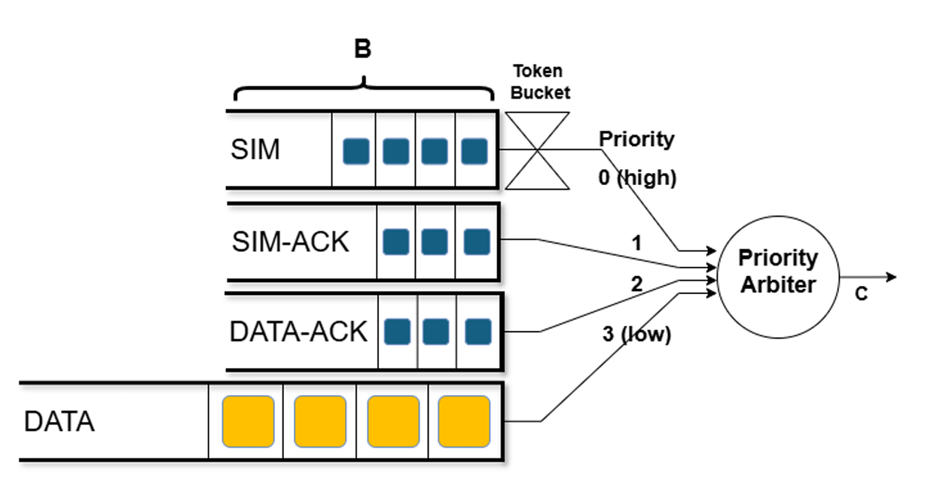
DCSIM Commodity Switches
Any SIM that arrives at the SIM buffer enters the queue if there is space, and is
dropped otherwise.
Once a SIM reaches D, D sends back a SIM-ACK to S.
SIMs (serviced at the highest priority) are rate-limited using a token bucket.
Motivation
DCSIM
Evaluation
Conclusion

Slide 10

DCSIM Challenge
DATAs may be dropped in multi-stage networks
A
A
SIM phase
B
C
B
C
Motivation
DCSIM
Evaluation
Conclusion

Slide 11
DCSIM Challenge
DATAs may be dropped in multi-stage networks
A
SIM phase
A
drop
B
C
B
C
Motivation
DCSIM
Evaluation
Conclusion

Slide 12
DCSIM Challenge
DATAs may be dropped in multi-stage networks
A
SIM phase
C
A
B
C
Motivation
DCSIM
Evaluation
Conclusion

Slide 13
DCSIM Challenge
DATAs may be dropped in multi-stage networks
A
A
DATA phase
B
C
C
Motivation
DCSIM
Evaluation
Conclusion

Slide 14
DCSIM Challenge
DATAs may be dropped in multi-stage networks
In evaluations, we found that if the DATA buffer can hold about 2× as many packets as the SIM buffer, then we could not see a single DATA loss
A
DATA phase
A
drop
B
C
C
Motivation
DCSIM
Evaluation
Conclusion

Slide 15
DCSIM Evaluation
We employ a 3-layer fat-tree topology with
  128 hosts
  800 Gbps links
  9 KB jumbo frames
We compare dcSim against pFabric, pHost and dcPIM.
We focus on collective communication patterns that are representative of AI
  Permutation
  All-to-all
  All-to-all-v
A
B
C
D
E
A
B
C
D
E
Motivation
DCSIM
Evaluation
Conclusion

Slide 16
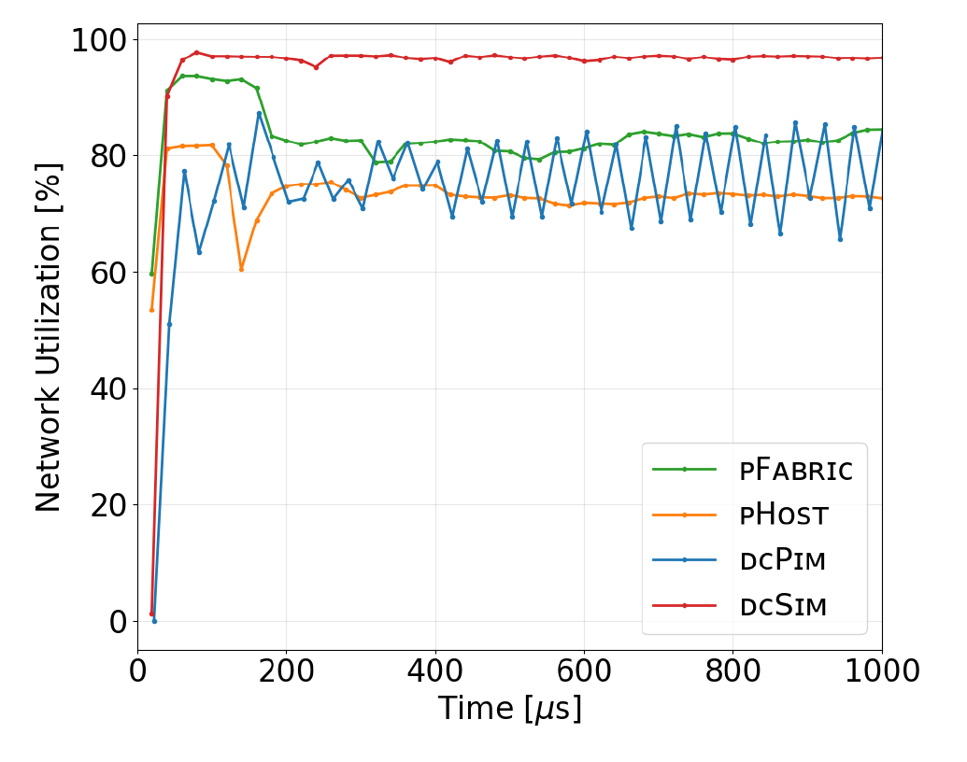
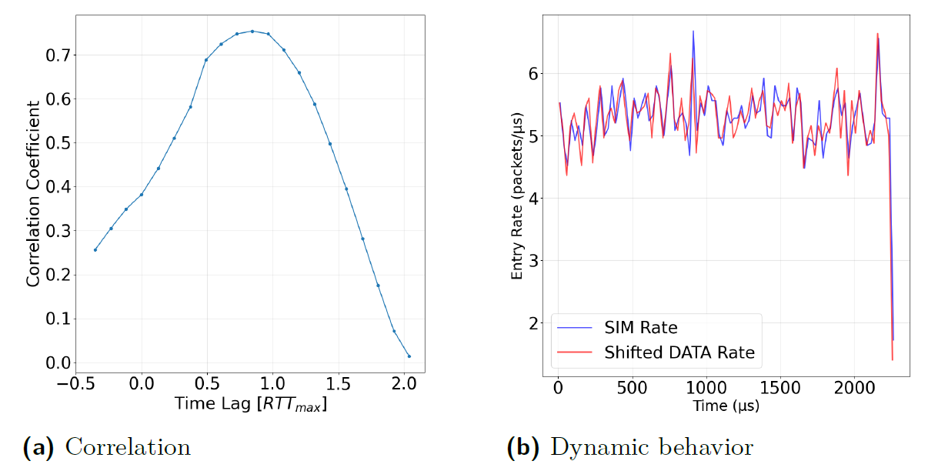
DCSIM Evaluation
Infinite all-to-all traffic pattern.
Rate of DATA packets corresponds indeed to the earlier rate of SIM packets.
Motivation
DCSIM
Evaluation
Conclusion

Slide 17
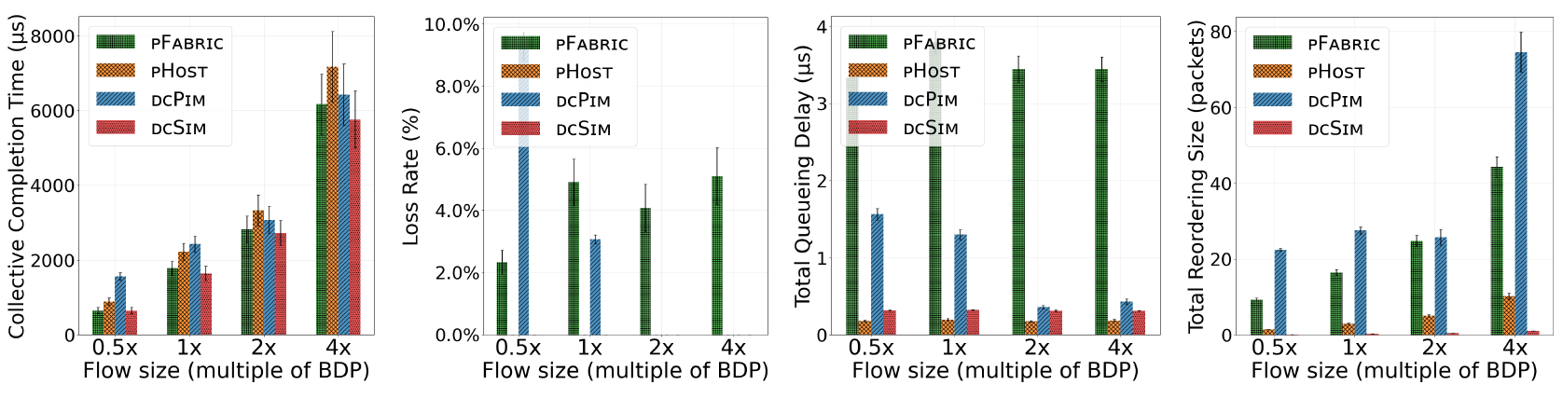
DCSIM Evaluation
Five all-to-all-v collectives with different average flow sizes.
CCT
Loss Rate
Queueing Delay
Reordering
Motivation
DCSIM
Evaluation
Conclusion

Slide 18
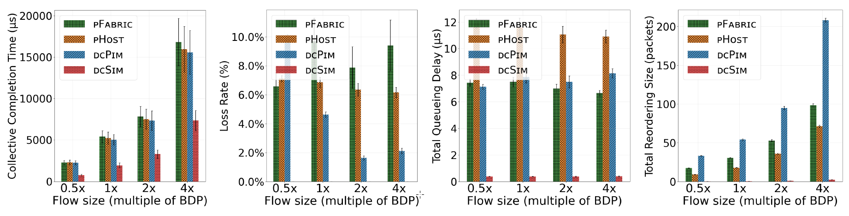
DCSIM Evaluation
Adverse scenario with an oversubscribed network using half the core switches, given
five all-to-all-v collectives.
CCT
Loss Rate
Queueing Delay
Reordering
Motivation
DCSIM
Evaluation
Conclusion

Slide 19
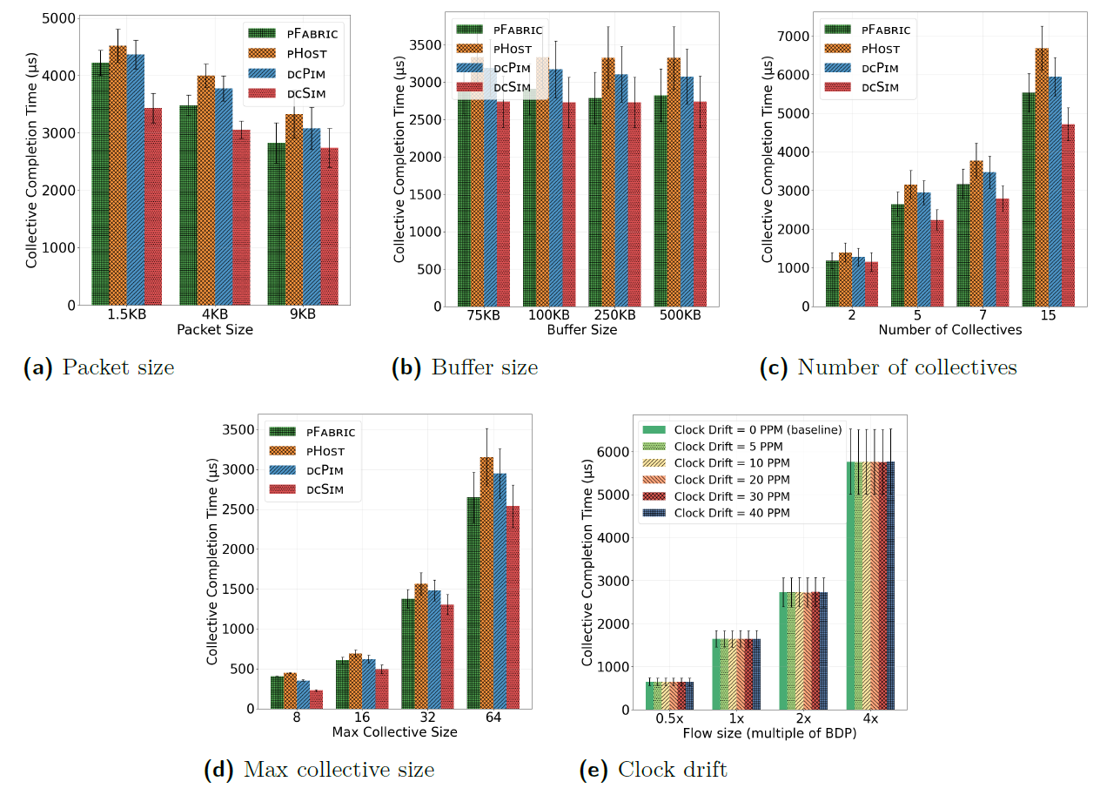
DCSIM Evaluation
buffer size
Sensitivity analysis shows that DCSIM outperforms other algos
Packet size
Buffer size
Number of collectives
Max collective size
Clock drift
Motivation
DCSIM
Evaluation
Conclusion

Slide 20


Conclusion
DCSIM achieves
Low CCTs
Practically lossless
Commodity switches
Shines under adverse conditions
Low queueing
The DCSIM source code is available online
https://github.com/danstr1/dcsim
Motivation
DCSIM
Evaluation
Conclusion

