Slide 1


2SYN: Congestion-Aware Multihoming
Kfir Toledo and Isaac Keslassy
Israeli Networking Day 2025

Slide 2



Multihoming Problem
Fundamental problem:
How should router R route a new flow?
Internet
R
LTE
S
D
Source Router
DSL
Motivation
Algorithm
Evaluation
Conclusion

Slide 3
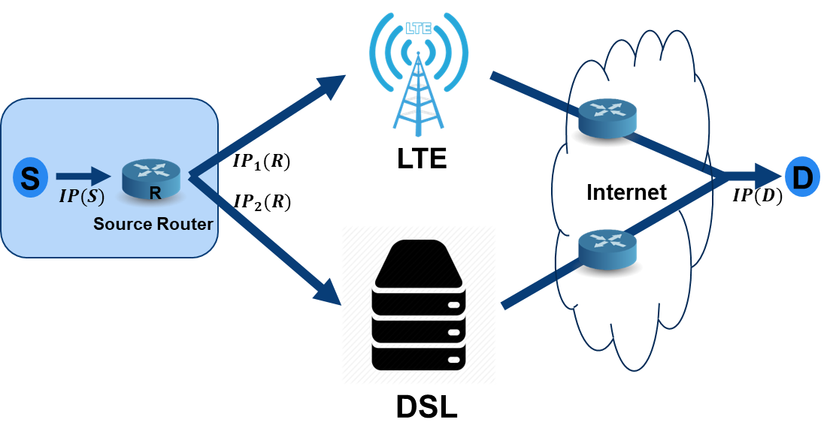
Multihoming Problem
Our goal in this talk:
Provide a general congestion-aware flow load-balancing algorithm given any arbitrary destination.
Motivation
Algorithm
Evaluation
Conclusion

Slide 4
Multihoming Problem
Current alternatives:
Static fail-over algorithm
  Not congestion-aware
Static load-balancing algorithm
  Not congestion-aware
MPTCP(Multipath TCP)
  Requires D to be compatible
Motivation
Algorithm
Evaluation
Conclusion

Slide 5

2SYN Algorithm
Design Goals:
Simplicity (standard TCP protocol)
Lightweight (no special hardware)
Only local knowledge in R (no tunnels)
Performance
Dynamic
Motivation
Algorithm
Evaluation
Conclusion

Slide 6





2SYN Algorithm
Internet
SYN
LTE
$$IP_{1}(R)$$
S
D
$$IP(S)$$
R
$$IP_{2}(R)$$
$$IP(D)$$
Source Router
DSL
Motivation
Algorithm
Evaluation
Conclusion

Slide 7
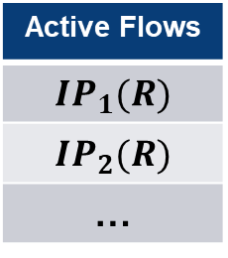
2SYN Algorithm
Internet
SYN
LTE
$$IP_{1}(R)$$
S
D
$$IP(S)$$
SYN
$$IP_{2}(R)$$
$$IP(D)$$
Source Router
Active Flows
$$IP_{1}(R)$$
$$IP_{2}(R)$$
…
DSL
Motivation
Algorithm
Evaluation
Conclusion

Slide 8
2SYN Algorithm
Internet
LTE
SYN-ACK
S
SYN-ACK
D
R
Source Router
Active Flows
$$IP_{1}(R)$$
$$IP_{2}(R)$$
…
DSL
Motivation
Algorithm
Evaluation
Conclusion

Slide 9
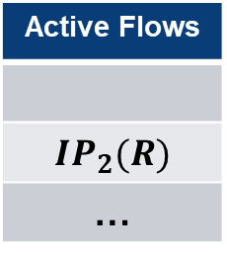
2SYN Algorithm
Internet
RST
$$IP_{1}(R)$$
LTE
Data
Data
Data
Data
S
Data
D
R
$$IP_{2}(R)$$
Source Router
Active Flows
$$IP_{1}(R)$$
$$IP_{2}(R)$$
…
Active Flows
$$IP_{2}(R)$$
…
DSL
Motivation
Algorithm
Evaluation
Conclusion

Slide 10




Lab Evaluation
Propagation delay
Queuing delay
Transmission delay
Bandwidth drop
Internet
$$IP_{1}(R)$$
LTE
S
D
$$IP(S)$$
R
$$IP_{2}(R)$$
$$IP(D)$$
Source Router
DSL
Motivation
Algorithm
Evaluation
Conclusion

Slide 11



Lab Evaluation
Propagation delay
Queuing delay
Transmission delay
Bandwidth drop
LTE
Internet
$$IP_{1}(R)$$
S
D
$$IP(S)$$
R
$$IP_{2}(R)$$
$$IP(D)$$
Source Router
DSL
Motivation
Algorithm
Evaluation
Conclusion

Slide 12
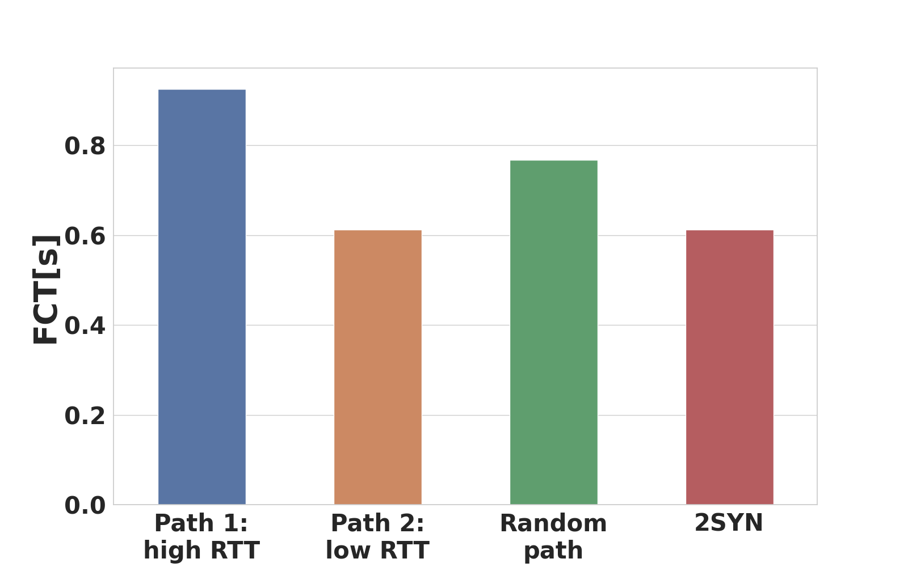
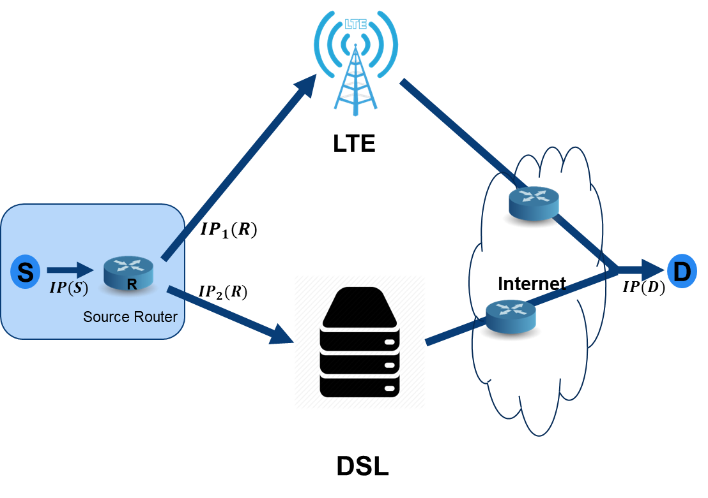
Evaluation: Propagation delay
Evaluation setup:
High RTT: 120ms, Low RTT: 80ms, average of 20 experiments with a 1MB file
Motivation
Algorithm
Evaluation
Conclusion

Slide 13

Lab Evaluation
Propagation delay
Queuing delay
Transmission delay
Bandwidth drop
Internet
$$IP_{1}(R)$$
LTE
S
D
$$IP(S)$$
R
$$IP_{2}(R)$$
$$IP(D)$$
Source Router
DSL
Motivation
Algorithm
Evaluation
Conclusion

Slide 14
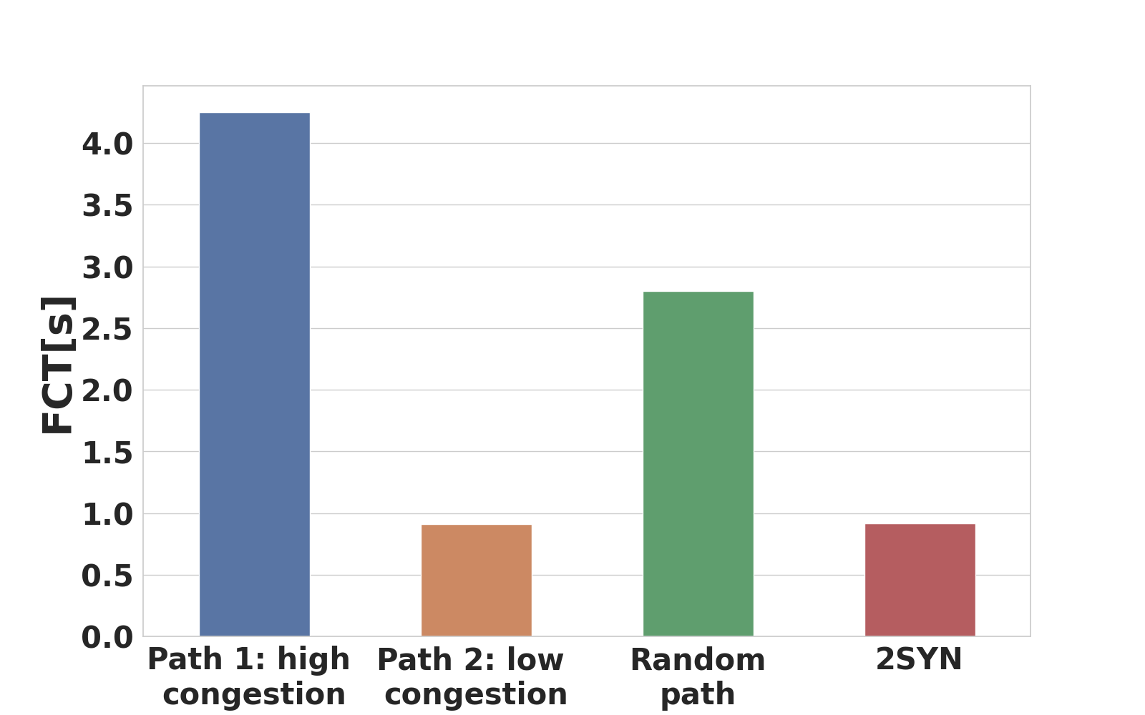
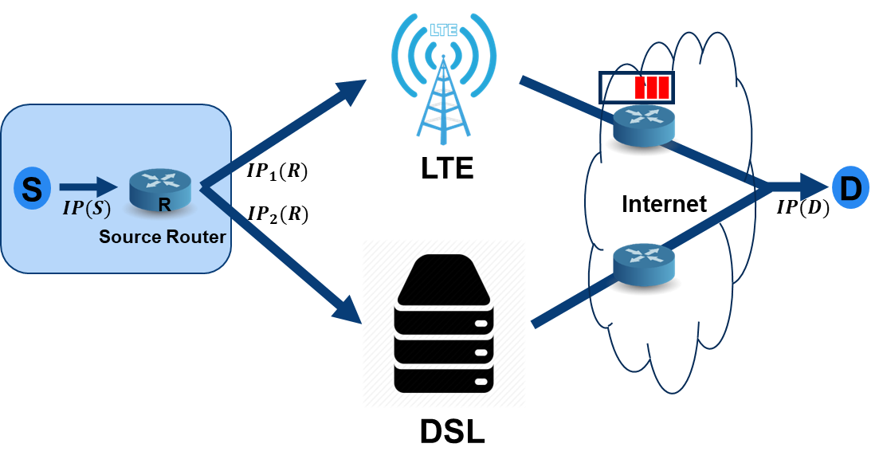
Lab Evaluation: Queueing delay
Evaluation setup:
BW: 300Mbps, RTT: 120ms, average of 20 experiments with a 1MB file
Motivation
Algorithm
Evaluation
Conclusion

Slide 15

Lab Evaluation
Propagation delay
Queuing delay
Transmission delay
Bandwidth drop
Internet
$$IP_{1}(R)$$
LTE
S
D
$$IP(S)$$
R
$$IP_{2}(R)$$
$$IP(D)$$
Source Router
DSL
Motivation
Algorithm
Evaluation
Conclusion

Slide 16
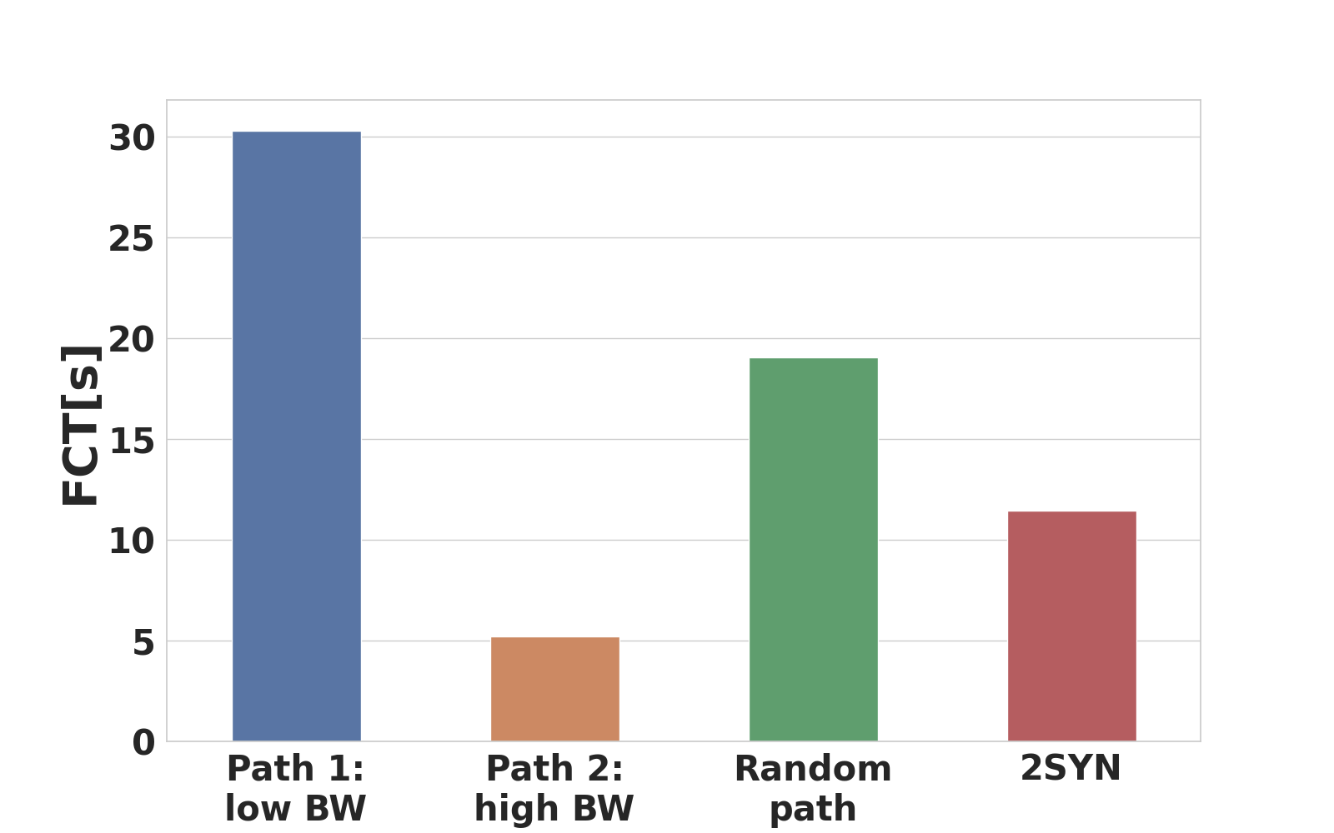
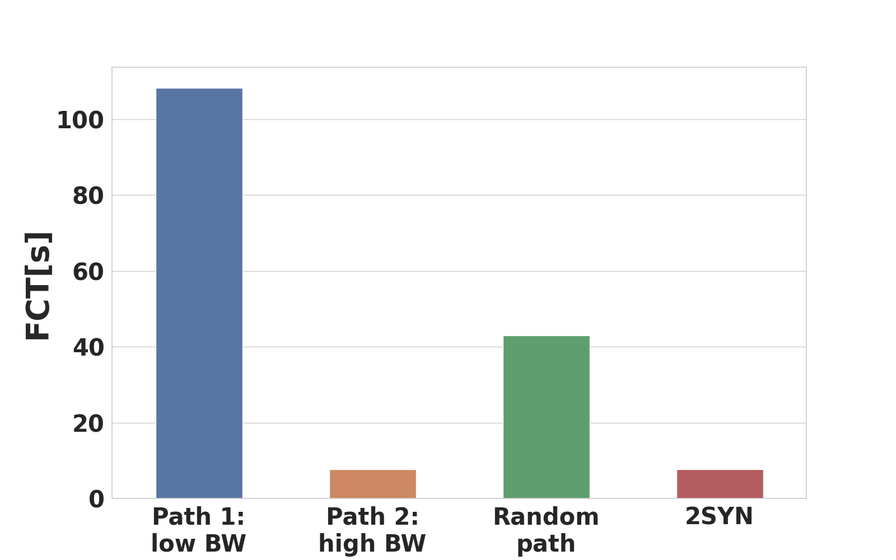

Lab Evaluation: Transmission delay
Evaluation setup:
Low BW: 30Mbps, High BW: 300Mbps, average of 20 experiments, no background traffic
Low BW: 30Mbps, High BW: 300Mbps, average of 20 experiments, with background traffic
Background traffic : ten flows limited to 30Mbps each
  100MB file: no background traffic
  100MB file: with background traffic
Motivation
Algorithm
Evaluation
Conclusion

Slide 17

Lab Evaluation
Propagation delay
Queuing delay
Transmission delay
Bandwidth drop
Internet
$$IP_{1}(R)$$
LTE
S
D
$$IP(S)$$
R
$$IP_{2}(R)$$
$$IP(D)$$
Source Router
DSL
Motivation
Algorithm
Evaluation
Conclusion

Slide 18
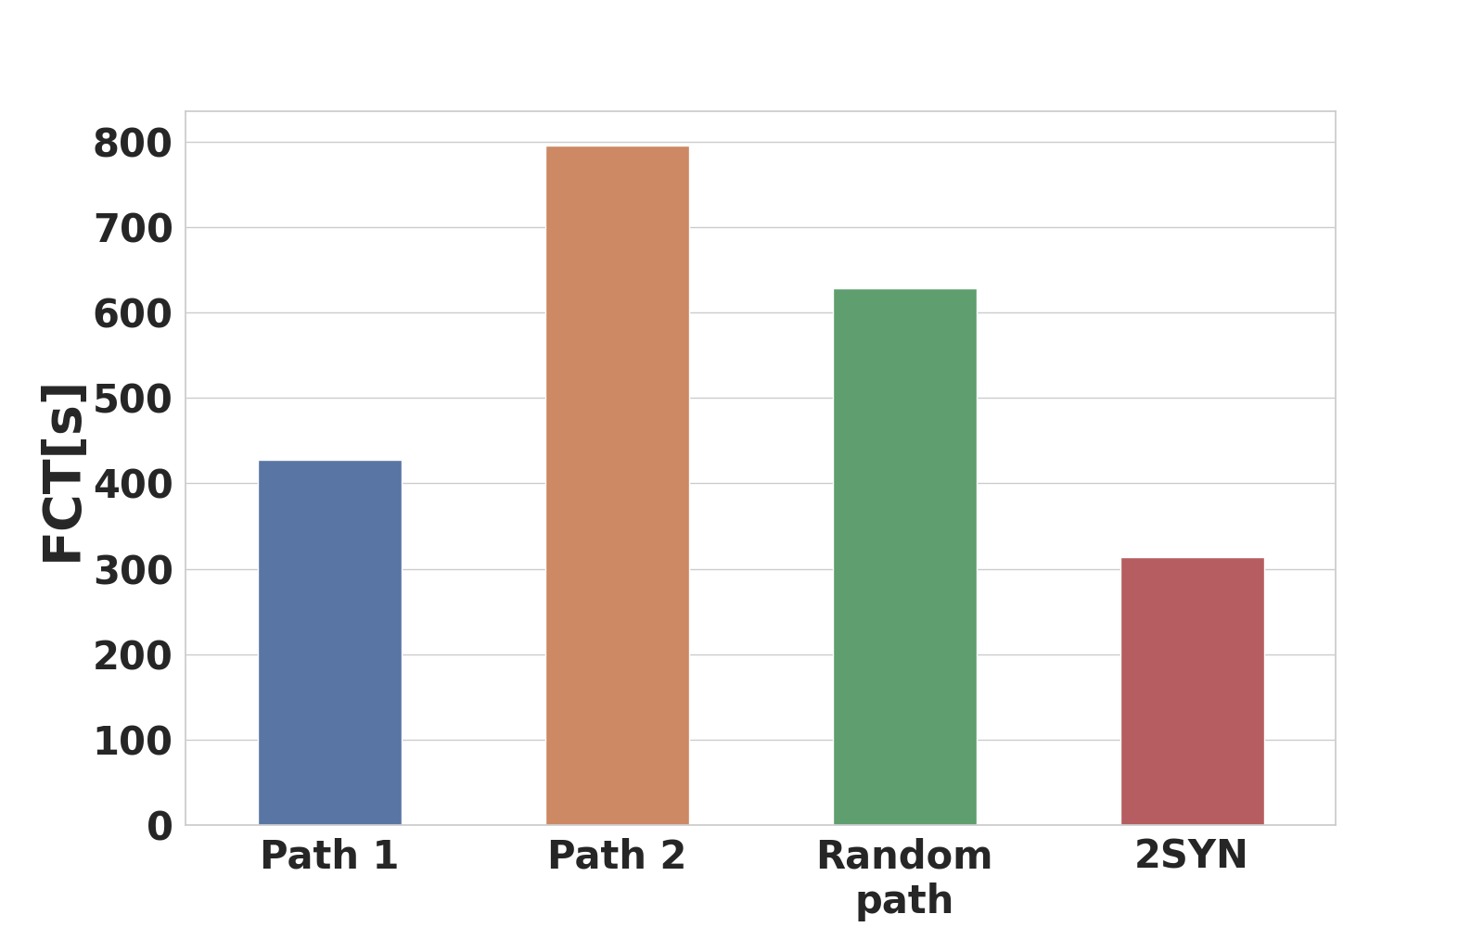
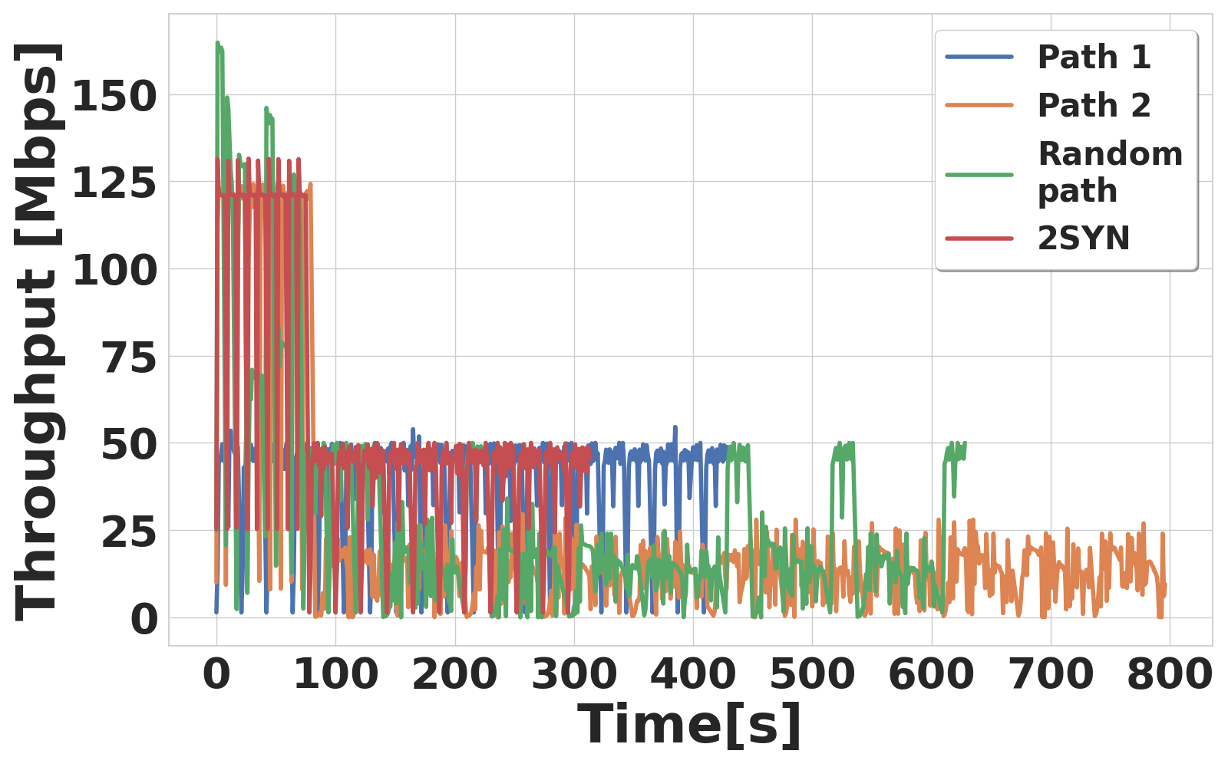
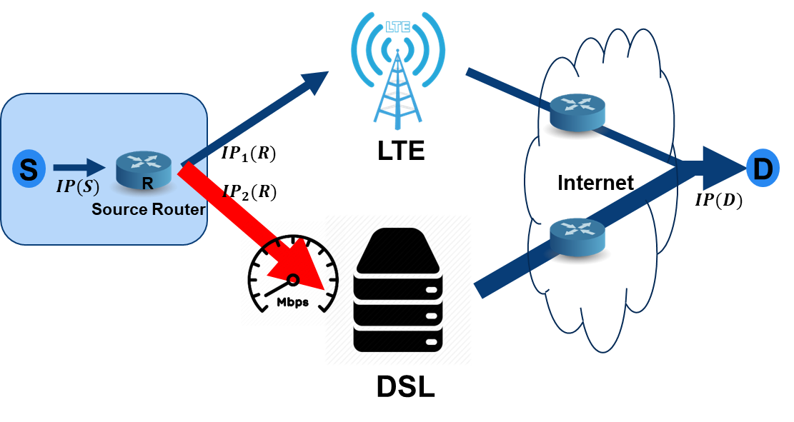
Lab Evaluation: Resilience to Bandwidth Drop
Evaluation setup:
Path 1 remains constant at 100 Mbps
Path 2 drops from 300 Mbps to 30 Mbps after downloading 40% of the files
3. Sending 20 files of 100 MB each.
Motivation
Algorithm
Evaluation
Conclusion

Slide 19
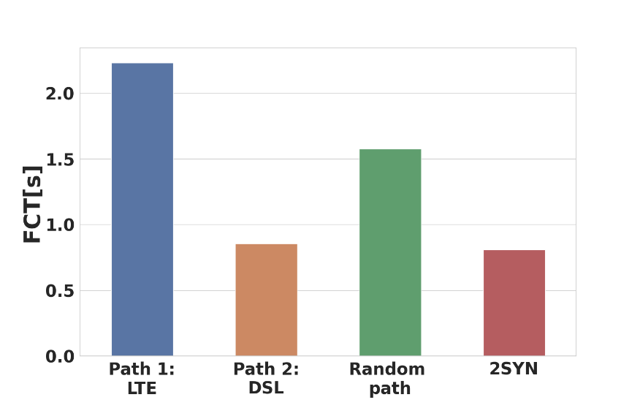
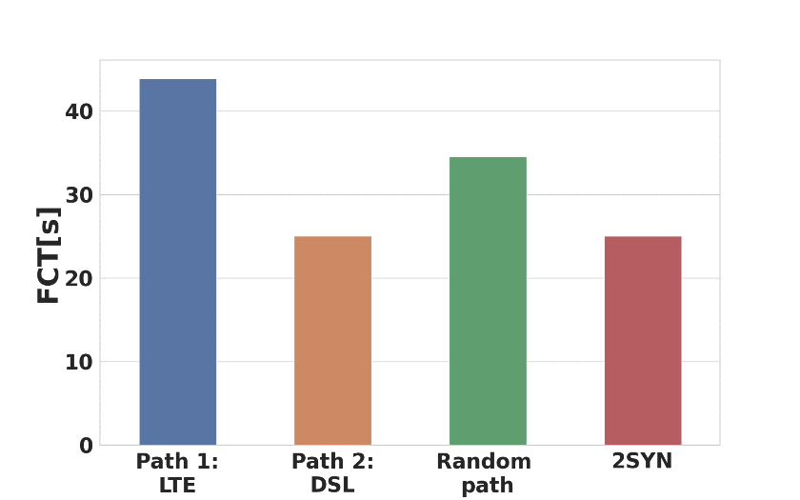
Real World Experiments: LTE vs DSL
Evaluation setup: Technion to London
Path1: 4G LTE
Path2: DSL link
Web search: Download link
30MB file: Upload link
Motivation
Algorithm
Evaluation
Conclusion

Slide 20
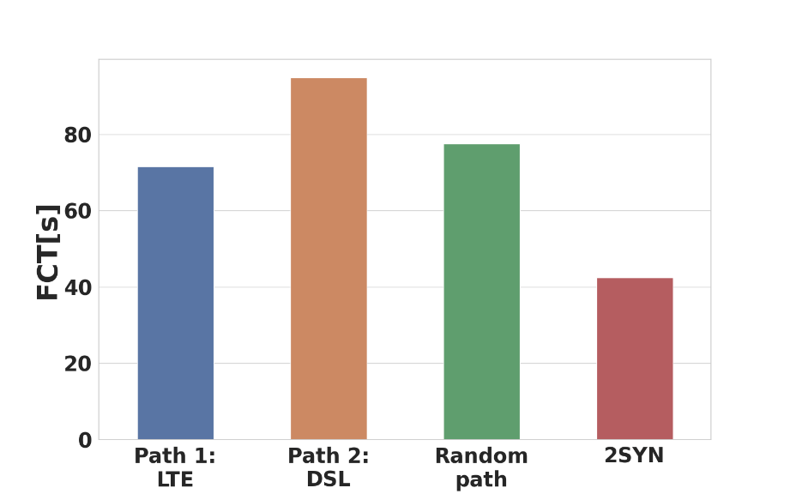
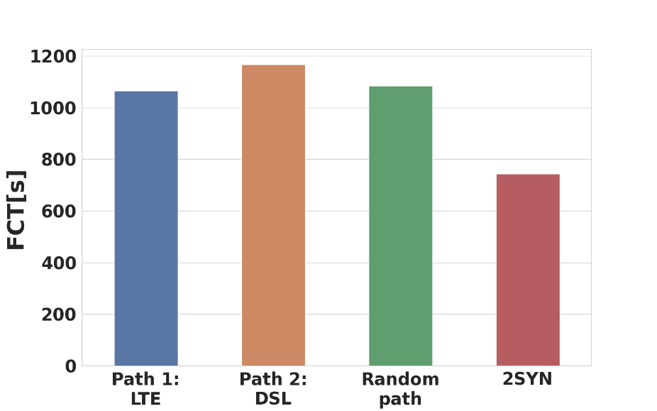
Real World Experiments: LTE vs DSL
Evaluation setup: Technion to London
Path1: 4G LTE
Path2: DSL link
Bandwidth drop for the DSL link
Web search: Download link
30MB file: Upload link
Motivation
Algorithm
Evaluation
Conclusion

Slide 21

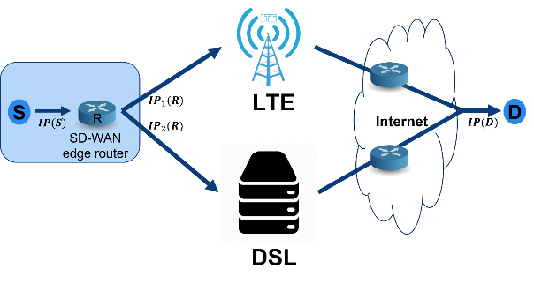

Why not Learning?
Multi-Armed Bandits' problem
$ε$ - greedy algorithm
Upper confidence bound (UCB1)
Thompson sampling
Why not?
Less reactive to changes
Motivation
Algorithm
Evaluation
Conclusion

Slide 22
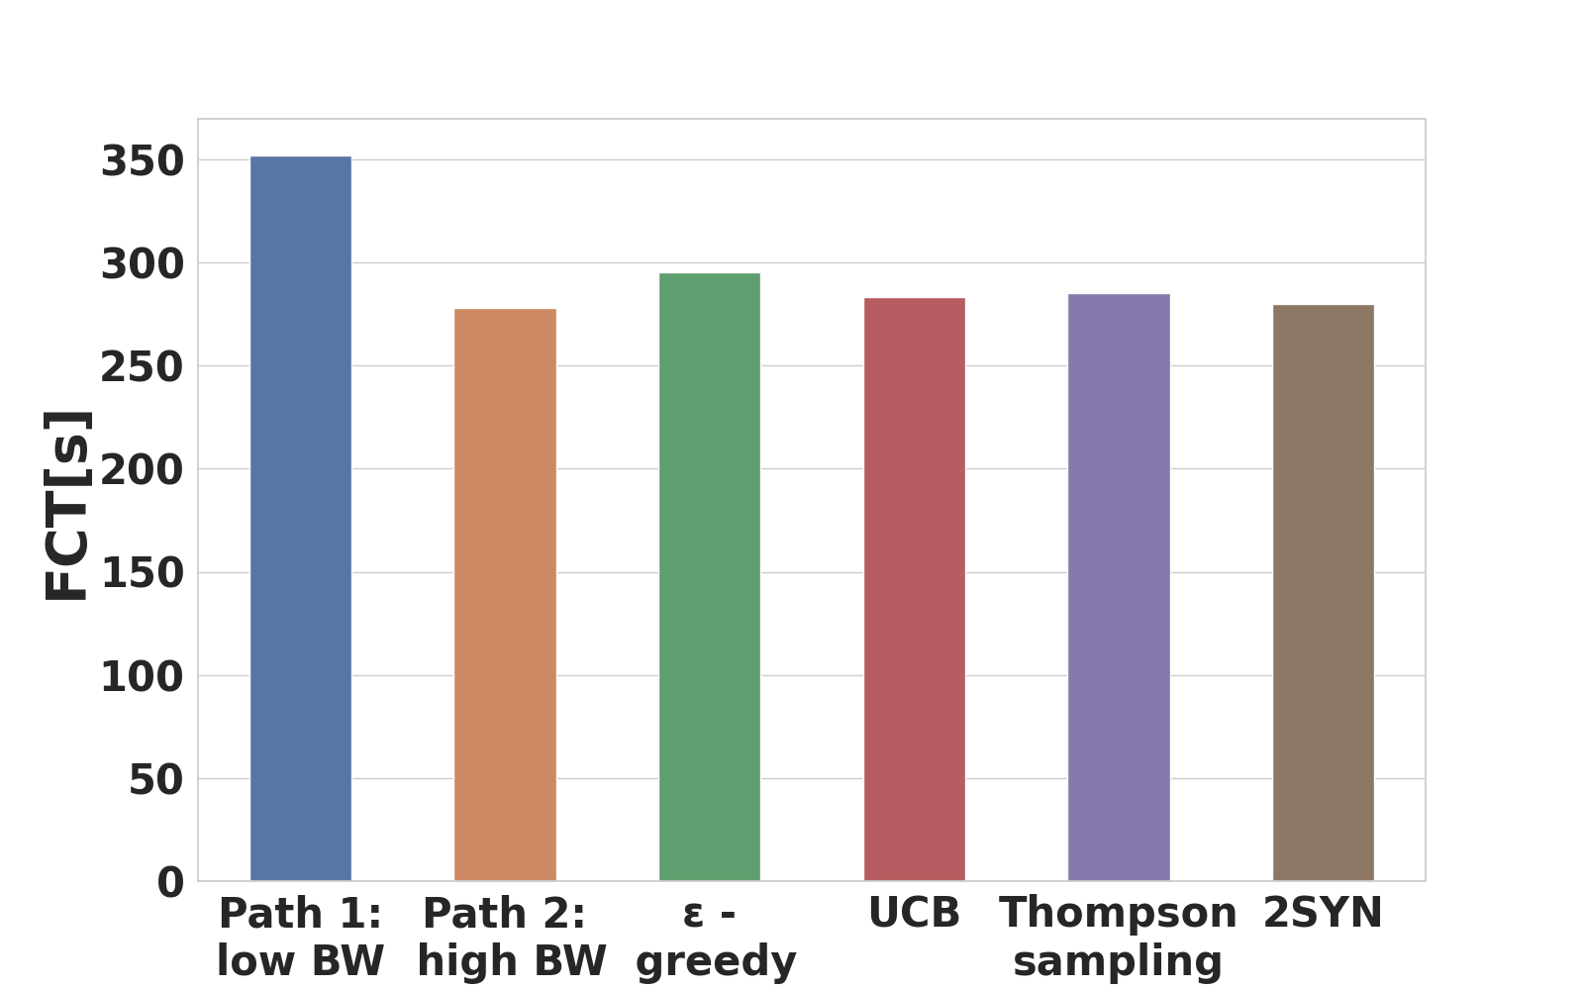
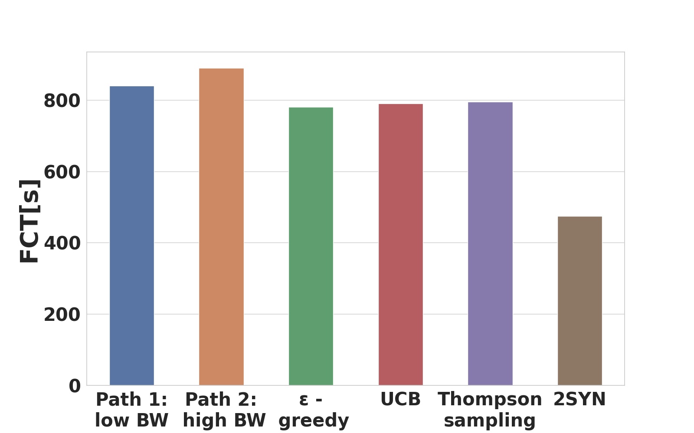
Why not Learning?
  Constant: without bandwidth drop
  With bandwidth drop
Evaluation setup:
5 flows, Low BW: 200 Mbps, High BW:300 Mbps, 50 files of 10MB
5 flows, Low BW: 200 Mbps, High BW:300 Mbps, 20 files of 200MB, with bandwidth drop
Motivation
Algorithm
Evaluation
Conclusion

Slide 23
Conclusion
Simple 2SYN algorithm for congestion-aware multihoming
Real world experiments
Real-time observation > history-based learning
Motivation
Algorithm
Evaluation
Conclusion

Slide 24
2SYN: Congestion-Aware Multihoming
Thank you!

