Slide 1

Measurement Matrix Optimization for Poisson Compressed Sensing
Moran Mordechay
Yoav Y. Schechner
Technion, Israel
Notes:
אפשר להגדיל קצת את הפונטים מתחת לכותרת. מספרי שקפים בכל השקפים פרט לראשון.

Slide 2
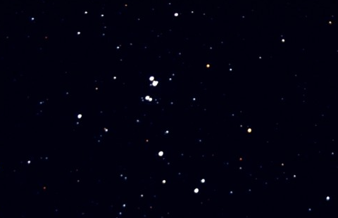
Examples for x
Astronomical images
http://www.warren-wilson.edu

Slide 3
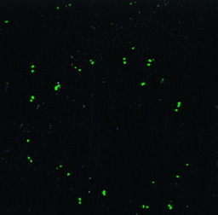
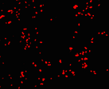
Examples for x
Cell biology images
http://www.pnas.org
http://www.plosone.org

Slide 4
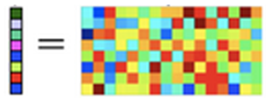
Compressed Sensing
Acquired samples
Given measurement matrix
Original
s’-sparse signal
For sparse signals, reconstruction is possible given is chosen in a certain way.
http://www.ece.ucsb.edu/wcsl/people/sriram/compEst

Slide 5
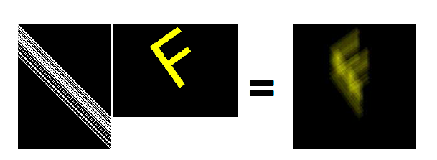

Examples for Mixing Matrices
Blur:
Raskar et al. 2006.
Spectral Mixing:
Alterman et al. 2010.

Slide 6
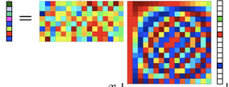
Goal
+
Poisson
noise
Optimized measurement matrix
Acquired samples
Uncontrolled mixing matrix (e.g. blur kernel)
Original
s’-sparse signal
The total output energy of cannot exceed the total input energy:
http://www.ece.ucsb.edu/wcsl/people/sriram/compEst

Slide 7
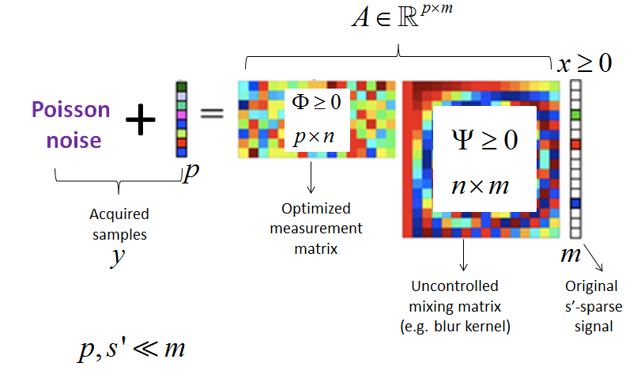
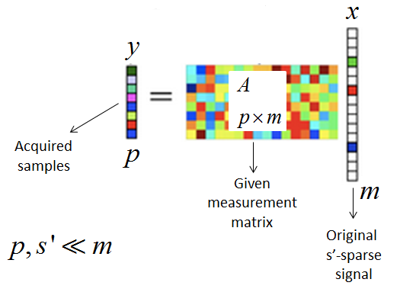
Our Problem vs. Compressed Sensing
Our problem is different:
Samples with Poisson noise
2 matrices:
Uncontrolled
to be optimized
Energy constraint
our problem
Compressed sensing
Notes:
האג'נדה מפורטת מדי. ממליץ לצמצם לעד 6 כותרות. אפשר להוריד את הביבליוגרפיה ולאחד את הסיכום וההצעות לעתיד תחת סיכום.

Slide 8
Poisson Compressed Sensing
By penalized ML reconstruction:
Poisson
log-likelihood
Penalty function
promoting
sparsity
Notes:
גם כאן אפשר לנסות לגרום לנקודות להיכנס בשורה אחת.

Slide 9
Previous Related Work
What has been done?
Compressed sensing – noiseless or Gaussian noise: Donoho, Candès, Tao…
optimization – noiseless or Gaussian noise: Elad, Duarte-Carvajalino et al, Xu et al…
Poisson compressed sensing – reconstruction algorithms: Harmany et al, Lingenfelter et al…
Poisson compressed sensing – suggestions (not optimized): Raginsky et al.

Slide 10
Our Contribution
What has not been done yet?
optimization – Poisson compressed sensing

Slide 11
Example Reconstruction Results
51 non-zeros
out of 1024

Slide 12
Example Reconstruction Results
51 non-zeros
out of 1024

Slide 13
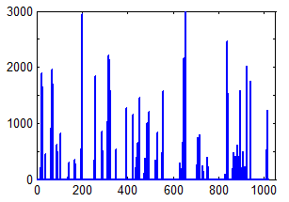
Example Reconstruction Results
Random matrix
51 non-zeros
out of 1024

Slide 14
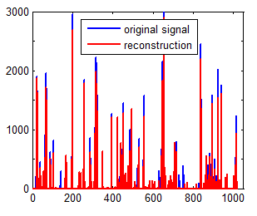
Example Reconstruction Results
Random matrix
51 non-zeros
out of 1024

Slide 15
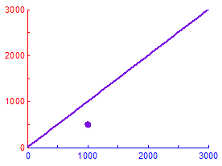
Example Reconstruction Results
Random matrix
51 non-zeros
out of 1024

Slide 16
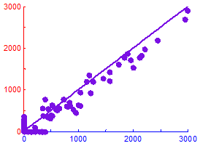
Example Reconstruction Results
Random matrix
51 non-zeros
out of 1024

Slide 17
Example Reconstruction Results
Random matrix
51 non-zeros
out of 1024

Slide 18
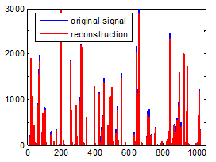
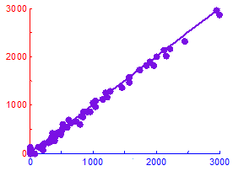
Example Reconstruction Results
Random matrix
Optimized matrix
51 non-zeros
out of 1024

Slide 19
What Should A Satisfy?
background
is s’-sparse
is s’-sparse
is 2s’-sparse
We want:
Signal domain
Samples domain

Slide 20
What Should A Satisfy?
background
is s’-sparse
is s’-sparse
is 2s’-sparse
We don’t want:
Signal domain
Samples domain

Slide 21
What Should A Satisfy?
background
is 2s’-sparse
f

Slide 22
What Should A Satisfy?
background
is 2s’-sparse
is 2s’-RIP
f

Slide 23
Restricted Isometry Property (RIP)
background
Satisfying s’-RIP means that every s’ columns of the matrix are nearly orthonormal.
The restricted isometry constant (RIC) is the smallest such that:
for every s’-sparse
s’-RIP is satisfied if is small

Slide 24

Restricted Isometry Property (RIP)
background
Satisfying s’-RIP means that every s’ columns of the matrix are nearly orthonormal.
The restricted isometry constant (RIC) is the smallest such that:
for every s’-sparse
s’-RIP is satisfied if is small
hard to compute.

Slide 25
Mutual Coherence
background
Cosine of the minimal angle between distinct columns of the matrix:
Notes:
בסדר, אבל עם אפשר להכניס לכאן עוד מידע ולמלא את השקף אז מומלץ.

Slide 26
Mutual Coherence
background
Cosine of the minimal angle between distinct columns of the matrix:
Notes:
בסדר, אבל עם אפשר להכניס לכאן עוד מידע ולמלא את השקף אז מומלץ.

Slide 27
Mutual Coherence
background
Cosine of the minimal angle between distinct columns of the matrix:
Notes:
בסדר, אבל עם אפשר להכניס לכאן עוד מידע ולמלא את השקף אז מומלץ.

Slide 28
Mutual Coherence
background
Cosine of the minimal angle between distinct columns of the matrix:
Notes:
בסדר, אבל עם אפשר להכניס לכאן עוד מידע ולמלא את השקף אז מומלץ.

Slide 29
Mutual Coherence
background
Cosine of the minimal angle between distinct columns of the matrix:
Notes:
בסדר, אבל עם אפשר להכניס לכאן עוד מידע ולמלא את השקף אז מומלץ.

Slide 30
Mutual Coherence
background
Cosine of the minimal angle between distinct columns of the matrix:
Notes:
בסדר, אבל עם אפשר להכניס לכאן עוד מידע ולמלא את השקף אז מומלץ.

Slide 31
Mutual Coherence
background
Cosine of the minimal angle between distinct columns of the matrix:
Notes:
בסדר, אבל עם אפשר להכניס לכאן עוד מידע ולמלא את השקף אז מומלץ.

Slide 32
Mutual Coherence
background
Cosine of the minimal angle between distinct columns of the matrix:
Notes:
בסדר, אבל עם אפשר להכניס לכאן עוד מידע ולמלא את השקף אז מומלץ.

Slide 33
Mutual Coherence
background
Cosine of the minimal angle between distinct columns of the matrix:
Notes:
בסדר, אבל עם אפשר להכניס לכאן עוד מידע ולמלא את השקף אז מומלץ.

Slide 34
Mutual Coherence
background
Cosine of the minimal angle between distinct columns of the matrix:
Notes:
בסדר, אבל עם אפשר להכניס לכאן עוד מידע ולמלא את השקף אז מומלץ.

Slide 35
Mutual Coherence
background
Cosine of the minimal angle between distinct columns of the matrix:
Notes:
בסדר, אבל עם אפשר להכניס לכאן עוד מידע ולמלא את השקף אז מומלץ.

Slide 36
Mutual Coherence
background
The mutual coherence is:
Low mutual coherence means that the columns of the matrix are nearly orthogonal.
Notes:
בסדר, אבל עם אפשר להכניס לכאן עוד מידע ולמלא את השקף אז מומלץ.

Slide 37
RIP vs. Mutual Coherence
background
and RIP are related:
hard to compute.
easy to compute.

Slide 38
RIP vs. Mutual Coherence
background
and RIP are related:
hard to compute.
easy to compute.
minimize

Slide 39
What About Poisson Compressed Sensing?
No proven recovery guarantees using RIP or mutual coherence.
However, importance of RIP was mentioned: Harmany et al, Raginsky et al.
- RIP relation still holds.

Slide 40
What About Poisson Compressed Sensing?
No proven recovery guarantees using RIP or mutual coherence.
However, importance of RIP was mentioned: Harmany et al, Raginsky et al.
- RIP relation still holds.
ww
We optimize by minimizing

Slide 41
What About Poisson Compressed Sensing?
Why is satisfying RIP important?
RIP
should be small

Slide 42
Energy Conservation
Energy conservation is important due to Poisson noise.
We require energy conservation:
Applies to photon sharing optical architectures.
Complicated to implement in hardware.

Slide 43
Mutual Coherence Minimization
Rusu solves the problem for nonnegativity constraint, but his algorithm is very slow for large matrices.
Our algorithm is much faster.
Rusu Design of incoherent frames via convex optimization

Slide 44
Mutual Coherence Minimization
is an equiangular tight frame (ETF).
ww
We wish to design a nonnegative ETF, with

Slide 45
Orthonormal Bases
background

Slide 46
Orthonormal Bases
background

Slide 47
Orthonormal Bases
background

Slide 48
Frames
background
Generalization of the idea of orthonormal bases to vector sets that might be linearly dependent.
is a frame if its columns span

Slide 49
Frames
background
Generalization of the idea of orthonormal bases to vector sets that might be linearly dependent.
is a frame if its columns span

Slide 50
Frames
background
Generalization of the idea of orthonormal bases to vector sets that might be linearly dependent.
is a frame if its columns span

Slide 51
Frames
background
Generalization of the idea of orthonormal bases to vector sets that might be linearly dependent.
is a frame if its columns span

Slide 52
UNTF
background
is a unit norm tight frame (UNTF) if its columns are normalized and also:

Slide 53
UNTF
background
is a unit norm tight frame (UNTF) if its columns are normalized and also:

Slide 54
EF
background
is an equiangular frame (EF) if for each pair of distinct columns:

Slide 55
Frame Types
Frame
UNF
TF
EF
UNTF
ETF
UNEF
EUNTF

Slide 56
Mutual Coherence Minimization
is an equiangular tight frame (ETF).
ww
We wish to design a nonnegative ETF, with

Slide 57
Problems
ETF’s exist only for a few frame dimensions:
Non-negative EF’s do not exist, generally.
We use instead quasi-equiangular frame (QEF).

Slide 58
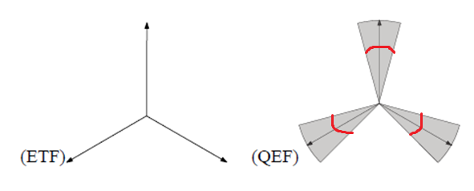
QEF
is a QEF with if:
Shi, Zhang Quasi-Equiangular Frame (QEF): A New Flexible Configuration of Frame

Slide 59
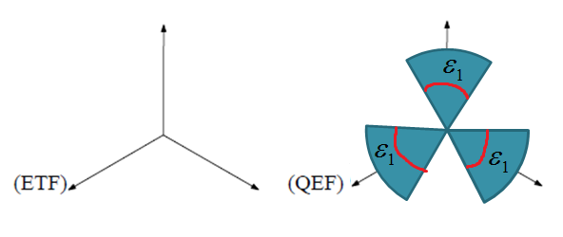
QEF
is a QEF with if:
Shi, Zhang Quasi-Equiangular Frame (QEF): A New Flexible Configuration of Frame

Slide 60
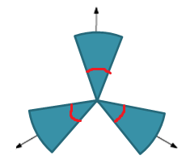
QEF
is a QEF with if:
Shi, Zhang Quasi-Equiangular Frame (QEF): A New Flexible Configuration of Frame

Slide 61
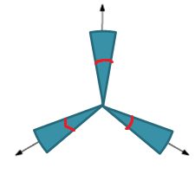
QEF
is a QEF with if:
Shi, Zhang Quasi-Equiangular Frame (QEF): A New Flexible Configuration of Frame

Slide 62
Gram Matrix
Suppose that the columns are normalized.
Then:

Slide 63
Algorithm – Step 1
Elad, 2007
Normalize the columns of and calculate

Slide 64
Algorithm – Step 1
Elad, 2007
Normalize the columns of and calculate

Slide 65
Algorithm – Step 1
Elad, 2007
Normalize the columns of and calculate

Slide 66
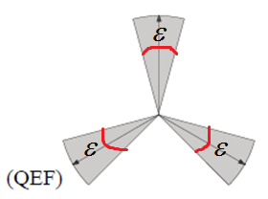
Algorithm – Step 2
Update to be the Gram matrix of a QEF with

Slide 67
Algorithm – Step 2
Update to be the Gram matrix of a QEF with

Slide 68
Algorithm – Step 2
Update to be the Gram matrix of a QEF with

Slide 69
Algorithm – Step 2
Update to be the Gram matrix of a QEF with

Slide 70
Step 2 – Previous Work
Xu et al, 2010

Slide 71
Step 2 – Previous Work
Xu et al, 2010

Slide 72
Algorithm – Step 3
Motivated by
Elad, 2007
Find a matrix

Slide 73
Algorithm – Step 3
Motivated by
Elad, 2007
Find a matrix

Slide 74
Algorithm – Step 3
Motivated by
Elad, 2007
Find a matrix

Slide 75
Algorithm – Step 3
Motivated by
Elad, 2007
Find a matrix

Slide 76
Algorithm – Step 3
Motivated by
Elad, 2007
Find a matrix

Slide 77
Algorithm – Step 3
Motivated by
Elad, 2007
Find a matrix

Slide 78
Algorithm – Step 3
Motivated by
Elad, 2007
Find a matrix

Slide 79
Algorithm – Step 3
Motivated by
Elad, 2007
Find a matrix

Slide 80
Algorithm – Step 4
Tsiligianni et al, 2012
Calculate the nearest tight frame

Slide 81
Algorithm – Step 4
Tsiligianni et al, 2012
Calculate the nearest tight frame

Slide 82
Algorithm – Step 4
Tsiligianni et al, 2012
Calculate the nearest tight frame

Slide 83
Algorithm – Final Step
Motivated by
Elad, 2007

Slide 84
Algorithm – Final Step Improvement
If
then it holds also for
for any unitary

Slide 85
Algorithm – Final Step Improvement
If
then it holds also for
for any unitary

Slide 86
Algorithm – Final Step Improvement
If
then it holds also for
for any unitary

Slide 87
Algorithm – Final Step Improvement
FISTA
Closed form solution

Slide 88
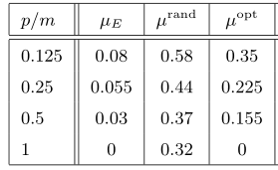
Results – Measurement Matrix Optimization

Slide 89
Average Mutual Coherence

Slide 90
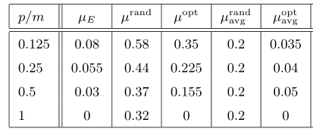
Results – Measurement Matrix Optimization

Slide 91
Results – Measurement Matrix Optimization
PDF
PDF

Slide 92
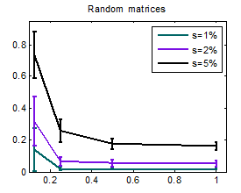
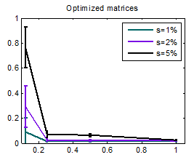
Results – Signal Reconstruction
p/m
p/m

Slide 93
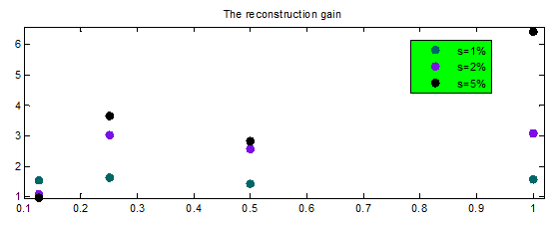
Results – Signal Reconstruction
p/m

Slide 94
Results – Signal Reconstruction
51 non-zeros
out of 1024

Slide 95
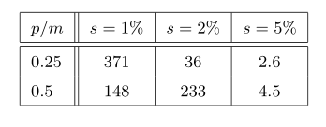
Results – Signal Reconstruction
The reconstruction gain when effectively there is no noise

Slide 96
Averaging Blur

Slide 97
Averaging Blur

Slide 98
Averaging Blur

Slide 99
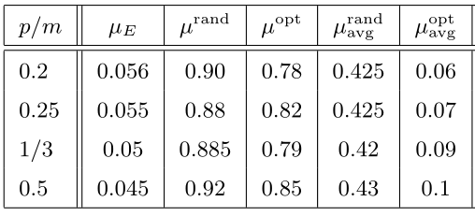
Averaging Blur- Measurement Matrix Optimization Results

Slide 100
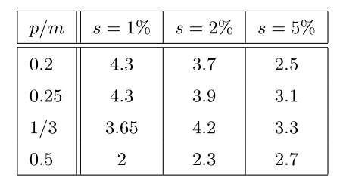
Averaging Blur- Signal Reconstruction Results
The reconstruction gain

Slide 101
Averaging Blur- Signal Reconstruction Results
22 non-zeros
out of 1024

Slide 102
Application to Spectrometry
Spectra are usually not sparse in the canonical basis – need to find a sparsifying basis
We assume no mixing matrix

Slide 103
Application to Spectrometry
http://omlc.org/spectra/PhotochemCAD/index.html

Slide 104
Application to Spectrometry
We use the DCT basis as sparsifying basis.
Sparse representation

Slide 105
Application to Spectrometry
We use the DCT basis as sparsifying basis.

Slide 106
Energy Conservation
Energy conservation is important due to Poisson noise.
We require energy conservation:
Applies to photon sharing optical architectures.
Complicated to implement in hardware.

Slide 107
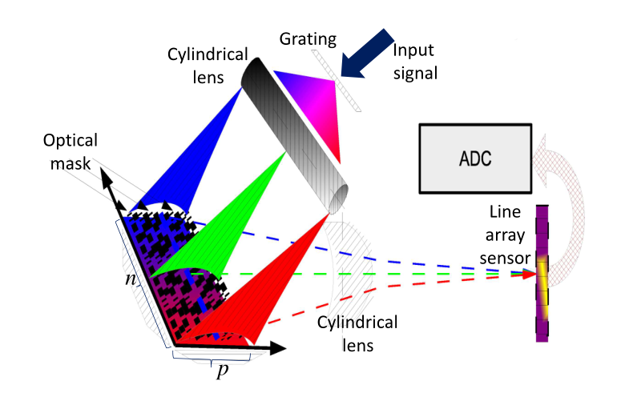
Application to Spectrometry
Simple parallel architecture for spectral multiplexing
No energy conservation
August et al Compressive hyperspectral imaging by random separable projections in both the spatial and the spectral domains

Slide 108
Application to Spectrometry
Limiting the energy loss
constants
Our choice

Slide 109
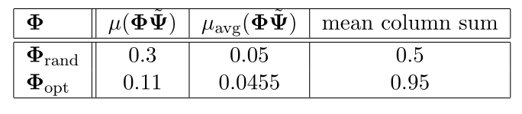
Application to Spectrometry

Slide 110
Application to Spectrometry
Poisson reconstruction algorithm promoting sparsity in a given basis.
Reconstruction results are not good.
Possible reasons are problematic behavior of the used reconstruction algorithm and insufficient sparsity in the DCT basis.

Slide 111
Conclusion
The goal is to find an optimal for Poisson compressed sensing.
Some mixing given by might occur before the measurements are taken by
Optimization by minimization of
under nonnegativity and energy constraints.
An iterative algorithm seeks a tight QEF.
Simulation results for no mixing matrix and for averaging blur.

Slide 112
Future Work
Unclear issues regarding sparsity in an arbitrary basis/dictionary.
Application of the energy loss limitation approach to serial architectures such as the single pixel camera.
Minimization of the average reconstruction error directly instead of
Using separable measurement matrix for high dimensional applications such as images.
Using signal structure beyond sparsity.

